Slide 1
Phonics of the Week
Sh
Notes:
Tell the student that we are going to review the phonogram sh, talk about reading strategies, review our sight words and complete a story retell for What Did They See?
Click to go to the next slide.

Slide 2


Show Me What You Know!
sh
shell
ship
Notes:
Notes to Teacher:
Click to bring the letters sh to the slide.
Teacher: “Point to the letters on the screen. “What sound does ‘sh’ make? (Student will answer /sh/.)
If student is struggling, teacher will model making the /sh/ sound and have the student repeat: /sh/ like in shell: /sh/, /sh/, /sh/.
Click to show a picture of a shell – When it appears on the screen, ask, “What is this?” When student responds “shell,” applaud his/her answer. If student does not respond correctly, teacher will tell student that it is a picture of a shell. Click to show the word “shell.”
Click to show the next image –ship. When it appears on the screen, ask, “What do you see?” If student responds “ship,” applaud his/her answer. If student does not respond correctly, teacher will tell student that it is a picture of a ship. Click to show the word “ship.”
Applaud student’s efforts.
Click to go to the next slide.

Slide 3


Let’s Practice - sh
sh
bicycle
shark
Notes:
Notes to Teacher:
Click to bring the letters sh to the slide.
Teacher: “What letters do you see?” (sh.) If student says sh, applaud his/her answer.
If student is still unsure, remind him/her by saying “sh.” (Student should repeat teacher.)
Click to show a picture of a bicycle. Ask: “What is this?” (Bicycle.) Applaud correct answer or assist in telling the correct name for the picture.
Click to show the word bicycle.
Click to show a shark. Ask: “What is this?” (Shark.) Applaud correct answer or assist in telling the correct name for the picture.
Click to show the word shark.
After identifying the pictures (bicycle and shark,) ask:
Teacher: “Which picture begins with the /sh/ sound?” (Shark.)
If student is struggling to name the picture that begins with sh, teacher will assist by saying each picture name and asking if it begins with /sh/?
- “Bicycle– Does it begin with /sh/?” (No.)
- “Shark- Does it begin with /sh/?” (Yes.)
Click to remove the bicycle from the screen.
Teacher will applaud efforts of student.
Click to go to the next slide.

Slide 4





Let’s Practice!
wash
bush
turtle
shell
fish
Notes:
Notes to Teacher:
Teacher: “Let’s look at some more pictures.
Click to show wash.
Ask: “What is this person doing?” (Washing hands.)
“Does wash end in /sh/?” (Yes.)
Click to show the turtle.
Ask: “What is this?” (Turtle.)
“Does it end in /sh/?” (No.)
Click to show fish.
Ask: “What is this?” (Fish.)
“Does it end with /sh/? (Yes.)
Ask: “Which two pictures end with the /sh/ sound?” (Wash and fish end with /sh/.)
Click to take the turtle off of the slide.
Click again to show the shell.
Teacher: “This week, we talked about the ‘sh’ sound. Some words begin with /sh/, like shell.”
Click to show bush.
Teacher: ”Some words end with /sh/, like bush.”
Applaud student’s effort.
Click to move to the next slide.

Slide 5
Sight Words
she
they
saw
Notes:
Notes to Teacher:
Teacher says: “Let’s look at our sight words from this week.” (There are 3 words on this slide.)
Click to show the word “she.”– When it appears on the screen, ask: “What word do you see?”
When student responds “she,” applaud his/her answer.
If student does not respond correctly, teacher will tell the student that the word is “she.” Have student say the word “she.” (Student repeats.)
Click to show the next word, “they.” - When it appears on the screen, ask: “What word do you see?”
When student responds “they,” applaud his/her answer.
If student does not respond correctly, teacher will tell the student that the word is “they.” Have student say the word “they” (Student repeats.)
Click to show the final word, “saw.” – When it appears on the screen, ask: “What word do you see?”
When student responds “saw,” applaud his/her answer.
If student does not respond correctly, teacher will tell the student that the word is “saw.” Have student say the word “saw.” (Student repeats.)
Applaud student’s effort.
Click to go to the next slide.

Slide 6

Sight Word Practice
She saw a pretty .
butterfly
Notes:
Notes to Teacher:
If student is ready, allow him/her to read each sentence to you. If student is not ready, assist him/her in reading.
-Click to make the sentence appear on the slide with images: She saw a pretty butterfly.
Applaud all efforts.
Click to move to next slide.

Slide 7



Reading Strategy #1
I see a shell.
Notes:
Notes to Teacher:
Click to show the image of a reader with a question mark.
Teacher: “What do you do when you are reading and come to a word that you do not know?”
Allow student to tell me what he/she might do when he/she comes to an unknown word. If student is struggling, ask:
“Do you give up?” (No.)
Click to show the pictures of the picture of the eyes.
Teacher: “We learned two reading strategies this week. The first one was to look at the pictures.”
If student is ready, allow him/her to read the sentence to you.
Click to bring up sentence and a picture of a shell.
Teacher: “You may not know all of the words in this sentence, but that is okay. We will use the picture to help us read.”
I see a shell.
If student can read the sentence, applaud student’s effort, and show him/her that the picture of the shell could help him or her read an unknown word.
If student is not ready, assist him/her in reading. Encourage him/her to read the words he/she knows and use the picture to read the unknown word.
I see a shell. {Picture of shell will assist student in reading shell.}
Applaud student’s effort.
Click to move to the next slide.

Slide 8

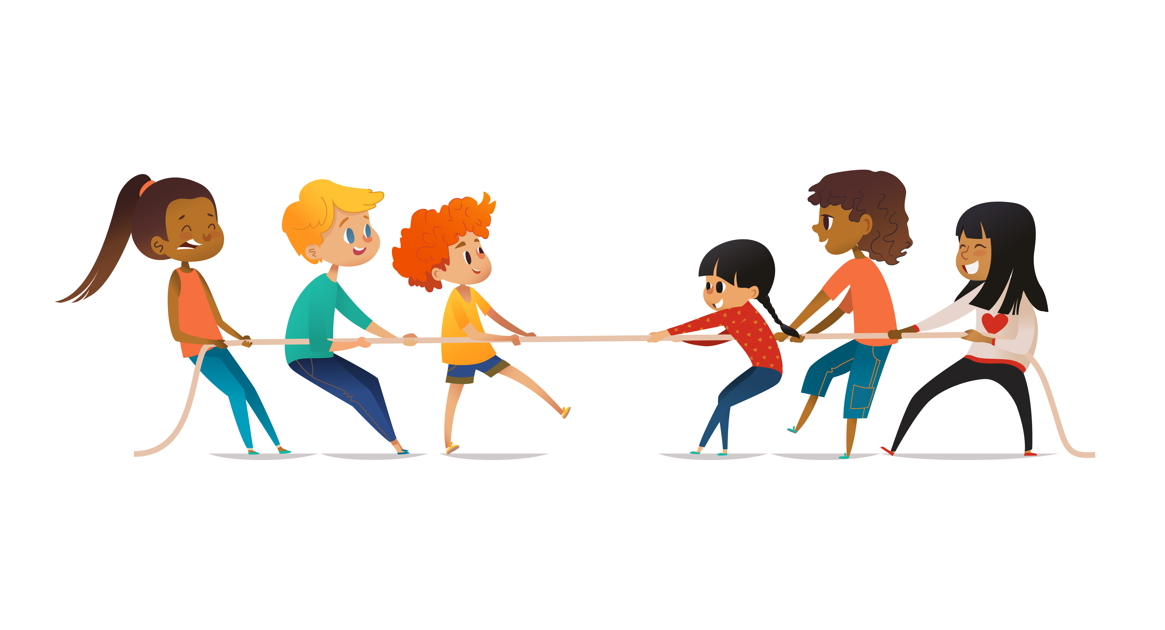

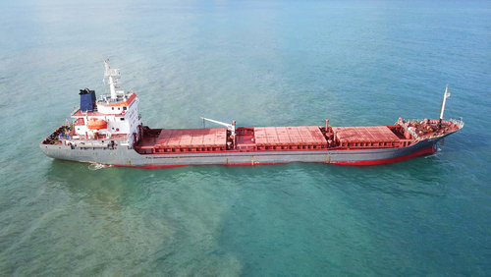
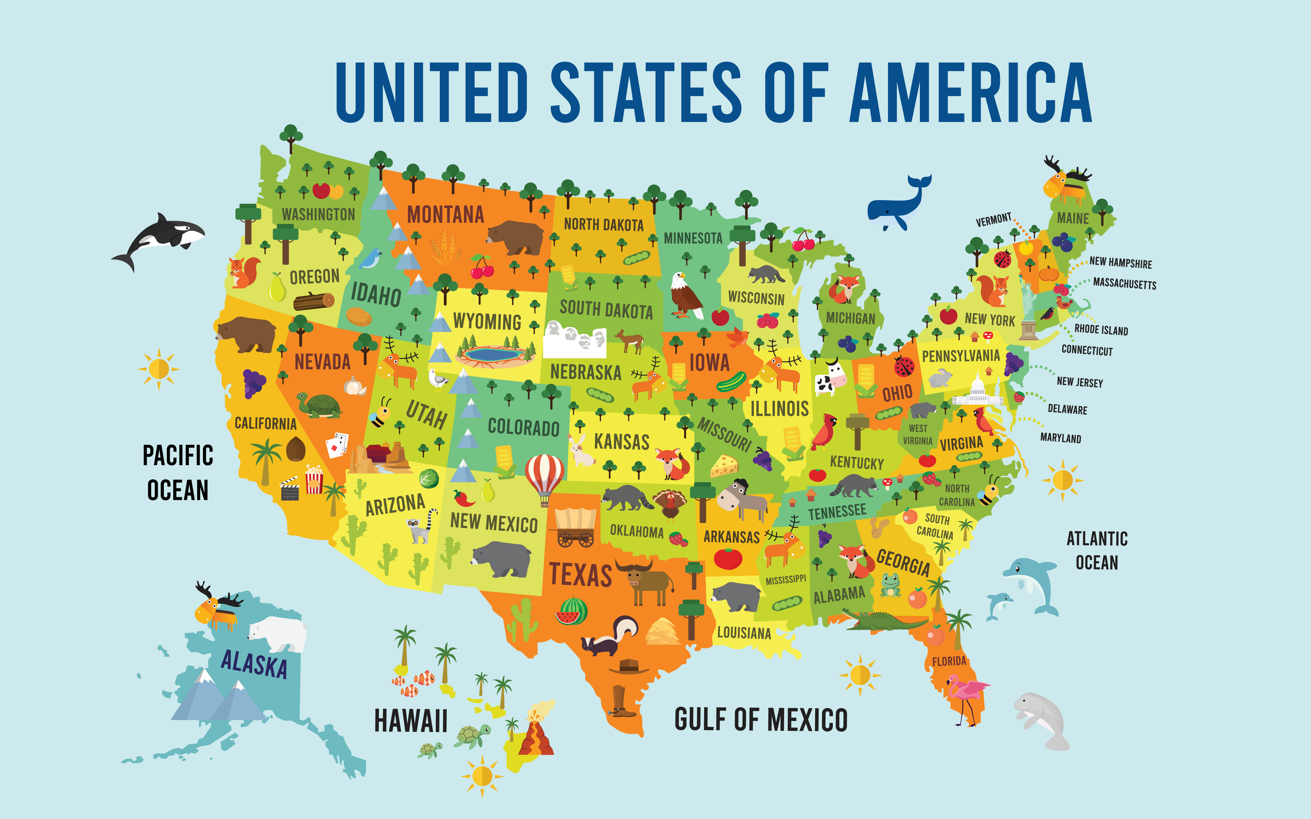
Reading Strategy #2
ship
map
cat
c
a
t
sh
i
p
m
a
p
Notes:
Notes to Teacher:
Click to show the image of a reader with a question mark.
Teacher: “What else can you do if you come to a word that you do not know?”
Allow student to tell me what he/she might do when he/she comes to an unknown word. If student is struggling, ask:
“If you do not see a picture that helps you read that word, should you give up?” (No.)
Click to show the pictures of the children pulling the rope.
Teacher: “We learned two reading strategies this week. The first one was to look at the pictures. The second was to stretch out the word.”
If student is ready, allow him/her to read the word to you.
Click to bring up word “cat” and allow student to read the word:
c a t spells cat, modeling how to stretch the word out:
“We are going to sound each part out.”
Click to show “c” (/k/)
Click to show “a” and remind student it is the short /a/ should, like /a/ as in apple. (/a/)
Click to show “t.” (/t/)
Teacher: “Let’s put the sounds together: /k/ + /a /+ /t/ = cat.”
Click to show a picture of a cat.
Repeat this strategy for the following words, allowing student to try to stretch out words independently, assisting if needed.
Click to show the word ship.
“Sound each part out.”
Click to show “sh.” (/sh/)
Click to show “i” and remind student it is the short /i/ should, like /i/ as in igloo. (/i/)
Click to show “p.” (/p/)
Teacher: “Let’s put the sounds together: /sh/ + /i /+ /p/ = ship.”
Click to show a picture of a ship.
Teacher: “Let’s try one more.”
Click to show the word map.
Click to show “m” (/m/.)
Click to show “a” and remind student it is the short /a/ should, like /a/ as in apple (/a/.)
Click to show “p” (/p/.)
Teacher: “Let’s put the sounds together: /m/ + /a/ + /p/ = map.”
Click to show a picture of a map.
Applaud student’s effort.
Click to move to the next slide.

Slide 9
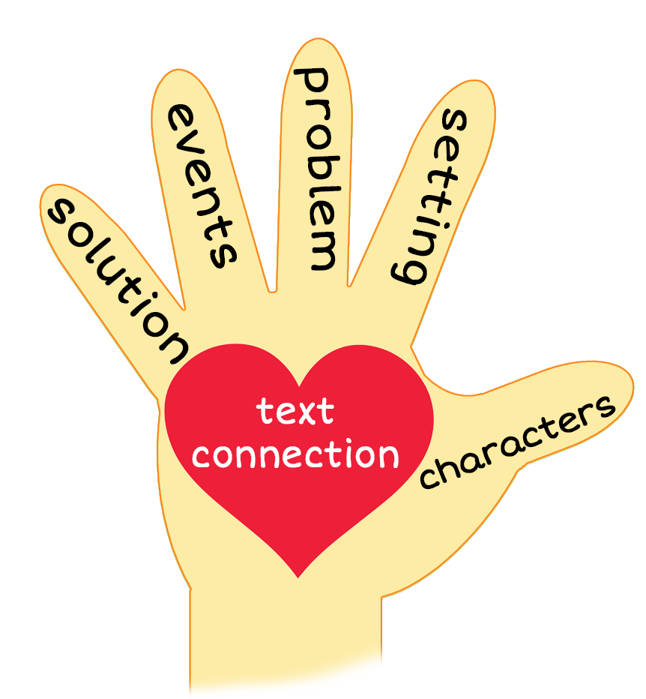

What Did They See?
Notes:
Notes to Teacher:
Teacher: “This week, you read the story, What Did They See? Let’s use our strategy to retell the story together.”
Click to bring the image to the slide.
“Let’s work on our story retell together.”
Characters: “Who were the characters in the story?” (Characters: There were many different people in the story.)
Setting: “What was the setting of the story? Where did it take place?” (The story took place in a few different places. The characters were inside and outside.)
Problem – “What was the problem in the story?” (There were not any problems in the story. I was trying to figure out what each character saw.)
Events: “What happened in the story?” (Each of the characters were looking at things.)
The two men saw a ship.
The lady saw a shell.
The family saw a fish.
The people saw a boy dash.
The children at the party saw a girl make a wish.
Ending: “What happened at the end of the story?” (The children were wondering what the birthday girl wished for.)
Connection: Possible questions to ask to help student to connect to this story:
What do you see in your room?
What do you see outside the window?
What was your favorite part of the story? Why?
Main Idea: What is this story about? (This story talks about what each character sees.)
Applaud student’s efforts in completing this story retell.
Click to the next slide.

Slide 10
Q & A
Any Questions?
Notes:
Ask – “Do you have any questions about anything that you learned in this lesson?”

