Slide 1
Phonics of the Week
Th
Notes:
Tell the student that we are going to review the phonogram th, talk abut details in stories, review our sight words and complete a story retell for Do You Think That Is Pretty?
Click to go to the next slide.

Slide 2


Think About It!
th
think
three
Notes:
Notes to Teacher:
Click to bring the letters ‘th’ to the screen.
Teacher: “Point to the letters on the screen and ask, “What sound does ‘th’ make? (Student will answer /th/.)
If student is struggling with this phonogram:
If student is struggling, teacher will model making the th sound and have the student repeat: /th/ like in think: /th/, /th/, /th/.
Teacher: “What pictures begin with the /th/ sound?”
Click to show a picture of a child thinking – When it appears on the screen, ask, “What is this child doing?” When student responds “thinking,” applaud his/her answer. If student does not respond correctly, teacher will tell student that it is a picture of a child thinking. Click to show the word “think.”
Click to show the next image –three. When it appears on the screen, ask, “How many fingers do you see?” If student responds “three,” applaud his/her answer. If student does not respond correctly, teacher will tell student that it shows three (fingers.) Click to show the word “three.”
Applaud student’s efforts.
Click to go to the next slide.

Slide 3


Let’s Practice - th
th
hand
thumb
Notes:
Notes to Teacher:
Click to show the letters th on the screen.
Teacher: “What letters do you see?” (th.) If student says th, applaud his/her answer.
If student is still unsure, remind him/her by saying “th. (Student should repeat teacher.)
Click to show a hand. Ask: “What is this?” (Hand.) Applaud correct answer or assist in telling the correct name for the picture.
Click to show the word hand.
Click to show a thumb with an arrow pointing to the thumb. Ask: “What is this?” (Thumb.) Applaud correct answer or assist in telling the correct name for the picture.
Click to show the word thumb.
After identifying the pictures (hand and thumb,) ask:
Teacher: “What picture begins with the ‘th’ sound?” (Thumb.)
If student is struggling to name the picture that begins with th, teacher will assist by saying each picture name and asking if it begins with /th/?
- “Hand- Does it begin with /th/?” (No.)
- “Thumb– Does it begin with /th/?” (Yes.)
Click to remove the hand from the screen.
Teacher will applaud efforts of student.
Click to go to the next slide.

Slide 4



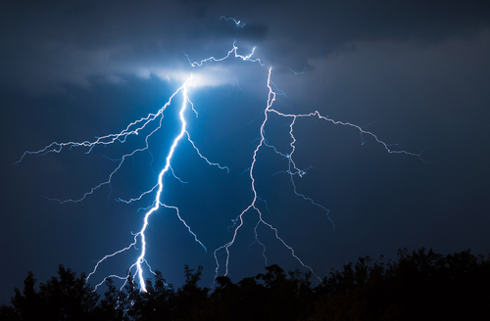
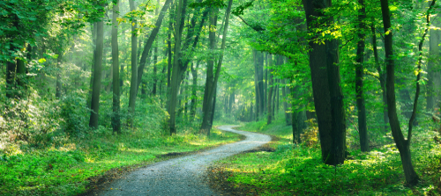
Let’s Practice!
thunder
bath
Earth
park
path
Notes:
Notes to Teacher:
Teacher: “Let’s look at some more pictures.”
Click to show bath.
Ask: “What is this?” (Bath.)
“Does it end in /th/?” (Yes.)
Click to show Earth.
Ask: “What is this?” (Earth.)
“Does it end in /th??” (Yes.)
Click to show park.
Ask: “What is this?” (Park.)
“Does it end with /th/? (No.)
Click to take the park off of the slide and add a picture of thunder.
Teacher: “This week, we talked about the ‘th’ sound. Some words begin with /th,/ like thunder.”
Click to show a path.
Teacher: ”Some words end with /th,/ like path.”
Applaud student’s effort.
Click to move to the next slide.

Slide 5
Sight Words
that
there
pretty
Notes:
Notes to Teacher:
Teacher says: “Let’s look at our sight words from this week.” (There are 3 words on this slide.)
Click to show the word “that.”– When it appears on the screen, ask: “What word do you see?”
When student responds “that,” applaud his/her answer.
If student does not respond correctly, teacher will tell the student that the word is “that.” Have student say the word “that.” (Student repeats.)
Click to show the next word, “there.” - When it appears on the screen, ask: “What word do you see?”
When student responds “there,” applaud his/her answer.
If student does not respond correctly, teacher will tell the student that the word is “there.” Have student say the word “there.” (Student repeats.)
Click to show the final word, “pretty.” – When it appears on the screen, ask: “What word do you see?”
When student responds “pretty,” applaud his/her answer.
If student does not respond correctly, teacher will tell the student that the word is “pretty.” Have student say the word “pretty.” (Student repeats.)
Applaud student’s effort.
Click to go to the next slide.

Slide 6

Sight Word Practice
Look at that pretty .
flower
Notes:
Notes to Teacher:
If student is ready, allow him/her to read each sentence to you. If student is not ready, assist him/her in reading.
-Click to make the sentence appear on the slide with images: Look at that pretty flower.
Applaud all efforts.
Click to move to next slide.

Slide 7
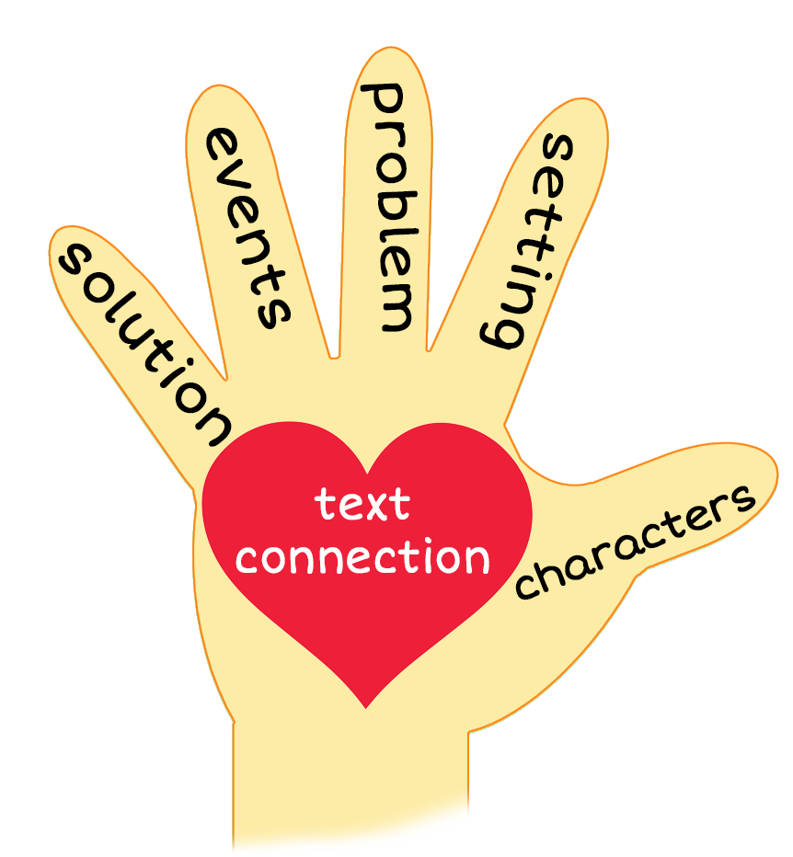
Fiction and Nonfiction Retells: What’s the Difference?
Notes:
Notes to Teacher:
Click to bring up five finger retell image.
Teacher: “When you do a five finger retell, what types of things do you tell me about?”
Allow student to tell me about doing a story retell to talk about characters, setting, events, problems, ending/solution, main idea and making a connection to a fiction book.
Applaud student’s effort.
Click to move to the next slide.

Slide 8
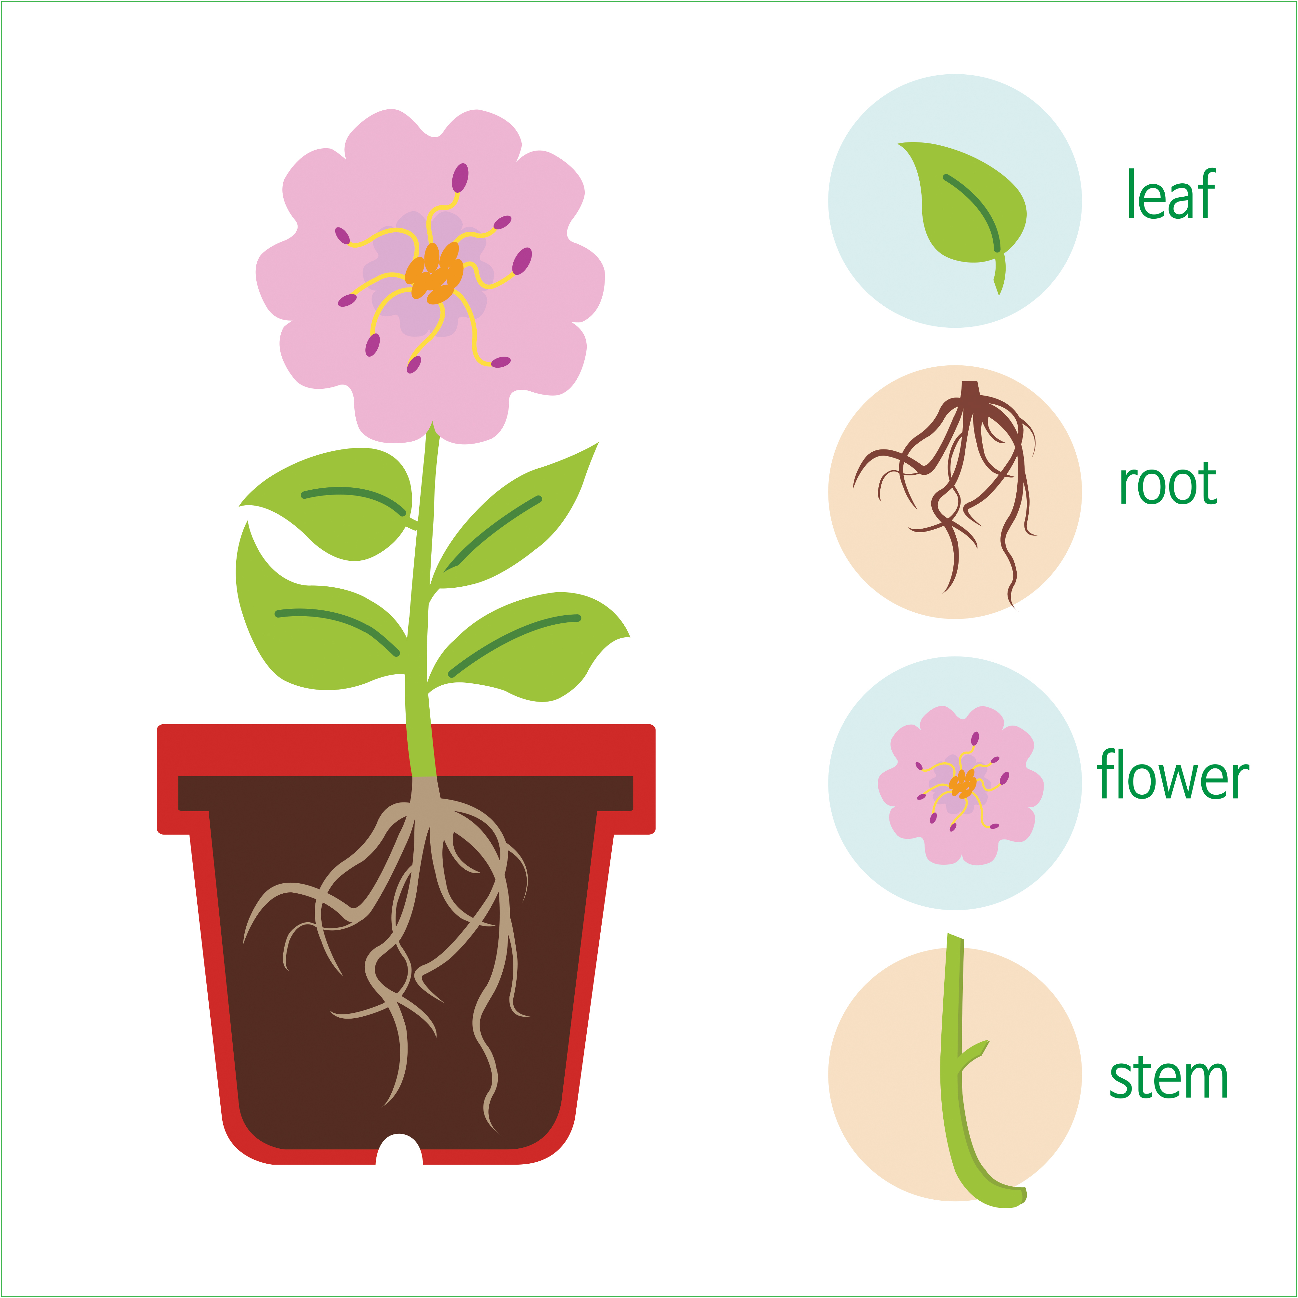
Nonfiction Books
Notes:
Notes to Teacher:
Teacher: “When we read fiction stories, we can do a story retell. When we read nonfiction books, we learn facts – or things that are true.”
Click to show image of plant.
“In Science, you may have learned about parts of a plant. Look at the picture. Can you name the different parts of the plant?” (Leaf, roots, flower and stem.)
Allow student to look at the picture and name the different parts of the plant.
If student is struggling, review the parts of the plant. (Flower, leaf, stem and roots.)
Applaud student’s effort.
Click to move to next slide.

Slide 9

Do You Think That Is Pretty?
Notes:
Notes to Teacher:
Teacher: “This week, you read the story, Do You Think That Is Pretty? Let’s use our strategy to retell the story together.”
Click to bring the image to the slide.
“Let’s work on our story retell together.”
Characters: “Who were the characters in the story?” (Characters: children.)
Setting: “What was the setting of the story? Where did it take place?” (The story took place outside.)
Problem – “What was the problem in the story?” (The children were having a difficult time finding something pretty.)
Events: “What happened in the story?” (The children were searching for pretty things.)
The children walked down a path looking for something pretty.
Was the brown tooth pretty? No.
Was the pig in the bath pretty? No.
Was math pretty? No.
What was pretty?
They found a pretty sky at the end of the path.
Ending: “What happened at the end of the story?” (The children found a beautiful sky at the end of the path.)
Connection: Possible questions to ask to help student to connect to this story:
What do you think is pretty?
What was your favorite part of the story? Why?
Main Idea: What is this story about? (This story is about children searching for something pretty.)
Applaud student’s efforts in completing this story retell.
Click to the next slide.

Slide 10
Q & A
Any Questions?
Notes:
Ask – “Do you have any questions about anything that you learned in this lesson?”

