Slide 1
Letter of the Week
Yy
Notes:
Tell the student that we are going to review the letter Yy, talk about what an author and illustrator does, review our sight words and complete a story retell for My New Yo-Yo.
Click to go to the next slide.

Slide 2
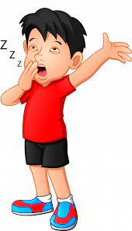
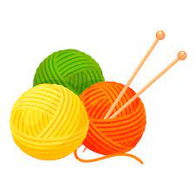
Yy
yarn
yawn
Notes:
Notes to Teacher:
Teacher: “Point to the letters on the screen. “What letters are we talking about today?” (Student will answer Yy.)
If student is struggling with this letter:
(Point to the uppercase Y.) “Uppercase Y.” (Student repeats.)
(Point to the lowercase y.) “Lowercase y.” (Student repeats.)
Teacher: “What sound does the letter y make?” (/y/ like in yarn.)
If student is struggling, teacher will model making the y sound and have the student repeat: /y/ like in yawn: /y/, /y/, /y/.
Teacher: “What pictures begin with the /y/ sound?”
Click to show the yawn – When it appears on the screen, ask, “What do you see?” When student responds “yawn,” applaud his/her answer. If student does not respond correctly, teacher will tell student that it is a yawn. Click to show the word “yawn.”
Click to show the next image –yarn. When it appears on the screen, ask, “What do you see?” If student responds “yarn,” applaud his/her answer. If student does not respond correctly, teacher will tell student that it is yarn. Click to show the word “yarn.”
Applaud student’s efforts.
Click to go to the next slide.

Slide 3


Yy
yo-yo
cup
yellow
Notes:
Notes to Teacher:
Teacher: “What letters do you see?” (Yy.) If student says Yy, applaud his/her answer.
If student is still unsure, remind him/her by saying “uppercase Y” and “lowercase y.” (Student should repeat teacher.)
Teacher: “What pictures do you see?” (Yo-yo, cup and yellow.)
Click to show a picture of a yo-yo. Ask: “What is this?” (Yo-yo.) Applaud correct answer or assist in telling the correct name for the picture. Click to show the word yo-yo.
Click to show a cup. Ask: “What is this?” (Cup.) Applaud correct answer or assist in telling the correct name for the picture. Click to show the word cup.
Click to show yellow. Ask: “What color is this?” (Yellow.) Applaud correct answer or assist in telling the correct name for the picture. Click to show the word yellow.
After identifying the pictures (Yoyo, cup and yellow,) ask:
“What pictures begin with the letter y?” (Yoyo and yellow begin with the letter y. Cup does not begin with the letter y.)
If student is struggling to name the pictures that begin with y, teacher will assist by saying each picture name and asking if it begins with /y/?
- “Yoyo– Does it begin with /y/?” (Yes.)
- “Cup - Does it begin with /y/?” (No.)
- “Yellow– Does it begin with /y/?” (Yes.)
Click to take the picture of the cup off of the slide.
Teacher will applaud efforts of student.
Click to go to the next slide.

Slide 4

Author
Notes:
Notes to Teacher:
Teacher: “This week, we talked about the author of a book.”
Click to show an image of the laptop.
Ask: “What does the author do?” (An author writes the words in a story.)
Click to move to the next slide.

Slide 5
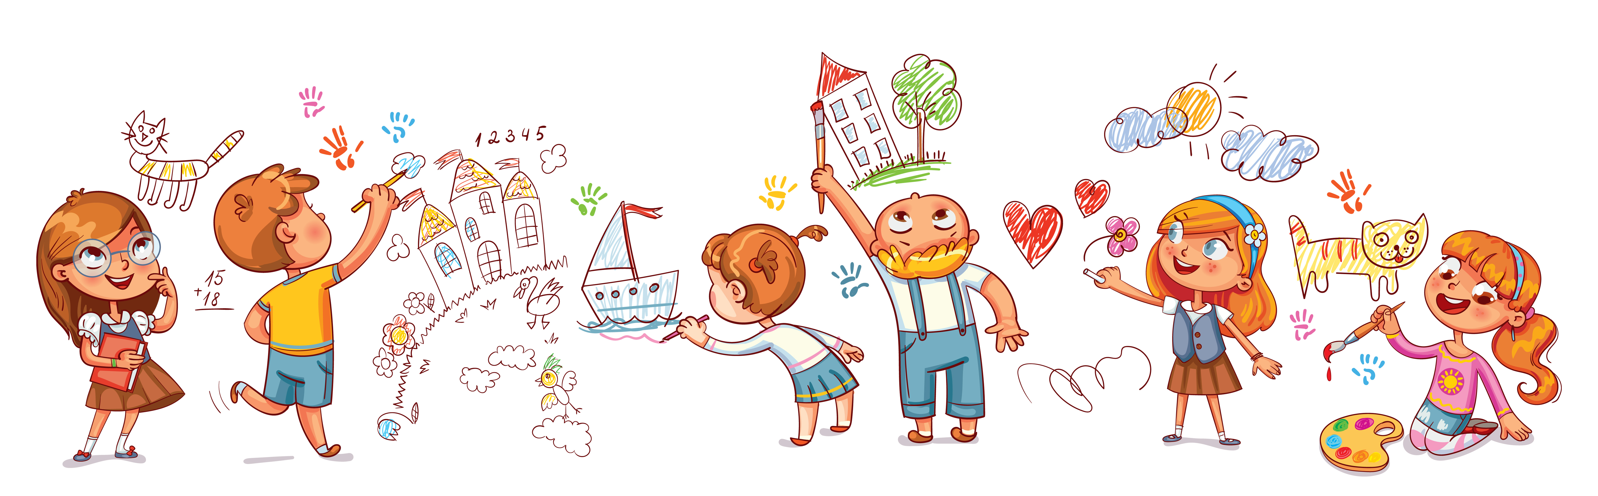
Illustrator
Notes:
Notes to Teacher:
Teacher: “This week, we also talked about the illustrator of a book.”
Click to show an image of illustrations.
Ask: “What does the illustrator do?” (An illustrator draws the pictures in a story.)
Applaud student’s effort.
Click to move to the next slide.

Slide 6
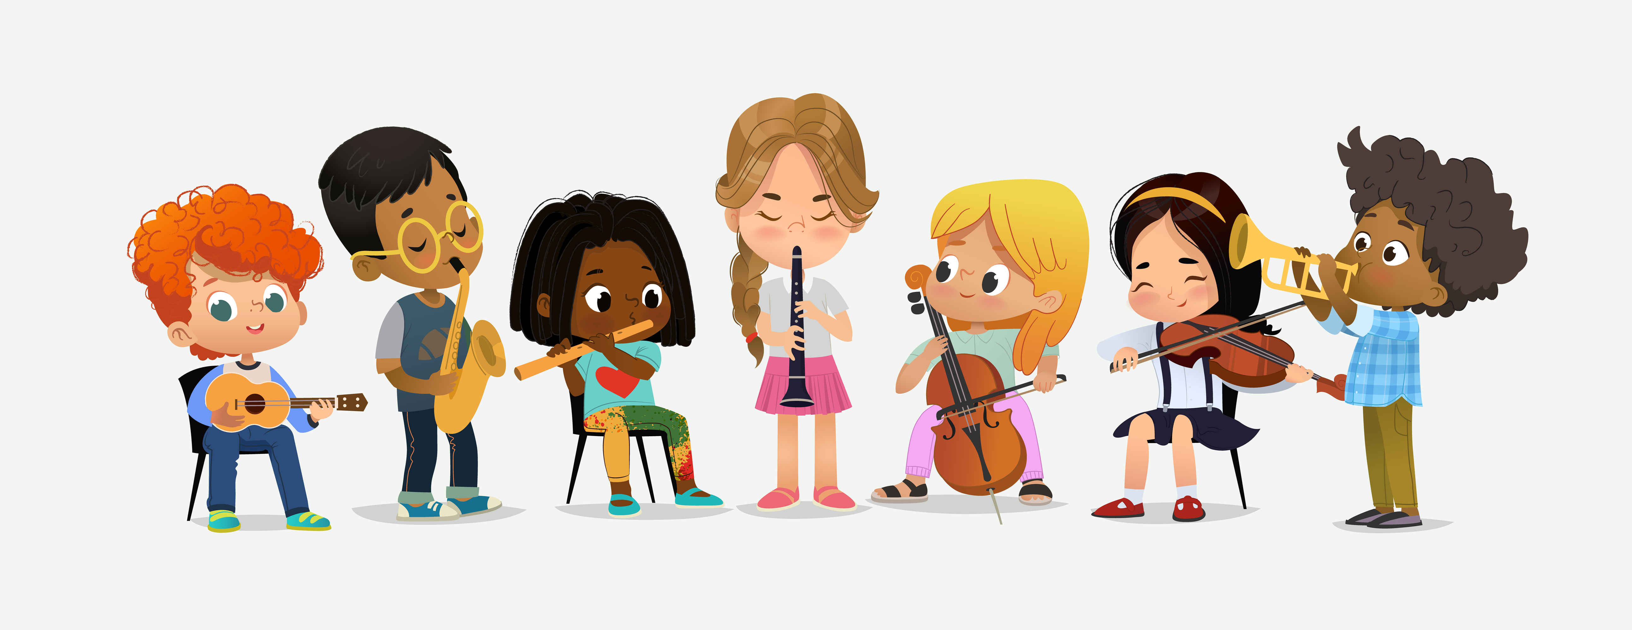
Tell Me All About It!
Notes:
Notes to Teacher:
Click to bring up the image of the children playing instruments.
Ask: “If this was an illustration in a story book, might this book be about?” (Children will use picture to tell you about the characters, the setting or the events in the story. Possible answers: This story is about children in music class. This story is about children playing at a school program.)
Remind student that illustrators help us see what is going on in the story.
Applaud student’s efforts.
Click to go to next slide.

Slide 7
Sight Words
must
new
no
Notes:
Notes to Teacher:
Teacher says: “Let’s look at our sight words from this week.” (There are 3 words on this slide.)
Click to show the word “must.”– When it appears on the screen, ask: “What word do you see?”
When student responds “must,” applaud his/her answer.
If student does not respond correctly, teacher will tell the student that the word is “must.” Have student say the word “must.” (Student repeats.)
Click to show the next word, “new.” - When it appears on the screen, ask: “What word do you see?”
When student responds “new,” applaud his/her answer.
If student does not respond correctly, teacher will tell the student that the word is “new.” Have student say the word “new.” (Student repeats.)
Click to show the next and final word, “no.” – When it appears on the screen, ask: “What word do you see?”
When student responds “no,” applaud his/her answer.
If student does not respond correctly, teacher will tell the student that the word is “no.” Have student say the word “no.” (Student repeats.)
Applaud student’s effort.
Click to go to the next slide.

Slide 8

Sight Word Practice
I must .
sit
Notes:
Notes to Teacher:
If student is ready, allow him/her to read each sentence to you. If student is not ready, assist him/her in reading.
-Click to make the sentence appear on the slide with images: I must ____________. (Allow student to fill in the last word. Possible answers: listen, sit.)
-Click to show the new sentence with the same image: I must sit. Allow student to read this sentence or assist student to read the sentence.
Applaud all efforts.
Click to move to next slide.

Slide 9
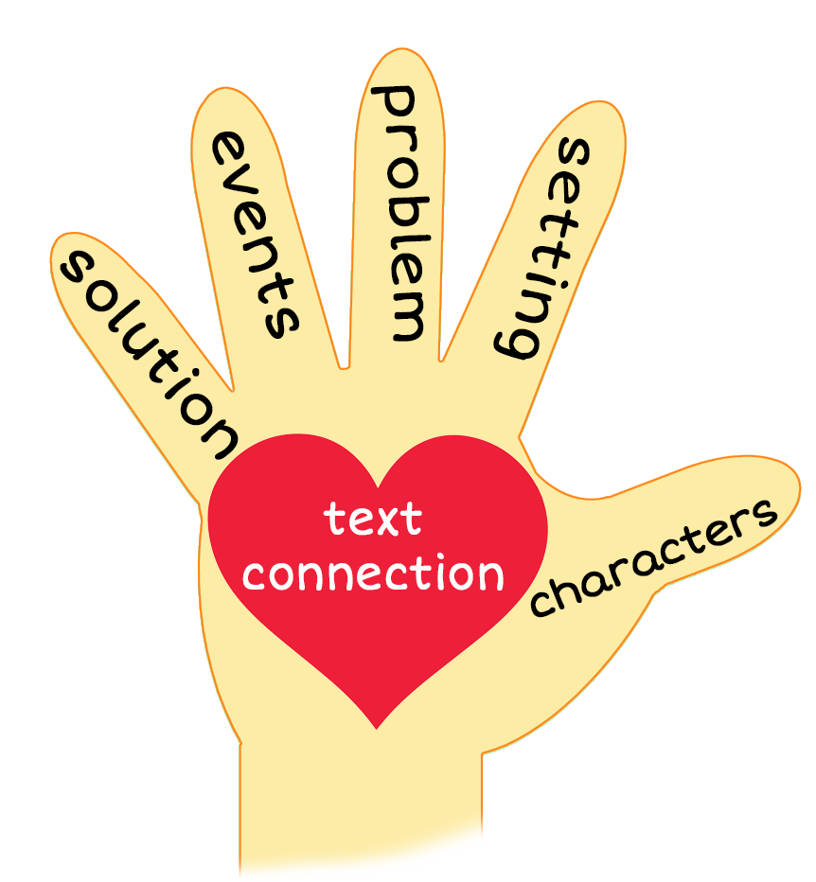
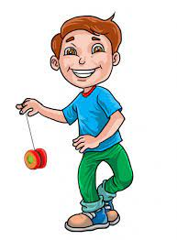
My New Yo-Yo
Notes:
Notes to Teacher:
Teacher: “This week, you read the story, My New Yo-Yo. Let’s look at the 5 finger retell chart to help us retell this story.”
Click to bring the image to the slide.
“Let’s work on our story retell together.”
Characters: “Who were the characters in the story?” (Characters: One boy and two girls.)
Setting: “What was the setting of the story? Where did it take place?” (The children were outside in the playground.)
Problem – “What was the problem in the story?” (Each child wanted to play with the yo-yo.)
Events: “What happened in the story?” (The children took turns playing with the yo-yo.)
The boy was playing with his new yo-yo.
A girl asked if she could play with the yo-yo.
The boy had her wait to play with the yo-yo.
She told him he must let her play with the yo-yo.
He agreed to let her play with the yo-yo.
Girl B asked Girl A if she could play with the yo-yo.
Girl A told Girl B to wait to play with the yo-yo.
Girl B told Girl A that she must let her play with the yo-yo.
Girl A let Girl B play with the yo-yo.
The boy asked Girl B if he could play with the yo-yo.
Girl B told him he had to wait to play with the yo-yo.
He told her she must let him play with the yo-yo.
Girl B let the boy play with the yo-yo.
He put the yo-yo in his pocket.
Ending: “What happened at the end of the story?” (The girls watched the boy play with his new yo-yo.)
Connection: Possible questions to ask to help student to connect to this story:
Did you ever have something new that everyone wanted to play with? If so, how did that make you feel?
Did you share your new toy or item? If so, how did that make you feel?
What was your favorite part of the story? Why?
Main Idea: What is this story about? (This story is about children taking turns playing with a yo-yo.)
Applaud student’s efforts in completing this story retell.
Click to the next slide.

Slide 10
Q & A
Any Questions?
Notes:
Ask – “Do you have any questions about anything that you learned in this lesson?”

