Slide 1
Letter and Phonics of the Week
Qq; qu sound
Notes:
Tell the student that we are going to review the letter Qq, talk about question words, review our sight words and complete a story retell for The Queen
Click to go to the next slide.

Slide 2


Qq
quiet
quarter
Notes:
Notes to Teacher:
Teacher: “Point to the letters on the screen. “What letters are we talking about today?” (Student will answer Qq.)
If student is struggling with this letter:
(Point to the uppercase Q.) “Uppercase Q.” (Student repeats.)
(Point to the lowercase q.) “Lowercase q.” (Student repeats.)
Teacher: “What sound does the letter q make?” (/qu/ like in quiet.)
If student is struggling, teacher will model making the /qu/ sound and have the student repeat: /qu/ like in quiet: //qu, /qu/, /qu/.
Teacher: “What pictures begin with the /qu/ sound?”
Click to show the quiet – When it appears on the screen, ask, “What do you think he is telling you?” When student responds “quiet,” applaud his/her answer. If student does not respond correctly, teacher will tell student that he is saying quiet. Click to show the word “quiet.”
Click to show the next image –quarter. When it appears on the screen, ask, “What do you see?” If student responds “quarter,” applaud his/her answer. If student does not respond correctly, teacher will tell student that it is quarter. Click to show the word “quarter.”
Applaud student’s efforts.
Click to go to the next slide.

Slide 3

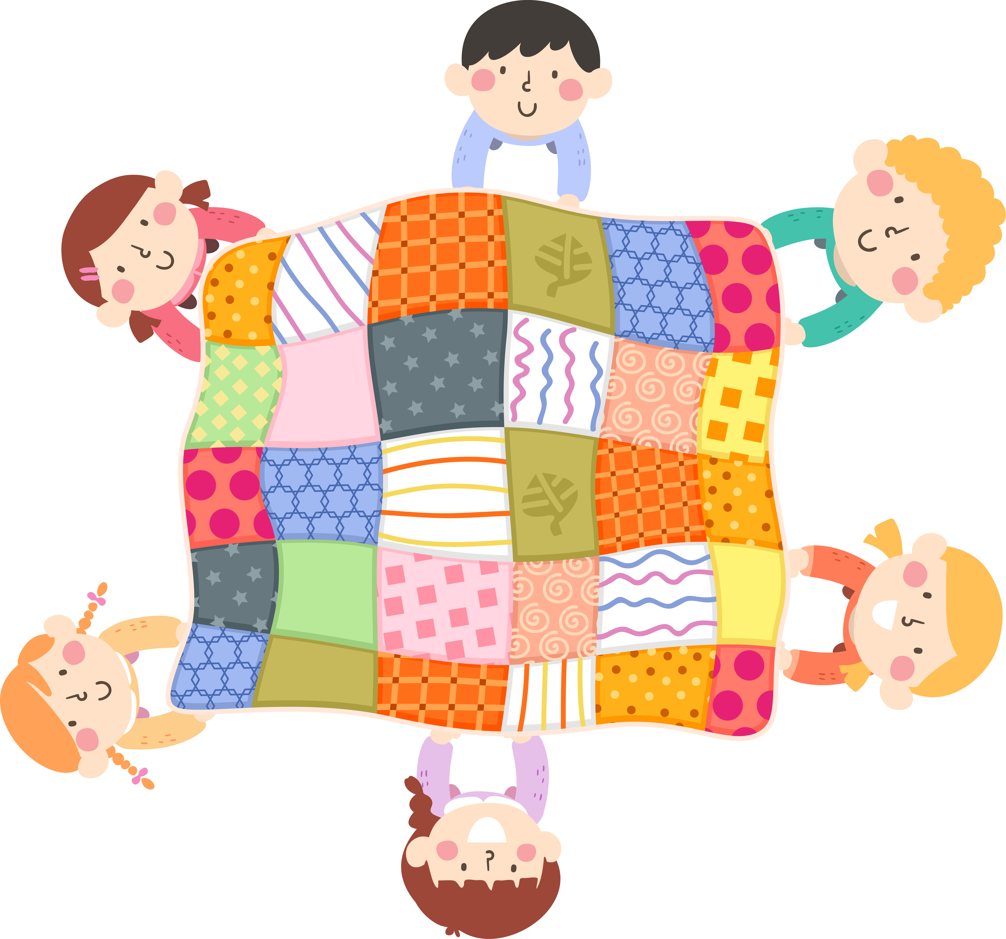

Qq
question mark
quilt
duck
Notes:
Notes to Teacher:
Teacher: “What letters do you see?” (Qq.) If student says Qq, applaud his/her answer.
If student is still unsure, remind him/her by saying “uppercase Q” and “lowercase q.” (Student should repeat teacher.)
Teacher: “Tell me about the pictures you see that appear on the screen.” (Question mark, quilt and duck.)
Click to show a picture of a question mark. Ask: “What is this?” (Question Mark.) Applaud correct answer or assist in telling the correct name for the picture. Click to show the word question mark.
Click to show a quilt. Ask: “What did the children make?” (Quilt.) Applaud correct answer or assist in telling the correct name for the picture. Click to show the word quilt.
Click to show the duck. Ask: “What is this?” (Duck.) Applaud correct answer or assist in telling the correct name for the picture. Click to show the word duck.
After identifying the pictures (question mark, quilt and duck,) ask:
“What pictures begin with the letter q?” (Question mark and quilt begin with the letter q. Duck does not begin with the letter q.)
If student is struggling to name the pictures that begin with q, teacher will assist by saying each picture name and asking if it begins with /qu/?
- “Question mark– Does it begin with /qu/?” (Yes.)
- "Quilt - Does it begin with /qu/?” (Yes.)
- “Duck- Does it begin with /qu/?” (No.)
Click to take the picture of the duck off of the slide.
Teacher will applaud efforts of student.
Click to go to the next slide.

Slide 4
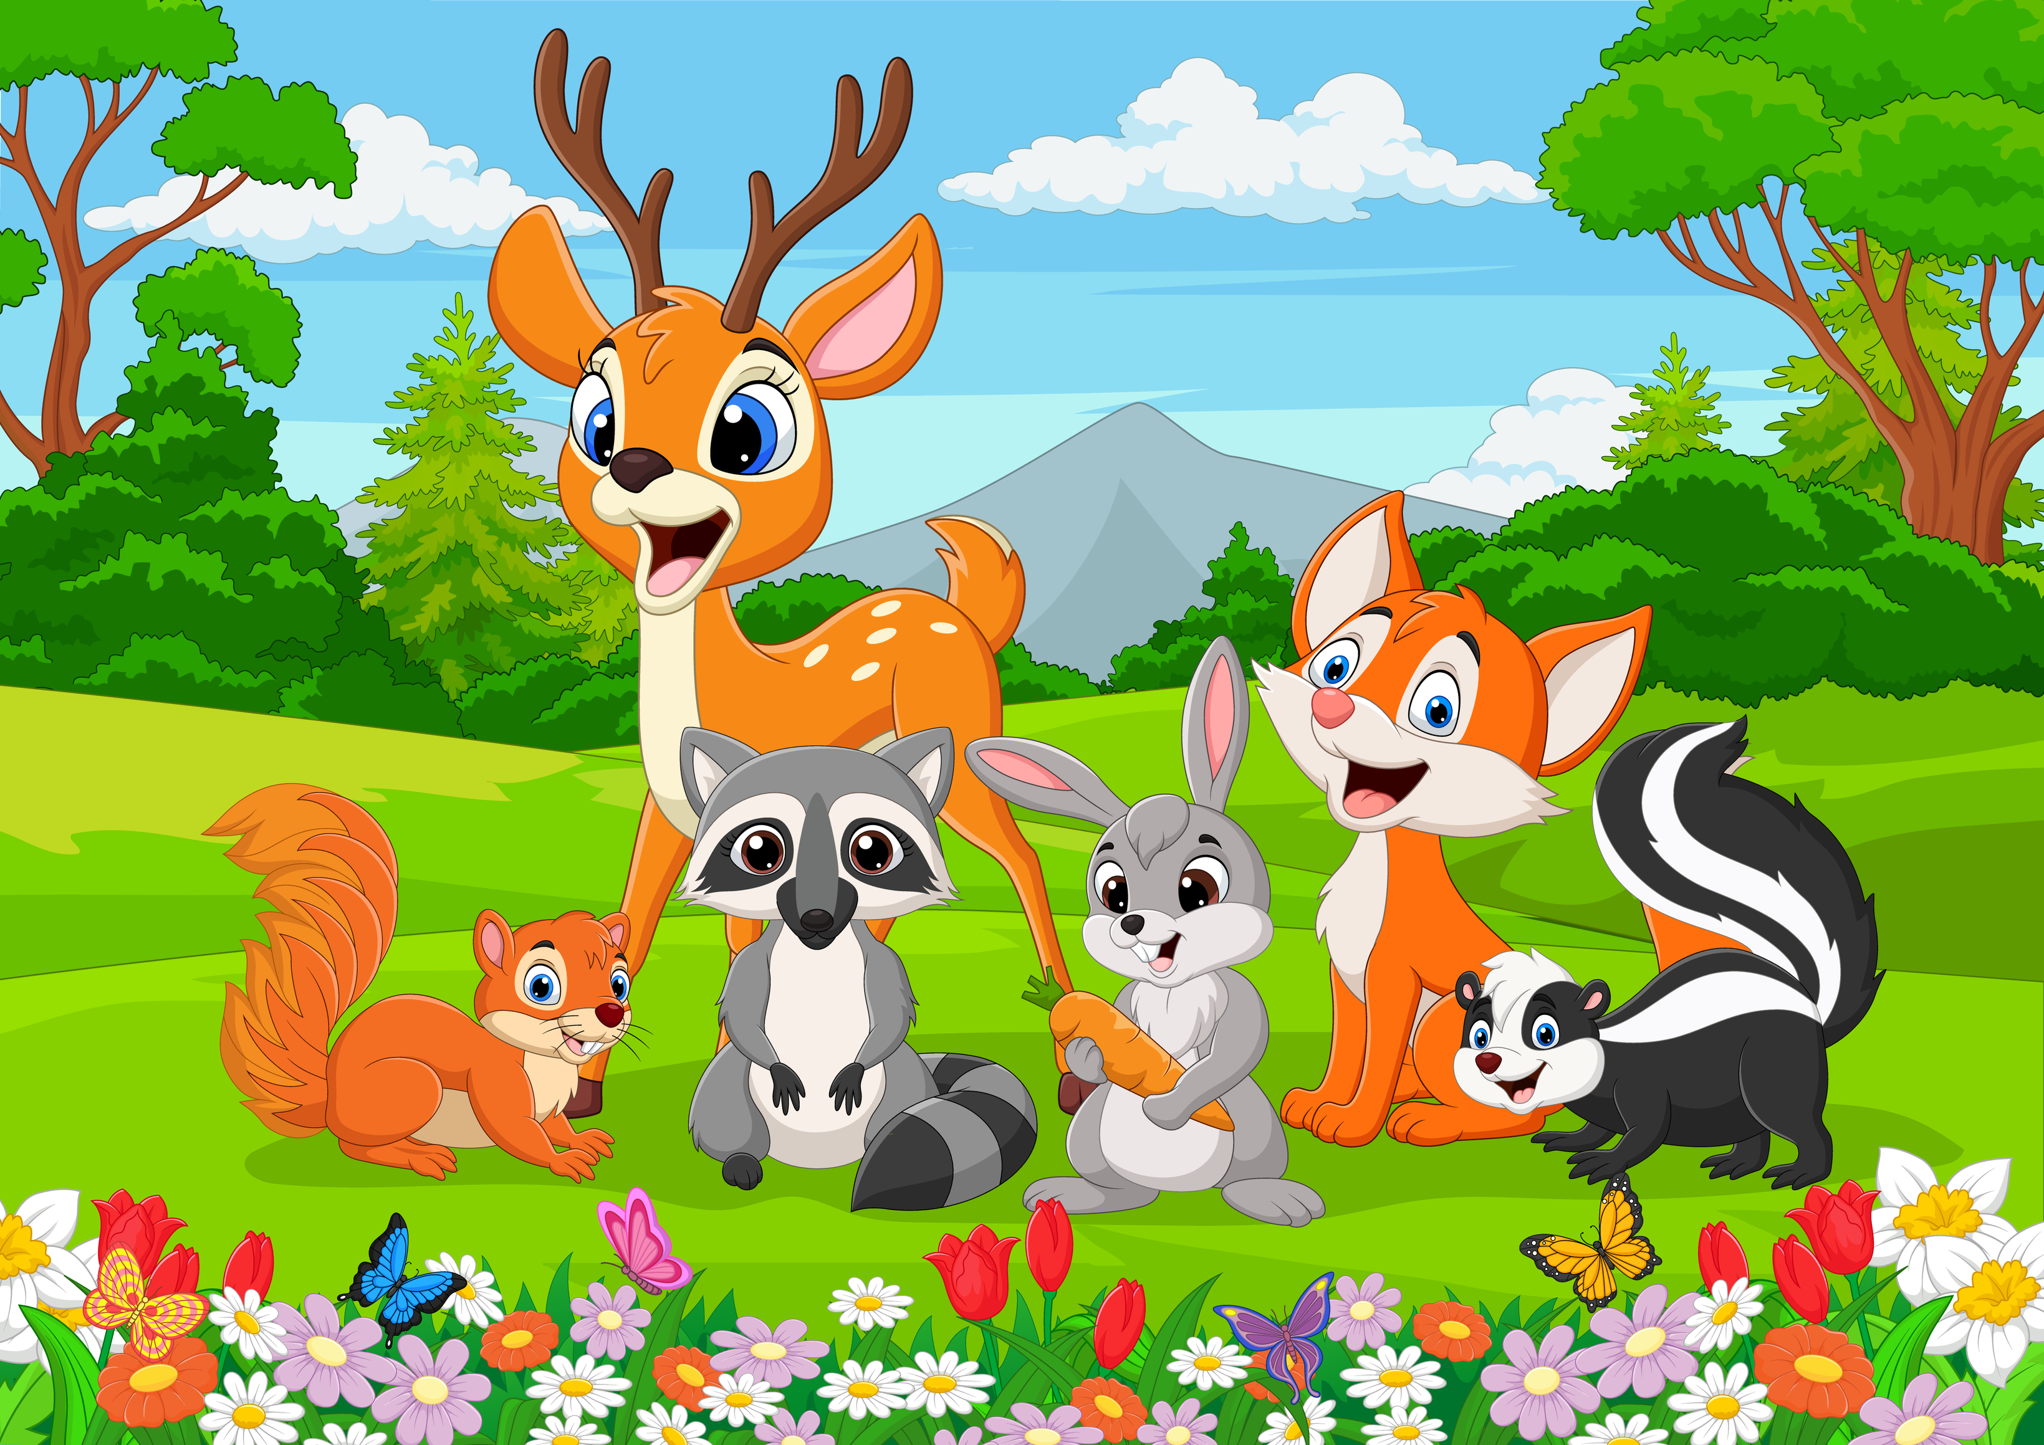

Question Words
What do you see?
Where are they?
question mark
Notes:
Notes to Teacher:
Click to show an image of a question mark.
Ask: “What do you see on the screen?” (Question Mark.)
Ask: “Where do you see question marks?” (At the end of a sentence that asks a question.)
Click to bring up a question with an image on the screen.
Ask: “What do you see?” (I see animals.)
Click to bring the next question onto the screen.
Ask: “Where are they?” (They are outside.)
Remind students that we ask questions to find out information.
Click to move to the next slide.

Slide 5
How Many?
Notes:
Notes to Teacher:
Click to show an image of a jungle scene.
Ask: “How many monkeys are in the jungle?” (Allow student to count – 3)
Ask: “How many zebras are in the jungle? (Allow student to count – 1 )
Ask: “What other animals are in the jungle?” (Possible answers: crocodile, elephant, lion, giraffe, birds and turtle.)
Remind students that you ask questions to find out information.
Applaud student’s effort.
Click to move to the next slide.

Slide 6
Sight Words
but
came
funny
all
at
Please go to the next slide.
Notes:
Notes to Teacher:
Teacher says: “Can you read these sight words?” (There are 5 words on this slide.)
Click to show the word “but.””– When it appears on the screen, ask: “What word do you see?”
When student responds “but,” applaud his/her answer.
If student does not respond correctly, teacher will tell the student that the word is “but.” Have student say the word “but.” (Student repeats.)
Click to show the next word, “came.”– When it appears on the screen, ask: “What word do you see?”
When student responds “came,” applaud his/her answer.
If student does not respond correctly, teacher will tell the student that the word is “came.” Have student say the word “came.” (Student repeats.)
Click to show the next word, “funny.” – When it appears on the screen, ask: “What word do you see?”
When student responds “funny,” applaud his/her answer.
If student does not respond correctly, teacher will tell the student that the word is “funny.” Have student say the word “funny.” (Student repeats.)
Click to show the next word, “all.” – When it appears on the screen, ask: “What word do you see?”
When student responds “all,” applaud his/her answer.
If student does not respond correctly, teacher will tell the student that the word is “all.” Have student say the word “all.” (Student repeats.)
Click to show the final word, “at.” – When it appears on the screen, ask: “What word do you see?”
When student responds “at,” applaud his/her answer.
If student does not respond correctly, teacher will tell the student that the word is “at.” Have student say the word “at.” (Student repeats.)
“Let’s look at another group of words.” Click to show the arrow.
Click to go to the next slide.

Slide 7
Sight Words
be
do
run
four
get
Notes:
Notes to Teacher:
Teacher says: “Can you read these sight words?” (There are 5 words on this slide.)
Click to show the word “be.””– When it appears on the screen, ask: “What word do you see?”
When student responds “be,” applaud his/her answer.
If student does not respond correctly, teacher will tell the student that the word is “be.” Have student say the word “be.” (Student repeats.)
Click to show the next word, “do.”– When it appears on the screen, ask: “What word do you see?”
When student responds “do,” applaud his/her answer.
If student does not respond correctly, teacher will tell the student that the word is “do.” Have student say the word “do.” (Student repeats.)
Click to show the next word, “run.” – When it appears on the screen, ask: “What word do you see?”
When student responds “run,” applaud his/her answer.
If student does not respond correctly, teacher will tell the student that the word is “run.” Have student say the word “run.” (Student repeats.)
Click to show the next word, “four.” – When it appears on the screen, ask: “What word do you see?”
When student responds “four,” applaud his/her answer.
If student does not respond correctly, teacher will tell the student that the word is “four.” Have student say the word “four.” (Student repeats.)
Click to show the final word, “get.” – When it appears on the screen, ask: “What word do you see?”
When student responds “get,” applaud his/her answer.
If student does not respond correctly, teacher will tell the student that the word is “get.” Have student say the word “get.” (Student repeats.)
“Now, let’s look at our last group of words.”
Click to go to the next slide.

Slide 8

Sight Words
good
have
he
into
like
Notes:
Notes to Teacher:
Teacher asks: “What words do you see?”
Click to show the word, “good.””– When it appears on the screen, ask: “What word do you see?”
When student responds “good,” applaud his/her answer.
If student does not respond correctly, teacher will tell the student that the word is “good.” Have student say the word “good.” (Student repeats.)
Click to show the next word, “have.”– When it appears on the screen, ask: “What word do you see?”
When student responds “have,” applaud his/her answer.
If student does not respond correctly, teacher will tell the student that the word is “have.” Have student say the word “have.” (Student repeats.)
Click to show the next word, “he.” – When it appears on the screen, ask: “What word do you see?”
When student responds “he,” applaud his/her answer.
If student does not respond correctly, teacher will tell the student that the word is “he.” Have student say the word “he.” (Student repeats.)
Click to show the next word, “into.” – When it appears on the screen, ask: “What word do you see?”
When student responds “into,” applaud his/her answer.
If student does not respond correctly, teacher will tell the student that the word is “into.” Have student say the word “into.” (Student repeats.)
Click to show the final word, “like.” – When it appears on the screen, ask: “What word do you see?”
When student responds “like,” applaud his/her answer.
If student does not respond correctly, teacher will tell the student that the word is “like.” Have student say the word “like.” (Student repeats.)
Applaud student’s effort.
Click to go to the next slide.

Slide 9
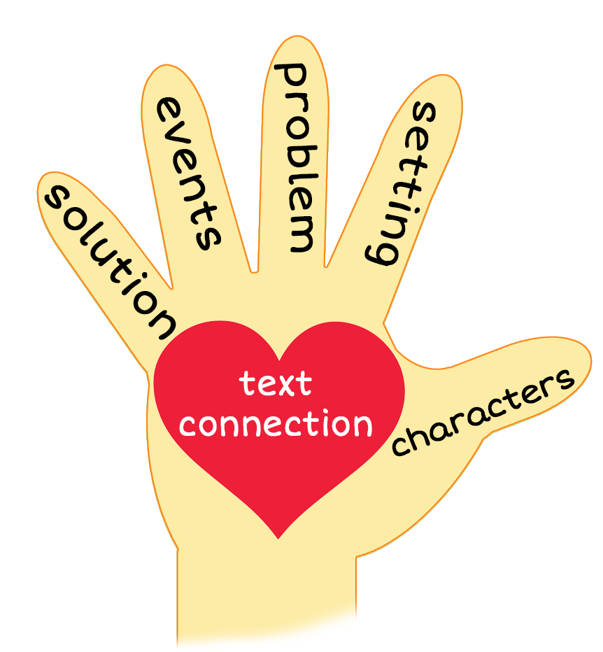
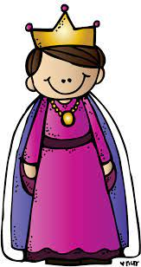
The Queen
Notes:
Notes to Teacher:
Teacher: “This week, you read the story, The Queen. Let’s look at the 5 finger retell chart to help us retell this story.”
Click to bring the image to the slide.
“Let’s work on our story retell together.”
Characters: “Who were the characters in the story?” (Characters: The queen and a boy)
Setting: “What is the setting of the story? Where does it take place?” (This story takes place outside a palace.)
Problem – “What is the problem in the story?” (The boy has to do as the queen says.)
Events: “What happened in the story?” (The queen gave the boy commands and he had to do as she said.)
The queen told the boy to get her four good quilts.
The boy did as she said.
The queen told the boy to run like a funny dog.
The boy did as the queen said.
The queen told the boy to quack like a quail.
The boy did as the queen said.
The queen told the boy he was a good boy and gave him a quarter.
The boy asked for quarters.
The queen gave the boy four quarters.
Ending: “What happened at the end of the story?” (The queen gave the boy four quarters. We learned that 4 quarters = $1.)
Connection: Possible questions to ask to help student to connect to this story:
What was your favorite part of the story?
How do you think the boy felt at the end of the story? Why?
Main Idea: What is this story about? (This story is about a boy following the directions from a queen.)
Applaud student’s efforts in completing this story retell.
Click to the next slide.

Slide 10
Q & A
Any Questions?
Notes:
Ask – “Do you have any questions about anything that you learned in this lesson?”

