Slide 1
Letter of the Week
Kk
Notes:
Tell the student that we are going to review the letter Kk, work with adjectives, review our sight words and complete a story retell for Koala and Kangaroo
Click to go to the next slide.

Slide 2
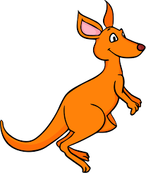

Kk
key
kangaroo
Notes:
Notes to Teacher:
Teacher: “Point to the letters on the screen. “What letters are we talking about today?” (Student will answer Kk.)
If student is struggling with this letter:
(Point to the uppercase K.) “Uppercase K.” (Student repeats.)
(Point to the lowercase k.) “Lowercase k.” (Student repeats.)
Teacher: “What sound does the letter k make?” (/k/ like in key.)
If student is struggling, teacher will model making the k sound and have the student repeat: /k/ like in key: /k/, /k/, /k/.
Teacher: “What pictures begin with the short /k/ sound?”
Click to show the key – When it appears on the screen, ask, “What do you see?” When student responds “key,” applaud his/her answer. If student does not respond correctly, teacher will tell student that it is a key. Click to show the word “key.”
Click to show the next image –kangaroo. When it appears on the screen, ask, “What do you see?” If student responds “kangaroo,” applaud his/her answer. If student does not respond correctly, teacher will tell student that it is kangaroo. Click to show the word “kangaroo.”
Applaud student’s efforts.
Click to go to the next slide.

Slide 3




Kk
koala
moon
kite
kitchen
Notes:
Notes to Teacher:
Teacher: “What letters do you see?” (Kk.) If student says Kk, applaud his/her answer.
If student is still unsure, remind him/her by saying “uppercase K” and “lowercase k.” (Student should repeat teacher.)
Teacher: “Tell me about the pictures you see that appear on the screen.” (Koala, moon, kite and kitchen.)
Click to show a picture of a koala. Ask: “What is this?” (Koala.) Applaud correct answer or assist in telling the correct name for the picture. Click to show the word koala.
Click to show a moon. Ask: “What is this?” (Moon.) Applaud correct answer or assist in telling the correct name for the picture. Click to show the word moon.
Click to show the kite. Ask: “What is this?” (Kite.) Applaud correct answer or assist in telling the correct name for the picture. Click to show the word kite.
Click to show a kitchen. Ask: “What room do you see?” (Kitchen.) Applaud correct answer or assist in telling the correct name for the picture. Click to show the word kitchen.
After identifying the pictures (koala, moon, kite and kitchen,) ask:
Teacher: “What pictures begin with the letter k?” (Koala, kite and kitchen begin with the letter k. Moon does not begin with the letter k.)
If student is struggling to name the pictures that begin with k, teacher will assist by saying each picture name and asking if it begins with /k/?
- “Koala– Does it begin with /k/?” (Yes.)
- “Moon - Does it begin with /k/?” (No.)
- “Kite – Does it begin with /k/?” (Yes.)
- “Kitchen- Does it begin with /k/?” (Yes.)
Click to take the picture of the moon off of the slide.
Teacher will applaud efforts of student.
Click to go to the next slide.

Slide 4
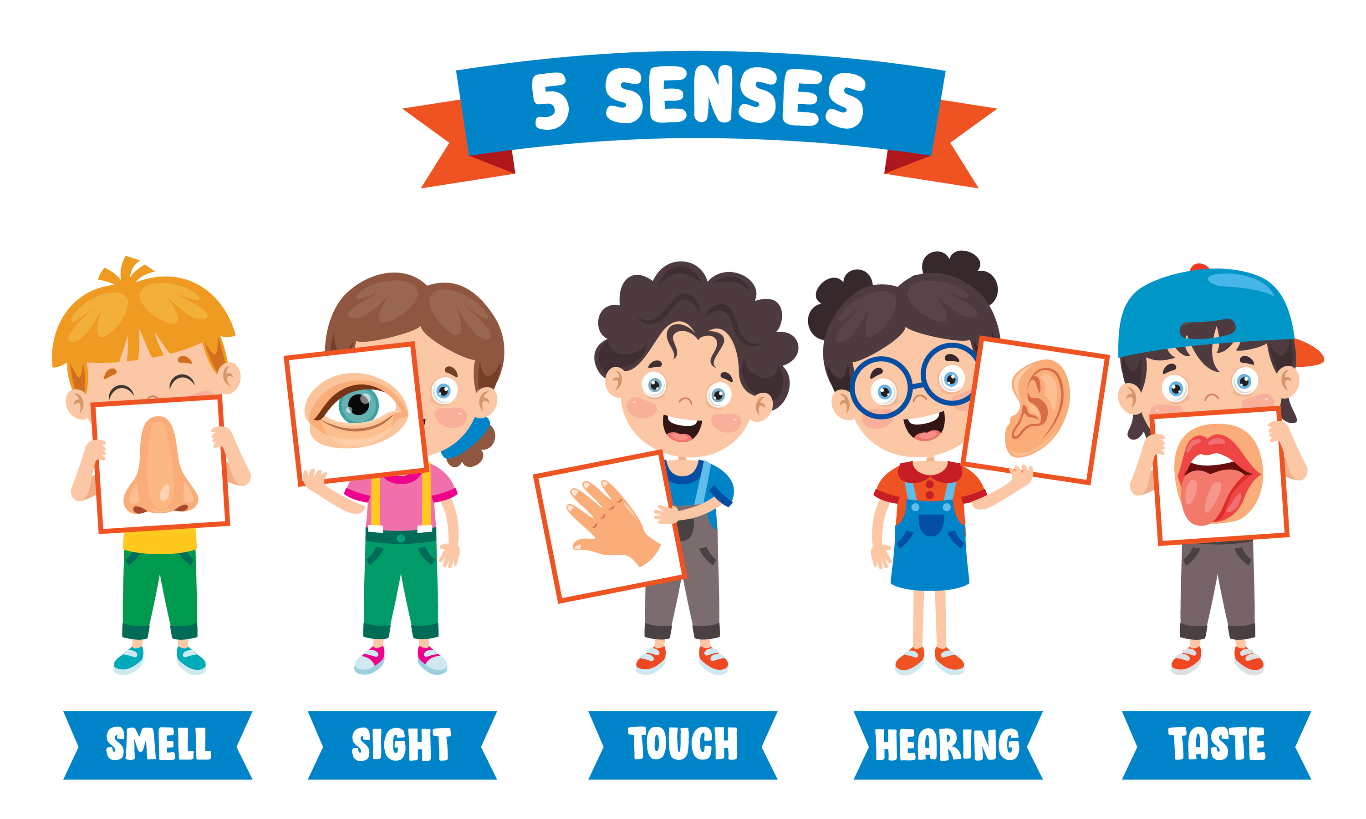
Adjectives
Notes:
Notes to Teacher:
Ask: “What are adjectives?” (Adjectives are describing words.)
Click to bring up an image of the five senses.
Remind student that we can use our five senses to talk about how something looks, sounds, tastes, feels, and sounds like.
Click to move to the next slide.

Slide 5
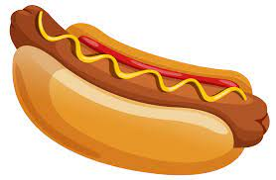
Let’s Practice!
Notes:
Notes to Teacher:
Click to bring the picture of a hot dog.
Ask: “What is this?” (Hot dog.)
Teacher: “Let’s use our five senses to describe this hot dog.”
Questions to ask to encourage student to use words to describe this food:
Sight- What color is it? What is it served in? (reddish to light brown; served in bun.)
Hearing – What sound might it make when cooking it on a grill? (May sizzle when it is cooking.)
Touch – How does it feel? (It is cold in the refrigerator. It is hot when cooked. It is soft if you push on it.)
Smell – What does it smell like? (Answers will vary.)
Taste – What does it taste like? (Answers will vary – yummy, yucky, delicious.)
Applaud student’s effort.
Click to move to the next slide.

Slide 6





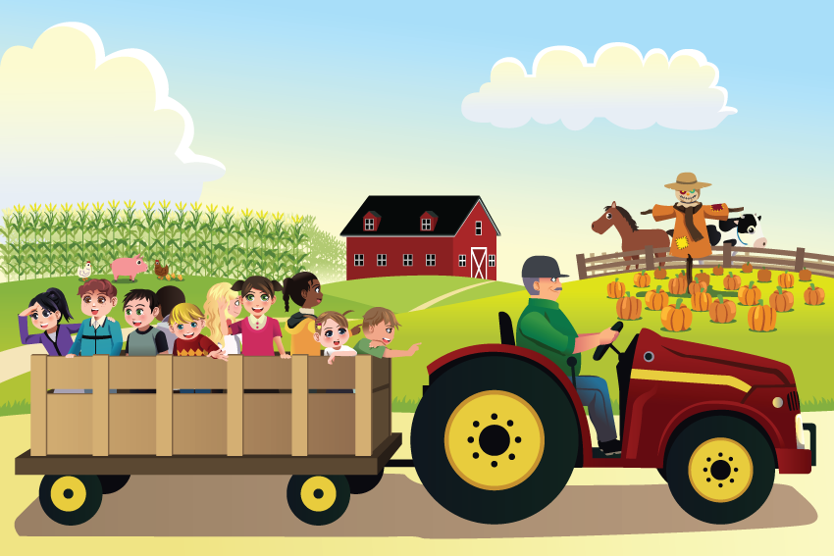
Describe this Picture!
Notes:
Notes to Teacher:
Click to bring up a pumpkin patch scene on the slide.
Click again to bring up an image of an eye.
Ask: “What do you see in this picture?” (I see people at a pumpkin patch.) “Let’s use describing words to tell me about a visit to a pumpkin patch.”
Ask: “What might you see at a pumpkin patch?” (Possible answers: children, farmer, families, pumpkins {orange, green or white,}, red tractor, scarecrow, barn, horse, fence, cornfield, grass, food stand.)
Click to bring up an image of an ear.
Ask: “What might you hear at a pumpkin patch?” (Possible answers: children laughing, talking and/or screaming, crying, birds, tractor.)
Click to bring up an image of a mouth.
Ask: “What might you taste at a pumpkin patch?” (Possible answers: hot dogs, popcorn, candy apples, nachos, lemonade.)
Click to bring up an image of a hand.
Ask: “What might you touch at the pumpkin patch?” (Possible answers: pumpkins – smooth, bumpy, rough hard; hay – smooth or dry; horse – soft, smooth.)
Click to bring up a image of a nose.
Ask: “What might you smell at the pumpkin patch?” (Possible answers – animals, hay, food.)
Applaud student’s efforts.
Click to go to next slide.

Slide 7
Sight Words
he
into
like
Notes:
Notes to Teacher:
Teacher says: “Let’s look at our sight words from this week.” (There are 3 words on this slide.)
Click to show the word “he.”– When it appears on the screen, ask: “What word do you see?”
When student responds “he,” applaud his/her answer.
If student does not respond correctly, teacher will tell the student that the word is “he.” Have student say the word “he.” (Student repeats.)
Click to show the next word, “into.” - When it appears on the screen, ask: “What word do you see?”
When student responds “into,” applaud his/her answer.
If student does not respond correctly, teacher will tell the student that the word is “into.” Have student say the word “into.” (Student repeats.)
Click to show the next and final word, “like.” – When it appears on the screen, ask: “What word do you see?”
When student responds “like,” applaud his/her answer.
If student does not respond correctly, teacher will tell the student that the word is “like.” Have student say the word “like.” (Student repeats.)
Applaud student’s effort.
Click to go to the next slide.

Slide 8
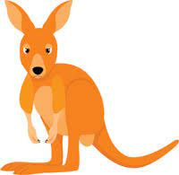

Sight Word Practice
He will get into the log.
Notes:
Notes to Teacher:
If student is ready, allow him/her to read each sentence to you. If student is not ready, assist him/her in reading.
-Click to make the sentence appear on the slide with images: He will get into the log.
Applaud all efforts.
Click to move to next slide.

Slide 9
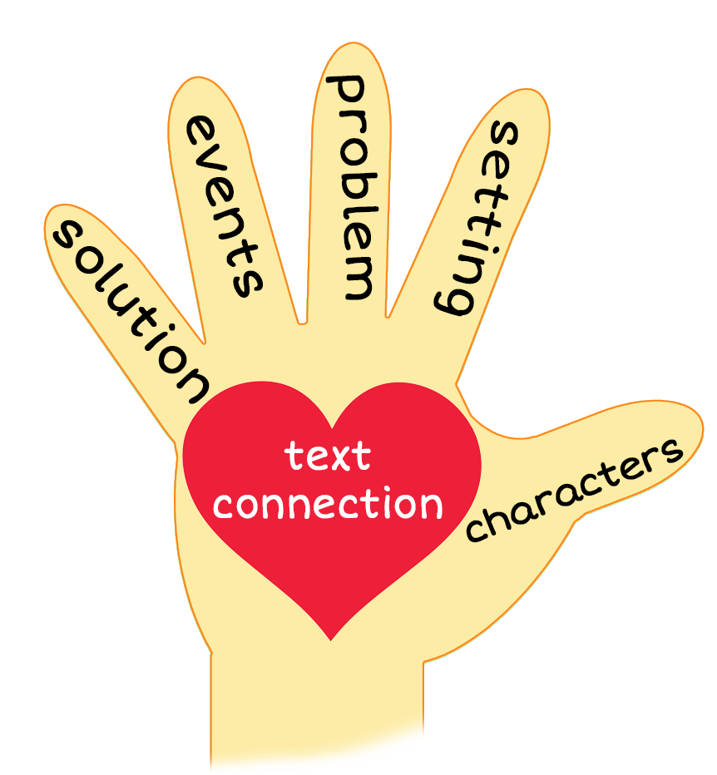
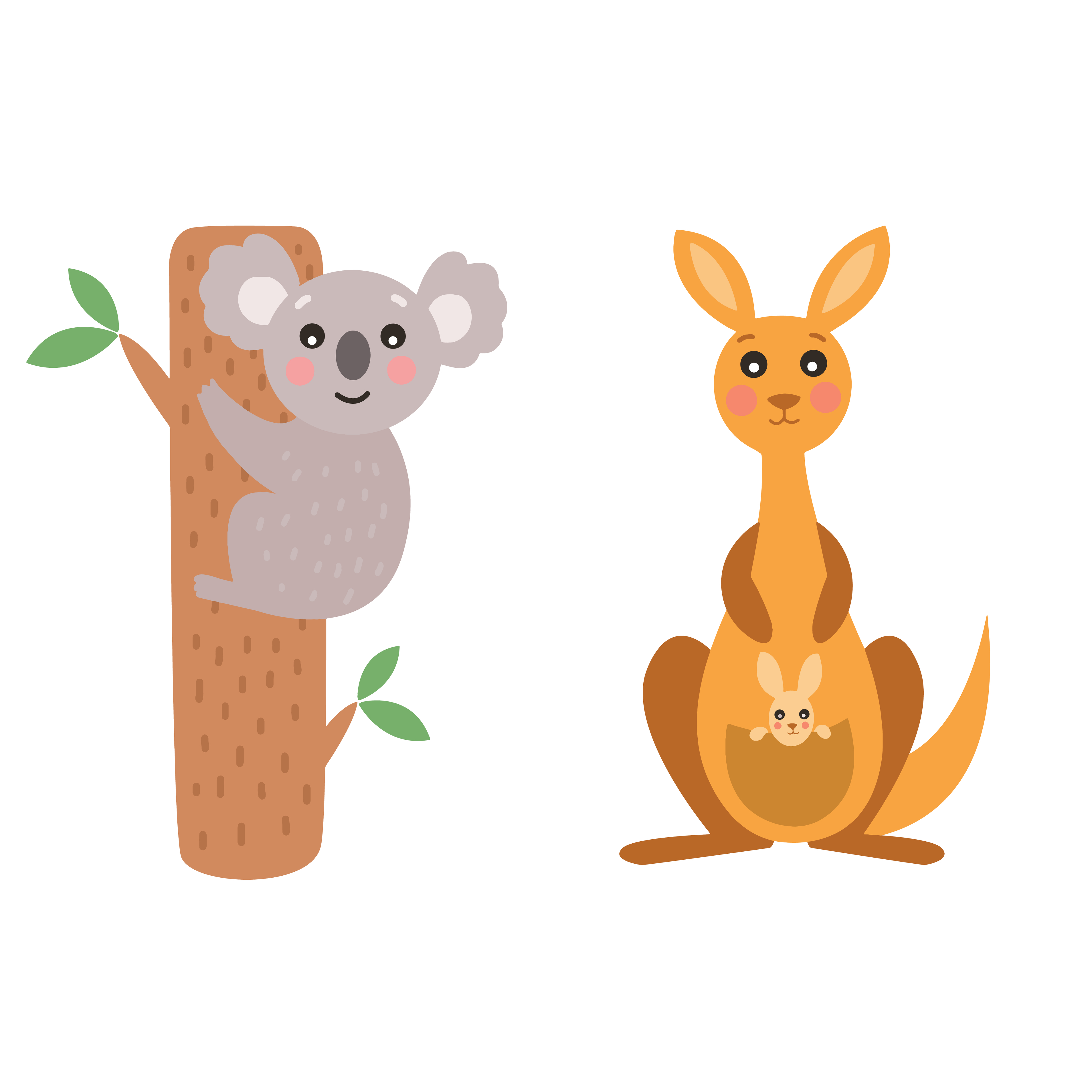
Koala and Kangaroo
Notes:
Notes to Teacher:
Teacher: “This week, you read the story, Koala and Kangaroo. Let’s look at the 5 finger retell chart to help us retell this story.”
Click to bring the image to the slide.
“Let’s work on our story retell together.”
Characters: “Who were the characters in the story?” (Characters: Koala and Kangaroo.)
Setting: “What was the setting of the story? Where did it take place?” (This story takes place outside in the forest.)
Problem – “What is the problem in the story?” (Koala kept telling Kangaroo what he would like, and Kangaroo disagreed.)
Events: “What happened in the story?” (Koala and Kangaroo finally found something that they both liked.)
Koala found a log and told Kangaroo he would like it.
Kangaroo said no and went for a job.
Koala got into a cot and told Kangaroo he would like it.
Kangaroo said no and played dot-to-dot.
Koala got a hot dog.
Kangaroo saw the hot dog and told Koala that he likes hot dogs.
Koala got kangaroo a hot dog and they ate them together.
Ending: “What happened at the end of the story?” (Koala and Kangaroo ate a hot dog together.)
Connection: Possible questions to ask to help student to connect to this story:
What was your favorite part of the story?
Do you like hot dogs?
Main Idea: What is this story about? (This story tells us about things Koala and Kangaroo do.)
Applaud student’s efforts in completing this story retell.
Click to the next slide.

Slide 10
Q & A
Any Questions?
Notes:
Ask – “Do you have any questions about anything that you learned in this lesson?”

