Slide 1
Letter of the Week
Jj
Notes:
Tell the student that we are going to review the letter Jj, work with prefixes and suffixes, review our sight words and complete a story retell for Jellyfish at the Party.
Click to go to the next slide.

Slide 2
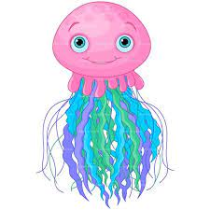
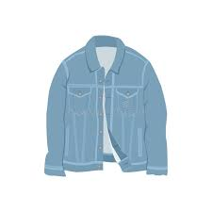
Jj
jellyfish
jacket
Notes:
Notes to Teacher:
Teacher: “Point to the letters on the screen. “What letters are we talking about today?” (Student will answer Jj.)
If student is struggling with this letter:
(Point to the uppercase J.) “Uppercase J.” (Student repeats.)
(Point to the lowercase j.) “Lowercase j.” (Student repeats.)
Teacher: “What sound does the letter j make?” (/j/ like in jellyfish.)
If student is struggling, teacher will model making the j sound and have the student repeat: /j/ like in jellyfish: /j/, /j/, /j/.
Teacher: “What pictures begin with the short /j/ sound?”
Click to show the jellyfish – When it appears on the screen, ask, “What do you see?” When student responds “jellyfish,” applaud his/her answer. If student does not respond correctly, teacher will tell student that it is a jellyfish. Click to show the word “jellyfish.”
Click to show the next image –jacket. When it appears on the screen, ask, “What do you see?” If student responds “jacket,” applaud his/her answer. If student does not respond correctly, teacher will tell student that it is jacket. Click to show the word “jacket.”
Applaud student’s efforts.
Click to go to the next slide.

Slide 3




Uu
butterfly
juice
jewels
jellybeans
Notes:
Notes to Teacher:
Teacher: “What letters do you see?” (Jj.) If student says Jj, applaud his/her answer.
If student is still unsure, remind him/her by saying “uppercase J” and “lowercase j.” (Student should repeat teacher.)
Teacher: “Tell me about the pictures you see that appear on the screen.” (butterfly, juice, jewels and jellybeans.)
Click to show a picture of a butterfly. Ask: “What is this?” (Butterfly.) Applaud correct answer or assist in telling the correct name for the picture.
Click to show a juice. Ask: “What is this?” (Juice.) Applaud correct answer or assist in telling the correct name for the picture.
Click to show the jewels. Ask: “What is this?” (Jewels.) Applaud correct answer or assist in telling the correct name for the picture.
Click to show a jellybeans. Ask: “What are these?” (Jellybeans.) Applaud correct answer or assist in telling the correct name for the picture.
After identifying the pictures (butterfly, juice, jewels and jellybeans,) ask:
Teacher: “What pictures begin with the letter j?” (Juice, jewels and jellybeans begin with the letter j. Butterfly does not begin with the letter j.)
If student is struggling to name the pictures that begin with j, teacher will assist by saying each picture name and asking if it begins with /j/?
- “Butterfly – Does it begin with /j/?” (No.)
- “Juice - Does it begin with /j/?” (Yes.)
- “Jewels – Does it begin with /j/?” (Yes.)
- “Jellybeans- Does it begin with /j/?” (Yes.)
Click to take the picture of the butterfly off of the slide.
Teacher will applaud efforts of student.
Click to go to the next slide.

Slide 4


Prefixes
happy
unhappy
Notes:
Notes to Teacher:
Click to bring the picture of a happy face to the screen.
Ask: “How does this person feel?” (Happy.)
Click to bring the word happy to the screen.
Click to bring the picture of the unhappy face to the screen.
Ask: “How does this person feel?” (Sad; unhappy.)
Click to add the “un” prefix to the word happy.
Explain that the person is not happy so adding the “un” prefix (before a word) tells us “not.”
In this case, the person is not + happy = unhappy
Click to move to the next slide.

Slide 5

Suffixes
colorful
Notes:
Notes to Teacher:
Click to bring the picture of a colorful blanket to the screen.
Ask: “What color is this blanket?” (It is many colors, or it is all different colors.)
Click to bring the word ‘colorful’ to the screen.
Teacher: “When we add the suffix ‘ful’ to the end of a word, it means it is full of. Color + ful = colorful; full of colors.
Click to move to the next slide.

Slide 6
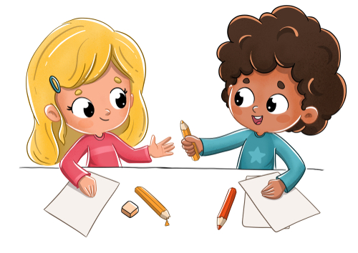
More Practice!
thankful
Notes:
Notes to Teacher:
Click to bring up the picture on the slide.
Ask: “What do you see in this picture?” (Children sharing.) “What are they sharing?” (Pencils.)
Click to circle the broken pencil.
Ask: “What happened to the yellow pencil?” (It broke.)
Teacher: “One girl is sharing her pencil with the other girl. How do you think the little girl with the broken pencil feels?” (Happy.)
Click to bring the word ‘thankful’ to the slide.
Teacher: “Thankful. Can you say thankful?” (Thankful.)
Teacher: “What does thankful mean?” (Thankful means full of thanks.)
Teacher: “When we add a word part to the beginning (prefix) or end (suffix) of a word, it changes the meaning of the word. Happy to unhappy. Color to colorful. Thank to thankful.
Applaud student’s efforts.
Click to go to next slide.

Slide 7
Sight Words
get
good
have
Notes:
Notes to Teacher:
Teacher says: “Let’s look at our sight words from this week.” (There are 3 words on this slide.)
Click to show the word “get.”– When it appears on the screen, ask: “What word do you see?”
When student responds “get” applaud his/her answer.
If student does not respond correctly, teacher will tell the student that the word is “get.” Have student say the word “get.” (Student repeats.)
Click to show the next word, “good.” - When it appears on the screen, ask: “What word do you see?”
When student responds “good,” applaud his/her answer.
If student does not respond correctly, teacher will tell the student that the word is “good.” Have student say the word “good.” (Student repeats.)
Click to show the next and final word, “have.” – When it appears on the screen, ask: “What word do you see?”
When student responds “have,” applaud his/her answer.
If student does not respond correctly, teacher will tell the student that the word is “have.” Have student say the word “have.” (Student repeats.)
Applaud student’s effort.
Click to go to the next slide.

Slide 8

Sight Word Practice
I have a pen.
Notes:
Notes to Teacher:
If student is ready, allow him/her to read each sentence to you. If student is not ready, assist him/her in reading.
-Click to make the sentence appear on the slide with images: I have a pen.
Applaud all efforts.
Click to move to next slide.

Slide 9
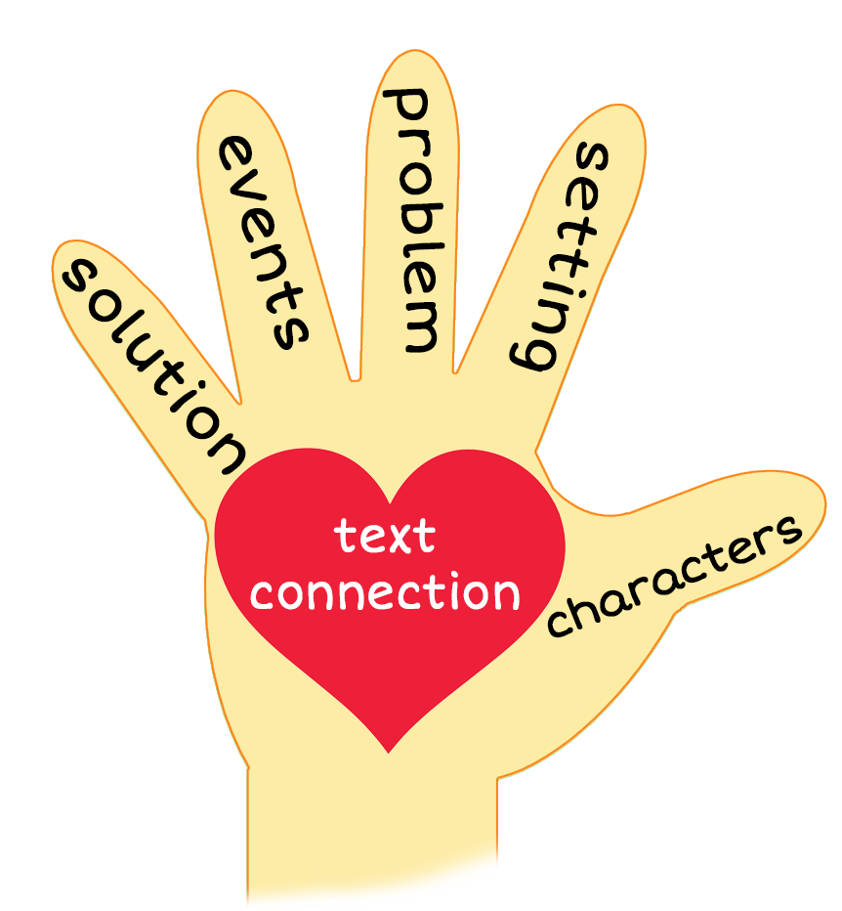
Jellyfish at the Party
Notes:
Notes to Teacher:
Teacher: “This week, you read the story, Jellyfish at the Party. Let’s look at the 5 finger retell chart to help us retell this story.”
Click to bring the image to the slide.
“Let’s work on our story retell together.”
Characters: “Who were the characters in the story?” (Characters: The main character was the jellyfish.)
Setting: “What was the setting of the story? Where did it take place?” (This story takes place in the sea.)
Problem – “What is the problem in the story?” (There were two problems in the story:
He had a rip in his wig.
He had a little mark on his lip.
Events: “What happened in the story?” (The jellyfish was looking for a wig and he wanted a sip.)
The jellyfish wanted a wig.
He did get a wig, but it had a rip in it.
The jellyfish got a new wig and did a jig.
The jellyfish got a big sip.
Someone gave the jellyfish a tip.
He had a little on his lip.
Ending: “What happened at the end of the story?” (The shark, crab and sea horse told the jellyfish to have a good one.)
Connection: Possible questions to ask to help student to connect to this story:
What was your favorite part of the story?
Do you think the jellyfish had fun at the party?
Main Idea: What is this story about? (This story tells us what the jellyfish did at the party.)
Applaud student’s efforts in completing this story retell.
Click to the next slide.

Slide 10
Q & A
Any Questions?
Notes:
Ask – “Do you have any questions about anything that you learned in this lesson?”

