Slide 1
Letter and Phonics of the Week
Uu; Short u
Notes:
Tell the student that we are going to review the letter Uu, work on word families, review our sight words and complete a story retell for The Four Cubs.
Click to go to the next slide.

Slide 2

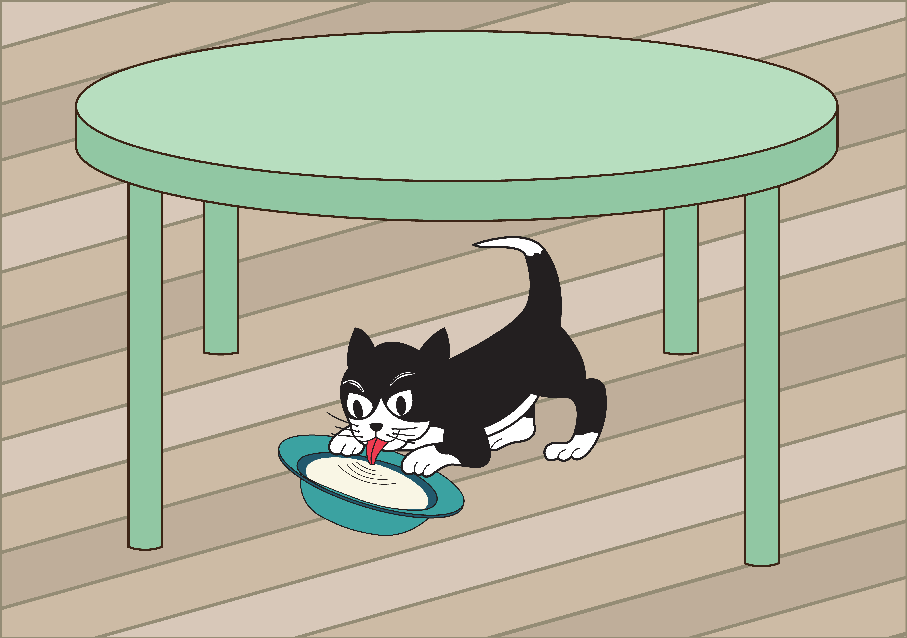
Uu
umbrella
under
Notes:
Notes to Teacher:
Teacher: “Point to the letters on the screen. “What letters are we talking about today?” (Student will answer Uu.)
If student is struggling with this letter:
(Point to the uppercase U.) “Uppercase U.” (Student repeats.)
(Point to the lowercase u.) “Lowercase u.” (Student repeats.)
Teacher: “What sound does the short u make?” (/u/ like in umbrella.)
If student is struggling, teacher will model making the short u sound and have the student repeat: /u/ like in umbrella: /u/, /u/, /u/.
Teacher: “What pictures begin with the short /u/ sound?”
Click to show the umbrella– When it appears on the screen, ask, “What do you see?” When student responds “umbrella,” applaud his/her answer. If student does not respond correctly, teacher will tell student that it is an umbrella. Click to show the word “umbrella.”
Click to show the next image --under– When it appears on the screen, ask, “Where is the cat?” If student responds “under,” applaud his/her answer. If student does not respond correctly, teacher will tell student that it is under. Click to show the word “under.”
Applaud student’s efforts.
Click to go to the next slide.

Slide 3


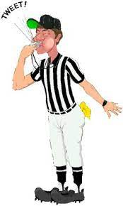
Uu
up
book
umpire
uppercase
Notes:
Notes to Teacher:
Teacher: “What letters do you see?” (Uu.) If student says Uu, applaud his/her answer.
If student is still unsure, remind him/her by saying “uppercase U” and “lowercase u.” (Student should repeat teacher.)
Teacher: “Tell me about the pictures you see that appear on the screen.” (Up, book, umpire and uppercase.)
-Click to show a picture of an arrow pointing up. Ask: “What is this?” (Up.) Applaud correct answer or assist in telling the correct name for the picture. Click to show the word up.
-Click to show a book. Ask: “What is this?” (Book.) Applaud correct answer or assist in telling the correct name for the picture. Click to show the word book.
-Click to show the umpire. Ask: “What is this?” (Umpire.) Applaud correct answer or assist in telling the correct name for the picture. Click to show the word umpire.
-Click to show an uppercase letter E. Ask: “What is this?” (uppercase E.) Applaud correct answer or assist in telling the correct name for the picture. Click to show the word uppercase.
After identifying the pictures (up, book, umpire and uppercase,) ask:
Teacher: “What pictures begin with the letter u?” (Up, umpire and uppercase begin with the letter u. Book does not begin with the letter u.)
If student is struggling to name the pictures that begin with u, teacher will assist by saying each picture name and asking if it begins with /u/?
- “Up – Does it begin with /u/?” (Yes.)
- “Book- Does it begin with /u/?” (No.)
- “Umpire - Does it begin with /u/?” (Yes.)
- “Uppercase - Does it begin with /u/?” (Yes.)
Click to take the picture of the book off of the slide.
Teacher will applaud efforts of student.
Click to go to the next slide.

Slide 4
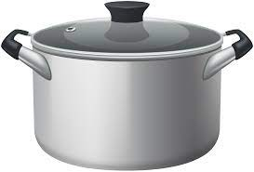


Word Family Practice
-ot
pot
hot
Notes:
Notes to Teacher:
Click to bring the house on the screen.
Ask: “Do you remember talking about word families this week?” (Remind student that words that end the same are part of the same word family.)
“Read each word to me:”
-Click to bring up the word ‘hot’ with a picture of hot. Have student read the word. (Hot.)
-Click to bring up the word ‘pot’ with a picture of a pot. Have student read the word. (Pot.)
Applaud student’s effort and/or assist reading the word.
Click to move to the next slide.

Slide 5
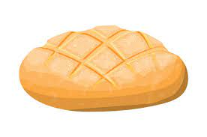

Word Family Practice
-un
bun
sun
Notes:
Notes to Teacher:
Click to bring the next house onto the screen.
“Read each word to me:”
-Click to bring up the word ‘sun’ with a picture of sun. Have student read the word. (Sun.)
-Click to bring up the word ‘bun’ with a picture of a bun. Have student read the word. (Bun.)
Applaud student’s effort and/or assist reading the word.
Click to move to the next slide.

Slide 6
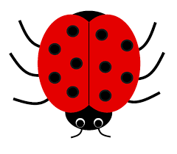

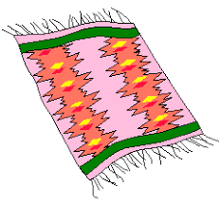

Tell Me About It!
-ug
-an
bug
bug
fan
fan
can
rug
rug
can
Notes:
Notes to Teacher:
Teacher: “Let’s sort the words that end the same.”
Click to bring up the -ug circle. Read “-ug.” (Have student repeat.)
Click to bring up the -an circle. Read “-an.” (Have student repeat.)
Click to show bug. Ask: “What is this?” (Bug.)
“Where does it belong?” (In the -ug circle.)
Click to place the bug in the –up circle.
Click to show fan. Ask: “What is this?” (Fan.)
“Where does it belong?” (In -an circle.)
Click to place the fan in the –an circle.
Click to show can. Ask: “What is this?” (Can.)
“Where does it belong?” (In -an circle.)
Click to place the can in the –an circle.
Click to show rug. Ask: “What is this?” (Rug.)
“Where does it belong?” (In -ug circle.)
Click to place the rug in the –ug circle.
Applaud student’s efforts.
Click to go to next slide.

Slide 7
Sight Words
do
four
run
Notes:
Notes to Teacher:
Teacher says: “Let’s look at our sight words from this week.” (There are 3 words on this slide.)
Click to show the word “do.”– When it appears on the screen, ask: “What word do you see?”
When student responds “do” applaud his/her answer.
If student does not respond correctly, teacher will tell the student that the word is “do.” Have student say the word “do.” (Student repeats.)
Click to show the next word, “four.” - When it appears on the screen, ask: “What word do you see?”
When student responds “four,” applaud his/her answer.
If student does not respond correctly, teacher will tell the student that the word is “four.” Have student say the word “four.” (Student repeats.)
Click to show the next and final word, “run.” – When it appears on the screen, ask: “What word do you see?”
When student responds “run,” applaud his/her answer.
If student does not respond correctly, teacher will tell the student that the word is “run.” Have student say the word “run.” (Student repeats.)
Applaud student’s effort.
Click to go to the next slide.

Slide 8
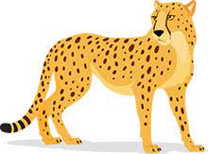
Sight Word Practice
He can run.
Notes:
Notes to Teacher:
If student is ready, allow him/her to read each sentence to you. If student is not ready, assist him/her in reading.
-Click to make the sentence appear on the slide with images: He can run.
Applaud all efforts.
Click to move to next slide.

Slide 9
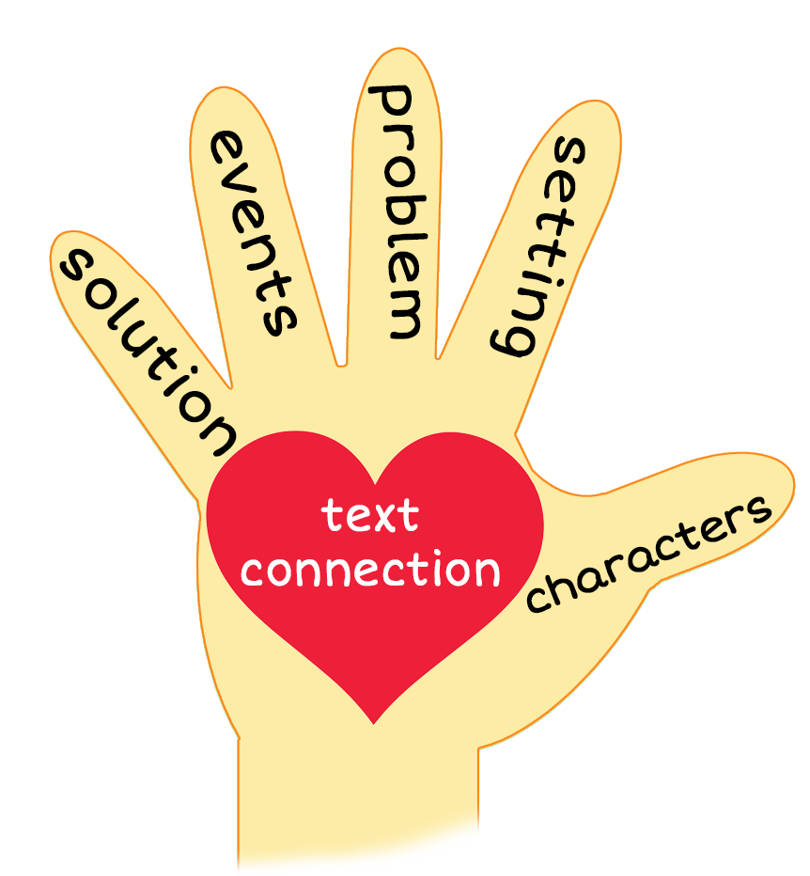
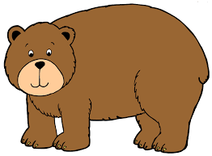
The Four Cubs
Notes:
Notes to Teacher:
Teacher: “This week, you read the story, The Four Cubs. Let’s look at the 5 finger retell chart to help us retell this story.”
Click to bring the image to the slide.
“Let’s work on our story retell together.”
Characters: “Who were the characters in the story?” (Characters: A boy and four cubs.)
Setting: “What was the setting of the story? Where did it take place?” (This story takes place inside a hut and out in the forest.)
Problem – “What is the problem in the story?” (The boy was afraid of the cubs and the cubs were afraid of the boy.)
Events: “What happened in the story?” (The boy watched the cubs. When they saw each other, they were frightened.)
The boy saw the four cubs in a hut.
The cubs took a bath.
The cubs hug on a rug.
The cubs eat nuts and bugs.
The cubs see the boy and run.
The boy runs away.
Ending: “What happened at the end of the story?” (The boy runs from the cubs.)
Connection: Possible questions to ask to help student to connect to this story:
What was your favorite part of the story?
Did you ever get scared? If so, what did you do?
Main Idea: What is this story about? (This story is about things the four cubs can do.)
Applaud student’s efforts in completing this story retell.
Click to the next slide.

Slide 10
Q & A
Any Questions?
Notes:
Ask – “Do you have any questions about anything that you learned in this lesson?”

