Slide 1
Letter of the Week
Zz
Notes:
Tell the student that we are going to review the letter Ww, talk about homonyms, review our sight words and complete a story retell for I Can Be That.
Click to go to the next slide.

Slide 2
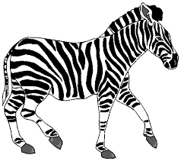

Zz
zebra
zoo
Notes:
Notes to Teacher:
Teacher: “Point to the letters on the screen. “What letters are we talking about today?” (Student will answer Zz.)
If student is struggling with this letter:
(Point to the uppercase Z.) “Uppercase Z. (Student repeats.)
(Point to the lowercase z.) “Lowercase z.” (Student repeats.)
Teacher: “What sound does the letter z make?” (/z/ like in zebra.)
If student is struggling, teacher will model making the h sound and have the student repeat: /z/ like in zebra: /z/, /z/, /z/.
Teacher: “What pictures begin with the /z/ sound?”
Click to show the zebra– When it appears on the screen, ask, “What do you see?” When student responds “zebra,” applaud his/her answer. If student does not respond correctly, teacher will tell student that it is a zebra. Click to show the word “zebra.”
Click to show the next image --zoo– When it appears on the screen, ask, “What do you see?” If student responds “zoo,” applaud his/her answer. If student does not respond correctly, teacher will tell student that it is zoo. Click to show the word “zoo.”
Applaud student’s efforts.
Click to go to the next slide.

Slide 3
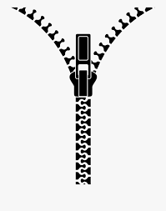



Zz
zipper
ball
zigzag
zero
Notes:
Notes to Teacher:
Teacher: “What letters do you see?” (Zz.) If student says Zz, applaud his/her answer.
If student is still unsure, remind him/her by saying “uppercase Z” and “lowercase z.” (Student should repeat teacher.)
Teacher: “Tell me about the pictures you see that appear on the screen.” (Zipper, ball, zigzag and zero.)
Click to show a picture of a zipper. Ask: “What is this?” (Zipper.) Applaud correct answer or assist in telling the correct name for the picture. Click to show the word zipper.
Click to show a ball. Ask: “What is this?” (Ball.) Applaud correct answer or assist in telling the correct name for the picture. Click to show the word ball.
Click to show the zigzag. Ask: “What is this?” (Zigzag.) Applaud correct answer or assist in telling the correct name for the picture. Click to show the word zigzag.
Click to show a zero. Ask: “What is this?” (Zero.) Applaud correct answer or assist in telling the correct name for the picture. Click to show the word zero.
After identifying the pictures (Zipper, ball, zigzag and zero.) ask:
Teacher: “What pictures begin with the letter z?” (Zipper, zigzag and zero begin with the letter z. Ball does not begin with the letter z.)
If student is struggling to name the pictures that begin with z, teacher will assist by saying each picture name and asking if it begins with /z/?
- “Zipper – Does it begin with /z/?” (Yes.)
- “Ball- Does it begin with /z/?” (No.)
- “Zigzag - Does it begin with /z/?” (Yes.)
- “Zero - Does it begin with /z/?” (Yes.)
Click to take the picture of the ball off of the slide.
Teacher will applaud efforts of student.
Click to go to the next slide.

Slide 4
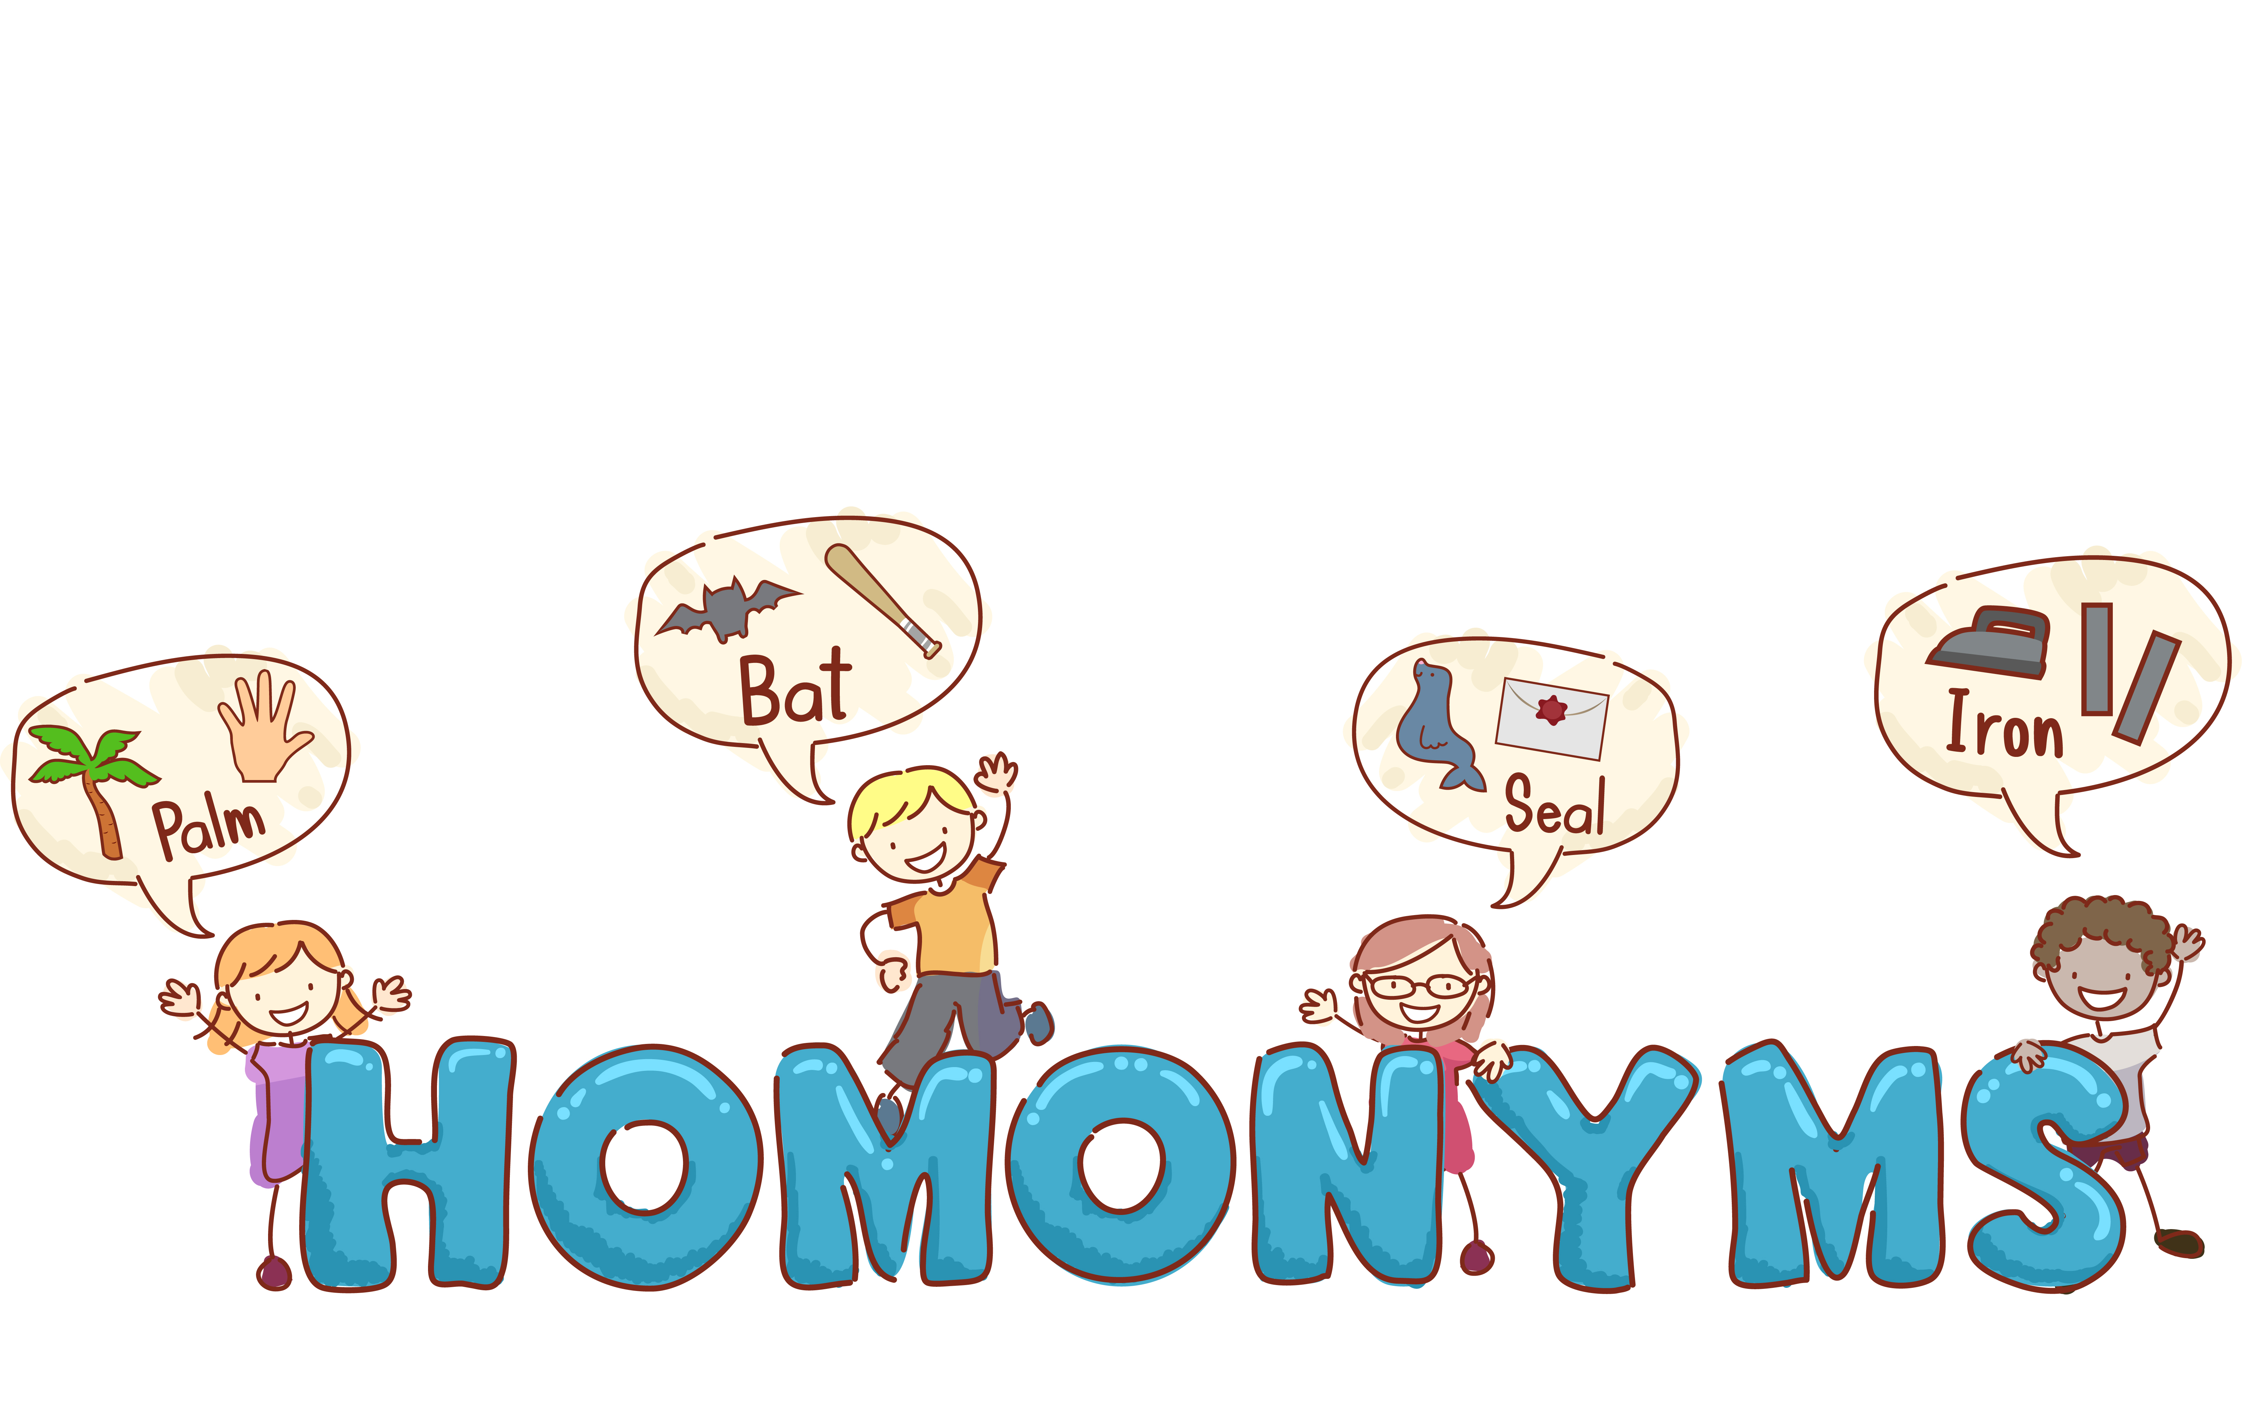
Homonyms
Notes:
Notes to Teacher:
Click to bring the word ‘homonyms’ to the screen.
Ask: “Do you see this big word?” (Yes.) “It says ‘homonyms.’ Can you say homonyms?” (Student repeats word: homonyms.)
- “Do you remember learning about homonyms?” (Wait for student’s response and talk about/review homonyms.
Homonyms are words that are spelled the same but have different meanings. Talk about the examples on the slide.)
Click to move to the next slide.

Slide 5

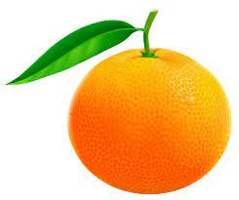



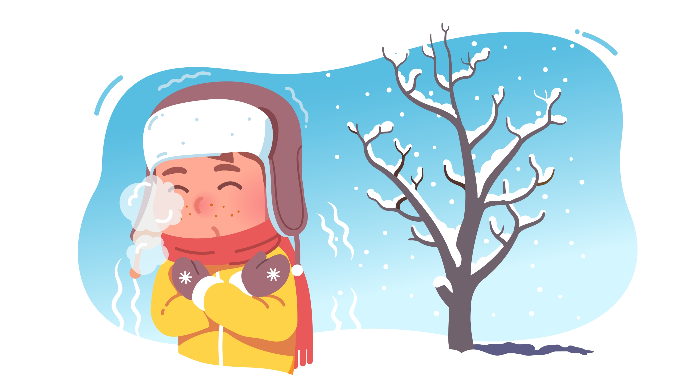
Homonym Practice
orange
cold
glasses
orange
glasses
cold
Notes:
Notes to Teacher:
“Look at each picture. Tell me what it is.”
-Click to show picture of an orange. Ask: “What is it?” (An orange.)
-Click to show picture of someone with a cold. Ask: “What is it?” (Someone with a cold.)
- Click to show picture of glasses. Ask: “What are these?” (Glasses.)
Explain to student that you will show him/her three more pictures and he/she will match each word to the correct homonym. Remind student that a homonym is a word that is spelled the same but has a different meaning.
- Click to show picture of drinking glass. Ask: “What are these?” (Glasses.)
Ask: “What is the homonym?” (Glasses.)
Click to draw the arrow from the glasses and drinking glasses.
- Click to show picture of the color orange. Ask: “What is it?” (Orange.)
Ask: “What is the homonym?” (An orange.)
Click to draw the arrow from the orange to the color orange.
- Click to show picture of someone with a cold. Ask: “What is it?” (Someone with a cold.)
Ask: “What is the homonym?” (Cold.)
Click to draw the arrow from the cold temperature to the person with the cold.
Applaud student’s effort.
Click to move to the next slide.

Slide 6
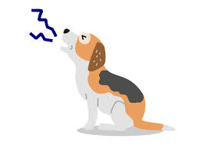
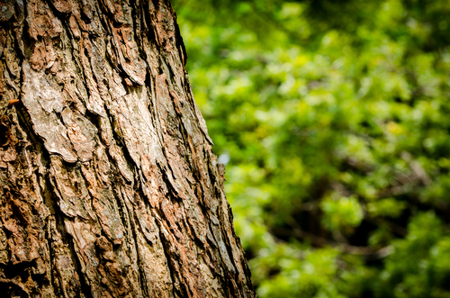
Tell Me About It!
bark
Notes:
Notes to Teacher:
-Click to bring the picture of the tree bark on the screen.
Ask: “What do you see?” (Assist student if needed or applaud correct answer – tree bark.) “Bark.” (Student repeats: bark.)
Ask: “Can you tell me about something else with the word bark?” (Assist student if needed or applaud correct answer – dog: bark.) “Bark.” (Student repeats: bark.)
-Click to show the picture of the dog barking.
Applaud student’s efforts.
Click to go to next slide.

Slide 7
Sight Words
all
at
be
Notes:
Notes to Teacher:
Teacher says: “Let’s look at our sight words from this week.” (There are 3 words on this slide.)
Click to show the word “all.”– When it appears on the screen, ask: “What word do you see?”
When student responds “all” applaud his/her answer.
If student does not respond correctly, teacher will tell the student that the word is “all.” Have student say the word “all.” (Student repeats.)
Click to show the next word, “at.” - When it appears on the screen, ask: “What word do you see?”
When student responds “at,” applaud his/her answer.
If student does not respond correctly, teacher will tell the student that the word is “at.” Have student say the word “at.” (Student repeats.)
Click to show the next and final word, “be.” – When it appears on the screen, ask: “What word do you see?”
When student responds “be,” applaud his/her answer.
If student does not respond correctly, teacher will tell the student that the word is “be.” Have student say the word “be.” (Student repeats.)
Applaud student’s effort.
Click to go to the next slide.

Slide 8


Sight Word Practice
All ten men see the jet.
Notes:
Notes to Teacher:
If student is ready, allow him/her to read each sentence to you. If student is not ready, assist him/her in reading.
-Click to make the sentence appear on the slide with images: All ten men see the jet.
Applaud all efforts.
Click to move to next slide.
sight word
spelling word}

Slide 9
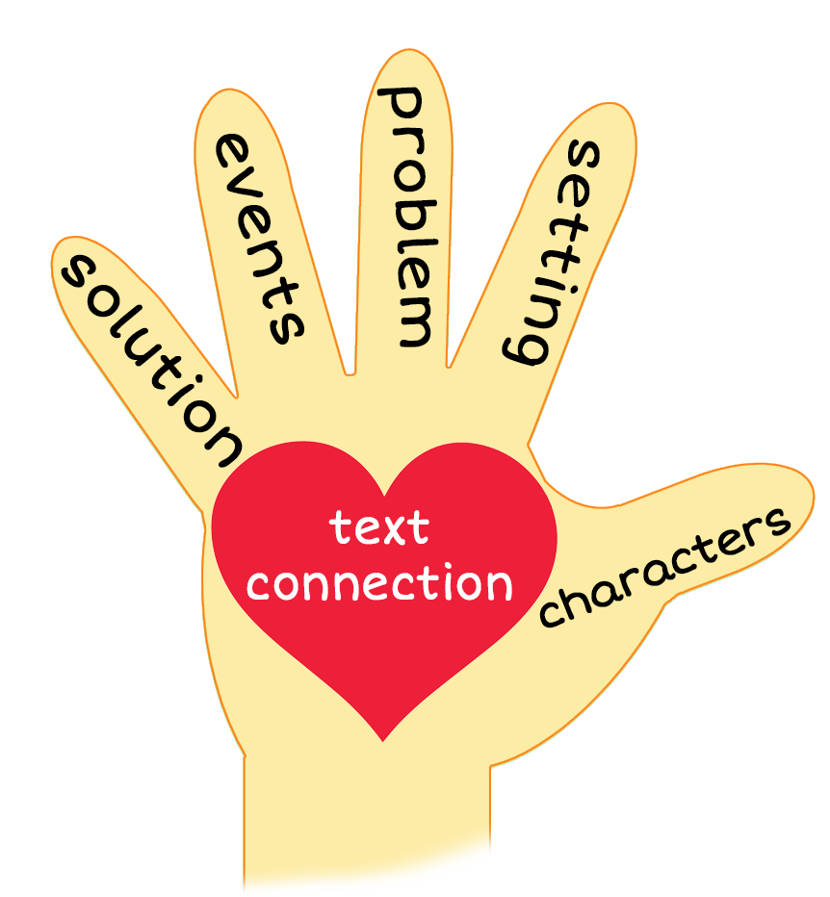

I Can Be That!
Notes:
Notes to Teacher:
Teacher: “This week, you read the story, I Can Be That! Let’s look at the 5 finger retell chart to help us retell this story.”
Click to bring the image to the slide.
“Let’s work on our story retell together.
Characters: “Who were the characters in the story?” (Characters: Boy and a brother or friend.)
Setting: “What was the setting of the story? Where did it take place?” (This story takes place inside a house in two different rooms.)
Problem – “What is the problem in the story?” (There is not a problem in the story.)
Events: “What happened in the story?” (The boy tells me about things that he can be.)
The boy tells me about men on a jet and shows me that he can be a jet.
He told me that his mom met a zebra and shows me that he can be a zebra.
He told me to look at all the hens.
His mom let him get a hen.
Mom tells him to zip it and play in the den.
Ending: “What happened at the end of the story?” (The boy and his brother (or friend) play in the den.)
Connection: Possible questions to ask to help student to connect to this story:
What was your favorite part of the story?
Did you ever pretend to be something? If so, what did you pretend to be? The boy pretended to be a jet and “flew” around the room.
Main Idea: What is this story about? (This story is about things the boy pretended to be.)
Applaud student’s efforts in completing this story retell.
Click to the next slide.

Slide 10
Q & A
Any Questions?
Notes:
Ask – “Do you have any questions about anything that you learned in this lesson?”

