Slide 1
Letter of the Week
Ww
Notes:
Tell the student that we are going to review the letter Ww, talk about prepositions, review our sight words and complete a story retell for Where is the Big, Bad Wolf?
Click to go to the next slide.

Slide 2

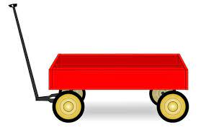
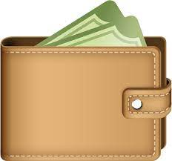
Ww
wagon
window
wallet
Notes:
Notes to Teacher:
Teacher: “Point to the letters on the screen. “What letters are we talking about today?” (Student will answer Ww.)
If student is struggling with this letter:
(Point to the uppercase W.) “Uppercase W. (Student repeats.)
(Point to the lowercase w.) “Lowercase w.” (Student repeats.)
Teacher: “What sound does the letter w make?” (/w/ like in wagon.)
If student is struggling, teacher will model making the h sound and have the student repeat: /w/ like in wagon: /w/, /w/, /w/.
Teacher: “What pictures begin with the /w/ sound?”
Click to show the wagon– When it appears on the screen, ask, “What do you see?” When student responds “wagon,” applaud his/her answer. If student does not respond correctly, teacher will tell student that it is a wagon. Click to show the word “wagon.”
Click to show the next image --window– When it appears on the screen, ask, “What do you see?” If student responds “window,” applaud his/her answer. If student does not respond correctly, teacher will tell student that it is window. Click to show the word “window.”
Click to show the final image –wallet- When it appears on the screen, ask, “What do you see?” If student responds “wallet,” applaud his/her answer. If student does not respond correctly, teacher will tell student that it is a wallet. Click to show the word “wallet.”
Click to go to the next slide.

Slide 3


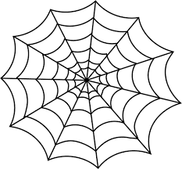
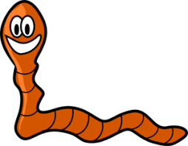
Ww
watermelon
table
web
worm
Notes:
Notes to Teacher:
Teacher: “What letters do you see?” (Ww.) If student says Ww, applaud his/her answer.
If student is still unsure, remind him/her by saying “uppercase W” and “lowercase w.” (Student should repeat teacher.)
Teacher: “Tell me about the pictures you see that appear on the screen.”
-Click to show a picture of a table. Ask: “What is this?” (Table.) Applaud correct answer or assist in telling the correct name for the picture. Click to show the word table.
-Click to show a watermelon. Ask: “What is this?” (Watermelon.) Applaud correct answer or assist in telling the correct name for the picture. Click to show the word watermelon.
-Click to show the web. Ask: “What is this?” (Web.) Applaud correct answer or assist in telling the correct name for the picture. Click to show the word web.
-Click to show a worm. Ask: “What is this?” (Worm.) Applaud correct answer or assist in telling the correct name for the picture. Click to show the word worm.
After identifying the pictures (table, watermelon, web and worm) ask:
Teacher: “What pictures begin with the letter w?” (Watermelon, web and worm begin with the letter w. Table does not begin with the letter w.)
If student is struggling to name the pictures that begin with w, teacher will assist by saying each picture name and asking if it begins with /w/?
- “Table – Does it begin with /w/?” (No.)
- “Watermelon- Does it begin with /w/?” (Yes.)
- “Web - Does it begin with /w/?” (Yes.)
- “Worm - Does it begin with /w/?” (Yes.)
Click to take the picture of the table off of the slide.
Teacher will applaud efforts of student.
Click to go to the next slide.

Slide 4

Prepositions
Notes:
Notes to Teacher:
“Do you see this big word at the top of the screen?” (Yes.)
“It says ‘prepositions.’ Can you say prepositions?”
(Student repeats word: prepositions.)
- “Do you remember learning about prepositions?” (Wait for student’s response and talk about/review prepositions.
Prepositions are lots of little words that connect the nouns to the rest of the words in sentences. It might tell me where something is. Example: The bird is in the tree. The dog is outside.)
-Click to show a picture of a puddle.
- Ask: “Who do you see in this picture?” (Possible answers: boy, girl, a child.)
-Ask: “Where is this girl/boy/child?” (jumping in a puddle.)
-Ask: “What is the preposition that tells me where the boy/girl/child is?” (in)
-Click to show the word “in” on the screen.
Applaud student’s effort.
Click to move to the next slide.

Slide 5

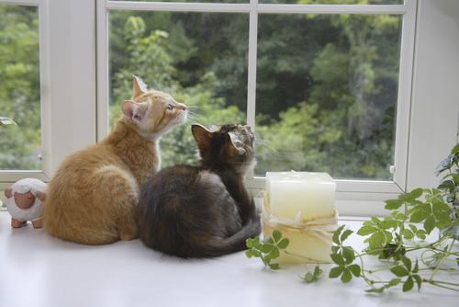
Prepositions
above
over
out
in
out
on
Notes:
Notes to Teacher:
“Look at this picture.”
Click to show picture of dolphins.
“Where are the dolphins?” (Allow student to talk to you about the picture. The student may say the dolphins are in the ocean. He/she may say the dolphins are out of the water. The student may say that the dolphins are jumping above or over the water.)
Click to show the preposition word: in
Click to show the preposition word: out
Click to show the preposition word: above
Click to show the preposition word: over
Explain that all of these words are prepositions and how each one of them may describe where the dolphins are.
Click to show pictures of kittens.
“Where are the kittens?” (Allow student to talk to you about the kittens in picture. The student should say the kittens are on the windowsill.)
“What are the kittens doing?” (Allow student to talk to you about the picture. The student should say the kittens are looking out of the window.)
Click to show the preposition word: on
Click to show the preposition word: out
The word out tells me where the kittens are and where they are looking.
Applaud student’s effort.
Click to move to the next slide.

Slide 6
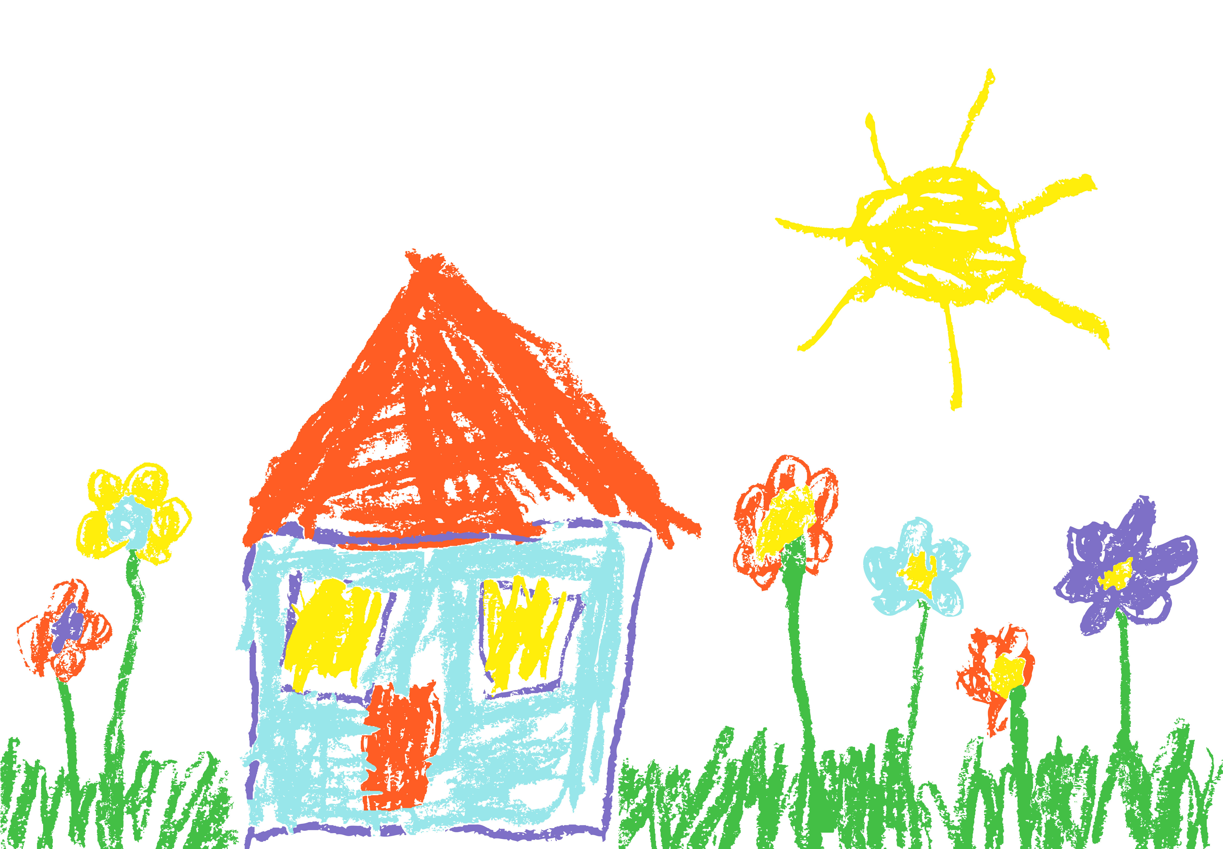
Tell Me About It!
The sun is in the sky.
The roof is on the house.
The flowers are in the grass.
Notes:
Notes to Teacher:
Click to show an image of a child’s drawing.
“What do you see in this picture?” (Possible answers: a house, the sun, grass, flowers, windows, door)
“Let’s use some prepositions to talk about where some things are in this drawing.”
-“Where is the sun?” (The sun is in the sky.)
After student answers, click to show the sentence and read it to the student, pointing out the preposition word underlined in the sentence.)
-“Where are the flowers?” (The flowers are in the ground/or grass.)
After student answers, click to show the sentence and read it to the student, pointing out the preposition word underlined in the sentence.)
-“Where is the roof?” (The roof is on the house.)
After student answers, click to show the sentence and read it to the student, pointing out the preposition word underlined in the sentence.)
Applaud student’s efforts.
Click to go to next slide.

Slide 7
Sight Words
but
came
funny
Notes:
Notes to Teacher:
Teacher says: “Let’s look at our sight words from this week.” (There are 3 words on this slide.)
Click to show the word “but.”– When it appears on the screen, ask: “What word do you see?”
When student responds “but” applaud his/her answer.
If student does not respond correctly, teacher will tell the student that the word is “but.” Have student say the word “but.” (Student repeats.)
Click to show the next word, “came.”– When it appears on the screen, ask: “What word do you see?”
When student responds “came,” applaud his/her answer.
If student does not respond correctly, teacher will tell the student that the word is “came.” Have student say the word “came.” (Student repeats.)
Click to show the next and final word, “funny.” – When it appears on the screen, ask: “What word do you see?”
When student responds “funny,” applaud his/her answer.
If student does not respond correctly, teacher will tell the student that the word is “funny.” Have student say the word “funny.” (Student repeats.)
Applaud student’s effort.
Click to go to the next slide.

Slide 8
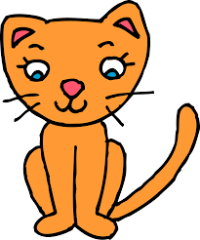
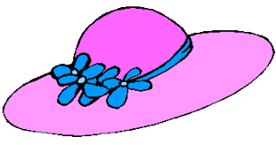
Let’s Read!
I see a funny cat and a hat.
Notes:
Notes to Teacher:
If student is ready, allow him/her to read each sentence to you. If student is not ready, assist him/her in reading.
-Click to make the sentence appear on the slide with images: I see a funny cat and a hat.
sight word
spelling word
Applaud all efforts.
Click to move to next slide.

Slide 9
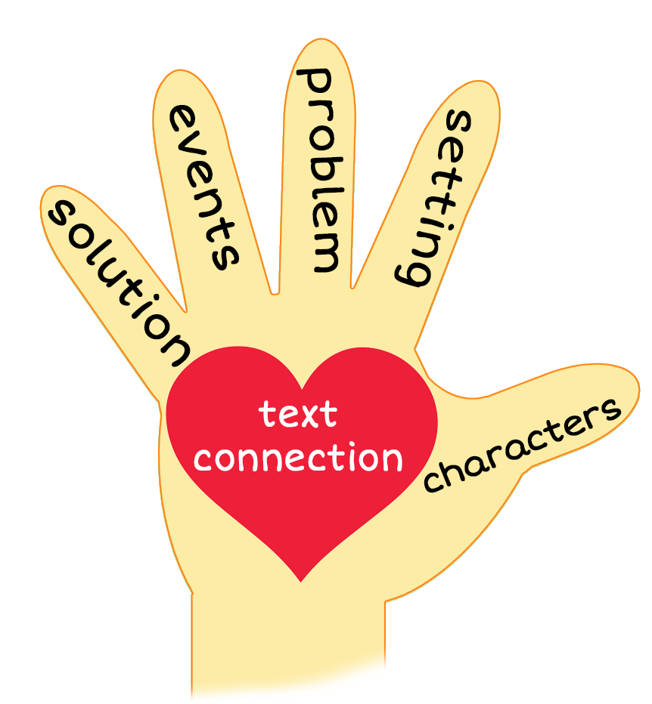
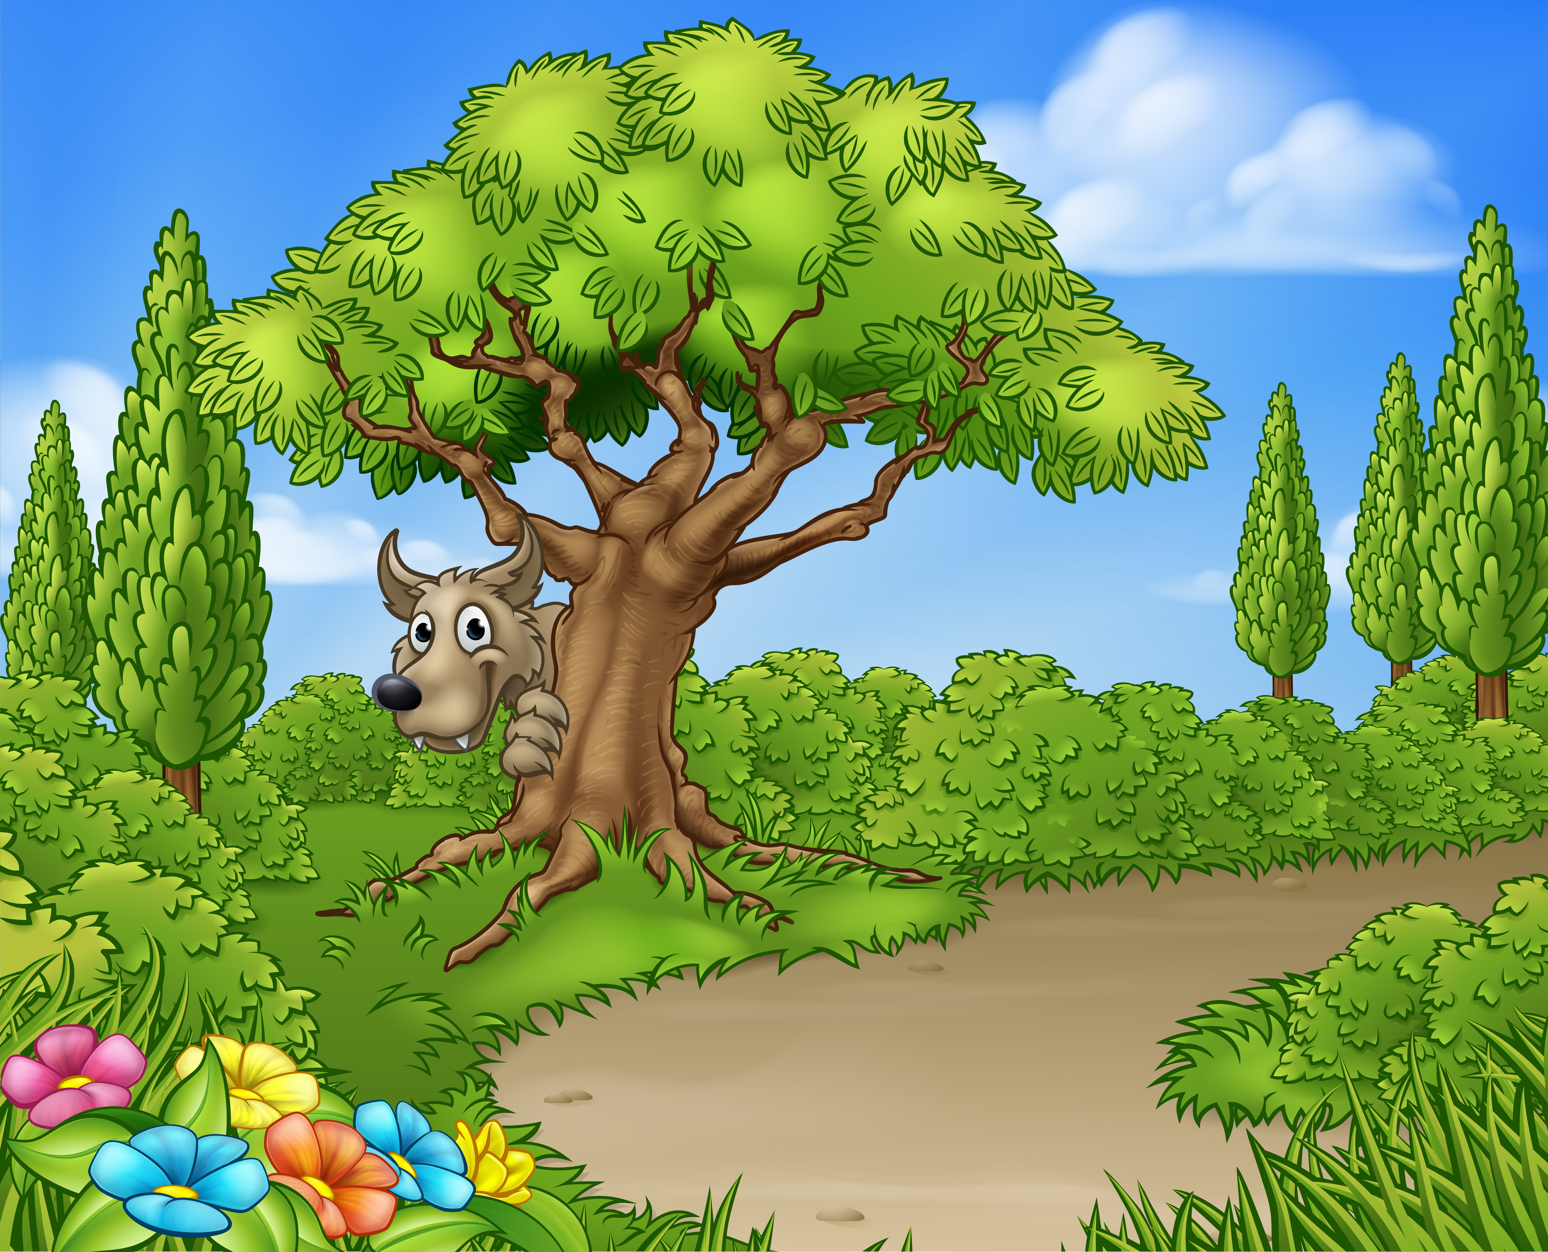
Where is the Big, Bad Wolf?
Notes:
Notes to Teacher:
Teacher: “This week, you read the story, Where is the Big, Bad Wolf? Let’s look at the 5 finger retell chart to help us retell this story.”
Click to bring the image to the slide.
“Let’s work on our story retell together.
Characters: “Who were the characters in the story?” (Characters: Girl, the big, bad wolf, the funny cat and the funny rat.)
Setting: “What was the setting of the story? Where did it take place?” (The girl was inside at the beginning of the story and outside toward the middle and end of the story.)
Problem – “What is the problem in the story?” (The girl can’t find the big, bad wolf.)
Events: “What happened in the story?” (The girl is looking for the big, bad wolf.)
The girl looked out the window for the big, bad wolf.
She saw a funny cat with a bat.
She looked in the well and saw a funny rat with a fan.
She looked at the wall and saw a funny cat with a tan hat.
She looked in the wagon and saw a funny rat with a pan.
Ending: “What happened at the end of the story?” (When the story ended, she was still looking for the big, bad wolf. The wolf was hiding in the forest behind a tree.)
Connection: Possible questions to ask to help student to connect to this story:
How do you think the girl felt in the story?
How do you feel when you are looking for something and can’t find it?
What was your favorite part of the story?
Main Idea: What is this story about? (This story is about a girl looking for the big, bad wolf.)
Applaud student’s efforts in completing this story retell.
Click to the next slide.

Slide 10
Q & A
Any Questions?
Notes:
Ask – “Do you have any questions about anything that you learned in this lesson?”

