Slide 1
Letter of the Week
Vv
Notes:
Tell the student that we are going to review the letter Vv, talk about descriptive sentences, review our sight words and complete a story retell for Eat Your Vegetables.
Click to go to the next slide.

Slide 2
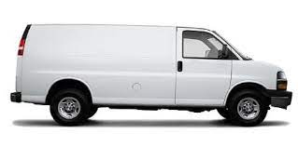
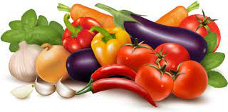

Vv
vegetables
van
vase
Notes:
Notes to Teacher:
Teacher: “Point to the letters on the screen. “What letters are we talking about today?” (Student will answer Vv.)
If student is struggling with this letter:
(Point to the uppercase V.) “Uppercase V. (Student repeats.)
(Point to the lowercase v.) “Lowercase v.” (Student repeats.)
Teacher: “What sound does the letter v make?” (/v/ like in vase.)
If student is struggling, teacher will model making the h sound and have the student repeat: /v/ like in vase: /v/, /v/, /v/.
Teacher: “What pictures begin with the /v/ sound?”
Click to show the vegetables– When it appears on the screen, ask, “What do you see?” When student responds “vegetables,” applaud his/her answer. If student does not respond correctly, teacher will tell student that they are vegetables. Click to show the word “vegetables.”
Click to show the next image -van– When it appears on the screen, ask, “What do you see?” If student responds “van,” applaud his/her answer. If student does not respond correctly, teacher will tell student that it is van. Click to show the word “van.”
Click to show the final image –vase- When it appears on the screen, ask, “What do you see?” If student responds “vase,” applaud his/her answer. If student does not respond correctly, teacher will tell student that it is a vase. Click to show the word “vase.”
Click to go to the next slide.

Slide 3

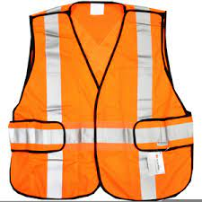
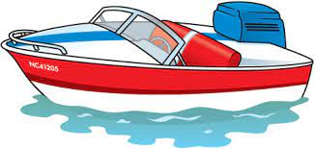
Vv
vest
violin
boat
Notes:
Notes to Teacher:
Teacher: “What letters do you see?” (Vv.) If student says Vv, applaud his/her answer.
If student is still unsure, remind him/her by saying “uppercase V” and “lowercase v.” (Student should repeat teacher.)
Teacher: “Tell me about the pictures you see that appear on the screen.”
-Click to show a violin. Ask: “What is this?” (Violin.) Applaud correct answer or assist in telling the correct name for the picture. Click to show the word violin.
-Click to show a vest. Ask: “What is this?” (Vest.) Applaud correct answer or assist in telling the correct name for the picture. Click to show the word vest.
-Click to show the boat. Ask: “What is this?” (Boat.) Applaud correct answer or assist in telling the correct name for the picture. Click to show the word boat.
After identifying the pictures (violin, vest and boat) ask:
“What pictures begin with the letter v?” (Violin and vest begin with the letter v. Boat does not begin with the letter v.)
If student is struggling to name the pictures that begin with v, teacher will assist by saying each picture name and asking if it begins with /v/?
- “Violin – Does it begin with /v/?” (Yes.)
- “Vest -Does it begin with /v/?” (Yes.)
-“Boat - Does it begin with /v/?” (No.)
Click to take the picture of the boat off of the slide.
Teacher will applaud efforts of student.
Click to go to the next slide.

Slide 4
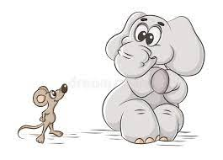
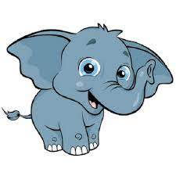
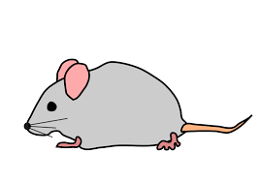
Descriptive Sentences
I see a big .
elephant
I see a little .
mouse
Notes:
Notes to Teacher:
Click to bring the picture of the elephant and the mouse.
Allow student to read each sentence, reminding student that pictures help us read sentences.
Click to bring the sentence onto the screen: I see a big (elephant.)
Click to bring the next sentence onto the screen: I see a little (mouse.)
Applaud student’s effort.
Click to move to the next slide.

Slide 5
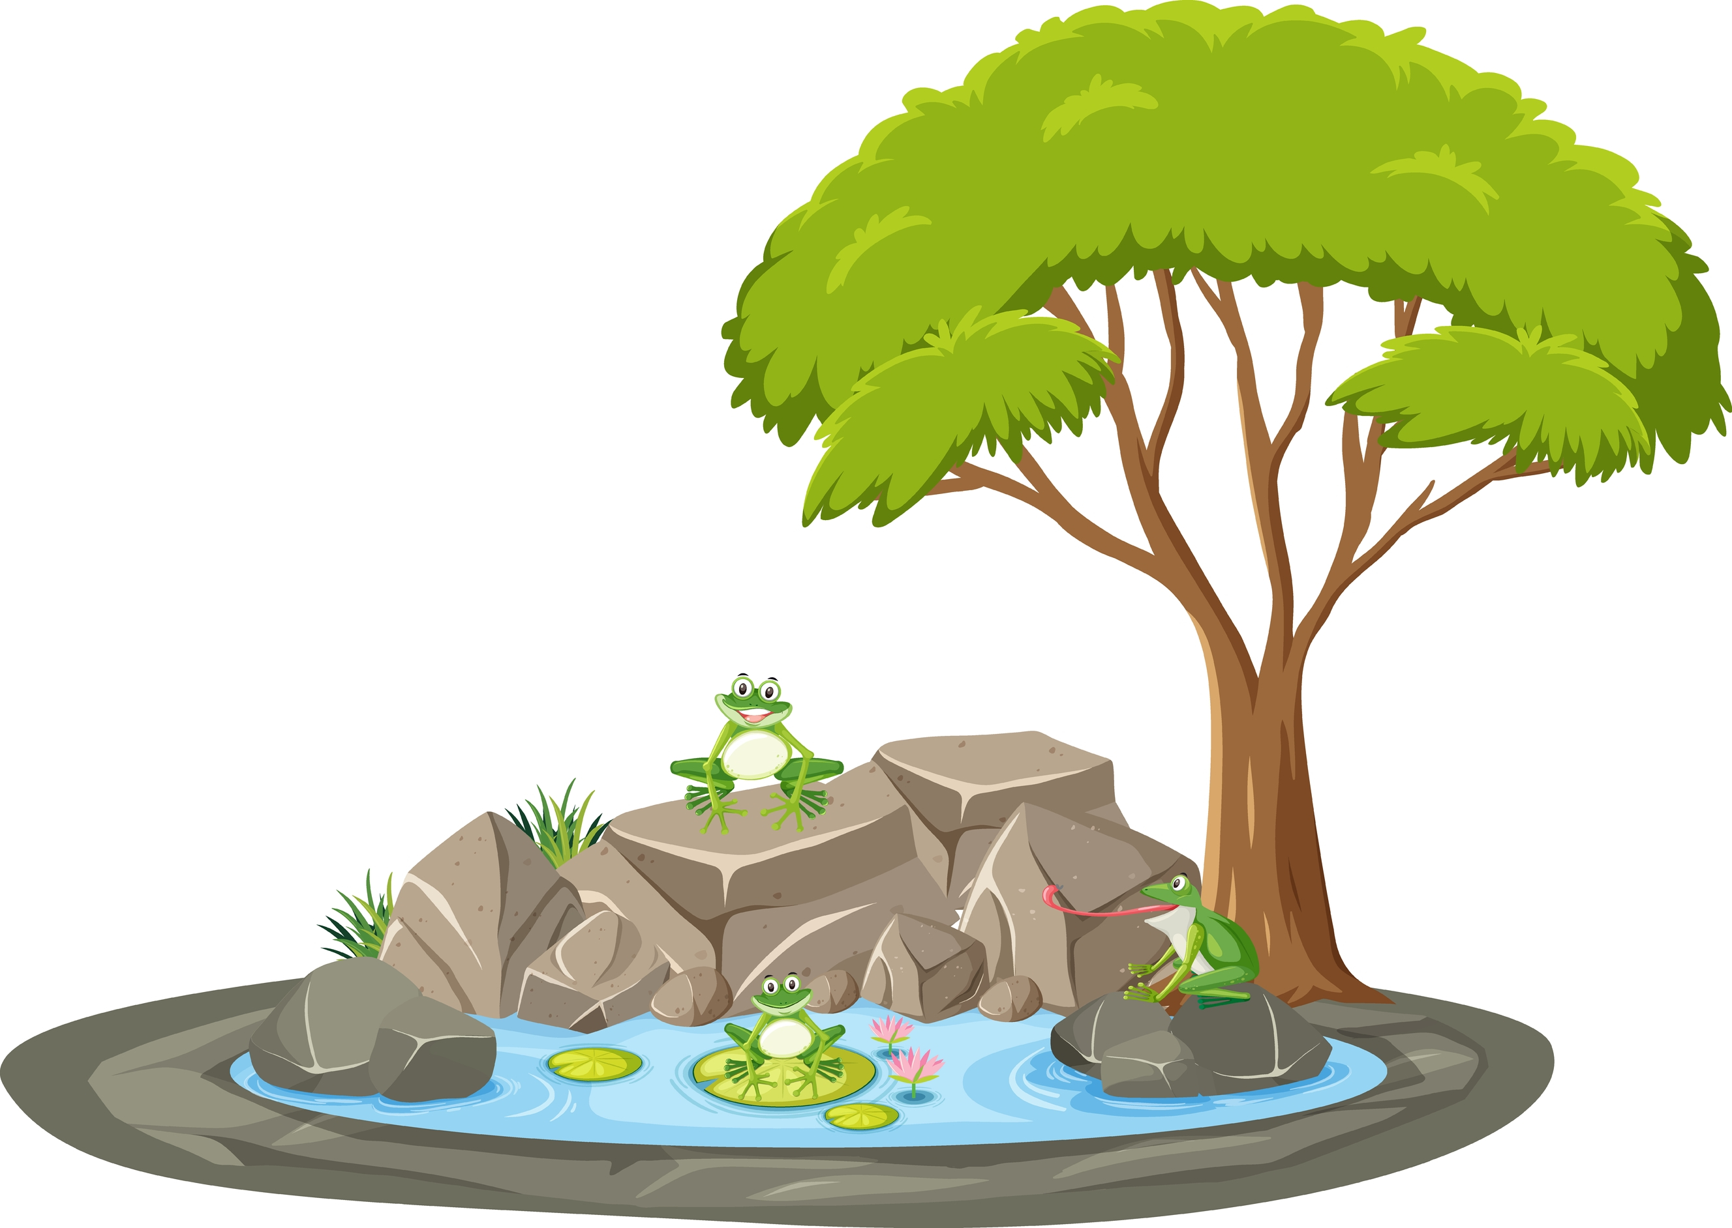
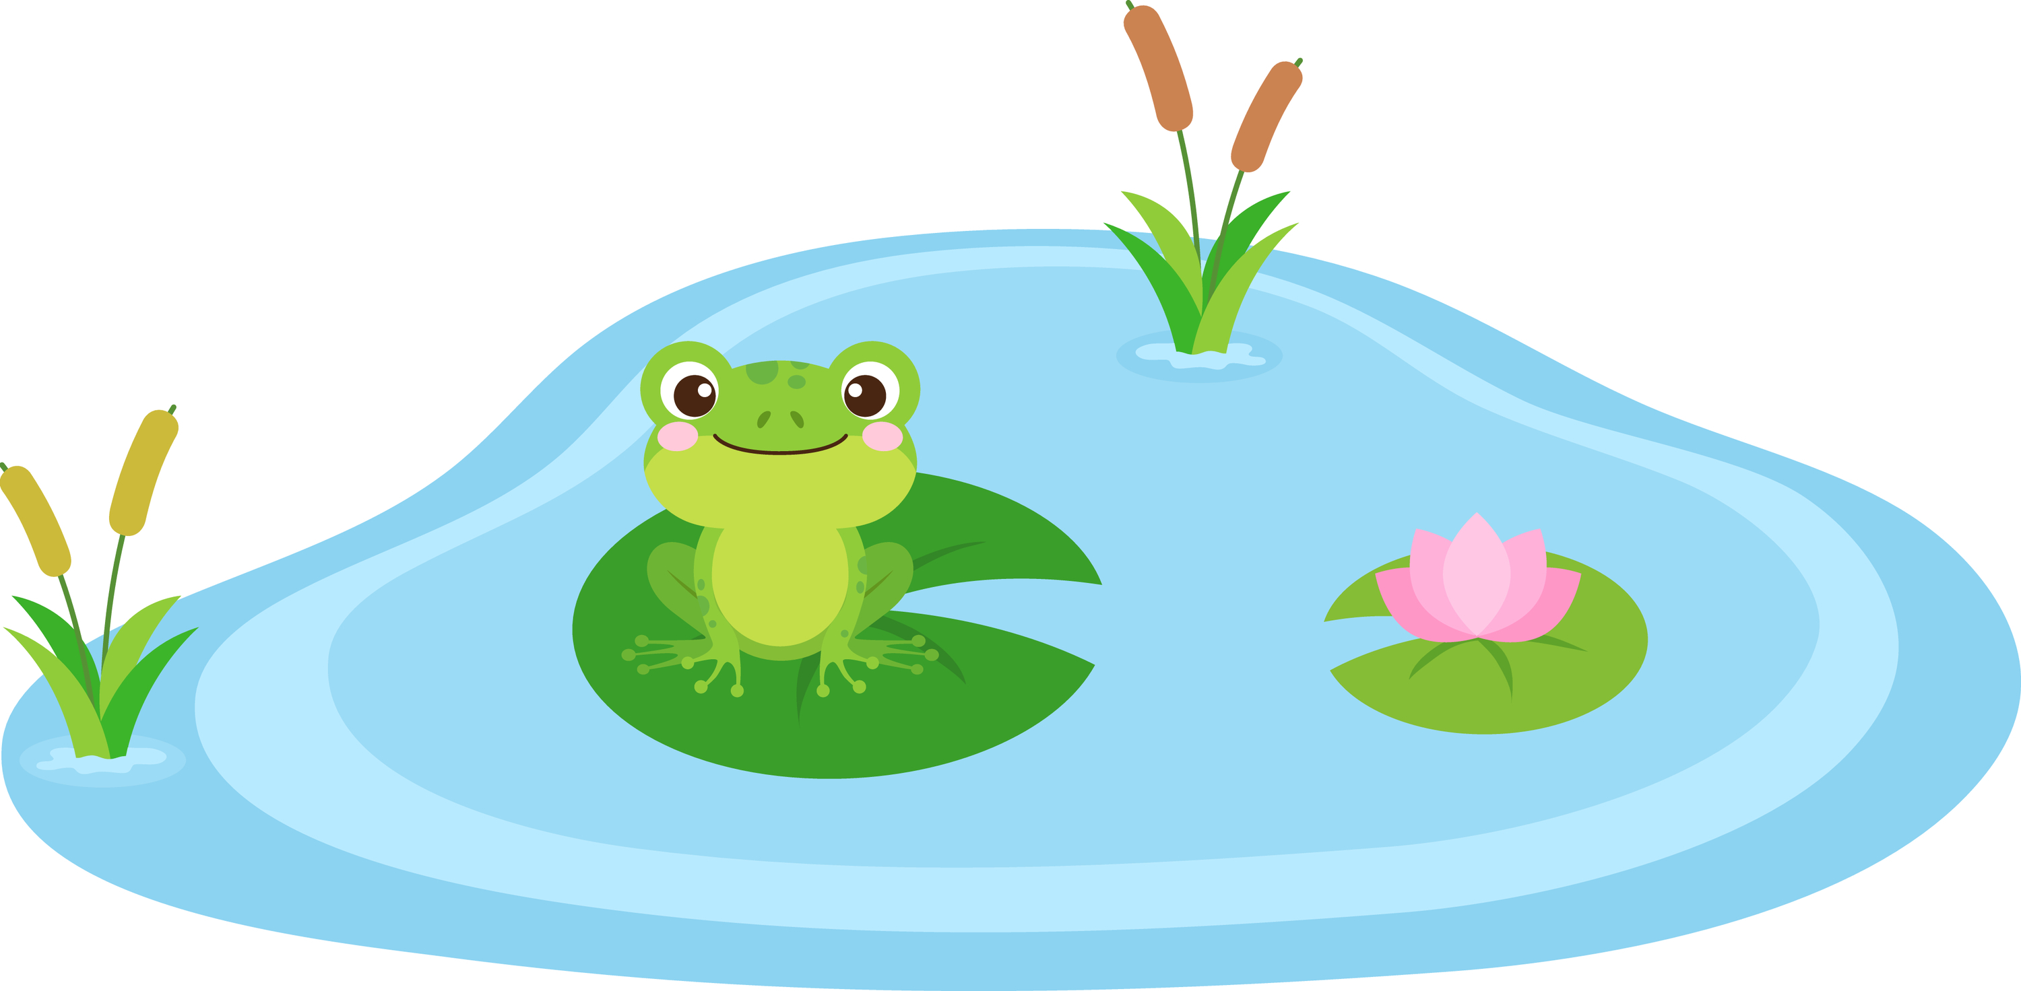
I see three frogs.
Notes:
Notes to Teacher:
“Look at the pictures. Count the number of frogs in each picture.” (The top picture has one frog, and the bottom picture has three frogs.)
Click to bring up first image.
Click to bring up second image.
Say: “I see three frogs in the pond.”
Ask: “Which picture matches that sentence?”
Repeat sentence again: “I see three frogs in the pond.”
Encourage students to look at the details in the picture.
After student tells you which picture goes along with the sentence (bottom picture,) click to remove the incorrect picture.
Applaud student’s efforts.
Click to go to next slide.

Slide 6
Sight Words
three
to
up
two
we
Notes:
Notes to Teacher:
Teacher says: “Now, let’s look at some of the words we worked on this year.” (There are 5 words on this slide.)
Click to show the word “three.””– When it appears on the screen, ask: “What word do you see?”
When student responds “three,” applaud his/her answer.
If student does not respond correctly, teacher will tell the student that the word is “three.” Have student say the word “three.” (Student repeats.)
Click to show the next word, “to.”– When it appears on the screen, ask: “What word do you see?”
When student responds “to,” applaud his/her answer.
If students does not respond correctly, teacher will tell the student that the word is “to.” Have student say the word “to.” (Student repeats.)
Click to show the next word, “up.” – When it appears on the screen, ask: “What word do you see?”
When student responds “up,” applaud his/her answer.
If student does not respond correctly, teacher will tell the student that the word is “up.” Have student say the word “up.” (Student repeats.)
Click to show the next word, “two.” – When it appears on the screen, ask: “What word do you see?”
When student responds “two,” applaud his/her answer.
If student does not respond correctly, teacher will tell the student that the word is “two.” Have student say the word “two.” (Student repeats.)
Click to show the next and final word, “we.” – When it appears on the screen, ask: “What word do you see?”
When student responds “we,” applaud his/her answer.
If student does not respond correctly, teacher will tell the student that the word is “we.” Have student say the word “we.” (Student repeats.)
“Now, let’s look at some more words.” Click to show the arrow.
Click to go to the next slide.

Slide 7
Sight Words
where
am
yellow
red
did
Notes:
Notes to Teacher:
Teacher says: “Can you read these sight words?” (There are 5 words on this slide.)
Click to show the word “where.””– When it appears on the screen, ask: “What word do you see?”
When student responds “where,” applaud his/her answer.
If student does not respond correctly, teacher will tell the student that the word is “where.” Have student say the word “where.” (Student repeats.)
Click to show the next word, “am.”– When it appears on the screen, ask: “What word do you see?”
When student responds “am,” applaud his/her answer.
If students does not respond correctly, teacher will tell the student that the word is “am.” Have student say the word “am.” (Student repeats.)
Click to show the next word, “yellow.” – When it appears on the screen, ask: “What word do you see?”
When student responds “yellow,” applaud his/her answer.
If student does not respond correctly, teacher will tell the student that the word is “yellow.” Have student say the word “yellow.” (Student repeats.)
Click to show the next word, “red.” – When it appears on the screen, ask: “What word do you see?”
When student responds “red,” applaud his/her answer.
If student does not respond correctly, teacher will tell the student that the word is “red.” Have student say the word “red.” (Student repeats.)
Click to show the next and final word, “did.” – When it appears on the screen, ask: “What word do you see?”
When student responds “did,” applaud his/her answer.
If student does not respond correctly, teacher will tell the student that the word is “did.” Have student say the word “did.” (Student repeats.)
“Now, let’s look at our last group of words.” Click to show the arrow.
Click to go to the next slide.

Slide 8

Sight Words
eat
ate
brown
Good Job!
black
help
Notes:
Notes to Teacher:
Teacher asks: “What words do you see?”
Click to show the word “eat.””– When it appears on the screen, ask: “What word do you see?”
When student responds “eat,” applaud his/her answer.
If student does not respond correctly, teacher will tell the student that the word is “eat.” Have student say the word “eat.” (Student repeats.)
Click to show the next word, “ate.”– When it appears on the screen, ask: “What word do you see?”
When student responds “ate,” applaud his/her answer.
If students does not respond correctly, teacher will tell the student that the word is “ate.” Have student say the word “ate.” (Student repeats.)
Click to show the next word, “brown.” – When it appears on the screen, ask: “What word do you see?”
When student responds “brown,” applaud his/her answer.
If student does not respond correctly, teacher will tell the student that the word is “brown.” Have student say the word “brown.” (Student repeats.)
Click to show the next word, “black.” – When it appears on the screen, ask: “What word do you see?”
When student responds “black,” applaud his/her answer.
If student does not respond correctly, teacher will tell the student that the word is “black.” Have student say the word “black.” (Student repeats.)
Click to show the next and final word, “help.” – When it appears on the screen, ask: “What word do you see?”
When student responds “help,” applaud his/her answer.
If student does not respond correctly, teacher will tell the student that the word is “help.” Have student say the word “help.” (Student repeats.)
Applaud student’s effort.
Click to go to the next slide.

Slide 9
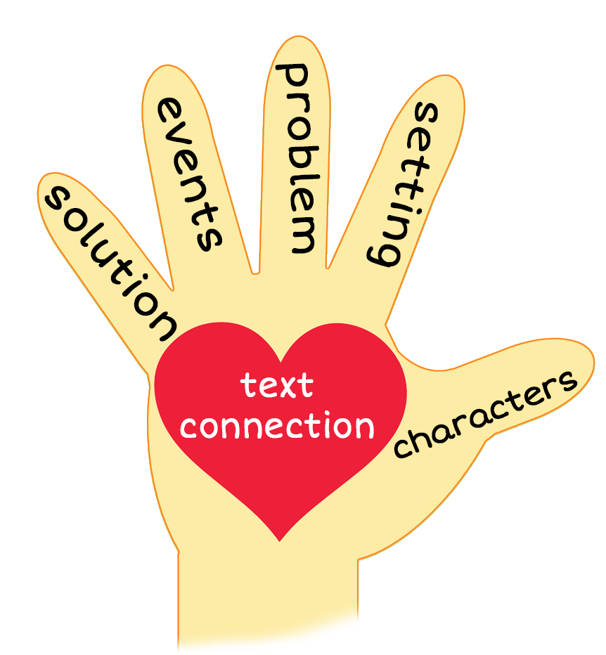

Eat Your Vegetables
Notes:
Notes to Teacher:
Teacher: “This week, you read the story, Eat Your Vegetables. Let’s look at the 5 finger retell chart to help us retell this story.”
Click to bring the image to the slide.
Characters: “Who were the characters in the story?” (Characters: a boy and a girl)
Setting: “What was the setting of the story? Where did it take place?” (They were sitting at a table in most of the story.)
Problem – “What is the problem in the story?” (The children had to find vegetables.)
Events: “What happened in the story?” (The boy and girl was finding and eating vegetables:
The boy and girl had to find a yellow vegetable (corn) and eat it.
The boy and girl found a red vegetable (red pepper) and ate it.
The boy and girl had to find a brown vegetable (onion) and eat it.
Ending: “What happened at the end of the story?” (The girl and boy ate the vegetables and told me to go eat the vegetables.)
Connection: Possible questions to ask to help student to connect to this story:
What was your favorite part of the story?
What vegetables do you like to eat?
Main Idea: What is this story about? (This story is about a girl and boy finding and eating vegetables.)
Applaud student’s efforts in completing this story retell.
Click to the next slide.

Slide 10
Q & A
Any Questions?
Notes:
Ask – “Do you have any questions about anything that you learned in this lesson?”

