Slide 1
Letter of the Week
Hh
Notes:
Tell the student that we are going to review the letter Hh, talk about different types of texts, review the sight words from this week and complete a story retell for Help Me Find My Horse.
Click to go to the next slide.

Slide 2



Hh
hippo
house
hotdog
Notes:
Notes to Teacher:
Teacher: “Point to the letters on the screen. “What letters are we talking about today?” (Student will answer Hh.)
If student is struggling with this letter:
(Point to the uppercase H.) “Uppercase H. (Student repeats.)
(Point to the lowercase h.) “Lowercase h.” (Student repeats.)
Teacher: “What sound does the letter h make?” (/h/ like in hippo.)
If student is struggling, teacher will model making the h sound and have the student repeat: /h/ like in hippo: /h/, /h/, /h/.
Teacher: “What pictures begin with the /h/ sound?”
Click to show the hippo– When it appears on the screen, ask, “What do you see?” When student responds “hippo,” applaud his/her answer. If student does not respond correctly, teacher will tell student that it is a hippo. Click to show the word “hippo.”
Click to show the next image - house– When it appears on the screen, ask, “What do you see?” If student responds “house,” applaud his/her answer. If student does not respond correctly, teacher will tell student that it is house. Click to show the word “house.”
Click to show the final image –hotdog. When it appears on the screen, ask, “What do you see?” If student responds “hotdog,” applaud his/her answer. If student does not respond correctly, teacher will tell student that it is a hotdog. Click to show the word “hotdog.”
Click to go to the next slide.

Slide 3


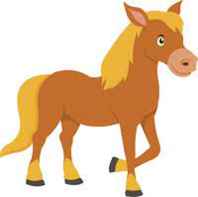

Hh
helicopter
hand
tablet
horse
Notes:
Notes to Teacher:
Teacher: “What letters do you see?” (Hh.) If student says Hh, applaud his/her answer.
If student is still unsure, remind him/her by saying “uppercase H” and “lowercase h.” (Student should repeat teacher.)
Teacher: “Tell me about the pictures you see that appear on the screen.”
-Click to show a picture of a helicopter. Ask: “What is this?” (Helicopter.) Applaud correct answer or assist in telling the correct name for the picture. Click to show the word helicopter.
-Click to show a hand. Ask: “What is this?” (Hand.) Applaud correct answer or assist in telling the correct name for the picture. Click to show the word hand.
-Click to show the tablet. Ask: “What is this?” (Tablet.) Applaud correct answer or assist in telling the correct name for the picture. Click to show the word tablet.
-Click to show a horse. Ask: “What is this?” (Horse.) Applaud correct answer or assist in telling the correct name for the picture. Click to show the word horse.
After identifying the pictures (helicopter, hand, tablet and horse) ask:
Teacher: “What pictures begin with the letter h?” (Helicopter, hand and horse begin with the letter h. Tablet does not begin with the letter h.)
If student is struggling to name the pictures that begin with h, teacher will assist by saying each picture name and asking if it begins with /h/?
- “Helicopter – Does it begin with /h/?” (Yes.)
- “ Hand - Does it begin with /h/?” (Yes.)
- “Tablet - Does it begin with /h/?” (No.)
- “Horse - Does it begin with /h/?” (Yes.)
Click to take the picture of the tablet off of the slide.
Teacher will applaud efforts of student.
Click to go to the next slide.

Slide 4

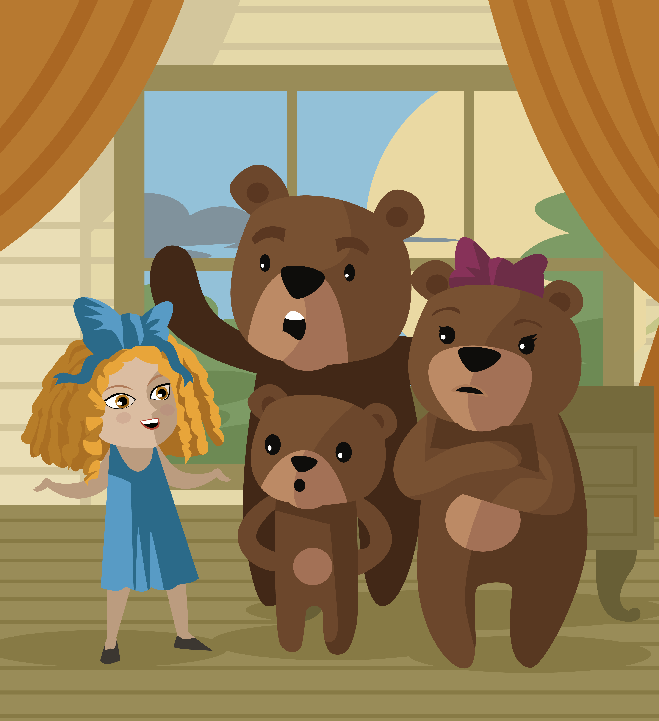
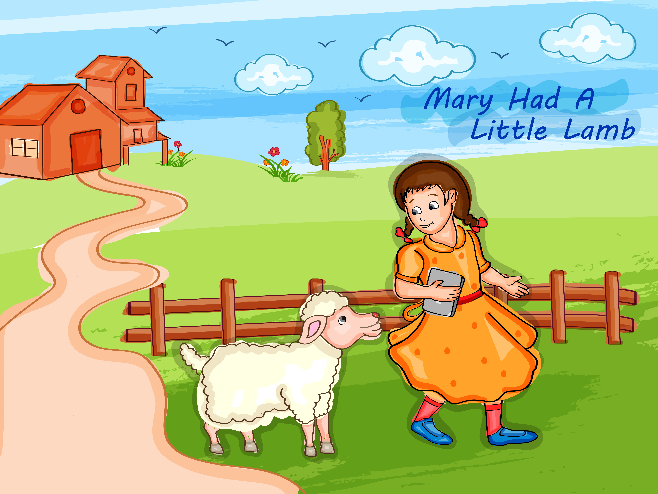

Types of Books
Poetry
Nonfiction
Fiction
Notes:
Notes to Teacher:
Click to bring a book image on the slide.
“What do you see?” (I see books on a shelf.)
“What types of books did you learn about in this module?” (Possible answers: Story books/Fiction, poetry and nonfiction.)
-“Let’s look at the different types of books!”
- Click to show a picture of a poem that student may recognize from the lesson. (Mary Had a Little Lamb)
“Do you know what type of story this is?” (Poem or poetry.)
Click to show the label: Poetry. Say “Poetry.”
“What type of story is this called again?” (Poetry.)
“Poems (or Poetry) are short stories that sometimes rhyme.”
- Click to show a picture of a children’s story book that student may relate to (Goldilocks and the Three Bears.)
“Do you know what type of story this is?” (Story Book or Fiction Story.)
Click to show the label: Story Book - Fiction. Say “Story Book and Fiction.”
“What type of story is this called again?” (Fiction Story.)
“Fiction books are longer than poems and are made-up stories.”
- Click to show a picture of a nonfiction story that student may relate to (Books about space.)
“Do you know what type of story this is?” (Nonfiction.)
Click to show the label: Nonfiction. Say “Nonfiction.”
“What type of story is this called again?” (Nonfiction.)
“Nonfiction stories include facts that teach us things.”
Applaud student’s effort.
Click to move to the next slide.

Slide 5

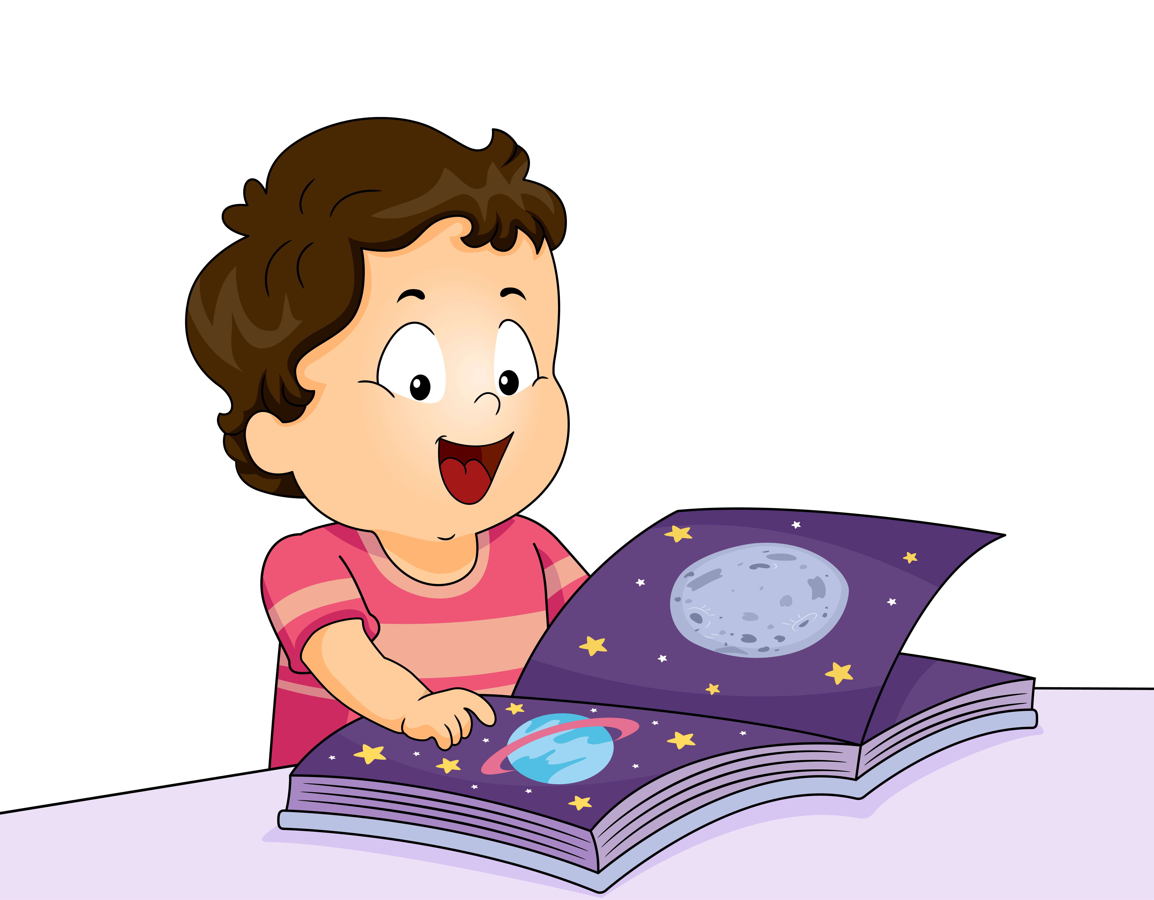
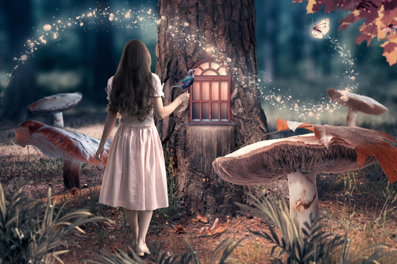
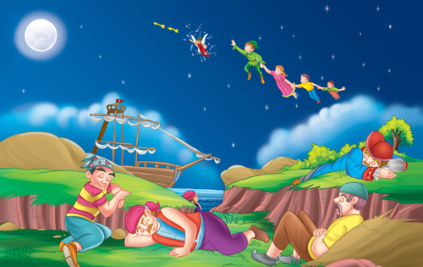

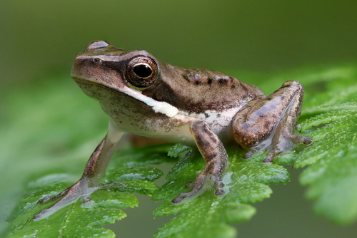
Let’s Use Picture Clues!
Fiction
Nonfiction
Notes:
Notes to Teacher:
“Look at these pictures.”
Click to show picture of a child reading about space.
Click to show a plant.
Click to show a frog.
“What type of stories do you think these are?” (Nonfiction.)
Click to show the label, Nonfiction.
Allow student to talk to you about what he/she thinks this is (A nonfiction story.)
If student is struggling, remind him/her it is called Nonfiction and it is a book that is teaching us about facts.
“Look at these pictures.”
Click to show picture of a child riding a rocket.
Click to show a girl in a forest
Click to show a fairytale.
“What type of stories do you think these are?” (Fiction.)
Allow student to talk to you about why he/she thinks this is a fiction story.
If student is struggling, remind him/her it is called fiction and it is a made-up story.
Click to go to the next slide.

Slide 6
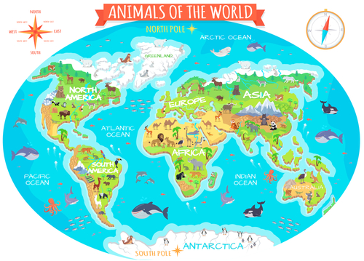

Tell Me All About It!
Nonfiction
Fiction
Notes:
Notes to Teacher:
Click to show an image of a fiction story.
“What do you think is happening in this story?” (Allow child to look at the picture and tell you about the characters. Who might they be? What is the setting? Where does the story take place? What do you think might happen in the story? What are they doing? Where are they going?)
“Do you think this is fiction or nonfiction?” (Fiction.)
Click to show label: Fiction.
“How do we know this is fiction?” (It is a made-up story.)
Click to show an image of a nonfiction story.
“What do you think we will learn about?” (Allow child to look at the picture. Student will tell you about the different animals they will learn about.
“Do you think this is fiction or nonfiction?” (Nonfiction.)
Click to show label: Nonfiction.
“How do we know this is nonfiction?” (It is a book that teaches us facts about animals all over the world.)
Applaud student’s efforts.
Click to go to next slide.

Slide 7
Sight Word Activity
help
black
brown
Notes:
Notes to Teacher:
Teacher says: “Let’s look at our sight words from this week.” (There are 3 words on this slide.)
Click to show the word “help.”– When it appears on the screen, ask: “What word do you see?”
When student responds “help” applaud his/her answer.
If student does not respond correctly, teacher will tell the student that the word is “help.” Have student say the word “help.” (Student repeats.)
Click to show the next word, “black.”– When it appears on the screen, ask: “What word do you see?”
When student responds “black,” applaud his/her answer.
If student does not respond correctly, teacher will tell the student that the word is “black.” Have student say the word “black.” (Student repeats.)
Click to show the next and final word, “brown.” – When it appears on the screen, ask: “What word do you see?”
When student responds “brown,” applaud his/her answer.
If student does not respond correctly, teacher will tell the student that the word is “brown.” Have student say the word “brown.” (Student repeats.)
Applaud student’s effort.
Click to go to the next slide.

Slide 8
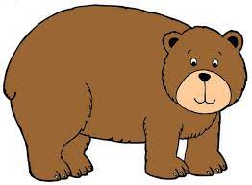
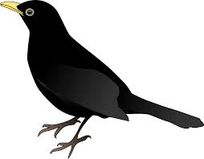
Sight Words
I see the brown .
bear
Did you see the black ?
bird
Notes:
Notes to Teacher:
If student is ready, allow him/her to read each sentence to you. If student is not ready, assist him/her in reading.
-Click to make the sentence appear on the slide: I see the brown (bear}.
-Click to make the next sentence and picture appear on the slide: Did you see the black {bird?}
Applaud all efforts.
Click to move to next slide.

Slide 9
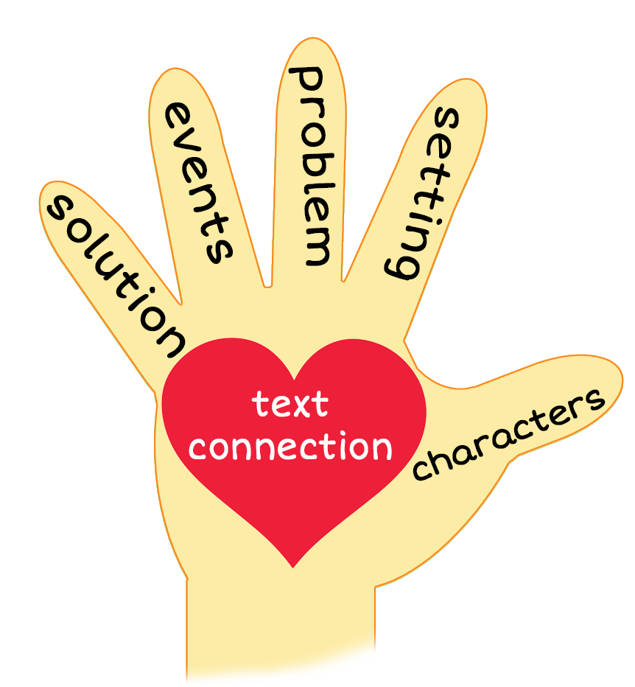
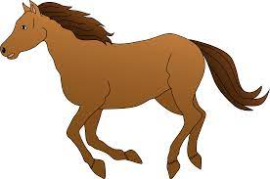
Help Me Find My Horse
Notes:
Notes to Teacher:
Teacher: “This week, you read the story, Help Me Find My Horse. Let’s look at the 5 finger retell chart to help us retell this story.”
Click to bring the image to the slide.
“Let’s work on our story retell together.
Characters: “Who were the characters in the story?” (There was a boy, a girl and a few different horses.)
Setting: “What was the setting of the story? Where did it take place?” (They were outside in the field by the barn.)
Problem – “What is the problem in the story?” (The boy can’t find his brown horse with black hair.)
Events: “What happened in the story?” (The boy asked the girl to help him find his horse.)
The boy asked the girl: Can you help me find my horse?
The girl asked if the brown horse with yellow hair was his horse.
The boy said no. His horse is brown with black hair.
The girl asked if the black horse with red hair was his horse.
The boy said no. His horse is brown with black hair.
The girl asked if the black horse with brown hair was his horse.
The boy said no. His horse is brown with black hair.
The girl finally found his brown horse with black hair.
Ending: “What happened at the end of the story?” (The girl helped the boy find his brown horse with black hair. They were happy!)
Connection: Possible questions to ask to help student to connect to this story:
What was your favorite part of the story?
Did you ever wonder where something went? If so, did you go and search for it?
Main Idea: What is this story about? (This story is a girl helping a boy find his lost horse.)
Applaud student’s efforts in completing this story retell.
Click to the next slide.

Slide 10
Q & A
Any Questions?
Notes:
Ask – “Do you have any questions about anything that you learned in this lesson?”

