Slide 1
Letter and Phonics of the Week
Oo; Short o
Notes:
Tell the student that we are going to review the letter Oo, walk about parts of a book, review the sight words from this week and complete a story retell for Where are the Oranges?
Click to go to the next slide.

Slide 2


Oo
octopus
orange
Notes:
Notes to Teacher:
Teacher: “Point to the letters on the screen. “What letters are we talking about today?” (Student will answer Oo.)
If student is struggling with this letter:
(Point to the uppercase O.) “Uppercase O. (Student repeats.)
(Point to the lowercase o.) “Lowercase o.” (Student repeats.)
Teacher: “What sound does the short o make?” (/o/ like o in octopus.)
If student is struggling, teacher will model making the short o sound and have the student repeat: /o/ like in octopus: /o/, /o/, /o/.
Teacher: “What pictures begin with the short o sound?”
Click to show the octopus– When it appears on the screen, ask, “What do you see?” When student responds “octopus,” applaud his/her answer. If student does not respond correctly, teacher will tell student that it is an octopus. Click to show the word “octopus.”
Click to show the next image - orange– When it appears on the screen, ask, “What do you see?” If student responds “orange,” applaud his/her answer. If student does not respond correctly, teacher will tell student that it is orange. Click to show the word “orange.”
Click to go to the next slide.

Slide 3


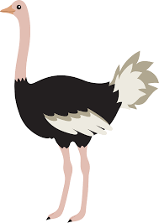
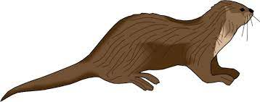
Oo
on
book
otter
ostrich
Notes:
Notes to Teacher:
Teacher: “What letters do you see?” (Oo.) If student says Oo, applaud his/her answer.
If student is still unsure, remind him/her by saying “uppercase O” and “lowercase 0.” (Student should repeat teacher.)
Teacher: “Tell me about the pictures you see that appear on the screen.”
-Click to show a picture of a light switch that is on. Ask: “What is this?” (On.) Applaud correct answer or assist in telling the correct name for the picture. Click to show the word on.
-Click to show a book. Ask: “What is this?” (Book.) Applaud correct answer or assist in telling the correct name for the picture. Click to show the word book.
-Click to show the otter. Ask: “What is this?” (Otter.) Applaud correct answer or assist in telling the correct name for the picture. Click to show the word otter.
-Click to show an ostrich. Ask: “What is this?” (Ostrich.) Applaud correct answer or assist in telling the correct name for the picture. Click to show the word ostrich.
After identifying the pictures (on, book, otter and ostrich,) ask:
Teacher: “What pictures begin with the letter o?” (On, otter and ostrich begin with the letter o. Book does not begin with the letter o.)
If student is struggling to name the pictures that begin with r, teacher will assist by saying each picture name and asking if it begins with /r/?
- “On – Does it begin with /o/?” (Yes.)
- “Book – Does it begin with /o/?” (No.)
- “Otter - Does it begin with /o/?” (Yes.)
- “Ostrich- Does it begin with /o/?” (Yes.)
Click to take the picture of the book off of the slide.
Teacher will applaud efforts of student.
Click to go to the next slide.

Slide 4

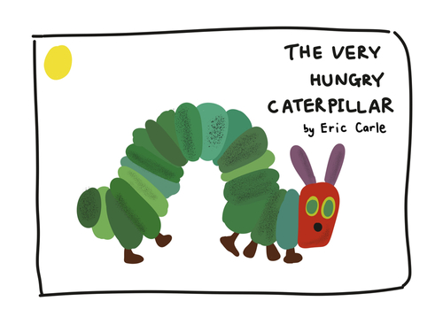
Parts of a Book
Title
Book cover
Author
Notes:
Notes to Teacher:
Click to bring a book image on the slide.
“What do you see?” (I see books.)
Click to bring one book image to the screen.
- Click to highlight the front of the book.
-“Can you name this part of the book?” (This is the book cover.)
Click to label book cover.
- Click to circle the title.
“What part of the book is this?” (This is the title of the story.)
Click to label the title.
-Click to point to the author.
“What does the author do?” (The author writes the story.)
Applaud student’s effort.
Click to move to the next slide.

Slide 5

Let’s Use Picture Clues!
Notes:
Notes to Teacher:
“Look at the book cover. What do you think the bear is reading about?”
(Answers will vary: He may be reading a book about an adventure that a bear took. On a hot summer day, the bear went for a walk and saw a bee and some flowers.)
Allow student to talk to you about what he/she thinks this book is about and why he/she thinks that (See example above.)

Slide 6

Create Your Own Cover
Notes:
Notes to Teacher:
“What do you think is happening in this story?”
(Allow child to look at the picture. Tell you about the characters. Who might they be? What is the setting? Where are they at? What do you think might happen in the story? What are they doing? Where are they going?)
“If you were creating a book cover for this story, what would you draw on the front cover?”
(Allow student to draw book cover and/or talk to you about the picture that would be on the front.)
Applaud student’s efforts.
Click to go to next slide.

Slide 7
Sight Word Activity
did
eat
ate
Notes:
Notes to Teacher:
Teacher says: “Let’s look at our sight words from this week.” (There are 3 words on this slide.)
Click to show the word “did.”– When it appears on the screen, ask: “What word do you see?”
When student responds “did” applaud his/her answer.
If student does not respond correctly, teacher will tell the student that the word is “did.” Have student say the word “did.” (Student repeats.)
Click to show the next word, “eat.”– When it appears on the screen, ask: “What word do you see?”
When student responds “eat,” applaud his/her answer.
If students does not respond correctly, teacher will tell the student that the word is “eat.” Have student say the word “eat.” (Student repeats.)
Click to show the next and final word, “ate.” – When it appears on the screen, ask: “What word do you see?”
When student responds “ate,” applaud his/her answer.
If student does not respond correctly, teacher will tell the student that the word is “ate.” Have student say the word “ate.” (Student repeats.)
Applaud student’s effort.
Click to go to the next slide.

Slide 8
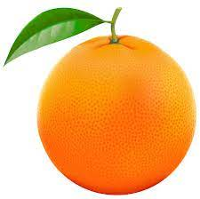
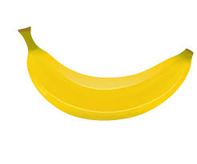
Sight Words
I ate the .
orange.
Did you eat the ?
banana
Notes:
Notes to Teacher:
If student is ready, allow him/her to read each sentence to you. If student is not ready, assist him/her in reading.
-Click to make the sentence appear on the slide: I ate the {orange.}.
-Click to make the next sentence and picture appear on the slide: Did you eat the {banana image?}
Applaud all efforts.
Click to move to next slide.

Slide 9
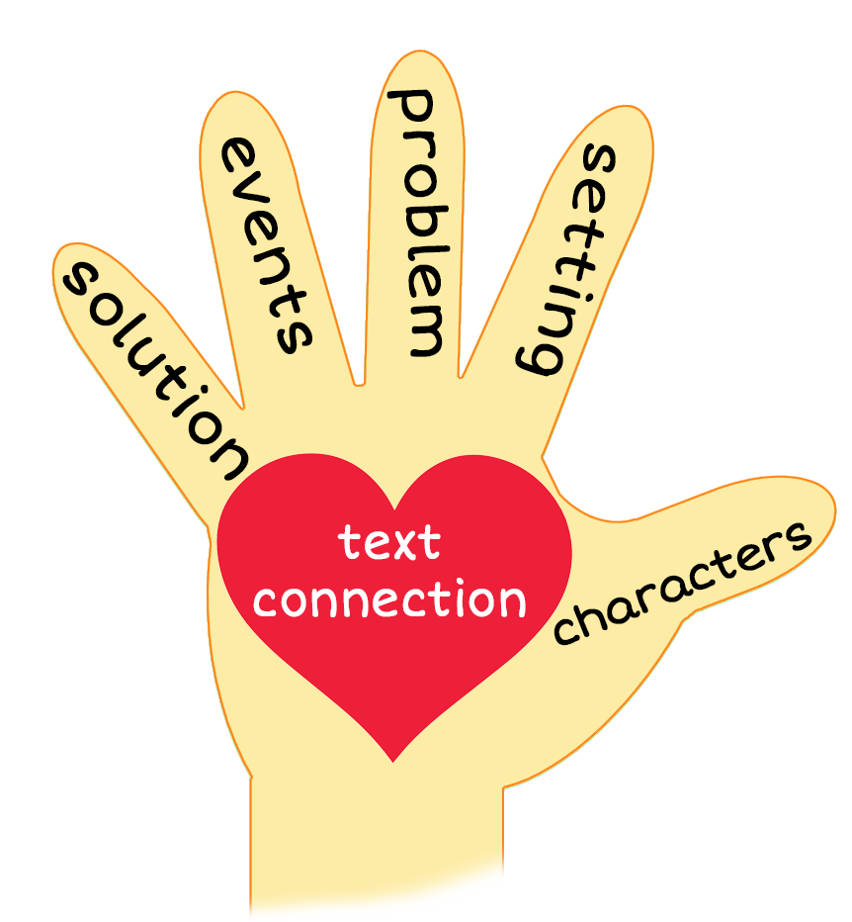
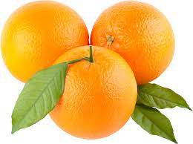
Where are the Oranges?
Notes:
Notes to Teacher:
Teacher: “This week, you read the story, Where are the Oranges? Let’s look at the 5 finger retell chart to help us retell this story.”
Click to bring the image to the slide.
“Let’s work on our story retell together.
Characters: “Who were the characters in the story?” (I see a family: mom, dad and two kids OR I see a man, a woman and two children.)
Setting: “What was the setting of the story? Where did it take place?” (They are sitting at a table. It looks like they are at a restaurant.)
Problem – “What is the problem in the story?” (The boy can’t find the oranges.)
Events: “What happened in the story?” (The boy was trying to figure out who ate the oranges. He asked:
Did the ostrich eat the oranges? (No, he ate insects.)
Did the owl eat the oranges? (No, he ate a mouse.)
Did the otter eat the otter or octopus eat the oranges? (No, they ate fish.)
Ending: “What happened at the end of the story?” (The boy found out that his family ate the oranges.)
Connection: Possible questions to ask to help student to connect to this story:
What was your favorite part of the story?
Did you ever wonder where something went? If so, did you have to search for it?
There were lots of ‘o’ words in this story. Can you name two things that start with the /o/ sound?
Main Idea: What is this story about? (This story is about the missing oranges.)
Applaud student’s efforts in completing this story retell.
Click to the next slide.

Slide 10
Q & A
Any Questions?
Notes:
Ask – “Do you have any questions about anything that you learned in this lesson?”

