Slide 1
Letter of the Week
Rr
Notes:
Tell the student that we are going to review the letter Rr, work on word families, review the sight words from this week and complete a story retell for What Am I?
Click to go to the next slide.

Slide 2


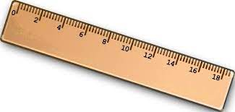
Rr
rainbow
raccoon
ruler
Notes:
Notes to Teacher:
Teacher: “Point to the letters on the screen. “What letters are we talking about today?” (Student will answer Rr.)
If student is struggling with this letter:
(Point to the uppercase R.) “Uppercase R. (Student repeats.)
(Point to the lowercase r.) “Lowercase r.” (Student repeats.)
Teacher: “What sound does the letter r make?” (/r/ like r in rose.)
If student is struggling, teacher will model making the /r/ sound and have the student repeat: /r/ like in rose: /r/, /r/, /r/.
Teacher: “What pictures begin with the /r/ sound?”
Click to show the rainbow– When it appears on the screen, ask, “What do you see?” When student responds “rainbow,” applaud his/her answer. If student does not respond correctly, teacher will tell student that it is a rainbow. Click to show the word “rainbow.”
Click to show the next image – raccoon – When it appears on the screen, ask, “What do you see?” If student responds “raccoon,” applaud his/her answer. If student does not respond correctly, teacher will tell student that it is raccoon. Click to show the word “raccoon.”
Click to show the final image –ruler- When it appears on the screen, ask, “What do you see?” If student responds “ruler,” applaud his/her answer. If student does not respond correctly, teacher will tell student that it is ruler. Click to show the word “ruler.”
Click to go to the next slide.

Slide 3

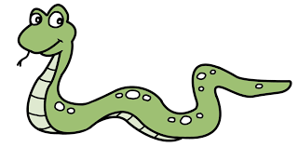
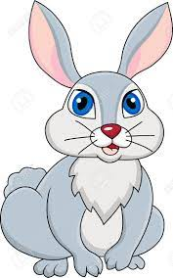
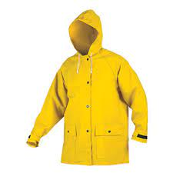
Rr
snake
rain
raincoat
rabbit
Notes:
Notes to Teacher:
Teacher: “What letters do you see?” (Rr.) If student says Rr, applaud his/her answer.
If student is unsure, remind him/her by saying “uppercase R” and “lowercase r.” (Student should repeat teacher.)
Teacher: “Tell me about the pictures you see that appear on the screen.”
-Click to show a snake. Ask: “What is this?” (Snake.) Applaud correct answer or assist in telling the correct name for the picture. Click to show the word snake.
-Click to show a rain. Ask: “What is this?” (Rain.) Applaud correct answer or assist in telling the correct name for the picture. Click to show the word rain.
-Click to show the raincoat. Ask: “What is this?” (Raincoat.) Applaud correct answer or assist in telling the correct name for the picture. Click to show the word raincoat.
-Click to show a rabbit. Ask: “What is this?” (Rabbit.) Applaud correct answer or assist in telling the correct name for the picture. Click to show the word rabbit.
After identifying the pictures (snake, rain, raincoat and rabbit.) ask:
Teacher: “What pictures begin with the letter r?” (Rain, raincoat and rabbit begin with the letter r. Snake does not begin with the letter r.)
If student is struggling to name the pictures that begin with r, teacher will assist by saying each picture name and asking if it begins with /r/?
- “Snake – Does it begin with /r/?” (No.)
- “Rain – Does it begin with /r/?” (Yes.)
- “Raincoat - Does it begin with /r/?” (Yes.)
- “Rabbit - Does it begin with /r/?” (Yes.)
Click to take the picture of the snake off of the slide.
Teacher will applaud efforts of student.
Click to go to the next slide.

Slide 4

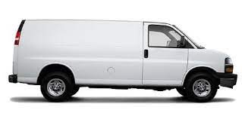



-an Word Family
van
-an
-an
ran
man
can
Notes:
Notes to Teacher:
Teacher: “This week, we talked about word families. What are word families?” (Word families are words that all end the same.)
Allow student the opportunity to read the word part of the house: -an. Tell him/her that all words are going to end with -an.
-Click on to bring up a picture and a word. Ask: “What does this say?” (man.) Applaud correct answer or encourage student to sound the word out. (Assistance: /m/ + an = man.)
-Click on to bring up a picture and a word. Ask: “What does this say?” (ran.) Applaud correct answer or encourage student to sound the word out. (Assistance: /r/ + an = ran.)
-Click on to bring up a picture and a word. Ask: “What does this say?” (can.) Applaud correct answer or encourage student to sound the word out. (Assistance: /c/ + an = can.)
-Click on to bring up a picture and a word. Ask: “What does this say?” (van.) Applaud correct answer or encourage student to sound the word out. (Assistance: /v/ + an = van.)
Applaud student’s effort.
Click to move to the next slide.

Slide 5
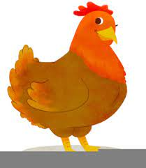


-en Word Family
-an
-en
hen
men
ten
Notes:
Notes to Teacher:
Teacher: “Now let’s talk about the next word family.
Allow student the opportunity to read the word part of the house: -en. Tell him/her that all words are going to end with -en.
-Click on to bring up a picture and a word. Ask: “What does this say?” (hen.) Applaud correct answer or encourage student to sound the word out. (Assistance: /h/ + en = hen.)
-Click on to bring up a picture and a word. Ask: “What does this say?” (men.) Applaud correct answer or encourage student to sound the word out. (Assistance: /m/ + en = men.)
-Click on to bring up one more picture and word. Ask: “What does this say?” (ten.) Applaud correct answer or encourage student to sound the word out. (Assistance: /t/ + en = ten.)
Applaud student’s effort.
Click to move to the next slide.

Slide 6



-in Word Family
-an
-in
fin
pin
bin
Notes:
Notes to Teacher:
Teacher: “Let’s look at our last word family:-in
Allow student the opportunity to read the word part of the house: -in. Tell him/her that all words are going to end with -in.
-Click on to bring up a picture and a word. Ask: “What does this say?” (bin.) Applaud correct answer or encourage student to sound the word out. (Assistance: /b/ + in = bin.)
-Click on to bring up a picture and a word. Ask: “What does this say?” (fin.) Applaud correct answer or encourage student to sound the word out. (Assistance: /f/ + in = fin.)
-Click on to bring up the last picture and word. Ask: “What does this say?” (pin.) Applaud correct answer or encourage student to sound the word out. (Assistance: /p/ + in = pin.)
Applaud student’s effort.
Click to move to the next slide.

Slide 7
Sight Word Activity
yellow
am
red
Notes:
Notes to Teacher:
Teacher says: “Let’s look at our sight words from this week.” (There are 3 words on this slide.)
Click to show the word “yellow.”– When it appears on the screen, ask: “What word do you see?”
When student responds “yellow” applaud his/her answer.
If student does not respond correctly, teacher will tell the student that the word is “yellow.” Have student say the word “yellow.” (Student repeats.)
Click to show the next word, “am.”– When it appears on the screen, ask: “What word do you see?”
When student responds “am,” applaud his/her answer.
If students does not respond correctly, teacher will tell the student that the word is “am.” Have student say the word “am.” (Student repeats.)
Click to show the next and final word, “red.” – When it appears on the screen, ask: “What word do you see?”
When student responds “red,” applaud his/her answer.
If student does not respond correctly, teacher will tell the student that the word is “red.” Have student say the word “red.” (Student repeats.)
Applaud student’s effort.
Click to go to the next slide.

Slide 8

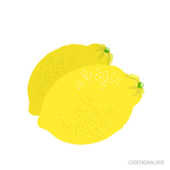
Sight Words
I am red and yellow.
I am yellow.
Notes:
Notes to Teacher:
If student is ready, allow him/her to read each sentence to you. If student is not ready, assist him/her in reading.
-Click to make the sentence appear on the slide: I am red and yellow.
Teacher: Ask, “What am I?” (Balloons.)
-Click to make the sentence and picture appear on the slide: I am yellow.
Teacher: Ask, “What am I?” (Lemons.)
Applaud all efforts.
Click to move to next slide.

Slide 9
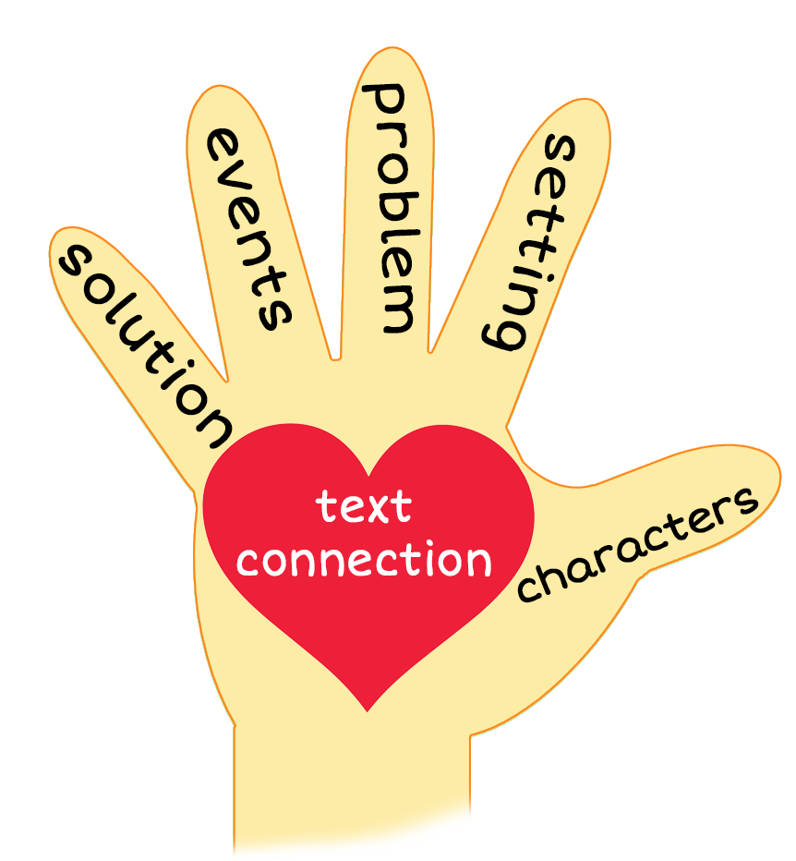
What Am I?
Notes:
Notes to Teacher:
Teacher: “This week, you read the story, What Am I? Let’s look at the 5 finger retell chart to help us retell this story.”
Click to bring the image to the slide.
“Let’s work on our story retell together.
Characters: “Who were the characters in the story?” (We did not meet a specific character this week. This week, we read about things that begin with the letter r.)
Setting: “What was the setting of the story? Where did it take place?” (There was not a specific setting. Each picture was on a white background.)
Problem – “What is the problem in the story?” (There did not seem to be a problem. Our job was to read the clue, look at the picture’s outline and guess what each picture was.)
Events: “What happened in the story?” (We were guessing what each picture was:
We found a red rose.
We found a green rectangle.
We found a yellow raft.
We found a raccoon.
We found a blue ring.
We found a rainbow.
Ending: “What happened at the end of the story?” (The story ended with the clue about the rainbow.)
Connection: Possible questions to ask to help student to connect to this story:
Did anyone ever give you clues to help you find something?
Did you ever see a rainbow?
What is your favorite color in the rainbow?
We found things that began with the letter r. Can you think of anything else that starts with the letter r?
Main Idea: What is this story about? (In this story, I used outlines of a picture and a clue to guess what each thing was. Each of the items began with the letter r.)
Applaud student’s efforts in completing this story retell.
Click to the next slide.

Slide 10
Q & A
Any Questions?
Notes:
Ask – “Do you have any questions about anything that you learned in this lesson?”

