Slide 1
Letter of the Week
Pp
Notes:
Tell the student that we are going to review the letter Pp, work on syllables, review the sight words from this week and complete a story retell for Hidden Food.
Click to go to the next slide.

Slide 2

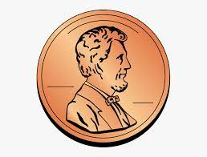
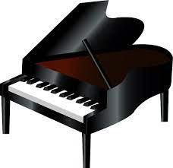
Pp
penny
pineapple
piano
Notes:
Teacher:
Point to the letters on the screen. Ask: “What letters are we talking about today?” (Student will answer Pp.)
If student is struggling with this letter:
(Pointing to uppercase P) “Uppercase P.” (Student repeats.)
(Pointing to lowercase p.) “Lowercase p”. (Student repeats.)
Teacher: “Do you remember what sound the letter p makes?” (Teacher will model making the p sound, like /p/ in penny.)
Click to show the penny– When it appears on the screen, ask, “What do you see?” When student responds “penny,” applaud his/her answer. If student does not respond correctly, teacher will tell student that it is a penny. Click to show the word “penny.”
Click to show the next image - pineapple– When it appears on the screen, ask, “What do you see?” If student responds “pineapple,” applaud his/her answer. If student does not respond correctly, teacher will tell student that it is a pineapple. Click to show the word “pineapple.”
Click to show the piano– When it appears on the screen, ask, “What do you see?” When student responds “piano,” applaud his/her answer. If student does not respond correctly, teacher will tell student that it is a piano. Click to show the word “piano.”
Click to go to the next slide.

Slide 3
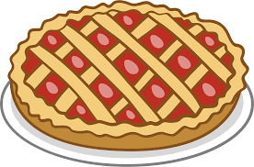
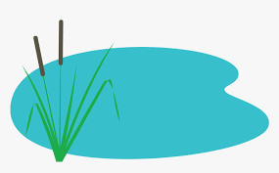

Pp
pie
pond
lamp
Notes:
Notes to Teacher:
Teacher: “What letters do you see?” (Pp) If student says Pp, applaud his/her answer.
If student is unsure, remind him/her by saying “uppercase P” and “lowercase p.” (Student should repeat teacher.)
Teacher: “Tell me about the pictures you see that appear on the screen.”
Click to show a pie. Ask: “What is this?” (Pie.) Applaud correct answer or assist in telling the correct name for the picture. Click to show the word pie.
Click to show a pond. Ask: “What is this?” (Pond.) Applaud correct answer or assist in telling the correct name for the picture. Click to show the word pond.
- Click to show a lamp. Ask: “What is this?” (Lamp.) Applaud correct answer or assist in telling the correct name for the picture. Click to show the word lamp.
After identifying the pictures (pie, pond and lamp) ask:
Teacher: “What pictures begin with the letter p?” (Pie and pond begin with the letter p. Lamp does not begin with the letter p.)
If student is struggling to name the pictures that begin with p, teacher will assist by saying each picture name and asking if it begins with /p/?
- “Pie – Does it begin with /p/?” (Yes.)
- “Pond. Does it begin with /p/?” (Yes.)
- “Lamp - Does it begin with /p/?” (No.)
Click to take the picture of the lamp off of the slide.
Teacher will applaud efforts of student.
Click to go to the next slide.

Slide 4

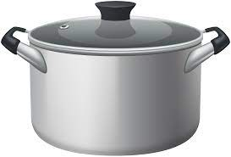
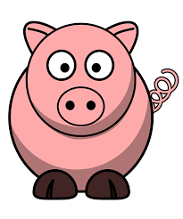
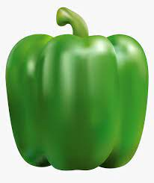

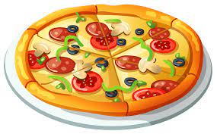
Syllables
Notes:
Notes to Teacher:
Teacher: “This week, we talked about syllables. What are syllables?” (Syllables are units of sounds in words. We can place our hand under our jaw and count how many times our jaw moves.)
Allow student the opportunity to practice saying words and counting syllables.
-Click on to bring up a number one on the screen. Ask: “What number is this?” (One.)
“We are going to practice saying words with one syllable. Place you hand under your jaw.” (Model doing this for the student.)
-Click to show a pot. “Say pot.” (Pot.) “Did you feel your jaw move one time?” (Yes.)
-Click to show a pig. “Say pig.” (Pig.) “Did you feel your jaw move one time?” (Yes.)
-Click on to bring up a number two on the screen. Ask: “What number is this?” (Two.)
“Now, we are going to practice saying words with two syllables. Place you hand under your jaw.” (Model doing this for the student.)
-Click to show a pepper. “Say pepper.” (Pepper.) “Did you feel your jaw move two times?” (Yes.)
-Click to show a pizza. “Say pizza.” (Pizza.) “Did you feel your jaw move two times?” (Yes.)
Applaud student’s effort.
Click to move to the next slide.

Slide 5
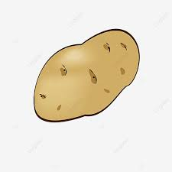

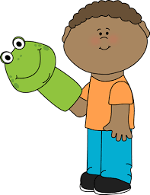
Let’s Count Syllables!
Notes:
-Click to show a potato. “What is this?” (It is a potato.) “Say potato.” (Potato.) “How many times did your jaw move?” (3.)
-Click to show a pear. “What is this?” (It is a pear.) “Say pear.” (Pear.) “How many times did your jaw move?” (1.)
-Click to show a puppet. “What is this?” (It is a puppet.) “Say puppet.” (Puppet.) “How many times did your jaw move?” (2.)
Applaud student’s efforts.
Click to move to the next slide.

Slide 6
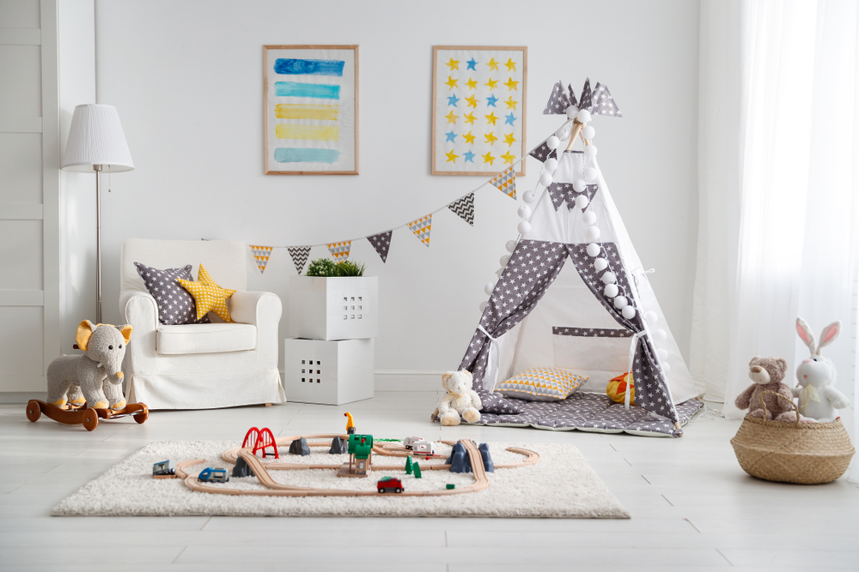
Syllable Search
lamp
rabbit
Notes:
Notes to Teacher:
Click to bring up the image of the playroom.
Teacher: “Tell me about what you see in this picture.” (Allow students an opportunity to talk to you about what they see in this playroom.)
Click to circle the lamp.
Ask: “What is this?” (Lamp.)
Teacher: “Yes, lamp. How many syllables do you hear?” (One.)
Teacher: “Yes, one. Can you find another thing in this room that has one syllable?” (Possible answer: rug or bear.)
Click to circle the rabbit.
Ask: “What is this?” (Rabbit.)
Teacher: “Yes, rabbit. How many syllables do you hear?” (Two.)
Teacher: “Yes, two. Name something else that has two syllables.” (Possible answers: teepee, basket, carpet, pillow or picture.)
Ask: ” Can you find something in this room that has three syllables?” (Elephant)
Applaud efforts.
Click to go to next slide.

Slide 7
Sight Word Activity
two
we
where
Notes:
Notes to Teacher:
Teacher says: “Let’s look at our sight words from this week.” (There are 3 words on this slide.)
Click to show the word “two.”– When it appears on the screen, ask: “What word do you see?”
When student responds “two” applaud his/her answer.
If student does not respond correctly, teacher will tell the student that the word is “two.” Have student say the word “two.” (Student repeats.)
Click to show the next word, “we.”– When it appears on the screen, ask: “What word do you see?”
When student responds “we,” applaud his/her answer.
If student does not respond correctly, teacher will tell the student that the word is “we.” Have student say the word “we.” (Student repeats.)
Click to show the next and final word, “where.” – When it appears on the screen, ask: “What word do you see?”
When student responds “where,” applaud his/her answer.
If student does not respond correctly, teacher will tell the student that the word is “where.” Have student say the word “where.” (Student repeats.)
Applaud student’s effort.
Click to go to the next slide.

Slide 8

Sight Words
Where can we go?
I see two .
peaches
Notes:
Notes to Teacher:
If student is ready, allow him/her to read each sentence to you. If student is not ready, assist him/her in reading.
Click to make the first sentence appear on the screen, along with a picture of question marks.: Where can we go?
Click to bring second sentence on the screen: I see two {peaches.}
Applaud all efforts.
Click to move to next slide.

Slide 9
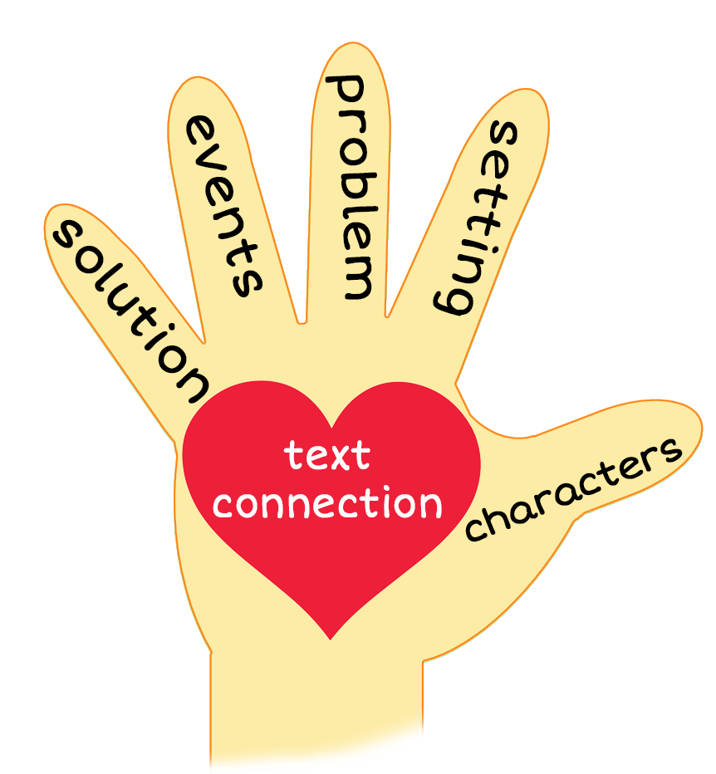
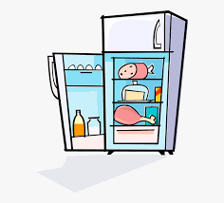
Hidden Food
Notes:
Notes to Teacher:
Teacher: “This week, you read the story, Hidden Food. Let’s look at the 5 finger retell chart to help us retell this story.”
Click to bring the image to the slide.
“Let’s work on our story retell together.
Characters: “Who were the characters in the story?” (They do not tell us who the characters are. The story refers to “we” so the character would be me and someone else.)
Setting: “What was the setting of the story? Where did it take place?” (We see a refrigerator, so I believe it takes place in a kitchen.)
Problem – “What is the problem in the story?” (We are searching for hidden food.)
Events: “What happened in the story?” (We are looking in the refrigerator for food.
We search for (and find) 2 pizzas.
We search for (and find) 2 potatoes.
We search for (and find) 2 pears.
We search for (and find) 2 pickles.
We search for (and find) 2 peaches.
Ending: “What happened at the end of the story?” (After we found the peaches, the story ended by saying, “Peachy!”)
Connection: Possible questions to ask to help student to connect to this story:
Did anyone ever ask you to look for something in the refrigerator?
When you are hungry. what do you like to eat?
Can you remember one thing they searched for in the refrigerator? (Pizza, potatoes, pears, pickles and peaches.) When student remembers an item, ask him/her if he/she likes to eat that.
Main Idea: What is this story about? (This story is about people searching for foods that begin with the letter p. When they search for the hidden food, they always look for two of each item.)
Applaud student’s efforts in completing this story retell.
Click to the next slide.

Slide 10
Q & A
Any Questions?
Notes:
Ask – “Do you have any questions about anything that you learned in this lesson?”

