Slide 1
Letter and Phonics of the Week
Cc; Soft and Hard Cc
Notes:
Tell the student that we are going to review the letter Cc, connecting words to pictures, review the sight words from this week and complete a story retell for My Cat is Three.
Click to go to the next slide.

Slide 2



Cc
circle
cat
candle
city
Notes:
Teacher:
Point to the letters on the screen. Ask: “What letters are we talking about today?” (Student will answer Cc.)
If student is struggling with this letter:
(Pointing to uppercase C) “Uppercase C.” (Student repeats.)
(Pointing to lowercase c.) “Lowercase c”. (Student repeats.)
Teacher: “Do you remember what sound the letter c makes?” (Teacher will model making the hard c sound, like /k/ in cat and the soft c sound like /s/ in city.)
Click to show the cat– When it appears on the screen, ask, “What do you see?” When student responds “cat,” applaud his/her answer. If student does not respond correctly, teacher will tell student that it is a cat. Click to show the word “cat.”
Click to show the next image - candle– When it appears on the screen, ask, “What do you see?” If student responds “candle,” applaud his/her answer. If student does not respond correctly, teacher will tell student that it is a candle. Click to show the word “candle.”
Click to show the circle– When it appears on the screen, ask, “What do you see?” When student responds “circle,” applaud his/her answer. If student does not respond correctly, teacher will tell student that it is a circle. Click to show the word “circle.”
Click to show the next image - city– When it appears on the screen, ask, “What do you see?” If student responds “city,” applaud his/her answer. If student does not respond correctly, teacher will tell student that it is a city. Click to show the word “city.”
Click to go to the next slide.

Slide 3


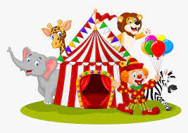
Cc
boot
cloud
circus
Notes:
Teacher: “What letters do you see?” (Cc) If student says Cc, applaud his/her answer.
If student is unsure, assist him/her by saying “uppercase C” and “lowercase c.” (Student should repeat teacher.)
Teacher: “Tell me about the pictures you see that appear on the screen.”
- Click to show the boot. Ask: “What is this?” (Boot.) Applaud correct answer or assist in telling the correct name for the picture. Click to show the word boot.
- Click to show the cloud. Ask: “What is this?” (Cloud.) Applaud correct answer or assist in telling the correct name for the picture. Click to show the word cloud.
- Click to show the circus Ask: “What is this?” (Circus.) Applaud correct answer or assist in telling the correct name for the picture. Click to show the word circus.
- Applaud correct answer or assist in telling the correct name for the picture.
After identifying the pictures (boot, cloud and circus,) ask:
Teacher: “What pictures begin with the letter c?” Remind student that the letter c says /k/ like in cat and /s/ like in city. (Cloud and circus begin with the letter c. Boot does not begin with the letter c.)
If student is struggling to name the pictures that begin with l, teacher will assist by saying each picture name and asking if it begins with /l/:
- “Boot– Does it begin with /k/ or /s/? (No.)
- “Cloud – Does it begin with /k/ or /s/? (Yes.)
- “Circus– Does it begin with /k/ or /s/? (Yes.)
Click to take the picture of the boot off of the slide.
Teacher will applaud efforts of student.
Click to go to the next slide.

Slide 4
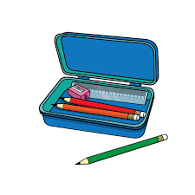





Connecting Words to Pictures
eraser
scissors
Pencil box
pencil
crayons
glue stick
Notes:
Notes to Teacher:
Teacher: “Name some school supplies that you may find in a pencil box.”
Allow student the opportunity to think of school tools that he/she may need to keep in a pencil box to use while doing schoolwork. (Answers will vary.)
-Click on to bring up a pencil on the screen. Ask: “What is this?” (Pencil.)
-Click to bring up an eraser on the screen. Ask: “What is this?” (Eraser.)
-Click to bring up a box of crayons. Ask: “What are these?” (Crayons.)
-Click to bring up a pair of scissors. Ask: “What are these?” (Scissors.)
-Click one last time to bring up a glue stick. Ask: What is this?” (Glue Stick.)
-Click to remove the tools, leaving the pencil box on the screen and bring the pencil box back to the screen
Teacher: “These are important tools that you need to do your schoolwork.”
Click to move to the next slide.

Slide 5
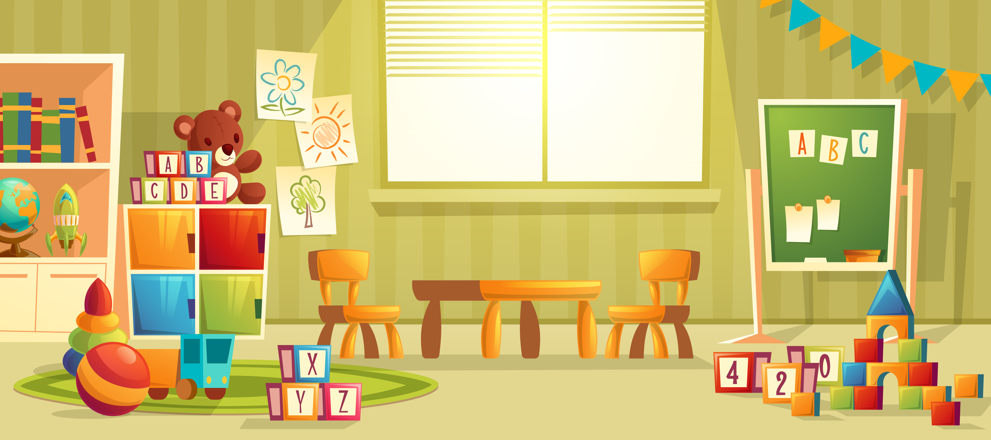
Playroom
table
truck
ball
blocks
Notes:
Notes to Teacher:
Click to show picture of a playroom.
-Ask: “What is under the window?” Click to circle table. (Table.) Click to show the word table. Click to take away circle.
-Ask: “What do you see on the carpet that you can build with?” Click to circle blocks. (Blocks.) Click to show the word blocks. Click to take away circle.
-Ask: “What toy on the carpet has wheels?” Click to circle truck. (Truck.) Click to show the word truck. Click to take away circle.
-“Look at the carpet. What is red and yellow and can roll?” Click to circle ball. (Ball.) Click to show the ball. Click to take away circle.
“These all are toys that you may find in a playroom. Do you have any of these toys? If so, what toys do you have?” (Allow for discussion to give the student an opportunity to make connections to this picture.)
Click to move to the next slide.

Slide 6

Time to Go Outside!
tree
outside
children
bubbles
grass
Notes:
Notes to Teacher:
Teacher: “Tell me about what you see in this picture.”
(Allow students an opportunity to talk to you about who is in the picture, where they may be at and what they are doing.)
-Ask: “Who did you see in the picture?” (Children: 2 boys and a girl.) Click to label children.
-Ask: “Where are they at?” (Outside.) Click to label outside.
-Ask: “What is green and under their feet?” (Grass.) Click to label grass.
Ask: “What is tall and green and behind the girl?” (A tree.) Click to label the tree.
Ask: “What are they doing?” (Have a conversation about blowing bubbles.) Click to label bubbles.
Allow children the opportunity to make further connections to this picture: blowing bubbles, playing outside, etc.
Click to go to next slide.

Slide 7
Sight Word Activity
three
to
up
Notes:
Notes to Teacher:
Teacher says: “Let’s look at our sight words from this week.” (There are 3 words on this slide.)
Click to show the word “three.”– When it appears on the screen, ask: “What word do you see?”
When student responds “three” applaud his/her answer.
If student does not respond correctly, teacher will tell the student that the word is “three.” Have student say the word “three.” (Student repeats.)
Click to show the next word, “to.”– When it appears on the screen, ask: “What word do you see?”
When student responds “to,” applaud his/her answer.
If student does not respond correctly, teacher will tell the student that the word is “to.” Have student say the word “to.” (Student repeats.)
Click to show the next and final word, “up.” – When it appears on the screen, ask: “What word do you see?”
When student responds “up,” applaud his/her answer.
If student does not respond correctly, teacher will tell the student that the word is “up.” Have student say the word “up.” (Student repeats.)
Applaud student’s effort.
Click to go to the next slide.

Slide 8
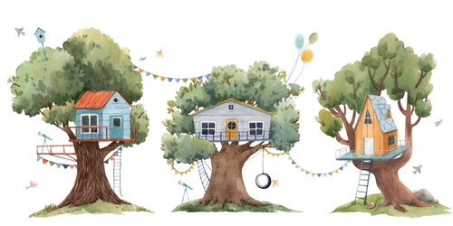
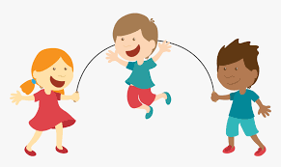
Sight Words
I see three .
I jump up and down.
Notes:
Notes to Teacher:
If student is ready, allow him/her to read each sentence to you. If student is not ready, assist him/her in reading.
Click to make the first sentence appear on the screen: I see three {treehouses.}
Click to bring 2nd sentence on the screen: I jump up and down.
Applaud all efforts.
Click to move to next slide.

Slide 9


My Cat is Three
Notes:
Notes to Teacher:
Teacher: “This week, you read the story, My Cat is Three. Let’s look at the 5 finger retell chart to help us retell this story.”
Click to bring the image to the slide.
“Let’s work on our story retell together.
Characters: “Who were the characters in the story?” (“I” am telling the story about my cat.)
Setting: “What was the setting of the story? Where did it take place?” (We don’t know where the story took place. I am thinking it took place at home.)
Problem – “What is the problem in the story?” (There was not a problem in this story.)
Events: “What happened in the story?” (I am getting ready to celebrate my cat’s third birthday.)
I see March 3rd on the calendar and circle the special day.
I draw a circle around the date and add a birthday cake.
My cat is turning three.
I count to three: 1, 2, 3.
I bake a cake for my cat.
I place three candles on my cat’s cake.
I count to three and sing Happy Birthday.
Ending: “What happened at the end of the story?” (I wish my cat a “Happy Birthday.”)
Connection: Possible questions to ask to help student to connect to this story:
Did you ever add a special date to a calendar?
Did you ever get ready for someone’s special day?
Did you ever make a cake?
What was your favorite part of this story?
Main Idea: What is this story about? (This story is about getting ready for and celebrating my cat’s 3rd birthday.)
Applaud student’s efforts in completing this story retell.
Click to the next slide.

Slide 10
Q & A
Any Questions?
Notes:
Ask – “Do you have any questions about anything that you learned in this lesson?”

