Slide 1
Letter of the Week
Ll
Notes:
Tell the student that we are going to review the letter Ll, talk about verbs , review all of our sight words and complete a story retell for Lemons and Limes.
Click to go to the next slide.

Slide 2


Ll
lollipop
ladder
Notes:
Teacher:
Point to the letters on the screen. Ask: “What letters are we talking about today?” (Student will answer Ll.)
If student is struggling with this letter:
(Pointing to uppercase L) “Uppercase L.” (Student repeats.)
(Pointing to lowercase l.) “Lowercase l”. (Student repeats.)
Teacher: “Do you remember what sound the letter L makes?” (Teacher will model making the /l/ sound, like /l/ in lollipop. Have student repeat /l/ sound: “/l/, /l,/ /l/.)
Click to show the lollipop– When it appears on the screen, ask, “What do you see?” When student responds “lollipop,” applaud his/her answer. If student does not respond correctly, teacher will tell student that it is a lollipop. Click to show the word “lollipop.”
Click to show the next image - ladder– When it appears on the screen, ask, “What do you see?” If student responds “ladder,” applaud his/her answer. If student does not respond correctly, teacher will tell student that it is a ladder. Click to show the word “ladder.”
Click to go to the next slide.

Slide 3



Ll
ant
leaves
ladybug
Notes:
Teacher: “What letters do you see?” (Ll) If student says Ll, applaud his/her answer.
If student is unsure, assist him/her by saying “uppercase L” and “lowercase l.” (Student should repeat teacher.)
Teacher: “Tell me about the pictures you see that appear on the screen.”
- Click to show ant. Ask: “What is this?” (An ant.) Applaud correct answer or assist in telling the correct name for the picture. Click to show the word ant.
- Click to show the leaves. Ask: “What are these?” (Leaves.) Applaud correct answer or assist in telling the correct name for the picture. Click to show the word leaves.
- Click to show a ladybug. Ask: “What is this?” (Ladybug.) Applaud correct answer or assist in telling the correct name for the picture. Click to show the word ladybug.
- Applaud correct answer or assist in telling the correct name for the picture.
After identifying the pictures (ant, leaves and ladybug,) ask:
Teacher: “What pictures begin with the letter l?” Remind student that the letter l says /l/ like in lollipop. (Leaves and ladybug begin with the letter l. Ant does not begin with the letter l.)
If student is struggling to name the pictures that begin with l, teacher will assist by saying each picture name and asking if it begins with /l/:
- “Ant– Does it begin with /l/? (No.)
- “Leaves – Does it begin with /l/? (Yes.)
- “Ladybug– Does it begin with /l/? (Yes.)
Click to take the picture of the ant off of the slide.
Teacher will applaud efforts of student.
Click to go to the next slide.

Slide 4

Verbs
Notes:
Notes to Teacher:
Ask: “What are the children doing in the picture?”
Applaud student’s answers or assist them identifying what they children are doing in the picture.
{Some possible verbs student may identify in this picture: sitting, listening, smiling, looking, learning and/or talking.}
Ask: “What are these ‘doing words’ called?” (Student should answer ‘verbs.’ If student does not remember that ‘doing words’ are called verbs, remind him/her.)
Click to go to next slide.

Slide 5
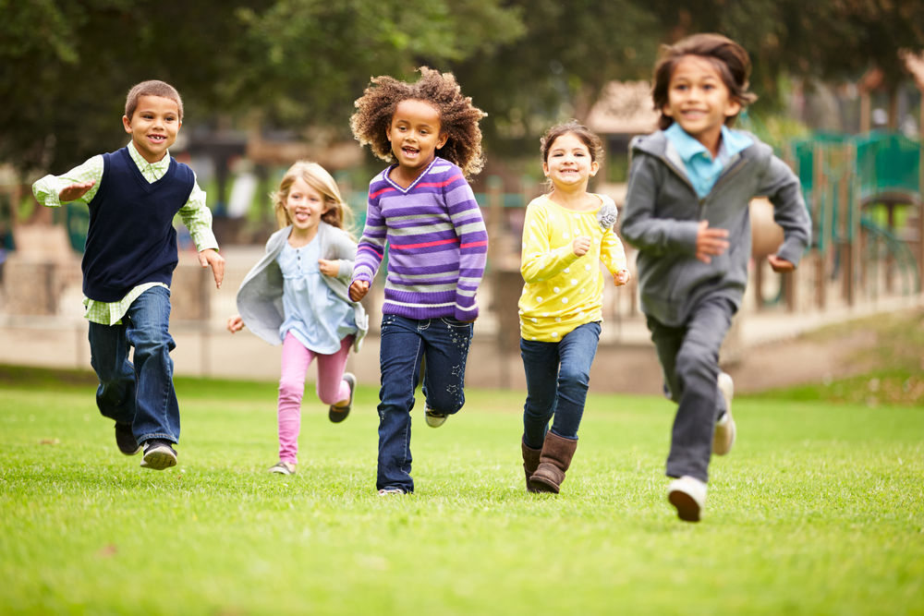

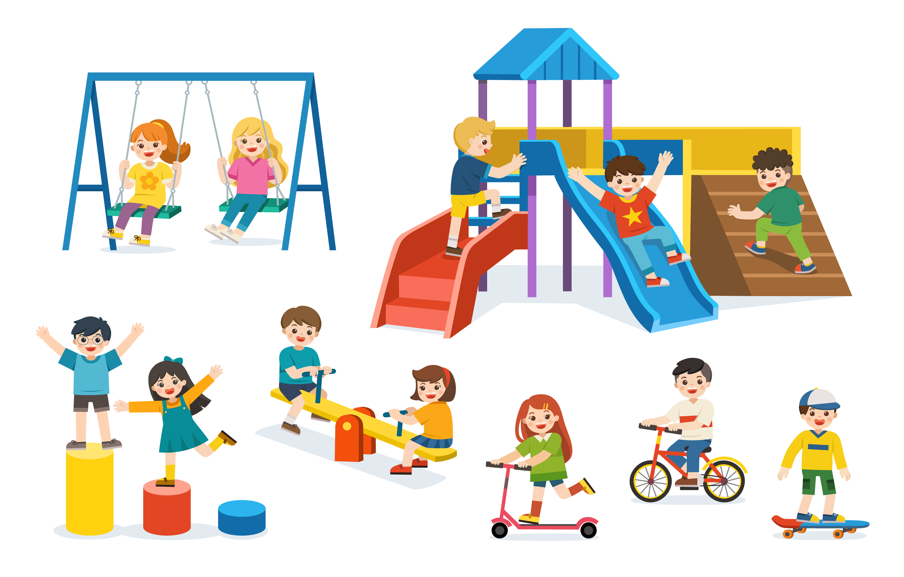
Verbs
Notes:
Notes to Teacher:
Teacher: “Let’s look at some more pictures and talk about some more verbs.”
Click to bring up the 1st image. Ask: “What are the children doing?” (Possible answers: running, laughing, smiling, listening, breathing and/or looking.)
Click to bring up the 2nd image. Ask: “What are these children doing?” (Possible answers: breathing, looking, listening, laughing, smiling and/or waving.)
Click to bring up the 3rd image. Ask: “What are these children doing?” (Possible answers: swinging, talking, listening, looking, climbing, running, sliding, jumping and/or riding {a scooter, seesaw and a bike/})
Click to go to the next slide.

Slide 6
Sight Word Activity
find
and
it
jump
little
Please go to the next slide.
Notes:
Notes to Teacher:
Teacher says: “Now, let’s look at some of the words we worked on this year.” (There are 5 words on this slide.)
Click to show the word “find.””– When it appears on the screen, ask: “What word do you see?”
When student responds “find,” applaud his/her answer.
If student does not respond correctly, teacher will tell the student that the word is “find.” Have student say the word “find.” (Student repeats.)
Click to show the next word, “and.”– When it appears on the screen, ask: “What word do you see?”
When student responds “and,” applaud his/her answer.
If students does not respond correctly, teacher will tell the student that the word is “and.” Have student say the word “and.” (Student repeats.)
Click to show the next word, “it.” – When it appears on the screen, ask: “What word do you see?”
When student responds “it,” applaud his/her answer.
If student does not respond correctly, teacher will tell the student that the word is “it.” Have student say the word “it.” (Student repeats.)
Click to show the next word, “jump.” – When it appears on the screen, ask: “What word do you see?”
When student responds “jump,” applaud his/her answer.
If student does not respond correctly, teacher will tell the student that the word is “jump.” Have student say the word “jump.” (Student repeats.)
Click to show the next and final word, “little.” – When it appears on the screen, ask: “What word do you see?”
When student responds “little,” applaud his/her answer.
If student does not respond correctly, teacher will tell the student that the word is “little.” Have student say the word “little.” (Student repeats.)
“Now, let’s look at some more words.” Click to show the arrow.
Click to go to the next slide.

Slide 7
Sight Word Activity
look
away
make
me
my
Please go to the next slide.
Notes:
Notes to Teacher:
Teacher says: “Let’s look at some more of our sight words.” (There are 5 words on this slide.)
Click to show the word “look.”– When it appears on the screen, ask: “What word do you see?”
When student responds “look,” applaud his/her answer.
If student does not respond correctly, teacher will tell the student that the word is “look.” Have student say the word “look.” (Student repeats.)
Click to show the next word, “away.”– When it appears on the screen, ask: “What word do you see?”
When student responds “away” applaud his/her answer.
If students does not respond correctly, teacher will tell the student that the word is “away.” Have student say the word “away.” (Student repeats.)
Click to show the next word, “make.” – When it appears on the screen, ask: “What word do you see?”
When student responds “make,” applaud his/her answer.
If student does not respond correctly, teacher will tell the student that the word is “make.” Have student say the word “make.” (Student repeats.)
Click to show the next word, “me.” – When it appears on the screen, ask: “What word do you see?”
When student responds “me,” applaud his/her answer.
If student does not respond correctly, teacher will tell the student that the word is “me.” Have student say the word “me.” (Student repeats.)
Click to show the next and final word, “my.” – When it appears on the screen, ask: “What word do you see?”
When student responds “my,” applaud his/her answer.
If student does not respond correctly, teacher will tell the student that the word is “my.” Have student say the word “my.” (Student repeats.)
“Now, let’s look at our last group of words.” Click to show the arrow.
Click to go to the next slide.

Slide 8

Sight Word Activity
not
one
play
with
you
Notes:
Notes to Teacher:
Teacher says: “Let’s look at the last group of words.” (There are 5 words on this slide.)
Click to show the word “not.”– When it appears on the screen, ask: “What word do you see?”
When student responds “not,” applaud his/her answer.
If student does not respond correctly, teacher will tell the student that the word is “not.” Have student say the word “not.” (Student repeats.)
Click to show the word “one.”– When it appears on the screen, ask: “What word do you see?”
When student responds “one,” applaud his/her answer.
If student does not respond correctly, teacher will tell the student that the word is “one.” Have student say the word “one.” (Student repeats.)
Click to show the next word, “play.”– When it appears on the screen, ask: “What word do you see?”
When student responds “play,” applaud his/her answer.
If students does not respond correctly, teacher will tell the student that the word is “play.” Have student say the word “play.” (Student repeats.)
Click to show the next word, “with.” – When it appears on the screen, ask: “What word do you see?”
When student responds “with,” applaud his/her answer.
If student does not respond correctly, teacher will tell the student that the word is “with.” Have student say the word “with.” (Student repeats.)
Click to show the next and final word, “you.” – When it appears on the screen, ask: “What word do you see?”
When student responds “you,” applaud his/her answer.
If student does not respond correctly, teacher will tell the student that the word is “you.” Have student say the word “you.” (Student repeats.)
Click to show the smiley face and applaud student’s efforts!
Click to go to the next slide.

Slide 9
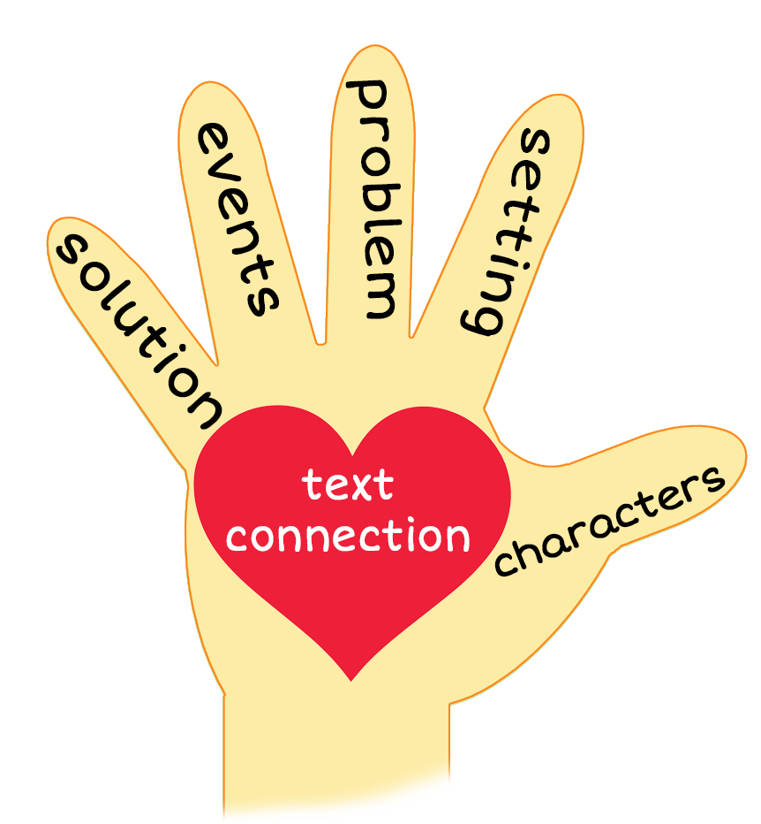

Lemons and Limes
Notes:
Notes to Teacher:
Teacher: “This week, you read the story, Lemons and Limes. Let’s look at the 5 finger retell chart to help us retell this story.”
Click to bring the image to the slide.
“Let’s work on our story retell together.”
Characters: Who are the characters in the story? (A boy, a girl and a dog.)
Setting: What was the setting of the story? Where did it take place? (The story took place outside in the city.)
Problem – What is the problem in the story? (The children were making lemonade and limeade and the dog looked like he wanted some. The children told the dog to go play.)
Events: “What happened in the story?” (A girl looked for lemons and made lemonade with a boy. A boy looked for limes and made limeade with the girl.)
Ending: What happened at the end of the story? (The children made lemonade and limeade and set up a lemonade/limeade stand in the city.)
Connection: Possible questions to ask to help student to connect to this story:
Did you ever drink lemonade or limeade?
If so, did you like it?
Did you ever make lemonade or limeade? (There is a recipe for lemonade and limeade at the end of the story.)
Main Idea: What is this story about? (This story is about a boy and a girl making lemonade and limeade to sell at a lemonade/limeade stand in the city.)

Slide 10
Q & A
Any Questions?
Notes:
Ask – “Do you have any questions about anything that you learned in this lesson?”

