Slide 1
Letter and Phonics of the Week
Ii; short i
Notes:
Tell the student that we are going to review the letter Ii, talk about capitalization, review our sight words from this week and complete a story retell for Come Play with Me.
Click to go to the next slide.

Slide 2
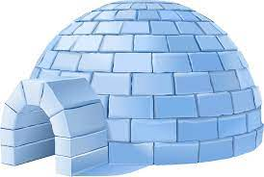
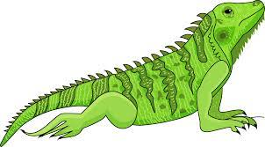
Ii
igloo
iguana
Notes:
Teacher:
Point to the letters on the screen. Ask: “What letters are we talking about today?” (Student will answer Ii.)
If student is struggling with this letter:
(Pointing to uppercase I) “Uppercase I.” (Student repeats.)
(Pointing to lowercase i.) “Lowercase i”. (Student repeats.)
Teacher: “Do you remember what sound the short i makes?” (Teacher will model making the short i sound, like /i/ in igloo. Have student repeat short i sound: “/i/, /i,/ /i/.)
Click to show the igloo– When it appears on the screen, ask, “What do you see?” When student responds “igloo,” applaud his/her answer. If student does not respond correctly, teacher will tell student that it is an igloo. Click to show the word “igloo.”
Click to show the next image - iguana– When it appears on the screen, ask, “What do you see?” If student responds “iguana,” applaud his/her answer. If student does not respond correctly, teacher will tell student that it is an iguana. Click to show the word “iguana.”
Click to go to the next slide.

Slide 3
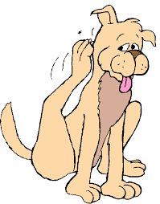

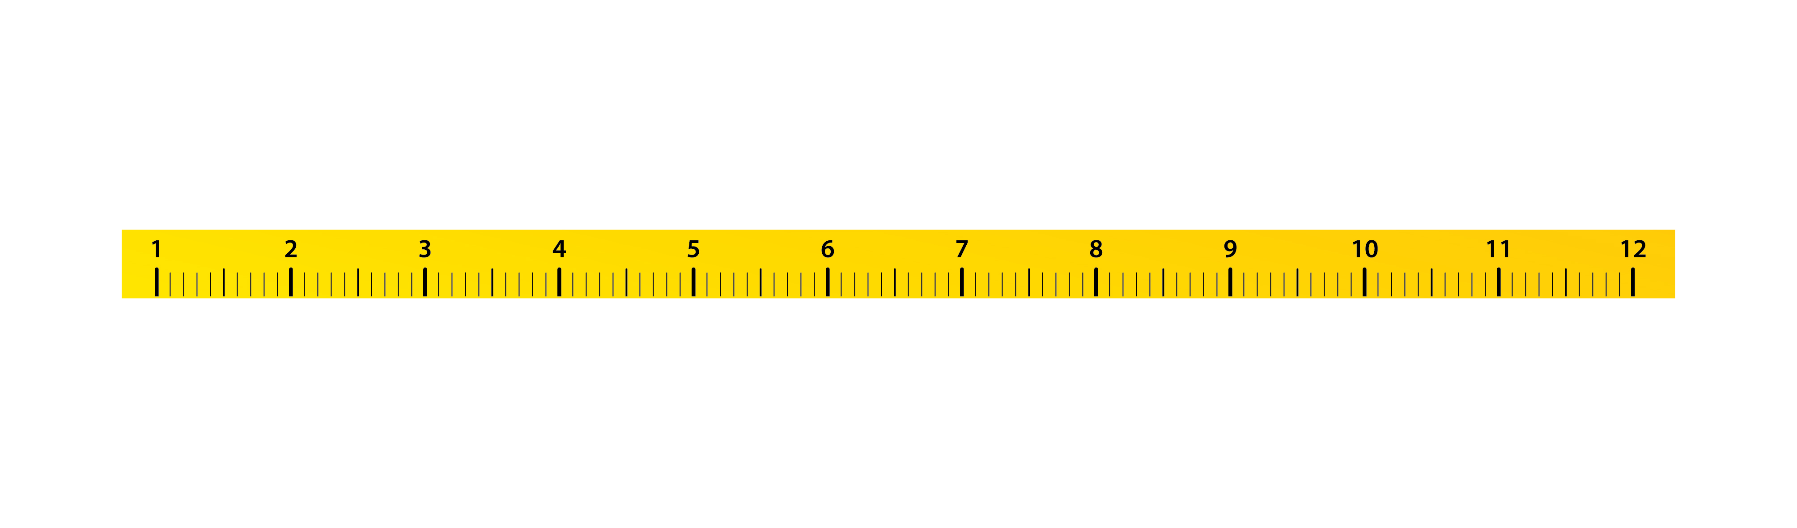
Ii
itch
pen
inch
Notes:
Teacher: “What letters do you see?” (Ii) If student says Ii, applaud his/her answer.
If student is unsure, assist him/her by saying “uppercase I” and “lowercase i.” (Student should repeat teacher.)
Teacher: “Tell me about the pictures you see that appear on the screen.”
- Click to show itch. Ask: “What does this dog have?” (An itch.) Applaud correct answer or assist in telling the correct name for the picture. Click to show the word itch.
- Click to show the pen. Ask: “What is this?” (Pen.) Applaud correct answer or assist in telling the correct name for the picture. Click to show the word pen.
- Click to show an inch. Ask: “What is this?” (Inch.) Applaud correct answer or assist in telling the correct name for the picture. Click to show the word inch.
- Applaud correct answer or assist in telling the correct name for the picture.
After identifying the pictures (itch, pen and inch) ask:
Teacher: “What pictures begin with the letter i?” Remind student that the short i says /i/ like in igloo. (Itch and inch begin with the letter i. Pen does not begin with the letter i.)
If student is struggling to name the pictures that begin with d, teacher will assist by saying each picture name and asking if it begins with /d/:
- “Itch – Does it begin with /i/? (Yes.)
- “Pen – Does it begin with /i/? (No.)
- “Inch– Does it begin with /i/? (Yes.)
Click to take the picture of the pen off of the slide.
Teacher will applaud efforts of student.
Click to go to the next slide.

Slide 4
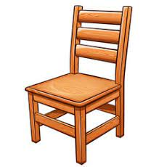
Capitalization
The
_____ is little.
chair
the
The
Notes:
Notes to Teacher:
Remind student that we talked about making sure that the first letter in a sentence is always an uppercase letter.
Teacher will read the sentence to the student, unless student can read it to you:
{The} chair is little. {The} will be missing from the sentence. Student will tell me which one should be used here: the or The.
Click to show the following choices: ‘the’ or ‘The’ to fill in the blank on the sentence.
Ask: “Which word is correct: the or The?” (The.) “Why?” (All sentences begin with an uppercase letter.)
Click to circle the correct word and insert it into the sentence.
Read the sentence together.
Click to go to the next slide.

Slide 5
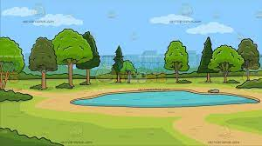
Capitalization
I
___ go to the .
park
i
I
Notes:
Notes to Teacher:
Teacher will read the sentence to the student, unless student can read it to you:
I go to the park. {I} will be missing from the sentence. Student will tell me which one should be used here: i or I.
Click to show the following choices: ‘i’ or ‘I’ to fill in the blank on the sentence.
Ask: “Which word is correct: i or I?” (I.) “Why?” (All sentences begin with an uppercase letter.)
Click to circle the correct word and insert it into the sentence.
Read the sentence together.
Click to go to the next slide.

Slide 6
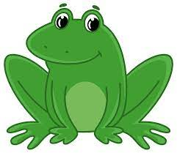
Let’s Practice!
A
___ can jump..
frog
A
a
Notes:
Notes to Teacher:
Teacher will read the sentence to the student, unless student can read it to you:
A frog can jump. {A} will be missing from the sentence. Student will tell me which one should be used here: A or a.
Click to show the following choices: ‘A’ or ‘a’ to fill in the blank on the sentence.
Ask: “Which word is correct: A or a?” (A.) “Why?” (All sentences begin with an uppercase letter.)
Click to circle the correct word and insert it into the sentence.
Read the sentence together.
Click to go to the next slide.
Teacher will read the sentence to the student, unless student can read it to you: {A} (frog image) can jump.
{A} will be missing from the sentence. Student will tell me which one should be used here: A or a.
I added the frog image here since most students will not be able to read this word. I will have the word under the image. Should this word under an image still be a font of 30?
Click to show the following choices: ‘A’ or ‘a’ to fill in the blank on the sentence.
Teacher: ask the student which word is correct. (Student should respond by telling me that the word ‘A” would be used. “Why?” (All sentences begin with an uppercase letter.)

Slide 7
Sight Word Review
play
with
you
Notes:
Teacher says: “Let’s look at our sight words from this week.” (There are 3 words on this slide.)
Click to show the word play.”– When it appears on the screen, ask: “What word do you see?”
When student responds “play,” applaud his/her answer.
If student does not respond correctly, teacher will tell the student that the word is “play.” Have student say the word “play.” (Student repeats.)
Click to show the next word, “with.”– When it appears on the screen, ask: “What word do you see?”
When student responds “with,” applaud his/her answer.
If students does not respond correctly, teacher will tell the student that the word is “with.” Have student say the word “with.” (Student repeats.)
Click to show the next and final word, “you.” – When it appears on the screen, ask: “What word do you see?”
When student responds “you,” applaud his/her answer.
If student does not respond correctly, teacher will tell the student that the word is “you.” Have student say the word “you.” (Student repeats.)
Applaud student’s effort.
Click to go to the next slide.

Slide 8

Let’s read!
I can play with you.
.
Notes:
If student is ready, allow him/her to read each sentence to you. If student is not ready, assist him/her in reading.
Click to bring the sentence with a picture onto the slide.
Student should attempt to read the sentence: I can play with you.
Applaud student’s effort.
Click to go to the next slide.

Slide 9
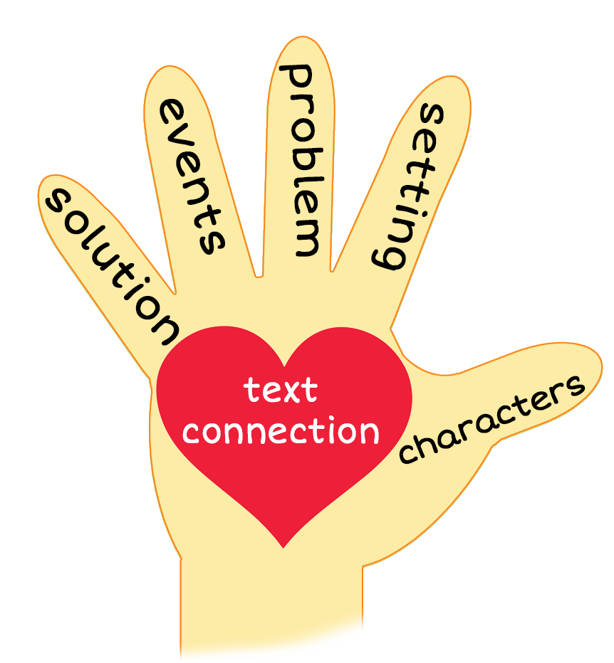
Come Play with Me
Notes:
Notes to Teacher:
Teacher: “This week, you read the story, Come Play with Me. Let’s look at the 5 finger retell chart to help us retell this story.”
Click to bring the image to the slide.
“Let’s work on our story retell together.”
Characters: “Who were the characters in the story?” (A boy, an insect and an iguana.)
Setting: “What was the setting of the story? Where did it take place?” (There were two setting in this story: outside and inside an igloo.)
Problem – “What is the problem in the story?” (There was not a problem in this story.)
Events: “What happened in the story?” (A boy found some things to play with.)
The boy found a one-inch insect and played with it.
The boy found a ten-inch iguana and played with it.
The boy found an igloo and took the insect and iguana inside.
When they were inside, the boy found ink and ice cream.
Ending: “What happened at the end of the story?” (The story ended with the boy playing with the insect and the iguana in the igloo.)
Connection: Possible questions to ask to help student to connect to this story:
What was your favorite part of this story?
Would you want to play with an insect? Why or why not?
Would you like to play with an iguana? Why or why not?
Where would you find ink?
Do you like ice cream? If so, what is your favorite flavor?
Main Idea: What is this story about? (This story is about a boy playing with and in things that begin with the letter i.)
Applaud student’s efforts in completing this story retell.
Click to the next slide.

Slide 10
Q & A
Any Questions?
Notes:
Ask – “Do you have any questions about anything that you learned in this lesson?”

