Slide 1
Letter and Phonics of the Week
Gg; Hard and Soft g
Notes:
Tell the student that we are going to review the letter Gg, talk about antonyms, review our sight words from this week and complete a story retell for Lost and Found.
Click to go to the next slide.

Slide 2


Gg
guitar
germs
Notes:
Teacher:
Point to the letters on the screen. Ask: “What letters are we talking about today?” (Student will answer Gg.)
If student is struggling with this letter:
(Pointing to uppercase G) “Uppercase G.” (Student repeats.)
(Pointing to lowercase g.) “Lowercase g”. (Student repeats.)
Teacher: “Do you remember what sound the letter g makes? It can make two different sounds.” (Teacher will model making the hard g sound, like /g/ in go and the soft g sound like /j/ in giraffe. Have student repeat hard g sound: “/g, /g,/ go.” Have student repeat soft g sound: “/j,/ /j,/ giraffe.)
Click to show the guitar– When it appears on the screen, ask, “What do you see?” When student responds “guitar,” applaud his/her answer. If student does not respond correctly, teacher will tell student that it is a guitar. Click to show the word “guitar.”
Click to show the next image - germs– When it appears on the screen, ask, “What do you see?” If student responds “germs,” applaud his/her answer. If student does not respond correctly, teacher will tell student that it is a germs. Click to show the word “germs.”
Click to go to the next slide.

Slide 3
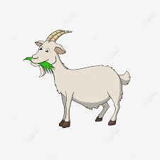
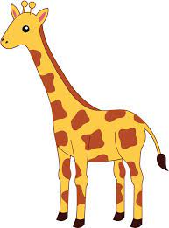


Gg
goat
giraffe
golf
clouds
Notes:
Teacher: “What letters do you see?” (Gg) If student says Gg, applaud his/her answer.
If student is unsure, assist him/her by saying “uppercase G” and “lowercase g.” (Student should repeat teacher.)
Teacher: “Tell me about the pictures you see that appear on the screen.”
- Click to show a goat. Ask: “What is this?” (Goat.) Applaud correct answer or assist in telling the correct name for the picture. Click to show the word goat.
- Click to show the giraffe. Ask: “What is this?” (Giraffe.) Applaud correct answer or assist in telling the correct name for the picture. Click to show the word giraffe.
- Click to show a golf. Ask: “What is this?” (Golf.) Applaud correct answer or assist in telling the correct name for the picture. Click to show the word golf.
- Click to show clouds. Ask: “What are these?” (Clouds.) Applaud correct answer or assist in telling the correct name for the picture. Click to show the word clouds.
After identifying the pictures (goat, giraffe, golf and clouds) ask:
Teacher: “What pictures begin with the letter g?” Remind student that the g can say /g/ like in guitar or /j/ like in germs. (Goat, giraffe and golf begin with the letter g. Cloud does not begin with the letter g.)
If student is struggling to name the pictures that begin with d, teacher will assist by saying each picture name and asking if it begins with /d/:
- “Goat – Does it begin with /g/ or /j/?” (Yes.)
- “Giraffe – Does it begin with /g/ or /j/?” (Yes.)
- “Golf – Does it begin with /g/ or /j/?” (Yes.)
- “Clouds - Does it begin with /g/ or /j/?” (No.)
Click to take the picture of the clouds off of the slide.
Teacher will applaud efforts of student.
Click to go to the next slide.

Slide 4
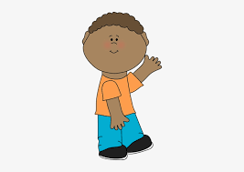
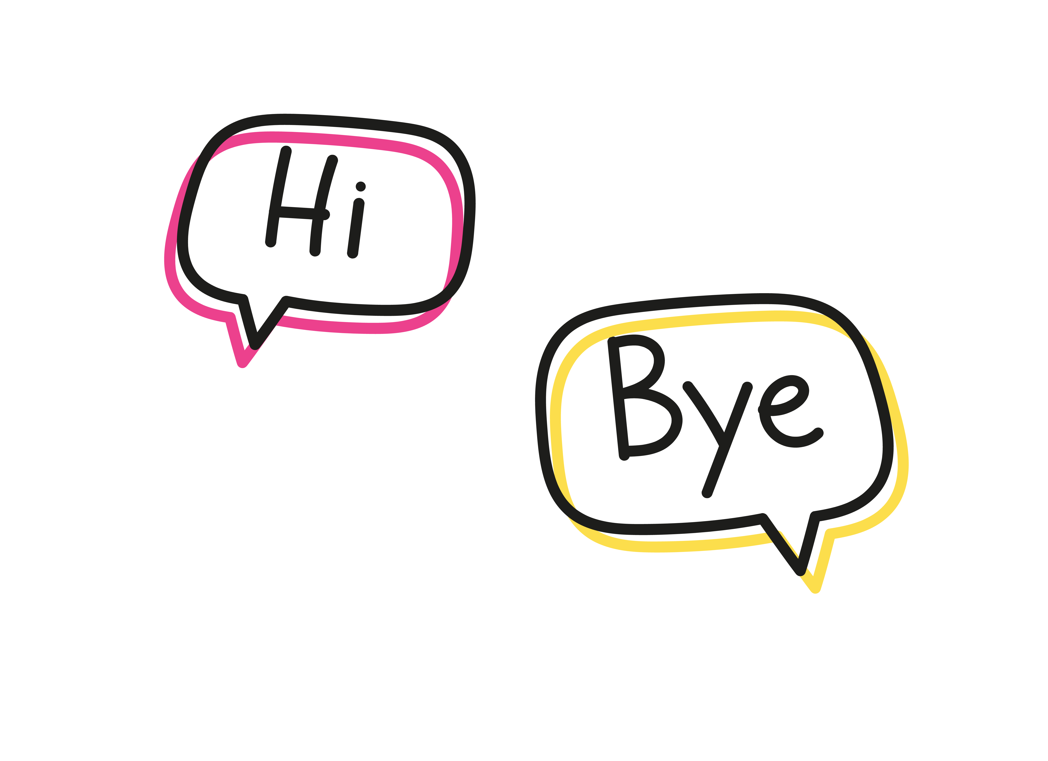


Antonyms
Happy
Sad
Notes:
Notes to Teacher:
Remind students that we talked about antonyms this week.
Ask: “What are antonyms?” (Antonyms are opposites.)
Ask student if he/she can think of any antonyms. Applaud correct answers and show some pictures to review antonyms.
Click once to show a boy and a man waving.
Ask: “What do you think the people are saying?”
Click again to show the words hi and bye. Click to go to next set of antonyms.
Click again to show happy and sad faces. Ask: “How do you think these faces are feeling?” Identify “happy and sad.”
Click to show the words happy and sad.
Click to move to the next slide.

Slide 5
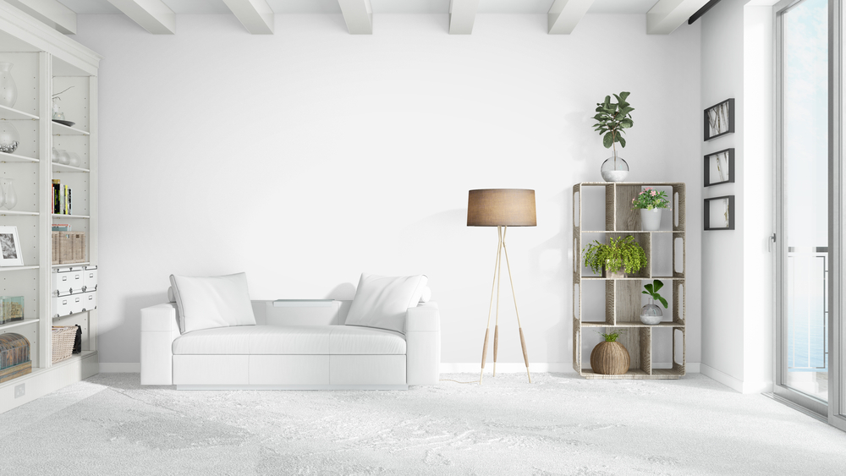
Antonym Work
Down
Up
Notes:
Notes to Teacher:
Click to show the image.
Ask: “What do you see?” (A living room.)
Click to show the arrow.
Ask: “Look at the floor and say down.” (Down.)
Click to show the label for down.
Ask: “What is the opposite of down?”
Click to show the arrow. (Up.)
Click to show the label for up.
Applaud student’s efforts.
Click to move to the next slide.

Slide 6
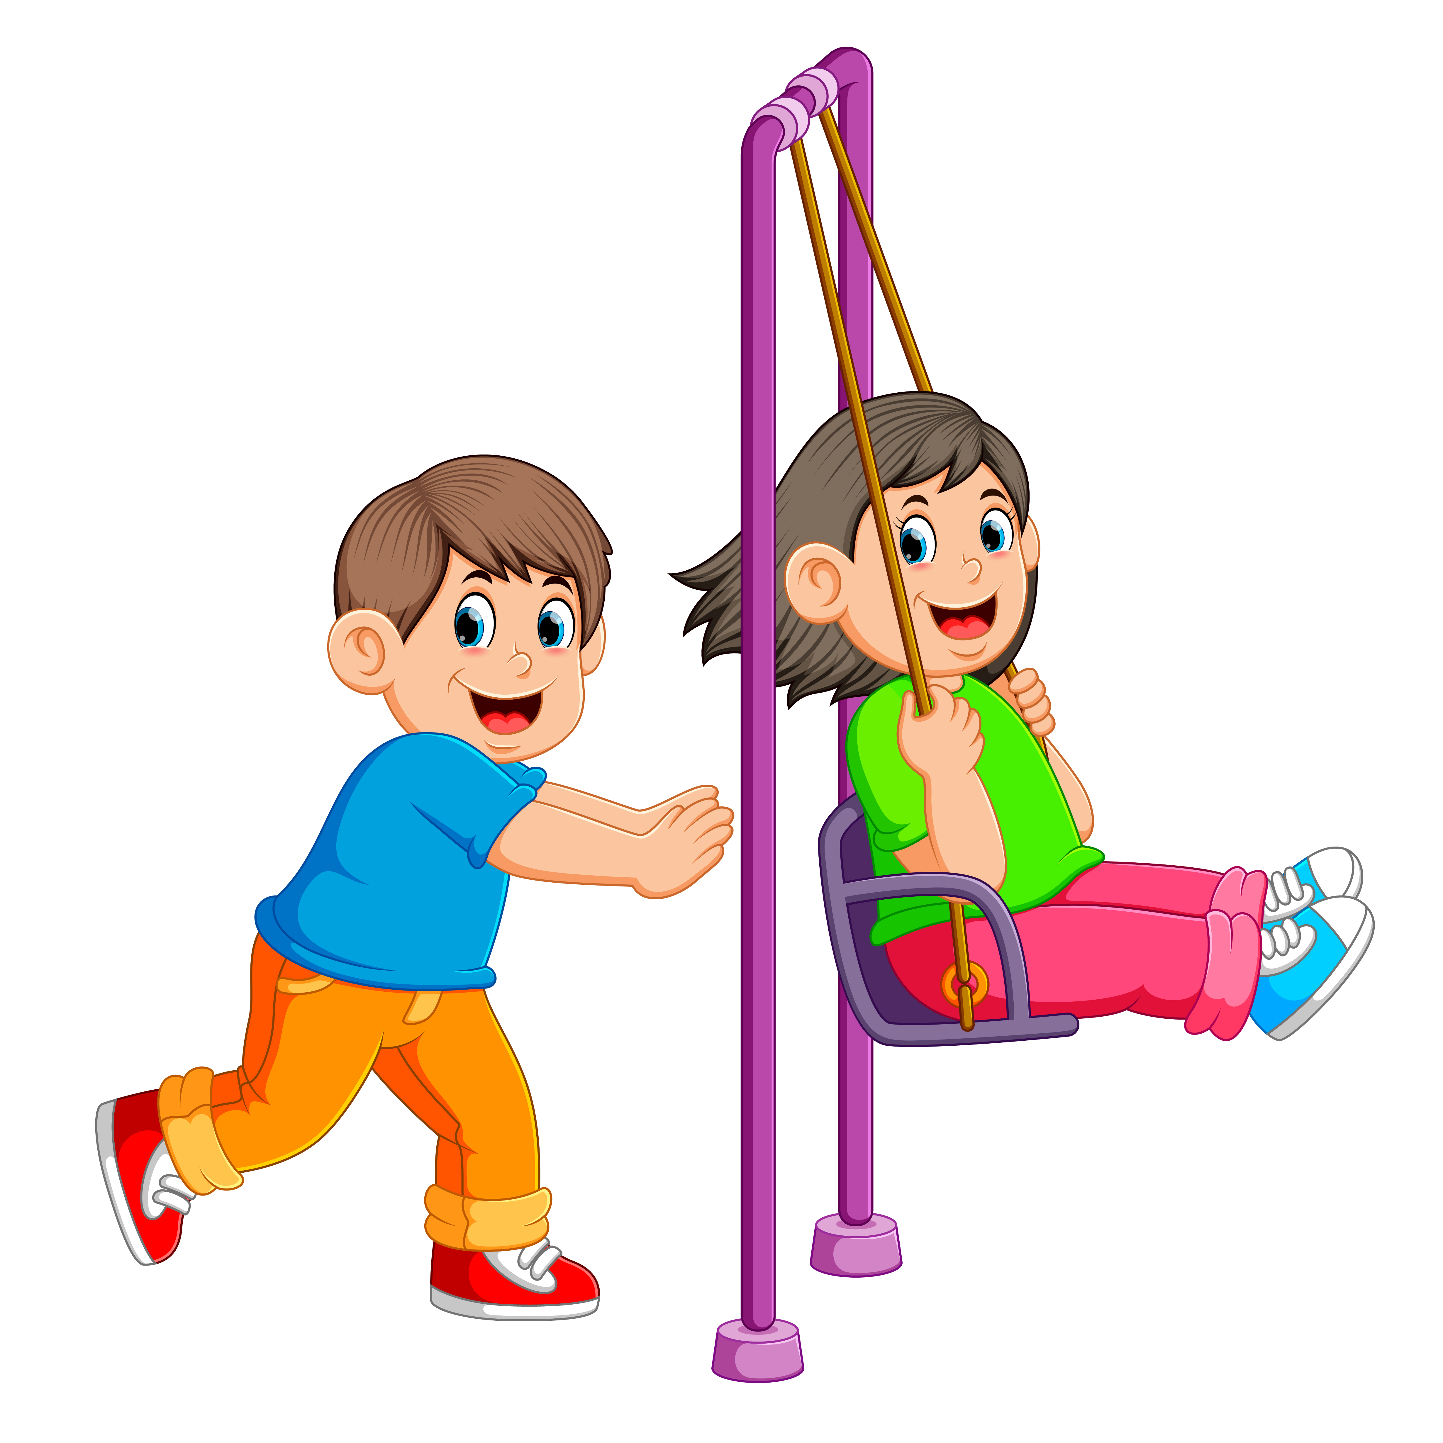
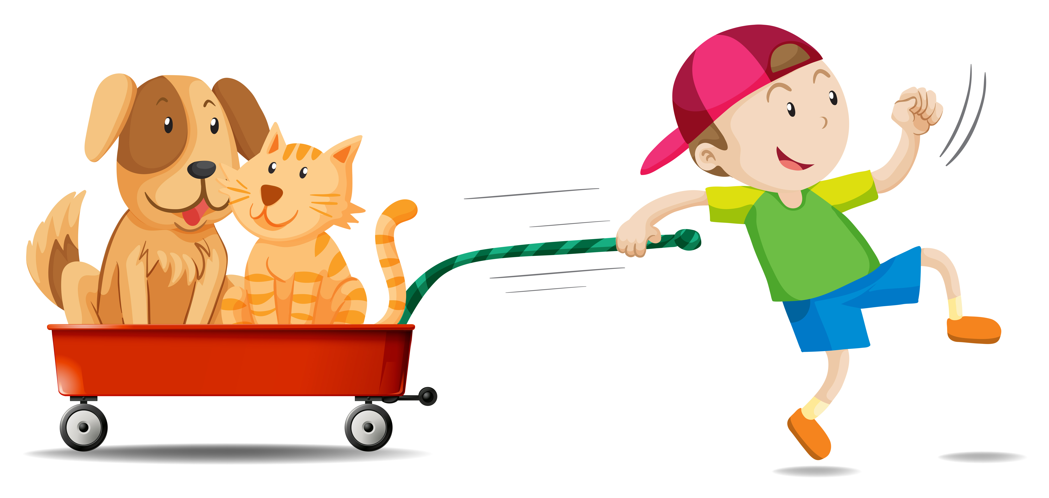

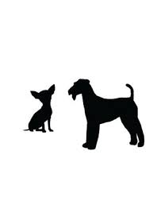
Antonyms
Day and Night
Push and Pull
Little
and
Big
Notes:
Notes to Teacher:
“Let’s talk about a few more antonyms.”
Click once to show push. Tell student this shows a boy pushing a girl. Ask: What is the opposite of push?” (Pull.) Click to show pull, along with the words “Push and Pull.”
Click once to show big and little. Ask student to name the opposite of big: (Little.) Click to show the words “Little and Big.”
Click once to show day and night. Ask: “What is the opposite of day?” (Night.) Click to show the words “Day and Night.”
Applaud all efforts.
Click to go to the next slide.

Slide 7
Sight Word Review
my
not
one
Notes:
Teacher says: “Let’s look at our sight words from this week.” (There are 3 words on this slide.)
Click to show the word “my.”– When it appears on the screen, ask: “What word do you see?”
When student responds “my,” applaud his/her answer.
If student does not respond correctly, teacher will tell the student that the word is “my.” Have student say the word “my.” (Student repeats.)
Click to show the next word, “not.”– When it appears on the screen, ask: “What word do you see?”
When student responds “not,” applaud his/her answer.
If students does not respond correctly, teacher will tell the student that the word is “not.” Have student say the word “not.” (Student repeats.)
Click to show the next and final word, “one.” – When it appears on the screen, ask: “What word do you see?”
When student responds “one,” applaud his/her answer.
If student does not respond correctly, teacher will tell the student that the word is “one.” Have student say the word “one.” (Student repeats.)
Applaud student’s effort.
Click to go to the next slide.

Slide 8
Let’s read!
My is brown.
guitar
.
Notes:
If student is ready, allow him/her to read each sentence to you. If student is not ready, assist him/her in reading.
Click to bring the sentence with a picture onto the slide.
Student should attempt to read the sentence: My guitar is brown.
Applaud student’s effort.
Click to go to the next slide.

Slide 9
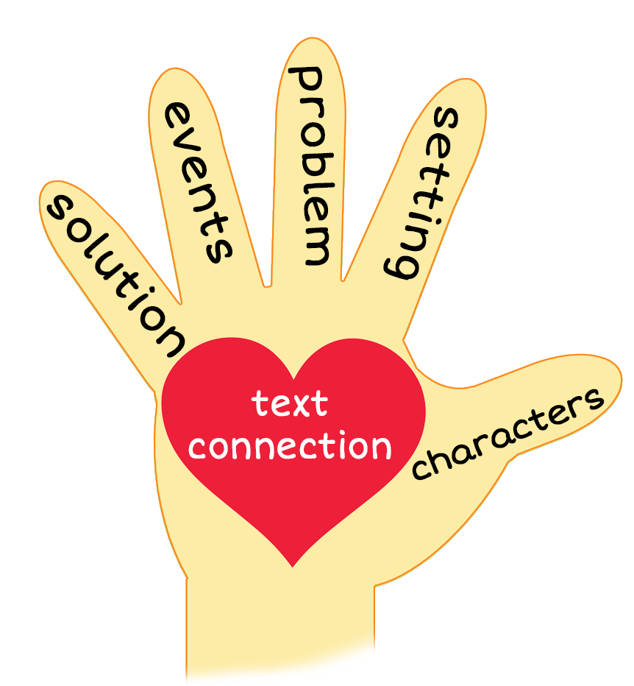
Lost and Found
Notes:
Notes to Teacher:
Teacher: “This week, you read the story, Lost and Found. Let’s look at the 5 finger retell chart to help us retell this story.”
Click to bring the image to the slide.
“Let’s work on our story retell together.
Characters: “Who were the characters in the story?” (This story was about a girl, a boy, goats and gerbils.)
Setting: “What was the setting of the story? Where did it take place?” (The story took place outside.)
Problem – “What is the problem in the story?” (The girl lost her goat, and the boy lost his gerbil.)
Events: “What happened in the story?” (The girl lost her goat and had to search for it. The boy lost his gerbil and had to search for it.)
The girl looked in the blue gate and found two goats: a big goat and a little goat. Her goat was little.
The boy looked in the little garden and found two gerbils: a blue gerbil and a green gerbil. His gerbil was green.
Ending: “What happened at the end of the story?” (The girl was holding her goat and the boy was holding his gerbil. They looked happy.)
Connection: Possible questions to ask to help student to connect to this story:
How do you think the girl and boy felt at the beginning of the story? Why?
Did you ever lose anything? If so, how did that make you feel?
How did you feel when you found it?
How did the girl and boy feel at the end of the story? Why?
What was your favorite part of this story?
Main Idea: What is this story about? (This story is about a boy and girl that had to search for missing animals. They were so happy at the end of the story when they found them.)
Applaud student’s efforts in completing this story retell.
Click to the next slide.

Slide 10
Q & A
Any Questions?
Notes:
Ask – “Do you have any questions about anything that you learned in this lesson?”

