Slide 1
Letter of the Week
Dd
Notes:
Tell the student that we are going to review the letter Dd, practice sorting, review our sight words from this week and complete a story retell for Balloon Animals.
Click to go to the next slide.

Slide 2


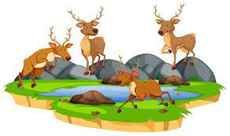
Dd
dolphin
detective
deer
Notes:
Teacher: “What letters are we talking about today?” (Student will answer Dd.)
If student is struggling with this letter:
(Point to the uppercase D.) “Uppercase D (Student repeats.)
(Point to the lowercase d.) “Lowercase d.” (Student repeats.)
Teacher: “What sound does the letter d make?” (/d/ like d in dog.)
If student is struggling, teacher will model making the /d/ sound and have the student repeat: /d/ like in dog: /d/, /d/, /d/.
Teacher: “What begins with the /d/ sound?”
Click to show the dolphin– When it appears on the screen, ask, “What do you see?” When student responds “dolphin,” applaud his/her answer. If student does not respond correctly, teacher will tell student that it is a dolphin. Click to show the word “dolphin.”
Click to show the next image - detective– When it appears on the screen, ask, “What do you see?” If student responds “detective,” applaud his/her answer. If student does not respond correctly, teacher will tell student that it is a detective. Click to show the word “detective.”
Click to show the third and final image –deer- When it appears on the screen, ask, “What do you see?” If student responds “deer,” applaud his/her answer. If student does not respond correctly, teacher will tell student that it is a deer. Click to show the word “deer.”
Click to go to the next slide.

Slide 3


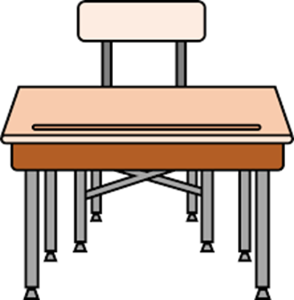
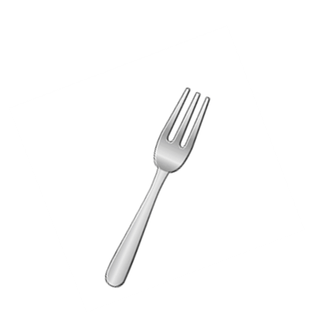
Dd
door
donut
fork
desk
Notes:
Teacher: “What letters do you see?” (Dd) If student says Dd, applaud his/her answer.
If student is unsure, assist him/her by saying “uppercase D” and “lowercase d.” (Student should repeat teacher.)
Teacher: “Tell me about the pictures you see that appear on the screen.”
(You will need to click to show the following images and allow student to tell you what he/she sees, correcting if necessary.)
- Click to show a donut. Ask: “What is this?” (Donut.) Applaud correct answer or assist in telling the correct name for the picture. Click to show the word donut.
- Click to show the door. Ask: “What is this?” (Door.) Applaud correct answer or assist in telling the correct name for the picture. Click to show the word door.
- Click to show a desk. Ask: “What is this?” (Desk.) Applaud correct answer or assist in telling the correct name for the picture. Click to show the word desk.
- Click to show a fork. Ask: “What is this?” (fork.) Applaud correct answer or assist in telling the correct name for the picture. Click to show the word fork.
After identifying the pictures (donut, door, desk and fork) ask:
Teacher: “What pictures begin with the letter d?” (Donut, door and desk begin with the letter d. Fork does not begin with the letter d.)
If student is struggling to name the pictures that begin with d, teacher will assist by saying each picture name and asking if it begins with /d/:
- “Donut – Does it begin with /d/?” (Yes.)
- “Door– Does it begin with /d/?” (Yes.)
- “Desk – Does it begin with /d/?” (Yes.)
- “Fork - Does it begin with /d/?” (No.)
Click to take the picture of the fork off of the slide.
Teacher will applaud efforts of student.
Click to go to the next slide.

Slide 4
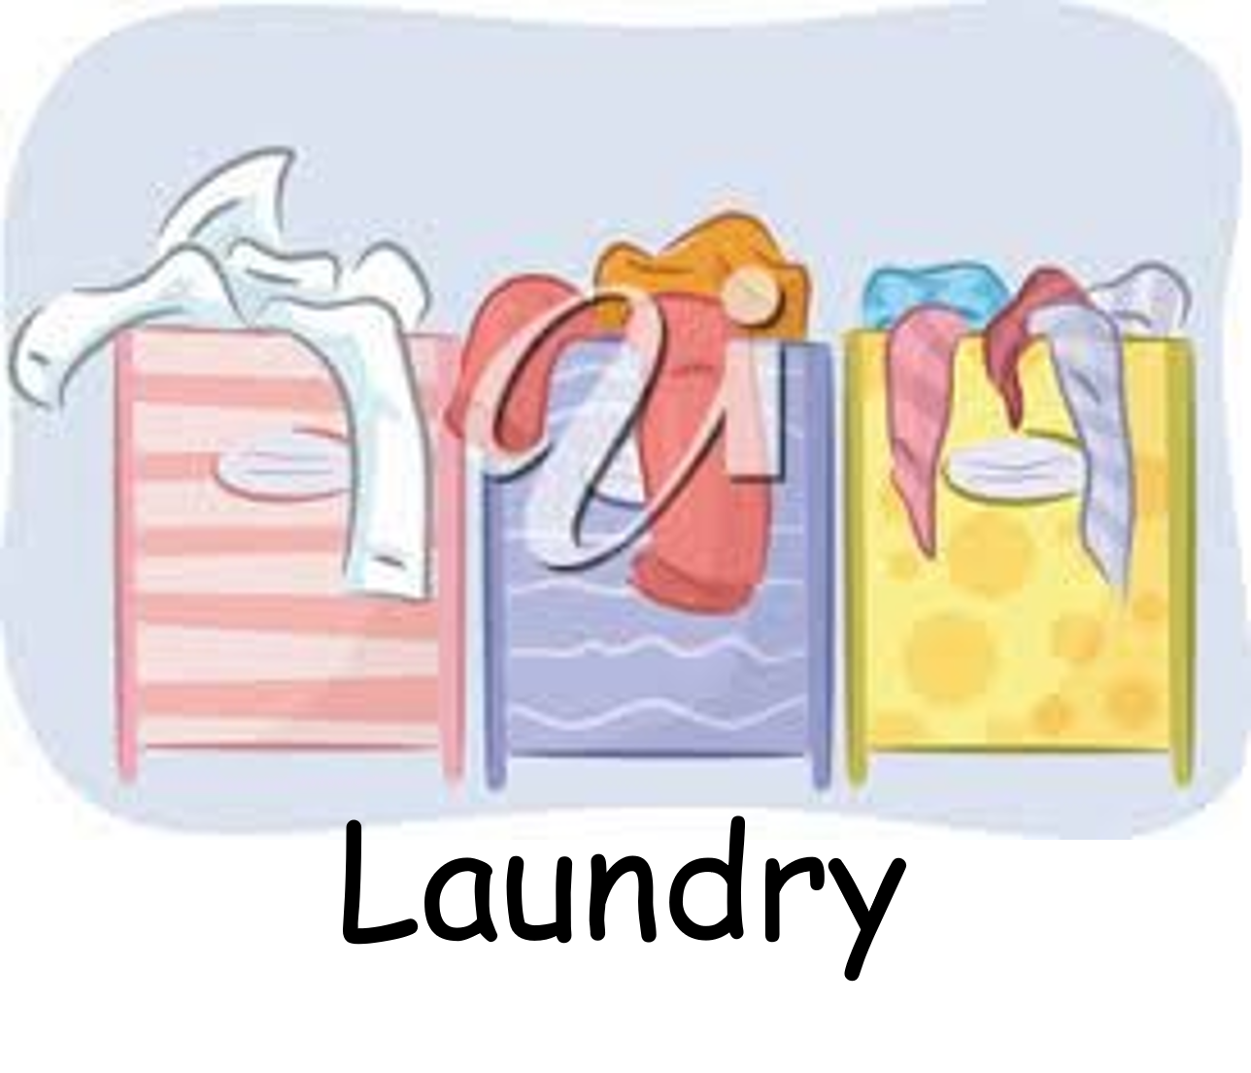
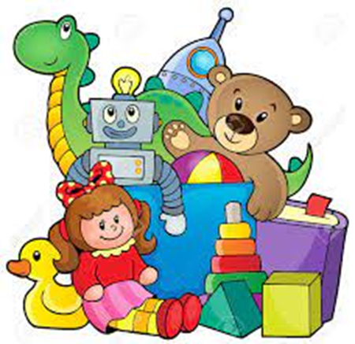
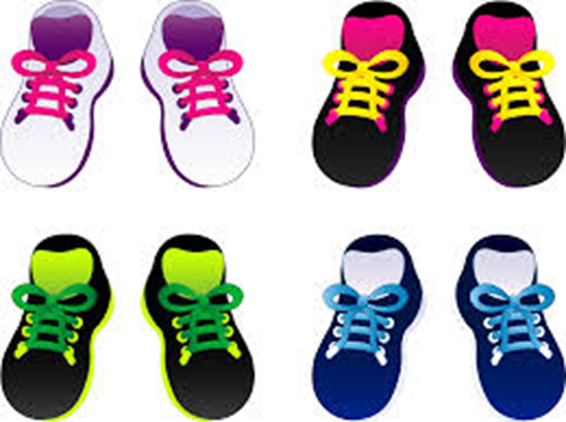
Sorting
Laundry
Toys
Shoes
Notes:
Notes to Teacher:
Ask: “What do we do when we sort things?” (We group things that are alike. We can sort things by color, size or item.)
Click to bring the picture of laundry onto the slide. Ask: “How do you sort clothes for the laundry?” (Answers may vary: we may sort by color, towels, sheets, or a particular person’s laundry.)
Click to show the first group of items. Ask: “What do you see in this picture?” (I see toys.)
Click to show the next group of items. Ask: “What do you see in this picture?” (I see shoes.)
Applaud student’s efforts.
Click to go to the next slide.

Slide 5
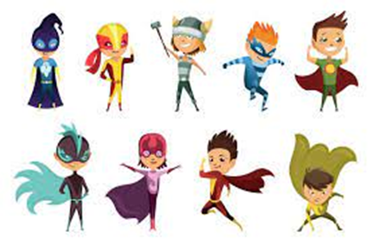


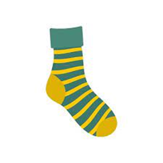

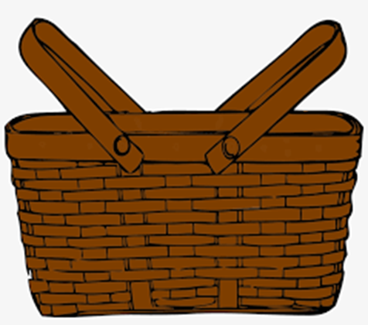
Super Sorters!
Fruit
Notes:
Notes to Teacher:
Remind student that we talked about being ‘Super Sorters.’ Tell him/her that we will practice sorting items that we see on the slide.
Click to show a basket.
“I see a basket on the slide. I want to put all of the same kinds of things in this basket. What should I put in my basket? Let’s check out some things that I have!”
Click to show an apple. “What is this?” Allow student to identify it as an apple.
Click again to show a banana. “What is this?” Allow student to identify it as a banana.
Click again to show a sock. “What is this?” Allow student to identify it as a sock.
Click one last time to show an orange. “What is this?” Allow student to identify it as an orange.
“Which one does not belong?”
Allow student time to think. You want the student to notice that we can eat three of the items. They may also notice that these three items are fruit (apple, orange and banana.) The sock does not belong. You cannot eat a sock. You wear a sock.
Click to move the sock from the slide and applaud student’s effort.
Click to go to the next slide.

Slide 6
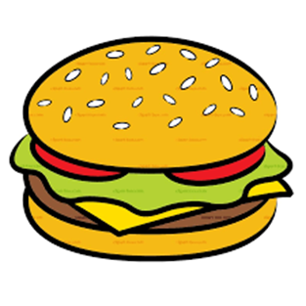
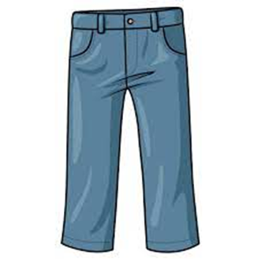
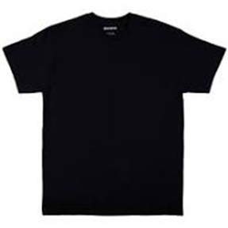

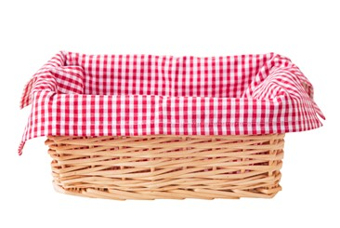
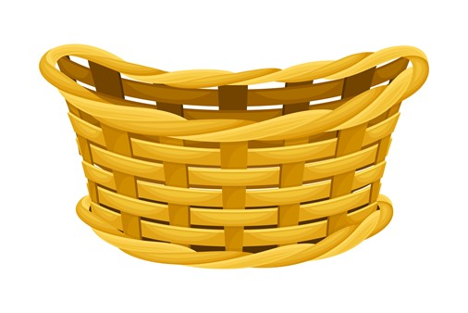

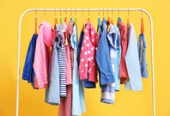
Sort With Me!
Food
Clothes
Notes:
“Are you ready to sort some more? I hope you are ready to go! We are going to sort items into two different baskets.”
Click to bring the first basket on slide. “What are we going to put in here?” (Food.)
Click to bring the second basket on the slide. “What are we going to put in here?” (Clothes.)
You are going to click to place each item on the slide:
-Click once to show a shirt. “What is this?” (Shirt.)
-Click again to show a hamburger. “What is this?” (Hamburger.)
-Click a 3rd time to show a pair of pants. “What is this?” (Pair of pants.”
-Click one last time to show a piece of pizza. “What is this?” (Piece of pizza.)
Tell student that we are going to place the items into the correct baskets.:
“What two things are we going to put in the “Food” basket?”
(Hamburger and piece of pizza.)
-Click one time to show an arrow from the hamburger to the “Food” basket.
-Click again to show an arrow from the pizza to the “Food” basket.
-Click a third time to remove both items from the slide.
“What two things are we going to put in the “Clothes” basket?” (Shirt and pair of pants.)
-Click one to show an arrow from the shirt to the “Clothes” basket.
-Click again to show an arrow from the pair of pants to the “Clothes” basket.
Applaud student’s effort.
Click to go to the next slide.

Slide 7
Sight Word Review
away
make
me
Notes:
Teacher says: “Let’s look at our sight words from this week.” (There are 3 words on this slide.)
Click to show the word “away.”– When it appears on the screen, ask: “What word do you see?”
When student responds “away,” applaud his/her answer.
If student does not respond correctly, teacher will tell the student that the word is “away.” Have student say the word “away.” (Student repeats.)
Click to show the next word, “make.”– When it appears on the screen, ask: “What word do you see?”
When student responds “make,” applaud his/her answer.
If students does not respond correctly, teacher will tell the student that the word is “make.” Have student say the word “make.” (Student repeats.)
Click to show the next and final word, “me.” – When it appears on the screen, ask: “What word do you see?”
When student responds “me,” applaud his/her answer.
If student does not respond correctly, teacher will tell the student that the word is “me.” Have student say the word “me.” (Student repeats.)
Applaud student’s effort.
Click to go to the next slide.

Slide 8


Let’s Read!
I look away.
I can make a .
(cake)
.
Notes:
If student is ready, allow him/her to read each sentence to you. If student is not ready, assist him/her in reading.
Click to bring a sentence with a picture onto the slide.
Student should attempt to read the sentence: I look away.
Click to bring the next sentence and picture onto the slide.
Student should attempt to read the sentence: I can make a {cake image.}
Applaud student’s effort.
Click to go to the next slide.

Slide 9
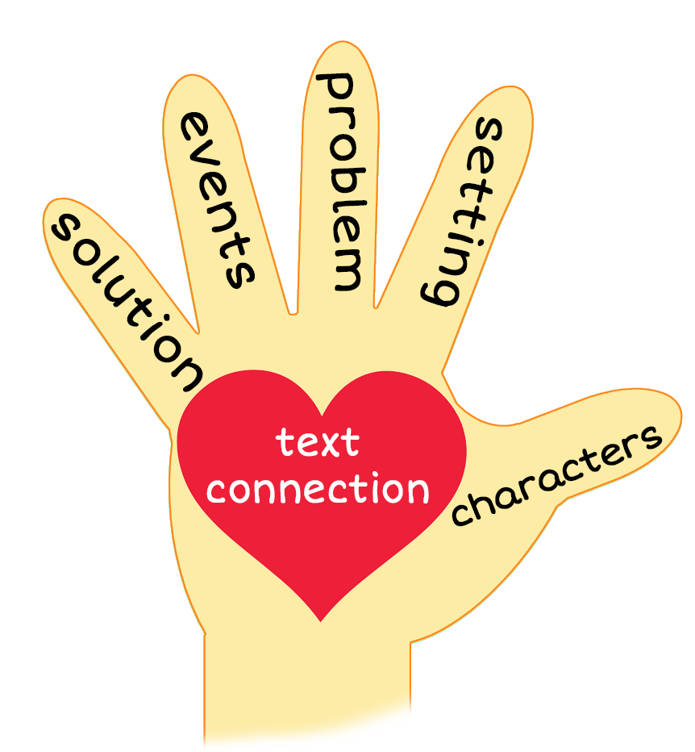
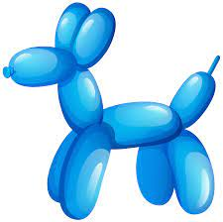
Balloon Animals
Notes:
Notes to Teacher:
Teacher: “This week, you read the story, Balloon Animals. Using the 5 finger retell strategy, can you tell me about the story?”
Click to bring the image to the slide.
“Let’s work on our story retell together.
Characters: “Who was the character in the story?” (This story was about a clown and 4 children.)
Setting: “What was the setting of the story? Where did it take place?” (The story took place outside. I see the sky and the grass.)
Problem – “What is the problem in the story?” (There was not a problem in this story.)
Events: “What happened in the story?” (The children asked the clown to make balloon animals. Each time the clown was making an animal, he had the child look away. When the clown completed the balloon animal, he gave it to the child.)
He made the first boy a dog.
He made the first girl a dolphin.
He made the second boy a dinosaur.
He made the second girl a duck.
Ending: “What happened at the end of the story?” (The children looked happy and were playing with their balloon animals.)
Connection: Possible questions to ask to help student to connect to this story:
Did you ever receive a balloon animal?
How did you feel while your balloon animal was being made?
Why do you think the children were happy at the end of the story?
What was your favorite part of this story?
7. Main Idea: What is this story about? (This story is about a clown making balloon animals for children.)
Applaud student’s efforts in completing this story retell.
Click to the next slide.

Slide 10
Q & A
Any Questions?
Notes:
Ask – “Do you have any questions about anything that you learned in this lesson?”

