Slide 1
Letter and Phonics of the Week
Ee; Short e
Notes:
Tell the student that we are going to review the letter Ee, talk about plural words, review our sight words from this week and complete a story retell for E at the Museum.
Click to go to the next slide.

Slide 2
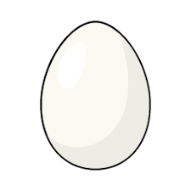
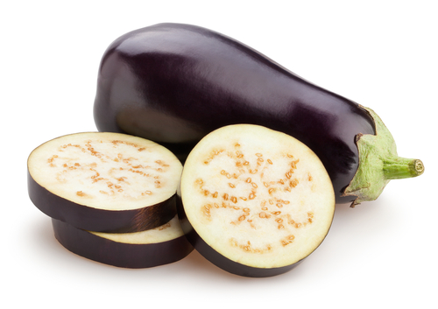

Ee
eggplant
egg
elevator
Notes:
“Today, we are going to talk about the letter E”.
(Point to the uppercase E.) “Uppercase E.” (Student repeats.)
(Point to the lowercase e.) “Lowercase e.” (Student repeats.)
“Do you remember what sound the letter e makes?” (Teacher will model making the short e sound and have the student repeat short e sound: /e/ like in elephant: /e/, /e/, /e/.)
Teacher: “Let’s look at some pictures that begin with the short e sound.”
Click to show the egg– When it appears on the screen, ask, “What do you see?” When student responds “egg,” applaud his/her answer. If student does not respond correctly, teacher will tell student that it is an egg. Click to show the word egg.
Click to show the next image - eggplant– When it appears on the screen, ask, “What do you see?” If student responds “eggplant,” applaud his/her answer. If student does not respond correctly, teacher will tell student that it is an eggplant. Click to show the word eggplant.
Click to show the third and final image – elevator - When it appears on the screen, ask, “What do you see?” If student responds “elevator,” applaud his/her answer. If student does not respond correctly, teacher will tell student that it is an elevator. Click to show the word elevator.
Click to go to the next slide.

Slide 3




Ee
exit
elephant
sun
elbow
Notes:
Ask the student– “What letters do you see?” If student says Ee, applaud his/her answer. If student is unsure, assist him/her by saying “uppercase E” and “lowercase e.” (Student should repeat teacher.)
Teacher: “Now, let’s look at the pictures.” (elephant, exit, sun and elbow.)
Click to show the elephant. Ask: “What is this?” (Elephant.) Click to show the word elephant.
Click to show the exit sign. Ask” What is this?” (Exit.) Click to show the word exit.
Click to show the sun. Ask: “What is this?” (Sun.) Click to show the word sun.
Click to show the elbow. Ask: “What is this?” (Elbow.) Click to show the word elbow.
After identifying the pictures (elephant, exit, sun and elbow,) ask:
Teacher: “What pictures begin with the letter e?” (Elephant, exit and elbow begin with the letter e. Sun does not begin with the letter e.) Click to take the sun off of the slide.
Teacher will applaud efforts of student.
If student is struggling to name the pictures that begin with e, teacher will assist by saying each picture name and asking if it begins with /e/:
- “Elephant – Does it begin with /e/?” (Yes.)
- “Exit– Does it begin with /e/?” (Yes.)
- “Sun – Does it begin with /e/?” (No.)
- “Elbow– Does it begin with /e/?” (Yes.)
Click to go to the next slide.

Slide 4
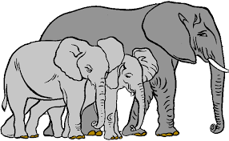
Plurals
elephant
elephants
Notes:
Notes to Teacher:
Click to bring the elephant to the slide. Ask: “What do you see?” (I see an elephant.)
Click to bring the elephants to the slide. Ask: “What do you see now?” (I see two elephants.)
Click to bring up the word ‘elephants.’
Teacher: “Today, we are going to talk about plurals. Plural means more than one. Under each picture, you will see a word.”
Point out the two words: elephant and elephants.
“Since there is more than one elephant in the 2nd group, the word ‘elephant’ has an ‘s’ on the word to show me that this word is plural.”
Click to go to the next slide.

Slide 5


Plurals
pencil
pencils
Notes:
Click to bring the first image to the slide. Teacher: “What do you see?” (I see one blue pencil.)
Click to bring the second image to the slide. Teacher: “What do you see?” (I see colored pencils. Student may say: I see four pencils.)
Ask the student to look at the pictures. Ask: “Which group shows one pencil?” (The first group has one pencil.) Click to make the word ‘pencil’ appear.
Ask: “Which group shows more than one pencil?” (The second group shows more than one pencil.)
Ask: “If the first group shows me a pencil, what word will go under the second group?” (Student should say ‘pencils.’) Click to show the word pencils.
Point out the two words: pencil and pencils.
“Since there is more than one pencil in the 2nd group, the word ‘pencil’ has an ‘s’ on the word to show me that this word is plural.”
Click to go to the next slide.

Slide 6
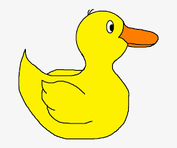

Plurals
duck
duck
s
Notes:
Notes to Teacher:
Click to bring the duck to the slide. Ask: “What do you see?” (I see a duck.)
Click to bring the ducks to the slide. Ask: “What do you see now?” (I see two ducks.)
Teacher: “Which group shows more than one: the first group or the second group?” (The second group shows more than one duck.)
Click to bring up the word ‘duck.’
Teacher: “I see the word duck under the picture of the first duck. Let’s spell the word together: d u c k. Since the second group shows me more than one duck, the word duck needs to be plural. What letter will I add to the end of the word duck to make that word plural?” (Student should say ‘s.’)
“Since there is more than one duck in the 2nd group, the word ‘duck’ will need an ‘s’ on the end of the word to show me that this word is plural.”
Click to show the word duck. Click one more time to put the ‘s’ on the end of duck to make it plural. “Read” the new word together: “Ducks.”
Click to go to the next slide

Slide 7
Sight Word Activity
find
and
it
Notes:
Teacher says: “Let’s look at our sight words from this week.” (There are 3 words on this slide.)
Click to show the word “find.”– When it appears on the screen, ask: “What word do you see?”
When student responds “find,” applaud his/her answer.
If student does not respond correctly, teacher will tell the student that the word is “find.” Have student say the word “find.” (Student repeats.)
Click to show the next word, “and.”– When it appears on the screen, ask: “What word do you see?”
When student responds “and,” applaud his/her answer.
If students does not respond correctly, teacher will tell the student that the word is “and.” Have student say the word “and.” (Student repeats.)
Click to show the next and final word, “it.” – When it appears on the screen, ask: “What word do you see?”
When student responds “I,” applaud his/her answer.
If student does not respond correctly, teacher will tell the student that the word is “it.” Have student say the word “it.” (Student repeats.)
Applaud student’s effort.
Click to go to the next slide.

Slide 8

Sight Word Activity
Find the bat.
.
Notes:
Click to bring an image and a sentence onto the slide.
Student should attempt to read the sentence: Find the bat. Teacher may assist student, if necessary. If student is struggling to read the word bat, help him/her sound it out.
After student reads the sentence, he/she should search the image for the bat.
After the student finds the bat, you may want to talk about the picture as an extension activity.
Some suggested questions to ask:
Did you ever hit a ball with a bat? Did you play t-ball, baseball or softball? Do you like playing t-ball/baseball/softball?
Click to go to the next slide.

Slide 9


E at the Museum
Notes:
Notes to Teacher:
Teacher: “This week, you read the story, E at the Museum. Let’s look at the 5 finger retell chart to help us retell this story.”
Click to bring the image to the slide.
“Let’s work on our story retell together.
Characters: “Who was the character in the story?” (A boy.)
Setting: “What was the setting of the story? Where did it take place?” (The story took place in a museum.)
Problem – “What is the problem in the story?” (There were not any problems. The boy was searching for things that started with the letter e.)
Events: “What happened in the story?” (The boy looked for things that started with the letter e as he walked throughout the museum. He found the following things in the museum: elephant, egg, escalator, Earth, East, elevator, elbow, ears and the exit.)
Ending: “What happened at the end of the story?” (After finding the exit, the boy waved goodbye.)
Connection: Possible questions to ask to help student to connect to this story:
What things did this boy find in the museum?
Did you ever go to a museum before? (If so, you could talk about his/her visit.)
7. Main Idea: What is this story about? (This story is about a boy that visits the museum. When he is at the museum, he searches for things that start with the letter e. You may encourage student to name three things from the story that start with the letter e: elephant, egg, escalator, Earth, East, elevator, elbow, ears and the exit
Applaud student’s efforts in completing this story retell.
Click to the next slide.

Slide 10
Q & A
Any Questions?
Notes:
Ask – “Do you have any questions about anything that you learned in this lesson?”

