Slide 1
Letter of the Week
Nn
Notes:
Tell the student that we are going to review the letter Nn, work on ear spelling, review all of our sight words and complete a story retell for Come Down Here.
Click to go to the next slide.

Slide 2

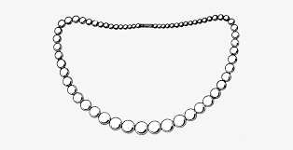
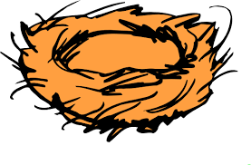
Nn
net
necklace
nest
Notes:
“Today, we are going to talk about the letter N”.
(Point to the uppercase N.) “Uppercase N.” (Student repeats.)
(Point to the lowercase n.) “Lowercase n.” (Student repeats.)
“Do you remember what sound the letter n makes?” (Teacher will model making the n sound and have the student repeat n sound: /n/ like in nut: /n/, /n/, /n/.)
Teacher: “Let’s look at some pictures that begin with the /n/ sound.”
Click to show the net– When it appears on the screen, ask, “What do you see?” When student responds “net,” applaud his/her answer. If student does not respond correctly, teacher will tell student that it is a net.
Click to show the next image - necklace– When it appears on the screen, ask, “What do you see?” When student responds “necklace,” applaud his/her answer. If student does not respond correctly, teacher will tell student that it is a necklace.
Click to show the third and final image – nest - When it appears on the screen, ask, “What do you see?” If student responds “nest,” applaud his/her answer. If student does not respond correctly, teacher will tell student that it is a nest.
Click to go to the next slide.

Slide 3


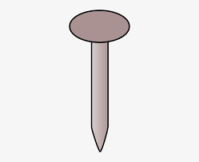
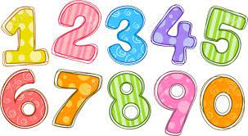
Nn
noodles
clock
numbers
nail
Notes:
Ask the students– “What letters do you see?” If student says Nn, applaud his/her answer. If student is unsure, assist him/her by saying “uppercase N” and “lowercase n.” (Student should repeat teacher.)
Teacher: “Now, let’s look at the pictures.” Teacher will need to click for each picture to appear. (Noodles, clock, numbers and nail.) There are four pictures in all. (Name the picture together as it comes on the screen or allow student to name what he/she sees as it appears on the screen.)
After identifying the pictures (noodles, clock, nail and numbers,) ask:
Teacher: “What pictures begin with the letter n?” (Noodles, numbers and nail begin with the letter n. Clock does not begin with the letter n.)
Click to take the picture of the clock off of the slide.
Teacher will applaud efforts of student.
If student is struggling to name the pictures that begin with n, teacher will assist by saying each picture name and asking if it begins with /n/:
- “Noodles – Does it begin with /n/?” (Yes.)
- “Clock– Does it begin with /n/?” (No.)
- “Numbers – Does it begin with /n/?” (Yes.)
- “Nail– Does it begin with /n/?” (Yes.)
Click to go to the next slide.

Slide 4

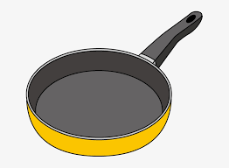
Ear Spelling
p
a
n
Notes:
Notes to Teacher:
Click to bring the picture to the slide.
Ask: “What picture do you see on the slide?” (I see a pan.)
Teacher: “Today, we are going to stretch out the word and listen for all of the sounds in the word.”
“What sound do you hear at the beginning of pan?” Teacher should isolate the /p/ sound to assist student if necessary. (Student should respond /p/.) “What letter makes the /p/ sound?” (Student should respond p or teacher should assist the student. Click to make the “p” appear.
“What sound do we hear next?” Teacher should stretch out the word making the following sounds: “/p/ /a/.” (Student should respond /a/.) “What letter makes the /a/ sound?” (Student should respond a or teacher should assist the student. Click to make the “a” appear.
“What sound do you hear at the end of pan?” Teacher should stretch out the word making the following sounds: “/p/ /a/ /n/.” (Student should respond /n/.) “What letter makes the /n/ sound?” (Student should respond n or teacher should assist the student. Click to make the “n” appear.
“Now let’s look at the word on the screen: p a n. What does that spell?” (Student should say pan.)
Teacher: “Great job! The word is pan.”
Teacher: “Now, let’s change pan to tan.” Click to go to the next slide.

Slide 5
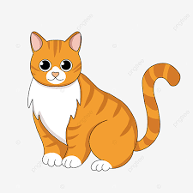
Ear Spelling
t
a
n
Notes:
Click to bring the image to the slide.
Ask the student to look at the picture. Ask: “What do you see?” (I see a cat.) Ask: “What color is the cat?” (The cat is tan.)
“Say tan.” (Student should say tan.)
“What sound do you hear at the beginning of tan?” Teacher should isolate the /t/ sound to assist student if necessary. (Student should respond /t/.) “What letter makes the /t/ sound?” (Student should respond t or teacher should assist the student. Click to make the “t” appear.
“What sound do we hear next?” Teacher should stretch out the word making the following sounds: “/t/ /a/.” (Student should respond /a/.) “What letter makes the /a/ sound?” (Student should respond a or teacher should assist the student. Click to make the “a” appear.
“What sound do you hear at the end of tan?” Teacher should stretch out the word making the following sounds: “/t/ /a/ /n/.” (Student should respond /n/.) “What letter makes the /n/ sound?” (Student should respond n or teacher should assist the student. Click to make the “n” appear.
“Now let’s look at the word on the screen: t a n. What does that spell?” (Student should say tan.)
Teacher: “Great job! The word is tan.”
Click to go to the next slide.

Slide 6
Sight Word Activity
I
see
big
a
blue
Please go to the next slide.
Notes:
Teacher says: “Now, let’s look at some of the words we worked on this year.” (There are 5 words on this slide.)
Click to show the word “I.”– When it appears on the screen, ask: “What word do you see?”
When student responds “I,” applaud his/her answer.
If student does not respond correctly, teacher will tell the student that the word is “I.” Have student say the word “I.” (Student repeats.)
Click to show the next word, “see.”– When it appears on the screen, ask: “What word do you see?”
When student responds “see,” applaud his/her answer.
If students does not respond correctly, teacher will tell the student that the word is “see.” Have student say the word “see.” (Student repeats.)
Click to show the next word, “big.” – When it appears on the screen, ask: “What word do you see?”
When student responds “big,” applaud his/her answer.
If student does not respond correctly, teacher will tell the student that the word is “big.” Have student say the word “big.” (Student repeats.)
Click to show the next word, “a.” – When it appears on the screen, ask: “What word do you see?”
When student responds “a,” applaud his/her answer.
If student does not respond correctly, teacher will tell the student that the word is “a.” Have student say the word “a.” (Student repeats.)
Click to show the next and final word, “blue.” – When it appears on the screen, ask: “What word do you see?”
When student responds “blue,” applaud his/her answer.
If student does not respond correctly, teacher will tell the student that the word is “blue.” Have student say the word “blue.” (Student repeats.)
“Now, let’s look at some more words.” Click to show the arrow.
Click to go to the next slide.

Slide 7
Sight Word Activity
can
said
the
in
for
Please go to the next slide.
Notes:
Teacher says: “Let’s look at some more of our sight words.” (There are 5 words on this slide.)
Click to show the word “can.”– When it appears on the screen, ask: “What word do you see?”
When student responds “can,” applaud his/her answer.
If student does not respond correctly, teacher will tell the student that the word is “can.” Have student say the word “can.” (Student repeats.)
Click to show the next word, “said.”– When it appears on the screen, ask: “What word do you see?”
When student responds “said,” applaud his/her answer.
If students does not respond correctly, teacher will tell the student that the word is “said.” Have student say the word “said.” (Student repeats.)
Click to show the next word, “the.” – When it appears on the screen, ask: “What word do you see?”
When student responds “the,” applaud his/her answer.
If student does not respond correctly, teacher will tell the student that the word is “the.” Have student say the word “the.” (Student repeats.)
Click to show the next word, “in.” – When it appears on the screen, ask: “What word do you see?”
When student responds “in,” applaud his/her answer.
If student does not respond correctly, teacher will tell the student that the word is “in.” Have student say the word “in.” (Student repeats.)
Click to show the next and final word, “for.” – When it appears on the screen, ask: “What word do you see?”
When student responds “for,” applaud his/her answer.
If student does not respond correctly, teacher will tell the student that the word is “for.” Have student say the word “for.” (Student repeats.)
“Now, let’s look at our last group of words.” Click to show the arrow.
Click to go to the next slide.

Slide 8

Sight Word Activity
is
go
come
down
here
.
Notes:
Teacher says: “Let’s look at the last group of words.” (There are 5 words on this slide.)
Click to show the word “is.”– When it appears on the screen, ask: “What word do you see?”
When student responds “is,” applaud his/her answer.
If student does not respond correctly, teacher will tell the student that the word is “is.” Have student say the word “is.” (Student repeats.)
Click to show the word “go.”– When it appears on the screen, ask: “What word do you see?”
When student responds “go,” applaud his/her answer.
If student does not respond correctly, teacher will tell the student that the word is “go.” Have student say the word “go.” (Student repeats.)
Click to show the next word, “come.”– When it appears on the screen, ask: “What word do you see?”
When student responds “come,” applaud his/her answer.
If students does not respond correctly, teacher will tell the student that the word is “come.” Have student say the word “come.” (Student repeats.)
Click to show the next word, “down.” – When it appears on the screen, ask: “What word do you see?”
When student responds “down,” applaud his/her answer.
If student does not respond correctly, teacher will tell the student that the word is “down.” Have student say the word “down.” (Student repeats.)
Click to show the next and final word, “here.” – When it appears on the screen, ask: “What word do you see?”
When student responds “here,” applaud his/her answer.
If student does not respond correctly, teacher will tell the student that the word is “here.” Have student say the word “here.” (Student repeats.)
Applaud student’s efforts!
Click to go to the next slide.

Slide 9
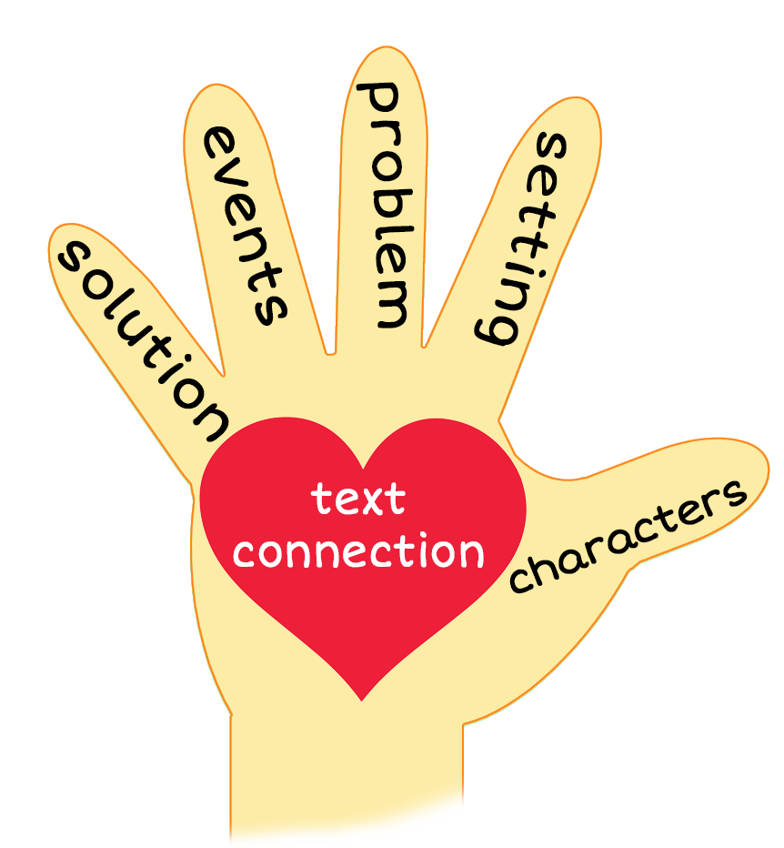
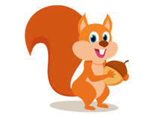
Come Down Here
Notes:
Notes to Teacher:
Teacher: “This week, you read the story, Come Down Here. Let’s look at the 5 finger retell chart to help us retell this story.”
Click to bring the images to the slide.
“Let’s work on our story retell together.”
Characters: “Who are the characters in the story?” (A boy, a girl and a squirrel.)
Setting: “What was the setting of the story? Where did it take place?” (The story took place downstairs in the kitchen.)
Problem – “What is the problem in the story?” (The children and squirrel may have been hungry.)
Events: “What happened in the story?” (Each one of the characters called another character down to the kitchen to get something to eat. See the following for specifics: Each item started with the letter n: nut, noodle, nugget.)
The boy called the squirrel down for a nut.
The squirrel called the boy down for a noodle.
The boy called the girl down for a nugget.
Ending: “What happened at the end of the story?” (Each character had something to eat. The boy and girl were happy.)
Connection: Possible questions to ask to help student to connect to this story:
What was your favorite part of the story?
What is your favorite food?
7. Main Idea: What is this story about? (This story is about a boy, a girl and squirrel calling each other down to the kitchen to eat.)
Applaud student’s efforts in completing this story retell.
Click to the next slide.

Slide 10
Q & A
Any Questions?
Notes:
Ask – “Do you have any questions about anything that you learned in this lesson?”

