Slide 1
Letter of the Week
Ss
Notes:
Tell the student that we are going to review the letter Ss, work on ear spelling, read our new sight words and complete a story retell for Smile.
Click to go to the next slide.

Slide 2


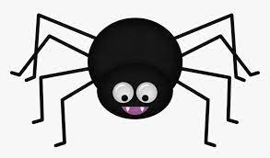
Ss
Notes:
“Today, we are going to talk about the letter S”.
(Point to the uppercase S.) “Uppercase S.” (Student repeats.)
(Point to the lowercase s.) “Lowercase s.” (Student repeats.)
“Do you remember what sound the letter s makes?” (Teacher will model making the s sound and have the student repeat s sound: /s/ like in sun: /s/, /s/, /s/.)
Teacher: “Let’s look at some pictures that begin with the /s/ sound.”
Click to show the sunglasses– When they appear on the screen, ask, “What do you see?” When student responds “sunglasses,” applaud his/her answer. If student does not respond correctly, teacher will tell student that they are sunglasses.
Click to show the next image - star – When it appears on the screen, ask, “What do you see?” When student responds “star,” applaud his/her answer. If student does not respond correctly, teacher will tell student that it is a star.
Click to show the third and final image - spider– When it appears on the screen, ask, “What do you see?” If student responds “spider,” applaud his/her answer. If student does not respond correctly, teacher will tell student that it is a spider.
Click to go to the next slide.

Slide 3


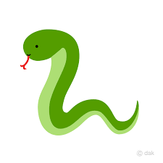
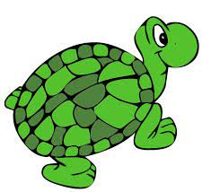
Ss
Notes:
Ask the students– “What letters do you see?” If student says Ss, applaud his/her answer. If student is unsure, assist him/her by saying “uppercase S” and “lowercase s.” (Student should repeat teacher.)
Teacher: “Now, let’s look at the pictures.” Teacher will need to click for each picture to appear. (Smile, gift, snake and turtle.) There are four pictures in all. (Name the picture together as it comes on the screen or allow student to name what he/she sees as it appears on the screen.)
After identifying the pictures (smile, gift, snake and turtle,) ask:
Teacher: “What pictures begin with the letter s?” (Smile and snake begin with the letter s. Gift and turtle do not begin with the letter s.)
Teacher will applaud efforts of student.
If student is struggling to name the pictures that begin with m, teacher will assist by saying each picture name and asking if it begins with /m/:
- “Smile – Does it begin with /s/?” (Yes.)
- “Gift– Does it begin with /s/?” (No.)
- “Snake– Does it begin with /s/?” (Yes.)
- “Turtle – Does it begin with /s/?” (No.)
Click to go to the next slide.

Slide 4


Ear Spelling
b
a
t
Notes:
Notes to Teacher:
“You are growing as a writer. We are learning lots of letters and sounds and now we can use our ear spelling to write words.
Click to bring up an image of an ear for “ear spelling.”
Ask: “What picture do you see on the slide?” (I see a bat.)
Say the word bat.” (Student should say bat.)
What sound do you hear at the beginning of bat?” (/b/.) “What letter says /b/?” (Student should respond b.) Click for the letter “b” to appear.
“What sound do we hear next?” Teacher should say the word slowly, separating each sound: /b/ /a/. (The middle sound is /a/.) “What letter makes the short /a/ sound?” (Student should respond a.) Click for the letter “a” to appear.
What sound do you hear at the end of bat?” Teacher should say the word slowly, separating each sound: /b/ /a/ /t/. (The sound at the end is /t/.) “What letters makes the /t/ sound?” (Student should respond t.) Click for the letter “t” to appear.
“Now let’s look at the word on the screen: b a t. What does that spell?” (Student should say bat.)
Teacher: “Great job! The word is bat. Let’s try some more!”
Teacher should applaud student’s effort..
Click to go to the next slide.

Slide 5
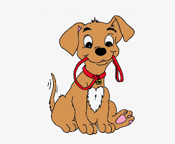
Ear Spelling
s
a
t
Notes:
Click to bring the first image to the slide.
Ask the student to look at the picture and talk about what the dog did and help him/her understand that the word is sat (versus sit or sitting.) The dog sat.
Teacher: “What did the dog do?” (He sat.)
“Let’s say the word again. Say the word sat.” (Student should say sat.)
“What sound do you hear at the beginning of sat?” Teacher should isolate the /s/ sound to assist student if necessary. (Student should respond /s/.) “What letter makes the /s/ sound?” (Student should respond s or teacher should assist the student. Click to make the “s” appear.
“What sound do we hear next?” Teacher should stretch out the word making the following sounds: “/s/ /a/.” (Student should respond /a/.) “What letter makes the /a/ sound?” (Student should respond a or teacher should assist the student. Click to make the “a” appear.
“What sound do you hear at the end of sat?” Teacher should stretch out the word making the following sounds: “/s/ /a/ /t/.” (Student should respond /t/.) “What letter makes the /t/ sound?” (Student should respond t or teacher should assist the student. Click to make the “t” appear.
“Now let’s look at the word on the screen: s a t. What does that spell?” (Student should say sat.)
Teacher: “Great job! The word is sat. Let’s try one more!”
Click to go to the next slide.

Slide 6

Ear Spelling
m
a
t
Notes:
Teacher: “Let’s practice ear spelling for one more word.” Click to have the picture of a mat appear.
“This is a mat. What is it?” (Student should respond ‘mat.’)
“A mat is something that you lay on. You may take a rest on a mat or do floor exercises on a mat. Tell me one more time. What is it?” (It is a mat.)
“What sound do you hear at the beginning of mat?” Teacher should isolate the /m/ sound to assist student if necessary. (Student should respond /m/.) “What letter makes the /m/ sound?” (Student should respond m or teacher should assist the student. Click to make the “m” appear.
“What sound do we hear next?” Teacher should stretch out the word making the following sounds: “/m/ /a/.” (Student should respond /a/.) “What letter makes the /a/ sound?” (Student should respond a or teacher should assist the student. Click to make the “a” appear.
“What sound do you hear at the end of mat?” Teacher should stretch out the word making the following sounds: “/m/ /a/ /t/.” (Student should respond /t/.) “What letter makes the /t/ sound?” (Student should respond t or teacher should assist the student. Click to make the “t” appear.
“Now let’s look at the word on the screen: m a t. What does that spell?” (Student should say mat.)
Teacher: “Great job!” Applaud student’s effort.
Click to go to the next slide.

Slide 7
Sight Word Activity
come
here
down
Notes:
Teacher says: “Now, let’s look at the words we worked on this week.”
Click to show the word “come.”– When it appears on the screen, ask: “What word do you see?”
When student responds “come,” applaud his/her answer.
If student does not respond correctly, teacher will tell the student that the word is “come.” Have student say the word “come.” (Student repeats.)
Click to show the next word, “here.”– When it appears on the screen, ask: “What word do you see?”
When student responds “here,” applaud his/her answer.
If students does not respond correctly, teacher will tell the student that the word is “here.” Have student say the word “here.” (Student repeats.)
Click to show the next and final word, “down.” – When it appears on the screen, ask: “What word do you see?”
When student responds “down,” applaud his/her answer.
If student does not respond correctly, teacher will tell the student that the word is “down.” Have student say the word “down.” (Student repeats.)
Click to go to the next slide.

Slide 8
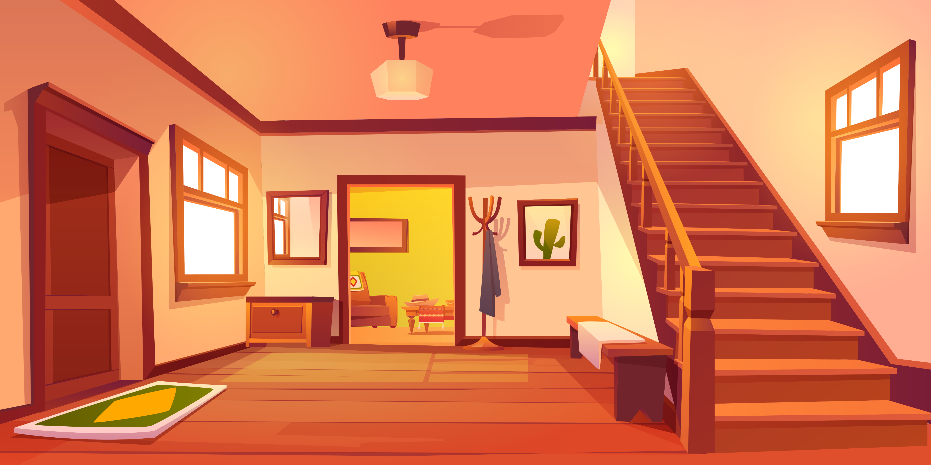
Sight Word Activity
“Come down here.”
Notes:
Click to bring the sentence and the picture to the slide.
“Let’s practice reading our sight words in a sentence.” {Come down here.}
If student is ready, allow him/her to read to you. If student is not ready, assist him/her in reading. Applaud his/her efforts.
Click to go to the next slide.

Slide 9
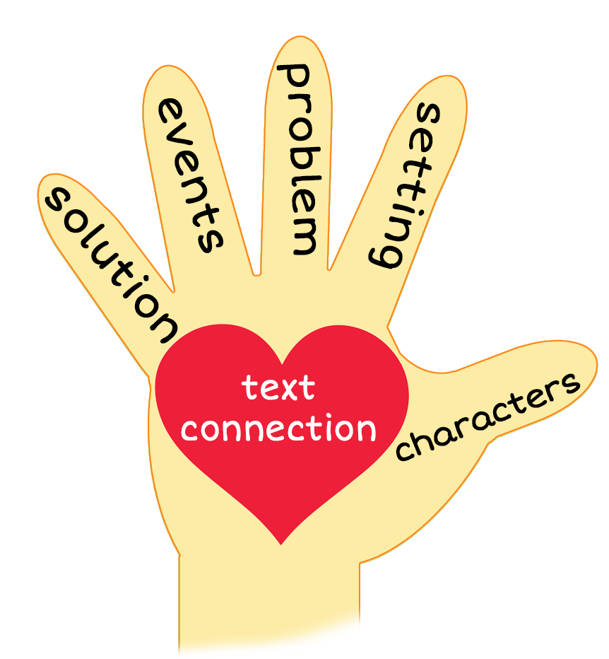
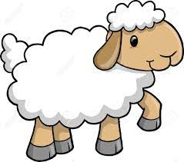
Smile
Notes:
Teacher: “This week, you read the story, Smile! Let’s look at the 5 finger retell chart to help us retell this story.”
Click to bring the image to the slide.
“Let’s work on our story retell together.
Characters: “Who are the characters in the story?” (A boy and a girl.)
Setting: “What was the setting of the story? Where did it take place?” (The story took place outside.)
Problem – “What is the problem in the story?” (The children wanted the animals to come down to them.)
Events: “What happened in the story?” (The children called each animal to them, one by one. See the following for specifics:)
The girl sees a sheep and calls it down to her.
The boy sees a squirrel and calls it down to him.
The girl sees a skunk and calls it down to her.
The boy sees a swan and calls it down to him.
The girl sees a snake and calls it down to her.
Ending: “What happened at the end of the story?” (The animals were all together, smiling for a picture with the girl and boy.)
Connection: Possible questions to ask to help student to connect to this story:
Did you ever have your picture taken?
Did you ever take any pictures?
How did you feel when you were getting your picture taken?
How did you feel taking someone/something’s picture?
Why did you feel this way?
What do you think might happen if a snake and a skunk get together?”
Main Idea: What is this story about? (This story is about a girl and boy calling the animals together for a picture.)
Applaud student’s efforts in completing this story retell.
Click to the next slide.

Slide 10
Q & A
Any Questions?
Notes:
Ask – “Do you have any questions about anything that you learned in this lesson?”

