Slide 1
Letter of the Week
Tt
Notes:
Tell the student that we are going to review the letter Tt, talk about nouns, read our new sight words and complete a story retell for What Can Mom See?
Click to go to the next slide.

Slide 2

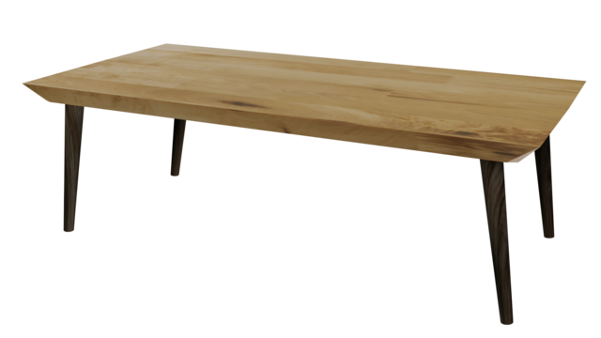
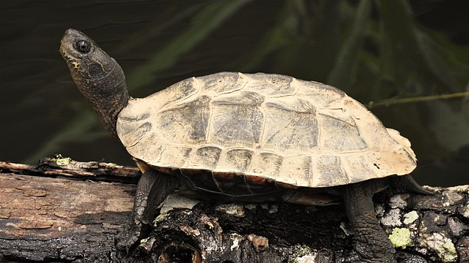
Tt
Notes:
“Today, we are going to talk about the letter T”.
(Point to the uppercase T.) “Uppercase T.” (Student repeats.)
(Point to the lowercase t.) “Lowercase t.” (Student repeats.)
“Do you remember what sound the letter t makes?” (Teacher will model making the t sound and have the student repeat t sound: /t/ like in ten. /t/, /t/, /t/.)
Teacher: “Let’s look at some pictures that begin with the t sound.”
Click to show the tent– When it appears on the screen, ask “What do you see?” When student responds “tent,” applaud his/her answer. If student does not respond correctly, teacher will tell student that it is a tent.
Click to show the next image - table – When it appears on the screen, ask “What do you see?” When student responds “table” applaud his/her answer. If student does not respond correctly, teacher will tell student that it is a table.
Click to show the third and final image - turtle– When it appears on the screen, ask “What do you see?” If student responds “turtle,” applaud his/her answer. If student does not respond correctly, teacher will tell student that it is a turtle.
Click to go to the next slide.

Slide 3
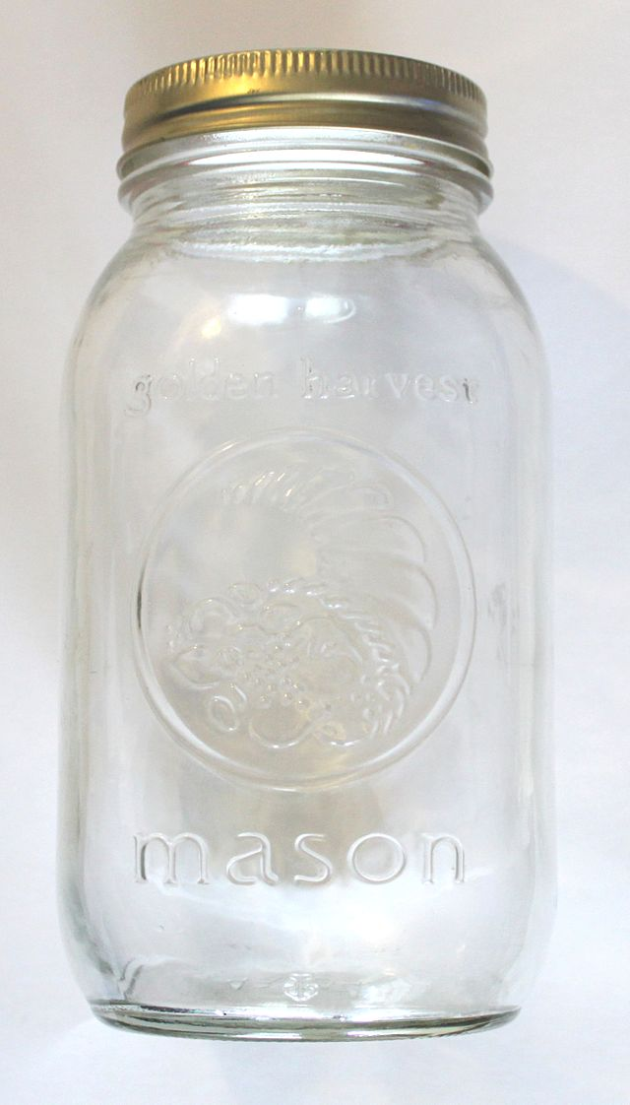
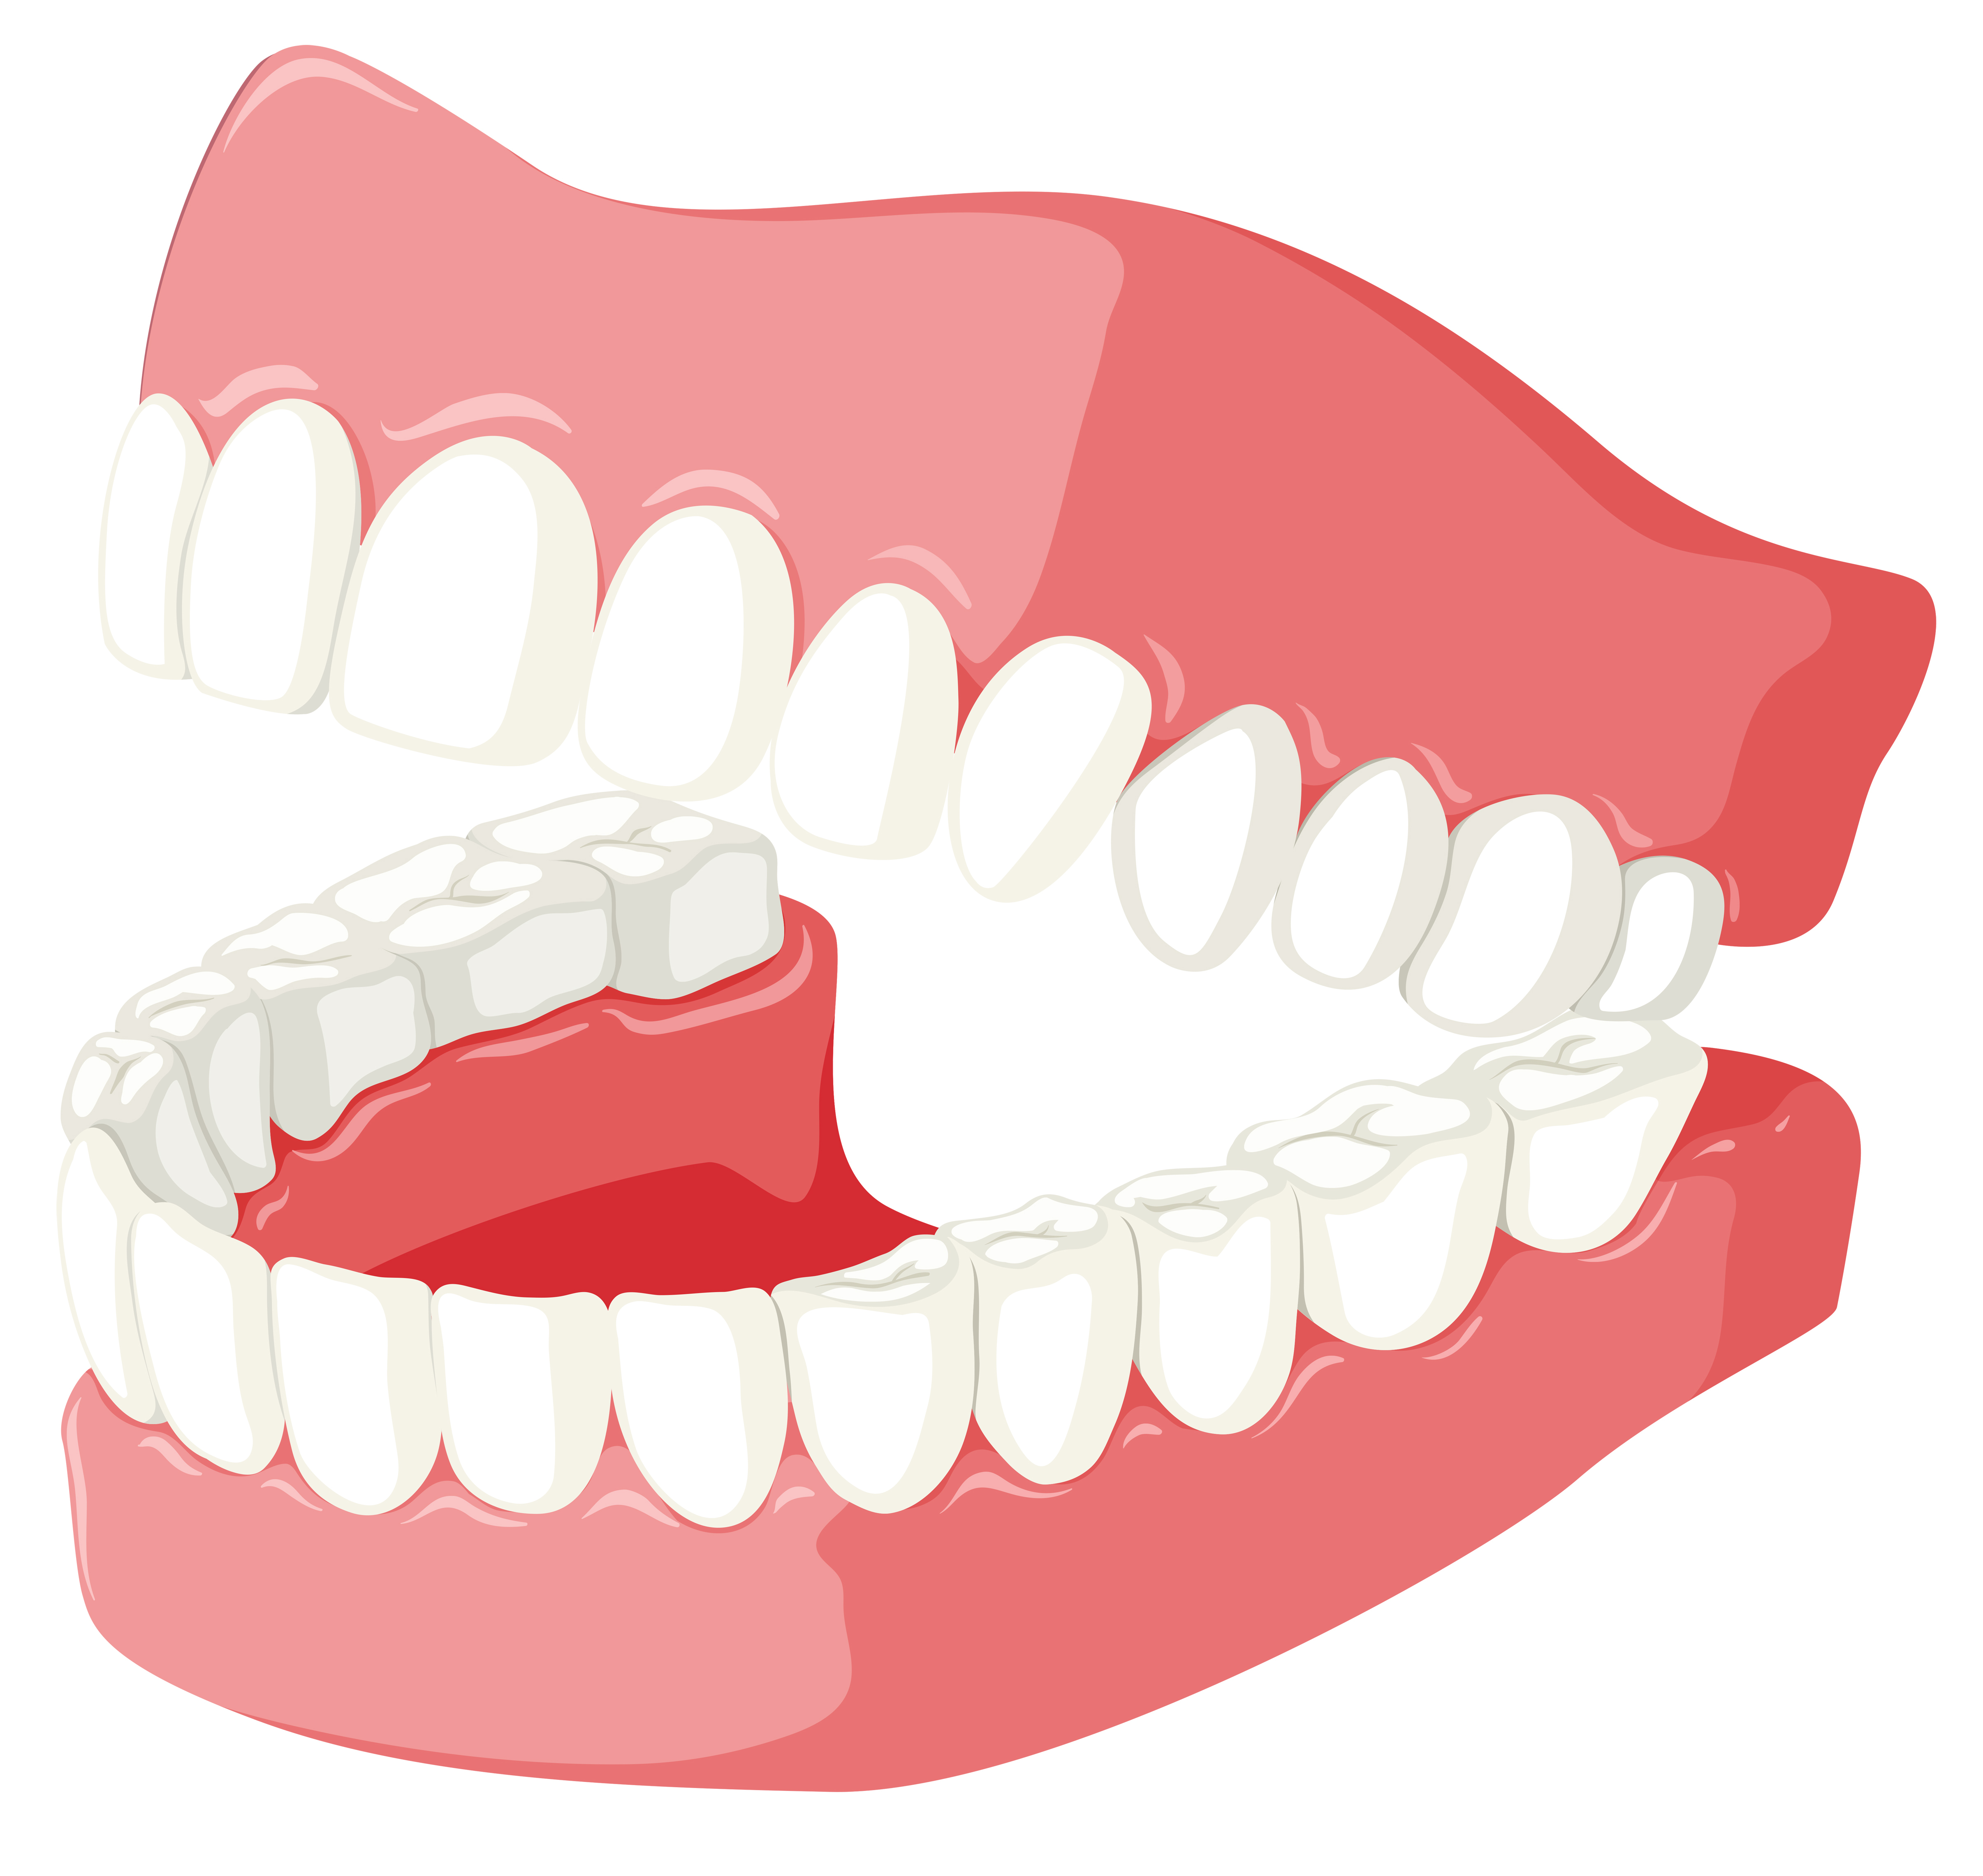


Tt
Notes:
Ask the students– “What letters do you see?” If student says Tt, applaud his/her answer. If student is unsure, assist him/her by saying “uppercase T” and “lowercase t.” (Student should repeat teacher.)
Teacher: “Now, let’s look at the pictures.” Teacher will need to click for each picture to appear. There are four pictures in all. (Name the picture together as it comes on the screen or allow student to name what he/she sees as it appears on the screen.)
After identifying the pictures (jar, teeth, taco and tiger,) ask:
Teacher: “What pictures begin with the letter t?” (Teeth, towels and tiger begin with the letter t. Jar does not begin with the letter t.)
Teacher will applaud efforts of student.
If student is struggling to name the pictures that begin with b, teacher will assist by saying each picture name and asking if it begins with /t/:
- “Jar – Does it begin with /t/?” (No.)
- “Teeth – Does it begin with /t/?” (Yes.)
- “Taco – Does it begin with /t/?” (Yes.)
- “Tiger – Does it begin with /t/?” (Yes.)
Click to go to the next slide.

Slide 4
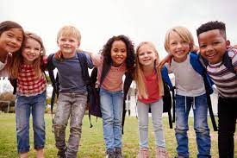
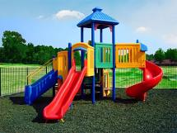
Nouns
Notes:
Tell student that you will talk about nouns today.
Remind student: “A noun can be a person (or people):”
Click one time to begin slide. A group of children will be on the slide.
Direct student to look at the picture.
Teacher: “Who do you see on the slide?” (I see children.)
Click again and say: “A noun can be a place. What place do you see?” (I see a playground.)
Click to go to the next slide.

Slide 5
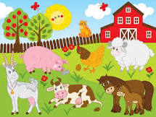
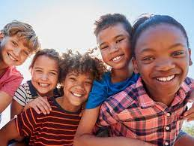
Nouns
Notes:
Remind student: “A noun can be an animal (or animals.) “What animals do you see?” (Allow student to name as many animals as he/she can in the picture.)
Stay on this picture.
“A noun can be a thing. I see a barn on the farm. A barn is a thing.”
Click one more time to begin bring up the picture of the children. A group of children will be on the slide.
“A noun can also be an idea. When I talk about a noun being ‘an idea,; I think of “friendship” or “love.” Looking at this picture, I see lots of smiles and it makes me believe these children are friends. This picture shows me friendship.”
Click to go to the next slide.

Slide 6
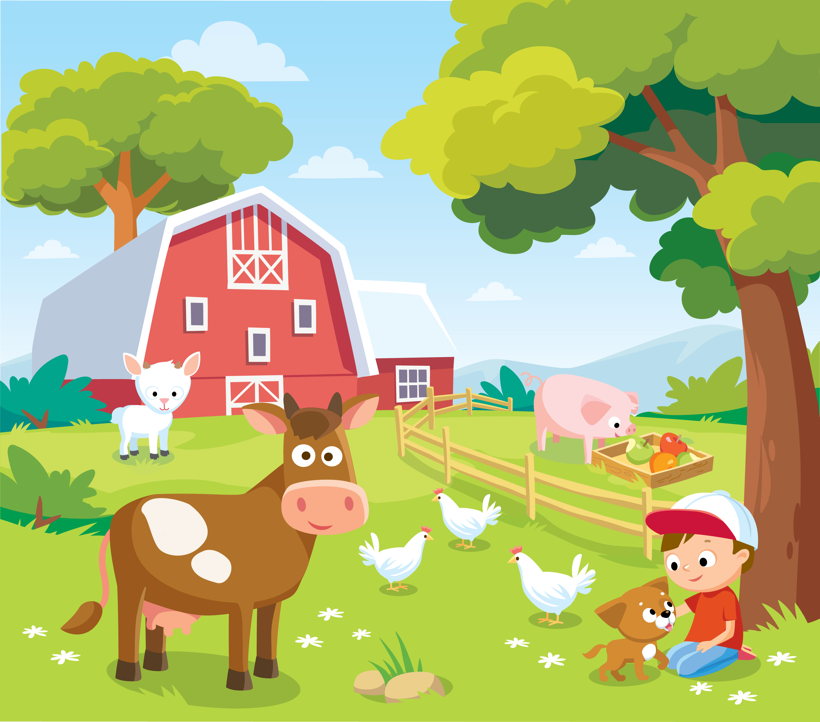
Nouns
Notes:
Teacher: “Remember, a noun can be a person, place, animal, thing or idea. Let’s look at a picture.” {Click to show student the picture of the farm scene on the slide.}
“Tell me about the nouns you see..” (If student is struggling, ask guiding questions to help student identify the nouns. Encourage student to tell you about as many nouns as he/she can:)
Guiding Questions:
Teacher: “Do you see any people in the picture?” (Yes.) Ask: “Who do you see?” (Person – I see a boy.)
Teacher: “Where is the boy?” (Place- He is on a farm.)
Teacher: “Do you see any animals in the picture?” (Yes.) “What animals do you see?” (Animals – I see a cow, sheep, pig, chicken and dog.)
Teacher: “Besides the boy and animals on the farm, what other things do you see in this picture?” (Things – I see a barn, doors, window, tree, fence grass, rocks, flowers, apples and sky.)
The ‘Idea’ is a difficult concept to understand. Teacher: talk about the idea of love/friendship and tell how you see ‘love’ between the boy and the dog.
Click to go to the next slide.

Slide 7
Sight Word Activity
said
the
in
Notes:
Teacher says: “Now, let’s look at the words we worked on this week.”
Click to show the word “said”. – When it appears on the screen, ask: “What word do you see?”
When student responds “said,” applaud his/her answer.
If student does not respond correctly, teacher will tell the student that the word is “said.” Have student say the word “said.” (Student repeats.)
Click to show the next word, “the.”– When it appears on the screen, ask: “What word do you see?”
When student responds “the,” applaud his/her answer.
If students does not respond correctly, teacher will tell the student that the word is “the.” Have student say the word “the.” (Student repeats.)
Click to show the next and final word, “in.” – When it appears on the screen, ask: “What word do you see?”
When student responds “in,” applaud his/her answer.
If student does not respond correctly, teacher will tell the student that the word is “in.” Have student say the word “in.” (Student repeats.)
Click to go to the next slide.

Slide 8
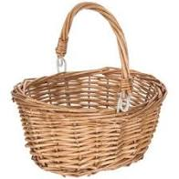
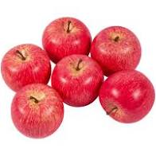
Sight Word Activity
I see the in the .
Notes:
“Let’s practice reading our sight words in a sentence.” {I see the (apples) in the (basket.}
If student is ready, allow him/her to read to you. If student is not ready, assist him/her in reading. Applaud all efforts.
Click to go to the next slide.

Slide 9


What Can Mom See?
Notes:
Teacher: “This week, you read the story, What Can Mom See? Let’s use our hand to do a story retell together.
Point to thumb – “Characters: Who are the characters in the story? (Mom, boy and a girl.)
Point to pointer finger – “Setting: What was the setting of the story? Where did it take place? (Most of the story took place outside. I know this because I can see the hills, grass and sky. It also takes place inside the house. It looks like it might be in a kitchen. I see the counter, cabinets, drawers and a garbage can.)
Point to tall finger – “Problem: Were there any problems in the story?” (No, there weren’t any problems in this story.)
Point to ring finger – “Events: What happened in the story?” (In this story, the mom, boy and girl tell us about the things they see. The things begin with the letter t. Examples: turtle, tent, tiger, train, tissue, trash can, tire and truck.)
Point to pinky – “Ending: How did the story end?” (The story ends with all of the characters standing together with a big smile on their faces.)
Point to palm of hand – “Connection: Did you ever see any of these things? If so, what did you see? Where did you see it? Would you like to see any of these things?” (Some examples of how students may connect to this story: Grandpa has a blue truck. I put my tissue in a trash can, but my tissue was white. Mom does not have a truck. I saw a tiger at the Zoo.)
Close hand and make a fist – “Main Idea: What is this story about? (This story is about things that start with the letter t. This story is about things a mom, boy and girl see.)
Applaud student’s efforts in completing this story retell.
Click to the next slide.

Slide 10
Q & A
Any Questions?
Notes:
Ask – “Do you have any questions about anything that you learned in this lesson?”

