Slide 1
Letter and Phonics of the Week
Aa; Short a

Slide 2
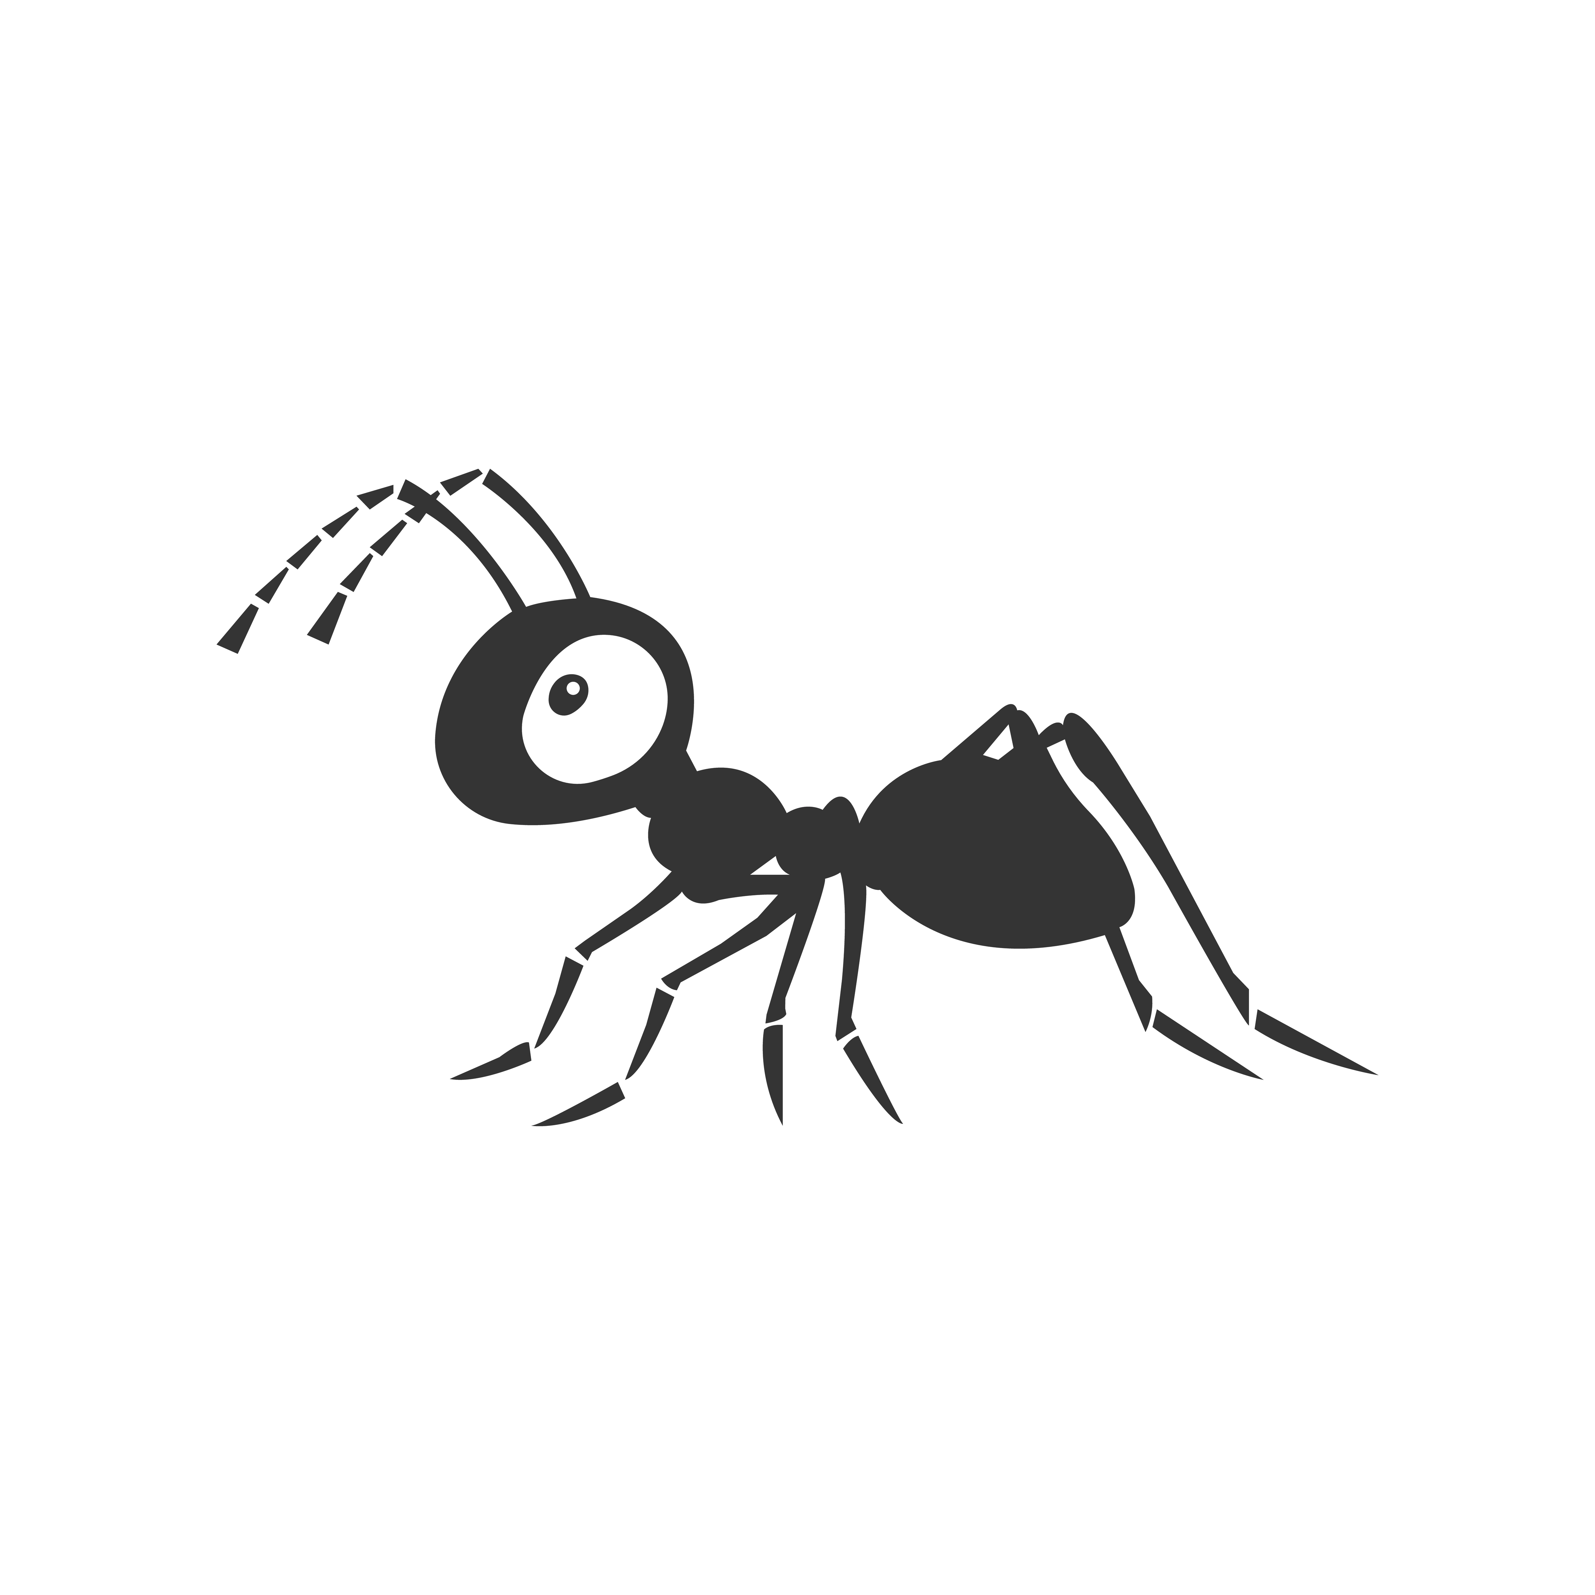

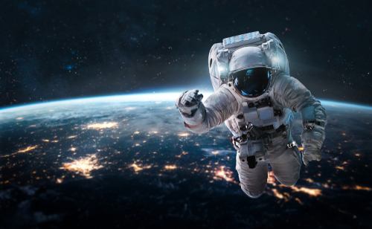
Aa
Notes:
“Today, we are going to talk about the letter A”.
(Point to the uppercase A.) “Uppercase A.” (Student repeats.)
(Point to the lowercase a.) “Lowercase a.” (Student repeats.)
“Do you remember what sound the short a makes?” (Teacher can model making the short a sound and having the student repeat short a sound: /a/ like in apple. /a/, /a/, /a/.)
“Let’s look at some pictures that begin with the short a sound.”
Click to show the ant – When it appears on the screen, ask “What do you see?” When student responds “ant,” applaud his/her answer. If student does not respond correctly, teacher can tell student that it is an ant.
Click to show the next image - apple – When it appears on the screen, ask “What do you see?” When student responds “apple,” applaud his/her answer. If student does not respond correctly, teacher can tell student that it is an apple.
Click to show the third and final image - astronaut – When it appears on the screen, ask “What do you see?” If student responds “astronaut,” applaud his/her answer. If student does not respond correctly, teacher can tell student that it is an astronaut.
Click to go to the next slide.

Slide 3
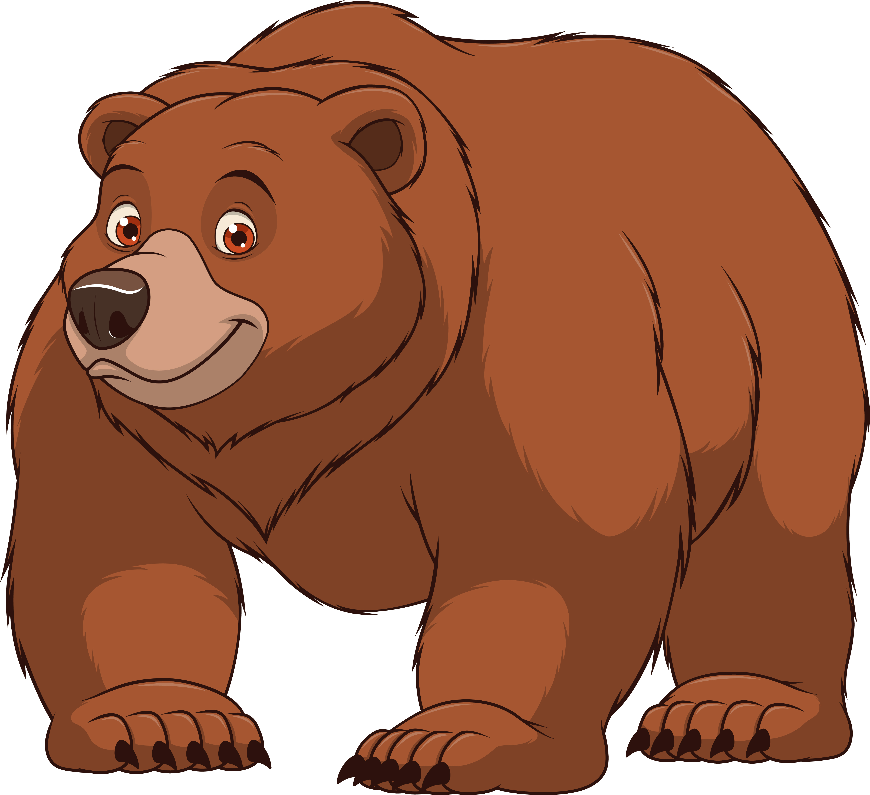
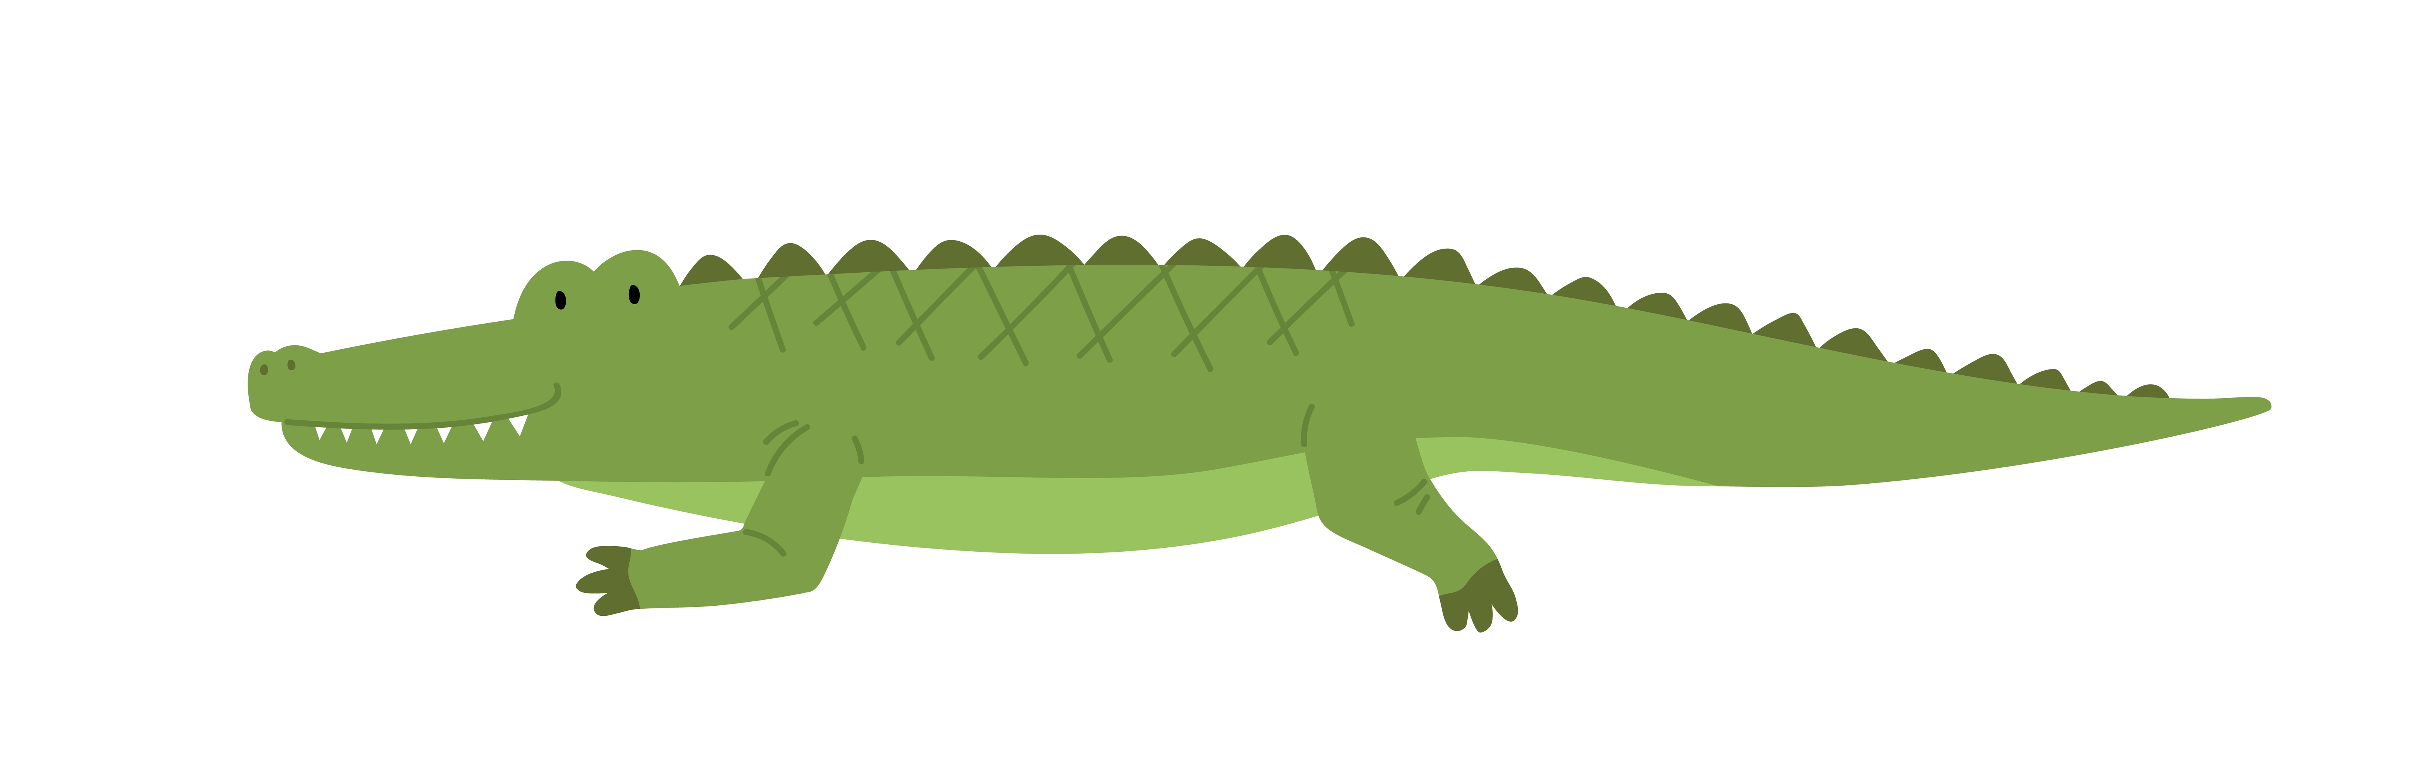

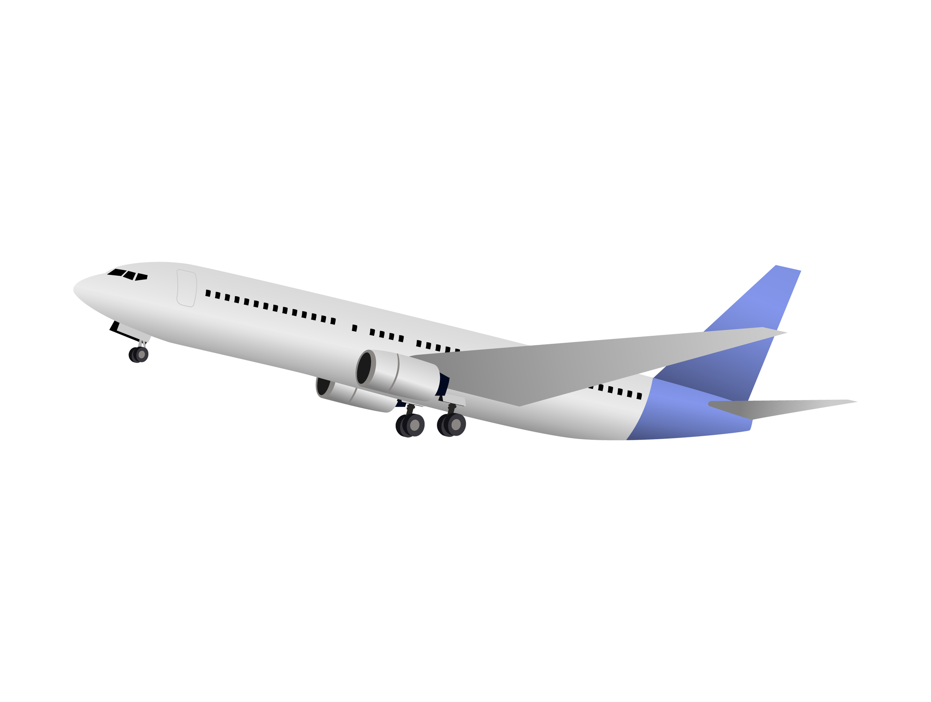
Aa
Notes:
Ask the students– “What letters do you see?” If student says Aa, applaud his/her answer. If student is unsure, assist him/her by saying “uppercase A” and “lowercase a.” (Student should repeat teacher.)
Teacher: “Now, let’s look at the pictures.” Click to allow pictures to appear on the slide, pausing to allow the student to identify each picture. Correct student if he/she names the picture incorrectly.
After identifying the pictures ~
Teacher: “Can you name one picture that begins with /a/? (Students should name alligator and airplane.)
Teacher should applaud efforts of student.
If student is struggling to name the pictures that begin with short /a/, teacher may assist by saying:
“Alligator. Bear. What begins with /a/?”
“Dog. Airplane. What begins with /a/?”
Click to go to the next slide.

Slide 4

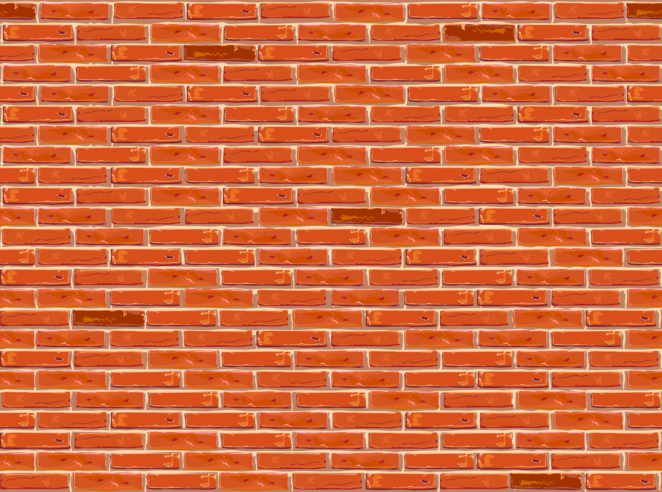


Rhyme Time
Notes:
Ask student what it means if words rhyme. Applaud efforts and assist if needed.
Transition student into rhyming by reminding him/her that words that rhyme sound the same at the end.
Click to make a box with two pictures appear (ball and wall.) Ask student:
“Can you name the first picture you see in the box?” (Ball.) Tell student to name the 2nd picture and remind him/her that it rhymes with ball (wall.)
Applaud student’s effort.
Tell student that we will look at three more pictures.
Click to make pictures appear.
Allow student to name the pictures on the slide. After naming all of the pictures correctly (key, pan and bee,) ask:
“What two words rhyme?” (Key and bee rhyme.)
If student is struggling, help him/her out by saying: “What word rhymes with key: key, pan or key, bee?” (Key and bee rhyme.)
Teacher should applaud student’s effort.
Click to go to the next slide.

Slide 5


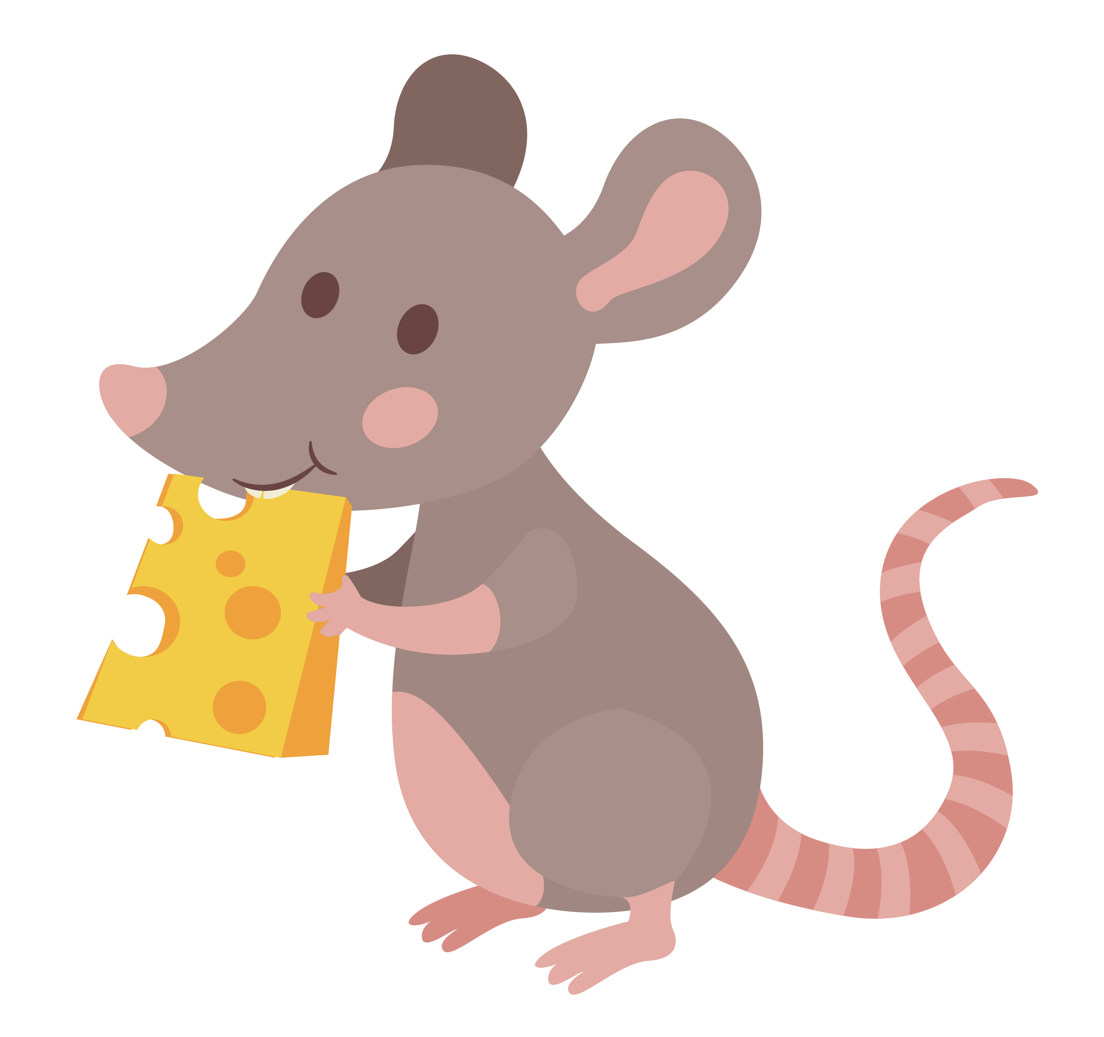
Rhyme Time
Notes:
Click to make pictures appear on the screen, pausing to let the student identify the picture, correcting if needed:
Ask the students to name each picture of the left-hand side of the slide as it appears on the screen (cake, mouse.) Do the same for the pictures on the right-hand side of the slide (house, rake.)
Afterwards, ask student:
“What rhymes with cake?” (rake.)
“What rhymes with mouse?” (house.)
Applaud student’s effort.
Click to go to the next slide.

Slide 6
Sight Words
I
see
big
Notes:
Teacher says: “Today, let’s review our sight words.”
Click to show the word “I. – When it appears on the screen, ask: “What word do you see?”
When student responds “I,” applaud his/her answer.
If student does not respond correctly, teacher can tell the student that the word is “I.” Have student say the word “I.” (Student repeats.)
Click to show the next word, “see.” – When it appears on the screen, ask: “What word do you see?”
When student responds “see,” applaud his/her answer.
If students does not respond correctly, teacher can tell the student that the word is “see.” Have student say the word “see.” (Student repeats.)
Click to show the next and final word, “big.” – When it appears on the screen, ask: “What word do you see?”
When student responds “big,” applaud his/her answer.
If students does not respond correctly, teacher can tell the student that the word is “big.” Have student say the word “big.” (Student repeats.)
Click two times to get to the next slide.

Slide 7

Sight Words
I see a big .
Notes:
If student is ready, allow him/her to read to you. If student is not ready, assist him/her in reading. Applaud all efforts.
Click to go to the next slide.

Slide 8
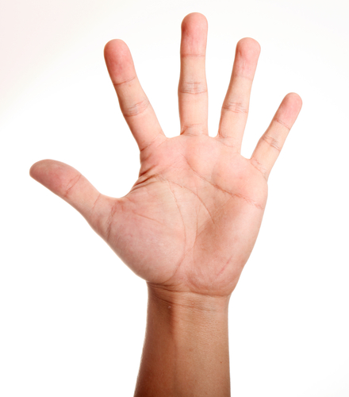
Story Retell
Notes:
Remind students of how we can use our hand to help retell a story, using the information below.
Click to bring the image of the hand to the slide.
Teacher will point to or circle “fingers” on image when talking about each part:
Thumb – Characters – Who are the characters in the story?
Pointer – Setting – Where does the story take place?
Tall Finger – Problem – Are there any problems in the story?
Ring Finger – Events – What happened in the story? What happened at the beginning? Middle? End?
Pinky – Ending – Restate how the story ended.
Palm of Hand – Connection – How does this story connect to my life?
Closed Fist (Represents lightbulb) – Main Idea – What is this story mostly about?
Click to the next slide.

Slide 9

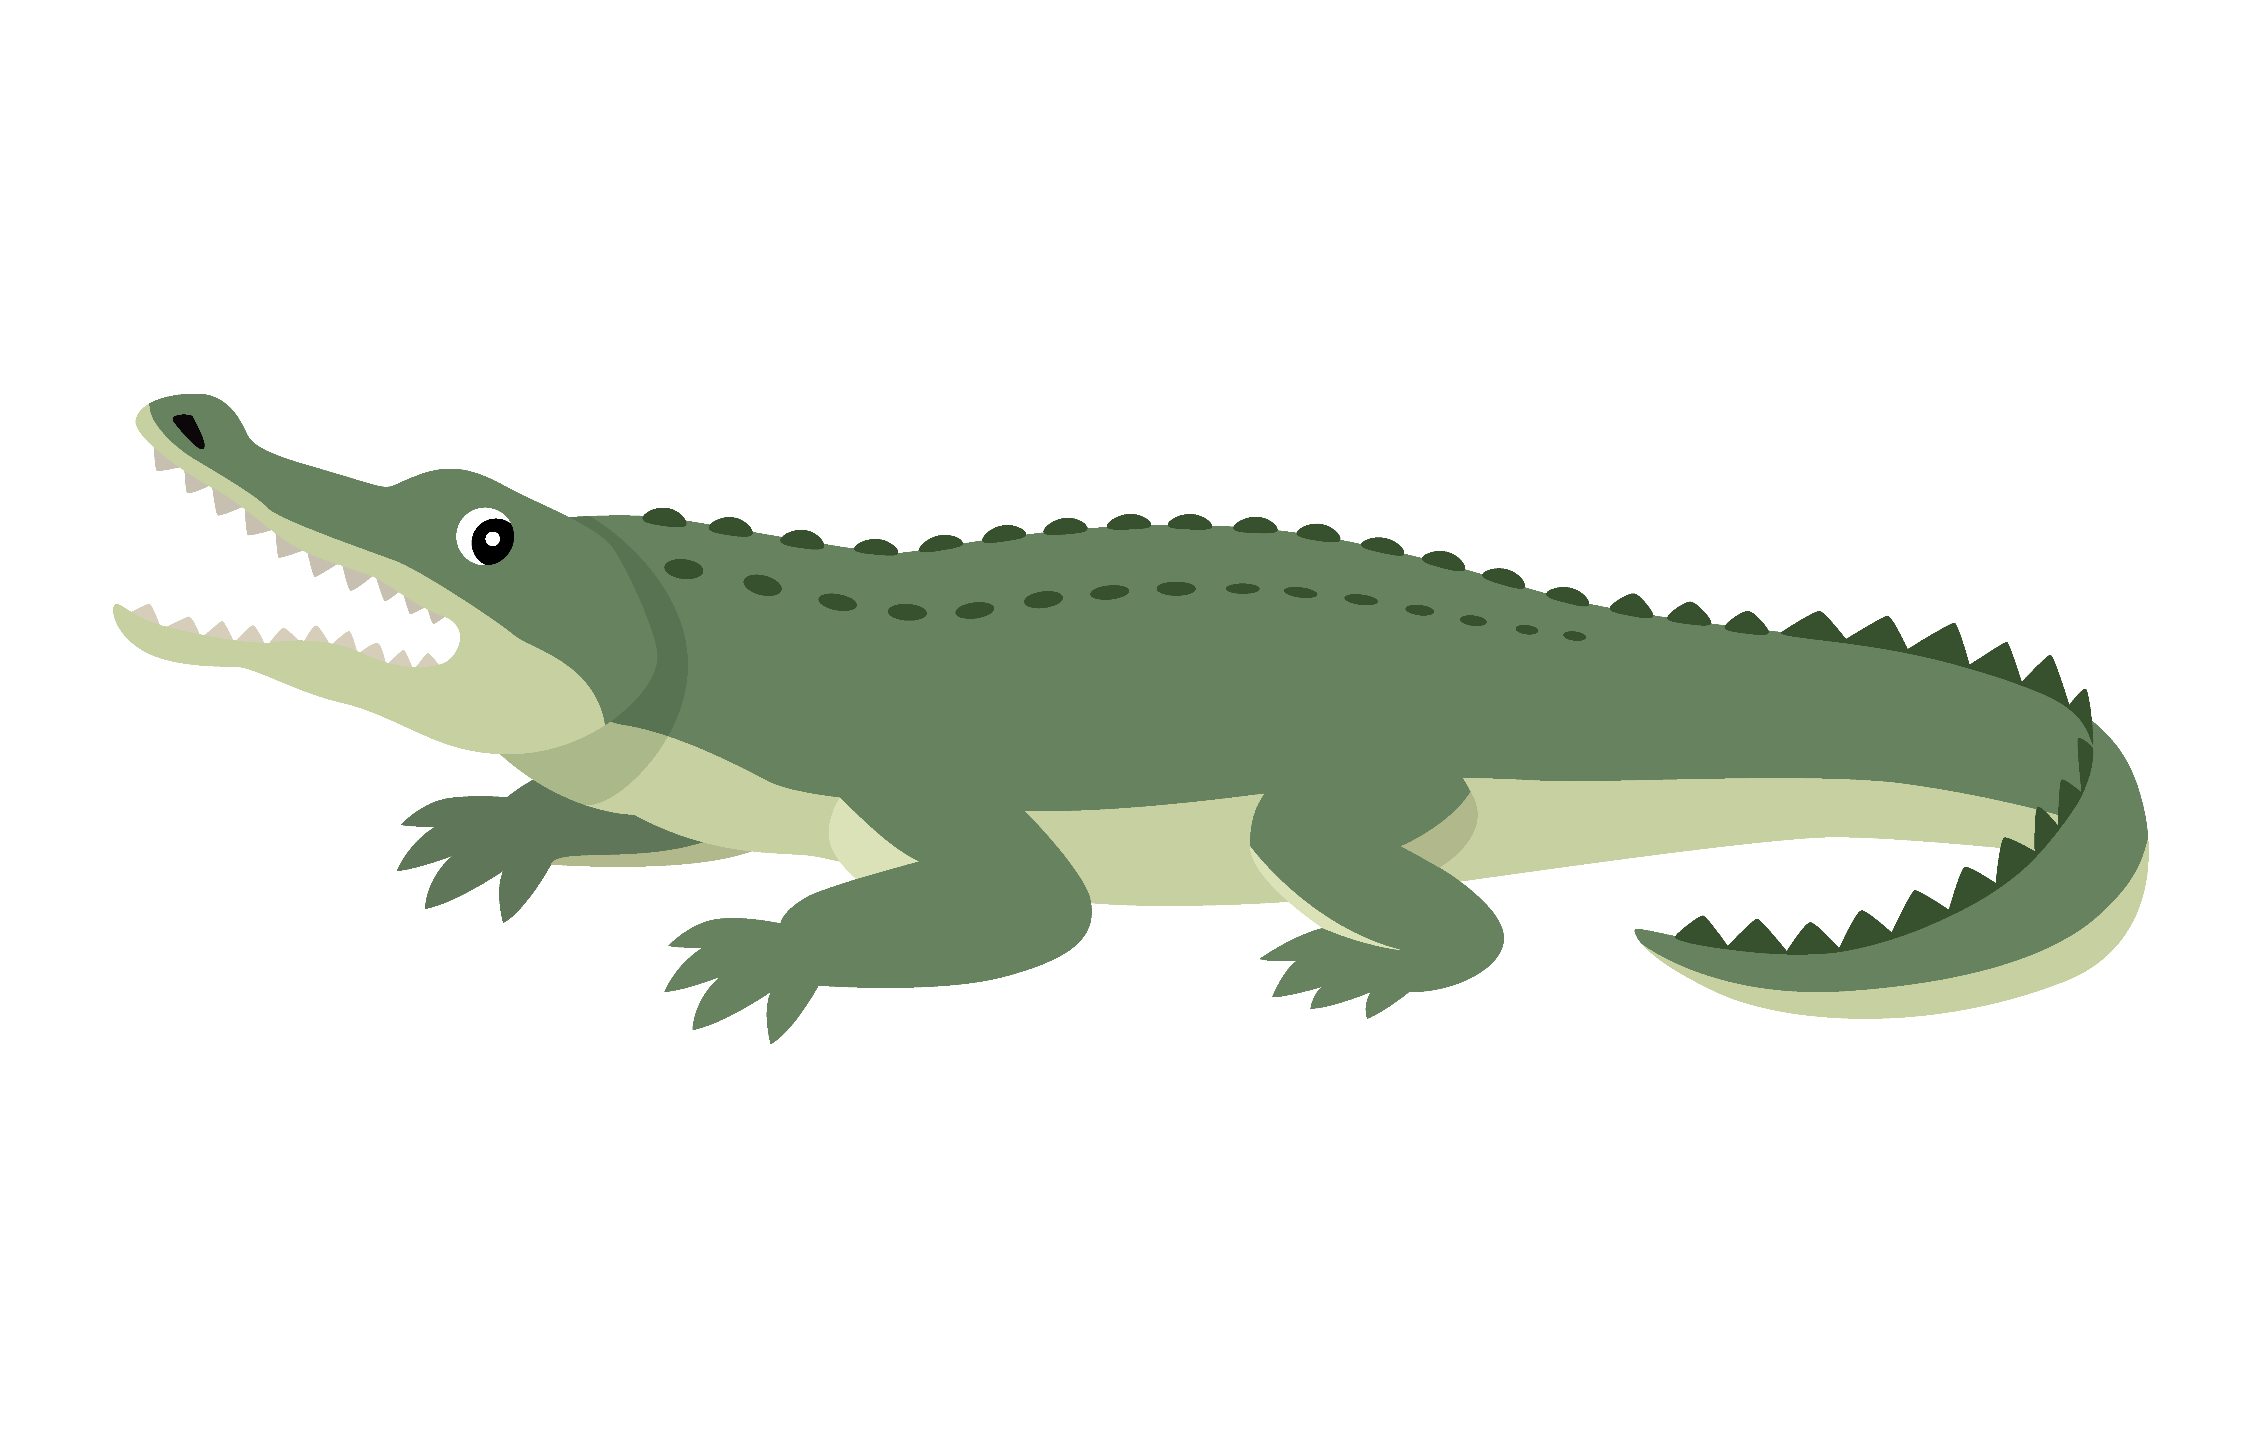
I See
Notes:
Teacher: “This week, you read the story, I See.”
Click to bring picture of a book and an alligator on the slide.
“Let’s use our hand to do a story retell together.”
“Point to your thumb – Characters – Who/what did we see in the story? This story is about things that start with the short a sound. Do you remember what you read about that start with the letter a?” (alligator, apple, airplane and astronaut.)
“Point to your pointer finger – Setting – What was the setting of the story? Where did it take place? Look back at the pictures for clues.” (Possible answers: It took place outside. I know this because I see water, grass and the sky.)
“Point to your tall finger – Problem – Was there a problem in this story?” (This story did not have any problems.)
“Point to your ring finger – Events – What happened in this story?” (In this story, I saw a alligators, apples airplanes and astronauts. After I read about these things, I saw a big alligator, a big apple, a big airplane and a big astronaut.)
“Point to your pinky finger – Ending – how did the story end?” (At the end of the story, I saw a child in an airplane, waving goodbye.)
“Point to the palm of your hand – Connection – Did you ever see any of these things? If so, what did you see? Where did you see it? Would you like to see any of these things? (Some examples of how student may relate to this story – I have apples in my refrigerator. I like to eat apples. I saw an astronaut on tv. I saw an alligator at the zoo. I went on an airplane to visit Grandma.)
“Close your hand and make a fist – Main Idea – What is this story about?” (This story is about things that start with the letter a – alligators, apples, airplanes and astronauts.)
Click to go to the next slide.

Slide 10
Q & A
Any Questions?
Notes:
Ask – “Do you have any questions about anything that you learned in the first lesson?”

