Slide 1
Letter of the Week
Ff
Notes:
Tell the student that we are going to review the letter Ff, talk about punctuation marks, review our sight words from this week and complete a story retell for Jump!
Click to go to the next slide.

Slide 2



Ff
football
flower
fork
Notes:
[use Shutterstock images 235589011(flower,) 1151420105(football) and 1564067512(fork.)]
“Today, we are going to talk about the letter F”.
(Point to the uppercase F.) “Uppercase F (Student repeats.)
(Point to the lowercase f.) “Lowercase f.” (Student repeats.)
Teacher: “What sound does the letter f make?” Wait to see if student responds. Teacher will model making the /f/ sound and have the student repeat: /f/ like in fox: /f/, /f/, /f/.
Teacher: “Let’s look at some pictures that begin with the /f/ sound.”
Click to show the flower– When it appears on the screen, ask, “What do you see?” When student responds “flower,” applaud his/her answer. If student does not respond correctly, teacher will tell student that it is a flower.
Click to show the next image - football– When it appears on the screen, ask, “What do you see?” If student responds “football,” applaud his/her answer. If student does not respond correctly, teacher will tell student that it is a football.
Click to show the third and final image –fork- When it appears on the screen, ask, “What do you see?” If student responds “fork,” applaud his/her answer. If student does not respond correctly, teacher will tell student that it is a fork.
Click to go to the next slide.

Slide 3



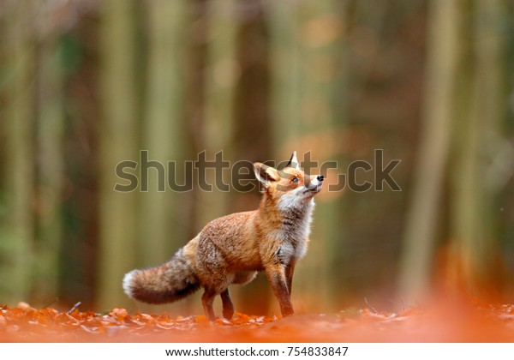
Ff
frog
shoe
fox
fish
Notes:
[use Shutterstock images 1188115291 (frog,) 1105607897 (shoe,) 754833847 (fox) and 439857235 (fish.)]
Ask the student– “What letters do you see?” If student says Ff, applaud his/her answer. If student is unsure, assist him/her by saying “uppercase F” and “lowercase f.” (Student should repeat teacher.)
Teacher: “Now, let’s look at the pictures.” (frog, shoe, fix and fish.) Teacher will need to click for each picture to appear. There are four pictures in all. (Name the picture together as it comes on the screen or allow student to name what he/she sees as it appears on the screen.)
After identifying the pictures (frog, shoe, fox and fish) ask:
Teacher: “What pictures begin with the letter f?” (Frog, fox and fish begin with the letter f. Shoe does not begin with the letter f.)
If student is struggling to name the pictures that begin with f, teacher will assist by saying each picture name and asking if it begins with /f/:
- “Frog – Does it begin with /f/?” (Yes.)
- “Shoe– Does it begin with /f/?” (No.)
- “Fox – Does it begin with /f/?” (Yes.)
- “Fish– Does it begin with /f/?” (Yes.)
Click to take the picture of the shoe off of the slide.
Teacher will applaud efforts of student.
Click to go to the next slide.

Slide 4



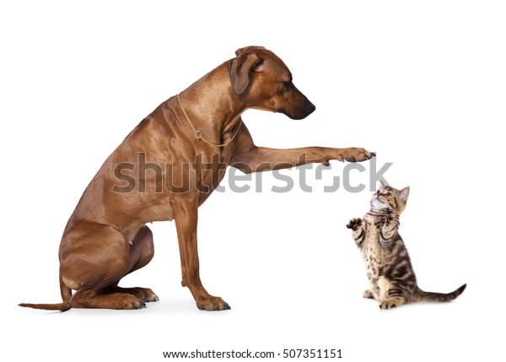

Punctuation Marks
Exclamation mark
Period
How old are you?
It is sunny.
The dog is so big!
Question mark
Notes:
[use Shutterstock images 113482882 (Question mark,) 647510014 (exclamation mark,) 188262686 (question marks,) 507351151 (dog) and 1029843514 (outdoor scene.)]
Notes to Teacher: Remind students that we learned about marks at the end of sentences.
Click to show a period on the slide. Ask: “Do you know what this ending mark is called?” (It is a period. It goes at the end of a telling sentence.) Applaud correct answer or tell student the name of the ending mark, if necessary.)
Click to show a telling sentence with a period at the end: It is sunny. (Read sentence to student.)
Click to show a picture that goes with the sentence.
Click to show a question mark on the slide. Ask: “Do you know what this ending mark is called?” (It is a question mark. It goes at the end of a sentence that asks a question.) Applaud correct answer or tell student the name of the ending mark, if necessary.)
Click to show a question with a question mark at the end: How old are you? (Read sentence to student.)
Click to show an exclamation mark on the slide. Ask: “Do you know what this ending mark is called?” (It is an exclamation mark. It goes at the end of a sentence to show excitement.? Applaud correct answer or tell student the name of the ending mark, if necessary.)
Click to show a sentence with an exclamation mark at the end: The dog is so big! (Read sentence to student showing excitement in your voice.)
Teacher should applaud student’s effort and/or assist if needed.
Click to go to the next slide.

Slide 5
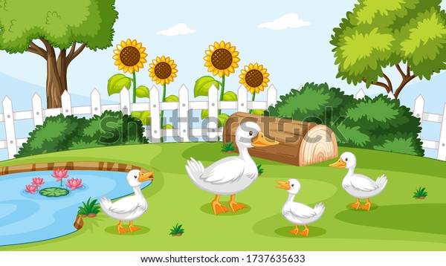
Tell me about it!
.
?
I see four ducks
What color are the ducks
This picture makes me feel happy
!
Notes:
[use Shutterstock image 1737635633.]
Notes to Teacher:
“Let’s look at the picture and talk about it. I see 4 ducks. This is a telling sentence. It tells me about how many ducks I see. Can you create a telling sentence about the sunflowers?” (Ex: I see 4 sunflowers.) Allow students to try and create a telling sentence. Assist if needed by providing example above.)
After talking about telling sentences, remind students that a period goes at the end of a telling sentence.
Click to show my telling sentence: I see 4 ducks.
Click again to make the period appear at the end of the sentence.
“Now, let’s form a question. What color are the ducks? This is a question. I am asking you to tell me something.
Click to show my question: What color are the ducks?
Click again to make the question mark appear at the end of the question. “A question mark goes at the end of my question. It lets me know that someone is asking something.”
Can you look at the picture and tell me what color the ducks are?” (They are white.)
“Can you create a question about the trees in the picture?” (Ex: How many trees are there? [There are 2 trees.])
“Before we go to the next slide, tell me how this picture makes you feel.” (Encourage student to use excitement in his/her voice to tell you about their feelings.)
Give this example and read it with excitement in your voice: “This picture makes me feel happy!” Click to show the sentence at the bottom of the slide. Click one more time to bring the exclamation mark to the slide. Remind students that the exclamation mark at the end lets you know to read the sentence with excitement.
Click to go to the next slide.

Slide 6
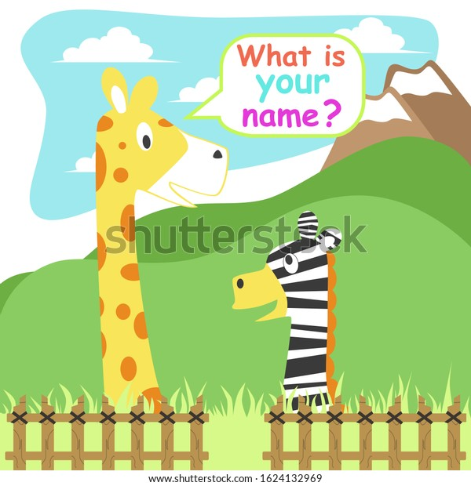

What mark goes at the end?
What is you name
?
I am so excited
!
Notes:
[use Shutterstock images 113482882 (Question mark,) 647510014 (exclamation mark,) 1624132969 (giraffe) and 1114465520 (children.)]
Notes to Teacher:
“I am going to read a sentence, or a question, and I want you to tell me what punctuation mark goes at the end:
Click to bring up the period. Say: “Period.”
Click to bring up the question mark Say: “Question Mark.”
Click to bring up the exclamation mark. Say: “Exclamation Mark.”
Click to bring the first question on the slide. Read it to the student: “What is your name”
Ask: “Am I telling you something or asking you something?” (I am asking you something.)
Click to bring the ending marks to the slide.
Ask: “What ending mark goes at the end of this question? (?)
Click to bring the question mark to the end of this question, along with a picture that matches the question.
Click to bring a sentence on the slide. Read it to the student with excitement in your voice: “I am so excited”
Ask: “Am I telling you something or asking you something?” (I am telling you something.)
Click to bring the ending marks to the slide.
Ask: “By listening to my voice, should I add a period or an exclamation mark to the end of the sentence?” (!)
Click to bring the exclamation mark to the end of this sentence., along with a picture that matches the sentence.
Applaud student’s effort.
Click to go to the next slide.

Slide 7
Sight Word Activity
jump
little
look
Notes:
Teacher says: “Let’s look at our sight words from this week.” (There are 3 words on this slide.)
Click to show the word “jump.”– When it appears on the screen, ask: “What word do you see?”
When student responds “jump,” applaud his/her answer.
If student does not respond correctly, teacher will tell the student that the word is “jump.” Have student say the word “jump.” (Student repeats.)
Click to show the next word, “little.”– When it appears on the screen, ask: “What word do you see?”
When student responds “little,” applaud his/her answer.
If students does not respond correctly, teacher will tell the student that the word is “little.” Have student say the word “little.” (Student repeats.)
Click to show the next and final word, “look.” – When it appears on the screen, ask: “What word do you see?”
When student responds “look,” applaud his/her answer.
If student does not respond correctly, teacher will tell the student that the word is “look.” Have student say the word “look.” (Student repeats.)
Applaud student’s effort.
Click to go to the next slide.

Slide 8
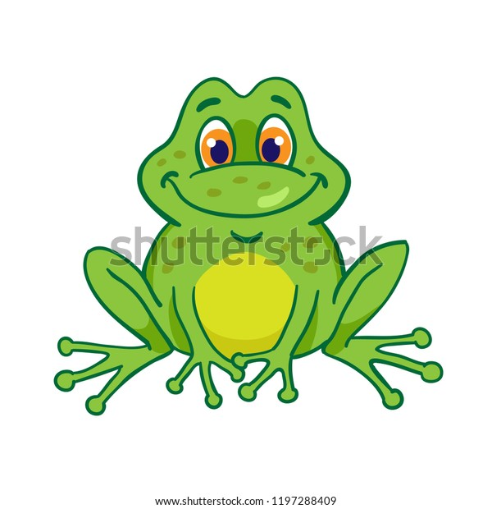
Let’s read!
The little can jump.
(frog)
.
Notes:
[use Shutterstock image 1197288409 ]
Click to bring a sentence with a picture onto the slide.
Student should attempt to read the sentence: The little frog can jump. Teacher may assist student, if necessary.
After student reads the sentence, he/she should search the image for the bat.
Applaud student’s effort.
Click to go to the next slide.

Slide 9

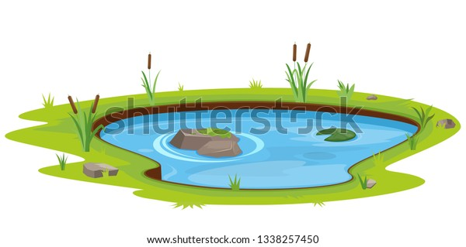
Jump!
solution
text connection
setting
characters
events
problem
Notes:
[use Shutterstock images 470176331 (book) and 1338257450 (pond scene.)]
Notes to Teacher:
Teacher: “This week, you read the story, Jump!
Click to bring the image to the slide.
“Let’s work on our story retell together.
Characters: “Who was the character in the story?” (This story was about a hunter, a fly, a fish, a frog and fox.)
Setting: “What was the setting of the story? Where did it take place?” (The story took place outside by a pond.)
Problem – “What is the problem in the story?” (Each animal/insect is being watched by another animal. They have to jump to safety to escape the animal.)
Events: “What happened in the story?” (The insect/animals had to jump to safety to escape the other animal:)
The fly has to jump to escape the fish.
The fish has to jump to escape the frog.
The frog has to jump to escape the fox.
The fox has to jump to escape the hunter.
Ending: “What happened at the end of the story?” (All of the animals were together and safe at the end.)
Connection: Possible questions to ask to help student to connect to this story:
How do you think this insect and the animals felt in the story?
Did you ever feel this way?
How was the insect and animals feeling at the end of the story?
7. Main Idea: What is this story about? (This story is about a fly, a fish, a frog and a fox jumping to escape. They were safe and happy at the end.)
Applaud student’s efforts in completing this story retell.
Click to the next slide.

Slide 10
Q & A
Any Questions?
Notes:
Ask – “Do you have any questions about anything that you learned in this lesson?”

