Slide 1
Inventions
Let’s Review!
Notes:
Notes to Teacher:
Tell the student that we are going to review our skills from this week.
We are going to talk about words with blends, past and present tense verbs, vocabulary and our story titled, Inventions that Changed the World.
Teacher clicks to bring up the next slide.

Slide 2

Reviewing Our Skills!
scr-
spl-
spr-
Notes:
Notes to Teacher:
Teacher will introduce the slide by telling the student that we are going to work on words with blends.
Remind the student that when we blend letters together, they make a new sound.
Click to show the letters scr-.
Ask: “What sound does scr-make?”
Allow the student to make the /scr/ sound or assist him/her in making that sound: scr…like in scrap.
Click to show the letters spl- and remove the letters scr-.
Ask: “What sound does spl-make?”
Allow the student to make the /spl/ sound or assist him/her in making that sound: spl…like in splash.
Click to show the letters spr- and remove the letters spl-.
Ask: “What sound does spr- make?”
Allow the student to make the /spr/ sound or assist him/her in making that sound: spr…like in spring.
Teacher: “Let’s take a look at some words that have these blends in them.”
Click to go to the next slide.

Slide 3



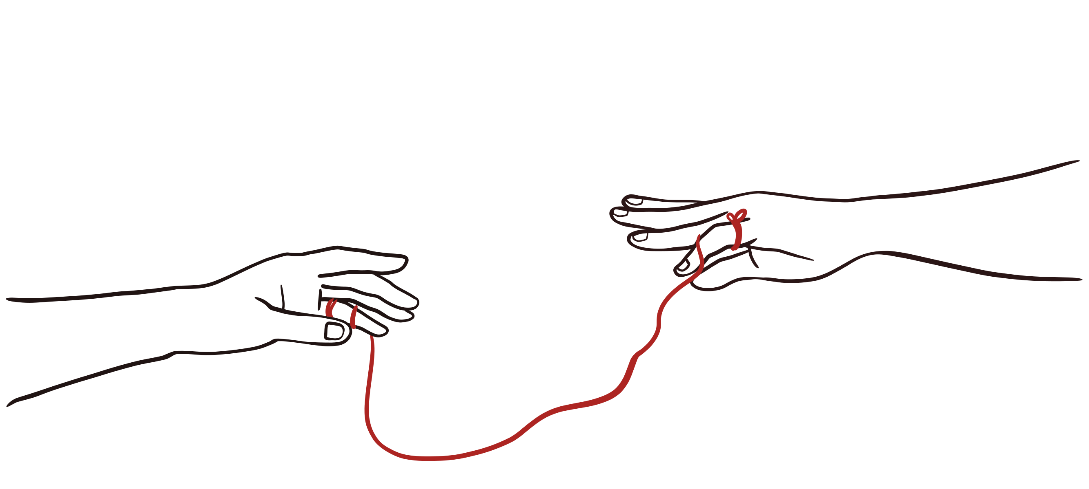
Let’s Practice!
screw
sprout
stretch
string
Notes:
Visual Element: images of string – ID: 1185940804; stretch – ID: 1372367633; screw – ID: 1920395159 and sprout – ID: 794592031
Notes to Teacher:
Teacher will introduce the slide by telling the student that we are going to continue to work with blends.
Click to show the first word: string.
Ask: “What does this word say?” Allow the student to read the word aloud. If he/she is having a difficult time, help him/her sound the word out.
Click to show a picture of string.
Click to show the next word: stretch (and remove the previous picture and word.)
Ask: “What does this word say?” Allow the student to read the word aloud. If he/she is having a difficult time, help him/her sound the word out.
Click to show a picture of the boy stretching.
Click to show the next word: screw (and remove the previous picture and word.)
Ask: “What does this word say?” Allow the student to read the word aloud. If he/she is having a difficult time, help him/her sound the word out.
Click to show a picture of the screw.
Click to show the next word: sprout (and remove the previous picture and word.)
Ask: “What does this word say?” Allow the student to read the word aloud. If he/she is having a difficult time, help him/her sound the word out.
Click to show a picture of a sprout.
Applaud student’s effort and click to go to the next slide.

Slide 4
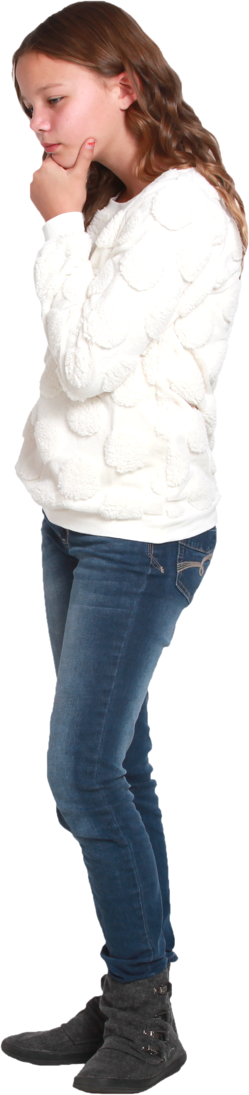
Verbs
Present tense verbs talk about things that are happening now or happening as a regular event.
Past tense verbs talk about things that happened before the present time or things that happened in the past.
Examples
Examples
eat walk hop
walked asked worked
Notes:
Visual Element: Kid Thinking – stock image
Notes to Teacher:
Tell the student that today we will look at verbs.
Click to show the following definition:
“Present tense verbs talk about things that are happening now or happening as a regular event.”
Click to show some examples of present tense verbs: eat, walk, hop
Click to show the next definition and take the previous information off the screen
“Past tense verbs talk about things that happened before the present time or things that happened in the past.”
Click to show some examples of past tense verbs: walked, asked, worked.
Teacher: “Let’s look at some past and present tense verbs!”
Click to go to the next slide.

Slide 5

Identifying Verbs
collect
bake
blinked
behaved
present
past
present
past
collected
baked
blink
behave
Notes:
Notes to Teacher:
Tell the student that you are going to show him/her a verb.
Click to show the first verb: blinked.
Teacher: “Is blinked past or present tense?” (Past.)
Click to show past.
Ask: “What is the present tense for blinked?” (Blink.)
Click to show blink.
Click to show the next verb: bake
Ask: “Is this past or present?” (Present.)
Click to show present.
Ask: “What is the past tense for bake?” (Baked.)
Click to show baked.
Click to show the next verb: behaved.
Ask: “Is this past or present?” (Past.)
Click to show past.
Ask: “What is the present tense for behaved?” (Behave.)
Click to show behave.
Click to show the last verb: collect.
Ask: “Is this past or present?” (Present.)
Click to show present.
Ask: “What is the past tense for collect?” (Collected.)
Click to show collected.
Applaud the student’s effort and click to move to the next slide.

Slide 6
Inventions that Changed the World– Vocabulary Review
process
intelligent
clever
-to take care of according to a routine
-having a sharp mind.
-quick in learning
Notes:
Teacher Notes:
Teacher: “Let’s review some of our vocabulary words.”
Click to bring the first word to the screen.
Ask: “What is this word?” (Process.)
Click to show three definitions.
Ask: “What is the definition for process?”
Allow the student the opportunity to tell you which definition means process.
Click to remove the incorrect definitions.
Click to bring the next word to the screen.
Ask: “What is this word?” (Intelligent.)
Click to show two definitions.
Ask: “What is the definition for intelligent?”
Allow the student the opportunity to tell you which definition means intelligent.
Click to remove the incorrect definition.
Click to bring the next word to the screen.
Ask: “What is this word?” (Clever.)
Click to show two definitions.
Ask: “What is the definition for clever?”
Allow the student the opportunity to tell you which definition means clever.
Click to remove the incorrect definition.
Vocabulary:
process – to take care of according to a routine.
intelligent– having a sharp mind.
clever – quick in learning.
Before clicking to the next slide, applaud the student’s effort.
Click to go to the next slide.

Slide 7
Vocabulary Review Take Two!
method
suitable
rely
-to be dependent
-adapted to a use or purpose.
-a way, plan or procedure for
doing something.
Notes:
Teacher: “Let’s review the rest of our vocabulary words.”
Click to bring the first word to the screen.
Ask: “What is this word?” (Method.)
Click to show two definitions.
Ask: “What is the definition for method?”
Allow the student the opportunity to tell you which definition means method.
Click to remove the incorrect definition.
Click to bring the next word to the screen.
Ask: “What is this word?” (Suitable.)
Click to show two definitions.
Ask: “What is the definition for suitable?”
Allow the student the opportunity to tell you which definition means suitable.
Click to remove the incorrect definition.
Click to bring the next word to the screen.
Ask: “What is this word?” (Rely.)
Click to show two definitions.
Ask: “What is the definition for rely?”
Allow the student the opportunity to tell you which definition means rely.
Click to remove the incorrect definition.
Vocabulary:
method – a way, plan or procedure for doing something.
suitable– adapted to a use or purpose.
rely – to be dependent.
Before clicking to the next slide, applaud the student’s effort.
Click to go to the next slide.

Slide 8
Our Vocabulary Adventure Continues!
You did well on the test. You
are very ___________.
process intelligent
I can always ____ on my mom.
rely clever
This _____ really works!
suitable method
Notes:
Notes to Teacher:
Teacher: “Let’s practice using some of our vocabulary words by filling in the correct word for each sentence.”
Click to bring up the first sentence: You did well on the test. You are very __________ (process or intelligent.)
Allow the student to tell you that the correct word is intelligent.
Click to circle the word intelligent.
Click to bring up the next sentence: I can always _____ on my mom! (rely or clever.)
Allow the student to tell you that the correct word is rely.
Click to circle the word rely and place it in the sentence.
Click to bring up the last sentence: This ______ really works! (suitable or method .)
Allow the student to tell you that the correct word is method.
Click to circle the word method and place it in the sentence.
Vocabulary:
process – to take care of according to a routine.
intelligent– having a sharp mind.
clever – quick in learning.
method – a way, plan or procedure for doing something.
suitable– adapted to a use or purpose.
rely – to be dependent.
Applaud the student’s effort and then click to move to the next slide.

Slide 9

Inventions that Changed
the World
Main Idea
?
Steam
Engine
Penicillin
Automobile
Notes:
Notes to Teacher:
Remind the student that we read a story called, Inventions that Changed the World.
Click to bring the image of the light bulb and the main idea/details graphic organizer.
Ask: “What is the main idea? What was this story mostly about?”
Allow the children to tell you that this story is about different inventions that made lives easier or helped people solve problems.
Teacher: “We are going to look at some inventions from our story.”
Click to show Steam Engine. Ask: “How did the steam engine make life easier?” (Possible answers - steam engines powered factories, allowed goods to be made faster and powered transportation to allow people to travel faster and further.)
Click to show Penicillin. Ask: “What did the invention of penicillin do for people?” (Possible answers – Penicillin helped treat infections and helped people to live longer lives.)
Click to show Automobile. Ask: “How did the invention of the automobile impact people’s lives?” (Possible answers – Cars allowed people to travel further. Many new job opportunities were created – Example: road construction and tire factories)
Click to show an empty detail box with a question mark inside. Ask: “What other inventions can you think of that made life easier for people or helped people solve problems?” (Possible answers – computer, internet, light bulb, etc.)
Applaud the student’s effort and click to move to the next slide.

Slide 10
Q & A
Any Questions?
Notes:
Thank the student for his/her effort. Ask the student if he/she has any questions.

