Slide 1
Asking Questions
Let’s Review!
Notes:
Notes to Teacher:
Tell the student that we are going to review our skills from this week.
We are going to talk about words with-sc and -st, verbs, vocabulary and our story titled, Our Class Eggs.
Teacher clicks to bring up the next slide.

Slide 2

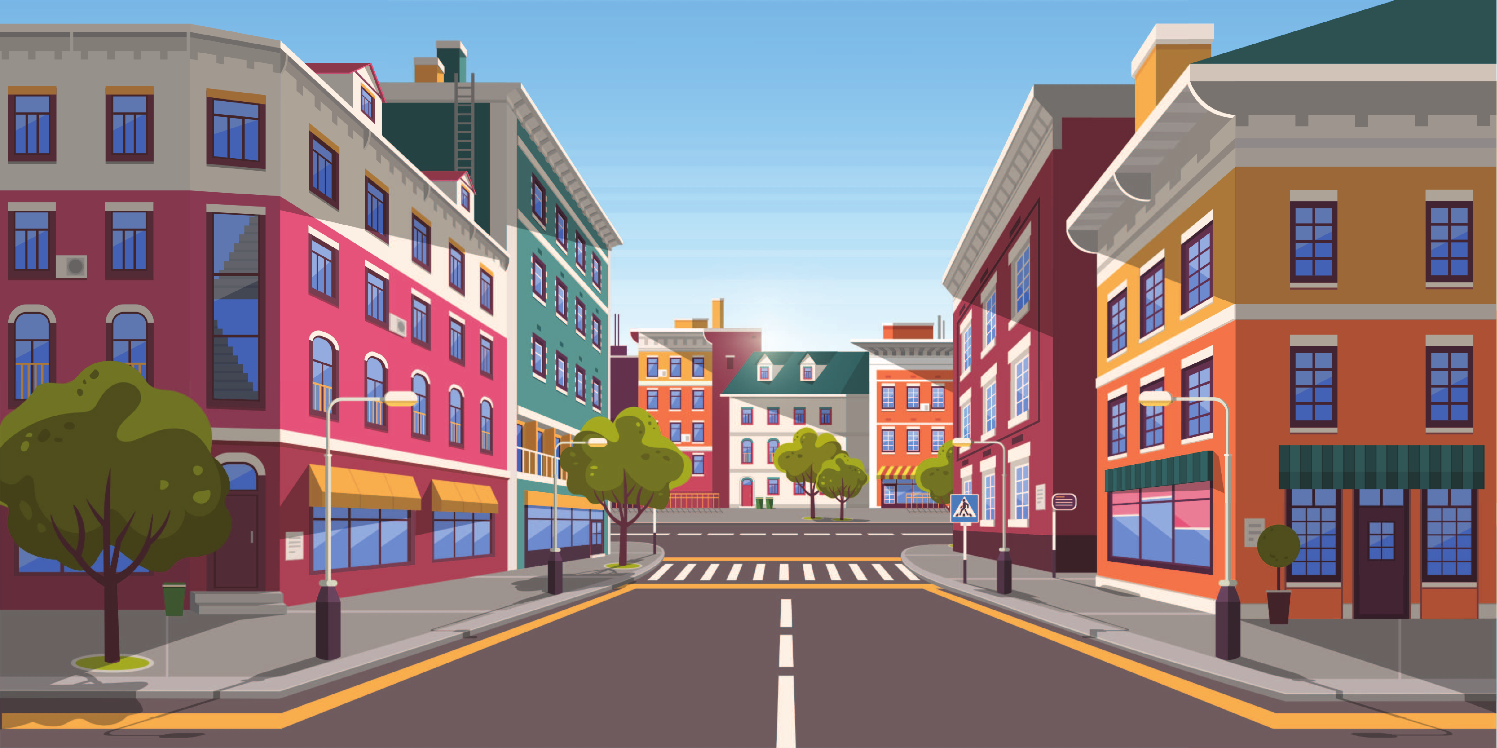
Reviewing Our Skills!
_ _reet
s t
tele_ _ ope
s c
Notes:
Notes to Teacher:
Teacher will introduce the slide by telling the student that we are going to work on words with -sc and -st.
Click to show a picture of a telescope and the word (tele_ _ ope.)
Teacher: “What do you see?” (Telescope.)
Ask: “What letters are missing from the word telescope?” (sc.)
Click to add the ‘sc’ in telescope.
Click to show a picture of a street and the word (_ _ reet.)
Teacher: “What do you see?” (Street.)
Ask: “What letters are missing from the word street?” (st.)
Click to add the ‘st’ in street.
Teacher: “Let’s talk about some more words with -sc and -st.”
Click to go to the next slide.

Slide 3




Let’s Practice!
mon_ _ er
s t
s c
micro _ _ ope
s t
hi _ _ ory
cry_ _ al
s t
Notes:
Notes to Teacher:
Teacher will introduce the slide by telling the student that we are going to continue to work on words with -st and -sc.
Click to show a monster and the word: mon__er.
Ask: “What is this?” (Monster.)
Ask: “How do we spell monster?” Allow time for the student to tell you how to spell the word (Monster.)
Click to add -st to the word to complete the word monster.
Click to show a microscope and the word: micro__ope.
Ask: “What is this?” (Microscope.)
Ask: “How do we spell microscope?” Allow time for the student to tell you how to spell the word (Microscope.)
Click to add -sc to the word to complete the word microscope.
Click to show a globe and books and the word: hi_ _ory.
Teacher: “This globe and these books represent history. Can you say history?” (History.)
Ask: “How do we spell history?” Allow time for the student to tell you how to spell the word (History.)
Click to add -st to the word to complete the word history.
Click to show a crystal and the word: cry__al.
Teacher: “This is a picture of a crystal.”
Ask: “How do we spell crystal?” Allow time for the student to tell you how to spell the word (Crystal.)
Click to add -st to the word to complete the word crystal.
Applaud student’s effort and click to go to the next slide.

Slide 4
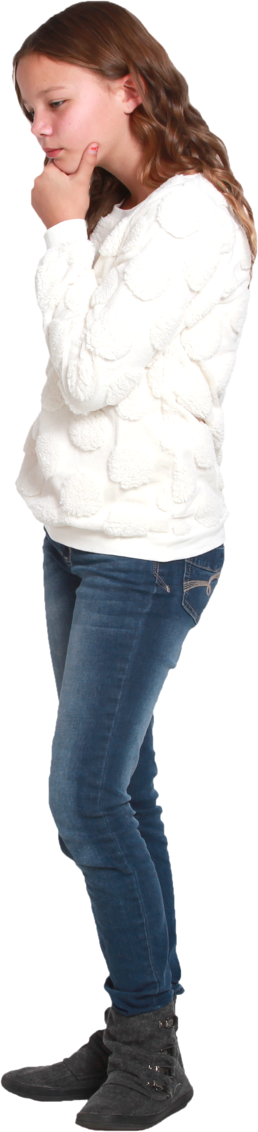
Verbs
Action Verb
Action verbs tell us what the
subject is doing.
Helping Verb
Helping verbs come
before the main verb.
Linking Verb
Linking verbs link the subject
to the predicate.
Notes:
Notes to Teacher:
Say: “We learned about three types of verbs.”
As you name each verb, click to show the type of verb with the definition.
Click to show ‘Action Verb.’
Ask: “What is an action verb?”
Allow the student the opportunity to tell you that action verbs tell us what the subject is doing.
Click to show the definition.
Click to show ‘Linking Verb’ and take ‘Action Verb’ away.
Ask: “What is a linking verb?”
Allow the student the opportunity to tell you that linking verbs link the subject to the word in the predicate part of the sentence.
Click to show the definition.
Click to show ‘Helping Verb’ and take ‘Linking Verb’ away.
Ask: “What is a helping verb?”
Allow the student the opportunity to tell you that helping verbs come before the main verb.
Click to show the definition.
Teacher: “Let’s take a look at some examples of the different types of verbs that we just talked about.”
Click to go to the next slide.

Slide 5

Sorting Verbs
Action
Verbs
Linking
Verbs
Helping
Verbs
hop
will
am
write
is
can
Notes:
Notes to Teacher:
Click to show the three types of verbs above baskets.
Teacher: “Today, we are going to decide if a verb is an action verb, a linking verb or a helping verb. Can you help sort the verbs in to the correct basket?”
Have the student read any verb. After the student reads the verb aloud and tells you where it belongs, click on that verb. Clicking on the verb will allow it to move to the correct basket.
If the student is incorrect, talk about why it is incorrect.
Repeat procedure for all of the verbs at the bottom of the page.
There will be 6 verbs in all (Action: hop, write; Linking: is, am; Helping: can, will.)
Applaud the student’s effort and click to move to the next slide.

Slide 6
Asking Questions – Vocabulary Review
volunteer
delicate
diagram
-easily torn or hurt.
-to offer oneself for a service.
-a drawing, sketch, plan or chart that makes something clearer or easier to understand.
Notes:
Notes to Teacher:
Teacher: “Let’s review some of our vocabulary words.”
Click to show the first word, diagram, and three definitions.
Teacher: “Our first word is diagram. (Have the student repeat the word – diagram.) What is the definition of diagram?”
Allow time for the student to tell you which definition matches diagram. If the student is correct, applaud his/her answer. If the student is wrong, review the definition with him/her.
As the student gives you the correct definition, click to make the incorrect definitions fade away.
Click to show the next word, volunteer, and three definitions.
Teacher: “Our next word is volunteer. (Have the student repeat the word – volunteer.) What is the definition of volunteer?”
Allow time for the student to tell you which definition matches volunteer. If the student is correct, applaud his/her answer. If the student is wrong, review the definition with him/her.
As the student gives you the correct definition, click to make the incorrect definitions fade away.
Click to show the last word, delicate, and three definitions.
Teacher: “Our last word is delicate. (Have the student repeat the word – delicate.) What is the definition of delicate?”
Allow time for the student to tell you which definition matches delicate. If the student is correct, applaud his/her answer. If the student is wrong, review the definition with him/her.
As the student gives you the correct definition, click to make the incorrect definitions fade away.
Vocabulary:
diagram – a drawing, sketch, plan or chart that makes something clearer or easier to understand.
volunteer– to offer oneself for a service.
delicate – easily torn or hurt.
Before clicking to the next slide, applaud the student’s effort.
Click to go to the next slide.

Slide 7
Vocabulary Review Take Two!
gasp
predict
struggled
-to declare in advance.
-to draw in a breath sharply.
-made a great effort to overcome
something or someone.
Notes:
Notes to Teacher:
Teacher: “Let’s review the rest of our vocabulary words.”
Click to show the first word, struggled, and three definitions.
Teacher: “Our first word is struggled. (Have the student repeat the word – struggled.) What is the definition of struggled?”
Allow time for the student to tell you which definition matches struggled. If the student is correct, applaud his/her answer. If the student is wrong, review the definition with him/her.
As the student gives you the correct definition, click to make the incorrect definitions fade away.
Click to show the next word, gasp, and three definitions.
Teacher: “Our next word is gasp. (Have the student repeat the word – gasp.) What is the definition of gasp?”
Allow time for the student to tell you which definition matches gasp. If the student is correct, applaud his/her answer. If the student is wrong, review the definition with him/her.
As the student gives you the correct definition, click to make the incorrect definitions fade away.
Click to show the last word, predict, and three definitions.
Teacher: “Our last word is predict. (Have the student repeat the word – predict.) What is the definition of predict.”
Allow time for the student to tell you which definition matches predict. If the student is correct, applaud his/her answer. If the student is wrong, review the definition with him/her.
As the student gives you the correct definition, click to make the incorrect definitions fade away.
Vocabulary:
struggled – made a great effort to overcome something or someone.
gasp – to draw in a breath sharply.
predict – to declare in advance.
Before clicking to the next slide, applaud the student’s effort.
Click to go to the next slide.

Slide 8
Our Vocabulary Adventure Continues!
I ______ that our team will win on Friday!
predict
struggled
They _________ walking up the hill!
gasp
I heard someone ____ when I walked in!
volunteer
I ________ at the library.
diagram
The venn _______ helps me compare characters.
Word Bank
predict
delicate
volunteer
gasp
diagram
struggled
Notes:
Notes to Teacher:
Teacher: “Let’s practice our vocabulary words by filling in the blanks. Use the word bank to help you out.”
Click to show the first sentence.
I _________ that our team will win on Friday! (predict.)
Pause and allow the student to tell you which word completes this sentence.
Click to place the word in the sentence and cross off the word in the word bank.
Click to show the next sentence.
They ____________ walking up the hill! (struggled)
Pause and allow the student to tell you which word completes this sentence.
Click to place the word in the sentence and cross off the word in the word bank.
Click to show next sentence.
I heard someone ______ when I walked in! (gasp)
Pause and allow the student to tell you which word completes this sentence.
Click to place the word in the sentence and cross off the word in the word bank.
Click to show the next sentence.
I ___________ at the library. (volunteer)
Pause and allow the student to tell you which word completes this sentence.
Click to place the word in the sentence and cross off the word in the word bank.
Click to show the last sentence.
The venn _________ helps me compare characters. (diagram)
Pause and allow the student to tell you which word completes this sentence.
Click to place the word in the sentence and cross off the word in the word bank.
Vocabulary:
diagram – a drawing, sketch, plan or chart that makes something clearer or easier to understand.
volunteer– to offer oneself for a service.
delicate – easily torn or hurt. (There will be no sentence for this vocab word)
struggled – made a great effort to overcome something or someone.
gasp – to draw in a breath sharply.
predict – to declare in advance.
Applaud the student’s effort and click to move to the next slide.

Slide 9
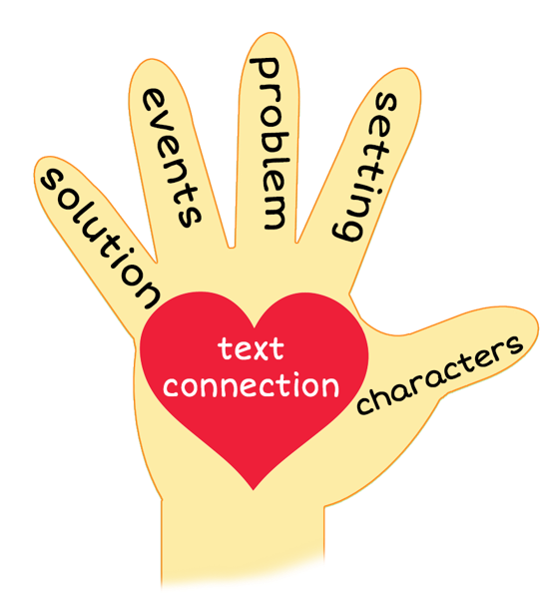
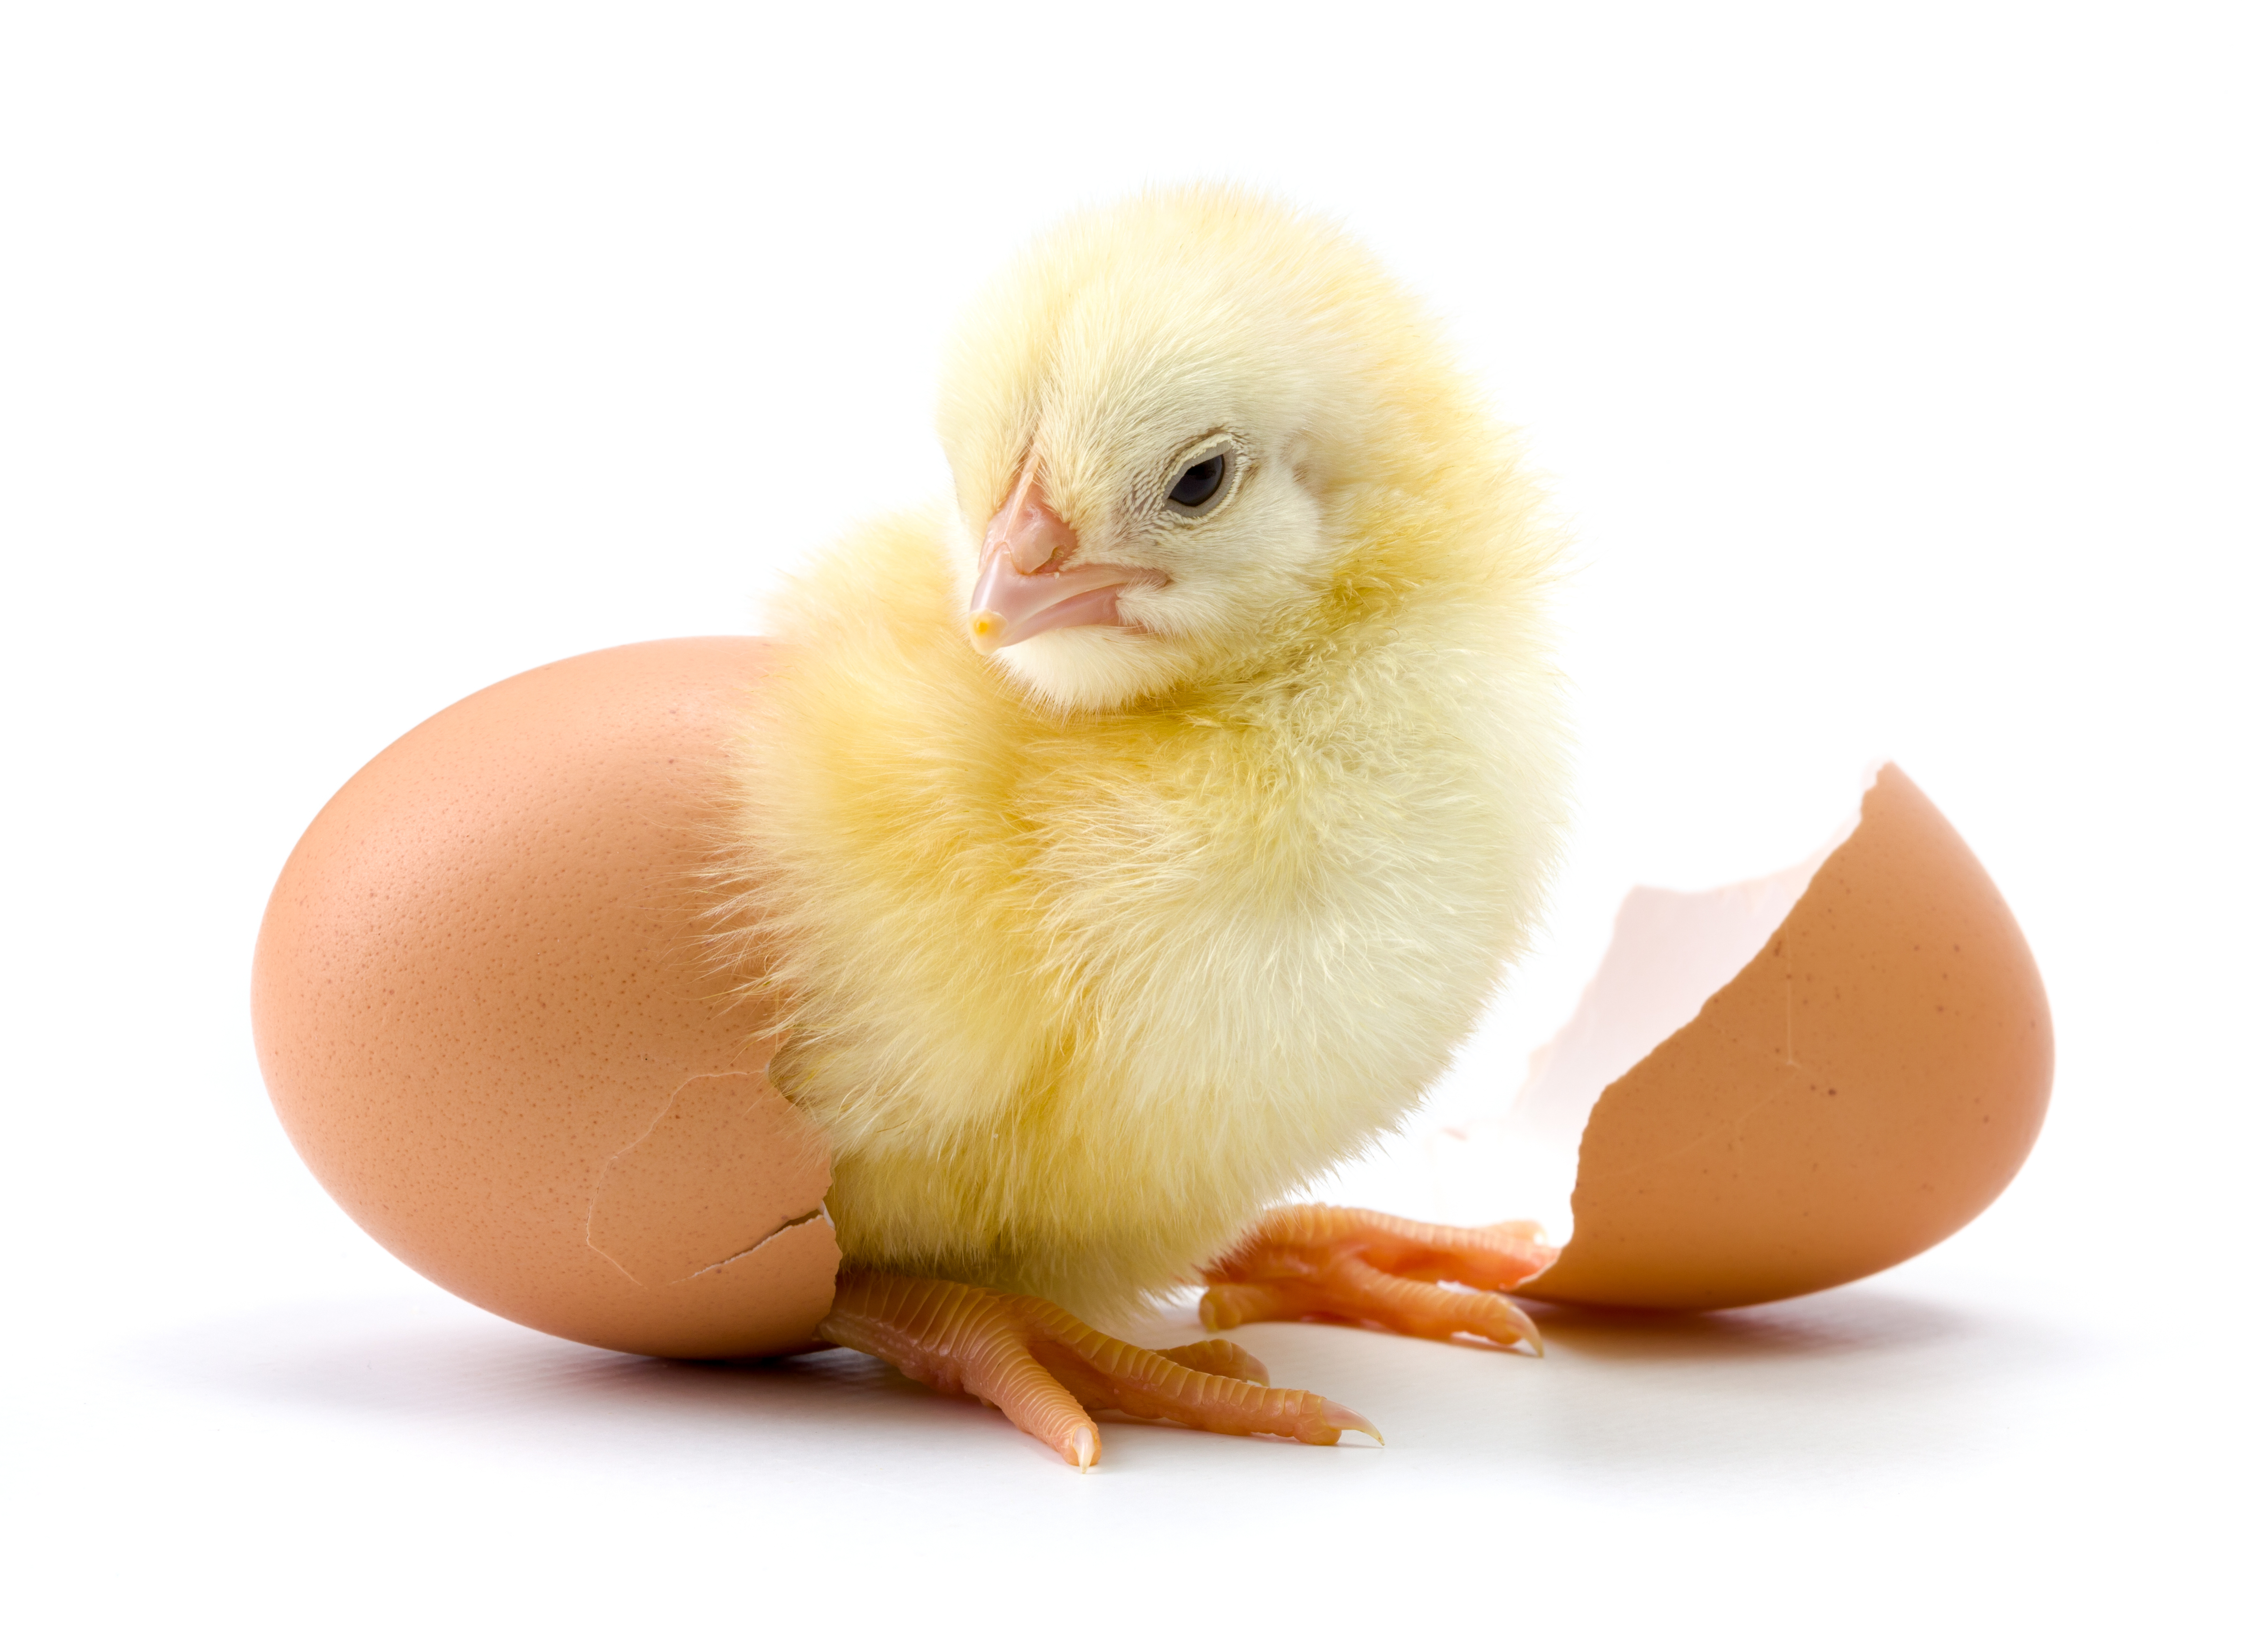
Our Class Eggs
Notes:
Notes to Teacher:
Remind the student that we read a story called, Our Class Eggs.
Thumb (Click to circle the thumb.) Who were the characters in the story – Mr. Schultz, classmates, chicks
Pointer Finger (Click to circle the pointer finger.) - Where did the story take place? The story took place in Mr. Schultz’s classroom.
Middle Finger (Click to circle the middle finger) – What was the problem in the story? There was not a problem in the story until the very end. The class was caring for eggs. At the end of the story, the last egg did not hatch. The students learned that not all eggs will hatch, even when we want them to.
Ring Finger (Click to circle the ring finger.) What happened in the story? In this story, Mr. Schultz gave his class the opportunity to learn about and care for chicks.
The story started off with the class learning how to take care of the eggs. The students created and completed a KWL Chart.
Each day, they observed the eggs, rotated the eggs and asked many questions.
Pinky (Click to circle the pinky finger.) Was the problem solved?
At the end of the story, all but one egg hatched. The students learned that not all eggs will hatch, even when we want them to.
Palm of Hand (Click to circle the palm of the hand.) Text Connection:
Did you ever have the opportunity to take care of something or someone? How did/does it make you feel?
Did you ever work on a project in school? If so, what was it? What did you learn?
What was your favorite part of this story?
Applaud the student’s effort.
Click to the next slide.

Slide 10
Q & A
Any Questions?
Notes:
Thank the student for his/her effort. Ask the student if he/she has any questions.

