Slide 1
Solving Problems
Let’s Review!
Notes:
Notes to Teacher:
Tell the student that we are going to review our skills from this week.
We are going to talk about -y and -igh words, concrete and abstract nouns, vocabulary and our story titled, Sassy, Not Sissy.
Teacher clicks to bring up the next slide.

Slide 2

Reviewing Our Skills!
right
my
Notes:
Visual Element: child – stock image
Notes to Teacher:
Teacher will introduce the slide by telling the student that we are going to work on -y and -igh words.
Remind the student that these word parts sound the same.
Click to show -igh and –y words: right and my.
Teacher: “Let’s take a look at some of our spelling words and see if we can spell our words correctly.”
Click to go to the next slide.

Slide 3



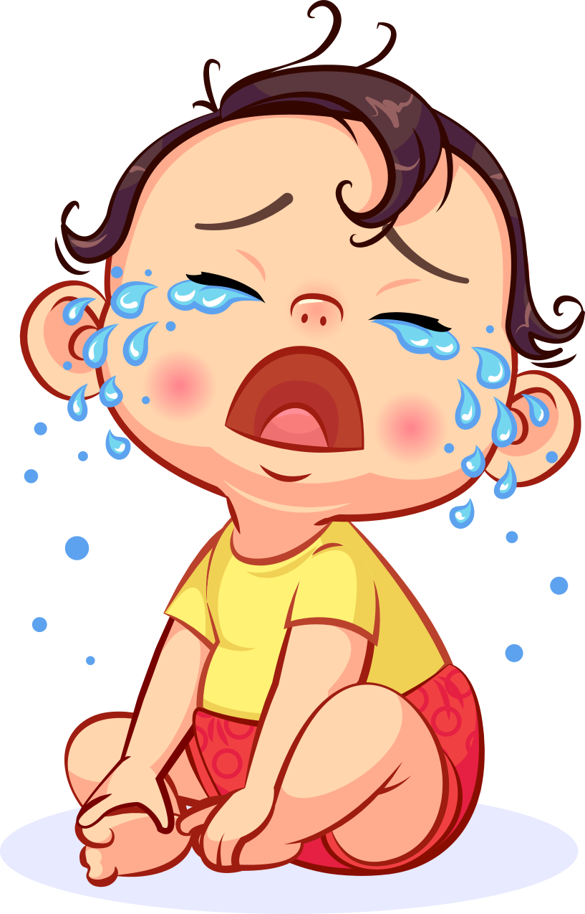
Let’s Practice!
-y
-igh
high jump
sky
cry
sk_
y
light
l___t
h___ jump
cr_
igh
igh
y
Notes:
Notes to Teacher:
Teacher will introduce the slide by telling the student that we are going to continue to work on -y and -igh words.
Click to show the two ‘word parts’ in a chart. Tell the student that we are going to look at a picture and decide if the word is spelled with -y or -igh.
Click to show a sky and the word: sk_.
Ask: “What is this?” (Sky.)
Ask: “How do we spell sky?” Allow time for the student to tell you how the word is spelled. (S k y)
Ask: “Does it belong in the -y or -igh column?” (-y.)
Click to add -y to the word.
Click to move the picture of the sky and the word ‘sky’ to the -y column.
Click to show the high jump and the word h___ jump
Ask: “What is this?” (High Jump.) If the student does not know that this is the high jump, take a moment to talk about this event.
Ask: “How do you spell high?” Allow time for the student to tell you how the word is spelled. (h igh.)
Ask: “Does it belong in the -y or -igh column?” (-igh.)
Click to add -igh to the word.
Click to move the picture of the high jump and the word ‘high jump’ to the -igh column.
Click to show the light and the word l___t.
Ask: “What is this?” (Light.) If the student does not know that this a picture of light, tell the student that the light is shining from the sun.
Ask: “How do you spell light?” Allow time for the student to tell you how the word is spelled. (l igh t.)
Ask: “Does it belong in the -y or -igh column?” (-igh.)
Click to add -igh to the word.
Click to move the picture of the light and the word ‘light’ to the -igh column.
Click to show the last picture of cry and the word cr_.
Ask: “What is this?” (Cry.)
Ask: “How do you spell cry?” Allow time for the student to tell you how the word is spelled. (c r y.)
Ask: “Does it belong in the -y or -igh column?” (-y.)
Click to add -y to the word.
Click to move the picture of cry and the word ‘cry’ to the -y column.
Applaud student’s effort and click to go to the next slide.

Slide 4

Concrete and Abstract Nouns
Concrete Noun:
computer
Abstract Nouns:
An idea
A feeling
Notes:
Notes to Teacher:
Ask: “What is a noun?” (A noun is a person, place, thing, or idea.)
Tell the student that today we will look at concrete and abstract nouns.
Ask: “What is a concrete noun?”
Allow the student the opportunity to tell you that a concrete noun names something that you can experience with your senses.
Click to show an example:
Concrete Noun: computer
Ask: “What is an abstract noun?”
Allow the student the opportunity to tell you that an abstract noun names something that you cannot experience with your senses.
Click to show examples:
Abstract Nouns: an idea, a feeling
Teacher: “Let’s look at some nouns and decide if they are concrete or abstract.”
Click to go to the next slide.

Slide 5
Identifying Concrete and Abstract Nouns
concrete
anger
bus
hope
beauty
table
tree
abstract
Notes:
Notes to Teacher:
Teacher: “Today, we are going to decide if a noun is concrete or abstract.”
Click to show each noun.
Have the student read the noun aloud.
Pause and allow the student to decide if the noun is concrete or abstract.
After the student identifies the noun as concrete or abstract, click to circle the word ‘concrete’ or ‘abstract’ next to it.
If the student is incorrect, talk about why it is incorrect.
There will be 6 nouns in all:
-table: concrete
-hope: abstract
-beauty: abstract
-tree: concrete
-anger: abstract
-bus: concrete
Extension Activity:
Once we discuss all six nouns, ask the student if he/she can name a concrete and/or an abstract noun of his/her own.
Applaud the student’s effort and click to move to the next slide.

Slide 6
Solving Problems –
Vocabulary Review
capture
doze
harsh
To sleep lightly.
Causing discomfort or pain.
Act of catching by force or trickery.
Notes:
Notes to Teacher:
Teacher: “Let’s review some of our vocabulary words.”
Click to show the first word, capture. Click to show the two definitions.
Teacher: “Our first word is capture. (Have the student repeat the word – capture.) What is the definition of capture?”
Allow time for the student to tell you which definition matches capture. If the student is correct, applaud his/her answer. If the student is wrong, review the definition with him/her.
As the student gives you the correct definition, click to make the incorrect definition fade away.
Click to show the next word, doze. Click to show the two definitions.
Teacher: “Our next word is doze. (Have the student repeat the word – doze.) What is the definition of doze?”
Allow time for the student to tell you which definition matches doze. If the student is correct, applaud his/her answer. If the student is wrong, review the definition with him/her.
As the student gives you the correct answer, click to make the incorrect definition fade away.
Click to show the last word, harsh. Click to show the two definitions.
Teacher: “Our last word is harsh. (Have the student repeat the word – harsh.) What is the definition of harsh?”
Allow time for the student to tell you which definition matches harsh. If the student is correct, applaud his/her answer. If the student is wrong, review the definition with him/her.
As the student gives you the correct answer, click to make the incorrect definition fade away.
Vocabulary:
capture – act of catching by force or trickery.
doze– to sleep lightly.
harsh – causing discomfort or pain.
Before clicking to the next slide, applaud the student’s effort.
Click to go to the next slide.

Slide 7
Vocabulary Review Take Two!
starve
outcome
risk
To suffer or die from lack of food.
Possibility of loss or injury.
Result.
Notes:
Visual Element: Oval around the vocabulary word
Notes to Teacher:
Teacher: “Let’s review the rest of our vocabulary words.”
Click to show the first word, starve. Click to show the two definitions.
Teacher: “Our first word is starve. (Have the student repeat the word – starve.) What is the definition of starve?”
Allow time for the student to tell you which definition matches starve. If the student is correct, applaud his/her answer. If the student is wrong, review the definition with him/her.
As the student gives you the correct definition, click to make the incorrect definition fade away.
Click to show the next word, outcome. Click to show the two definitions.
Teacher: “Our next word is outcome. (Have the student repeat the word – outcome.) What is the definition of outcome?”
Allow time for the student to tell you which definition matches outcome. If the student is correct, applaud his/her answer. If the student is wrong, review the definition with him/her.
As the student gives you the correct answer, click to make the incorrect definition fade away.
Click to show the last word, risk. Click to show the two definitions.
Teacher: “Our last word is risk. (Have the student repeat the word – risk.) What is the definition of risk?”
Allow time for the student to tell you which definition matches risk. If the student is correct, applaud his/her answer. If the student is wrong, review the definition with him/her.
As the student gives you the correct answer, click to make the incorrect definition fade away.
Vocabulary:
starve – to suffer or die from lack of food.
risk– possibility of loss or injury.
outcome – result.
Before clicking to the next slide, applaud the student’s effort.
Click to go to the next slide.

Slide 8
Our Vocabulary Adventure Continues!
outcome
doze
capture
starve
risk
harsh
Notes:
Notes to Teacher:
Teacher: “Let’s practice our vocabulary words by using each word in a sentence.”
Click to bring up one word onto the screen. As the word appears on the screen, the teacher or the student will read the word aloud.
*Give the student the opportunity to use it in a sentence. You may have the student verbalize the sentence or write the sentence on a white board. (After writing the sentence, have the student hold the white board up to the screen.)
*If the student uses the word correctly in a sentence, applaud his/her answer.
*If the student is having trouble using the word in a sentence, you may assist the student by reviewing the definition.
*Follow the same procedure for each of the six words.
Vocabulary:
capture – act of catching by force or trickery.
doze – to sleep lightly.
harsh – causing discomfort or pain.
starve – to suffer or die from lack of food.
risk – possibility of loss or injury.
outcome – result.
Applaud the student’s effort and then click to move to the next slide.

Slide 9
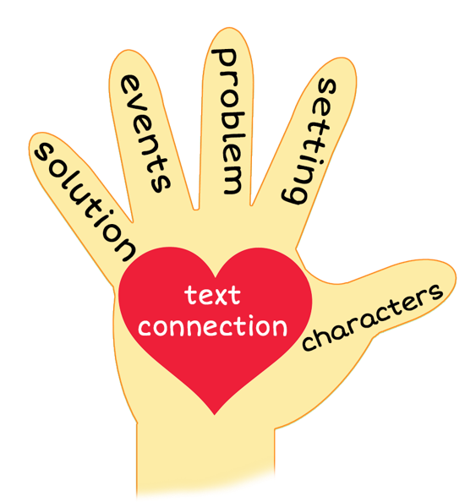
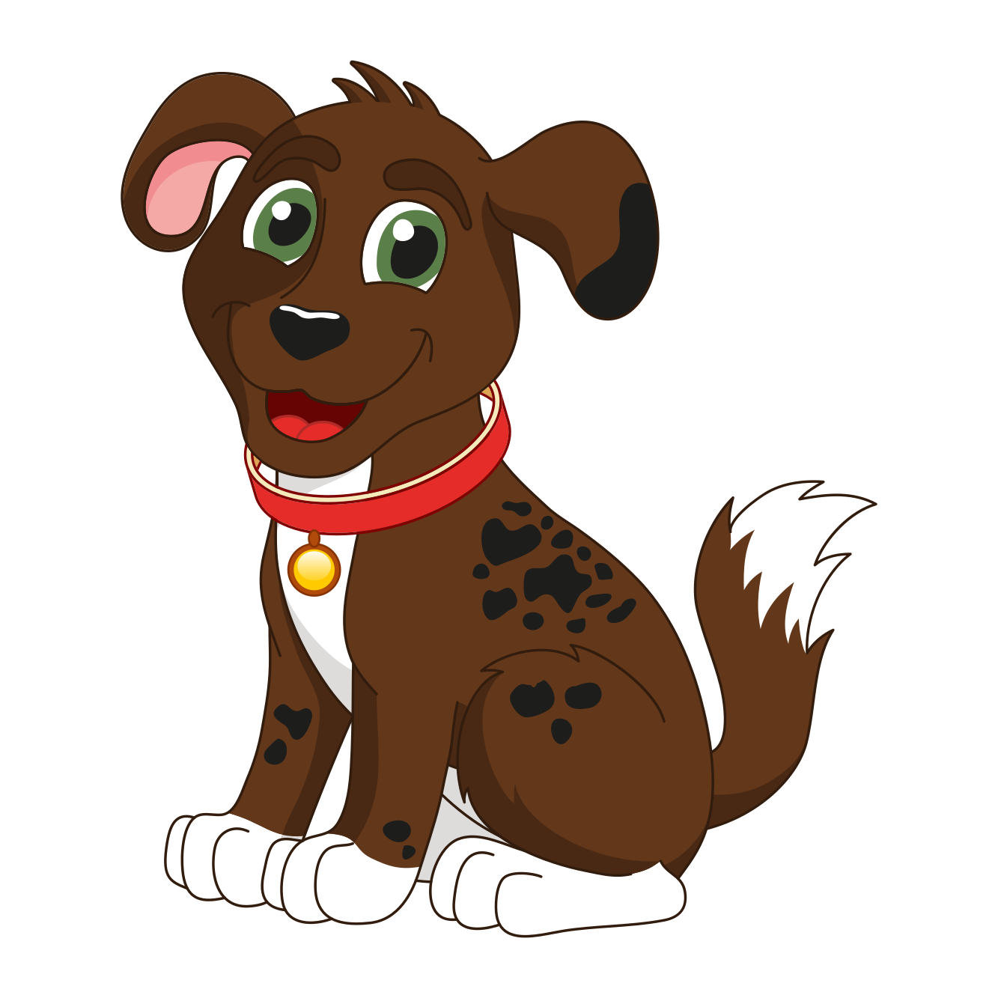
Sassy, Not Sissy
Notes:
Notes to Teacher:
Remind the student that we read a story called, Sassy, Not Sissy.
Thumb (Click to circle the thumb.) Who were the characters in the story – Sassy, Sassy’s owner (Mommy,) Milo (the tabby cat,) Sasha (the stray dog,) a lizard, a snake and a snapping turtle.
Pointer Finger (Click to circle the pointer finger.) - Where did the story take place? The setting changed – It took place at Sassy’s home, neighborhood and the woods.
Middle Finger (Click to circle the middle finger) – What was the problem in the story? Yes and No. At the end of the story, Milo still called Sassy ‘Sissy,’ but Sassy knows that she is not a sissy and made a new friend.
Ring Finger (Click to circle the ring finger.) What happened in the story? After Sassy’s owner left the house, Sassy went through the doggy door and went out into her neighborhood. Milo, the tabby cat, teased Sassy and called her Sissy. Sassy wanted to be brave, so she ran across the street and went for an adventure into the woods. There, she ran into a lizard, a snake, a snapping turtle and a big dog named Sasha.
When Sassy ran into Sasha, Sasha read her tag and asked if her name was Sassy. Sassy replied that it was but that her name should be Sissy. She explained her run in with Milo and Sasha proceeded to tell Sassy about how she scared Milo off. Sasha offered to walk Sassy home.
Sassy invited Sasha over to her house, but Sasha did not think that was a good idea. Instead, Sasha walked her most of the way home. While walking the rest of the way home, Sassy was greeted by Milo. Milo called her Sissy but Sassy kept walking. While walking, Sassy heard a loud bark followed by a hiss. She watched Milo run out of sight.
After Sassy’s owner came home, she brought the leash over and they went for a walk. While on a walk, Sassy pulled her owner to the edge of the neighborhood where she was able to see Sasha again.
Pinky (Click to point to the pinky finger.) Solution – Was the problem solved? Although Milo still called Sassy a Sissy, Sally learned that she was not a sissy. While on her adventure, she made a new friend, Sasha.
Palm of Hand (Click to point to the palm of the hand.) Text Connection –Did anyone ever call you a name? How did that make you feel? How did you overcome this label?
How did you feel about Milo calling Sassy Sissy?
What was your favorite part of the story?
Applaud the student’s effort.
Click to the next slide.

Slide 10
Q & A
Any Questions?
Notes:
Thank the student for his/her effort. Ask the student if he/she has any questions.

