Slide 1
Why Tales
Let’s Review!
Notes:
Notes to Teacher:
Tell the student that we are going to review our skills from this week.
We are going to talk about -oo and -ou words, singular and plural nouns, vocabulary and our tale titled, How the Camel Got His Hump.
Teacher clicks to bring up the next slide.

Slide 2
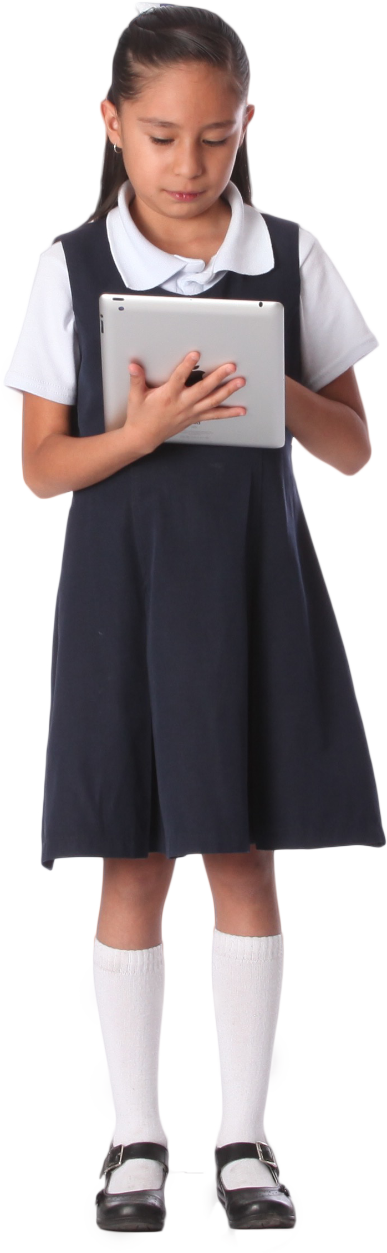
Reviewing Our Skills!
took look
out loud
Notes:
Visual Element: child – stock image
Notes to Teacher:
Teacher will introduce the slide by telling the student that we are going to work on -oo and -ou words.
Remind the student that these word parts make different sounds.
Click to show these words: took and look .
Tell the student that the -oo word part sounds like /oo/ like in took or look.
Click to show these words: out and loud (and remove the previous words.)
Tell the student that the -ou word part sounds like /ow/ like in out or loud.
Teacher: “Let’s take a look at some pictures and see if we can use what we know to spell our words correctly.”
Click to go to the next slide.

Slide 3
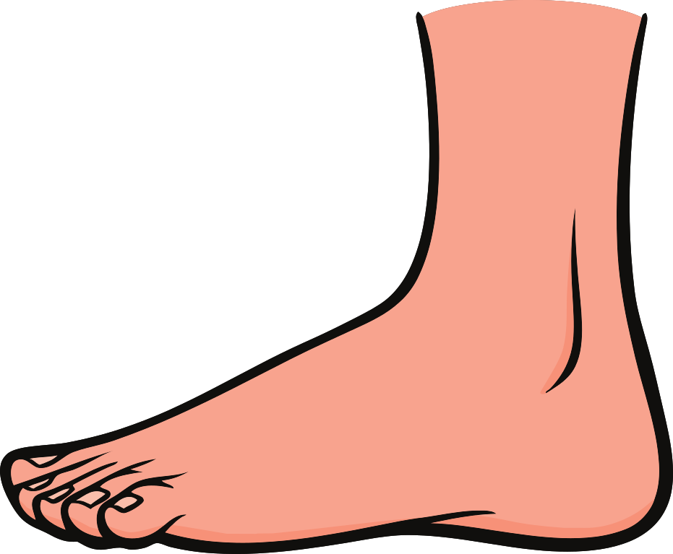

Let’s Practice!
-oo
-ou
cloud
foot
cl__d
ou
oo
f__t
Notes:
Notes to Teacher:
Teacher will introduce the slide by telling the student that we are going to continue to work on -oo and -ou words.
Click to add the two ‘word parts’ in the chart. Tell the student that we are going to look at a picture and decide if the word is spelled with -oo or -ou.
Click to show a cloud and the word: cl__d.
Ask: “What is this?” (Cloud.)
Ask: “How do we spell cloud?” Allow time for the student to tell you how the word is spelled. (C l ou d.)
Click to add -ou to the word.
Ask: “Does it belong in the -oo or -ou column?” (-ou.)
Click to move the cloud and the word ‘cloud’ to the -ou column.
Click to show a foot and the word f__t.
Ask: “What is this?” (Foot.)
Ask: “How do you spell foot?” Allow time for the student to tell you how the word is spelled. (F oo t.)
Click to add -oo to the word.
Ask: “Does it belong in the -oo or -ou column?” (-oo.)
Click to move the foot and the word ‘foot’ to the -oo column.
Applaud student’s effort and click to go to the next slide.

Slide 4
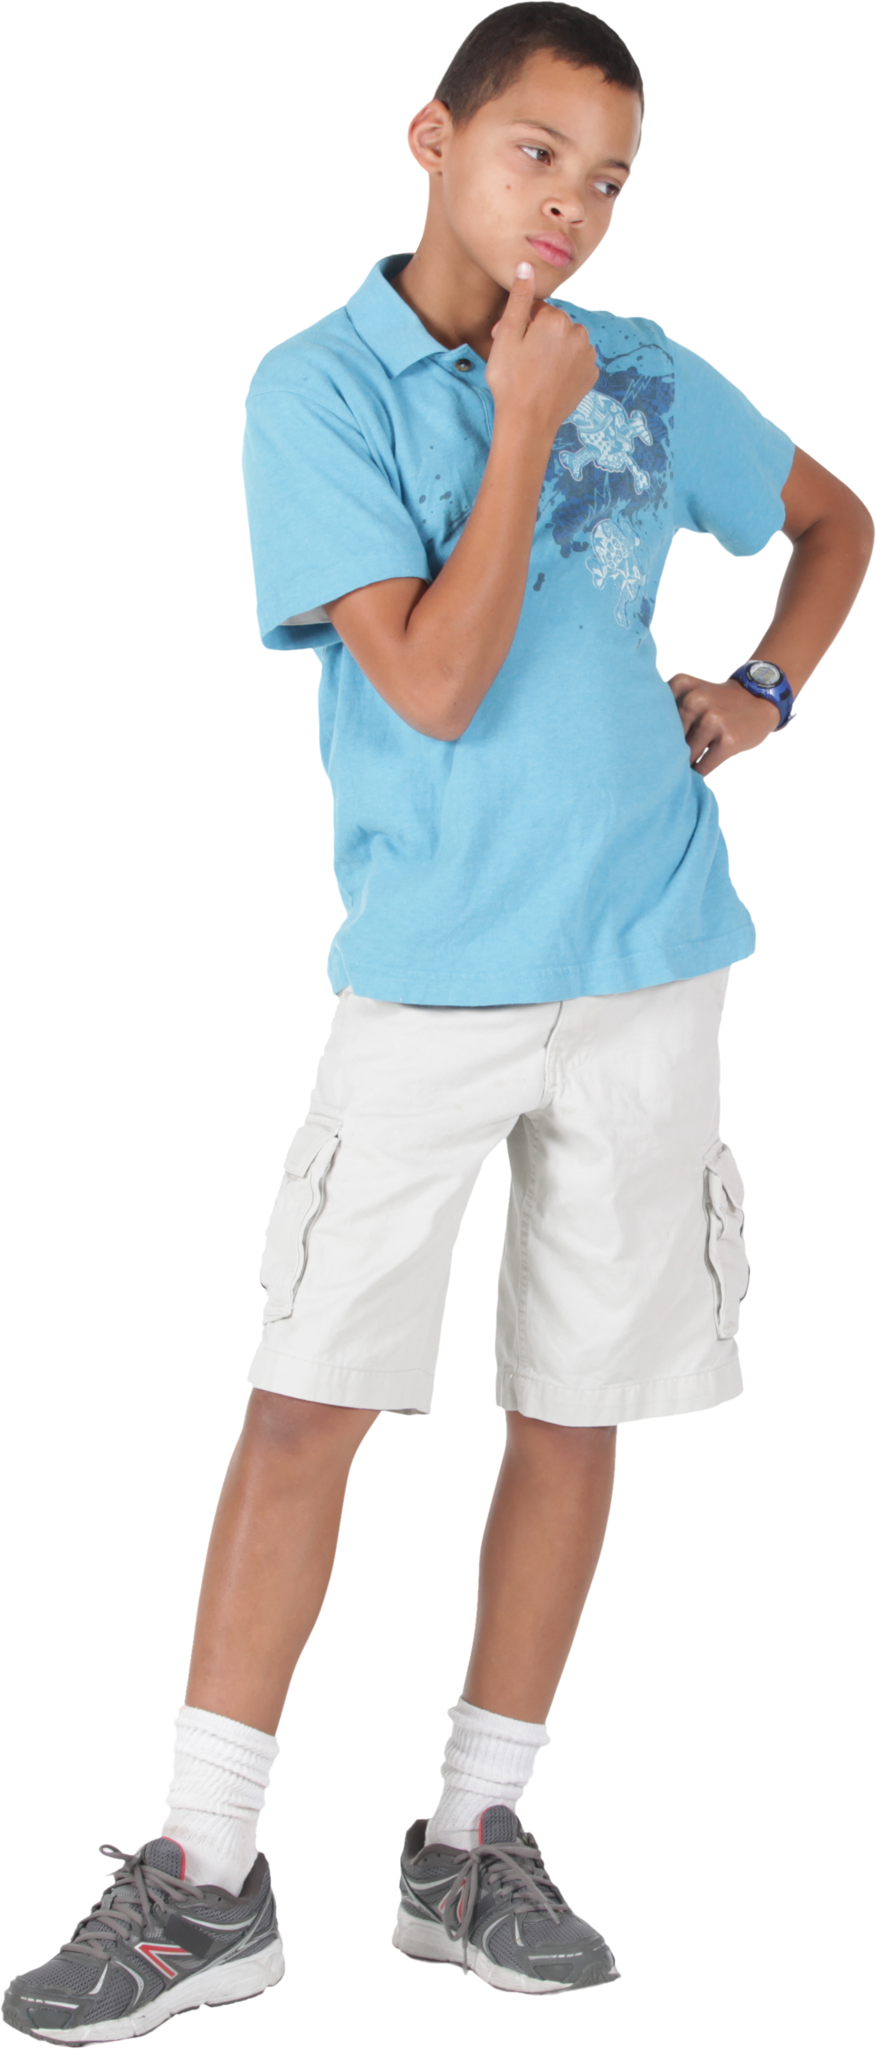
Nouns
Singular Nouns:
dog
pencil
box
Irregular Nouns:
mouse
mice
child
children
Plural Nouns:
dogs
pencils
boxes
Notes:
Visual Element: Kid Thinking
Notes to Teacher:
Ask: “What is a noun?” (Allow the student to tell you that a noun is a person, place, thing, or idea.)
Tell the student that today we will look at singular and plural nouns.
Ask: “What is a singular noun?”
Allow the student the opportunity to tell you that a singular noun names one person, place, thing, or idea.”
Click to show examples:
Singular Nouns: dog, pencil and box
Ask: “What is a plural noun?”
Allow the student to tell you that a plural noun names more than one person, place, thing, or idea.” Remind the student that we usually add an -s or an -es to a noun to make it plural.
Click to show examples: dogs, pencils and boxes. (The singular examples will disappear.)
Teacher: “We also have irregular nouns.”
Ask: “What is an irregular noun?”
Allow the student the opportunity to tell you that irregular nouns do not follow the same rule .
Click to show some examples: mouse and mice; child and children (The plural nouns will disappear.)
Teacher: “Let’s look at some nouns and decide if they are singular, plural or irregular.”
Click to go to the next slide.

Slide 5
Identifying Nouns
Singular
Plural
Irregular
girl
boys
men
tree
dishes
teeth
car
desks
desks
teeth
tree
men
dishes
girl
boys
car
Notes:
Visual Element: Chart to sort nouns
Notes to Teacher:
Click to show a chart where the student will sort nouns.
Teacher: “Today, we are going to decide if a noun is singular, plural or irregular.”
Click to show each noun. After the student reads the noun, pause and allow the student to decide if the noun is singular, plural or irregular. After the student identifies the noun as singular, plural or irregular, click to have the noun move to the correct part of the chart. If the student is incorrect, talk about why it is incorrect. Repeat procedure for the rest of the nouns.
There will be 8 nouns in all (girl, men, tree, boys, dishes, car, teeth, and desks.)
Once the chart is full, applaud the student’s effort and click to go to the next slide.

Slide 6
Why Tales - Vocabulary Review
plow
An image produced by
or as if by a mirror.
reflection
To open, break up or
work the land.
Dry land with few
plants and little
rainfall.
desert
Notes:
Notes to Teacher:
Teacher: “Let’s review some of our vocabulary words.”
Click to show the first three vocabulary words: plow, reflection and desert.
Click to show three definitions. Read the definitions with the student.
Teacher: “Our first word is plow. (Have the student repeat the word – plow.) What is the definition for plow?”
Allow time for the student to tell you which definition matches plow. If the student is correct, applaud his/her answer. If the student is incorrect, review the definition with him/her.
As the student gives you the correct definition, click to make an arrow appear from the word, plow, to the correct definition.
Click again to make the word and the definition disappear.
Teacher: “Our next word is reflection. (Have the student repeat the word – reflection.) What is the definition for reflection?”
Allow time for the student to tell you which definition matches reflection. If the student is correct, applaud his/her answer. If the student is incorrect, review the definition with him/her.
As the student gives you the correct definition, click to make an arrow appear from the word, reflection, to the correct definition.
Teacher: “Our last word is desert. (Have the student repeat the word – desert.) What is the definition for desert?”
Allow time for the student to tell you which definition matches desert. If the student is correct, applaud his/her answer. If the student is incorrect, review the definition with him/her.
As the student gives you the correct definition, click to make an arrow appear from the word, desert, to the correct definition.
Vocabulary:
plow – to open, break up or work the land.
reflection – an image produced by or as if by a mirror.
desert – dry land with few plants and little rainfall.
Applaud the student’s effort and click to go to the next slide.

Slide 7
Vocabulary Review Take Two!
A power that seems
mysterious.
yoke
A wooden bar or frame
that goes around the neck
of an animal for pulling a
load.
lazy
magic
Not willing to act or work.
Notes:
Notes to Teacher:
Teacher: “Let’s review the rest of our vocabulary words.”
Click to show the last three vocabulary words: yoke, lazy and magic.
Click to show three definitions. Read the definitions with the student.
Teacher: “Our first word is yoke. (Have the student repeat the word – yoke.) What is the definition for yoke?”
Allow time for the student to tell you which definition matches yoke. If the student is correct, applaud his/her answer. If the student is incorrect, review the definition with him/her.
As the student gives you the correct definition, click to make an arrow appear from the word, yoke to the correct definition.
Click again to make the word and the definition disappear.
Teacher: “Our next word is lazy. (Have the student repeat the word – lazy.) What is the definition for lazy?”
Allow time for the student to tell you which definition matches lazy. If the student is correct, applaud his/her answer. If the student is incorrect, review the definition with him/her.
As the student gives you the correct definition, click to make an arrow appear from the word, lazy, to the correct definition.
Teacher: “Our last word is magic. (Have the student repeat the word – magic.) What is the definition for magic?”
Allow time for the student to tell you which definition matches magic. If the student is correct, applaud his/her answer. If the student is incorrect, review the definition with him/her.
As the student gives you the correct definition, click to make an arrow appear from the word, magic, to the correct definition.
Vocabulary:
yoke – a wooden bar or frame that goes around the neck of an animal for pulling a load.
lazy – not willing to act or work.
magic – a power that seems mysterious.
Applaud the student’s effort and click to go to the next slide.

Slide 8
Our Vocabulary Adventure Continues!
reflection
desert
magic
yoke
plow
lazy
Notes:
Notes to Teacher:
Teacher: “Let’s practice using our vocabulary words in a sentence.”
Click to bring up one word (the previous word will disappear) onto the screen. As the word appears on the screen, the teacher or the student will read the word aloud.
*Give the student the opportunity to use it in a sentence.
*If the student uses the word correctly in a sentence, applaud his/her answer.
*If the student is having trouble using the word in a sentence, you may assist the student by reviewing the definition.
*Follow the same procedure for each of the six words.
Vocabulary:
plow – to open, break up or work the land.
reflection – an image produced by or as if by a mirror.
desert – dry land with few plants and little rainfall.
yoke – a wooden bar or frame that goes around the neck of an animal for pulling a load.
lazy– not willing to act or work.
magic – a power that seems mysterious.
Applaud the student’s effort and then click to move to the next slide.

Slide 9
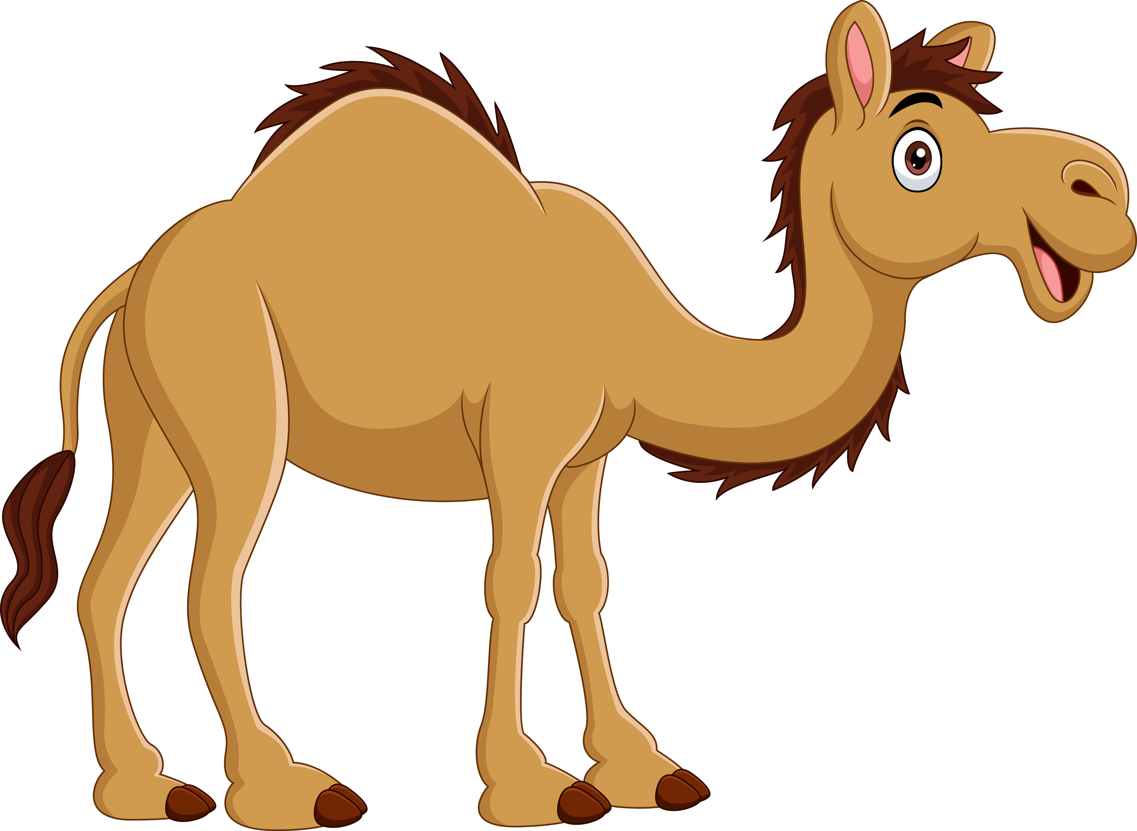
How the Camel Got His Hump
Main Idea
Detail
Detail
Detail
Since the camel would not
do any work, the Djinn
gave him a hump to store
food while he worked.
The tiger got his
stripes from trying to
get man’s wisdom.
The dog, horse and ox
helped the man since
the beginning of time.
The camel was very lazy.
Notes:
Notes to Teacher:
Remind the student that we read a story called, How the Camel Got His Hump.
Teacher: “This type of story is called a ‘Why Tale.’ These stories try to explain something that happens in nature. The characters are usually animals.”
Click to circle the “Main Idea” in the graphic organizer.
Ask: “What was this story mostly about?” (The student should tell you that this story explained why a camel has a hump.)
Teacher: “We are now going to figure out which of the following are details from the story. What did you learn about in our story, How the Camel Got a Hump?
Teacher: “Tell me which details are from our story.” Have the student read each sentence as they come to the slide.”
Click to show the first sentence: The dog, horse and ox helped the man since the beginning of time.
Ask: “Is this a detail from the story?” (Yes.)
Click to show a star on the first detail box to show that it is a detail from the story.
Click to show the next sentence: The camel was very lazy.
Ask: “Is this a detail from the story?” (Yes.)
Click to show a star on the second detail box to show that it is a detail from the story.
Click to show the next sentence: The tiger got his stripes from trying to get man’s wisdom.
Ask: “Is this a detail from the story?” (No.)
Click to show an “x” on the sentence and then click to remove this sentence from the slide.
Click to show the last sentence: Since the camel would not do any work, the Djinn gave him a hump to store food while he worked.
Ask: “Is this a detail from the story?” (Yes.)
Click to show a star on the last detail box to show that it is a detail from the story.
Applaud student’s effort and click to move to the final slide.

Slide 10
Q & A
Any Questions?
Notes:
Thank the student for his/her effort. Ask the student if he/she has any questions.

