Slide 1
Myths
Let’s Review!
Notes:
Notes to Teacher:
Tell the student that we are going to review our skills from this week. We are going to talk about -oy and -oi words, common and proper nouns, vocabulary and our myth, The Golden Touch.
Teacher clicks to bring up the next slide.

Slide 2
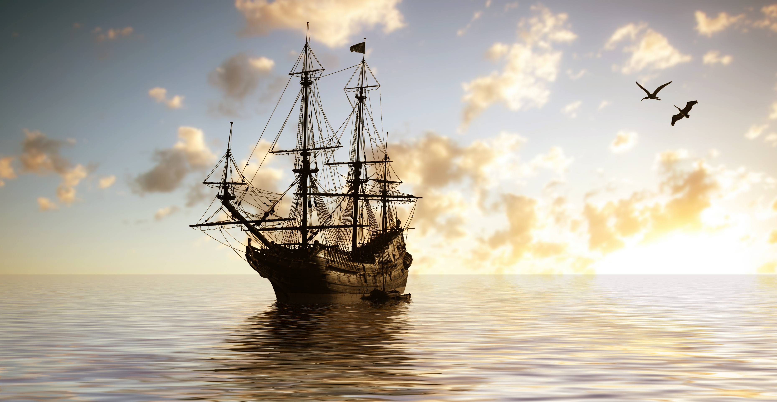
Sailing Through Our Skills!
-oy
-oi
boil
joy
loyal
join
Notes:
Notes to Teacher:
Teacher will introduce the slide by telling the student that we are going to work on -oy and -oi words.
Remind the student that these word parts sound the same but are spelled differently.
Click to show the –oi word part. Tell the student that the -oi word part is usually found in the middle of words.
Click to show these words: boil and join.
Click to take the –oi word part, as well as the words boil and join, off of the slide. This click will also bring the –oy word part to the screen.
Tell the student that the -oy word part is usually found at the end of words or before a vowel in longer words.
Click to show these words: joy and loyal.
Teacher: “Let’s take a look at some pictures and see if we can use what we know to spell our words correctly.”
Click to go to the next slide.

Slide 3
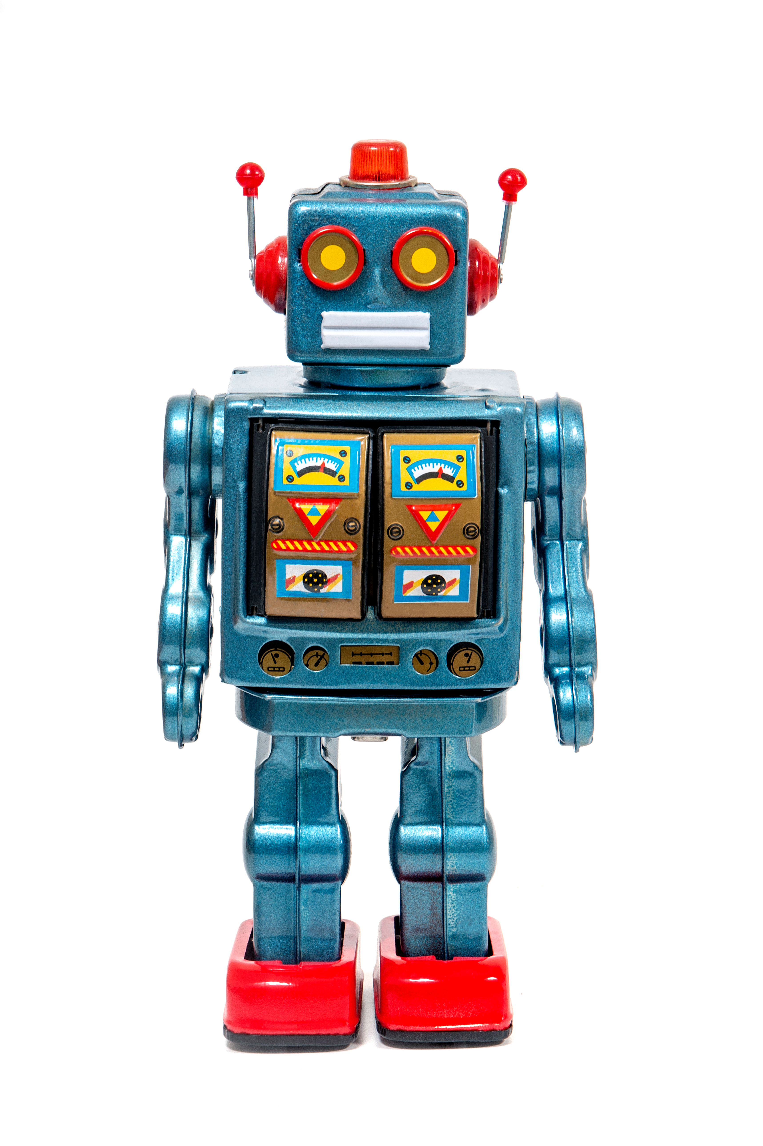
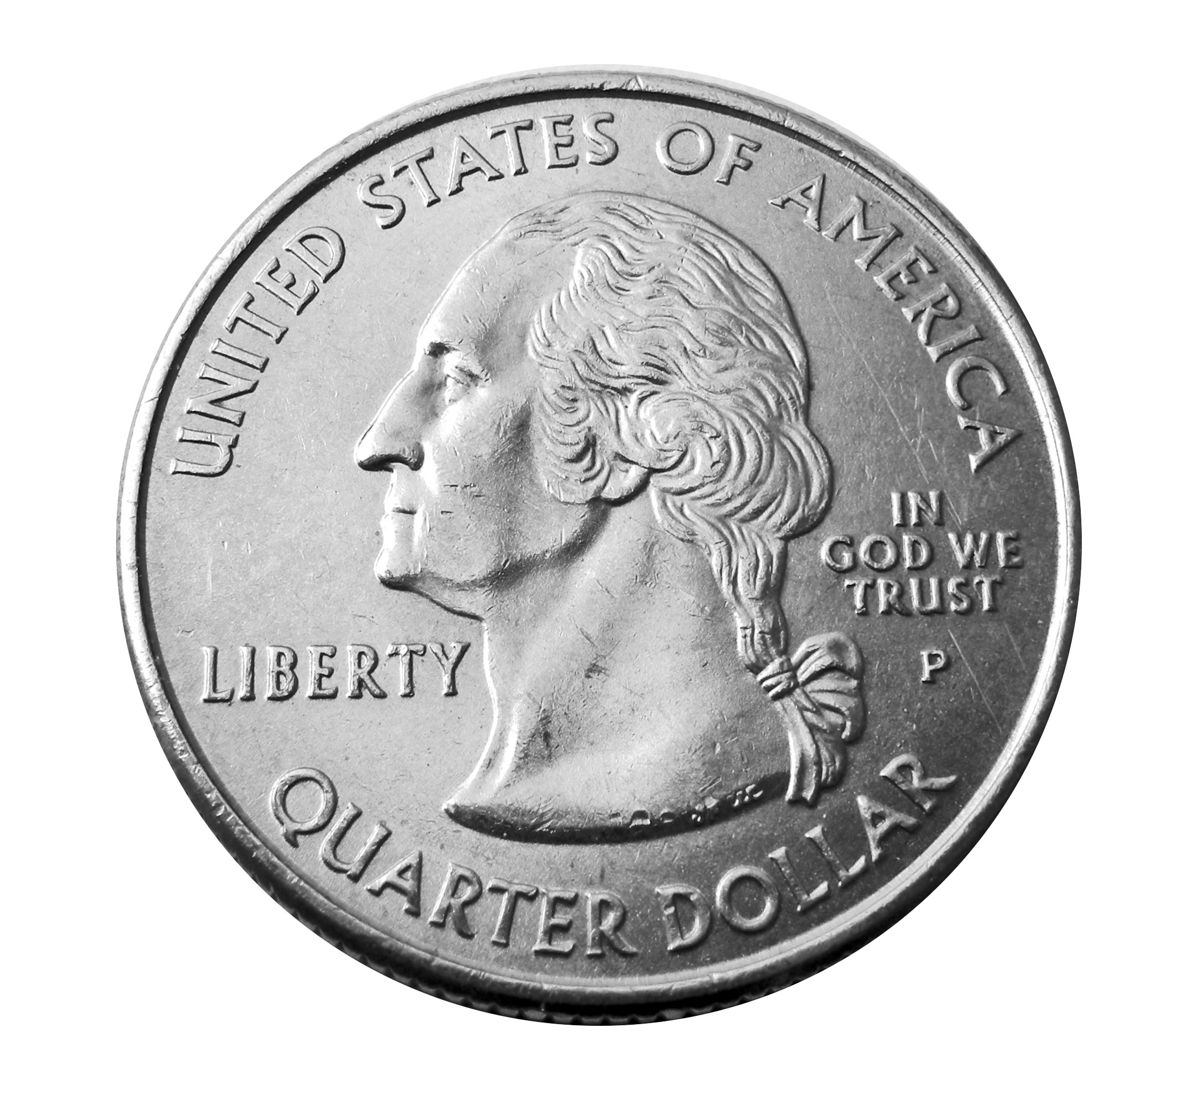
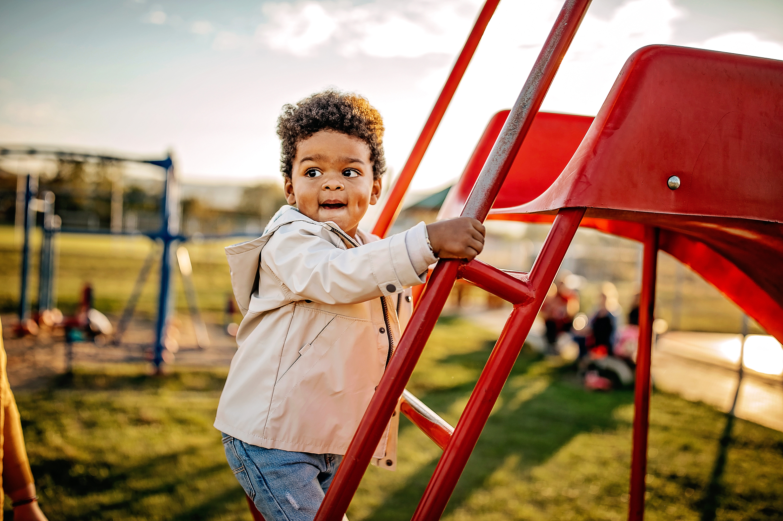
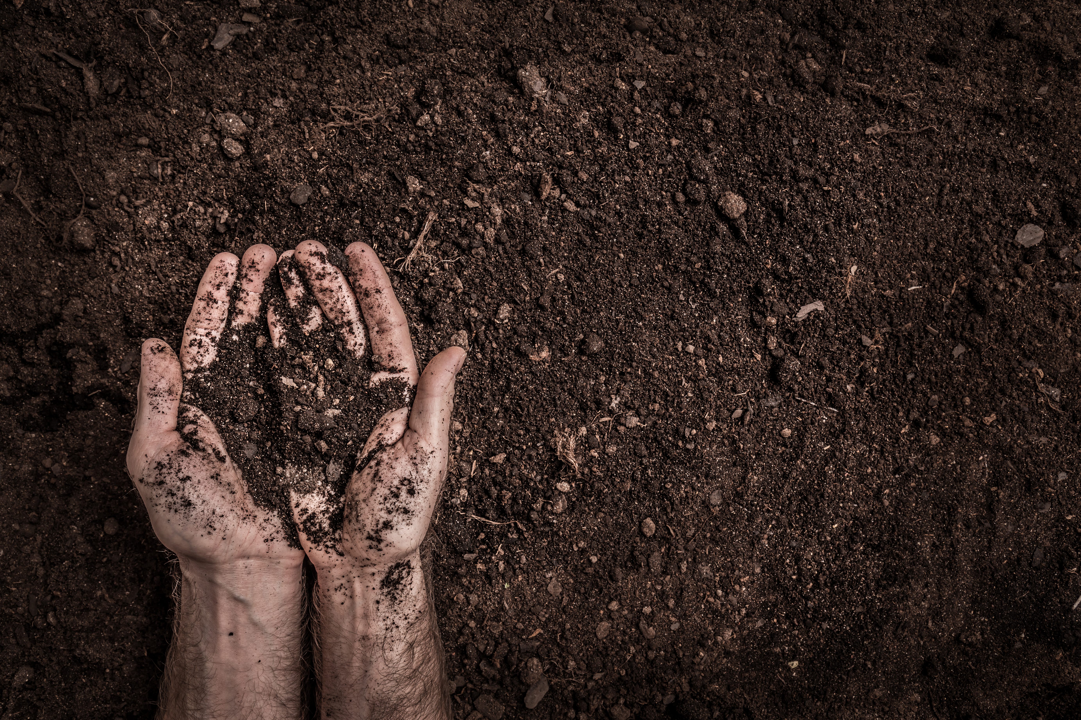
Let’s Practice!
-oy
-oi
oi
oi
oy
c_ n
oy
t__
b__
s__l
Notes:
Notes to Teacher:
Teacher will introduce the slide by telling the student that we are going to continue to work on -oy and -oi words.
Click to show the two ‘word parts’ in a chart. Tell the student that we are going to look at a picture, say the word and decide if the word is spelled with -oy or -oi.
Click to show a coin. Ask: “What is this?” (Coin.) Ask: “How do we spell coin?” Allow time for the student to tell you how the word is spelled. (C oi n.) Click to add ‘oi’ to the word coin. Ask: “Does it belong in the -oy or -oi column?” (-oi.) Click to move the coin to the -oi column.
Click to show a boy. Ask: “What is this?” (Boy.) Ask: “How do you spell boy?” Allow time for the student to tell you how the word is spelled. (B oy.) Click to add ‘oy’ to the word boy. Ask: “Does it belong in the -oy or -oi column?” (-oy.) Click to move the boy to the -oy column.
Click to show soil. Ask: “What is this?” (Soil.) Ask: “How do we spell soil?” Allow time for the student to tell you how the word is spelled. (S oi l.) Click to add ‘oi’ to the word soil. Ask: “Does it belong in the -oy or -oi column?” (-oi.) Click to move the soil to the -oi column.
Click to show a toy. Ask: “What is this?” (Toy.) Ask: “How do we spell toy?” Allow time for the student to tell you how the word is spelled. (T oy.) Click to add ‘oy’ to the word toy. Ask: “Does it belong in the -oy or -oi column?” (-oy.) Click to move the toy to the -oy column.
Applaud student’s effort and click to move to the next slide.

Slide 4
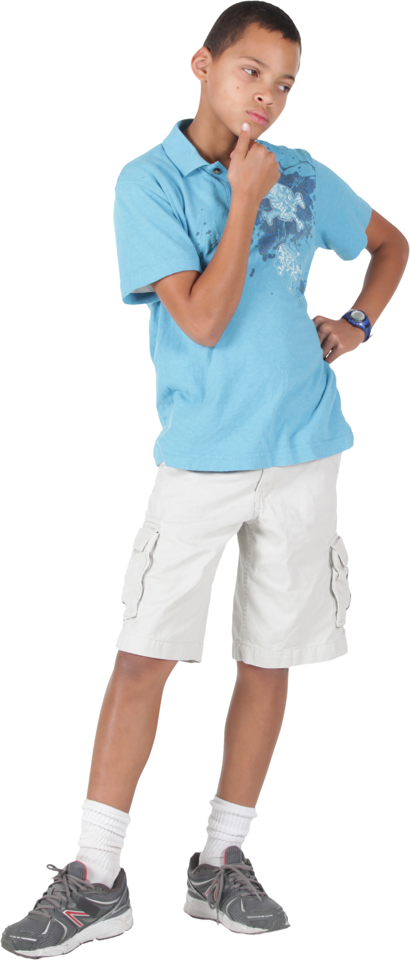
Nouns
A common noun names any
person, place, thing or idea.
state
Pennsylvania
park
Central Park
A proper noun names a
particular person, place,
thing or idea. Proper Nouns
are capitalized.
Notes:
Notes to Teacher:
Ask: “What is a noun?” (A noun is a person, place, thing, or idea.)
Tell the student that a common noun is the same thing. Click to show the definition: “A common noun names any person, place, thing or idea.”
Ask: “What is a proper noun?”
Allow the student the opportunity to tell you that a proper noun names a specific person, place, thing, or idea.”
Click to show the definition: “A proper noun names a particular person, place, thing, or idea. Proper nouns are capitalized.”
Click to show ‘state.’
Teacher: “State is a common noun.”
Click to show an arrow.
Click to show ‘Pennsylvania.”
Teacher: “Pennsylvania is a proper name.”
Click to show ‘park.’
Teacher: “Park is a common noun.”
Click to show an arrow.
Click to show “Central Park.”
Teacher: “Central Park is a proper noun.”
Ask the student if he/she can tell you the difference between ‘state’ and ‘Pennsylvania.’ (Pennsylvania is a particular state so we capitalize it.) Click to underline the P in Pennsylvania.
Ask the student to tell you the difference between ‘park’ and ‘Central Park.’ (Central Park is a particular park so we capitalize it.)
Applaud the student’s effort and click to go to the next slide.

Slide 5
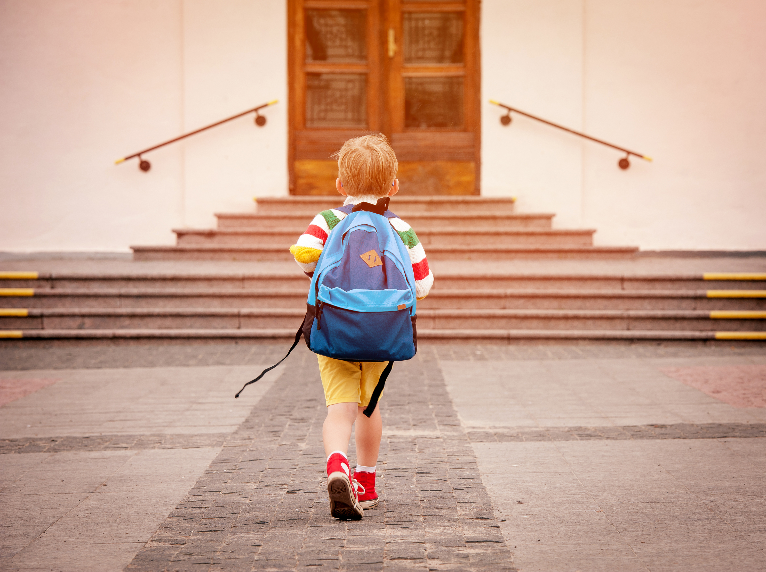
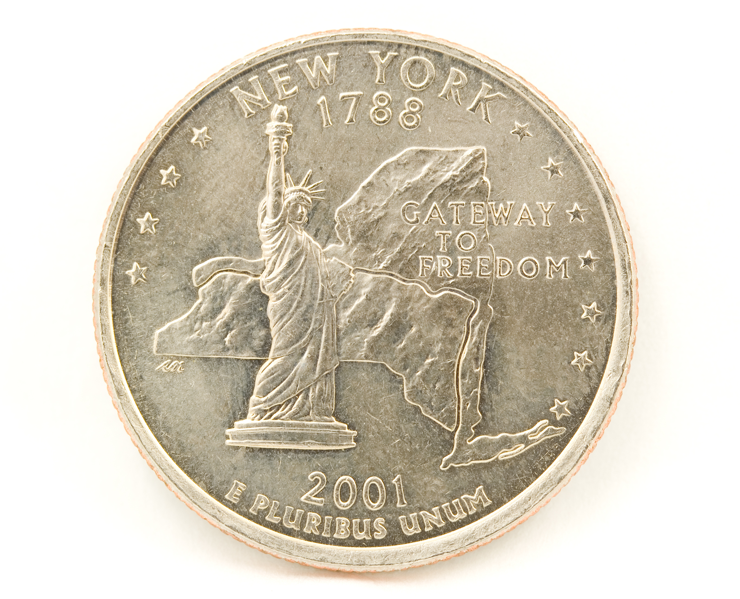
Identifying Common and Proper Nouns
Jennifer sees the Statue of Liberty on the New York quarter.
David is going to school on Wednesday.
Notes:
Notes to Teacher:
Teacher: “Today, we are going to read sentences and identify the common and proper nouns in each sentence.”
Click to show the first sentence:
Jennifer sees the Statue of Liberty on the New York quarter.
Ask the student to identity the nouns in the sentence.
Allow time for the student to identify the nouns: Jennifer, Statue of Liberty, New York and quarter.
Click to underline the nouns. If the student missed any nouns, talk about them.
Teacher: “Tell me which nouns are proper.”
Allow time for the student to identify the proper nouns: Jennifer, Statue of Liberty and New York.
Click to circle the proper nouns. If the student is having a difficult time, review proper nouns. Proper nouns name a specific person, place, thing, or idea.
Teacher will click to show another sentence:
David is going to school on Wednesday.
Ask the student to identity the nouns in the sentence.
Allow time for the student to identify the nouns: David, school, and Wednesday.
Click to underline the nouns. If the student missed any nouns, talk about them.
Teacher: “Tell me which nouns are proper.”
Allow time for the student to identify the proper nouns: David and Wednesday.
Click to circle the proper nouns. If the student is having a difficult time, review proper nouns. Proper nouns name a specific person, place, thing, or idea.
Applaud the student’s effort and click to go to the next slide.

Slide 6
Vocabulary Review
satisfy
To strike with sudden
wonder or surprise.
astonish
To make happy.
frenzy
Great and often wild
activity.
Notes:
Teacher: “Let’s review some of our vocabulary words.”
Click to show the first three vocabulary words: satisfy, astonish, and frenzy. Read the words with the student.
Click to show three definitions. Read the definitions with the student.
Teacher: “Our first word is satisfy. (Have the student repeat the word – satisfy.) What is the definition for satisfy?”
Allow time for the student to tell you which definition matches satisfy. If the student is correct, applaud his/her answer. If the student is incorrect, review the definition with him/her.
As the student gives you the correct definition, click to make an arrow appear from the word, satisfy, to the correct definition.
Teacher: “Our next word is astonish. (Have the student repeat the word – astonish.) What is the definition for astonish?”
Allow time for the student to tell you which definition matches astonish. If the student is correct, applaud his/her answer. If the student is incorrect, review the definition with him/her.
As the student gives you the correct definition, click to make an arrow appear from the word, astonish, to the correct definition.
Teacher: “Our last word is frenzy. (Have the student repeat the word – frenzy.) What is the definition for frenzy?”
Allow time for the student to tell you which definition matches frenzy. If the student is correct, applaud his/her answer. If the student is incorrect, review the definition with him/her.
As the student gives you the correct definition, click to make an arrow appear from the word, frenzy, to the correct definition.
Vocabulary:
satisfy – to make happy.
astonish – to strike with sudden wonder or surprise.
frenzy – great and often wild activity.
Before clicking to the next slide, applaud the student’s effort.
Click to go to the next slide.

Slide 7
Vocabulary Review Take Two!
wealthy
Wealth (like money or
jewels) stored up.
despair
Having riches.
treasure
To lose all hope or
confidence.
Notes:
Notes to Teacher:
Teacher: “Let’s review the rest of our vocabulary words.”
Click to show the last three vocabulary words: wealthy, despair and treasure. Read the word with the student.
Click to show three definitions. Read the definitions with the student.
Teacher: “Our first word is wealthy. (Have the student repeat the word – wealthy.) What is the definition for wealthy?”
Allow time for the student to tell you which definition matches wealthy. If the student is correct, applaud his/her answer. If the student is incorrect, review the definition with him/her.
As the student gives you the correct definition, click to make an arrow appear from the word, wealthy, to the correct definition.
Teacher: “Our next word is despair. (Have the student repeat the word – despair.) What is the definition for despair?”
Allow time for the student to tell you which definition matches despair. If the student is correct, applaud his/her answer. If the student is incorrect, review the definition with him/her.
As the student gives you the correct definition, click to make an arrow appear from the word, despair, to the correct definition.
Click to show the last word, treasure.
Teacher: “Our last word is treasure. (Have the student repeat the word – treasure.) What is the definition for treasure?”
Allow time for the student to tell you which definition matches treasure. If the student is correct, applaud his/her answer. If the student is incorrect, review the definition with him/her.
As the student gives you the correct definition, click to make an arrow appear from the word, treasure, to the correct definition.
Vocabulary:
wealthy – having riches.
despair – to lose all hope or confidence.
treasure – wealth (like money or jewels) stored up.
Before clicking to the next slide, applaud the student’s effort.
Click to go to the next slide.

Slide 8
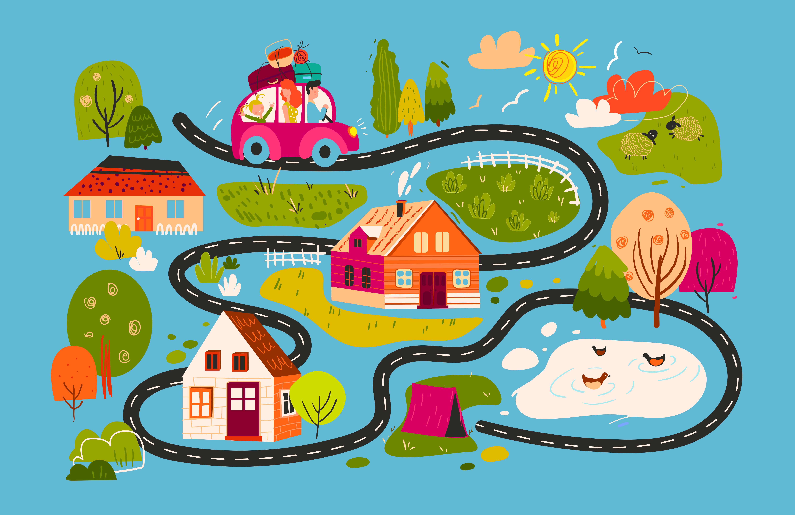
Our Vocabulary Adventure Continues!
treasure
Let’s use the map to find buried _______.
despair treasure
King Midas was a _______ man.
wealthy
wealthy satisfy
astonished
I was __________ to see that the
treasure was not there!
wealthy astonished
Notes:
Notes to Teacher:
Teacher: “Let’s practice using some of our vocabulary words in sentences.”
{Teacher will click to bring up one sentence at a time, allowing the student to read the sentence or reading the sentence to the student.}
Click to bring up the first sentence with word choices: Let’s use the map to find buried _______! (despair or treasure) Once the student tells you the correct word choice, click to bring the word to the line in the sentence.
*Teacher or student will read the sentence aloud.
*The student will decide which of the two words is correct.
*If the student identifies the correct word, applaud his/her answer, and click to show the word in the sentence.
*If the answer is incorrect, click to show the correct word and read the sentence with the student.
*Follow the same procedure for the rest of the sentences. The previous sentence will disappear.
Click to bring up the next sentence: King Midas was a ______ man (wealthy or satisfy) Once the student tells you the correct word choice, click to bring the word to the line in the sentence.
Click to bring up the last sentence: I was ______ to see that the treasure was not there! (wealthy or astonished) Once the student tells you the correct word choice, click to bring the word to the line in the sentence.
Applaud the student’s effort.
Click to move to the next slide.

Slide 9
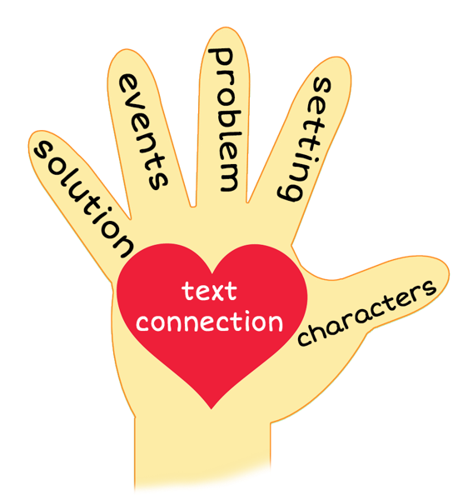
5 Finger Retell
Notes:
Notes to Teacher:
Remind the student of how we can use our hand to help retell a story using the information below.
Click to bring up the image of a hand.
Ask the student to hold up his/her hand and point to each finger as we go through the retell. Teacher will click on the slide so that each finger is circled as we work through this review.
Thumb (Click to circle the thumb.) We will talk about the characters in the story. Who did we meet in the story? We may meet people and/or animals.
Pointer Finger (Click to circle the pointer finger.) - We will talk about the setting- Where and when did the story talk place?
Middle Finger (Click to circle the middle finger) – We will talk about the problem -Was there a problem in the story? If so, what was the problem?
Ring Finger (Click to circle the ring finger.) We will talk about the events in the story. What happened in the story?
Pinky (Click to point to the pinky finger.) Solution – Was the problem solved? If so, how did the characters solve this problem?
Palm of Hand (Click to point to the palm of the hand.) Text Connection – How does this story connect to your life?
Remind the student that we will use our hand to help us retell our story today.
Click to the next slide.

Slide 10
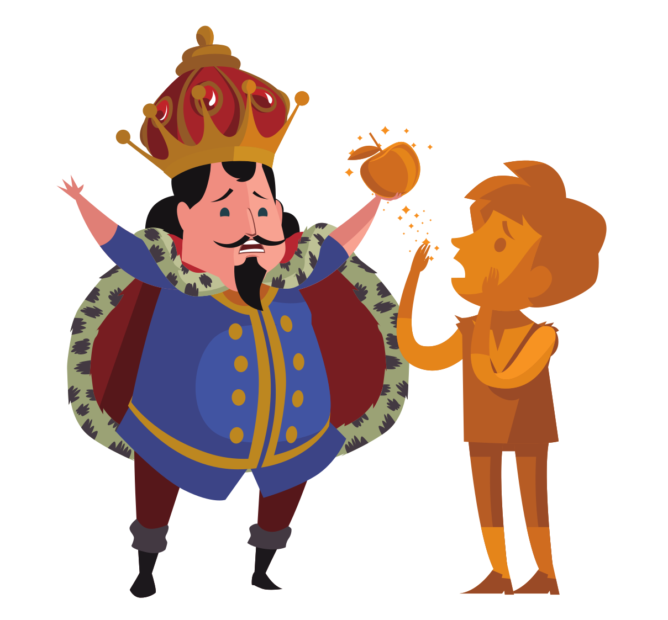
The Golden Touch
Notes:
Notes to Teacher:
Remind the student that we read a myth called, The Golden Touch.
Click to bring the image of the 5 finger retell and King Midas.
Thumb (Click to circle the thumb.) Who were the characters in the story – King Midas, his daughter (Marigold) and a stranger.
Pointer Finger (Click to circle the pointer finger.) - Where did the story take place? The story took place at the home of King Midas and his daughter, Marigold.
Middle Finger (Click to circle the middle finger) – What was the problem in the story? King Midas was very fond of gold and thought more of it would make him happy.
Ring Finger (Click to circle the ring finger.) What happened in the story? King Midas met a young man. He told him that gold was the most wonderful thing in the world. King Midas was not as happy as he could be. He told the stranger that he wished everything he touched would turn into gold. He thought this would make him a happy man. The man granted him this wish. The next day, everything he touched, turned into gold! He was so happy, until all his food turned into gold. He was not able to enjoy his food. His daughter came to him. She was incredibly sad because her beautiful garden turned into gold. King Midas did not know how to tell her that he did this. When he went to kiss her forehead, even she turned into gold. King Midas was so sad when this happened.
Pinky (Click to point to the pinky finger.) Solution – Was the problem solved? No and yes. Toward the end of the story, King Midas met the stranger again. King Midas told him that he was so miserable. Even though King Midas was granted his wish and had more gold than he could ever wish for, his heart was full of sadness. He lost everything that his heart cared for. He wanted his daughter more than gold. The stranger granted this new wish and King Midas was able to turn everything back from gold. He found out that more gold would not make him happier.
Palm of Hand (Click to point to the palm of the hand.) Text Connection –Did you ever wish for something that you did not have? If you received it, did it make you happier? Was there ever a time that you wished you had something but later realized that you did not need that item to make you happy?
When King Midas was granted his wish at the beginning of the story, how did it make you feel? Did you think that more gold was going to make him a happier man?
What did we learn from this story?
Applaud the student’s effort.
Click to the next slide.

Slide 11
Q & A
Any Questions?
Notes:
Thank the student for his/her effort. Ask the student if he/she has any questions.

