Slide 1
Fables
Reviewing Skills!
Notes:
Notes to Teacher:
Tell the student that we are going to review our skills from this week. We are going to talk about CVVC words (words that follow the consonant-vowel-vowel-consonant pattern,) compound sentences, vocabulary and our fable, The Country Mouse and the City Mouse.
Teacher clicks to bring up the next slide.

Slide 2
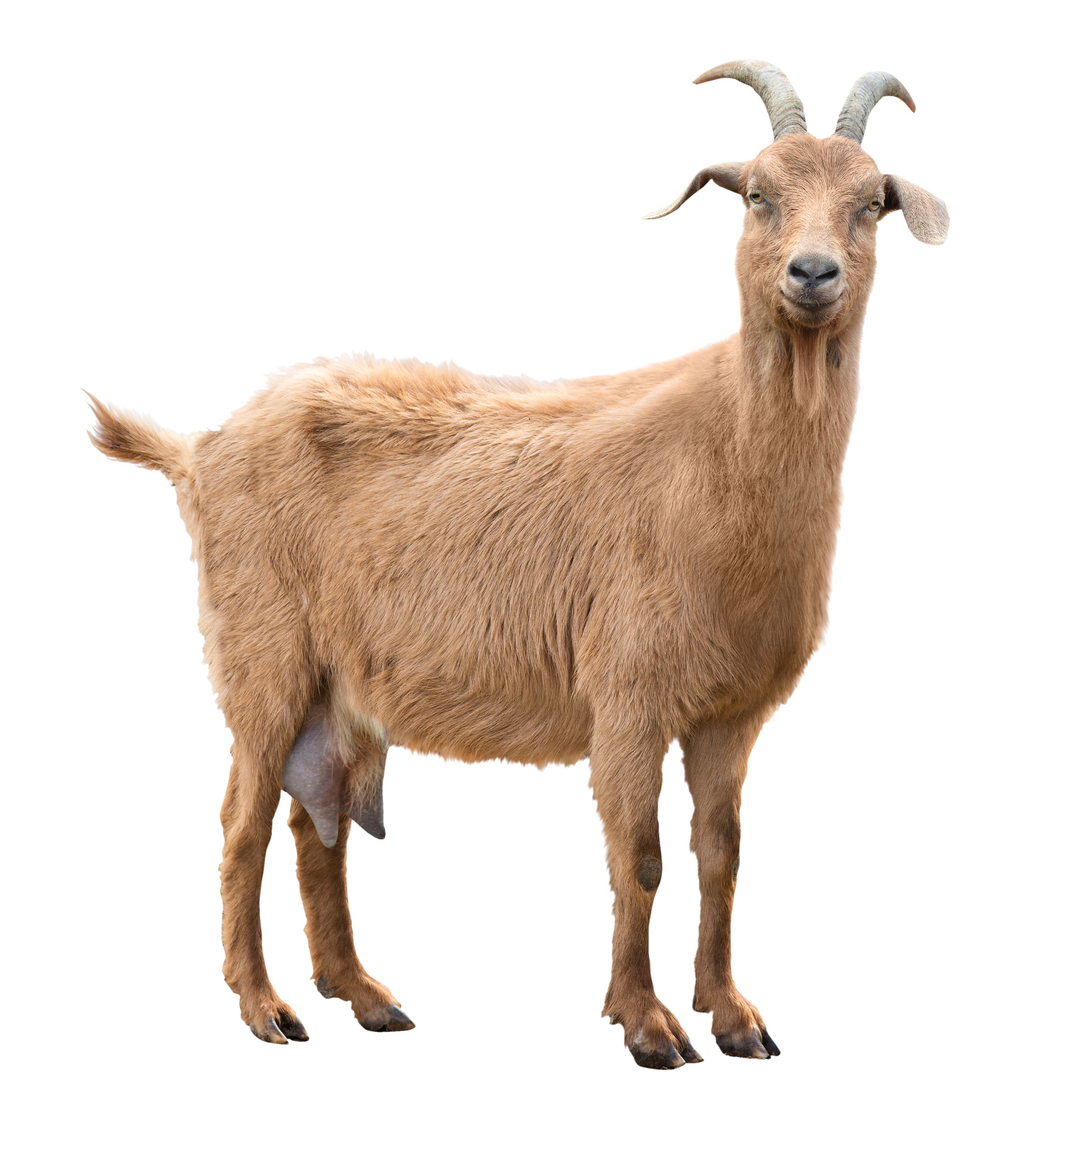


Soaring Through Our Skills!
g_at
o
j_ep
e
Notes:
Notes to Teacher:
Teacher will introduce the slide by telling the student that we are going to work on CVVC (consonant-vowel-vowel-consonant) words.
Remind the student that we hear the sound of the first vowel in CVVC words.
Click to show the first word part and image of a jeep (j_ep.)
Ask: “What do you see?” (Jeep.)
Ask: “What letter is missing in jeep?” (e.)
Click to add the missing letter in jeep.
Click to show the next picture and word part: goat (g_at.)
Ask: “What do you see?” (Goat.)
Ask: “What letter is missing in goat?” (o.)
Click to add the missing letter in goat.
Applaud student’s effort.
Teacher: “Let’s try some more CVVC (consonant-vowel-vowel-consonant) words!”
Click to go to the next slide.

Slide 3

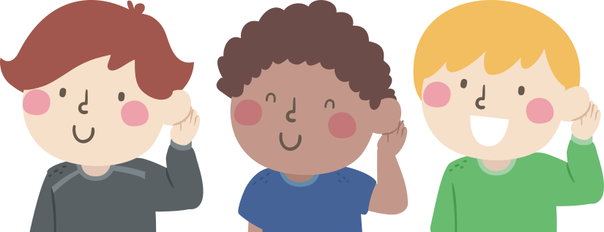
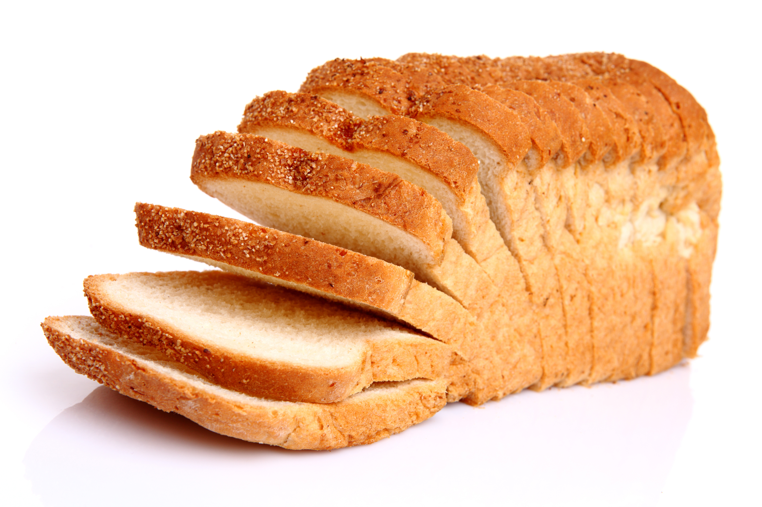
Let’s Read CVVC Words!
l_af
o
e
loaf
leaf
Notes:
Notes to Teacher:
Tell the student that you will say a word. Remind the student that when working with CVVC words, the first vowel is the sound that we hear.
Click to show the following letters on the screen: l_af.
Teacher: “Today, we are going to fill in the missing letter.”
Click to show the picture of a loaf of bread.
Teacher: “What is this?” (loaf of bread.) What letter is missing in loaf? (o.)
Click to show the missing letter in loaf.
Click to remove the loaf of bread (and the letter) and show the picture of a leaf.
Teacher: “What is this?” (leaf.) What letter is missing in leaf? (e.)
Click to show the missing letter in leaf.
Remind the student how important it is to listen to the sounds that you hear so that you can spell words correctly.
Click to show the words loaf and leaf. The picture of the children will appear with these words. Remind the student that changing one letter changes the whole word.
Applaud the student’s effort and click to go to the next slide.

Slide 4
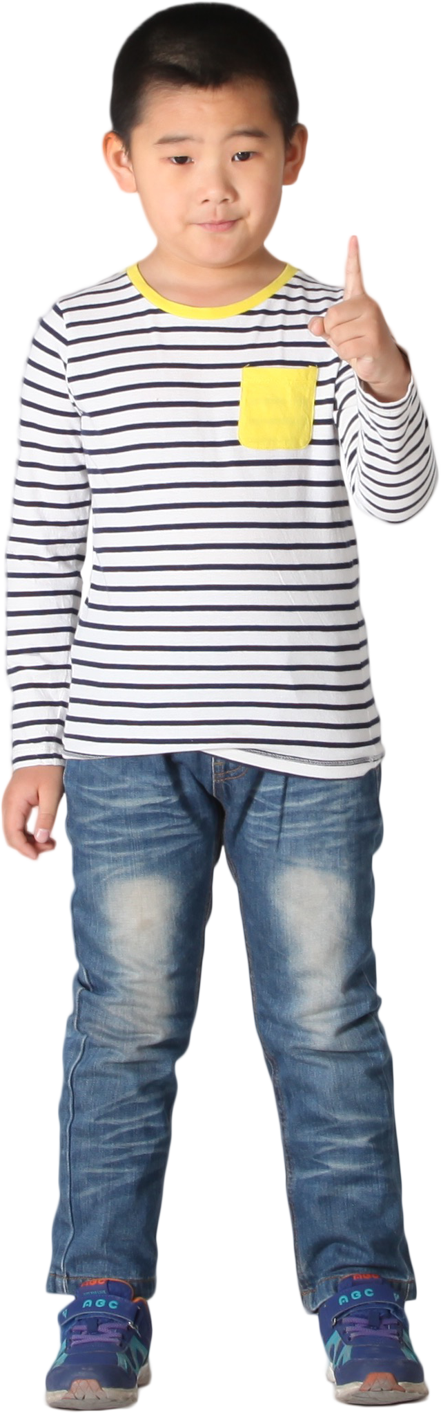

Compound Sentences
Sentence = Subject + Predicate
Compound Sentence
I wanted to go outside.
It was raining.
I wanted to go outside, but it was raining.
Notes:
Notes to Teacher:
Remind the student that a sentence is made up of a subject and a predicate.
Click to show “Sentence = Subject + Predicate”
Ask: “If a sentence is made up of a subject and a predicate, what is a compound sentence?
Click to show the words “Compound Sentence” with an image of a figure and a question mark.
Allow the student the opportunity to tell you that a compound sentence is made up of two simple sentences using a comma and a conjunction.
Teacher: “Let’s take a look at two simple sentences.”
Click to show the two simple sentences:
I wanted to go outside.
It was raining.
Tell the student that these are two simple sentences. We can join them together and create a compound sentence.
Click to show how you can combine the sentences by adding a comma and the word but:
I wanted to go outside, but it was raining.
Click to go to the next slide.

Slide 5
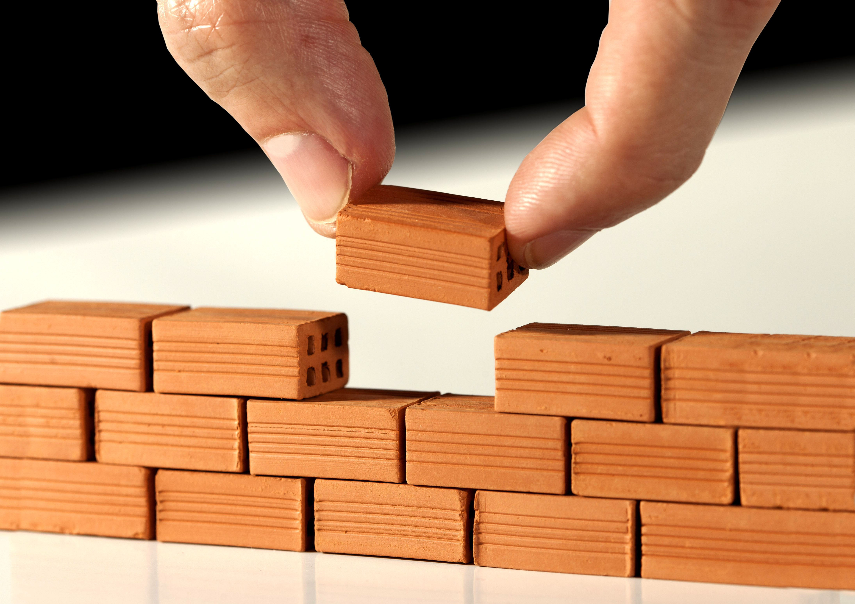
Building Compound Sentences
The children painted a picture.
They made a tower with blocks.
My mom said I can go to the park, or
I can bake cookies.
1. I went to the park.
2. My mom said I can go to the park.
The children painted a picture, and
they made a tower with blocks.
3. I can bake cookies.
Notes:
Notes to Teacher:
Tell the student that today, he/she will build compound sentences.
Teacher will click to show two sentences:
The children painted a picture. They made a tower with blocks.
Remind the student that both of these sentences tell us about what the children did.
Teacher: “Use these two sentences to build a compound sentence.”
Allow the student time to think about how to join these sentences together using a comma and the word and.
Once the student verbalizes the compound sentence, check the student’s answer by clicking on the screen to show an arrow pointing to the compound sentence:
The children painted a picture, and they made a tower with blocks.
Click to show the next compound sentence: My mom said I can go to the park, or I can bake cookies.
Click to show an arrow pointing to the three simple sentences:
1. I went to the park.
2. My mom said I can go to the park .
3. I can bake cookies.
Ask: “Which two sentences were used to build the compound sentence?”
Allow the student to tell you that the 2nd and 3rd sentences were used to build the compound sentence.
Click to take the first sentence off of the slide.
Ask: “What conjunction was used after the comma?” (or.)
Click to underline the comma and the word or.
Applaud the student’s effort and click to go to the next slide.

Slide 6
Fables–
Vocabulary Review
gnaw
cupboard
peace
A state of quiet
To bite or chew with the teeth
A closet with shelves for
cups, dishes or food.
Notes:
Notes to Teacher:
Teacher: “Let’s review some of our vocabulary words.”
Click to show the first word, cupboard.
Teacher: “Our first word is cupboard. (Have the student repeat the word – cupboard.) What is a cupboard?”
Click to show two definitions under the word cupboard.
Allow time for the student to tell you which definition matches cupboard. If the student is correct, applaud his/her answer. If the student is wrong, review the definition with him/her.
As the student gives you the correct definition, click to make the incorrect definition fade away.
Click to show the next word, gnaw .
Teacher: “Our next word is gnaw. (Have the student repeat the word – gnaw.) What is the definition for gnaw?”
Click to show two definitions under the word gnaw.
Allow time for the student to tell you which definition matches gnaw. If the student is correct, applaud his/her answer. If the student is wrong, review the definition with him/her.
As the student gives you the correct answer, click to make the incorrect definition fade away.
Click to show the last word, peace
Teacher: “Our last word is peace. (Have the student repeat the word – peace.) What is peace?”
Click to show two definitions under the word peace.
Allow time for the student to tell you which definition matches peace. If the student is correct, applaud his/her answer. If the student is wrong, review the definition with him/her.
As the student gives you the correct answer, click to make the incorrect definition fade away.
Vocabulary:
cupboard – a closet with shelves for cups, dishes or food.
gnaw – to bite or chew with the teeth.
peace – a state of quiet.
Before clicking to the next slide, applaud the student’s effort.
Click to go to the next slide.

Slide 7
Vocabulary Review Take Two!
Fine
cellar
trap
A device for catching animals.
A room or set of rooms below
the ground, basement.
Excellent in quality or appearance.
Notes:
Notes to Teacher:
Teacher: “Let’s review the rest of our vocabulary words.”
Click to show the first word, fine
Teacher: “Our first word is fine. (Have the student repeat the word – fine.) What is the definition for fine?”
Click to show two definitions under the word fine.
Allow time for the student to tell you which definition matches fine. If the student is correct, applaud his/her answer. If the student is wrong, review the definition with him/her.
As the student gives you the correct definition, click to make the incorrect definition fade away.
Click to show the next word, cellar.
Teacher: “Our next word is cellar. (Have the student repeat the word – cellar.) What is the definition for cellar?”
Click to show two definitions under the word cellar.
Allow time for the student to tell you which definition matches cellar. If the student is correct, applaud his/her answer. If the student is wrong, review the definition with him/her.
As the student gives you the correct answer, click to make the incorrect definition fade away.
Click to show the last word, trap
Teacher: “Our last word is trap. (Have the student repeat the word – trap.) What is the definition for trap?”
Click to show two definitions under the word trap.
Allow time for the student to tell you which definition matches trap. If the student is correct, applaud his/her answer. If the student is wrong, review the definition with him/her.
As the student gives you the correct answer, click to make the incorrect definition fade away.
Vocabulary:
fine – excellent in quality or appearance
cellar – a room or set of rooms below the ground, basement
trap – a device for catching animals.
Before clicking to the next slide, applaud the student’s effort.
Click to go to the next slide.

Slide 8
Our Vocabulary Adventure Continues!
gnaw
Did the mice ____ through the bag of bread?
Please put the glass in the _______.
cupboard
Take the basket down to the _____.
cellar
peace
I love the _____ and quiet.
fine
Thank you for the ____ meal!
trap
Did you see the skunk in the ____?
Word Bank
cupboard fine peace
cellar trap gnaw
Notes:
Notes to Teacher:
Teacher: “Let’s use the word bank to fill in the blank in each sentence.”
Click to bring up a word bank with six vocabulary words.
Review the words in the word bank.
{Teacher will click to bring up one sentence at a time, allowing the student to read the sentence or reading the sentence to the student.}
Click to bring up the first sentence: Did the mice ____ through the bag of bread? (Gnaw.) Click to show the word gnaw.
*Teacher or student will read the sentence aloud.
*Give the student the opportunity to fill in the missing word.
*If the student verbally fills in the correct word, applaud his/her answer.
*If the answer is incorrect, assist the student in filling in the sentence with the correct word.
*Click to add the vocabulary word to the line in the sentence and make the word will be crossed out in the word bank.
*Follow the same procedure for the rest of the sentences. The previous sentence will disappear.
Click to bring up the next sentence: Please put the glass in the ______ (Cupboard.) Click to show the word cupboard.
Click to bring up the next sentence: Take the basket down to the ____ (Cellar.) Click to show the word cellar.
Click to bring up the next sentence: I love the _____ and quiet (Peace.) Click to show the word peace.
Click to bring up the next sentence: Thank you for the ____ meal! (Fine.) Click to show the word fine.
Click to bring up the last sentence: Did you see the skunk in the ____? (Trap.) Click to show the word trap.
Applaud student’s effort.
Click to move to the next slide.

Slide 9
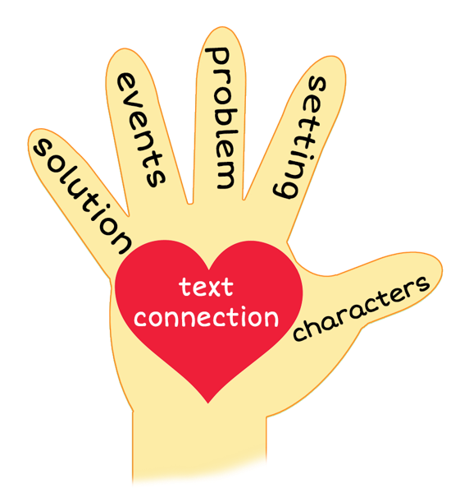
5 Finger Retell
Notes:
Notes to Teacher:
Remind the student of how we can use our hand to help retell a story using the information below.
Click to bring the image of a hand to the slide.
Ask the student to hold up his/her hand and point to each finger as we go through the retell. Teacher will click on the slide so that each finger is circled as we work through this review.
Thumb (Click to circle the thumb.) We will talk about the characters in the story. Who did we meet in the story? We may meet people and/or animals.
Pointer Finger (Click to circle the pointer finger.) - We will talk about the setting- Where and when did the story talk place?
Middle Finger (Click to circle the middle finger) – We will talk about the problem -Was there a problem in the story? If so, what was the problem?
Ring Finger (Click to circle the ring finger.) We will talk about the events in the story. What happened in the story?
Pinky (Click to circle the pinky finger.) Solution – Was the problem solved? If so, how did the characters solve this problem?
Palm of Hand (Click to circle the palm of the hand.) Text Connection – How does this story connect to your life?
Remind the student that we will use our hand to help us retell our story today.
Click to the next slide.

Slide 10
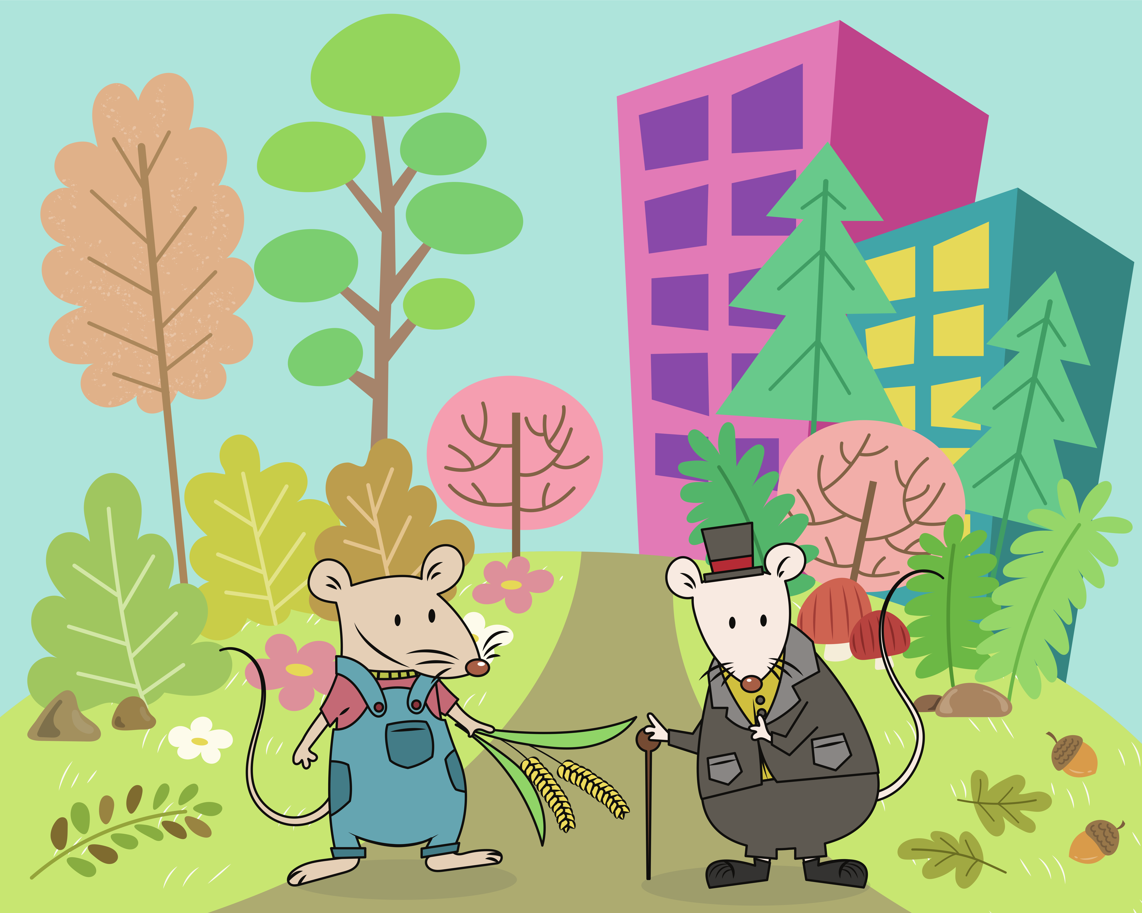
The Country Mouse and the
City Mouse
Notes:
Notes to Teacher:
Remind the student that we read a fable called, The Country Mouse and the City Mouse.
Click to bring the image of the 5 finger retell and the mice.
Thumb (Click to circle the thumb.) Who were the characters in the story? – The Country Mouse, The City Mouse, the cook and the cat.
Pointer Finger (Click to circle the pointer finger.) - Where did the story take place? The story started in the country, moved to the city and ended back in the country.
Middle Finger (Click to circle the middle finger) – What was the problem in the story? Each mouse longed for something different.
Ring Finger (Click to circle the ring finger.) What happened in the story? The country mouse invited the city mouse to the country. Although the city mouse was excited for the visit, he quickly became bored. Next, the City Mouse invited the Country Mouse to his home. Although they had lots of fine food, the Country Mouse missed his peace and quiet.
Pinky (Click to circle the pinky finger.) Solution – Was the problem solved? Yes. Although each mouse longed for something different, they learned to appreciate what they had. City Mouse loved his fine foods and Country Mouse loved his peace and quiet.
Palm of Hand (Click to circle the palm of the hand.) Text Connection –Did you ever wish for something that you did not have? How did you feel if you received it?
Did you ever visit someone far away? What did you like about where you traveled? What did you miss about home?
Applaud the student’s effort.
Click to the next slide.

Slide 11
Q & A
Any Questions?
Notes:
Thank the student for his/her effort. Ask the student if he/she has any questions.

