Slide 1
Freedom
Expression of Words
Notes:
Say, “Today we are going to review the digraphs ch and tch, complex sentences, our vocabulary words, and a 5 finger retell of the story Barb's Brilliant Plan.

Slide 2

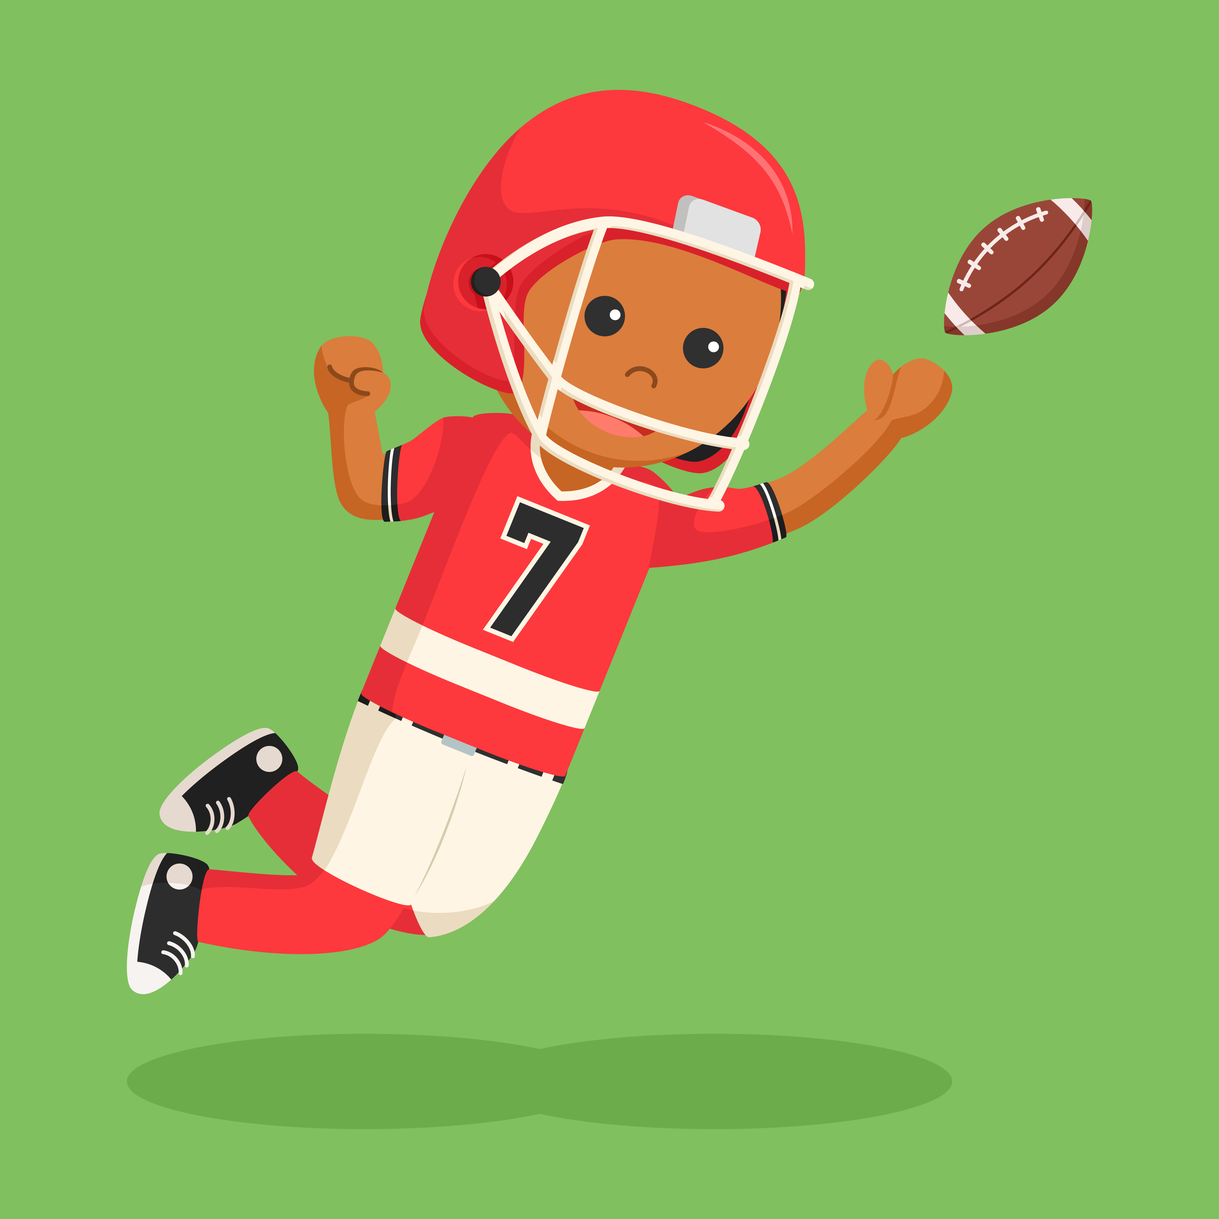

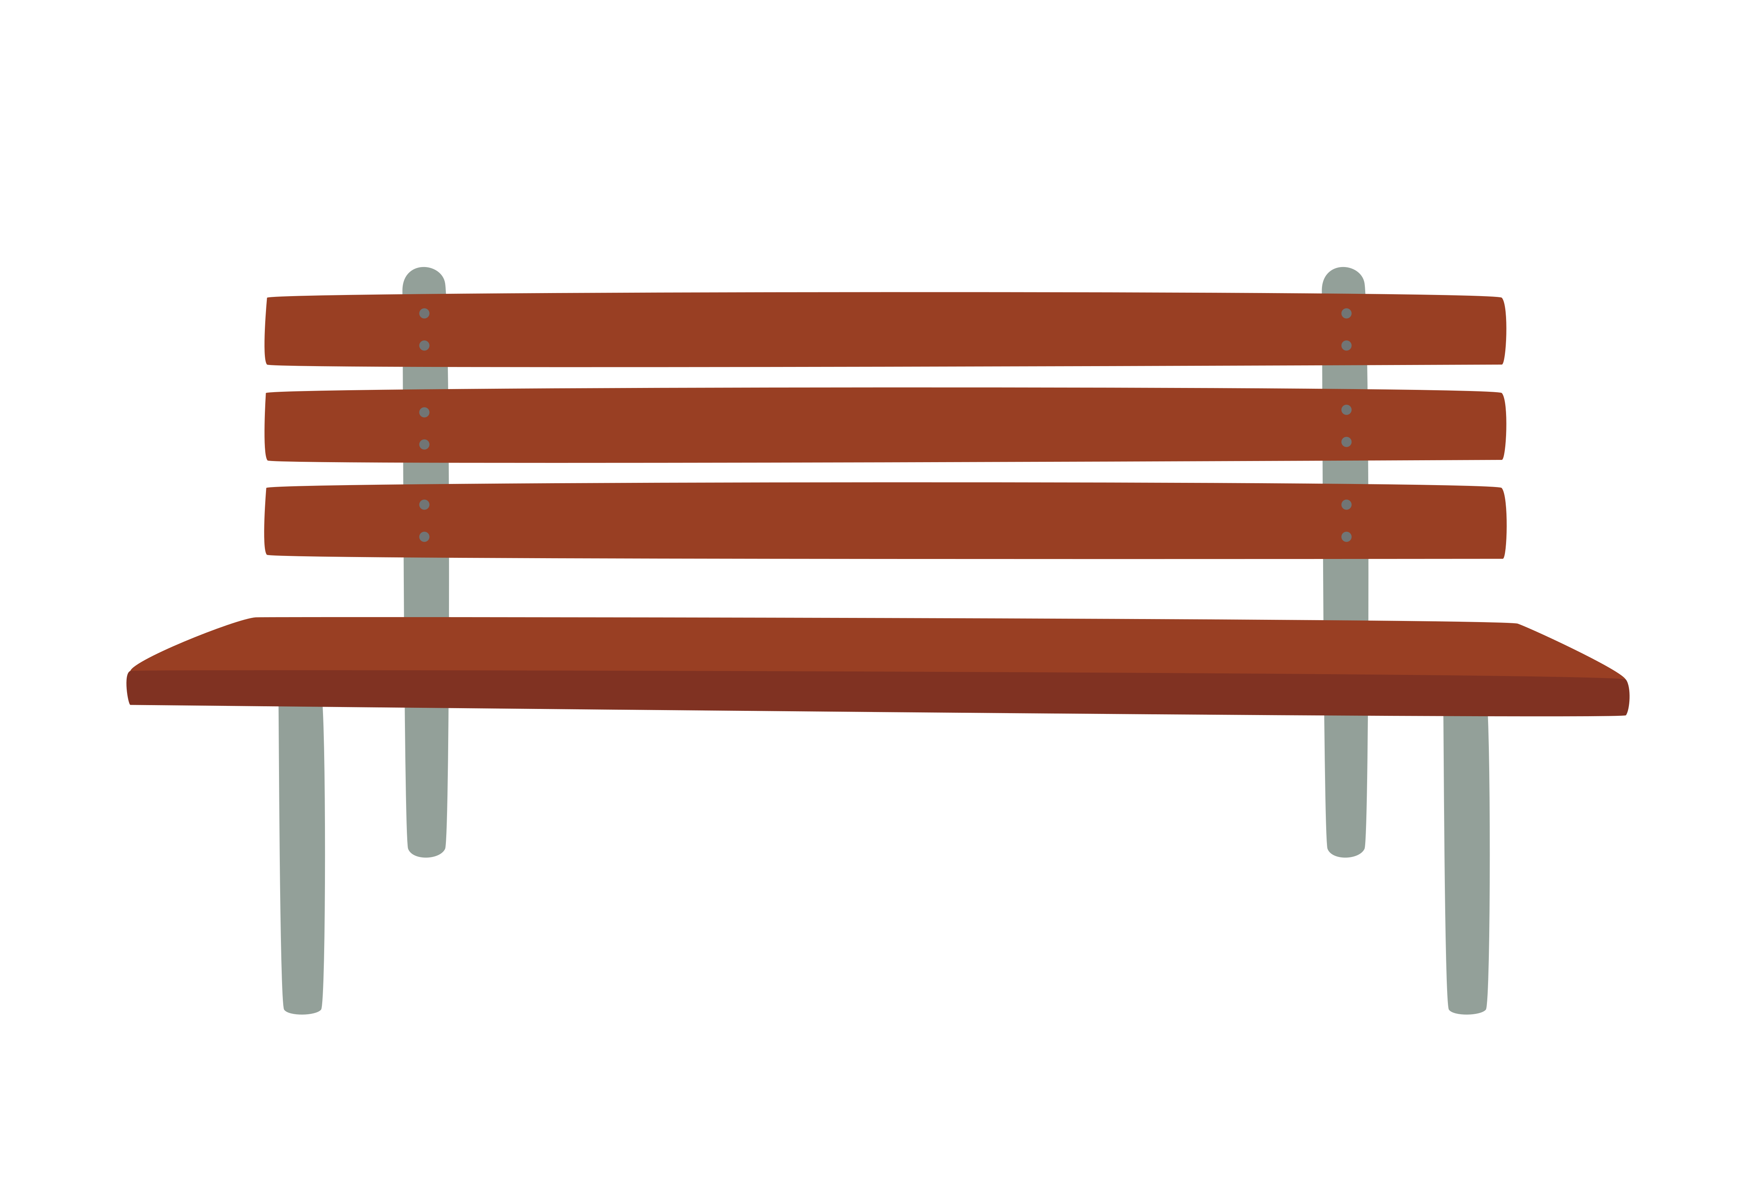
Liberty of Digraphs ch and tch Practice
ch
ch
ch
ch
tch
tch
tch
tch
Notes:
Say, “Today we are going to practice the digraphs ch and tch. I will show you a picture and you need to tell me if it ends in tch or ch.”
Click to show the picture of a watch and the choices ch and tch. Say, “What does the word watch end with ch or tch?” Wait for the student to answer. Click for tch to be circled. Say, “yes, it ends in tch.”
Click to show the picture of a bench. Say, “What does the word bench end with ch or tch?” Wait for the student to answer. Click for ch to be circled. Say, “yes, it ends in ch.”
Click to show the picture of a branch. Say, “What does the word branch end with ch or tch?” Wait for the student to answer. Click for ch to be circled. Say, “yes, it ends in ch.”
Click to show the picture of a boy catching a ball. Say, “What does the word catch end with ch or tch?” Wait for the student to answer. Click for tch to be circled. Say, “yes, it ends in tch.”

Slide 3
Rights of Complex Sentence Review
complex sentence
dependent clause
If they place first, they might win five hundred dollars.
has one simple sentence, but it also contains one dependent clause
can't stand alone as a complete sentence
Notes:
Say, “Let’s review complex sentences.”
Click to show the word complex sentence and its definition. Say, “A complex sentence has one simple sentence, but it also contains one dependent clause.” Click for it to disappear.
Click to show dependent clause and its definition. Say, ‘a dependent clause is one that can't stand alone as a complete sentence. It depends on the rest of the sentence to make sense.” Click for it to disappear.
Click to show the sentence If they place first, they might win five hundred dollars. Say, “This is an example of a complex sentence. If they place first is the dependent clause. It cannot stand alone as a complete sentence. We combine it with they might win five hundred dollars to make the entire sentence complete.

Slide 4
Independence of Complex Sentence Practice
We got lost in the woods, but my brother had a map in his backpack.
When Uncle Jack comes to town, we all have a good time.
Their robot can follow a simple path through a maze.
If you want your car really clean, let George wash it.
compound
simple
complex
Notes:
Say, “You have learned about simple, compound, and complex sentences. Today, I an going to show you a sentence and you need to tell me if it is a simple sentence, a compound sentence, or a complex sentence.”
Click to show the sentence Their robot can follow a simple path through a maze and the choices. Say, “Can you read this sentence to me? Is this a simple, compound, or complex sentence?” Wait for the student to respond. Click for simple to be circled. Say, “yes, it is a simple sentence.” Click for the sentence and the circle to disappear.
Click to show the sentence If you want your car really clean, let George wash it. Say, “Can you read this sentence to me? Is this a simple, compound, or complex sentence?” Wait for the student to respond. Click for complex to be circled. Say, “yes, it is a complex sentence.” Click for the sentence and the circle to disappear.
Click to show the sentence When Uncle Jack comes to town, we all have a good time. Say, “Can you read this sentence to me? Is this a simple, compound, or complex sentence?” Wait for the student to respond. Click for complex to be circled. Say, “yes, it is a complex sentence.” Click for the sentence and the circle to disappear.
Click to show the sentence We got lost in the woods, but my brother had a map in his backpack. Say, “Can you read this sentence to me? Is this a simple, compound, or complex sentence?” Wait for the student to respond. Click for compound to be circled. Say, “yes, it is a compound sentence.”

Slide 5
Value of Vocabulary Review
spoil - to damage the quality or effect of
border - an outer part or edge
rate - a constant ratio between two things
coward - one who shows shameful fear or timidity
limit - a point beyond which a person or thing cannot go
loyal - faithful to a cause
Notes:
Say, “Let’s review our vocabulary words.”
Say, “I will show you a word and the definition and I need you to read it to me.”
Click to show coward - one who shows shameful fear or timidity Say, “Read the word and the definition.” Click for it to disappear.
Click to show border - an outer part or edge Say, “Read the word and the definition.” Click for it to disappear.
Click to show spoil - to damage the quality or effect of Say, “Read the word and the definition.” Click for it to disappear.
Click to show limit - a point beyond which a person or thing cannot go Say, “Read the word and the definition.” Click for it to disappear.
Click to show rate - a constant ratio between two things Say, “Read the word and the definition.” Click for it to disappear.
Click to show loyal - faithful to a cause Say, “Read the word and the definition.”

Slide 6
Patriotic Vocabulary Practice
perimeter
improve
minimum
devoted
wimp
coward
amount
rate
limit
border
spoil
loyal
synonym
antonym
Notes:
Say, “Now that we reviewed the definitions of our vocabulary words, let’s practice identifying synonyms and antonyms of those words. I will show you the vocabulary word and another word. You need to tell me whether it is a synonym or an antonym of the vocabulary word. Remember a synonym means the same and an antonym means the opposite.”
Click to show the words coward and wimp. Say, “Are these 2 words synonyms or antonyms?” Wait for the student to respond. Click to show the synonym circle. Say, “yes, coward and wimp are synonyms.” Click for it to disappear.
Click to show the words border and perimeter. Say, “Are these 2 words synonyms or antonyms?” Wait for the student to respond. Click to show the synonym circle. Say, “yes, they are synonyms.” Click for it to disappear.
Click to show the words spoil and improve. Say, “Are these 2 words synonyms or antonyms?” Wait for the student to respond. Click to show the antonym circle. Say, “yes, they are antonyms.” Click for it to disappear.
Click to show the words limit and minimum. Say, “Are these 2 words synonyms or antonyms?” Wait for the student to respond. Click to show the antonym circle. Say, “yes, they are antonyms.” Click for it to disappear.
Click to show the words rate and amount . Say, “Are these 2 words synonyms or antonyms?” Wait for the student to respond. Click to show the synonym circle. Say, “yes, they are synonyms.” Click for it to disappear.
Click to show the words loyal and devoted. Say, “Are these 2 words synonyms or antonyms?” Wait for the student to respond. Click to show the synonym circle. Say, “yes, they are synonyms.”

Slide 7
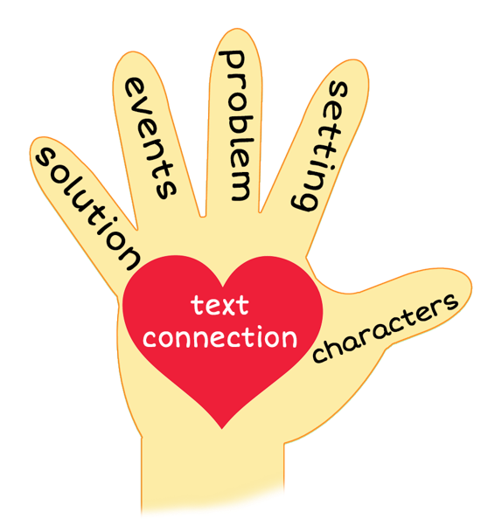
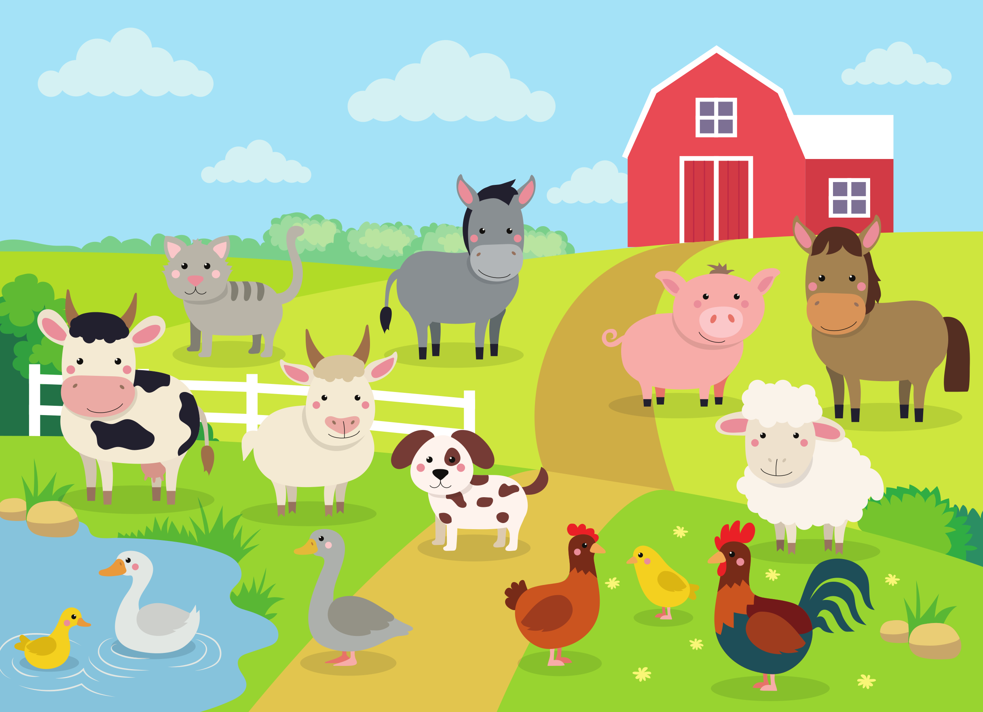
5 Finger Retell
Notes:
Say, “This week you read the story Barb's Brilliant Plan. Using the 5 finger retell strategy, can you tell me about the story.
Say, “Hold up your thumb, tell me the characters.” (Barb and all the other cows)
Say, “Hold up your pointer, tell me the setting.” (A farm)
Say, “Hold up your tall finger, tell me the problem.” (The cows’ days are always the same. They graze. They give milk. Then, they graze some more. It’s boring!)
Say, “Hold up your ring finger, tell me the events.” (Barb proposed that they escape from the farm for a day, they decide to escape Monday night, Jen is the lookout, they are going to walk to town and walk around, they are lucky to have Barb as a leader) The student does not need to name all of these events. They need to be able to tell at least 3 events from the story.
Say, “Hold up your little finger, tell me the ending/solution.” (They have 3 days to plan their adventure)
Say, “Make a heart with your fingers, have you ever gone on an adventure?” (answers will vary)

Slide 8
Q & A
Any Questions?

