Slide 1
Immigration
Depart for a Review
Notes:
Say, “Time for us to depart for a review. We will review the suffixes able and ably, prepositions, our vocabulary words, and do a 5 finger retell of the story Lawrence’s Journey to America.”

Slide 2
Travel to the Suffixes able and ably Practice
ably
able
noticeably
reusable
fixable
reasonably
able means can be done or able to
ably means in an able manner
erasable
miserably
Notes:
Say, “Today we are going to review the suffixes able and ably. Then I am going to give you a word, we will go over the meaning, and then you need to use that word in a sentence.”
Click to show able and the meaning. Say, “able means can be done or able to.” Click to show the word erasable. “Say, erasable means able to be erased.” Click for it to disappear.
Click to show ably and the meaning. Say, “ably means in an able manner.” Click to show the word miserably. Say, “miserably means in a miserable manner.” Click for it to disappear.
Click to show the word fixable. Say, “What is the meaning of fixable? Yes, it means able to be fixed. Can you use it in a sentence?” Wait for the student to answer. Click for it to disappear.
Click to show the word reasonably. Say, “What is the meaning of reasonably? Yes, it means in a reasonable manner. Can you use it in a sentence?” Wait for the student to answer. Click for it to disappear.
Click to show the word reusable. Say, “What is the meaning of reusable. Yes, it means able to be reused. Can you use it in a sentence?” Wait for the student to answer. Click for it to disappear.
Click to show the word noticeably. Say, “What is the meaning of noticeably? Yes, it means in a noticeable manner. Can you use it in a sentence?” Wait for the student to answer.

Slide 3
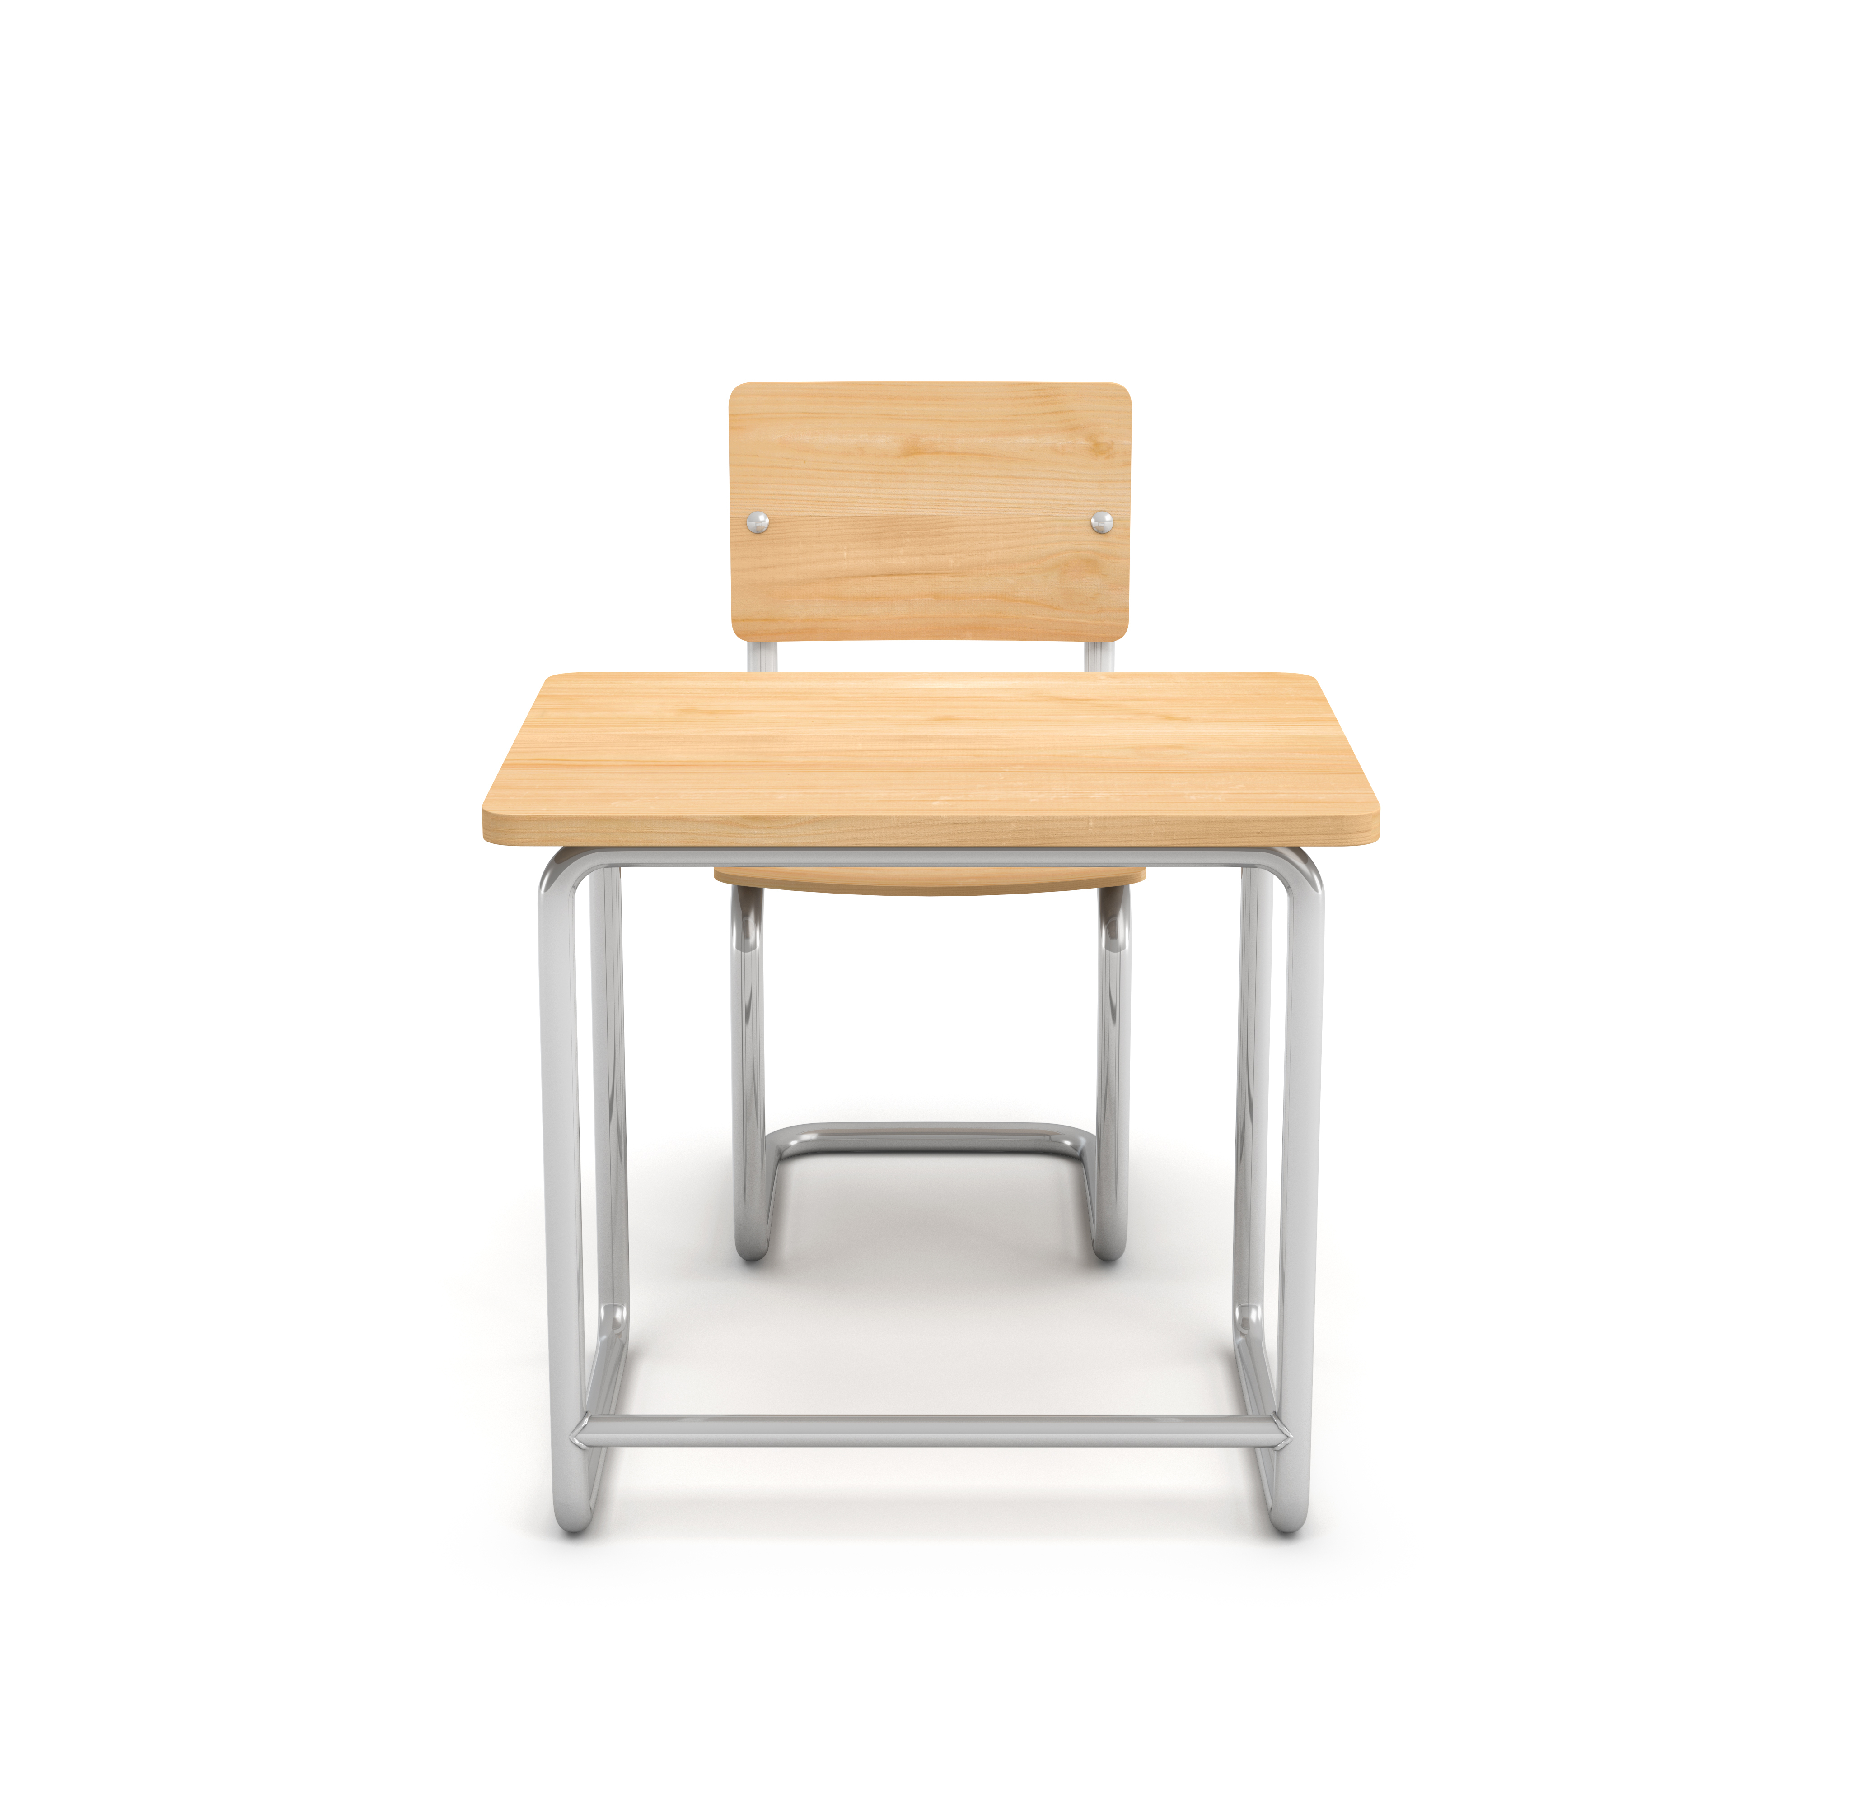

Migrate to a Preposition Review
preposition
under the desk
on the desk
The pencil is _____________ the desk.
on the desk
a preposition connects the noun to the sentence. They can show time, direction, and location
under the desk
Notes:
Say, “Today we are going to review prepositions.”
Click to show preposition and the definition. Say, “a preposition connects the noun to the sentence. They can show time, direction, and location. Click for it to disappear.
Click to show a desk and the sentence The pencil is ____ the desk. Click to show the pencil with the label on the desk and on the desk appears in the blank. Say, “This pencil is on the desk. On tells you the location of the pencil.” Click for on the desk to disappear from the sentence.
Click to show the pencil with the label under the desk and under the desk appears in the blank. Say, “This pencil is under the desk. Under tells you the location of the pencil.”

Slide 4


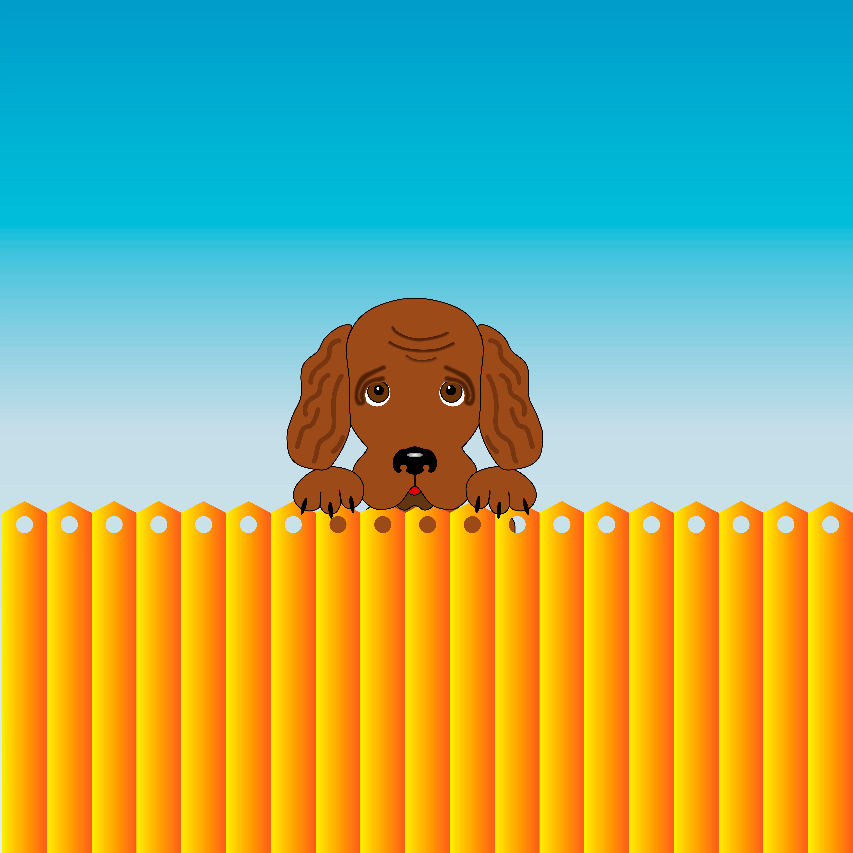

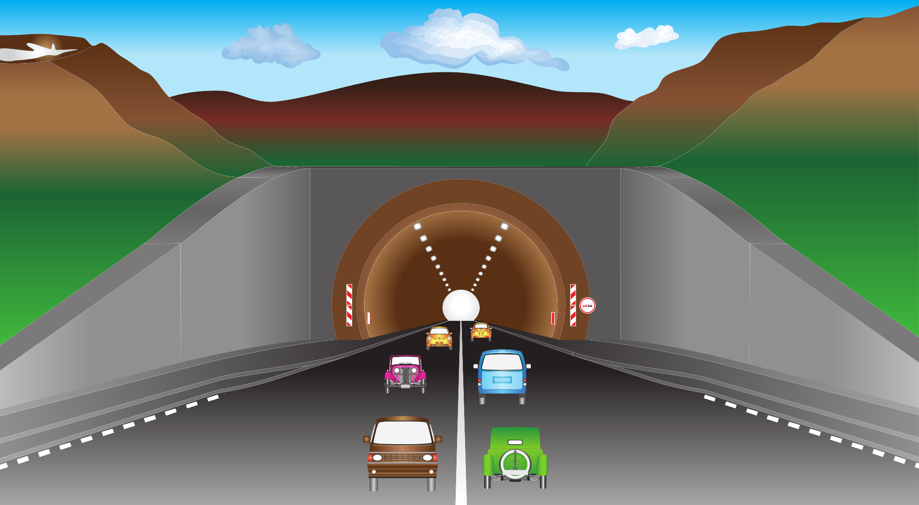
Citizenship of Preposition Practice
The butterfly is above the tree .
The car drove through the tunnel.
The pillow is on the chair.
The dog is behind the fence.
Notes:
Say, “Now it’s time to practice prepositions. I will show you a sentence and you need to tell the preposition in the sentence.”
Click to show the sentence The dog is behind the fence and the picture. Say, “What is the preposition in this sentence?” Wait for the student to answer. Click for behind to be highlighted. Say, “yes, behind is the preposition. Click for it to disappear.
Click to show the sentence The pillow is on the chair and the picture. Say, “What is the preposition in this sentence?” Wait for the student to answer. Click for on to be highlighted. Say, “yes, on is the preposition. Click for it to disappear.
Click to show the sentence The butterfly is above the tree and the picture. Say, “What is the preposition in this sentence?” Wait for the student to answer. Click for above to be highlighted. Say, “yes, above is the preposition.
Click to show the sentence The car drove through the tunnel and the picture. Say, “What is the preposition in this sentence?” Wait for the student to answer. Click for through to be highlighted. Say, “yes, through is the preposition.” Click for it to disappear.
Say, “You will need a whiteboard and whiteboard marker or a piece of paper and a pencil for the next activity. If you do not have it, go grab it now.”

Slide 5
Visa for Vocabulary Practice
Word Bank
pause
brief
disease
actual
cling
continent
an abnormal bodily condition of a living plant or animal that interferes with functioning
one of the great divisions of land on the globe
existing in fact and not just a possibility, real
to stick to as if glued
not very long, short
a temporary stop or rest
Notes:
Say, “Now we are going to practice our vocabulary words.”
Click to show the vocabulary word bank. Say, “These are our vocabulary words from this week’s story. Can you read them to me?” Student will read the following vocabulary words. (pause, actual, continent, disease, brief, cling)
Say, “I am going to show you a definition and I want you to write the vocabulary word on your whiteboard and then hold it up for me to see.”
Click to show the definition not very long, short. Say, “What is the correct vocabulary word for not very long, short.” Wait for the student to write the vocab word. If correct say, “yes, brief is correct.” If incorrect repeat the definition and have them try again. Click for the definition to disappear and for brief to get a line through it.
Click to show the definition one of the great divisions of land on the globe. Say, “What is the correct vocabulary word for one of the great divisions of land on the globe.” Wait for the student to write the vocab word. If correct say, “yes, continent is correct.” If incorrect repeat the definition and have them try again. Click for the definition to disappear and for continent to get a line through it.
Click to show the definition a temporary stop or rest. Say, “What is the correct vocabulary word for a temporary stop or rest.” Wait for the student to write the vocab word. If correct say, “yes, pause is correct.” If incorrect repeat the definition and have them try again. Click for the definition to disappear and for pause to get a line through it.
Click to show the definition to stick to as if glued. Say, “What is the correct vocabulary word for to stick to as if glued.” Wait for the student to write the vocab word. If correct say, “yes, cling is correct.” If incorrect repeat the definition and have them try again. Click for the definition to disappear and for cling to get a line through it.
Click to show the definition an abnormal bodily condition of a living plant or animal that interferes with functioning. Say, “What is the correct vocabulary word for an abnormal bodily condition of a living plant or animal that interferes with functioning.” Wait for the student to write the vocab word. If correct say, “yes, disease is correct.” If incorrect repeat the definition and have them try again. Click for the definition to disappear and for disease to get a line through it.
Click to show the definition existing in fact and not just a possibility, real. Say, “What is the correct vocabulary word for existing in fact and not just a possibility, real.” Wait for the student to write the vocab word. If correct say, “yes, actual is correct.” If incorrect repeat the definition and have them try again. Click for actual to get a line through it.

Slide 6
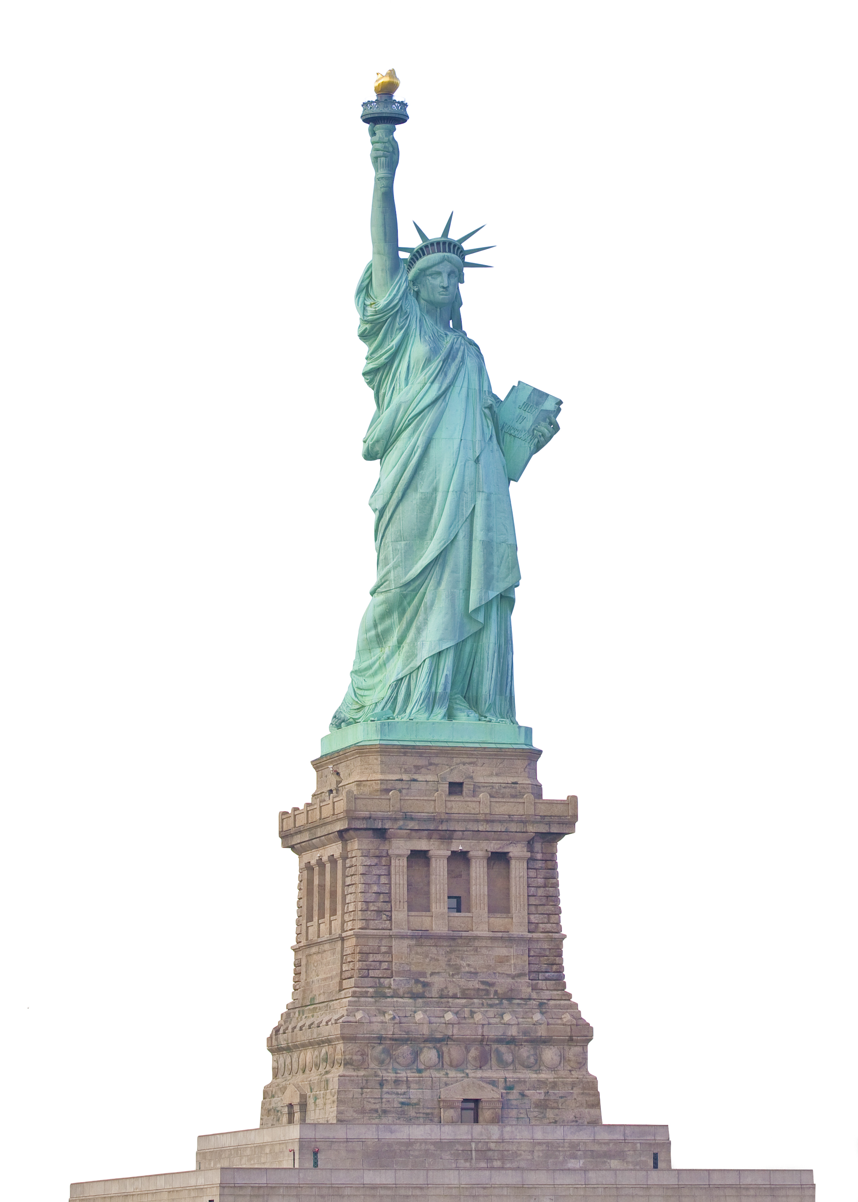
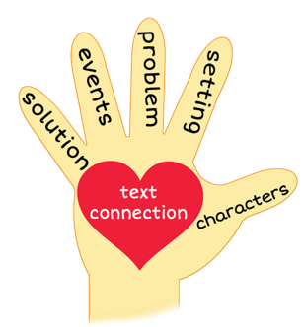
5 Finger Retell
Notes:
Say, “This week you read the story Lawrence’s Journey to America. Using the 5 finger retell strategy, can you tell me about the story.
Say, “Hold up your thumb, tell me the characters.” (Lawrence and his family)
Say, “Hold up your pointer, tell me the setting.” (A boat)
Say, “Hold up your tall finger, tell me the problem.” (Lawrence and his father had a long. difficult trip on the boat to America)
Say, “Hold up your ring finger, tell me the events.” (The room on the boat was very, crowded, it began to smell, people spoke many different languages, it was loud, messy and dirty, there was a bad storm, people got sick) The student does not need to name all of these events. They need to be able to tell at least 3 events from the story.
Say, “Hold up your little finger, tell me the ending/solution.” (They saw the Statue of Liberty and arrived at Ellis Island. They found Papa’s brother. He had come to get them and take them to his home. It was the beginning of their new life in their new country.)
Say, “Make a heart with your fingers, do you have any family members that came to America from a different country?” (answers will vary)

Slide 7
Q & A
Any Questions?

