Slide 1
Attraction
Magnetic Words
Notes:
Say, “Today we will be pulled into a magnetic review. We will review suffixes less and ful, types of sentences, our vocabulary words, text features, and find the main idea and details of the story Magnet Fun.”

Slide 2


Gravitational Suffix less and ful Review
less
ful
means full of
means without
colorful
colorless
Notes:
Say, “Today we are going to review the suffixes less and ful.”
Click to show less and definition. Say, “less means without” Click to show the picture and the word colorless. Say, “colorless means without color.” Click for it to disappear.
Click to show ful and the definition. Say, ful means full of.” Click to show the picture and the word colorful. Say, “colorful means full of color.”

Slide 3
Focus on Suffixes less and ful Practice
The student who picked up the books was very help___.
The brave knight who fought the dragon was fear____.
Opera singers have very power____.
The pizza was awful, and the cheese was taste____.
ful
less
ful
less
ful
less
Notes:
Say, “Let’s practice choosing the correct suffix for the base word. I will show you a sentence with the base word missing the suffix. You need to decide which suffix fits the best.”
Click to show the sentence The pizza was awful, and the cheese was taste____. and the choices ful and less. Say, “The pizza was awful, and the cheese was taste____. Which suffix would you put at the end of taste so that it makes sense in the sentence?” Wait for the student to answer. Click for less to appear in the blank and to be circled. Say, “yes, you would add less to taste to make tasteless.” Click to have the sentence disappear.
Click to show the sentence Opera singers have very power____ voices. Say, “Opera singers have very power____ voices. Which suffix would you put at the end of power so that it makes sense in the sentence?” Wait for the student to answer. Click for ful to appear in the blank and to be circled. Say, “yes, you would add ful to power to make powerful.” Click to have the sentence disappear.
Click to show the sentence The student who picked up the books was very help___. Say, “The student who picked up the books was very help___. Which suffix would you put at the end of help so that it makes sense in the sentence?” Wait for the student to answer. Click for ful to appear in the blank and to be circled. Say, “yes, you would add ful to help to make helpful.” Click to have the sentence disappear.
Click to show the sentence The brave knight who fought the dragon was fear____. Say, “The brave knight who fought the dragon was fear____. Which suffix would you put at the end of fear so that it makes sense in the sentence?” Wait for the student to answer. Click for less to appear in the blank and to be circled. Say, “yes, you would add less to fear to make fearless.”

Slide 4
Drawn to Types of Sentences Review
Exclamatory sentence
Declarative sentence
Interrogative sentence
makes a statement
makes an exclamation
asks a question
tells you something
shows strong feeling
What store did Bella go to?
Bella went to the store.
I love that store!
Notes:
Say, “Now we are going to review types of sentences. There are 3 types of sentences; declarative, interrogative, and exclamatory.”
Click to show the word declarative sentence and the definition. Say, “A declarative sentence makes a statement. It tells you something.” Click to show the sentence. Say, “Bella went to the store. This sentence is telling you what Bella did. Declarative sentences end in a period. Click for it to disappear.
Click to show the word interrogative sentence and the definition. Say, “An interrogative sentence asks a question.” Click to show the sentence. Say, “What store did Bella go to? This sentence is asking you what store she went to. Interrogative sentences end in a question mark. Click for it to disappear.
Click to show the word exclamatory sentence and the definition. Say, “An exclamatory sentence makes an exclamation. It shows strong feeling.” Click to show the sentence. Say, “I love that store! This sentence is showing you how I feel about that store. Exclamatory sentences end in an exclamation mark.

Slide 5
Magnitude of Types of Sentence Practice
!
Today will be a great day
.
?
?
.
!
Where is your homework
What is the date today
I have two pets
Oh no, I forgot my math book
I read a book for 15 minutes
declarative
interrogative
exclamatory
Notes:
Say, “Now it is time to practice types of sentences. I will show you a sentence without its punctuation and you need to tell me if it is declarative, interrogative, or exclamatory.”
Click to show the sentence Oh no, I forgot my math book and choices. Say, “What type of sentence is this and what punctuation goes at the end of the sentence?” Wait for the student to answer. Click for exclamatory to be circled and the exclamation point to appear at the end of the sentence. Say, “yes, this is an exclamatory sentence, and an exclamation point goes at the end.” Click for the sentence and answers to disappear.
Click to show the sentence I read a book for 15 minutes Say, “What type of sentence is this and what punctuation goes at the end of the sentence?” Wait for the student to answer. Click for declarative to be circled and the period to appear at the end of the sentence. Say, “yes, this is a declarative sentence, and a period goes at the end.” Click for the sentence and answers to disappear.
Click to show the sentence What is the date today Say, “What type of sentence is this and what punctuation goes at the end of the sentence?” Wait for the student to answer. Click for interrogative to be circled and the question mark to appear at the end of the sentence. Say, “yes, this is an interrogative sentence, and a question mark goes at the end.” Click for the sentence and answers to disappear.
Click to show the sentence I have two pets Say, “What type of sentence is this and what punctuation goes at the end of the sentence?” Wait for the student to answer. Click for declarative to be circled and the period to appear at the end of the sentence. Say, “yes, this is a declarative sentence, and a period goes at the end.” Click for the sentence and answers to disappear.
Click to show the sentence Today will be a great day Say, “What type of sentence is this and what punctuation goes at the end of the sentence?” Wait for the student to answer. Click for exclamatory to be circled and the exclamation point to appear at the end of the sentence. Say, “yes, this is an exclamatory sentence, and an exclamation point goes at the end.” Click for the sentence and answers to disappear.
Click to show the sentence Where is your homework Say, “What type of sentence is this and what punctuation goes at the end of the sentence?” Wait for the student to answer. Click for interrogative to be circled and the question mark to appear at the end of the sentence. Say, “yes, this is an interrogative sentence, and a question mark goes at the end.”

Slide 6
Electric Vocabulary Review
magnetism is the property of attracting certain metals or producing a magnetic field
magnet is a piece of some material that is able to attract iron
attract means to pull to or toward oneself or itself
observe means to watch carefully
scatter means to cause to separate widely
repel means to push or drive back
Notes:
Say, “Now it’s time to review your vocabulary words.”
Click to show the vocabulary word and its definition. Say, “observe means to watch carefully. Click for it to disappear.
Click to show the vocabulary word and its definition. Say, “scatter means to cause to separate widely. Click for it to disappear.
Click to show the vocabulary word and its definition. Say, “magnetism is the property of attracting certain metals or producing a magnetic field. Click for it to disappear.
Click to show the vocabulary word and its definition. Say, “a magnet is a piece of some material that is able to attract iron. Click for it to disappear.
Click to show the vocabulary word and its definition. Say, “attract means to pull to or toward oneself or itself. Click for it to disappear.
Click to show the vocabulary word and its definition. Say, “repel means to push or drive back.

Slide 7
Physics of Vocabulary
Word Bank
magnet
scatter
repel
attract
magnetism
observe
the property of attracting certain metals or producing a magnetic field
to pull to or toward oneself or itself
a piece of some material that is able to attract iron
to push or drive back
to watch carefully
to cause to separate widely
Notes:
Say, “Now let’s practice our vocabulary words. I will read the definition and you have to choose the correct vocabulary word from the box.”
Click to show the vocabulary words.
Click to show the definition. Say, “to cause to separate widely. What is the vocabulary word that goes with this definition?” Wait for the student to respond. Repeat the definition if necessary. Click for a line to go through scatter. Say, “yes, scatter means to cause to separate widely.” Click for the definition to disappear.
Click to show the definition. Say, “to watch carefully. What is the vocabulary word that goes with this definition?” Wait for the student to respond. Repeat the definition if necessary. Click for a line to go through observe. Say, “yes, observe means to watch carefully.” Click for the definition to disappear.
Click to show the definition. Say, “a piece of some material that is able to attract iron. What is the vocabulary word that goes with this definition?” Wait for the student to respond. Repeat the definition if necessary. Click for a line to go through magnet. Say, “yes, a magnet is a piece of some material that is able to attract iron.” Click for the definition to disappear.
Click to show the definition. Say, “the property of attracting certain metals or producing a magnetic field. What is the vocabulary word that goes with this definition?” Wait for the student to respond. Repeat the definition if necessary. Click for a line to go through magnetism.
Say, “yes, magnetism is the property of attracting certain metals or producing a magnetic field.” Click for the definition to disappear.
Click to show the definition. Say, “to push or drive back. What is the vocabulary word that goes with this definition?” Wait for the student to respond. Repeat the definition if necessary. Click for a line to go through repel. Say, “yes, repel means to push or drive back.” Click for the definition to disappear.
Click to show the definition. Say, “to pull to or toward oneself or itself. What is the vocabulary word that goes with this definition?” Wait for the student to respond. Repeat the definition if necessary. Click for a line to go through attract. Say, “yes, attract means to pull to or toward oneself or itself.”

Slide 8
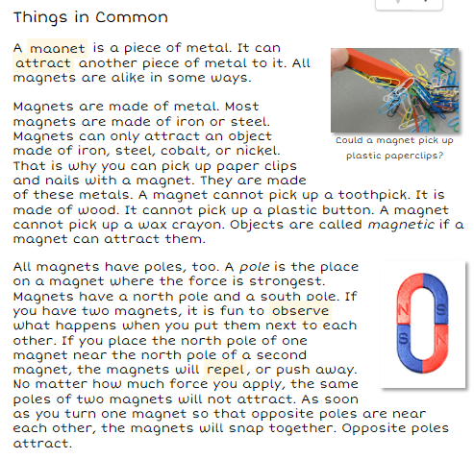
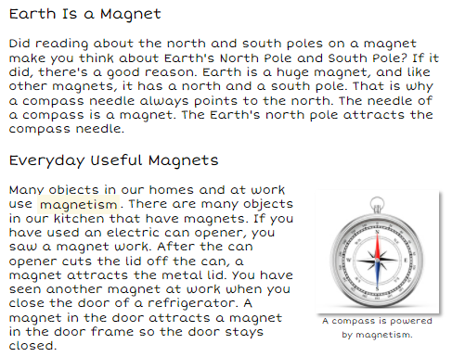

Induction of Text Feature
All Shapes and Sizes
Magnets come in all shapes and sizes. They can be round or square. Some have a horseshoe shape. Some are shaped like donuts. Some magnets are tiny. Some are huge. Magnets can be painted different colors, too.
Caption
Heading
a caption is a word, phrase, or sentence underneath an image that give more information about it
The purpose of a heading is to let the reader know what the next section will be about
A compass is powered by magnetism.
Notes:
Say, “Today we are going to review text features and see if we can find them in the text you read Magnet Fun.”
Click to show the word heading and the definition. Say, “The purpose of a heading is to let the reader know what the next section will be about.” Click for it to disappear.
Click to show a paragraph with a heading
All Shapes and Sizes
Magnets come in all shapes and sizes. They can be round or square. Some have a horseshoe shape. Some are shaped like donuts. Some magnets are tiny. Some are huge. Magnets can be painted different colors, too.
Say, “What is the heading of this paragraph?” Wait for the student to answer. Say, “yes, it is All Shapes and Sizes. What do you think this paragraph is about?” Wait for the student to answer. Say, “yes, it is about magnets that come in all different shapes and sizes. Click for it to disappear.
Click to show the word caption and the definition. Say, “a caption is a word, phrase, or sentence underneath an image that give more information about it.”
Click to show a picture with a caption. Say, “What is the caption for this picture?” Wait for the student to answer. Say, “yes, it giving you the information about the picture that a compass is powered by magnetism.” Click for it to disappear.
Click to show a page from the text Magnet Fun. Say, “What text features do you see on this page?” Wait for the student to answer. Say, “yes, there is a heading and a caption. Click for it to disappear.
Click to show a page from the text Magnet Fun. Say, “What text features do you see on this page?” Wait for the student to answer. Say, “yes, there are 2 headings and a caption.

Slide 9
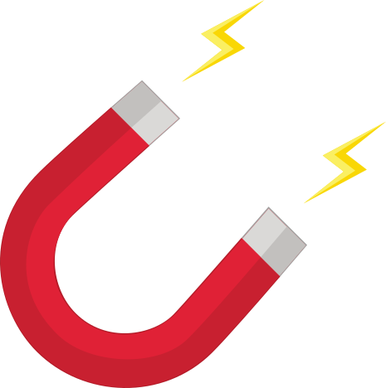
Inviting Main Idea and Details
Notes:
Click to show the picture of the magnet. Say, “This week you read the story Magnet Fun. This story is a non-fiction story. Do you remember what the main idea and details are of a story?” Wait for the student to answer. Say, “Correct, the main idea is what the story is mostly about, and the details support the main idea.”
Say, “What is the main idea of this story? (The main idea of the story is we are learning about magnets)
Say, “What are some details that explain more about the main idea?” (There are many details in this text. The student should name 3)
Here are some examples of details from the text:
Magnets come in all shapes and sizes.
Magnets are made of metal.
Magnets can only attract an object made of iron, steel, cobalt, or nickel.
All magnets have poles and opposite poles attract.
Earth is a huge magnet, and like other magnets, it has a north and a south pole.

Slide 10
Q & A
Any Questions?

