Slide 1
Electricity
Power of Words
Notes:
Say, “Time for us to review the power of words. We will review changing y to i, formal and informal language, our vocabulary words, and find the main idea and details of the story Ben Franklin.”

Slide 2
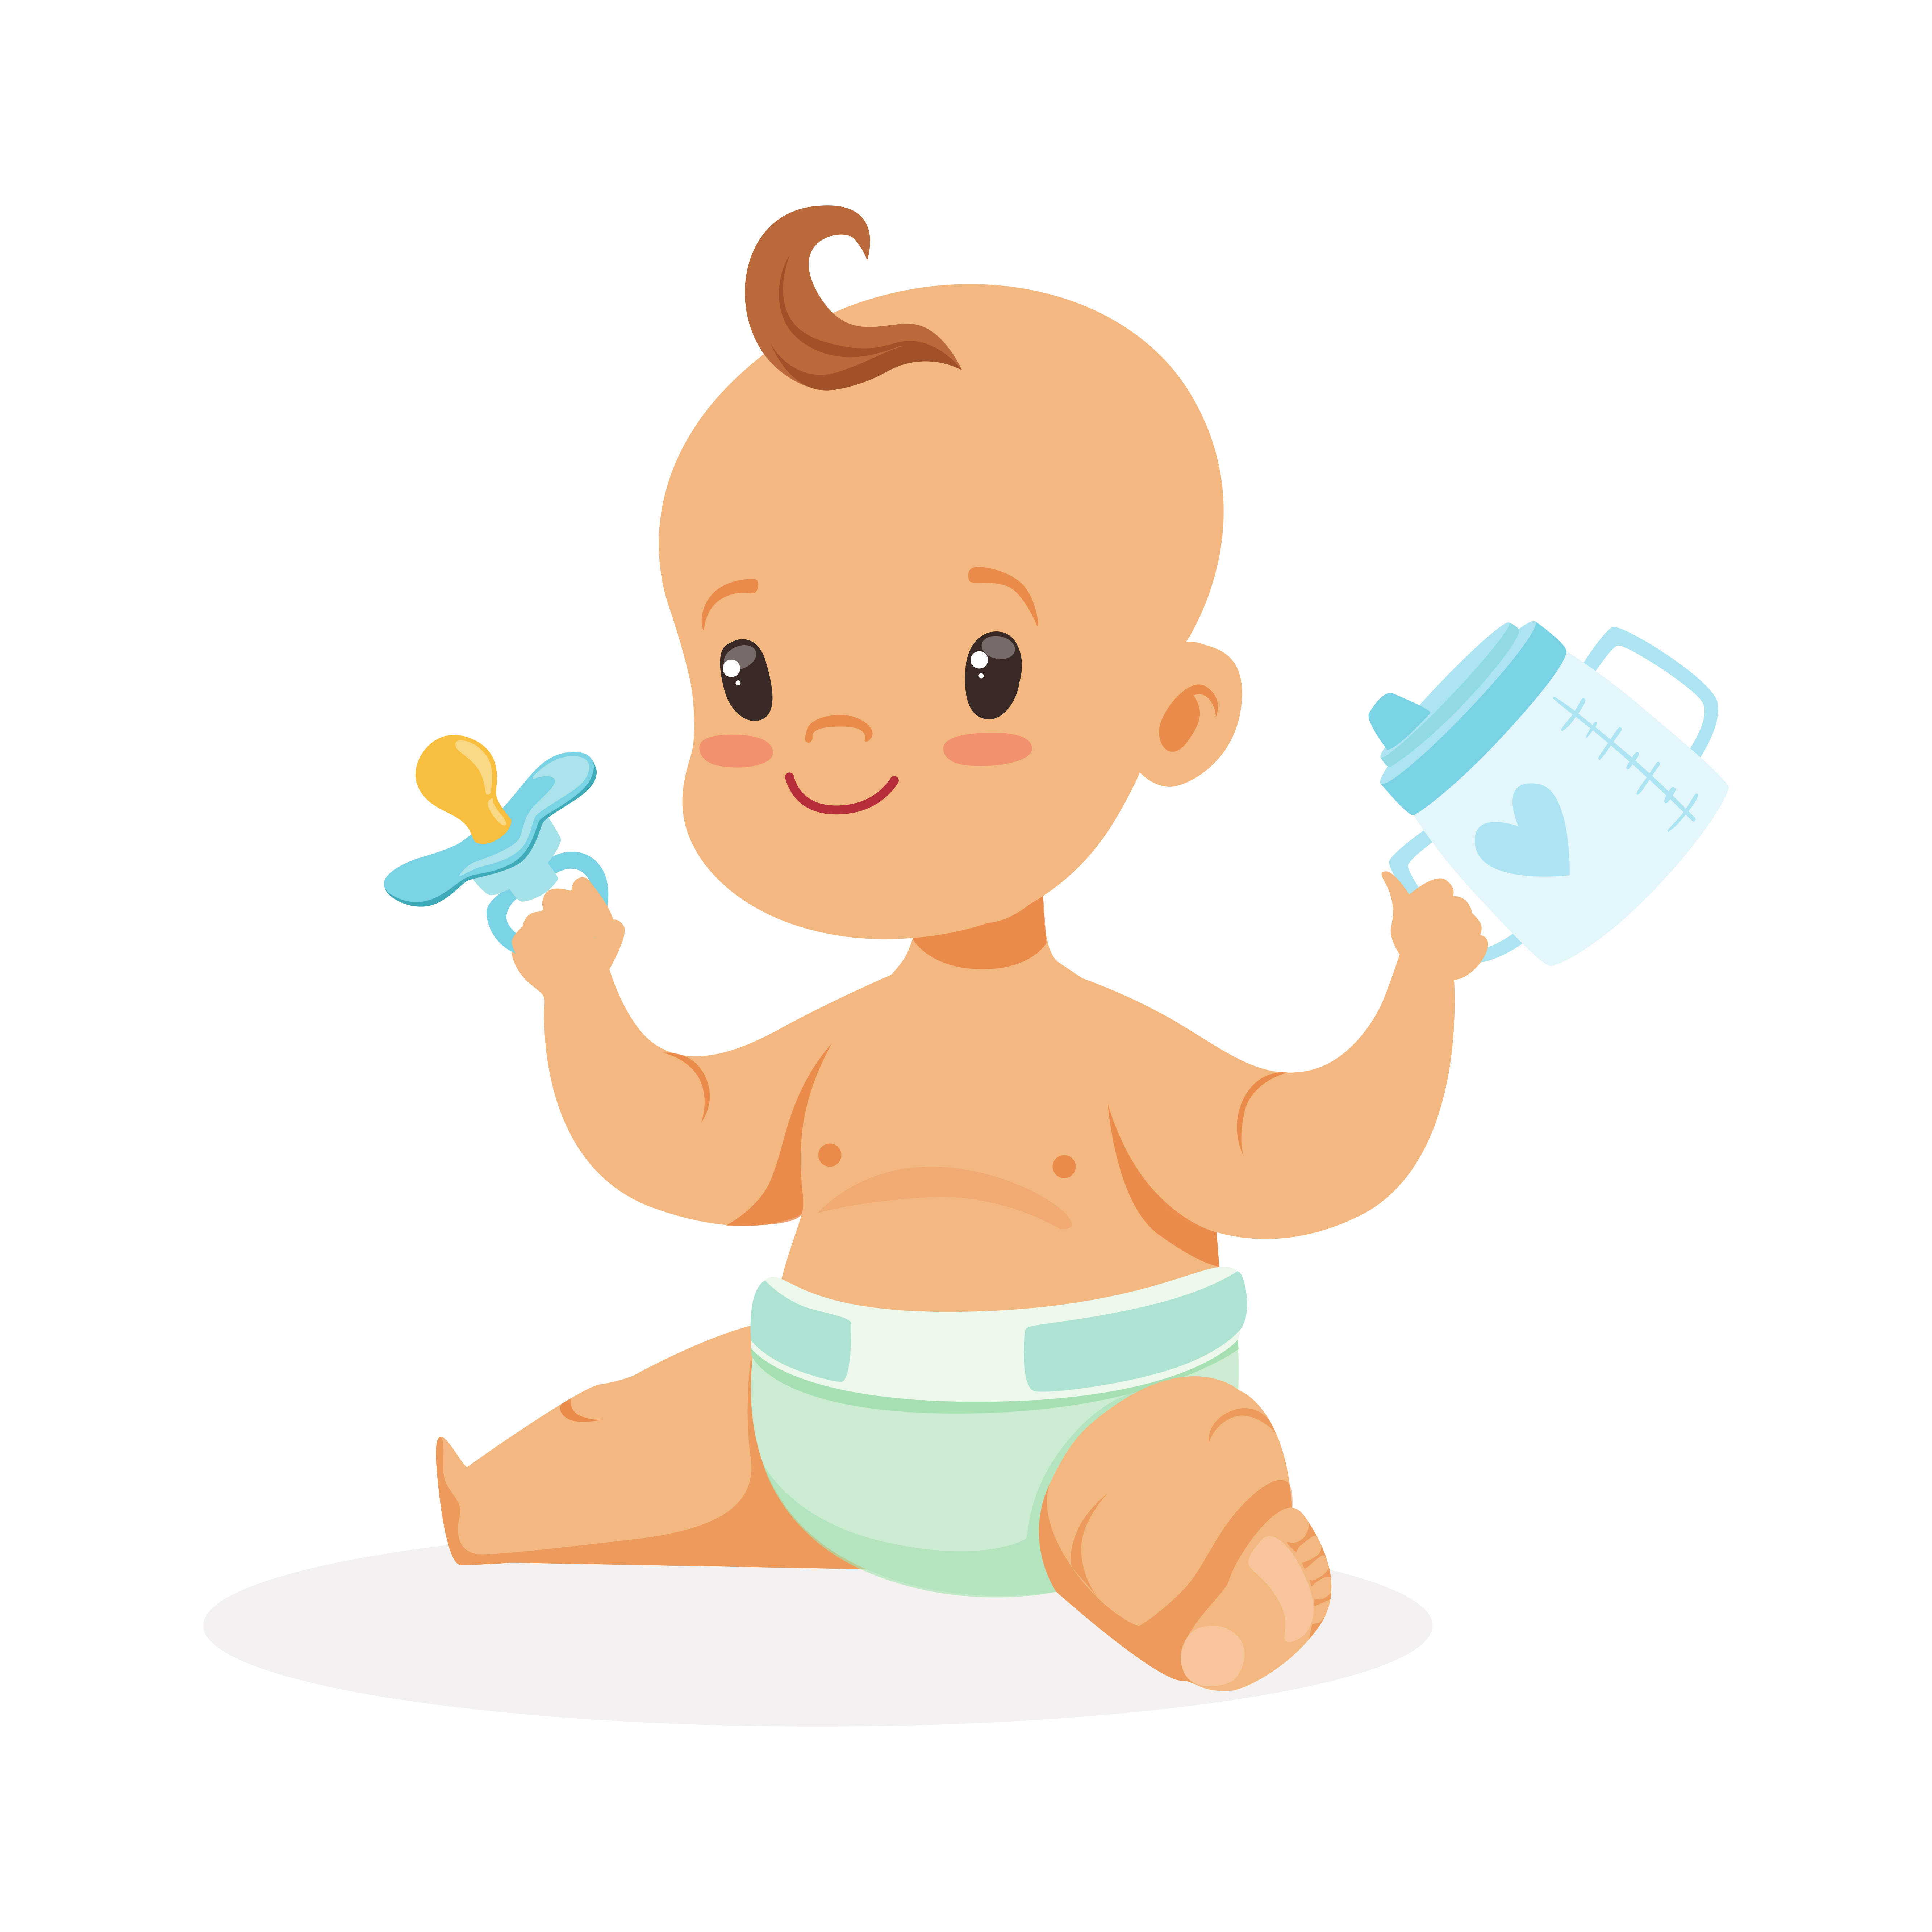

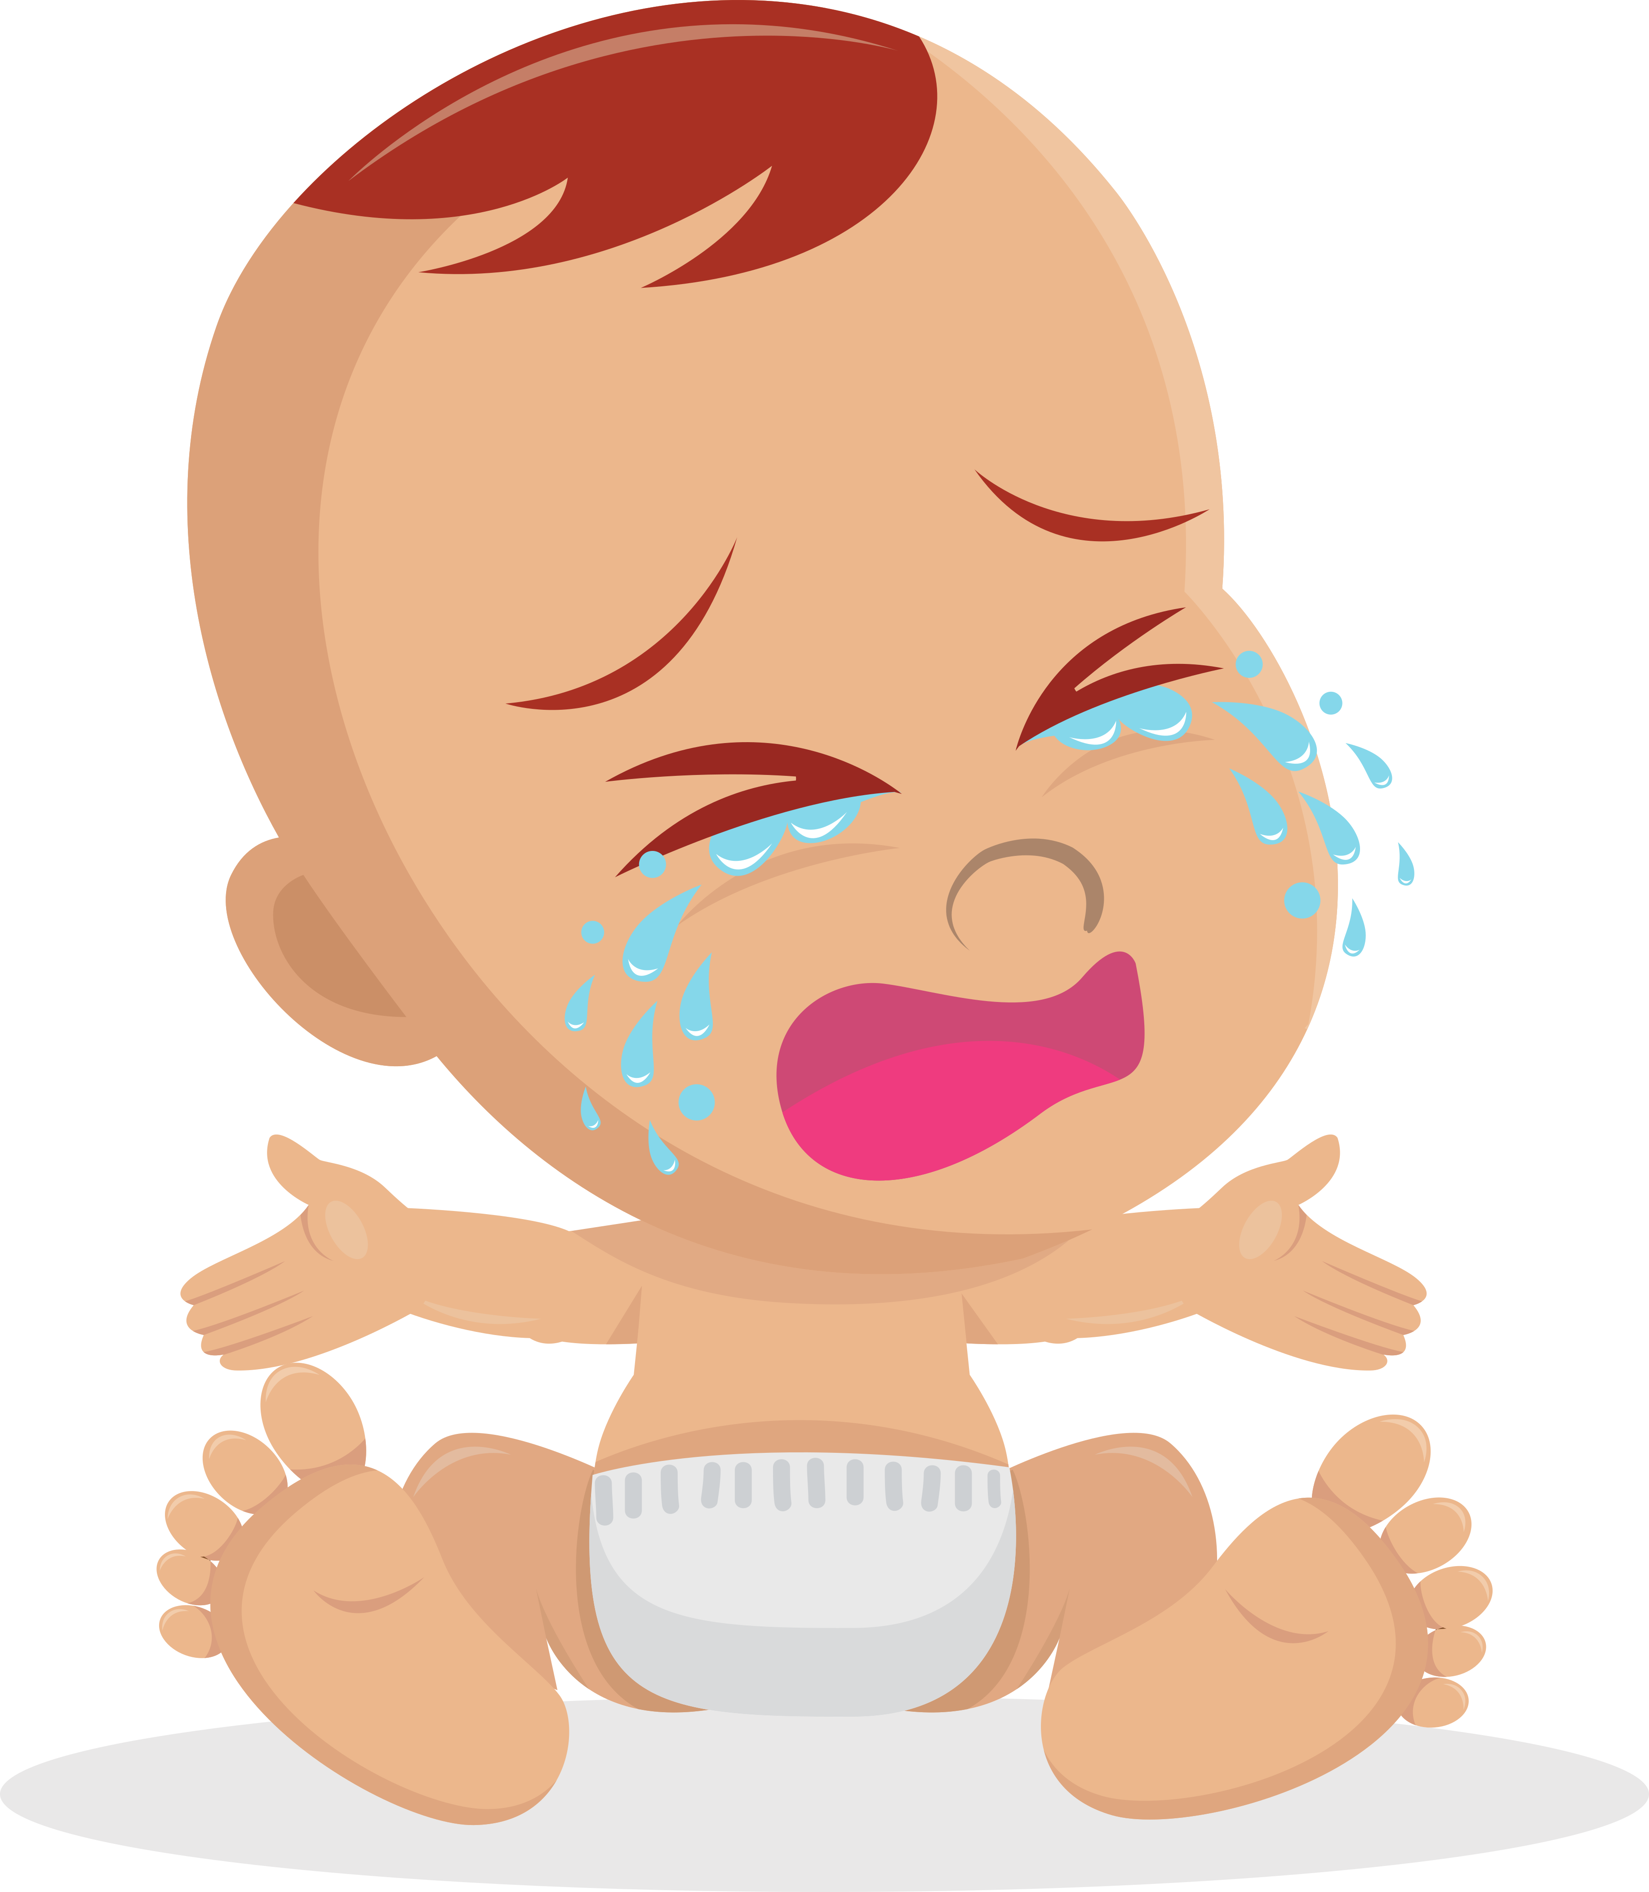
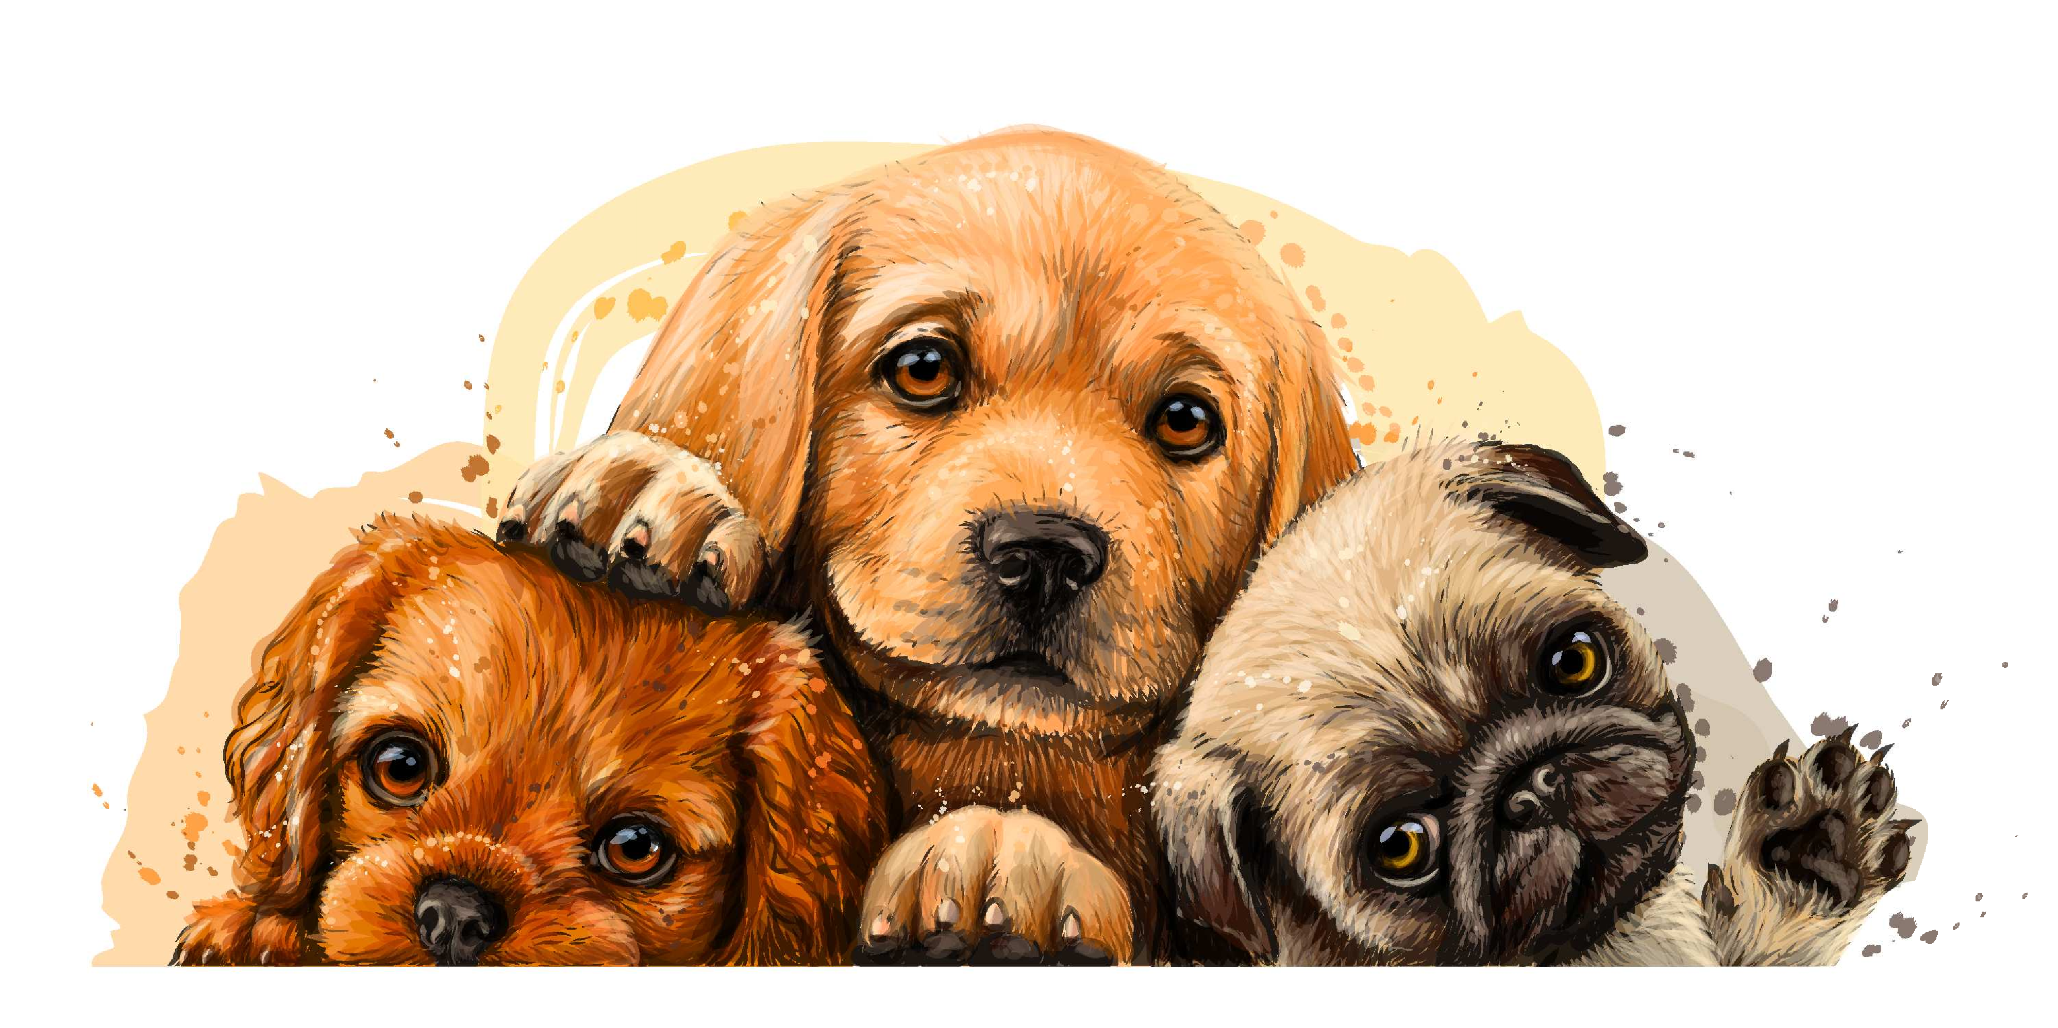
Energy to Change y to i Review
When the letters before a ‘y’ is a consonant, change the ‘y’ to an i and add the suffix es or ed.
y
pupp
y
cr
ies
ied
Notes:
Shutterstock Image ID: 1373065391, 1561050611, 1081927841, 399194584
Say, “Today, we are going to review changing y to i before adding the suffixes es and ed.”
Click to show definition of changing y to i. “When the letters before a ‘y’ is a consonant, change the ‘y’ to an i and add the suffix es or ed.” Click for it to disappear.
Click to show the word puppy and the picture of a puppy. Say, “This is the word puppy. There is one puppy” Click to show the y change to an i and the es added and a picture of multiple puppies. Say, “When you change the y to an i and add es it creates the word puppies Adding the suffix es changes the word to mean more than one.”
Click to show the word cry and a picture of a baby crying. Say, “This is the word cry.” Click to show the y change to an i and the ed added and a picture of the baby not crying. Say, “When you change the y to an i and add ed it creates the word cried. Adding the suffix ed changes the word to mean it happened in the past.”

Slide 3
Flip the Switch Changing y to i Practice
city + es
A. cites
B. cities
C. cityes
Notes:
Say, “Now it’s time to practice changing our y to an i and adding es or ed.”
Click to show the word city + es and the choices. Say, “Which one of these (A, B, or C) correctly adds es to city?” Wait for the student to respond. Click to highlight the correct answer. Say, “yes, the answer is cities. Let’s try again!”

Slide 4
Plug Into Changing y to i Practice
hurry + ed
A. hurried
B. hurred
C. hurryed
Notes:
Click to show the word hurry + ed and the choices. Say, “Which one of these (A, B, or C) correctly adds ed to hurry?” Wait for the student to respond. Click to highlight the correct answer. Say, “yes, the answer is hurried. Let’s try again!”

Slide 5
Current of Changing y to i Practice
carry + ed
A. carryed
B. carried
C. carreed
Notes:
Click to show the word carry + ed and the choices. Say, “Which one of these (A, B, or C) correctly adds ed to carry?” Wait for the student to respond. Click to highlight the correct answer. Say, “yes, the answer is carried. Let’s try again!”

Slide 6
Charged Up for a Changing y to i Practice
penny + es
A. pennees
B. pennyes
C. pennies
Notes:
Click to show the word penny + es and the choices. Say, “Which one of these correctly adds es to penny?” Wait for the student to respond. Click to highlight the correct answer. Say, “yes, the answer is pennies.

Slide 7
Wired Formal and Informal Language Review
Formal Language
Informal Language
is proper, it is used when talking to an adult or a person of authority
it includes correct spelling and punctuation when written
informal language is casual, it is used when talking to friends
it includes incorrect spelling and punctuation when written
How are you?
Yo! What’s up?
Notes:
Say, “Today we are going to review formal and informal language.”
Click to show the word formal language and the definition. Say, formal language is proper, it is used when talking to an adult or a person of authority, and it includes correct spelling and punctuation when written.” Click to show the example. Say, “How are you? This is an example of formal language.”
Click to show the word informal language and the definition. Say, informal language is casual, it is used when talking to friends, and it includes incorrect spelling and punctuation when written.” Click to show the example. Say, “Yo! What’s up? This is an example of informal language.”

Slide 8
Light Up Informal and Formal Language Practice
formal
informal
We are going to relax.
I’m gonna eat a snack.
We really enjoy these things.
Uh-huh, we’re gonna chill.
This stuff is awesome.
I am hungry for a snack .
I’m gonna eat a snack.
Uh-huh, we’re gonna chill.
We are going to relax.
I am hungry for a snack .
We really enjoy these things.
This stuff is awesome.
Notes:
Say, “Now it is time to practice informal and formal language.”
Click for the chart and choices to appear. Say, “is I’m gonna eat a snack formal or informal?” Wait for the student to answer. Click to move it under informal. Say, “yes, it is informal.”
Say, “is We are going to relax formal or informal?” Wait for the student to answer. Click to move it under formal. Say, “yes, it is formal.”
Say, “is We really enjoy these things formal or informal?” Wait for the student to answer. Click to move it under formal. Say, “yes, it is formal.”
Say, “is Uh-huh, we’re gonna chill formal or informal?” Wait for the student to answer. Click to move it under informal. Say, “yes, it is informal.”
Say, “I am hungry for a snack formal or informal?” Wait for the student to answer. Click to move it under formal. Say, “yes, it is formal.”
Say, “is This stuff is awesome formal or informal?” Wait for the student to answer. Click to move it under informal. Say, “yes, it is informal.”
Say, “You will need a whiteboard and whiteboard marker or a piece of paper and a pencil for the next activity. If you do not have one, please go and get it.”

Slide 9
A Volt of Vocabulary
Word Bank
successful
future
theory
grasp
advantage
impact
a general principle or set of principles that explains facts or events of the natural world
gaining or having gained wealth, respect, or fame
something that helps the one it belongs to
to comprehend or understand
coming after the present
to have a strong effect on
Notes:
Say, “Now we are going to practice our vocabulary words.”
Click to show the vocabulary word bank. Say, “These are our vocabulary words from this week’s story. Can you read them to me?” Student will read the following vocabulary words. (advantage, impact, grasp, future, theory, successful)
Say, “I am going to show you a definition and I want you to write the vocabulary word on your whiteboard and then hold it up for me to see.”
Click to show the definition coming after the present. Say, “What is the correct vocabulary word for coming after the present.” Wait for the student to write the vocab word. If correct say, “yes, future is correct.” If incorrect repeat the definition and have them try again. Click for the definition to disappear and future to get a line through it.
Click to show the definition to comprehend or understand. Say, “What is the correct vocabulary word for to comprehend or understand.” Wait for the student to write the vocab word. If correct say, “yes, grasp is correct.” If incorrect repeat the definition and have them try again. Click for the definition to disappear and grasp to get a line through it.
Click to show the definition something that helps the one it belongs to. Say, “What is the correct vocabulary word for something that helps the one it belongs to.” Wait for the student to write the vocab word. If correct say, “yes, advantage is correct.” If incorrect repeat the definition and have them try again. Click for the definition to disappear and advantage to get a line through it.
Click to show the definition gaining or having gained wealth, respect, or fame. Say, “What is the correct vocabulary word for gaining or having gained wealth, respect, or fame.” Wait for the student to write the vocab word. If correct say, “yes, successful is correct.” If incorrect repeat the definition and have them try again. Click for the definition to disappear and successful to get a line through it.
Click to show the definition to have a strong effect on. Say, “What is the correct vocabulary word for to have a strong effect on.” Wait for the student to write the vocab word. If correct say, “yes, impact is correct.” If incorrect repeat the definition and have them try again. Click for the definition to disappear and impact to get a line through it.
Click to show the definition a general principle or set of principles that explains facts or events of the natural world. Say, “What is the correct vocabulary word for a general principle or set of principles that explains facts or events of the natural world.” Wait for the student to write the vocab word. If correct say, “yes, theory is correct.” If incorrect repeat the definition and have them try again. Click for the definition to disappear and theory to get a line through it.

Slide 10
Movement of Main Idea and Details
Main Idea
In the 1750s, Ben became a great leader for the colonies
Benjamin Franklin
In the 1730s, Ben started the first library
Benjamin Franklin made early discoveries about electricity
Detail
Detail
In the 1730s, Ben started the first library
In the 1750s, Ben became a great leader for the colonies
Detail
Benjamin Franklin
Ben was a successful inventor
Detail
Ben was a successful inventor
Benjamin Franklin made early discoveries about electricity
Notes:
Say, “This week you read the story Benjamin Franklin. This story is a non-fiction story. Do you remember what the main idea and details are of a story?” Wait for the student to answer what the main idea and details of a story are. Say, “Correct, the main idea is what the story is mostly about, and the details support the main idea.”
Say, Today we are going to move the main idea and details into the correct part of the graphic organizer. First, I’m going to read to you your answer choices.”
•In the 1750s, Ben became a great leader for the colonies
•Benjamin Franklin made early discoveries about electricity
•In the 1730s, Ben started the first library
•Benjamin Franklin
•Ben was a successful inventor
Say, “What is the main idea of the story in? Once the student tells you the main idea, click to move it to the graphic organizer. (Main Idea: Ben Franklin)
Say, “What is the detail from the story in?” Once the student tells you the detail, click to move it to the graphic organizer. They can name them in any order. (Details: In the 1750s, Ben became a great leader for the colonies, Benjamin Franklin made early discoveries about electricity, In the 1730s, Ben started the first library, Ben was a successful inventor)
Say, “What is the detail from the story in?” Once the student tells you the detail, click to move it to the graphic organizer. They can name them in any order. (Details: In the 1750s, Ben became a great leader for the colonies, Benjamin Franklin made early discoveries about electricity, In the 1730s, Ben started the first library, Ben was a successful inventor)
Say, “What is the detail from the story in?” Once the student tells you the detail, click to move it to the graphic organizer. They can name them in any order. (Details: In the 1750s, Ben became a great leader for the colonies, Benjamin Franklin made early discoveries about electricity, In the 1730s, Ben started the first library, Ben was a successful inventor)
Say, “What is the detail from the story in?” Once the student tells you the detail, click to move it to the graphic organizer. They can name them in any order. (Details: In the 1750s, Ben became a great leader for the colonies, Benjamin Franklin made early discoveries about electricity, In the 1730s, Ben started the first library, Ben was a successful inventor)

Slide 11
Q & A
Any Questions?

