Slide 1
Rolling Objects
Get Things Rolling with a Review
Notes:
Say, “Let’s get things rolling with a review. We will review double consonants, analogies, our vocabulary words, and find the main idea and details of the story The Wheel.”

Slide 2
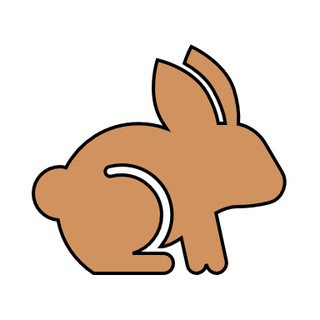

Spinning Double Consonant Review
What is the rabbit rule?
In a two-syllable word, if the first syllable has a short vowel with only one consonant sound between the next vowel, you can double the consonant
rabbit
Notes:
Say, “Today we are going to review the rabbit rule for double consonants.”
Click to show “What is the rabbit rule? “ Say, “What is the rabbit rule?” Click to show the definition. Say, “In a two-syllable word, if the first syllable has a short vowel with only one consonant sound between the next vowel, you can double the consonant.” Click for it to disappear.
Click to show the rabbit picture. Say, “What is this?” Wait for the student to answer. Say, yes, it is a rabbit. Give me a thumbs up if you hear a short vowel in the first syllable.” Wait for the student to give a thumbs up. Click to show the thumbs up icon. Click for it to disappear. Say, “Give me a thumbs up if you hear one consonant between the first vowel and the second vowel.” Wait for the student to give a thumbs up. Click to show the thumbs up icon. Say, “Then you double the middle consonant.” Click to show the word rabbit. Say, “Let’s practice! You will need a whiteboard and whiteboard marker or a piece of paper and a pencil. If you do not have one, please get it now.”

Slide 3
Whirling Double Consonant
word | divided | 1st syllable | 2nd syllable
happy
hap/py
hap
py
kitten
kit/ten
kit
ten
silly
sil/ly
sil
ly
ladder
lad/der
lad
der
supper
sup/per
sup
per
Notes:
Say, “Now we are going to divide and write the syllables of words with double consonants. I will show you a word, then you will need to divide it, and then write each syllable. Watch, I will do the first one for you.”
Click to show the word happy. Say, “the word is happy.” Click to show the word divided – hap/py. Say, “you divide the word into 2 syllables by putting a line between the 2 p’s.” Click to show hap. Say, “ hap is the 1st syllable.” Click to show py. Say, “py is the 2nd syllable.
Click to show the word kitten. Say, “Divide the word, write the 1st syllable and the 2nd syllable, then hold it up for me to see.” Wait for the student to respond. Click to show the answer.
Click to show the word silly. Say, “Divide the word, write the 1st syllable and the 2nd syllable, then hold it up for me to see.” Wait for the student to respond. Click to show the answer.
Click to show the word ladder. Say, “Divide the word, write the 1st syllable and the 2nd syllable, then hold it up for me to see.” Wait for the student to respond. Click to show the answer.
Click to show the word supper. Say, “Divide the word, write the 1st syllable and the 2nd syllable, then hold it up for me to see.” Wait for the student to respond. Click to show the answer.

Slide 4
Circling Analogies
analogies
bird is to fly as fish is to
swim
meow
sky is to blue as grass is to
green
10
an analogy compares two things that are alike in some way
dog is to bark as cat is to
meow
pencil
ink is to pen as lead is to
pencil
swim
10
green
4 is to 8 as 5 is to
Notes:
Say, “Today we are going to learn about analogies.”
Click to show the word analogies and the definition. Say, “an analogy compares two things that are alike in some way.” Click for it to disappear.
Click for the table and word choices to appear. Say, “I am going to show you an analogy and you need to choose the correct word that completes the analogy.”
Click to show the phrase “bird is to fly as fish is to”. Say, “bird is to fly as fish is to.” Wait for the student to answer. Click to have swim move into the box next to the phrase.
Click to show the phrase “sky is to blue as grass is to”. Say, “sky is to blue as grass is to.” Wait for the student to answer. Click to have green move into the box next to the phrase.
Click to show the phrase “dog is to bark as cat is to”. Say, “dog is to bark as cat is to.” Wait for the student to answer. Click to have meow move into the box next to the phrase.
Click to show the phrase “ink is to pen as lead is to”. Say, “ink is to pen as lead is to.” Wait for the student to answer. Click to have pencil move into the box next to the phrase.
Click to show the phrase “4 is to 8 as 5 is to”. Say, “4 is to 8 as 5 is to.” Wait for the student to answer. Click to have 10 move into the box next to the phrase.

Slide 5
Rotating Vocabulary Practice
invention is something thought up or created
function is the particular purpose for which something is used
ancient is of or relating to a period of time long past
steer is to direct the course or the course of
reverse is bringing about backward movement
enable is to make able
Notes:
Say, “Today we are going to practice our vocabulary words. First, let’s go over the words and definitions.
Click to show steer and the definition. Say, “steer is to direct the course or the course of” Click for it to disappear.
Click to show ancient and the definition. Say, “ancient is of or relating to a period of time long past” Click for it to disappear.
Click to show invention and the definition. Say, “invention is something thought up or created” Click for it to disappear.
Click to show reverse and the definition. Say, “reverse is bringing about backward movement” Click for it to disappear.
Click to show function and the definition. Say, “function is the particular purpose for which something is used” Click for it to disappear.
Click to show enable and the definition. Say, “enable is to make able”

Slide 6
Rotational Vocabulary Practice
creation
invention
allow
enable
reverse
steer
function
purpose
ancient
follow
forward
past
synonym
antonym
Notes:
Say, “Now that we reviewed the definitions of our vocabulary words, let’s practice identifying synonyms and antonyms of those words. I will show you the vocabulary word and another word. You need to tell me whether it is a synonym or an antonym of the vocabulary word. Remember a synonym means the same and an antonym means the opposite.”
Click to show the words function and purpose. Say, “Are these 2 words synonyms or antonyms?” Wait for the student to respond. Click to show the synonym circled. Say, “yes, function and purpose are synonyms.” Click for it to disappear.
Click to show the words ancient and past. Say, “Are these 2 words synonyms or antonyms?” Wait for the student to respond. Click to show the synonym circle. Say, “yes, ancient and past are synonyms.” Click for it to disappear.
Click to show the words steer and follow. Say, “Are these 2 words synonyms or antonyms?” Wait for the student to respond. Click to show the antonym circle. Say, “yes, steer and follow are antonyms.” Click for it to disappear.
Click to show the words reverse and forward. Say, “Are these 2 words synonyms or antonyms?” Wait for the student to respond. Click to show the antonym circle. Say, “yes, reverse and forward are antonyms.” Click for it to disappear.
Click to show the words enable and allow. Say, “Are these 2 words synonyms or antonyms?” Wait for the student to respond. Click to show the synonym circle. Say, “yes, enable and allow are synonyms.” Click for it to disappear.
Click to show the words invention and creation. Say, “Are these 2 words synonyms or antonyms?” Wait for the student to respond. Click to show the synonym circle. Say, “yes, invention and creation are synonyms.”

Slide 7
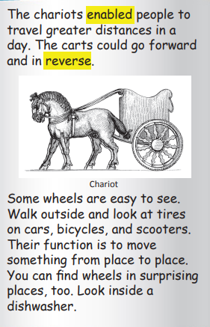
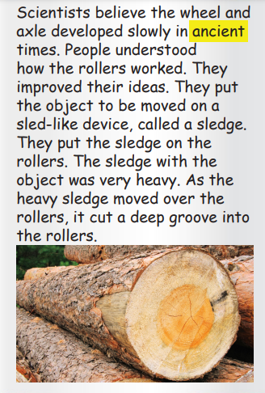
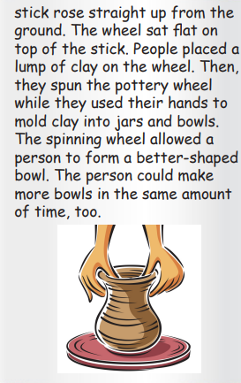

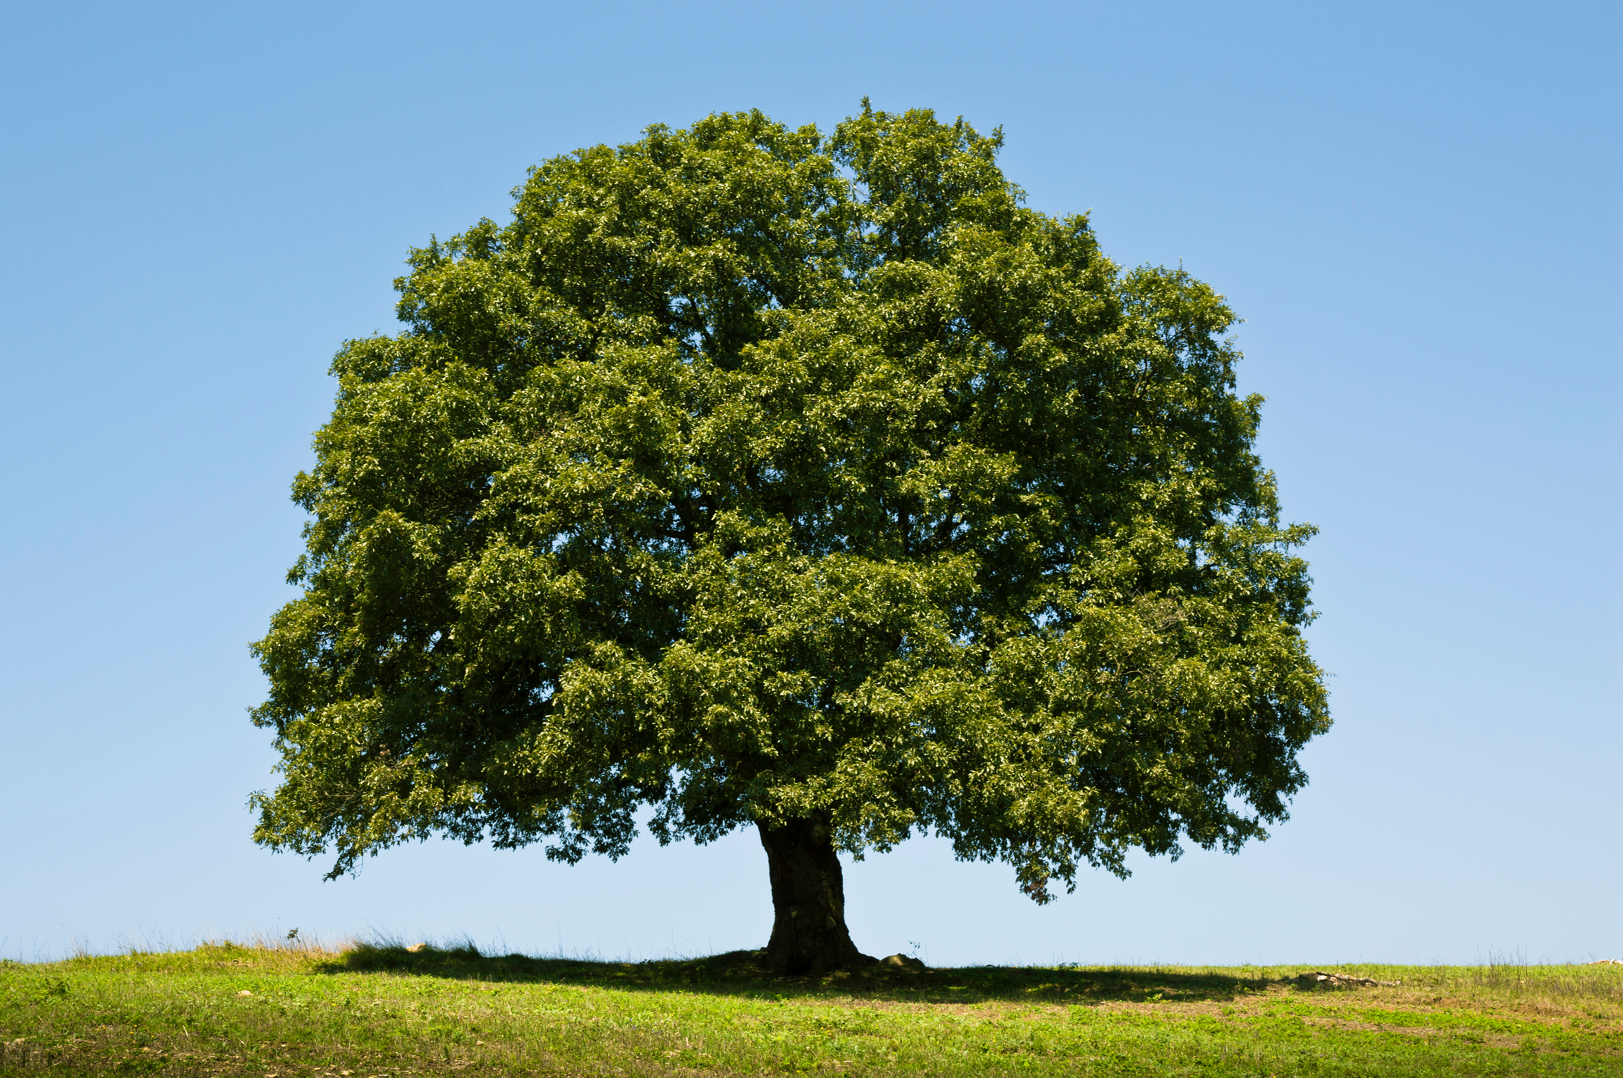
Twirling Text Features
illustration
photograph
Keywords are words in the text that are important. They can be bold, italics, highlighted, or in color.
The chariots enabled people to travel greater distances in a day. The carts could go forward and in reverse.
Notes:
Say, “Today we are going to review text features and see if we can find them in the text you read The Wheel.”
Click to show the word keywords and the definition. Say, “keywords are words in the text that are important. They can be bold, italics, highlighted, or color.” Click to show a paragraph with the words highlighted. Say, “Look at this paragraph. (The chariots enabled people to travel greater distances in a day. The carts could go forward and in reverse.) Can you tell me what words you think are important?” Wait for the student to answer. Say, “yes, enabled and reverse are highlighted so they are important.” Click for it to disappear.
Click to show the word photograph and the example. Say, “a photograph is a picture taken with a camera that shows how something looks in real life.” Click for it to disappear.
Click to show the word illustration and the example. Say, “an illustration is a picture that has been drawn or painted to show how something looks.” Click for it to disappear.
Click to show a page from the text The Wheel. Say, “What text features do you see on this page?” Wait for the student to answer. Say, “yes, it is an illustration. Click for it to disappear.
Click to show a page from the text The Wheel. Say, “What text features do you see on this page?” Wait for the student to answer. Say, “yes, there is a keyword and a photo. Click for it to disappear.
Click to show a page from the text The Wheel. Say, “What text features do you see on this page?” Wait for the student to answer. Say, “yes, there are 2 keywords and an illustration.

Slide 8
Revolving Main Idea and Details
Notes:
Click to show the picture of the wheel.
Say, “This week you read the story The Wheel. This story is a non-fiction story. Do you remember what the main idea and details are of a story?” Wait for the student to answer. Say, “Correct, the main idea is what the story is mostly about, and the details support the main idea.”
Say, “What is the main idea of this story? (The main idea of the story is we are learning about the wheel)
Say, “What are some details that explain more about the main idea?” (There are many details in this text. The student should name at least 2 or 3)
Here are some examples of details from the text:
Scientists believe that some of the first wheels were used to make pottery about 5,000 years ago.
Early wheels did not look like wheels we use today. They looked like large logs.
In the early carts, one wheel was attached to each end of an axle. Over time, people learned to make lighter wheels. They built wheels with a hub, spokes, and a rim.
Chariots enabled people to travel greater distances in a day. The carts could go forward and in reverse.

Slide 9
Q & A
Any Questions?

