Slide 1
Ocean Adventures
Diving Into Our Skills!
Notes:
Notes to Teacher:
Tell the student that we are going to dive into our skills from this week. We are going to talk about CVVC words (words that follow the consonant-vowel-vowel-consonant pattern,) compound subjects and predicates, vocabulary and our story, Deep Sea Mystery.
Teacher clicks to bring up the next slide.

Slide 2
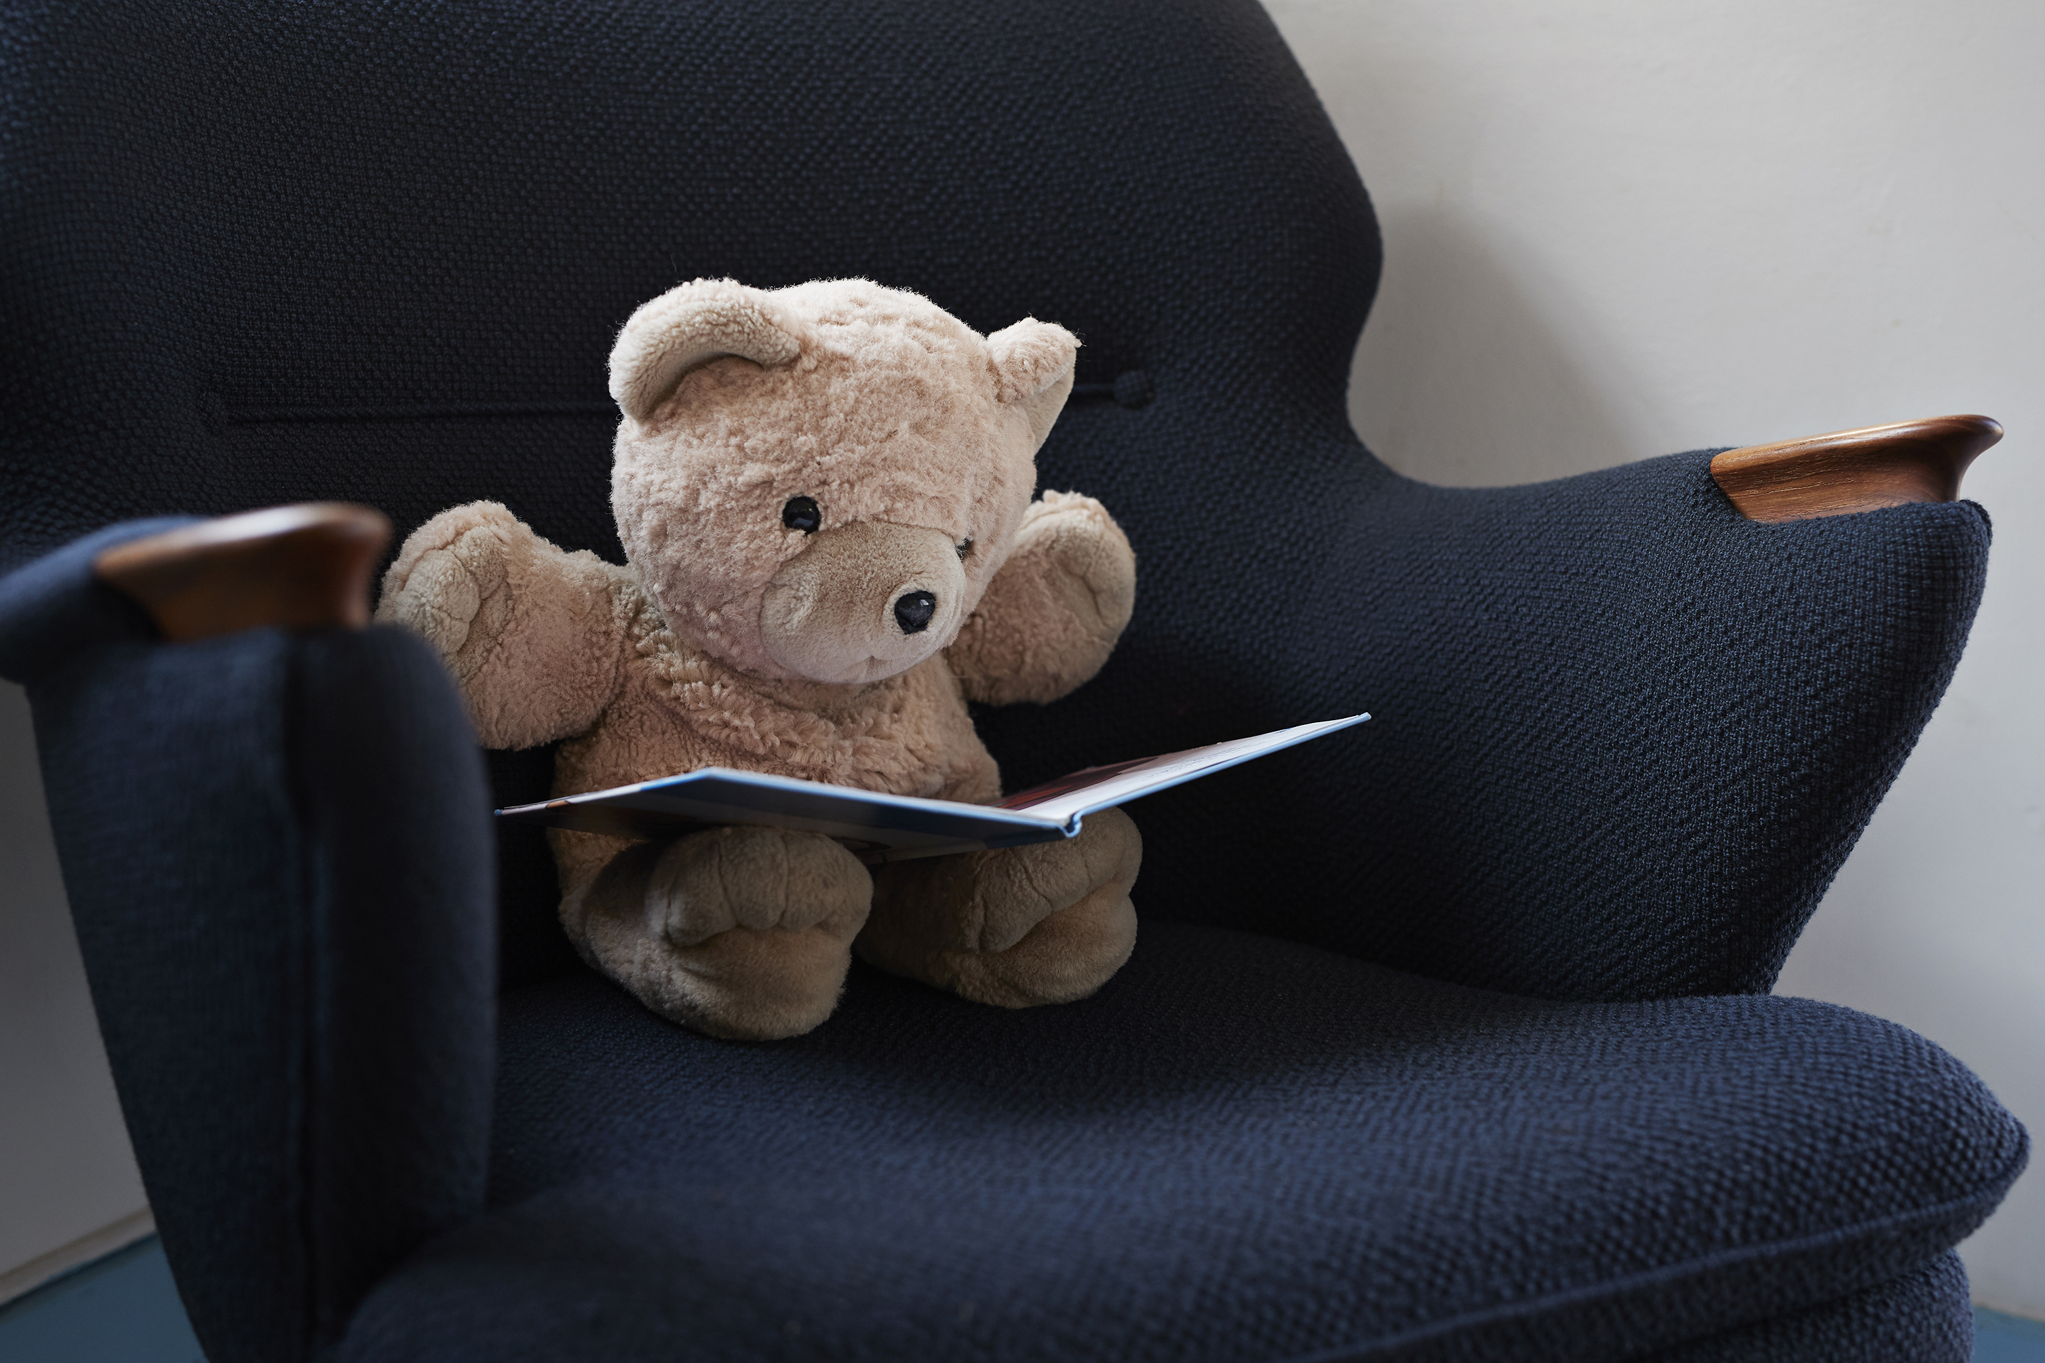

On the Road to Success!
road
read
Notes:
Notes to Teacher:
Teacher will introduce the slide by telling the student that we are going to work on CVVC (consonant-vowel-vowel-consonant) words.
Ask the student what he/she sees. The student should identify it as a road.
Teacher: “When we look at the consonant-vowel-vowel-consonant pattern in words, you will notice that we will hear the first vowel. Let’s take a look at one of our words.”
Click to show the word, road.
Teacher: “What is this word?” (Road.) Point out that the first vowel is an o and that is the vowel sound that we hear.
Teacher:” Let’s try another word.”
Click to show the next word: read (with an image of a bear reading a book.)
Teacher: “What is this word?” (Read.) Point out that the first vowel is an e and that is the vowel sound that we hear.
Applaud student’s effort.
Teacher: “Let’s try some more CVVC (consonant-vowel-vowel-consonant) words!”
Click to go to the next slide.

Slide 3
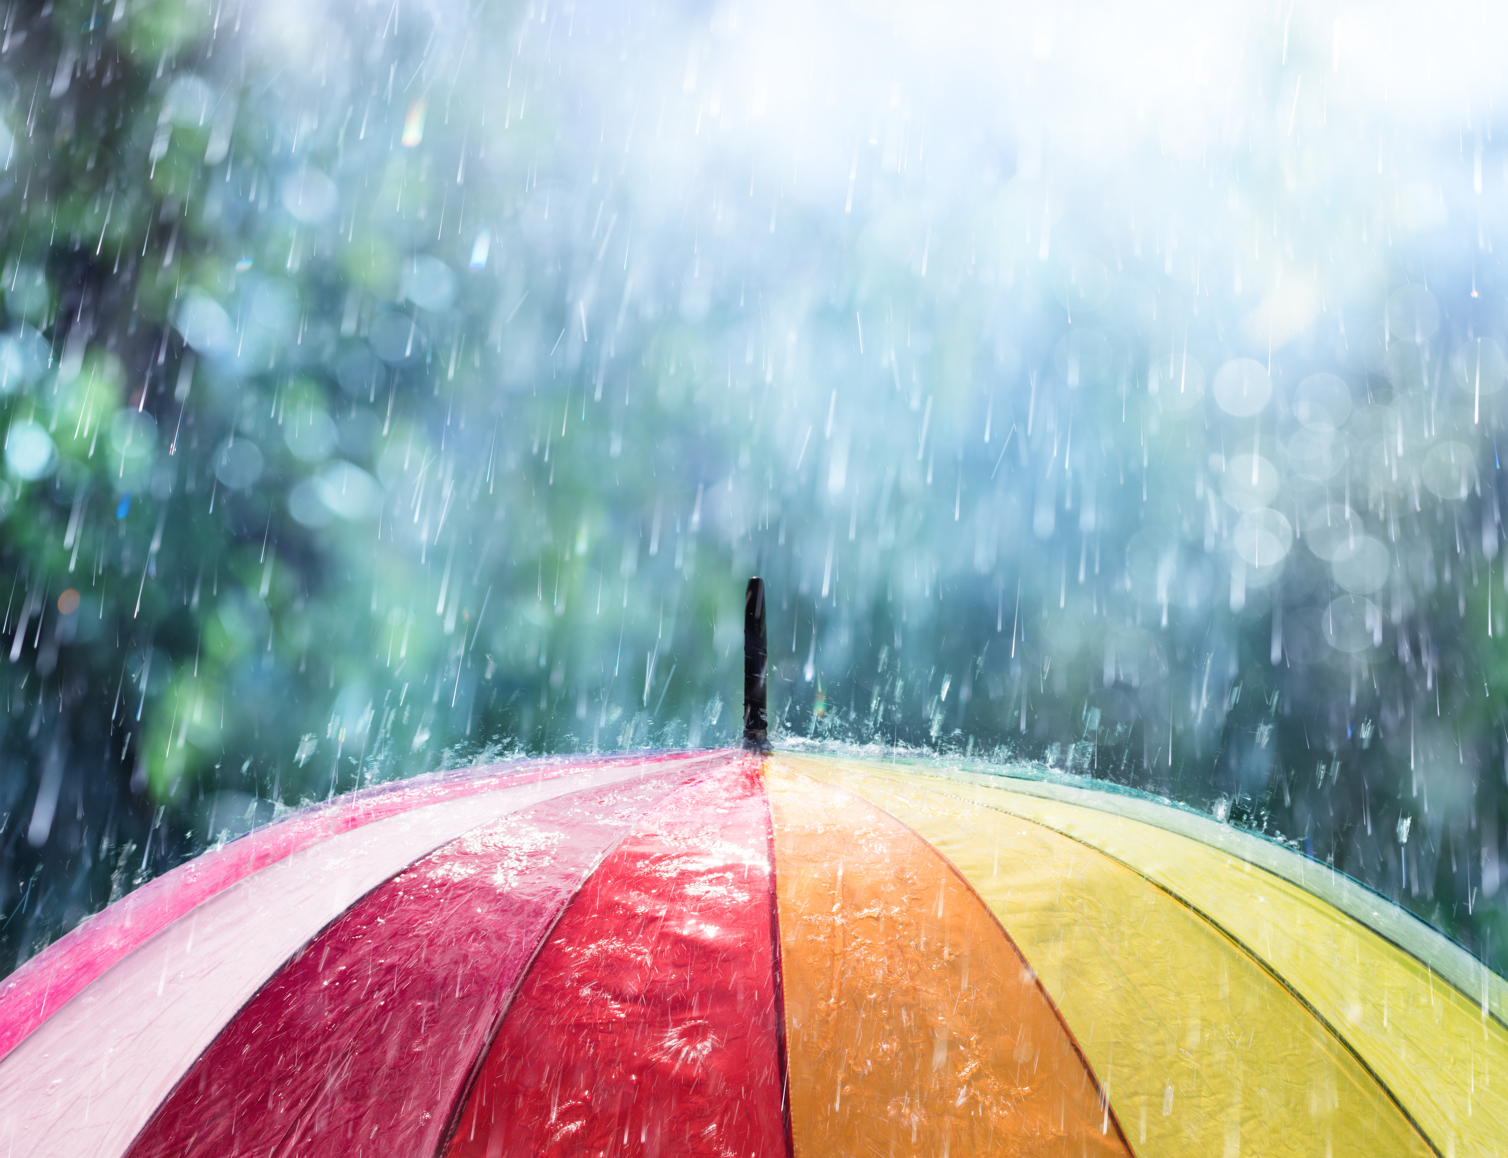

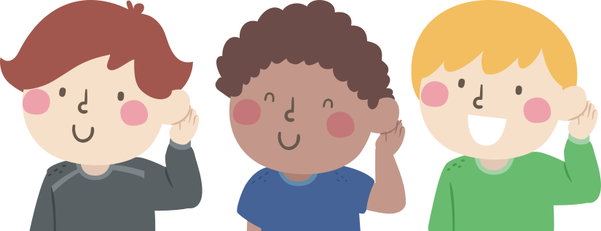
Let’s Practice CVVC Words!
boat
baot
rian
rain
Notes:
Notes to Teacher:
Tell the student that you will say a word. Remind the student that when working with CVVC words, the first vowel is the sound that we hear.
Click to show a picture of rain.
Teacher: “Rain. Which word spells rain?”
Click to show two words: rian and rain.
Ask: “Which word spells rain? Rian or rain?” Allow the student to tell you that r a i n spells rain. Click to circle the word rain.
Click to bring up the picture of a boat.
Teacher: “Boat. Which word spells boat?”
Click to show two words: boat and baot.
Ask: “Which word spells boat? Boat or baot?” Allow the student to tell you that b o a t spells boat. Click to circle the word boat.
Applaud the student’s effort and click to go to the next slide.

Slide 4
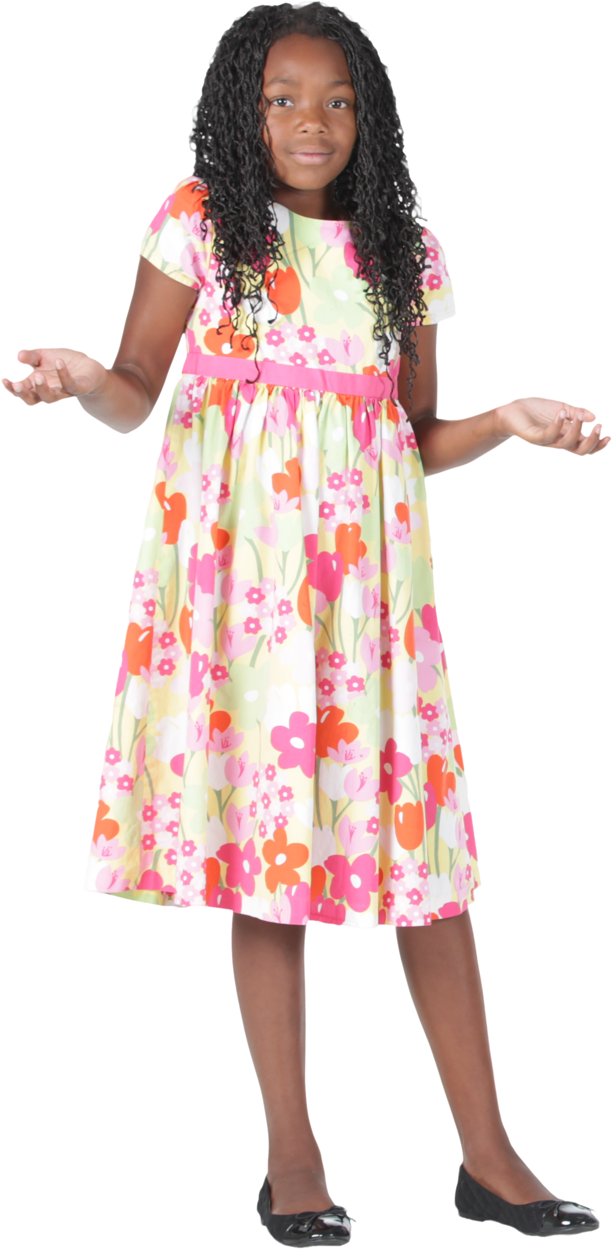
Compound Subjects and Predicates
Compound Subject
I laughed and danced in
the rain.
Compound Predicate
The whale and the dolphin
swim in the ocean.
Notes:
Notes to Teacher:
Click to show the words ‘Compound Subject’ and ‘Compound Predicate.’
Have the student read the words: “Compound Subject” and “Compound Predicate.”
Remind the student that the subject tells who or what the sentence is about. The predicate tells what the subject is doing.
Ask: “What is the compound subject?” (A compound subject is two or more subjects.)
Ask” “What is a compound predicate?” (A compound predicate is two or more simple verbs.)
Teacher: “Let’s take a look at a sentence and identify the compound subject.”
Teacher will click to show a sentence: The whale and dolphin swim in the ocean.
Teacher will have the student read the sentence aloud, pausing to have the student identify the subjects.
Click to underline the words whale and dolphin. Applaud effort or review the subjects.
After reading the sentence (above) and identifying the compound subjects, tell the student that we are now going to identify the compound predicates. Remind the student that the predicate tells about what the subject is doing.
Teacher will click to show the next sentence: I laughed and danced in the rain.
Teacher will have the student read the sentence aloud, pausing to have student identify the predicates.
Ask: “What did I do?” (laughed and danced.)
Click to underline the words laughed and danced. Tell the student that laughed and danced are the predicates. They tell what I did.
Applaud student’s effort and click to go to next slide.

Slide 5

Searching for Compound
Subjects and Predicates!
Compound Subject
Compound Predicate
John and Max went to play basketball.
Mary brushed her teeth and combed
her hair.
Notes:
Notes to Teacher:
Tell the student that today, he/she will search for compound subjects and compound predicates in sentences.
Teacher will click to show a sentence: John and Max went to play basketball.
Have the student read the text (or assist as needed.)
Click to show the words ‘Compound Subject’ and ‘Compound Predicate.’
Ask: “Do you see a compound subject or a compound predicate?” (Compound subject.)
Click to show the box around “Compound Subject.”
Ask: “Who is this sentence about?” (John and Max.)
Click to underline John and Max.
Applaud the student’s effort.
Teacher: “Let’s look at another sentence.”
Click to show another sentence: Mary brushed her teeth and combed her hair.
Ask: “Do you see a compound subject or a compound predicate?” (Compound Predicate.)
Click to show the box around “Compound Predicate.”
Ask: “What did Mary do?”
Click to underline brushed and combed.
Applaud the student’s effort and click to go to the next slide.

Slide 6
Ocean Adventures –
Vocabulary Review
journey
predator
crew
An animal that lives by killing
and eating other animals.
A group of people working together.
Having impressive beauty.
A trip, travel.
Notes:
Notes to Teacher:
Teacher: “Let’s review some of our vocabulary words.”
Click to show the first word, predator.
Click again to show the two definitions.
Teacher: “Our first word is predator. (Have the student repeat the word – predator.) What is a predator?”
Allow time for the student to tell you which definition matches predator. If the student is correct, applaud his/her answer. If the student is wrong, review the definition with him/her.
As the student gives you the correct definition, click to make the incorrect definition fade away.
Click to show the next word, journey.
Click again to show the two definitions.
Teacher: “Our next word is journey. (Have the student repeat the word – journey.) What is a journey?”
Allow time for the student to tell you which definition matches journey. If the student is correct, applaud his/her answer. If the student is wrong, review the definition with him/her.
As the student gives you the correct answer, click to make the incorrect definition fade away.
Click to show the last word, crew.
Click again to show the two definitions.
Teacher: “Our last word is crew. (Have the student repeat the word – crew.) What is a crew?”
Allow time for the student to tell you which definition matches crew. If the student is correct, applaud his/her answer. If the student is wrong, review the definition with him/her.
As the student gives you the correct answer, click to make the incorrect definition fade away.
Vocabulary:
predator – an animal that lives by killing and eating other animals.
journey – a trip, travel.
crew – a group of people working together.
Before clicking to the next slide, applaud the student’s effort.
Click to go to the next slide.

Slide 7
Vocabulary Review Take Two!
coast
magnificent
swift
Moving or capable of
moving with great speed.
The land near a shore.
Having impressive beauty.
Notes:
Notes to Teacher:
Teacher: “Let’s review the rest of our vocabulary words.”
Click to show the first word, coast.
Click again to show the two definitions.
Teacher: “Our first word is coast. (Have the student repeat the word – coast.) What is a coast?”
Allow time for the student to tell you which definition matches coast. If the student is correct, applaud his/her answer. If the student is wrong, review the definition with him/her.
As the student gives you the correct definition, click to make the incorrect definition fade away.
Click to show the next word, magnificent.
Click again to show the two definitions.
Teacher: “Our next word is magnificent. (Have the student repeat the word – magnificent.) What does magnificent mean?”
Allow time for the student to tell you which definition matches magnificent. If the student is correct, applaud his/her answer. If the student is wrong, review the definition with him/her.
As the student gives you the correct answer, click to make the incorrect definition fade away.
Click to show the last word, swift.
Click again to show the two definitions.
Teacher: “Our last word is swift. (Have the student repeat the word – swift.) What does swift mean?”
Allow time for the student to tell you which definition matches swift. If the student is correct, applaud his/her answer. If the student is wrong, review the definition with him/her.
As the student gives you the correct answer, click to make the incorrect definition fade away.
Vocabulary:
coast – the land near the shore.
magnificent– having impressive beauty.
swift – moving or capable of moving with great speed.
Before clicking to the next slide, applaud the student’s effort.
Click to go to the next slide.

Slide 8

Our Vocabulary Adventure
Continues!
magnificent
Look at that _________ sunset!
journey
I am ready for the ________!
magnificent
predator
magnificent
journey
I’m headed to the _____ this
weekend!
coast
coast
journey
Notes:
Notes to Teacher:
Teacher: “Let’s practice our vocabulary words by filling in the blank with the correct word.”
Click to bring up the first sentence: Look at that ___________ sunset!
*Teacher or student will read the sentence aloud.
Click to bring up the word choices.
*The student will decide which of the two words is correct.
The teacher will click to circle the correct word. The incorrect word will disappear.
The teacher will click again to show the correct word in the sentence. As the next sentence is brought to the slide, this one will disappear.
Click to bring up the next sentence: I’m headed to the ______ this weekend.
*Teacher or student will read the sentence aloud.
Click to bring up the word choices.
*The student will decide which of the two words is correct.
The teacher will click to circle the correct word. The incorrect word will disappear.
The teacher will click again to show the correct word in the sentence. As the next sentence is brought to the slide, this one will disappear.
Click to bring up the last sentence: I am ready for the _______!
*Teacher or student will read the sentence aloud.
Click to bring up the word choices.
*The student will decide which of the two words is correct.
The teacher will click to circle the correct word. The incorrect word will disappear.
The teacher will click again to show the correct word in the sentence.
Applaud the student’s effort and click to move to the next slide.

Slide 9
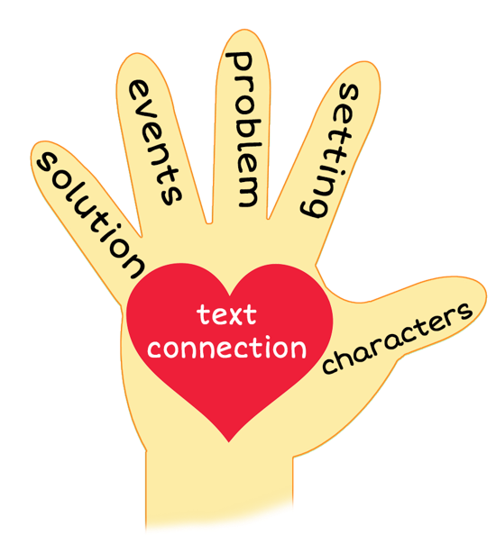
5 Finger Retell
Notes:
Notes to Teacher:
Remind the student of how we can use our hand to help retell a story, using the information below.
Click to bring the image of a hand to the slide.
Ask the student to hold up his/her hand and point to each finger as we go through the retell. Teacher will click on the slide so that each finger is circled as we work through this review.
Thumb (Click to circle the thumb.) “We will talk about the characters in the story. Who did we meet in the story? We may meet people and/or animals.”
Pointer Finger (Click to circle the pointer finger.) - We will talk about the setting- Where and when did the story talk place?
Middle Finger (Click to circle the middle finger) – We will talk about the problem -Was there a problem in the story? If so, what was the problem?
Ring Finger (Click to circle the ring finger.) We will talk about the events in the story. What happened in the story?
Pinky (Click to point to pinky finger.) Solution – Was the problem solved? If so, how did the characters solve this problem?
Palm of Hand (Click to point to the palm of the hand.) Text Connection – How does this story connect to your life?
Remind the student that we will use our hand to help us retell our story today.
Click to the next slide.

Slide 10
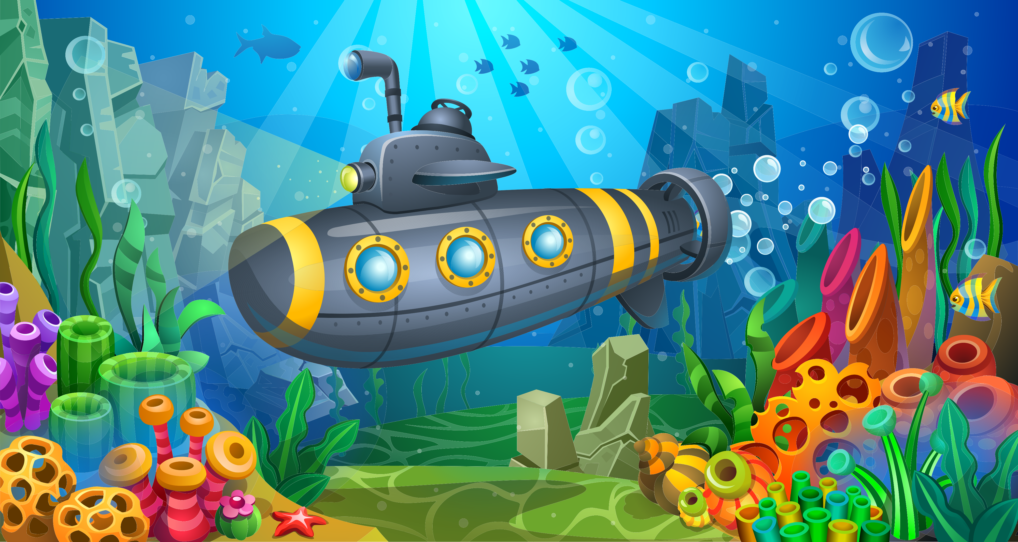
Deep Sea Mystery
Notes:
Notes to Teacher:
Remind the student that we read a story called, Deep Sea Mystery.
Click to bring the image of the 5 finger retell and the submarine.
Thumb (Click to circle the thumb.) Who were the characters in the story – Jorge, Lana Haines, Marcus and the crew on the ship.
Pointer Finger (Click to circle the pointer finger.) - Where did the story take place? The story took place on the ship deck and in the ocean. It took place off the coast of Florida at 5:00 in the morning (and throughout the day.).
Middle Finger (Click to circle the middle finger) – What was the problem in the story? The crew “lost” Lana, one of their crew members.
Ring Finger (Click to circle the ring finger.) What happened in the story? The crew was sent out to look for never-seen-before sea creatures along the bottom of the ocean. They left at 5:00 in the morning. Hours later, they discovered that they were missing Lana. Jorge questioned the crew and decided that Marcus was being very mysterious. While they retraced her steps. Marcus and Jorge discovered a secret hatch that Lana may have used to escape.
Pinky (Click to point to the pinky finger.) Solution – Was the problem solved? When the story ended, they did not find Lana. Marcus believes he may know where she may be.
Palm of Hand (Click to point to the palm of the hand.) Text Connection –Did you ever have to solve a mystery? What was missing/lost? How did you solve it? Did anyone help you try to solve the mystery? If so, who helped you.
Applaud the student’s effort.
Click to the next slide.

Slide 11
Q & A
Any Questions?

