Slide 1
Musicians
Melody of Words
Notes:
Say, “Today we are going to experience melody of words. We will review the augh and ough, possessive pronouns, our vocabulary words, and identify the main idea and details of the story A History of Music.

Slide 2

Presenting augh and ough Practice
o
u
g
h
d_ _ _ _
Notes:
Say, “Today we are going to practice augh and ough. I will show you a picture and a word with augh and ough missing. You have to decide which one goes in the missing blank to complete the word.”
Click to show the picture and the word d ____. Say, “What is the picture of? Yes, it is dough.” If the student answers incorrectly tell them, it is dough. Say, “What would complete this word augh or ough?” Wait for the student to respond. Click to make ough appear. Say, “yes, ough completes the word dough. Let’s try again!”

Slide 3
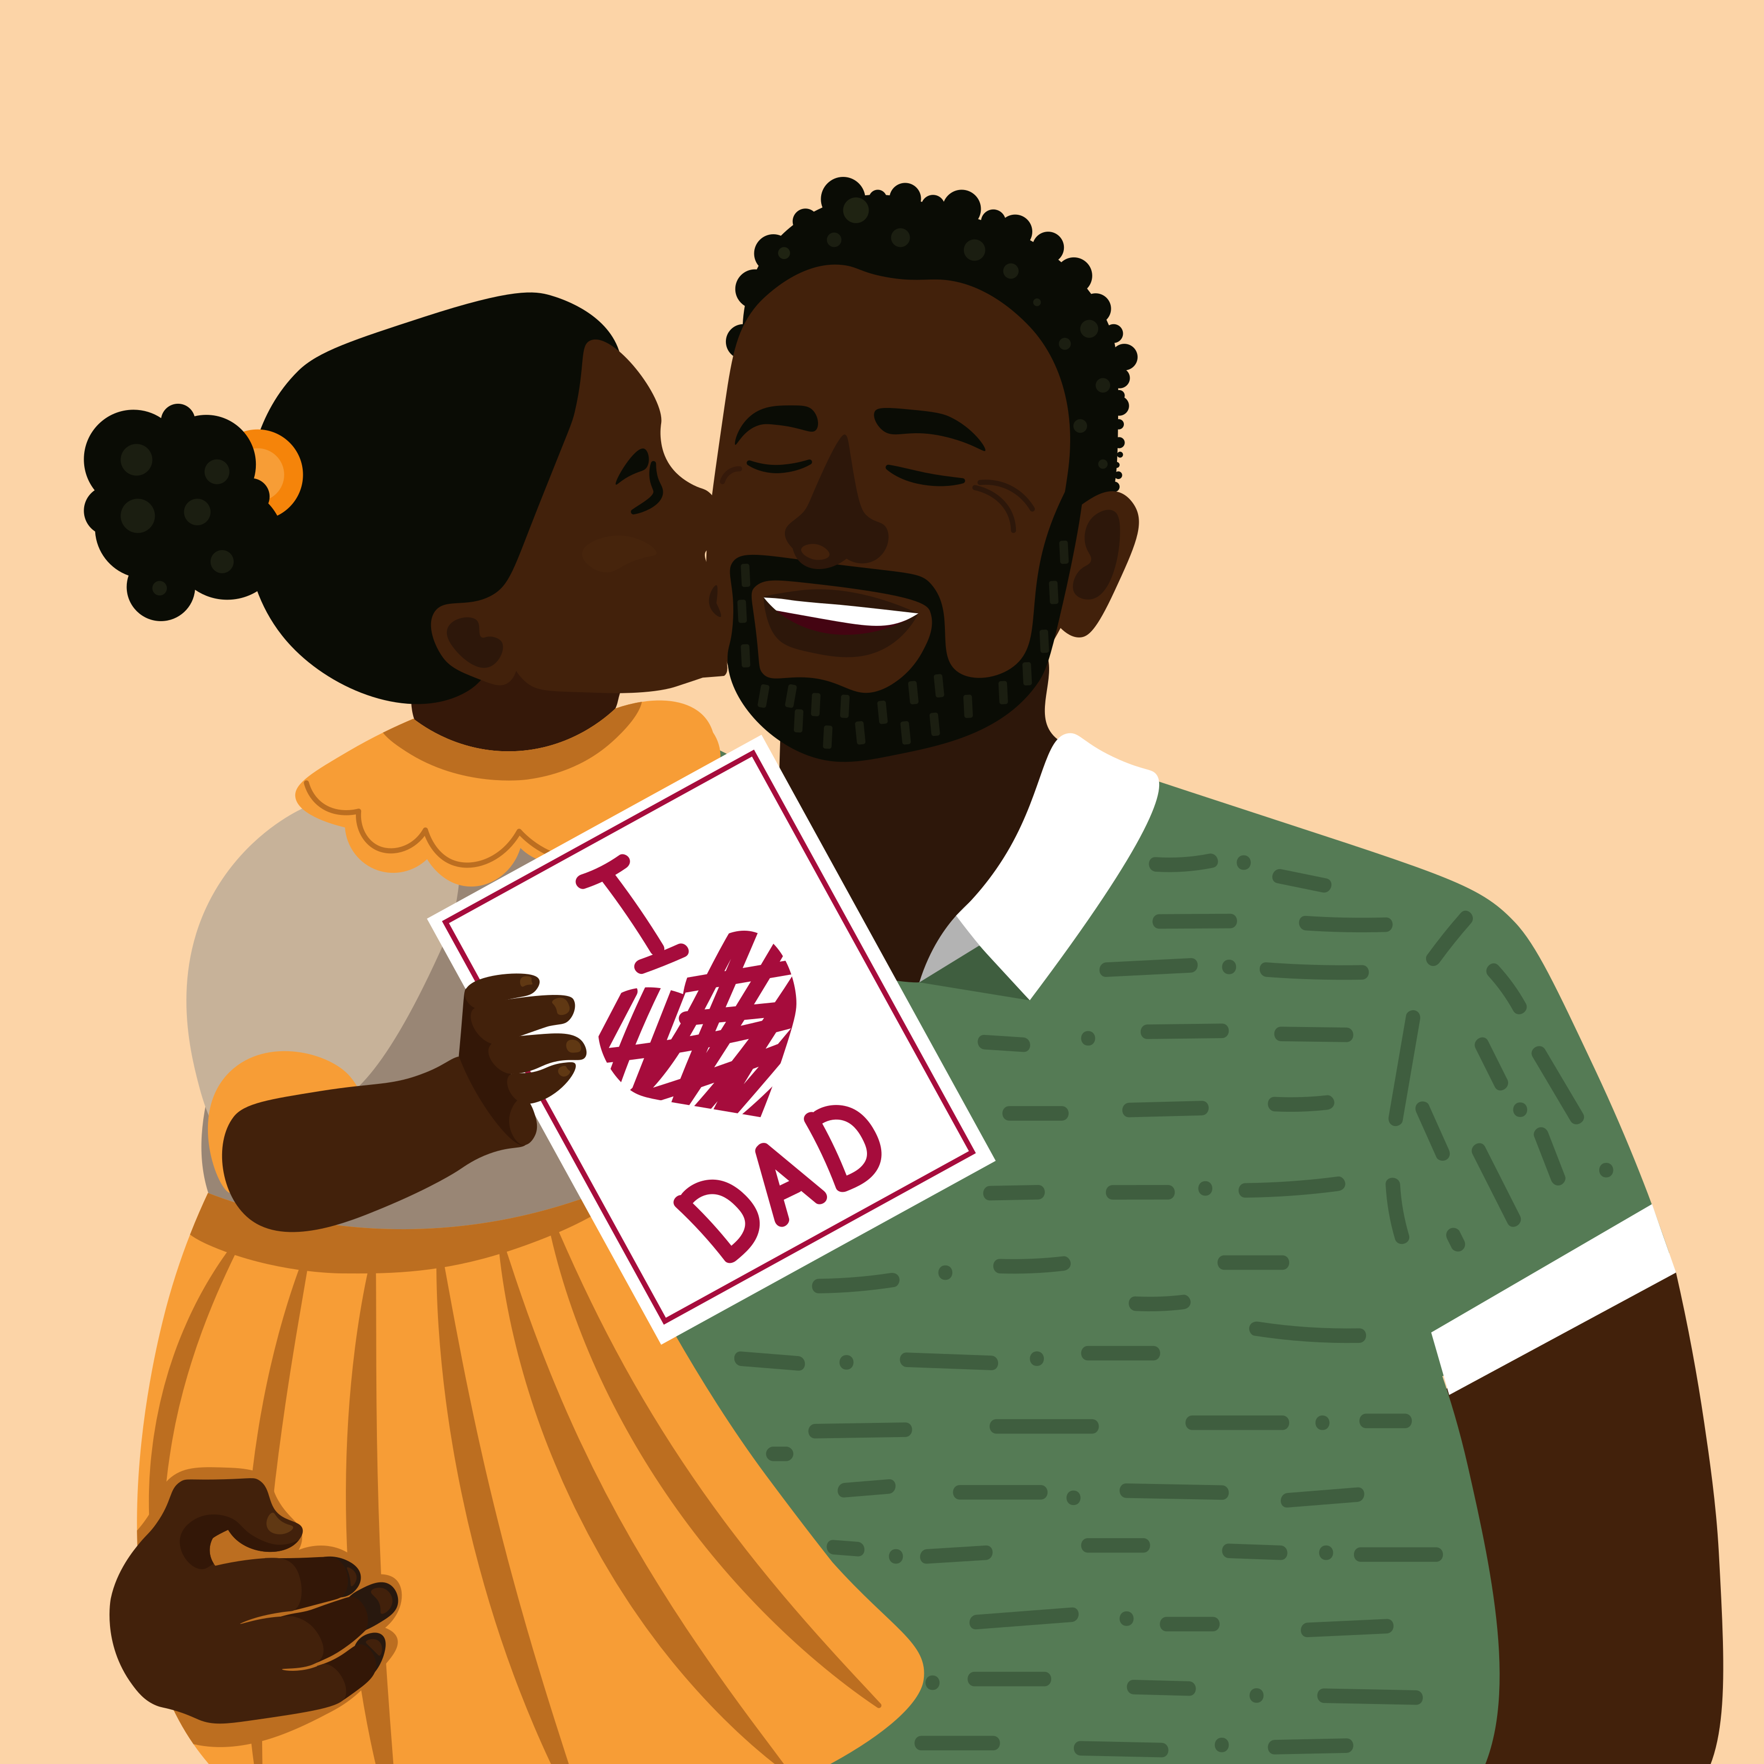
Symphony of augh and ough Practice
a
g
d_ _ _ _ter
u
h
Notes:
Click to show the picture with an arrow pointing to the little girl and the word d ____ter. Say, “What is the picture of? Yes, it is a daughter.” If the student answers incorrectly tell them, it is daughter. Say, “What would complete this word augh or ough?” Wait for the student to respond. Click to make augh appear. Say, “yes, augh completes the word daughter. Let’s try again!”

Slide 4
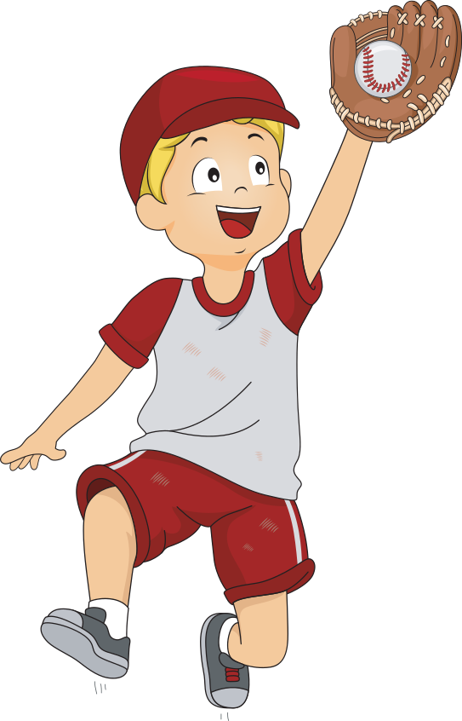
Opera of augh and ough Practice
a
g
c_ _ _ _t
u
h
Notes:
Click to show the picture with an arrow pointing to the ball being caught and the word c ____t. Say, “What is the picture representing? Yes, it is a caught.” If the student answers incorrectly tell them, it is caught. Say, “What would complete this word augh or ough?” Wait for the student to respond. Click to make augh appear. Say, “yes, augh completes the word caught. Let’s try again!”

Slide 5
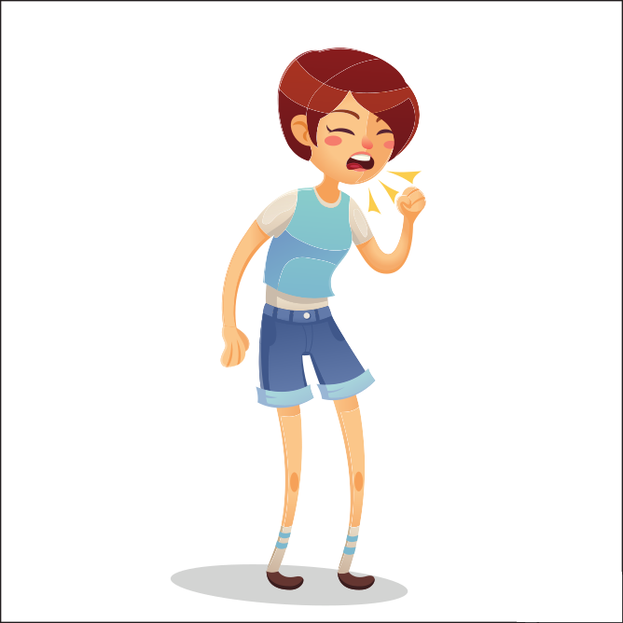
Tempo of augh and ough Practice
o
u
g
h
c_ _ _ _
Notes:
Click to show the picture and the word c____. Say, “What is the picture o representing? Yes, it is cough.” If the student answers incorrectly tell them, it is cough. Say, “What would complete this word augh or ough?” Wait for the student to respond. Click to make ough appear. Say, “yes, ough completes the word cough.

Slide 6
Performance of Possessive Pronoun Review
Possessive Pronoun - a possessive pronoun shows ownership
Pronoun - a pronoun is a word that takes the place of a common or proper noun
my mine our ours
its his her hers
their theirs your yours
This toy is mine.
Notes:
Say, “Today we are going to review possessive pronouns. First, let’s review what a pronoun is.”
Click to show the word pronoun and the definition. Say, “a pronoun is a word that takes the place of a common or proper noun.” Click for it to disappear.
Click to show the word possessive pronoun and the definition. Say, “a possessive pronoun shows ownership.” Click to show possessive pronouns. Say, “my, mine, our, ours, its, his, her, hers, their, theirs, your and yours are possessive pronouns.” Click to show the sentence with a possessive pronoun. Say, “This toy is mine. What is the possessive pronoun in this sentence?” Wait for the student to answer. Say, “Yes, mine. What is it showing ownership of?” Wait for the student to answer. Say, “Yes, the toy.”
Say, “you will need a white board and whiteboard marker or a piece of paper and pencil for this next activity. If you do not have one, please get it now.”

Slide 7
Singing Possessive Pronoun Practice
That is her pretty purse.
You can’t have my drink.
It is our turn.
Is this your bag?
Notes:
Say, “Now are you ready to practice identifying possessive nouns? I will show you a sentence. You need to write the possessive noun on your whiteboard and what it shows ownership of.”
Click to show the sentence. Is this your bag? Say, “Write the possessive noun and what it shows ownership of on your whiteboard and then hold it up so I can see it. Yes, the possessive noun is your and it shows ownership of the bag. Click for it to disappear.
Click to show the sentence. You can’t have my drink. Say, “Write the possessive noun and what it shows ownership of on your whiteboard and then hold it up so I can see it. Yes, the possessive noun is my and it shows ownership of the drink. Click for it to disappear.
Click to show the sentence. That is her pretty purse. Say, “Write the possessive noun and what it shows ownership of on your whiteboard and then hold it up so I can see it. Yes, the possessive noun is her and it shows ownership of the purse. Click for it to disappear.
Click to show the sentence. It is our turn. Say, “Write the possessive noun and what it shows ownership of on your whiteboard and then hold it up so I can see it. Yes, the possessive noun is our and it shows ownership of the turn.

Slide 8
Entertaining Vocabulary
What is a flow of sound in music having regular accented beats?
beat
What is a rhythmic stress in poetry or music?
orchestra
What is a group of musicians who perform instrumental music using mostly stringed instruments?
rhythm
Notes:
Say, “Today we are going to review our vocabulary words.”
Click to show the vocabulary words. Say each word, “beat, orchestra, rhythm.”
Click to show the definitions. Say, “We are going to match the word with its definition.”
Say, “What is a flow of sound in music having regular accented beats? Yes, rhythm! Click to show the line from the definition to the word.
Say, “What is a rhythmic stress in poetry or music? Yes, beat!” Click to show the line from the definition to the word.
Say, “What is a group of musicians who perform instrumental music using mostly stringed instruments? Yes, orchestra!” Click to show the line from the definition to the word.
Click to review the remaining vocabulary words.

Slide 9
Sound of Vocabulary
What is the natural abilities of a person?
instrument
What is a device used to produce music?
variety
talent
What is a number or collection of different things?
Notes:
Say, “We are going to review our remaining vocabulary words.”
Click to show the vocabulary words. Say each word, “instrument, variety, talent”
Click to show the definitions. Say, “We are going to match the word with its definition.”
Say, “What is the natural abilities of a person? Yes, talent!” Click to show the line from the definition to the word.
Say, “What is a device used to produce music? Yes, instrument!” Click to show the line from the definition to the word.
Say, “What is a number or collection of different things? Yes, variety!” Click to show the line from the definition to the word.

Slide 10
Cause and Effect Practice
cause
effect
cause - why something happened
Cowboy’s sang songs that often matched a horses trot.
Country music was born.
America wanted independence from England
Yankee Doodle and the Star-Spangled Banner were written.
People came from all over the world to America
new music like polka, came to America
effect - what happened as a result
African Americans gained their freedom but still worked long hard hours
blues were born
Yankee Doodle and the Star-Spangled Banner were written.
Country music was born.
new music like polka, came to America
blues were born
Notes:
Say, “Today we will review what cause and effect is and then we will identify the cause and effect of the story A History of Music.”
Click to show the word cause and the definition. Say, “Cause is why something happened.” Click to show the word effect and the definition. Say, “Effect is what happened as a result.” Click for it to disappear.
Click to show the cause-and-effect T-chart.(Causes will appear in the chart as you go along, and effects are at the bottom.) Say, “Read the cause and match each cause with the correct effect on the right.”
Click to show the first cause. Say, “The cause is Cowboy’s sang songs that often matched a horses trot. What is the effect?” Wait for the student to respond. Click for the effect to appear in the effect column. Say, “Yes, Country music was born.”
Click to show the second cause. Say, “The cause is America wanted independence from England. What is the effect?” Wait for the student to respond. Click for the effect to appear in the effect column. Say, “Yes, “Yankee Doodle and the Star-Spangled Banner were written.”
Click to show the third cause. Say, “The cause is people came from all over the world to America. What is the effect?” Wait for the student to respond. Click for the effect to appear in the effect column. Say, “Yes, new music like polka, came to America.”
Click to show the fourth cause. Say, “The cause is African Americans gained their freedom but still worked long hard hours. What is the effect?” Wait for the student to respond. Click for the effect to appear in the effect column. Say, “Yes, the blues were born.”

Slide 11
Q & A
Any Questions?

