Slide 1
Lazy Days
Relaxing Review
Notes:
Say, “Today it’s lazy day of review. We will review –le and -el, commas in dates, vocabulary, and do a 5 finger retell of the story July with Gram and Pop.”

Slide 2









Having a Sweet le and el Review
le
el
Notes:
Say, “Today we are going to sort pictures with le and el endings.” You will tell me if that picture goes on the le cone or el cone.”
Say, “Can you tell me what each of these pictures are?” (apple, bagel, waffle, camel, shovel, marble)
Say, “What cone does the picture of an apple go on? Yes, it goes on the cone with le!” If the student answers incorrectly. Say, “apple has a le at the end so it would go on the le cone.” Click on the apple to move it onto the le cone.
Say, “What cone does the picture of a bagel go on? Yes, it goes on the cone with el!” If the student answers incorrectly. Say, “bagel has an el at the end so it would go on the el cone.” Click on the bagel to move it onto the el cone.
Say, “What cone does the picture of a waffle go on? Yes, it goes on the cone with le!” If the student answers incorrectly. Say, “waffle has a le at the end so it would go on the le cone.” Click on the waffle to move it onto the le cone.
Say, “What cone does the picture of a camel go on? Yes, it goes on the cone with el!” If the student answers incorrectly. Say, “camel has an el at the end so it would go on the el cone.” Click on the camel to move it onto the el cone.
Say, “What cone does the picture of a shovel go on? Yes, it goes on the cone with el!” If the student answers incorrectly. Say, “shovel has an el at the end so it would go on the el cone.” Click on the shovel to move it onto the el cone.
Say, “What cone does the picture of a marble go on? Yes, it goes on the cone with le!” If the student answers incorrectly. Say, “marble has a le at the end so it would go on the le cone.” Click on the marble to move it onto the le cone.

Slide 3

Peaceful Comma Review
,
August 15 2021
comma
Notes:
Say, “Today we are going to review commas used in dates.”
Click to show a comma. Say, “This is a comma and commas are used in a variety of ways. Today we will practice using them in dates.
Click to show a date without the comma. Say, “Commas in a date are placed between the day and the year to separate them. Where do you think the comma should be in this date? Yes, between 15, 2021. Good job! Let’s Practice!”

Slide 4
Calming Comma Practice
January 20 2021
,
,
October 6, 2021
July 4 2020
,
February 17, 2021
,
Notes:
Say, “I am going to show you a date. Look at the date and tell me if the comma is in the correct or incorrect place. If it is incorrect, you need to tell me the correct placement of the comma. Ready?”
Click to show the first date. (October 6, 2021) Say, “Is the comma in the correct place in this date?” Wait for the student to answer. Say, “Yes, it is in the correct place. Let’s try again.” Click for it to disappear.
Click to show the date. (January 20 2021,) “Is the comma in the correct place in this date?” Wait for the student to answer. Say, “No, it is not in the correct place. Can you tell me where it belongs?” Wait for the student to answer. Click to show the comma in the correct place. Say, “Yes, that’s the correct place. Let’s try again.” Click for it to disappear.
Click to show the date. (February 17, 2021) Say, “Is the comma in the correct place in this date?” Wait for the student to answer. Say, “Yes, it is in the correct place. Let’s try again.” Click for it to disappear.
Click to show the date. (July, 4 2020) “Is the comma in the correct place in this date?” Wait for the student to answer. Say, “No, it is not in the correct place. Can you tell me where it belongs? Wait for the student to answer. Click to show the comma in the correct place. Say, “Yes, that’s the correct place.”
Say, “You will need a whiteboard and whiteboard marker or a piece of paper and a pencil for the next activity. If you do not have it, go grab it now.”

Slide 5
Soothing Vocabulary Practice
Word Bank
consider
contain
recall
peaceful
active
schedule
producing or involving action or movement
program or agenda
to think about carefully
to keep within limits
quiet, tranquil
to remember
Notes:
Say, “Now we are going to practice our vocabulary words.” Click to show the vocabulary word bank. Say, “These are our vocabulary words from this week’s story. Can you read them to me?” Students will read the following vocabulary words. (consider, contain, recall, peaceful, active, schedule)
Say, “I am going to show you a definition and I want you to write the vocabulary word on your whiteboard and then hold it up for me to see.” Click to show the definition to keep within limits. Say, “What is the correct vocabulary word for to keep within limits.” Wait for the student to write the vocab word. If correct say, “yes, contain is correct.” If incorrect repeat the definition and have them try again. Click for the definition to disappear and contain to get a line through it.
Click to show the definition quiet, tranquil. Say, “What is the correct vocabulary word for quiet, tranquil.” Wait for the student to write the vocab word. If correct say, “yes, peaceful is correct.” If incorrect repeat the definition and have them try again. Click for the definition to disappear and peaceful to get a line through it.
Click to show the definition producing or involving action or movement. Say, “What is the correct vocabulary word for producing or involving action or movement.” Wait for the student to write the vocab word. If correct say, “yes, active is correct.” If incorrect repeat the definition and have them try again. Click for the definition to disappear and active to get a line through it.
Click to show the definition to think about carefully. Say, “What is the correct vocabulary word for to think about carefully.” Wait for the student to write the vocab word. If correct say, “yes, consider is correct.” If incorrect repeat the definition and have them try again. Click for the definition to disappear and consider to get a line through it.
Click to show the definition program or agenda. Say, “What is the correct vocabulary word for program or agenda.” Wait for the student to write the vocab word. If correct say, “yes, schedule is correct.” If incorrect repeat the definition and have them try again. Click for the definition to disappear and schedule to get a line through it.
Click to show the definition to remember. Say, “What is the correct vocabulary word for to remember.” Wait for the student to write the vocab word. If correct say, “yes, recall is correct.” If incorrect repeat the definition and have them try again. Click recall to get a line through it.

Slide 6
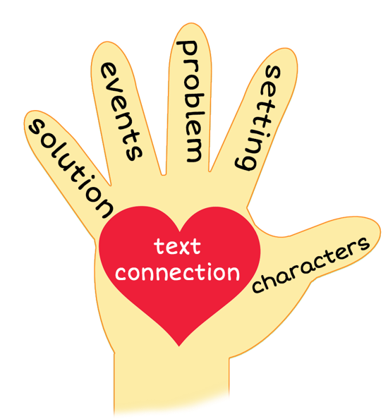

5 Finger Retell
Notes:
Say, “This week you read the story July with Gram and Pop. Using the 5 finger retell strategy, can you tell me about the story.
Say, “Hold up your thumb, tell me the characters.” (Ian, Dad, and the grandparents)
Say, “Hold up your pointer, tell me the setting.” (at the grandparents’ house/farm)
Say, “Hold up your tall finger, tell me the problem.” (Ian doesn’t want to stay the whole month of July at his grandparents’ house)
Say, “Hold up your ring finger, tell me the events.” (Ian didn’t want to go out and see the horse with Pop. He decided to watch TV, but his grandparent only had a few channels. The next day Ian went outside with Pop. He fed the horses, brushed them, and cleaned out their stalls. Then Pop let Ian ride the horse. After lunch they skipped rocks across the pond and began working on a tree house.) The student does not need to name all of these events. They need to be able to tell at least 3 events from the story.
Say, “Hold up your little finger, tell me the ending/solution.” (Ian realized he was going to have a peaceful summer with his grandparents)
Say, “Make a heart with your fingers, have you ever gone somewhere in the summer that you didn’t want to go to? Did you end up enjoying yourself and why?” (answers will vary)

Slide 7
Q & A
Any Questions?

