Slide 1
Rainy Days
It’s Raining! It’s Pouring! Reviews
Notes:
Say, “Today it’s raining and pouring a review. We will review –le and -al, commas in addresses, vocabulary, and do a 5 finger retell of the story Attic Memories.”

Slide 2

Caught in the Rain -le and -al Practice
al
le
medal
Notes:
Say, “Today we will look at the picture and figure out if that word ends in -al or -le. Are you ready?
Click to show the picture of a medal and -al and -le Say, “what is this a picture of?” If the student answers incorrectly tell them, it’s a medal.
Say, “What does this word end with, -al or -le?” Wait for the student to answer. Click to circle al and have the word medal appear.
Say, “Correct, medal ends in al. Let’s try again!”

Slide 3

Downpour of -le and -al Practice
al
le
table
Notes:
Click to show the picture of a table and -al and -le Say, “what is this a picture of?” If the student answers incorrectly tell them, it’s a table.
Say, “What does this word end with, -al or -le?” Wait for the student to answer. Click to circle le and have the word table appear.
Say, “Correct, table ends in -le. Let’s try again!”

Slide 4

Caught in the Rain -le and -al Practice
al
le
hospital
Notes:
Click to show the picture of a hospital and -al and -le Say, “what is this a picture of?” If the student answers incorrectly tell them, it’s a hospital.
Say, “What does this word end with, -al or -le?” Wait for the student to answer. Click to circle al and have the word hospital appear.
Say, “Correct hospital ends in al. Let’s try again!”

Slide 5

Downpour of -le and -al Practice
al
le
bicycle
Notes:
Click to show the picture of a bicycle and -al and -le Say, “what is this a picture of?” If the student answers incorrectly tell them, it’s a bicycle.
Say, “What does this word end with, -al or -le?” Wait for the student to answer. Click to circle le and have the word bicycle appear.
Say, “Correct, bicycle ends in -le.”

Slide 6

Storm of a Comma Review
100 Main St.
Phoenix AZ 55867
,
comma
Notes:
Say, “Today we are going to review commas used in addresses.”
Click to show a comma. Say, “This is a comma and commas are used in a variety of ways. Today we will practice using them in addresses.” Click for the comma to disappear.
Click to show an address without the commas. Say, “Commas in an address are placed between the city and the state. Where do you think the comma should be in this address? Click for the comma to appear. Yes, between Phoenix and AZ. Good job!”

Slide 7
Sprinkling Commas Review
85 West Rd.
Houston TX 55867
23 Branch Rd.
Orlando FL 55867
16 Roger St.
New Orleans LA 55867
,
,
,
Notes:
Click to show address without the comma. Say, “Where does the comma go in this address?”
Click to make comma appear. Say, “Yes, it goes between Houston and TX. Click for the address to disappear and a new address to appear.
Say, “Where does the comma go in this address?” Click to make comma appear. Say, “Yes, it goes between Orlando and Fl. Click for the address to disappear and a new address to appear.
Say, “Where does the comma go in this address?” Click to make comma appear. Say, “Yes, it goes between New Orleans and LA.

Slide 8
It’s Raining Abbreviations Practice
What gets abbreviated?
Abbreviations
Mister
Mr.
a short way to write a word
Friday
Fri.
people
roads
days of the week
December
Dec.
months of the year
Notes:
Click to show the word abbreviations. Say, “What are abbreviations?” Wait for the student to answer. Click to show meaning. Say, “An abbreviation is a short way to write a word.” Click for it to disappear.
Click to show the question What gets abbreviated? Say, “What gets abbreviated?” Wait for the student to answer. Click to show the word people. Say, “People” Click to show the word roads. Say, “Roads” Click to show the words days of the week. Say, “Days of the week” Click to show the words months of the year. Say, “Months of the year” Click for them to disappear.
Click to show the word Mister. Say, “Do you know how to abbreviate Mister?” Wait for the student to answer. Click to show Mr. Say, “Mister is abbreviated M..r..period. Remember that abbreviations are capitalized!”
Click to show the word Friday. Say, “Do you know how to abbreviate Friday?” Wait for the student to answer. Click to show Fri. Say, “Friday is abbreviated F..r..i….period.”
Click to show the word December. Say, “Do you know how to abbreviate December?” Wait for the student to answer. Click to show Dec. Say, “December is abbreviated D..e..c….period.”
Let’s Practice

Slide 9
Flooding with Abbreviation Practice
street
Thursday
doctor
A. Thur.
A. Str.
A. doc
B. thurs.
B. St.
B. Dr.
C. Thurs.
C. st.
C. dr.
Notes:
Say, “Now we are going to practice abbreviations. I will show you a word and then 3 choices. Then, you need to tell me the correct abbreviation. Ready?”
Click to show the word doctor and the 3 choices. Say, “Which one of these are the correct abbreviation for doctor? A. doc B. Dr. or C. dr.” Wait for student to answer and then click for the circle to appear around B. Dr. Say, “Yes! B is the correct answer!” Click for it to disappear.
Click to show the word Thursday and the 3 choices. Say, “Which one of these are the correct abbreviation for Thursday? A. Thur. B. thurs. or C. Thurs. “Wait for student to answer and then click for the circle to appear around C. Thurs. Say, “Yes! C is the correct answer!” Click for it to disappear.
Click to show the word street and the 3 choices. Say, “Which one of these are the correct abbreviation for street? A. Str. B. St. or C. st. “Wait for student to answer and then click for the circle to appear around B. St. Say, “Yes! B is the correct answer!”

Slide 10
Rainy Day Vocabulary
word bank
treasure – wealth (money, jewels, or precious metals) stored up or held in reserve
examine
primary
treasure
locate
misery
attic
primary – of first rank, importance or value
The ___________ reason for her visit was to meet the new baby.
The crew had to ____________ the position of the other ship so that they could both get home.
They explored the _____________ trying to find his grandmother’s old painting.
locate – to look for and find the position of
He watched his mom _________ his report card to see how he was doing in school.
primary
misery
He was in _________ after his dog went missing.
The king kept his ___________ locked in his safe.
locate
attic
examine
misery – a state of unhappiness
treasure
examine – to look at or check carefully
attic – a room or space just below the roof of a building
Notes:
Say, “Today we are going to practice our vocabulary words in sentences. First, let’s go over the words and definitions.
Click to show treasure – wealth (money, jewels, or precious metals) stored up or held in reserve Say, “treasure – wealth (money, jewels, or precious metals) stored up or held in reserve “
Click to show primary – of first rank, importance or value. Say, “primary – of first rank, importance or value “
Click to show locate – to look for and find the position of. Say, “locate – to look for and find the position of “
Click to show misery – a state of unhappiness Say, “misery – a state of unhappiness “
Click to show examine – to look at or check carefully Say,” examine – to look at or check carefully “
Click to show attic – a room or space just below the roof of a building Say, “attic – a room or space just below the roof of a building “
Click for them to disappear and the vocabulary word bank appears.
Click for the sentence to appear. Say, “what vocabulary word completes this sentence?” Wait for the student to answer. Click misery to appear on the line and to disappear from word bank. Say, “That’s correct!” Click for sentence to disappear.
Click for the sentence to appear. Say, “what vocabulary word completes this sentence?” Wait for the student to answer. Click primary to appear on the line and to disappear from word bank. Say, “That’s correct!” Click for sentence to disappear.
Click for the sentence to appear. Say, “what vocabulary word completes this sentence?” Wait for the student to answer. Click locate to appear on the line and to disappear from word bank. Say, “That’s correct!” Click for sentence to disappear.
Click for the sentence to appear. Say, “what vocabulary word completes this sentence?” Wait for the student to answer. Click treasure to appear on the line and to disappear from word bank. Say, “That’s correct!” Click for sentence to disappear.
Click for the sentence to appear. Say, “what vocabulary word completes this sentence?” Wait for the student to answer. Click examine to appear on the line and to disappear from word bank. Say, “That’s correct!” Click for sentence to disappear.
Click for the sentence to appear. Say, “what vocabulary word completes this sentence?” Wait for the student to answer. Click attic to appear on the line and to disappear from word bank. Say, “That’s correct!”

Slide 11

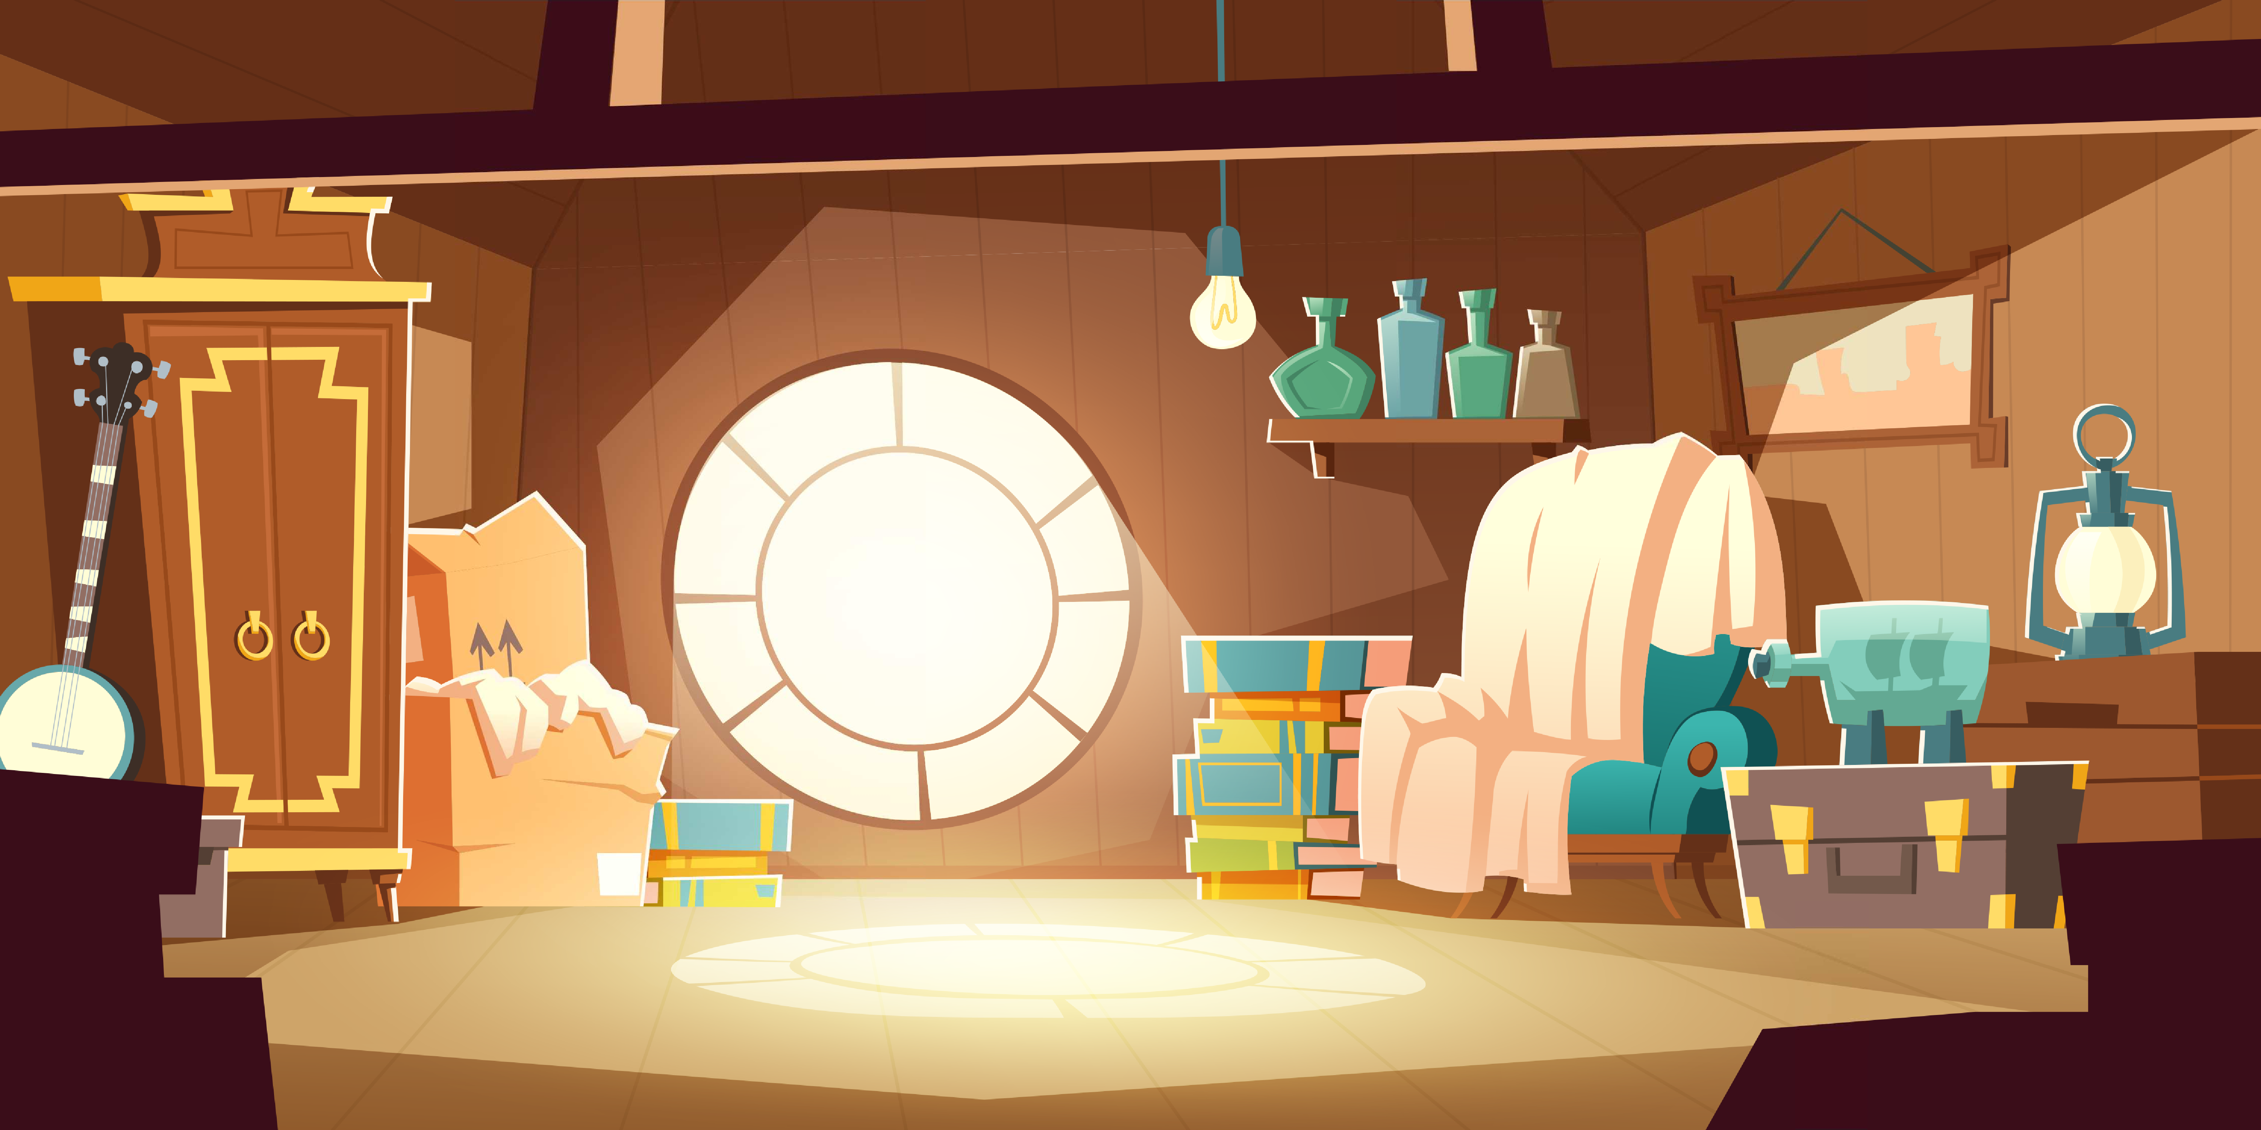
Give Me Five
Notes:
Shutterstock Image ID: 1563668263
Say, “This week you read the story Attic Memories. Using the 5 finger retell strategy, can you tell me about the story.
Say, “Hold up your thumb, tell me the characters.” (Andres and mom)
Say, “Hold up your pointer, tell me the setting.” (In the house and the attic)
Say, “Hold up your tall finger, tell me the problem.” (Andres likes to play outside in the fall but it was raining. He is bored.)
Say, “Hold up your ring finger, tell me the events.” (Andres watched TV, helped his mom in the attic, saw his old toys and they shared past memories, they found a box that belonged to his great grandfather, he tried on his Army uniform) The student does not need to name all of these events. They need to be able to tell at least 3 events from the story.
Say, “Hold up your little finger, tell me the ending/solution.” (He ended up having fun going through the boxes in the attic)
Say, “Make a heart with your fingers, does this story remind you of anything from your own life” (answers will vary)

Slide 12
Q & A
Any Questions?

