Slide 1
Vacation Days
Adventure with Words
Notes:
Say, “Today we are going to go on an adventure with words. We will review the suffix –ly, double negatives, vocabulary, and do a 5 finger retell of the story Hiking the Grand Canyon.”

Slide 2

All About the -ly Suffix
ly
quickly
= in a way that is quick.
Adding -ly to the end of a word adds the meaning “in a way that is”. It tells how something is done.
Notes:
Click to show the suffix -ly. Say, “Today we are going to review the suffix -ly”.
Click to show the meaning of the suffix -ly. Say, “Adding -ly to the end of a word adds the meaning in a way that is. It tells how something is done.” Click for it to disappear.
Click to show the word quickly and a picture of a racecar. Ask the student, “What do you think the word quickly means?” Wait for the student to answer. Click to show the meaning of quickly. If the student answers correctly. Say, “Yes! Quickly means in a way that is quick.” If the student answers incorrectly. Say, “Remember, -ly means in a way that is. So, quickly means in a way that is quick.

Slide 3

Taking a Trip to Practice -ly
sad
ly
= in a way that is sad
Notes:
Click to show the word sad and a picture of a sad face. Say, “What is the new word if I add the suffix -ly?” Wait for the student to answer sadly. Then click to show the word sadly.
Say, “what does the new word mean?” Wait for the student to answer. Click to show the meaning of sadly. If the student answers correctly,. Say, “Yes, sadly means in a way that is sad.” If the student answers incorrectly. Say, “Remember, -ly means in a way that is. So, sadly means in a way that is sad.”

Slide 4
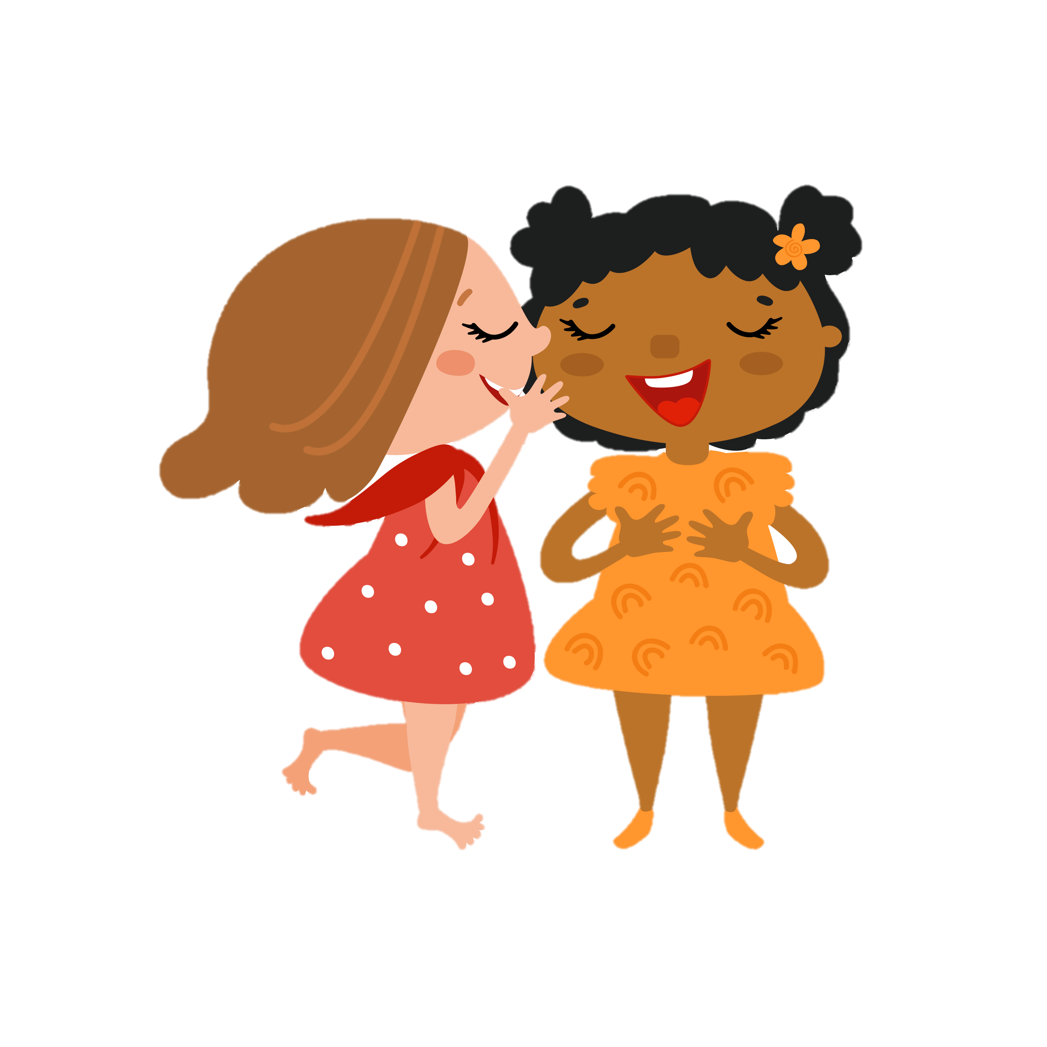
Destination to Practice -ly
soft
ly
= in a way that is soft
Notes:
Click to show the word soft and a picture of the 2 girls whispering. Say, “What is the new word if I add the suffix -ly?” Wait for the student to answer softly. Then click to show the word softly.
Say, “what does the new word mean?” Wait for the student to answer. Click to show the meaning of softly. If the student answers correctly,. Say, “Yes, softly means in a way that is soft.” If the student answers incorrectly. Say, “Remember, -ly means in a way that is. So, softly means in a way that is soft.”

Slide 5

Explore Practicing -ly
slow
ly
= in a way that is slow
Notes:
Click to show the word slow and a picture of a turtle. Say, “What is the new word if I add the suffix -ly?” Wait for the student to answer slowly. Then click to show the word slowly.
Say, “what does the new word mean?” Wait for the student to answer. Click to show the meaning of slowly. If the student answers correctly,. Say, “Yes, slowly means in a way that is slow.” If the student answers incorrectly. Say, “Remember, -ly means in a way that is. So, slowly means in a way that is slow.”

Slide 6
Traveling to a Double Negative Review
A double negative is when you use two negatives in one sentence.
Negatives are words that mean no or not
never nobody none
no no one nor not nothing n’t
I haven’t told nobody your secret.
Notes:
Say, “Today we are going to review double negatives.”
Click to show the word negatives and the meaning. Say, “Negatives are words that mean no or not.” Click to show examples of negative words. Say, “Here are some examples of negative words. (never, no, nobody, none, no one, nor, not, nothing, and n’t) Click for it to disappear
Click to show double negatives and the meaning. Say, “A double negative is when you use two negatives in one sentence. "Click to show an example of a sentence with a double negative. Say, “This sentence has a double negative. I haven’t told nobody your secret. Can you tell me the two negatives used in this sentence?” Wait for student to answer. Click to have the words highlighted. If the student says correct answer. Say, “Yes, n’t and nobody are negatives.” If the student answers incorrectly. Say, “Remember our negative words we discussed. The negative words in this sentence are n’t and nobody.”

Slide 7
Relaxing with Double Negative
I would never go to the movies alone.
I shouldn’t have never tried to mess with him.
I never get to go nowhere with friends.
No
Yes
Notes:
Say, “Remember a double negative is a sentence that uses two negative words in it. We only need one negative word in a sentence. When we try to use two, then we run into a problem. I will show you a sentence. If the sentence contains a double negative give me a thumbs up. If the sentence does not contain a double negative give me a thumbs down.”
Click to show the sentence. Say, “I never get to go nowhere with friends. Does this sentence contain a double negative? Thumbs up if it does and thumbs down if it doesn’t” Wait for the student to give a thumbs up or down. Click to show the word yes. Say, “You should have your thumb up because I never get to go nowhere with friends has a double negative.” Click for sentence and yes/no to disappear.
Click to show the sentence. Say, “I shouldn’t have never tried to mess with him. Does this sentence contain a double negative? Thumbs up if it does and thumbs down if it doesn’t” Wait for the student to give a thumbs up or down. Click to show the word yes. Say, “You should have your thumb up because I shouldn’t have never tried to mess with him has a double negative.” Click for sentence and yes/no to disappear.
Click to show the sentence. Say, “I would never go to the movies alone. Does this sentence contain a double negative? Thumbs up if it does and thumbs down if it doesn’t” Wait for the student to give a thumbs up or down. Click to show the word no. Say, “You should have your thumb down because I would never go to the movies alone does not have a double negative.”

Slide 8
On Vacation with Vocabulary
survey
something that causes a strong feeling of excitement
plunge
to look over and examine closely
erosion
to leap or dive into water
to confuse thoroughly the understanding of
canyon
a deep narrow valley with steep sides and often with a stream flowing through it
thrill
mystify
the act or process of wearing away by water, wind, or glaciers
Notes:
Say, “Today we are going to review our vocabulary words.”
Click to show the vocabulary words. Say each word, “survey, plunge, erosion, canyon, thrill, mystify”
Click to show the definitions. Say, “We are going to match the word with its definition.”
Say, “What is something that causes a strong feeling of excitement? Yes, thrill! Click to show the line from the definition to the word.
Say, “What is to look over and examine closely? Yes, survey! Click to show the line from the definition to the word.
Say, “What is to leap or dive into water? Yes, plunge! Click to show the line from the definition to the word.
Say, “What is to confuse thoroughly the understanding of? Yes, mystify! Click to show the line from the definition to the word.
Say, “What is a deep narrow valley with steep sides and often with a stream flowing through it? Yes, canyon! Click to show the line from the definition to the word.
Say, “What is the act or process of wearing away by water, wind, or glaciers? Yes, erosion! Click to show the line from the definition to the word.

Slide 9
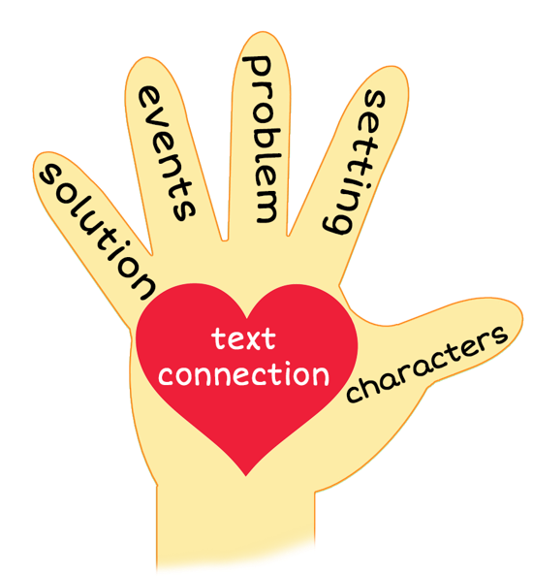
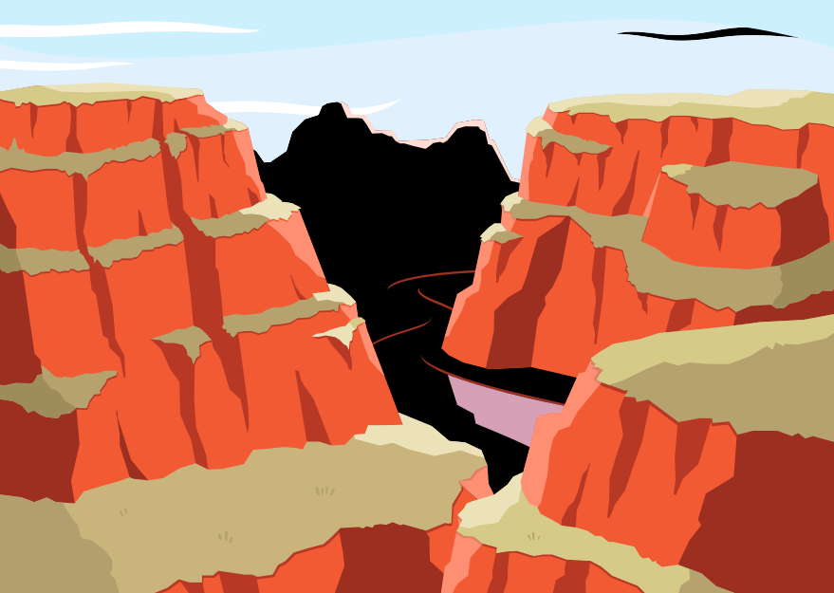
5 Finger Retell
Notes:
Say, “This week you read the story Hiking the Grand Canyon. Using the 5 finger retell strategy, can you tell me about the story.
Say, “Hold up your thumb, tell me the characters.” (Family – Mom, Dad, Sister, brother, and kid)
Say, “Hold up your pointer, tell me the setting.” (The Grand Canyon)
Say, “Hold up your tall finger, tell me the problem.” (The kid doesn’t want to go on a summer vacation to the Grand Canyon)
Say, “Hold up your ring finger, tell me the events.” (They trained for the vacation by going on hikes, they rented a car to drive from Texas to Arizona, they spent the night at a hotel, they went to the visitors center to watch a movie about the Grand Canyon, they went hiking, and camped at the bottom of the canyon) The student does not need to name all of these events. They need to be able to tell at least 3 events from the story.
Say, “Hold up your little finger, tell me the ending/solution.” (It ended up being a great trip)
Say, “Make a heart with your fingers, does this story remind you of anything from your own life” (answers will vary)

Slide 10
Q & A
Any Questions?

