Slide 1
Glaciers
Synonyms, Adverbs, and Vocabulary
Notes:
Say: Today we will be reviewing synonyms, adverbs and our vocabulary. We will end by discussing the main idea and details from this week's passage. We will be using dry erase boards or paper for a few slides. Please gather the supplies you need now.

Slide 2
Adventurous Adverbs
An adverb describes a verb. It tells how, where, or when something is done.
Quickly, I ran to my room and quickly grabbed my book bag. I quickly ran back down the stairs.”
A synonym is a word that means almost the same as another word.
Quickly, I ran to my room and hurriedly grabbed my book bag. I rapidly ran back down the stairs
Notes:
Say: In a previous module we learned about adverbs. An adverb describes a verb. It tells how, where, or when something is done. (Click to show on the screen.)
We have also learned about synonyms. Who remembers what a synonym is? (Give the students a moment to answer, then click to show the definition- A synonym is a word that means almost the same as another word.)
This week we are working on synonyms for adverbs. We don’t want to use the same adverbs over and over again in our sentences. Our paragraph would become boring. For example, (click to show the sentence and make the definitions disappear)
I could say “Quickly, I ran to my room and quickly grabbed my bookbag. I quickly ran back down the stairs.”
This sentence makes sense; however, the word “quickly” is used too many times, and it makes the sentence sound funny. We can use synonyms to replace some of the “quickly”s.
Here is an example (click to show the sentence).
“Quickly, I ran to my room and hurriedly grabbed my bookbag. I rapidly ran back down the stairs.” This sentence means the same as the previous sentence, however it sounds much better and it flows off the tongue better.

Slide 3
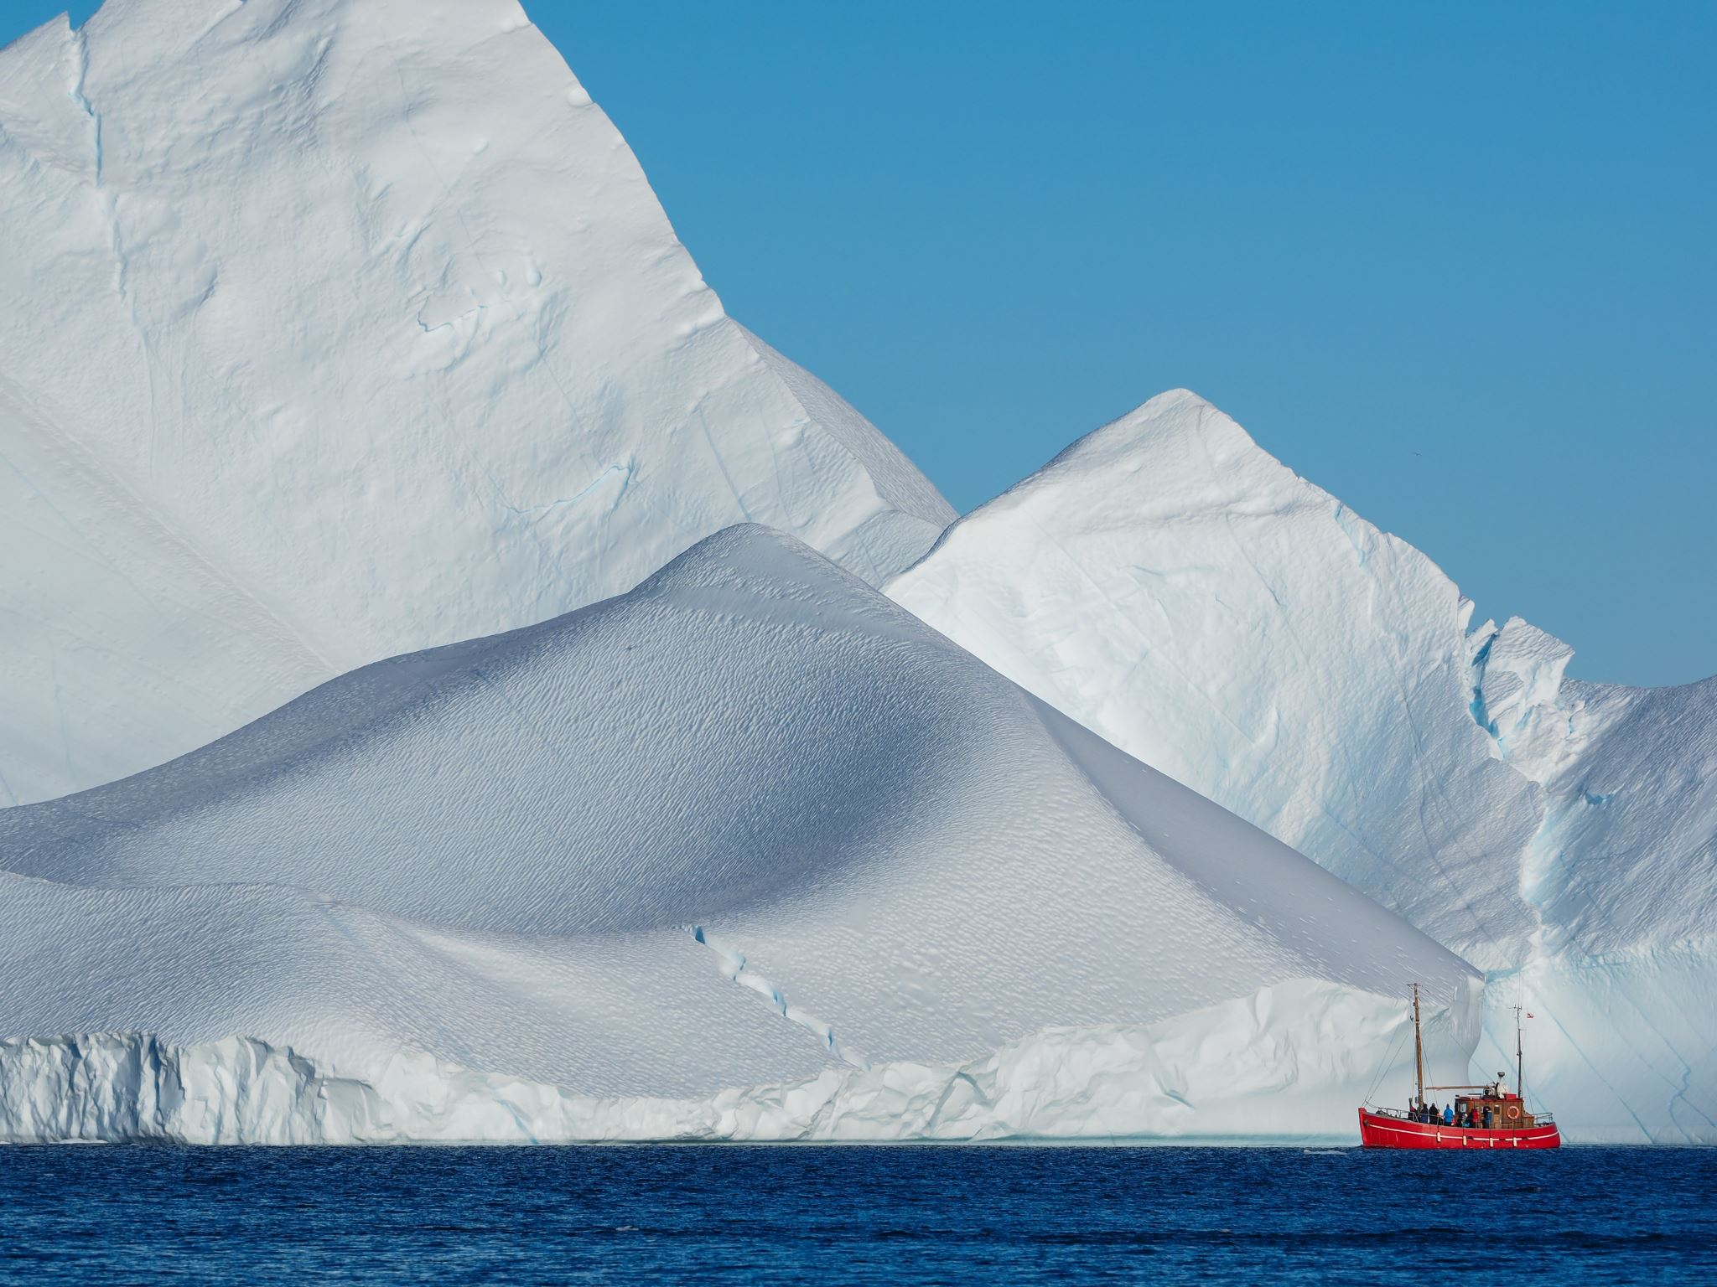
Synonym Sentences
We are going to the park soon.
She happily walked into the store.
She ran across the room quietly.
She cheerfully walked into the store.
The cat jumped on the table next to
the couch.
Notes:
Say: Let’s practice using synonyms and adverbs. I will show you a few sentences with the adverb underlined. For each one, please rewrite the sentence on your dry erase board using a synonym for the adjective.
Here is an example. (Click to show the sentence and have a student read it. “She happily walked into the store.”)
Let’s use a synonym for the underlined adverb “happily”. (Click to show the sentence.)
We can write "She cheerfully walked into the store.”
(Click to remove the examples.) Now it’s your turn! Please give me a synonym for the underlined adverb in this sentence. (Click to show each sentence and give the students a few minutes to think of a synonym and write the new sentence on their boards). Allow the students to share their work. If you have more time, you can allow the students to take turns making up a sentence and have the other students replace the adverb with a synonym.
2. We are going to the park soon. -ex: shortly
3. She ran across the room quietly. -ex: softly
4. The cat jumped on the table next to the couch. -ex: beside)

Slide 4
Glacier Vocabulary Review
to move smoothly, silently, and effortlessly
being at a great distance
a road, path, channel, or course by which something can pass.
a large body of ice moving slowly down a slope or valley or spreading outward on a land surface
to change from a solid to a liquid state usually through heat
to move along without effort
word bank
glacier
melt
glide
distant
drift
passage
Notes:
Say: Let’s review our vocabulary words from this week. When I read a definition, please tell me which word matches the definition. (Click to show the first definition.) Here is the first one- a road, path, channel, or course by which something can pass. Which word matches this definition? (Give the students a moment to answer then click to circle the correct answer - passage. Repeat with the remaining words.
a road, path, channel, or course by which something can pass - passage
a large body of ice moving slowly down a slope or valley or spreading outward on a land surface - glacier
being at a great distance - distant
to change from a solid to a liquid state usually through heat - melt
to move along without effort - drift
to move smoothly, silently, and effortlessly - glide)

Slide 5
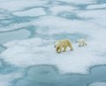
Our Vocabulary Adventure Continues!
word bank
glacier
passage
glide
distant
drift
melt
drift
We watched the iceberg _______ across the water.
I like to watch the ice skaters _______ across the ice.
glacier
We walked through the narrow ________ in the woods.
distant
melt
passage
glide
Your Turn!
Notes:
Say: Let’s practice using our vocabulary words in sentences. The first three sentences will be fill in the blanks. For the last three, when I show you the word please use it in a sentence for me. Here is the first one. (Click to show the sentence, then click to show the answer appear in the sentence and disappear in the word bank after a student answers.)
1. I like to watch the ice skaters _______ across the ice. -glide
2. We walked through the narrow ____ in the woods.- -passage
3. We watched the iceberg _______ across the water. -drift)
Now we will write sentences for the remaining words. Can you please give me a sentence for the word glacier? (Click to show the word.)
(Repeat process for remaining words- click to show each one.
glacier
distant
melt)

Slide 6
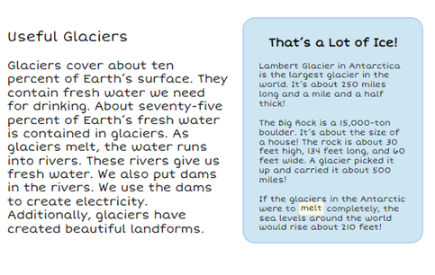
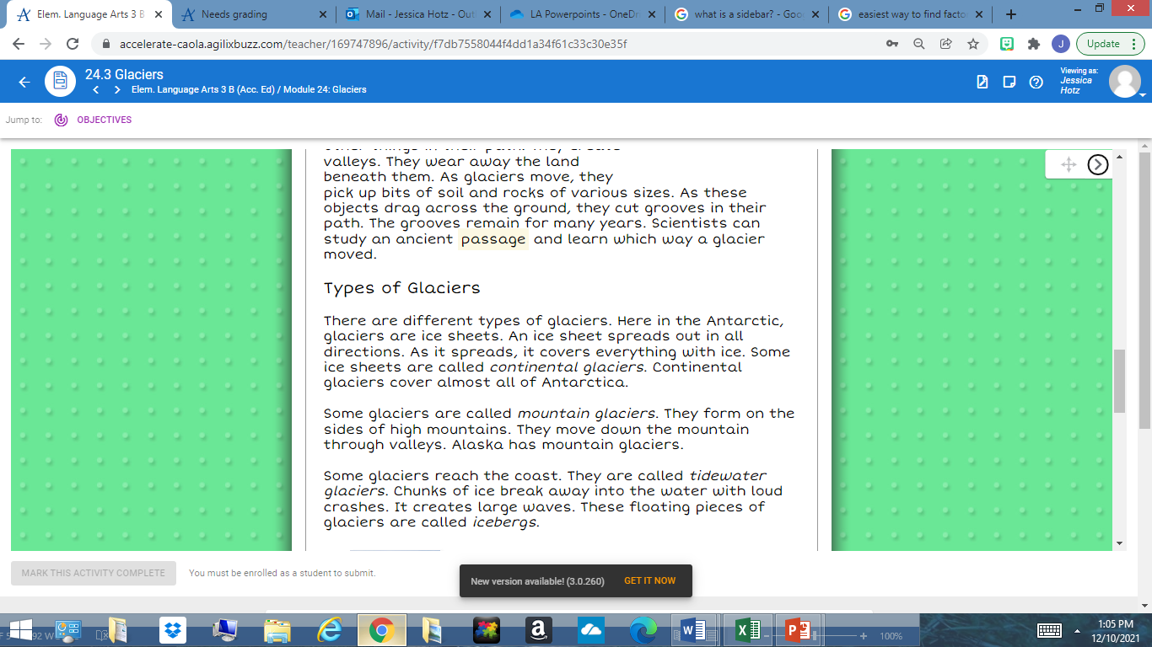
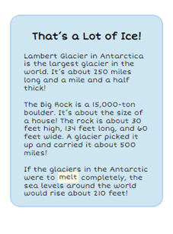
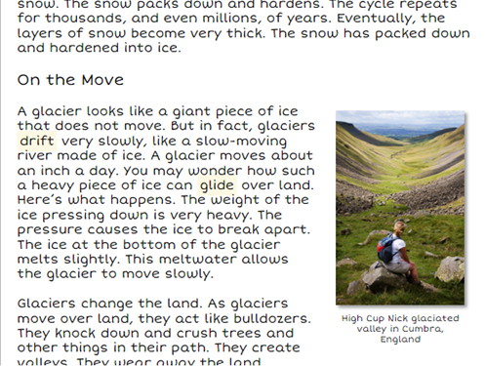
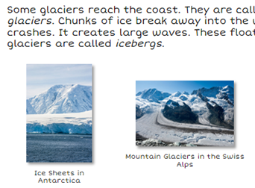
Reviewing Text Features
Sidebar
Caption
Heading
A caption is a word, phrase, or sentence underneath an image that give more information about it.
The purpose of a heading is to let the reader know what the next section will be about.
A sidebar is a box inserted alongside the text that has additional information.
Notes:
Say, “Today we are going to review text features and see if we can find them in the text you read Glaciers.”
(Click to show the word heading and the definition.)
Say, “The purpose of a heading is to let the reader know what the next section will be about.” (Click for it to disappear.
Click to show a picture of a paragraph with a heading ) Say "What is the heading for this paragraph?" Wait for the student to answer. Say, “yes, it's Types of glaciers.” (Click for it to disappear.)
(Click to show the word caption and the definition.) Say, “a caption is a word, phrase, or sentence underneath an image that give more information about it.” (Click for it to disappear.)
(Click to show a picture with a caption.) Say, “Do you see a caption on this page?” Wait for the student to answer. Say, “Yes, there are two captions! What do the captions tell us? Wait for the student to answer. Say, “Yes, the captions tell us about two different types of glaciers and where they located.” (Click for it to disappear.)
(Click to show the word sidebar and the definition.) Say, “a sidebar is a box inserted alongside the text that has additional information.” (Click to make it disappear.)
(Click to show a picture with a sidebar.) Say, “What does the sidebar tell you in this picture?” Wait for the student to answer. Say, “yes, it's telling us fun facts about glaciers.” (Click for it to disappear.)
(Click to show a page from the text Glaciers.) Say, “What text features do you see on this page?” Wait for the student to answer. Say, “yes, there is a heading and a caption. Click for it to disappear.
(Click to show a page from the text Glaciers.) Say, “What text features do you see on this page?” Wait for the student to answer. Say, “yes, there is a heading and a sidebar.

Slide 7
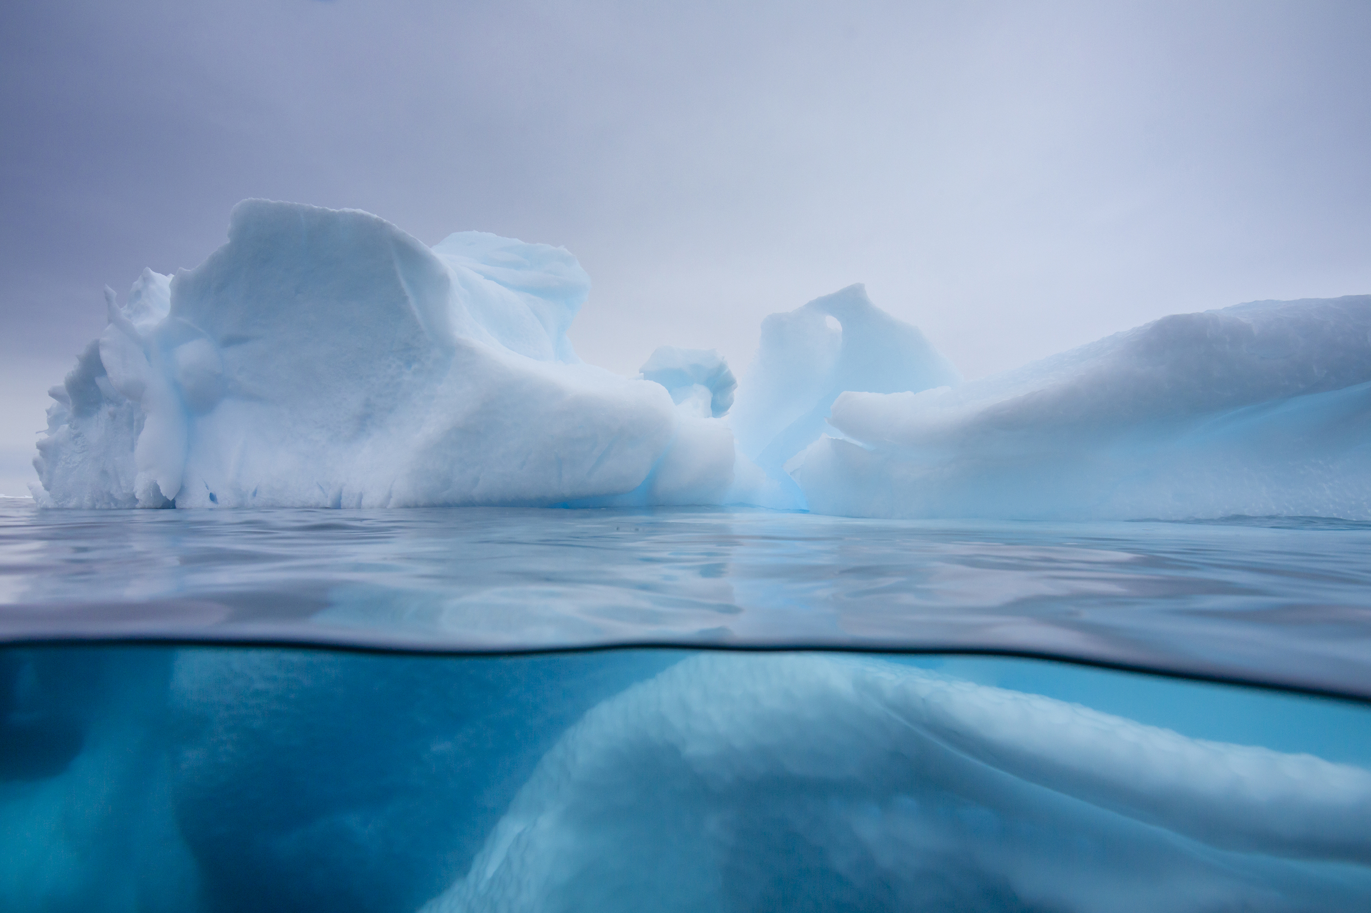
Icy Details!
Making a Glacier
1.
2.
3.
On The Move
1.
2.
3.
Types of Glaciers
1.
2.
3.
Useful Glaciers
1.
2.
3.
Notes:
Say: This week we read a passage about glaciers. We also learned about some of the features of a non-fiction text. There are four headings from our passage this week (click to show- “Making a Glacier” and three numbers for details.)
Let’s start with “Making a Glacier,” together we will come up with at least three details for this section. (Give the students a chance to discuss their details. Repeat the process for the three remaining headings. Click to show each new heading and numbers.
Details will vary, here are some examples.
Making a Glacier- formed in dry, cold places-Snow packs down and hardens, and eventually becomes very thick
On the Move- They move very slowly. The weight of the ice pressing down is heavy. Glaciers change the landscape. The bottom melts a little bit, allowing the glacier to move.
Types of Glaciers- There are different types of glaciers-ice sheets, mountain glaciers and tidewaters. Floating glaciers are called icebergs.
Useful Glaciers- They are freshwater. About 75%of the Earth’s fresh water is in glaciers)

Slide 8
Q & A
Any Questions?

