Slide 1
Natural Disasters
Adverbs and Vocabulary
Notes:
Say: Today we will be reviewing adverbs and our vocabulary. We will end by discussing the main idea and details from this week's passage. We will be using dry erase boards or paper for a few slides. Please gather the supplies you need now.

Slide 2
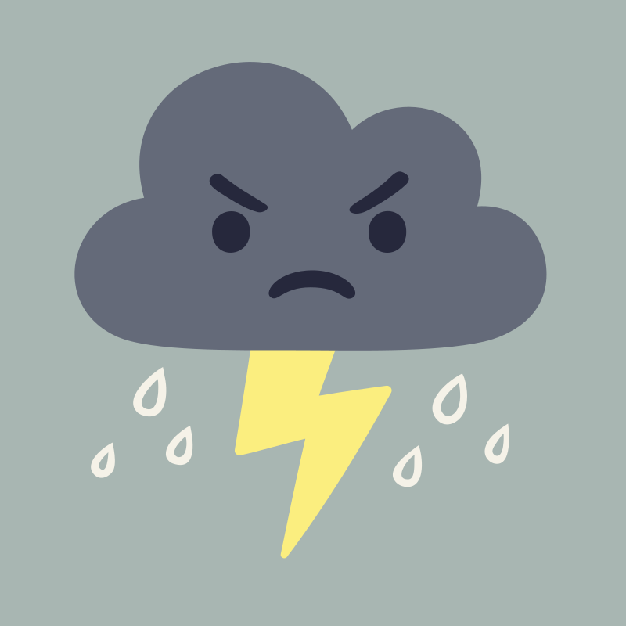
Why Use Adverbs?
An adverb describes a verb. It tells how, where, or when something is done.
The storm roared loudly.
They could hear the rain outside.
The storm will be over soon.
Notes:
Say: This week we are learning about adverbs. Does anyone remember what an adverb is? (Give the students a chance to answer, then click to show the definition.)
An adverb describes a verb. It tells how, where, or when something is done. For example, let’s look at this sentence (click to show the sentence).
The storm roared loudly. What is the verb in this sentence? (Allow the students to answer- roared.)
Correct! The verb is roared. We use the adverb “loudly” to show how the storm roared (click to underline “loudly”)
Here is another sentence (click to show). They could hear the rain outside.
Where could they hear the rain? They could hear it outside (click to underline “outside”). Outside is our adverb in this sentence.
Here is the last example (click to show the sentence).
The storm will be over soon. Which word is the adverb? (Give the students a chance to answer-soon and click to underline it).
The word soon tells us when.
Let’s brainstorm some adverbs on the next page.

Slide 3
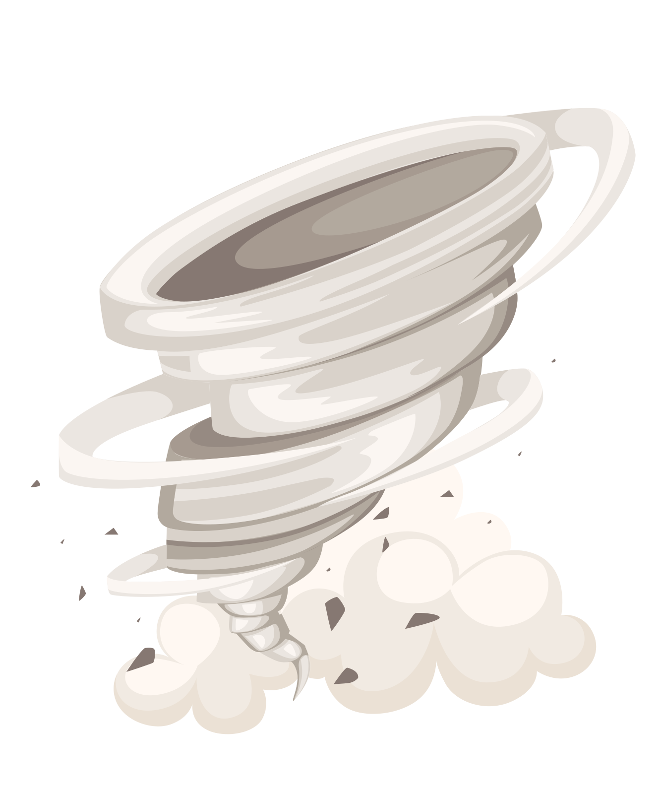
Brewing Up Some Adjectives
how | when | where
rapidly noisily sweetly carefully | today immediately now before | beside here everywhere later
Notes:
Say: We will be using our dry erase boards for this activity. We are going to brainstorm adverbs for each of the three categories (click to show each category and read it as it appears- how, when, where).
Here are some examples for how (click to show words and have a student read them aloud).
What are some other adverbs for the “how” category? Take the next minute and write down as many as you can think of. (Give the students one minute to write them down, then encourage the students to share what they wrote.)
Here are some examples for where (click to show words and have a student read them aloud).
What are some other adverbs for the “where” category? Take the next minute and write down as many as you can think of. (Give the students one minute to write them down, then encourage the students to share what they wrote.)
Here are some examples for when (click to show words and have a student read them aloud). What are some other adverbs for the “when” category? Take the next minute and write down as many as you can think of. (Give the students one minute to write them down, then encourage the students to share what they wrote.)

Slide 4
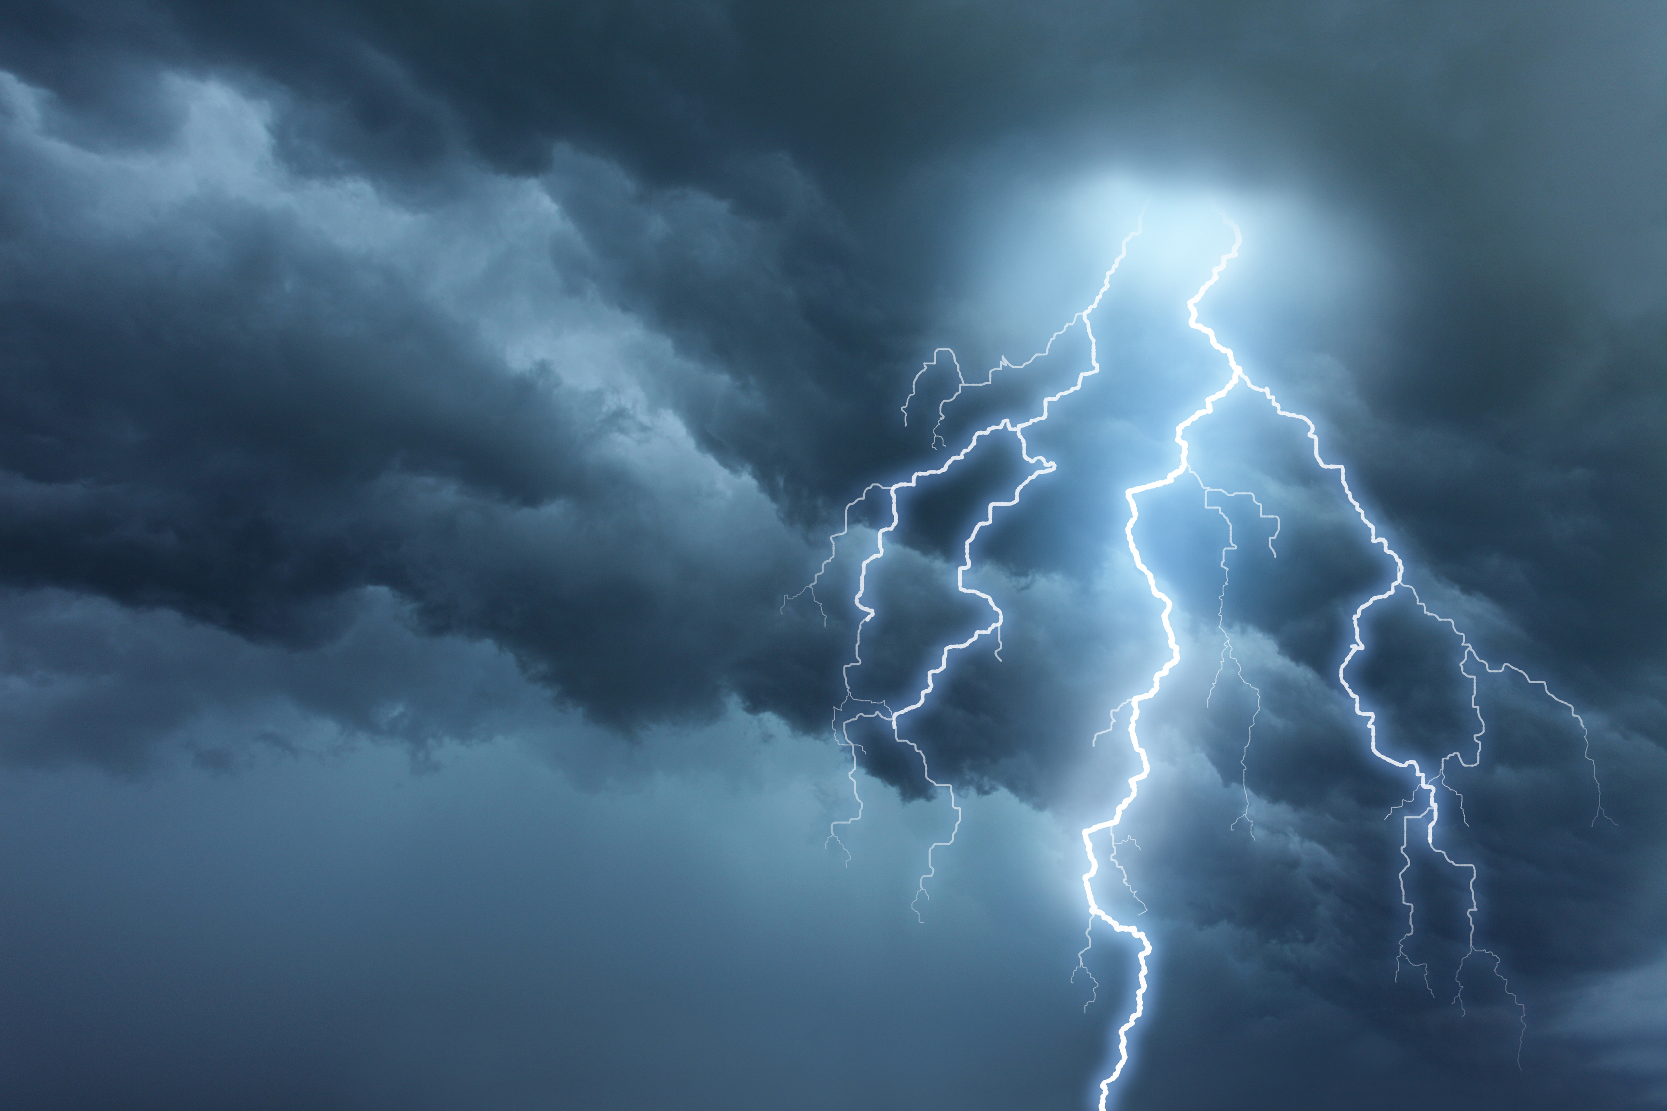
Natural Disaster Vocabulary
a great flow of water that rises and spreads over the land
a severe test or experience
a vent in the earth's crust from which melted rock or hot rock and steam come out
a shaking or trembling of a portion of the earth
notice given beforehand, especially of danger or evil
a great sea wave produced especially by an earthquake or volcano eruption under the sea
word bank
volcano
warning
tsunami
flood
ordeal
earthquake
Notes:
Say: Let’s review our vocabulary words for the week. When you see the definition, please tell me the word on the slide that matches. Here is an example. (The first one is on the screen- a severe test or experience. Read it to the student.)
Which word matches this definition? (Student should say “ordeal”. Click to show the answer crossed out, then click for a new definition. Repeat the process with the remaining words.
ordeal: a severe test or experience
warning: notice given beforehand, especially of danger or evil
earthquake: a shaking or trembling of a portion of the earth
flood: a great flow of water that rises and spreads over the land
tsunami: a great sea wave produced especially by an earthquake or volcano eruption under the sea
volcano: a vent in the earth's crust from which melted rock or hot rock and steam come out)

Slide 5
Earth Shaking Sentences
The spiraling ________ripped the tree up by the roots.
The people who lived through the hurricane said it was a terrifying ________.
The reporter said that the huge wave was actually a ________!
The tsunami caused the whole town to _____.
They siren sounded a loud ________ when the tornado was spotted.
The hot lava spewing from the _______ was a frightening sight!
word bank
warning
tsunami
flood
tornado
volcano
ordeal
Notes:
Say: I’m going to show you some sentences. Please read the sentence and tell me the vocabulary word that fits best in the sentence. The first one is already on the slide.
(Click to show a sentence and give the students a moment to choose the best answer. Then click to show the correct answer move to the sentence, click again for a new sentence to appear. Repeat for each sentence .
1. The hot lava spewing from the _______ was a frightening sight! - volcano
2. They siren sounded a loud ______ when the tornado was spotted. -warning
3. The people who lived through the hurricane said it was a terrifying ______. - ordeal
4. The spiraling ______ripped the tree up by the roots. - tornado
5. The reporter said that the huge wave was actually a ______! - tsunami
6. The tsunami caused the whole town to _____. - flood

Slide 6
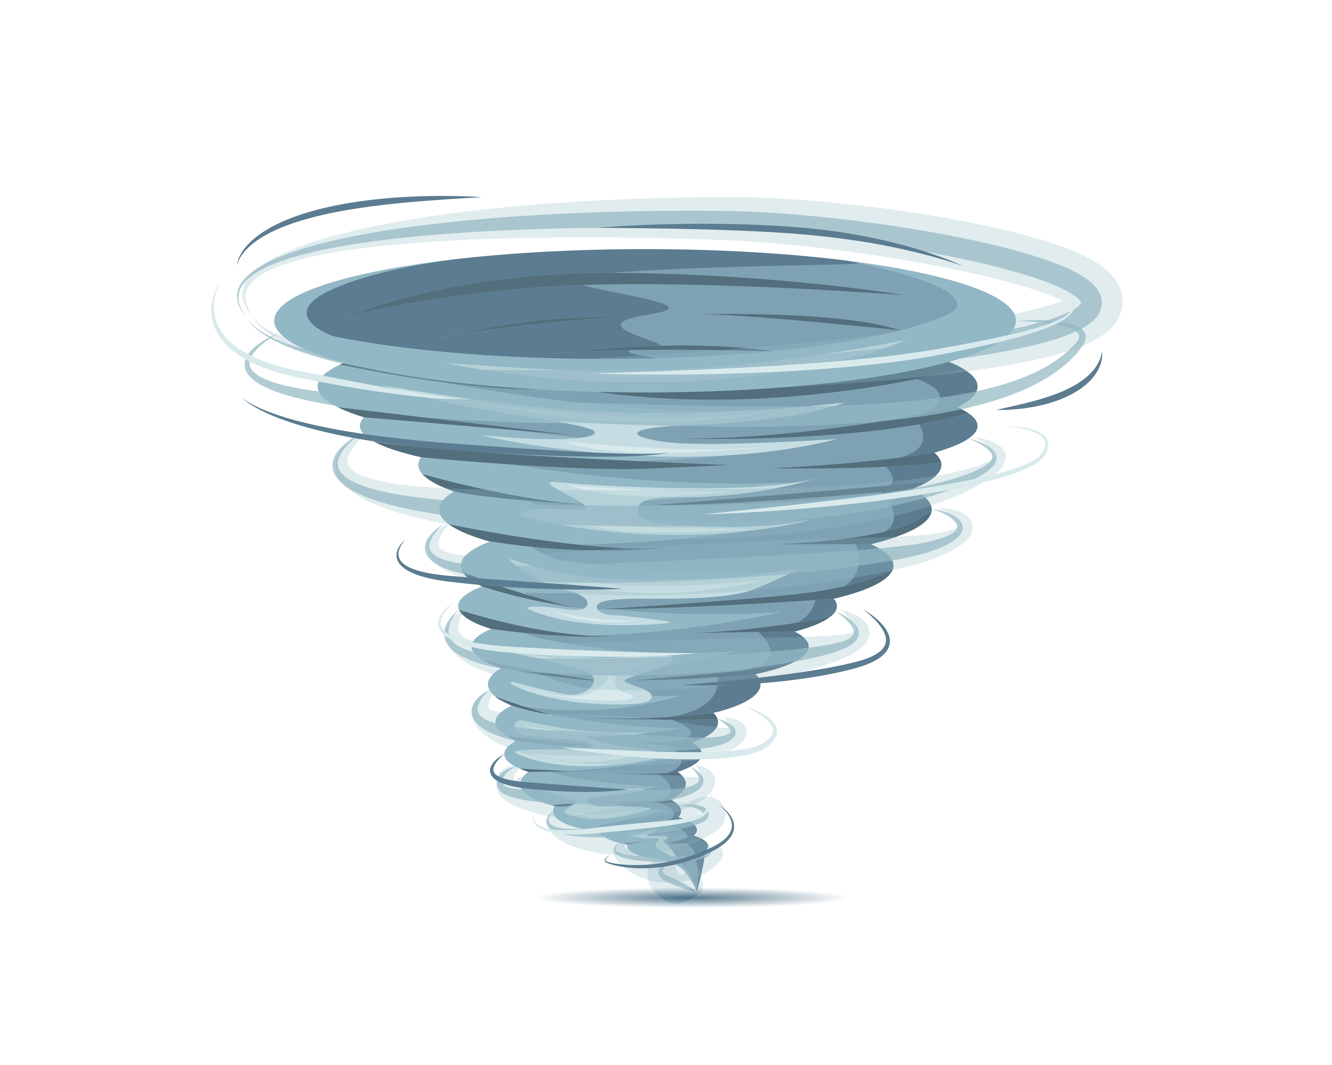

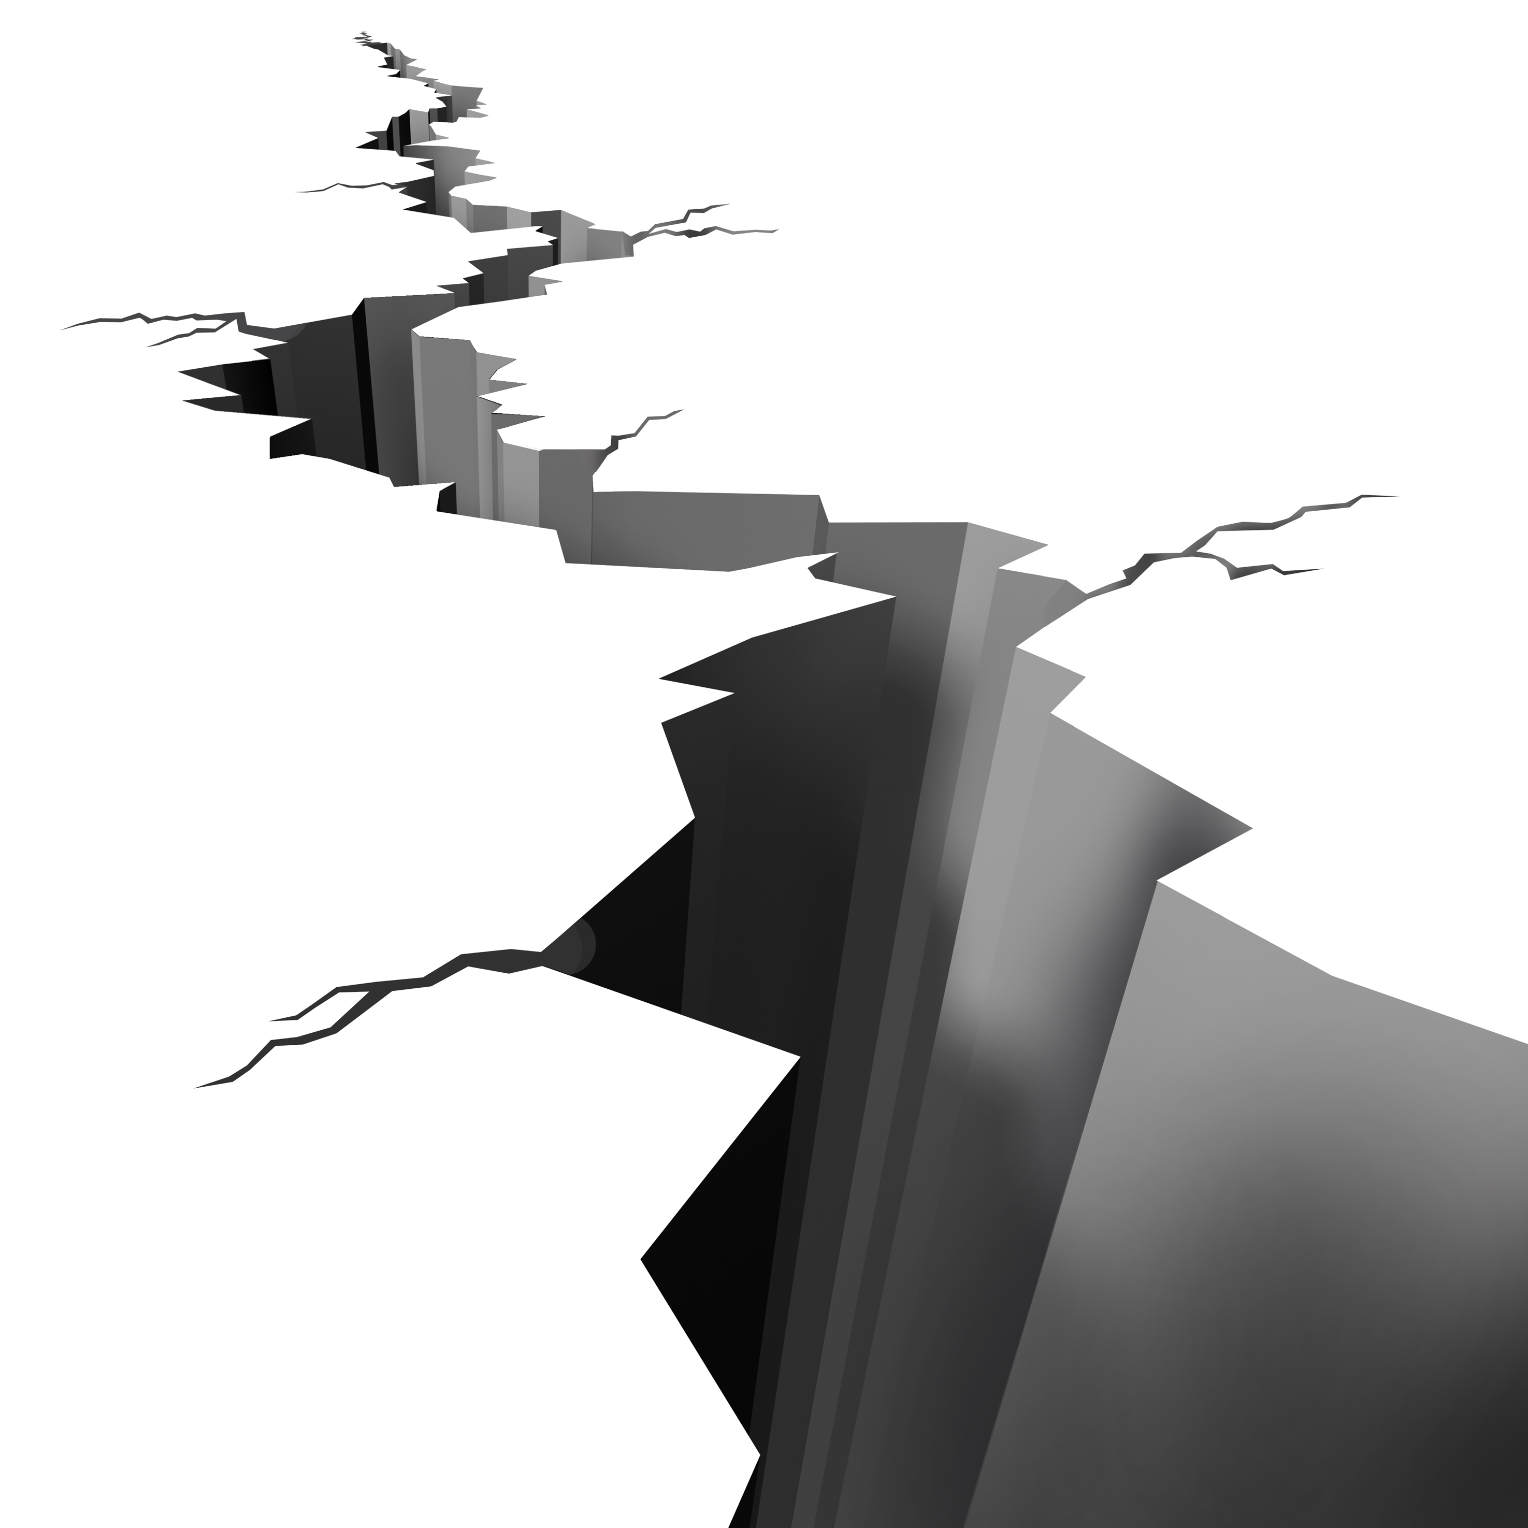
Disastrous Details
Main idea- There are many different types of natural disasters.
Tornado
Tsunami
Earthquake
Notes:
Say: We are going to use our dry erase boards again for this lesson. The main idea of our story is that there are many types of natural disasters. There were many different details in this story, and three main topics. Who can tell me what the three main topics were in the story? (Give the students a moment to answer- a tornado, a tsunami, and an earthquake then click to show the three topics. If the students struggle, tell them to look at the pictures for a clue.) Using your dry erase board or paper, please write down any details that you remember about a tornado. ( Click to point to the picture of the tornado. Give the students a few minutes to write down their details, then allow students to share their details. Repeat the process with a tsunami and an earthquake)

Slide 7
Q & A
Any Questions?

