Slide 1
Weather Patterns
Sensory Adjectives and Synonyms
Notes:
Say: Today we will review sensory adjectives and synonyms. We will also end with a story recap. We will be using dry erase boards or paper for a few slides. Please gather the supplies you need now.

Slide 2
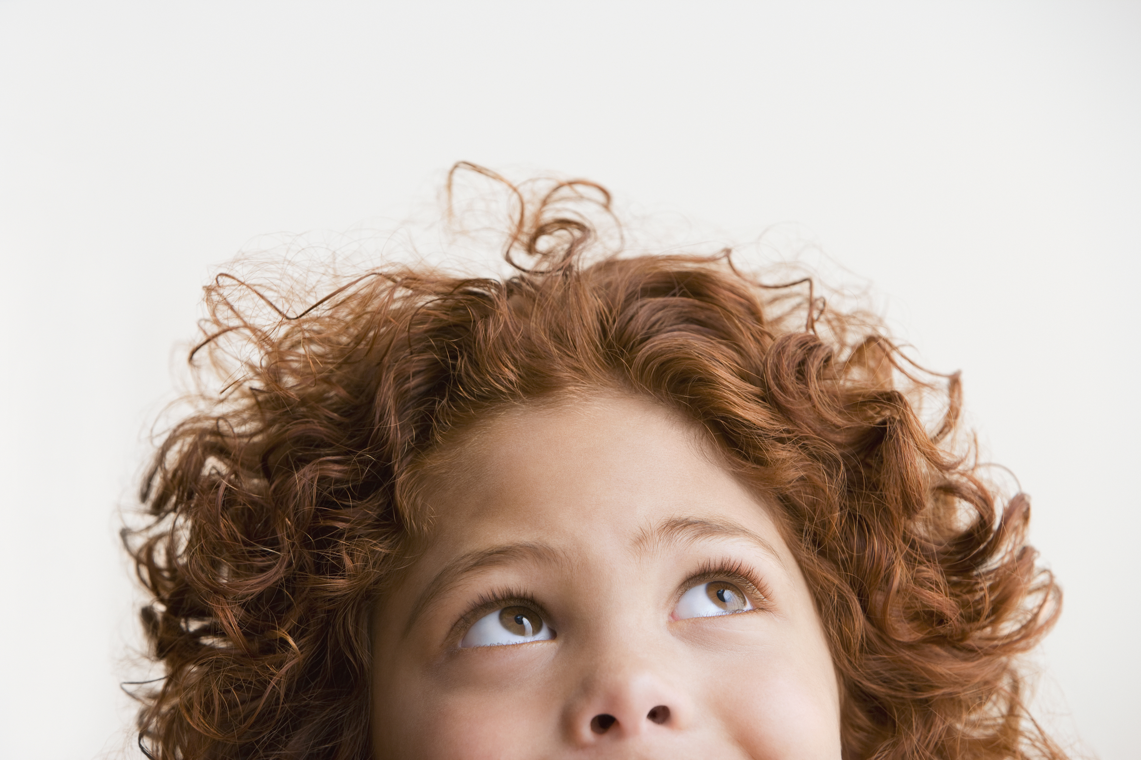

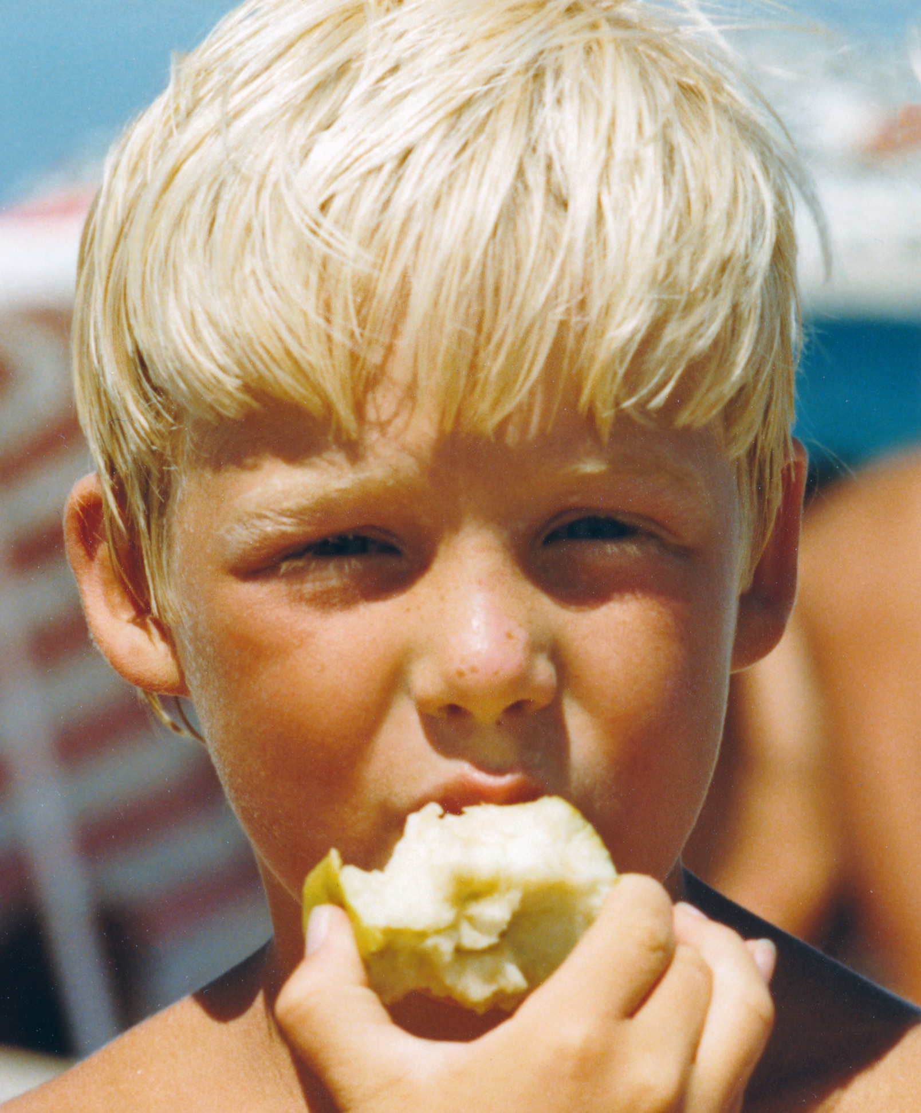


Adjectives with Feeling
looks
smells
Sensory Adjectives
tastes
feels
sounds
Notes:
Say: In a previous module we discussed how using adjectives can make your writing more interesting. There are many different adjectives, but today we are talking about sensory adjectives (click to show “sensory adjectives”).
Can anyone tell me what the five senses are? (Give the students a moment to answer, then read the next sentence.) Sensory adjectives are adjectives that describe how something (click to show each word and picture) looks, smells, tastes, feels, and sounds. Let’s come up with some examples on the next slide.

Slide 3
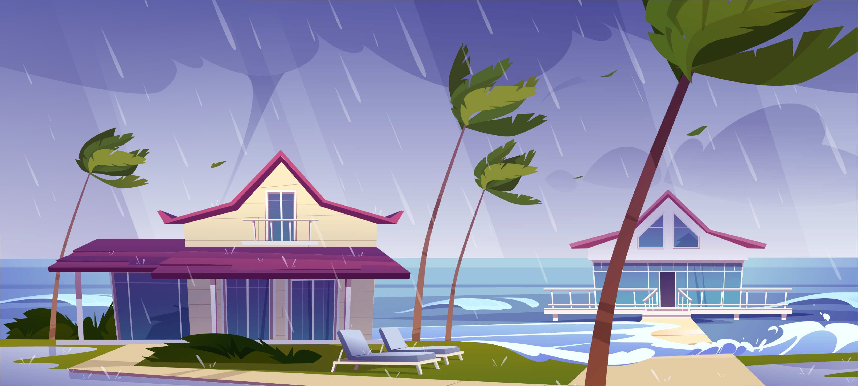
A Hurricane of Adjectives
looks
smells
tastes
feels
sounds
Notes:
Say: Let’s brainstorm together! We read about hurricanes in our module this week, so we are going to come up with sensory adjectives for a hurricane (click to show a hurricane picture).
You can use your whiteboards or paper for this activity. Here is the first sensory word (click to show the word “looks”).
What are some adjectives to describe how a hurricane looks? Write them down on your board or paper.
[Give the students a moment to write down some examples. Allow the students to share with each other. If someone gets stuck, allow some of the other students to share their answers and encourage the student. Repeat the process with the remaining words- examples are below.
Looks- windy, flashing (lightning), messy, strong, violent, gloomy
smells- stinky, salty, rainy
tastes- salty (water whipping around), bitter, earthy]
feels(touch)- windy, painful (water and debris), wet
sounds- roaring, thunderous, howling

Slide 4
Sad Synonyms
sad
fun
melancholy
unhappy
miserable
down
?
Synonym- A synonym is a word that means almost the same as another word
Notes:
Say: This week we are reviewing synonyms.
Who remembers what a synonym is? (Give the students a moment to answer then click to show the answer.)
A synonym is a word that means almost the same as another word. For example, let’s look at the word sad (click to show the word ).
Here are some synonyms for sad (click to show the words and pick a student to read them). They mean almost the same as sad.
Now it’s your turn! Please give me a synonym for fun. (Click to show the word. Give students time to discuss their answers. They could also use their whiteboards to write them down.
Examples for fun: enjoyable, exciting, entertaining, lively, thrilling) Great work! We are going to practice identifying synonyms with our vocabulary words this week!

Slide 5
A Wave of Vocabulary
word bank
hurricane
crumple
climate
moisture
wave
fierce
a cyclone formed in the tropics with winds of 74 miles per hour or greater that is usually accompanied by rain, thunder, and lightning
a moving ridge on the surface of water
wild or threatening in appearance
A small amount of liquid that causes wetness
to press, bend, or crush out of shape
a region with specific weather conditions
Notes:
Say: Before we identify synonyms, let’s review our words quickly. When I show you the definition, please tell me which word matches. Here is the first one (click to show-a moving ridge on the surface of water). Which word matches this definition? (Give the students a moment to answer then click to make the correct word disappear -wave.) Click again for a new definition. Repeat with the remaining words.
wave: a moving ridge on the surface of water
hurricane: a cyclone formed in the tropics with winds of 74 miles per hour or greater that is usually accompanied by rain, thunder, and lightning
crumple: to press, bend, or crush out of shape
moisture: a small amount of liquid that causes wetness
fierce: wild or threatening in appearance
climate: a region with specific weather conditions

Slide 6

Synonym Practice
fierce
crumple
climate
wave
hurricane
moisture
weather patterns, weather region, conditions, temperature
wet, damp, humidity
storm, cyclone, tropical storm
bold, savage, dangerous, ferocious
ripple, flow, tide, move, rush
wrinkle, crinkle, crush, crease
Notes:
Say: I will show you a group of synonyms. Please tell me the vocabulary word that best matches the synonyms.
Here is the first one. (Click to show ripple, flow, tide, move, rush.)
Which vocabulary word best matches these words? (Give the students a moment to answer, then click to make the word “wave” to disappear. Click again for a new group of synonyms and repeat process for all of the groups. If the students get stuck, discuss it as a group. You could also ask the students if they could think of any other synonyms for each word as you discuss the answers.
climate: weather patterns, weather region, conditions, temperature
crumple: wrinkle, crinkle, crush, crease
moisture: wet, damp, humidity
fierce: bold, savage, dangerous, ferocious
hurricane: storm, cyclone, tropical storm

Slide 7
Weather Patterns Retell
topic
fact 1
fact 2
fact3
I wonder....
My favorite thing I learned was....
Notes:
Say: Let’s see what you remember about this week’s story. (Click to show the first box-topic)
What is the topic of this week’s story? (Give the students a moment to answer -hurricanes.)
Great! Now please tell me 3 facts from the story (click to show three fact boxes appear. Give the students a moment to answer. Answers will vary. They should list three facts about hurricanes [how they form, where they usually are, what makes it a hurricane, etc.]
(Click to show the “I wonder” box)
The next box asks if you have any questions. What do you still wonder about hurricanes? (Give the students a moment to answer. Answers will vary.)
Here is the last box (click to show “My favorite thing I learned was...” Give the students a moment to answer. Answers will vary.)

Slide 8
Q & A
Any Questions?

