Slide 1
Making Mistakes
Verb Endings and Adjectives
Notes:
Say: Today we will review past and present tense verb endings. We will also review the use of adjectives and end with the 5 finger retell. We will be using dry erase boards or paper for a few slides. Please gather the supplies you need now.

Slide 2
Past and Present Tense Verbs
Base word​ | -ed | ing​
​bake | ​baked | ​baking
​cry | cried​ | crying​
stop | stopped | stopping
Notes:
Say: This week we've been learning about the rules for changing verbs to past and present tense. Let’s look at some examples.
Does anyone remember the rule for words that end in e? (Give the students a moment to answer.) If the verb ends in e, we drop the e and add –ed or -ing.
For example, let’s change the verb bake (click to show the word in the chart).
To change the tense of bake to past tense, we drop the e and add -ed (click to show the word in the chart -baked).
To change the tense of bake to the present tense, we drop the e and add -ing (click to show the word in the chart - baking).
What is the rule for words that end in y? (Give the students a moment to answer.) We change the y to i before adding –ed. We don’t need to do that for the –ing ending though. We just add –ing. For example, let’s change the verb cry to past tense. (Click to show the word in the chart).
We change the y to an i and add -ed (click to show the word in the chart -cried). For present tense, we just add ing (click to show the word in the chart -crying).
Sometimes we need to double that final consonant before adding the ending. If our verb has a short vowel sound, what do we do? (Give the students a moment to answer.)
We double the consonant. Because it has a short vowel sound, we need to double the consonant at the end before adding –ed.
For example, let’s look at the word stop (click to show the word in the chart). Do you hear the short vowel sound? In order to change stop to the past tense, we double the p and add -ed (click to show the word in the chart- stopped). For present tense, we double the p and add -ing (click to show the word in the chart -stopping).

Slide 3
Can You Change the Verb?
grab
skate
try
grabbed
grabbing
skated
skating
tried
trying
shine
nap
dry
shined
shining
napped napping
dried
drying
Notes:
Say: Let’s practice some changing verbs! On this slide, there are several verbs. We will take turns picking a word and then everyone will write the correct past and present tense spelling on their board or paper. After everyone is finished writing, we can click on the word and see if you are correct. (Allow one student at a time to pick a word, then have the students write the past and present tense on paper or a white board to hold up. When the students are ready, click on the word to make the correct past and present tense words appear. They can check their answers and the teacher can check for mastery when the boards are held up.
grab, nap, try, dry, skate, shine)

Slide 4
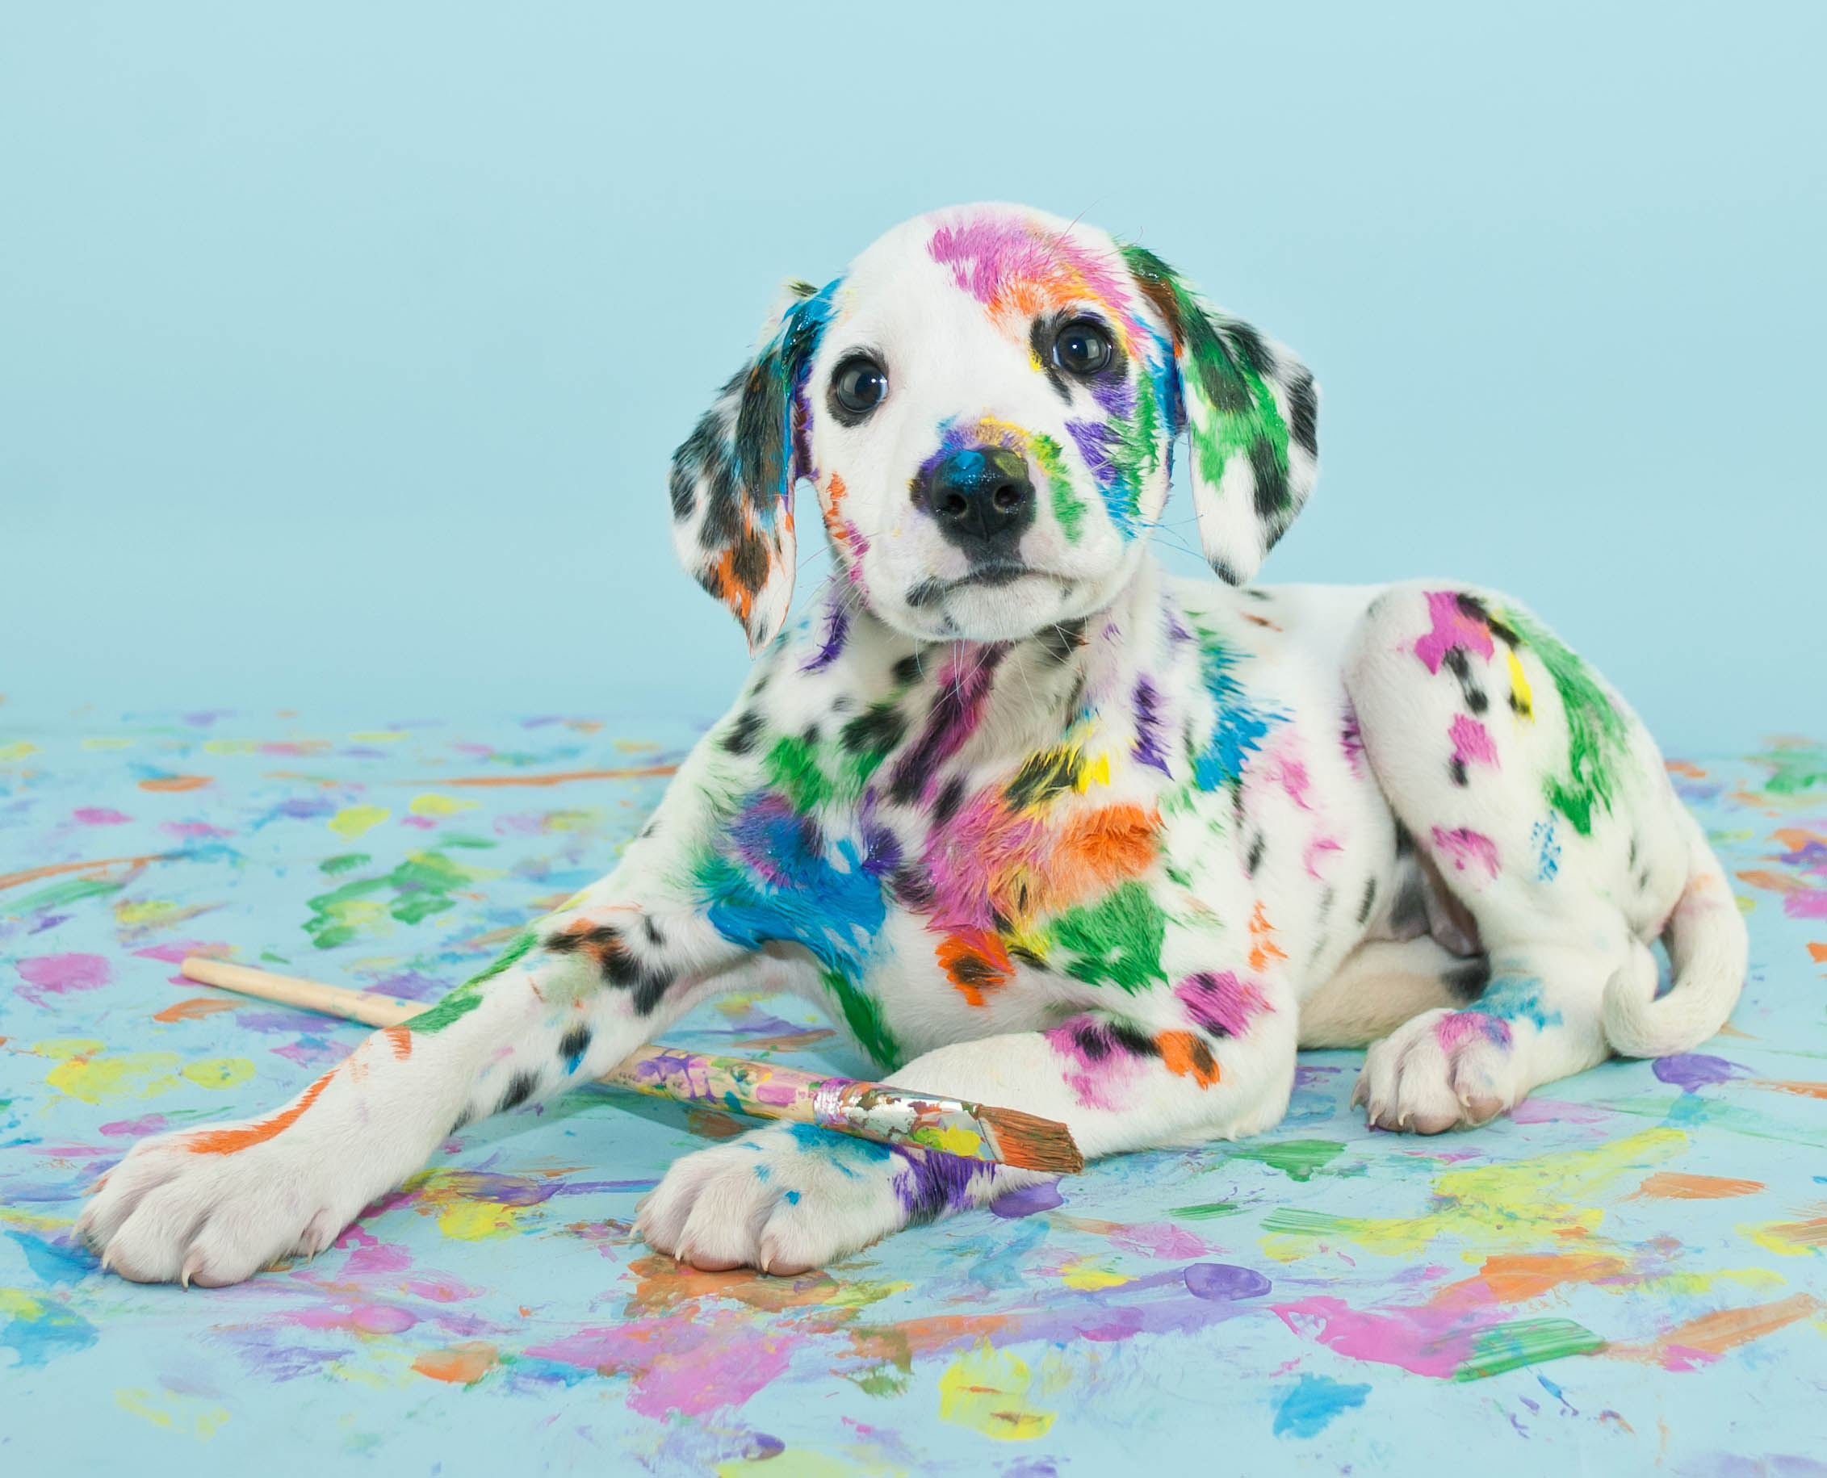
Awesome Adjectives!
I see a dog.
I see a cute and colorful spotted dog.
Notes:
Say: The use of adjectives enhances our writing and helps the reader understand what we are trying to convey. An adjective is a word used to describe a noun. For example, let’s take a look at the picture on the screen. (Click to show the sentence.) We could write a sentence that says “I see a dog.” and we would be correct. However, it doesn’t give the reader much information. What adjectives can we add to make the sentence better? (Give the students a chance to discuss some adjectives -big, spotted, colorful, cute, etc. Then instruct the students to write their new sentence on their whiteboards or paper. Give all the students a chance to share their sentences. Then click to show and read the example sentence, “I see a cute and colorful spotted dog.”)

Slide 5
Brainstorming Adjectives!
strong
gray
smart
elephant
huge
wrinkled
loud
Notes:
Say: We are going to make a graphic organizer. Using your whiteboard or paper, please draw a graphic organizer like the one on the screen. Make sure the circles are big enough to write inside of them. Start with a big circle in the middle of the page and add six more connected circles around the outside. Watch my example, don’t write anything else yet.
In the middle of my organizer, I wrote a noun (click to show the word elephant).
In each outer circle I wrote an adjective that describes an elephant (click to show and say each adjective –strong, smart, wrinkled, loud, huge, gray)
In your circle, I’d like you to write a noun. (Give the students a moment to fill in their circle. Have each student tell you what they are writing. If any student struggles, remind them that a noun is a person, place, or a thing. You can help with ideas if they don’t have one. [ex a friend, a pet, something in their house, a park or somewhere they like to visit.)
Please fill in each outer circle with an adjective that describes your noun. (Give the students time to work. When complete, ask each student to share their answers. If a student struggles to fill all their circles, ask the other students to help brainstorm ideas.)

Slide 6
Good Deeds Vocabulary Review
opponent
convince
friendship
a person or thing that stands against another
the state of being friends
to make a person agree or believe by arguing or showing evidence
Notes:
Say: Let’s review our vocabulary words! On the top of the screen in the gray box are the words, and the bottom has the definitions. Choose the definition that matches each word. (Choose one student at a time. Have them choose a word and definition that they think matches. Click on the word to make it move to the correct definition. Repeat for each word. There are three on this slide and three on the next slide.
opponent - a person or thing that stands against another
convince - to make a person agree or believe by arguing or showing evidence
friendship - the state of being friends)

Slide 7
Vocabulary Review Continued
confess
defend
accuse
to support against opposition
to charge with a fault, and especially with a crime
to make known
Notes:
Say: Let’s continue with the last three
(confess - to make known
accuse - to charge with a fault, and especially with a crime
defend - to support against opposition)

Slide 8

Making Connections
defend
opponent
convince
friendship
confess
accuse
Notes:
Say: We are going to use our white boards or paper again for this slide.
I will show you the words one at a time. For each word, we are going to write what the word makes us think of, then we will share our answers with the group. Remember, we need to keep the words appropriate for school. Here is the first one (click to show the word-defend).
What does this word make you think of? (Discuss answers, lead students at first if they need a little help. There aren’t any wrong answers, it’s whatever the student associates with the word.
When finished sharing, click to show a new word and repeat the process.
Ex: defend- court, police, lawyer, football, offense, crime, basketball-ect
opponent - sports, defense, offense, enemy
convince - persuade, buying something, commercials
friendship - friendly, nice, kind –students might list the names of friends or events they went to with friends
confess - lie, truth, trouble, crime, love
accuse - angry, fight, argument)

Slide 9
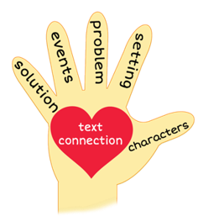


Give Me Five!
Notes:
[Insert Shutterstock image Id: 221243806 and 1054962065 both set to appear on the first click]
Say: It’s time for the five finger retell! (Click to show the hand and images appear.)
Show me your fingers! (Have the students hold up their hand and point to each finger as they go through the retell.)
Characters-Eddie and Dillon
Setting- mostly the Eddie’s house, a little time in school and on the bus
Problem- Eddie and Dillon get in a fight over who won a game.
Events-
*Eddie and Dillon are best friends and spend a lot of time together.
*Eddie gets a new video racing game.
*They spend a lot of time learning how to play the game.
*They decide to race, Eddie goes first, then Dillon gets a turn.
*Eddie wins the most points, but Dillon has the quickest time.
*Both boys say they won, and they get in a big fight.
*Dillon and Eddie say the friendship is over. They don’t speak to each other for a week.
Solution- Dillon finally goes to Eddie’s house and apologizes. Eddie apologizes too. The boys decide to play again- one time for points, and the next time for the fastest score. They both say that they will have fun no matter who wins!
Text connection- Say: Tell me about a time when you and a friend had a fight. How did you resolve it?

Slide 10
Q & A
Any Questions?

