Slide 1
Good Deeds
Irregular Verbs and Vocabulary
Notes:
Say: Today we will review and practice irregular verbs. We will also review our vocabulary and end with the five finger retell.

Slide 2
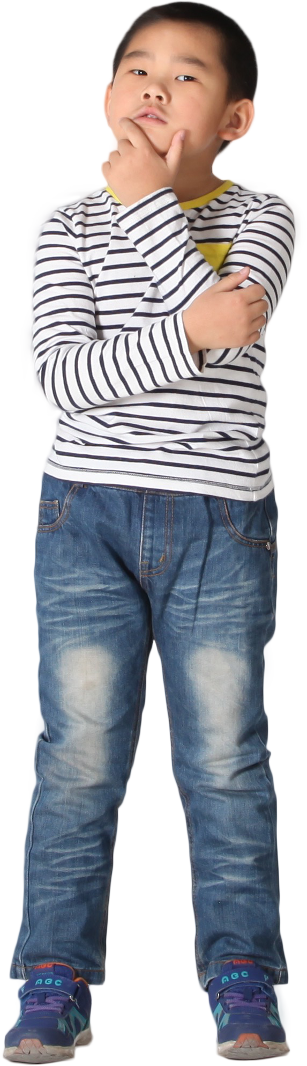
Gived or Gave?
irregular verbs
a verb that doesn’t follow a specific spelling pattern
walk
walked
give
gived
gave
Notes:
Say: In this module we are learning about past tense irregular verbs. Who can tell me what an irregular verb is? (Give the students a moment to answer then click to show the definition.)
An irregular verb is a verb that doesn’t follow a specific spelling pattern when changed to past tense.
For example, here we have the word walk (click to show the word). To make this past tense, we simply add ed to the end of the word (click to show the new spelling).
This is a regular verb. We add ed and nothing else changes. Here is an example of an irregular verb- give (click to show the word).
This word doesn’t follow a regular pattern. If it did, it would be gived (click to show the word).
We know gived isn’t a real word. Who can tell me what the past tense of give is? (Give the students a moment to answer then click to show the word- gave.)
Gave is the past tense of give. The vowel and the pronunciation have both changed.
Because these verbs are irregular, they don’t have a specific rule to follow. The more you practice them, the easier it will be to identify and learn them.
On the next two slides we will be using dry erase boards or paper. Please gather the supplies you need now. (Wait for the students to return.)

Slide 3
Irregular Verb Practice
held
tell
hold
told
felt
pay
feel
paid
find
make
found
made
speak
meet
spoke
met
Notes:
Say: Let’s practice some irregular verbs! On this slide, there are several irregular verbs. We will take turns picking a word and then everyone will write the correct past tense spelling on their board or paper. After everyone writes the past tense, we can click on the word and see if you are correct. (Allow one student at a time to pick a word, then have the students write the past tense on paper or a white board to hold up. When the students are ready, click on the word to make the correct past tense appear. They can check their answers.)

Slide 4
Good Deeds Vocabulary Review
word bank
sensitive
opposite
ignore
gradual
imitate
attitude
a particular feeling or way of thinking about something
moving or changing slightly
to follow as a pattern, model, or example
being at the other end, side, or corner
pay no attention to
easily or strongly affected or hurt
Notes:
Say: Let’s review our vocabulary words from this week. When I read a definition, please write the word that matches the definition on your dry erase board or paper. Then when I say so, hold your board or paper up for me to see what you wrote.
Here is the first one- - pay no attention to. Which word matches this definition? (Give the students a moment to answer then ask them to hold up their boards/paper. Check student work, then click to make the correct answer disappear - ignore. Click for a new definition. Repeat with the remaining words.
easily or strongly affected or hurt - sensitive
being at the other end, side, or corner - opposite
moving or changing slightly - gradual
a particular feeling or way of thinking about something - attitude
to follow as a pattern, model, or example - imitate

Slide 5

Vocabulary Practice
imitate
opposite
gradual
ignore
sensitive
attitude
Notes:
Say: Let’s practice using our vocabulary words in a sentence. When the word shows up on the chalkboard, please use it in a sentence for me. Here is an example. (Click to show the word imitate.)
Imitate. The monkeys at the zoo like to imitate the people they see. Can you please give me a sentence for the word opposite? (Click to show the word.)
(Repeat process for remaining words and give each student a chance to give you a sentence- click to show each word. If a student struggles, review the meaning of the word on the previous slide.
3. gradual
4. ignore
5. sensitive
6. attitude)

Slide 6
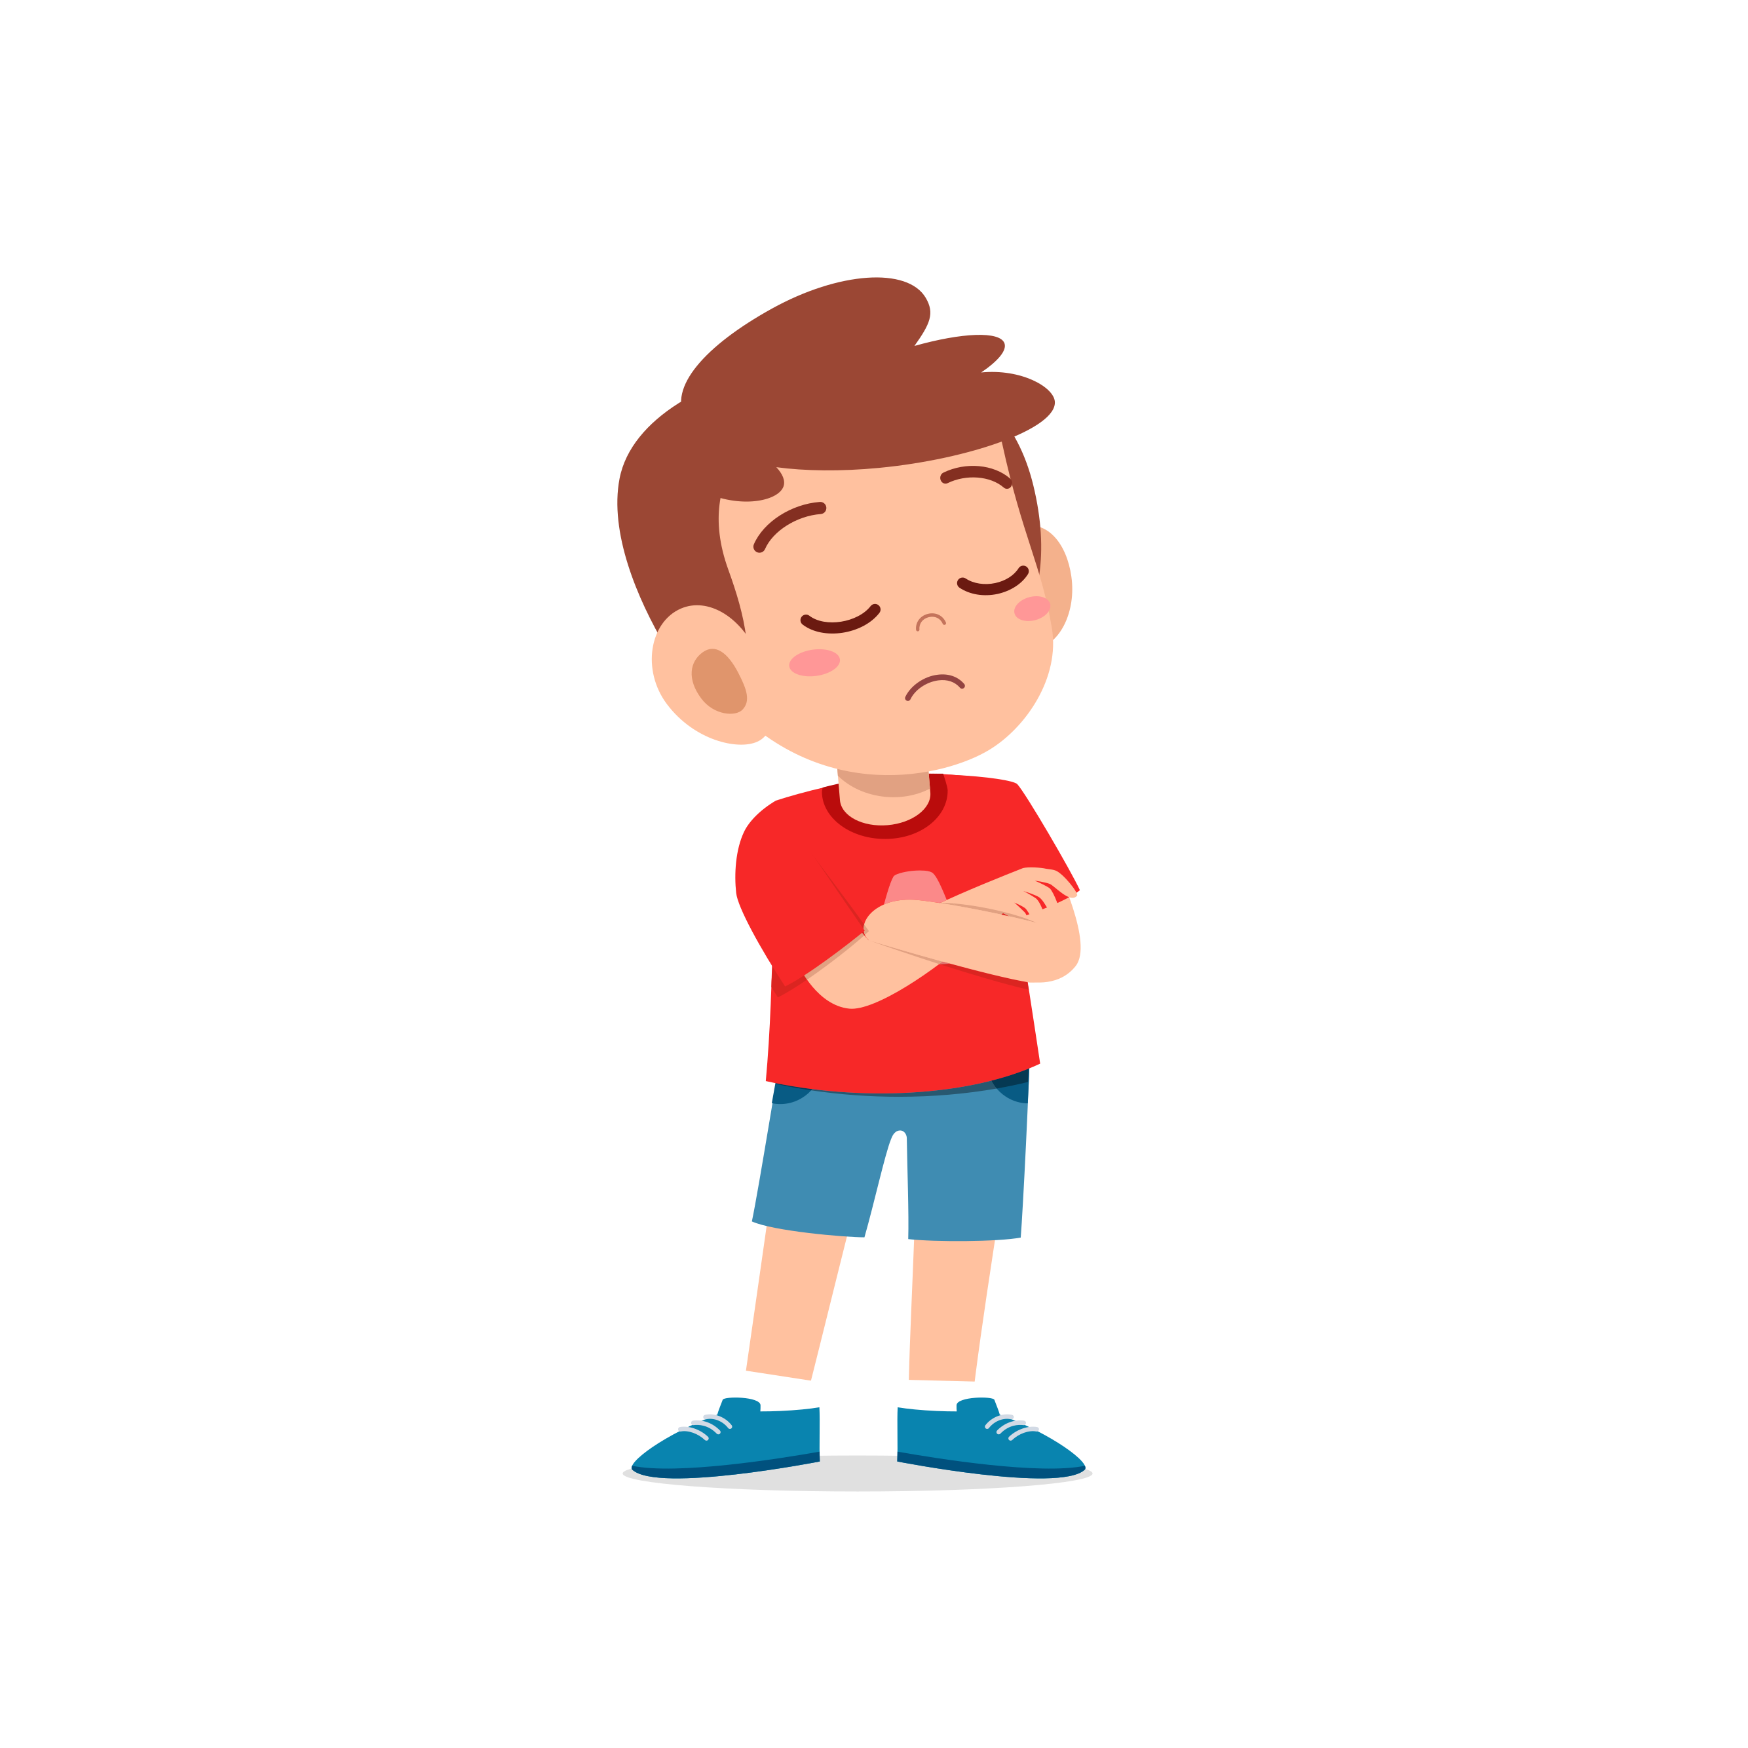
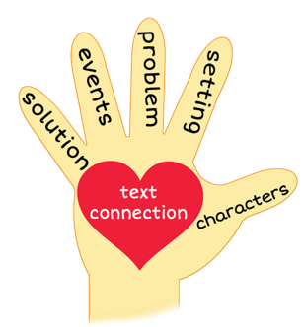
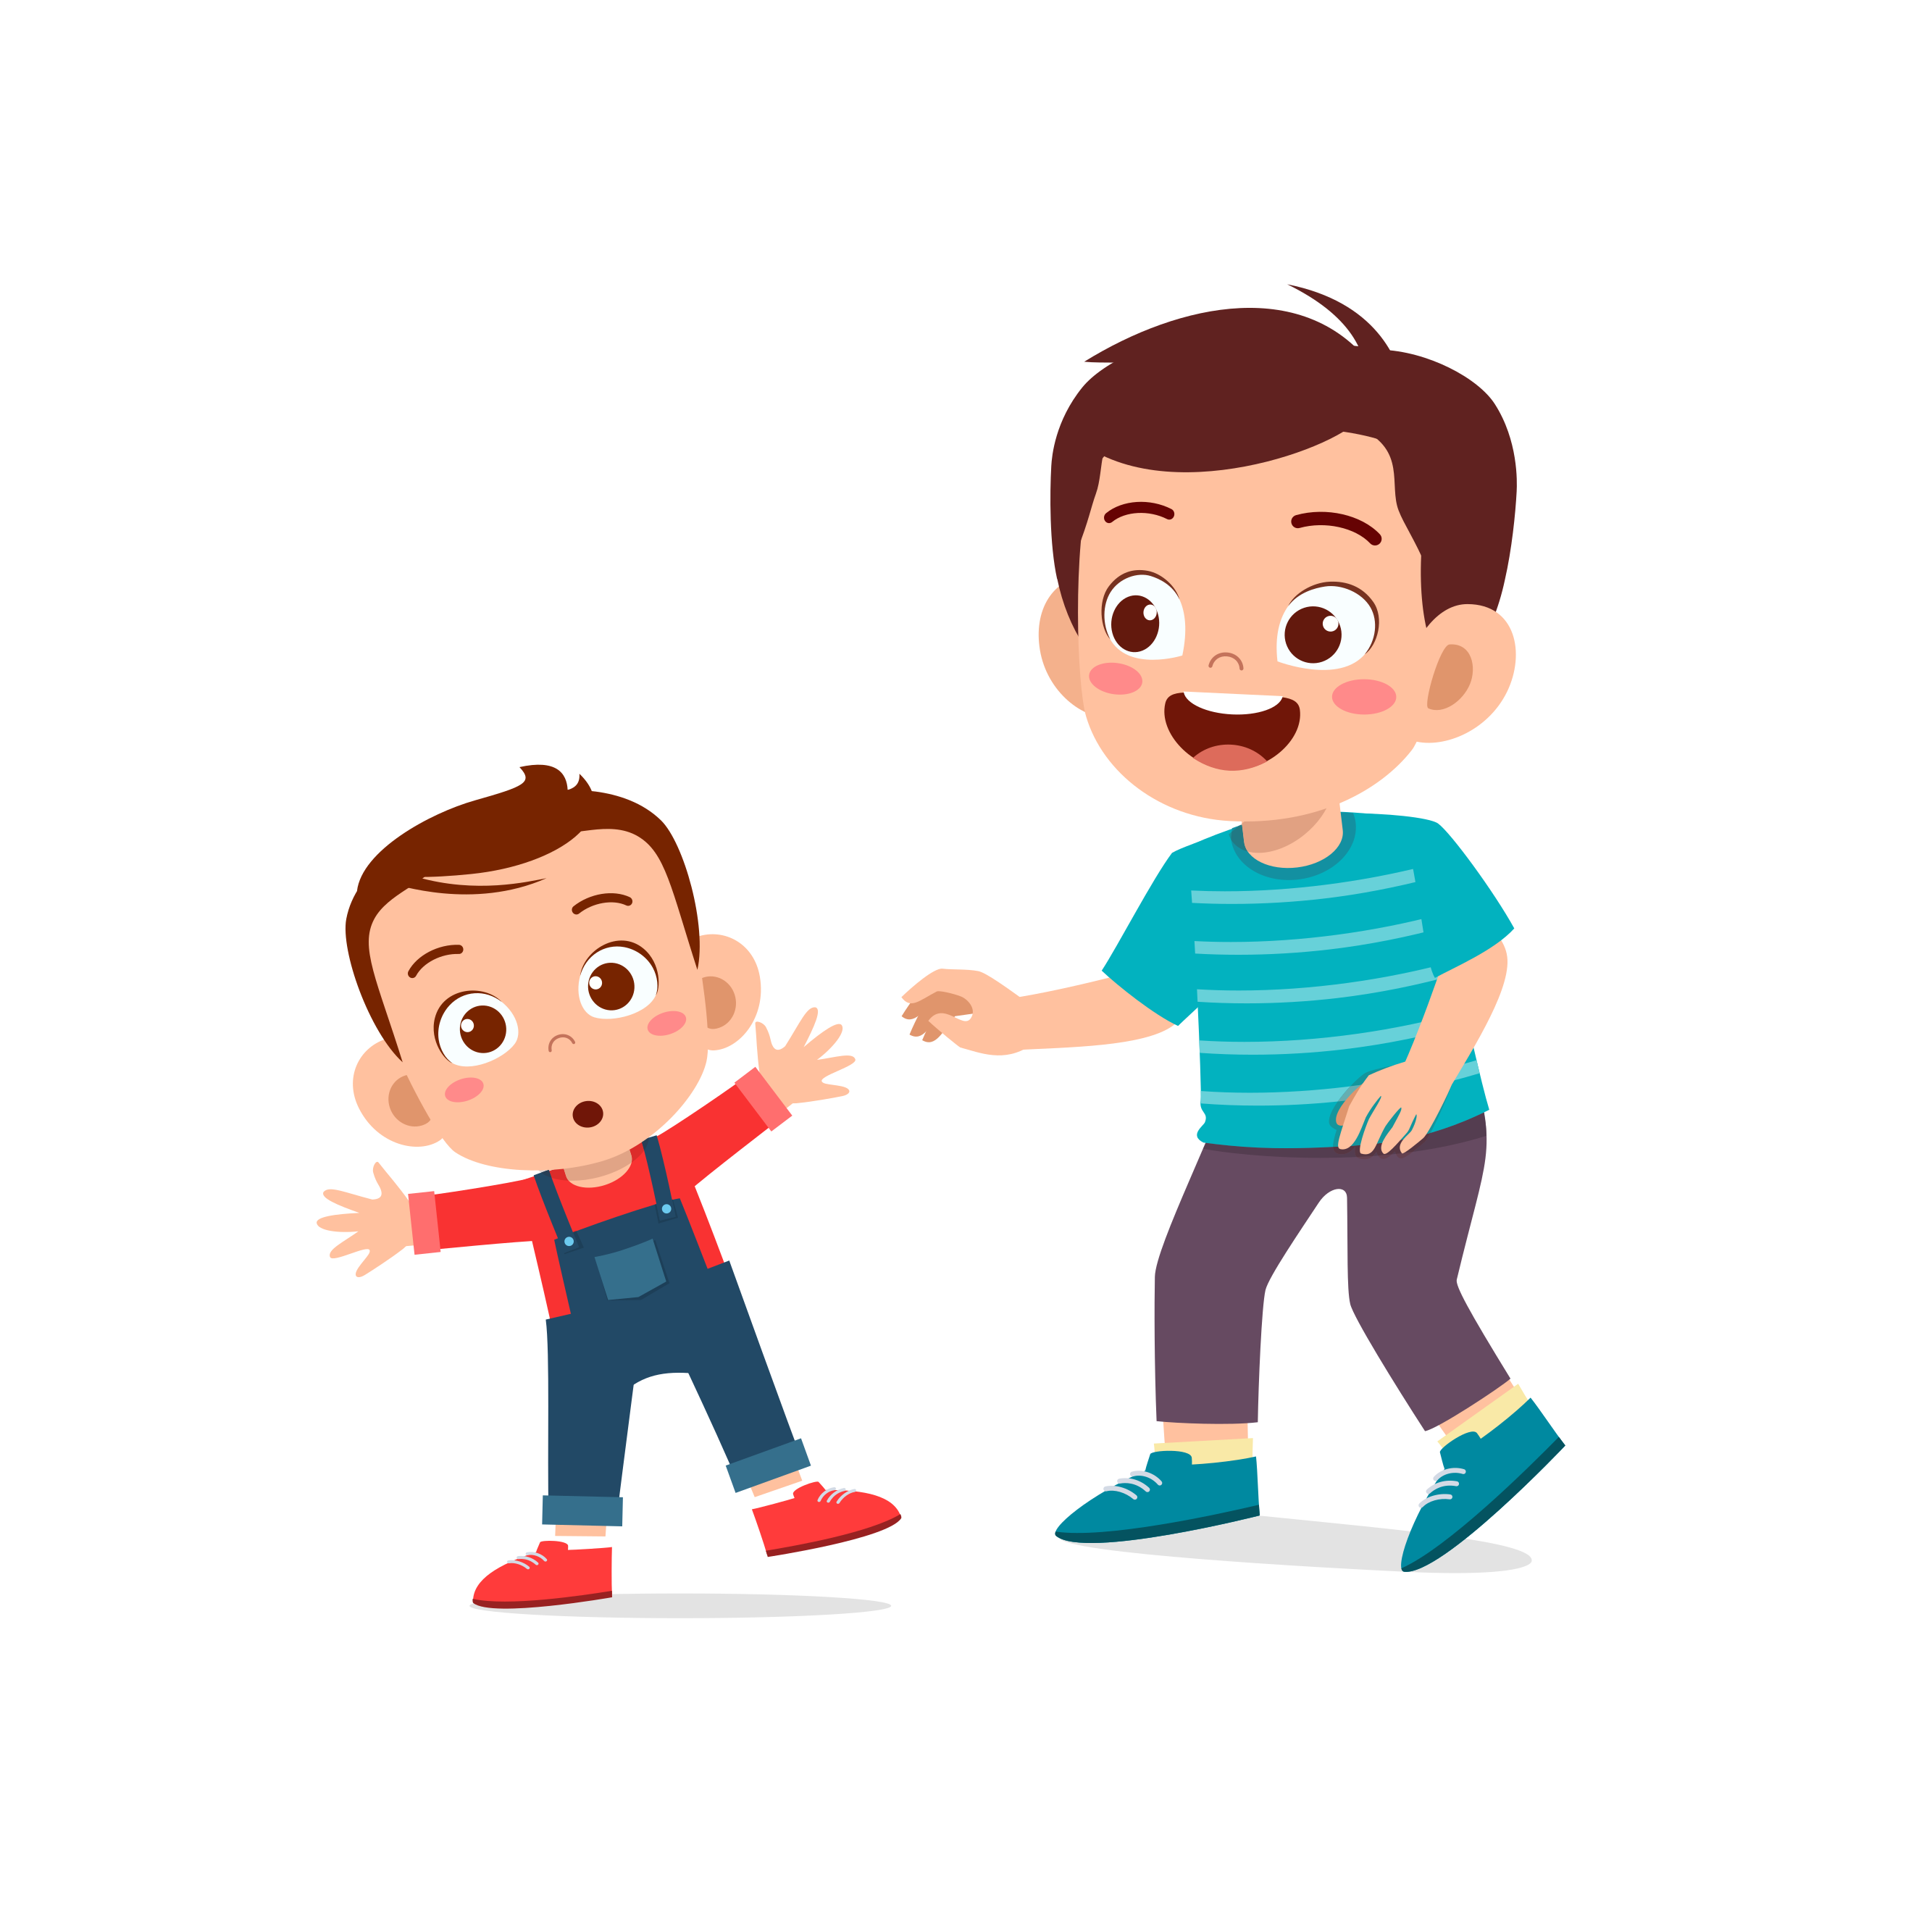
Give Me Five!
Notes:
Say: It’s time for the five finger retell! (Click to show the hand and images appear.)
Show me your fingers! (Have students hold up hand and point to each finger as they go through the retell.)
Characters-mom, dad, the boy, his baby brother Jacob and cousin Jay
Setting- mostly the boy’s house
Problem- the boy isn’t happy with his baby brother
Events-
*The boy is excited about his new baby brother.
*He wants to be a good big brother.
*He holds the baby in the hospital and is happy.
*The baby comes home, and mom and dad are busy with the baby all the time.
*The boy is jealous and decided to ignore his brother.
*His cousin Jay comes over and says that Jacob is loud, cries a lot and is ugly.
Solution- When Jay says those things, the boy defends his brother. The boy goes back inside and kisses Jacob on the forehead. Jacob smiles, and the boy realizes that he loves his baby brother and wants to spend time with him. Text connection- Say: Do you have any siblings? Are you the youngest or oldest? What do you like to do with your siblings? If you don’t have any, would you rather have a sister or a brother?

Slide 7
Q & A
Any Questions?

