Slide 1
Space Adventures
Zooming Through Our Skills!
Notes:
Welcome the student.
Teacher: “Today, we are going to “zoom” through skills together. We will work on CVCe words (words with the consonant-vowel-consonant- silent e pattern,) sentences and punctuation, vocabulary and Discovering Space.”

Slide 2


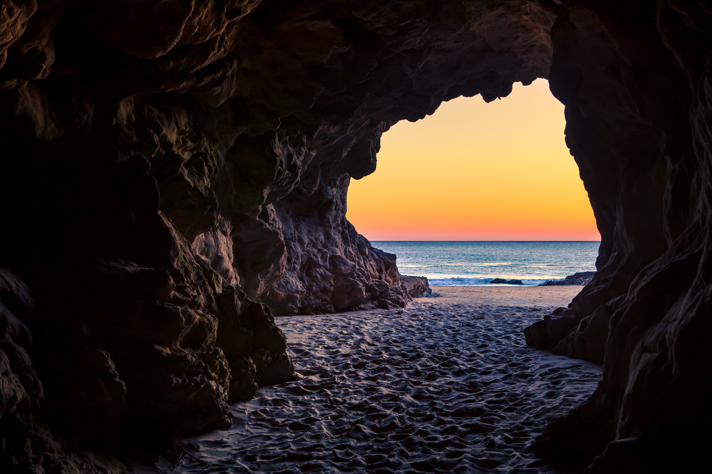
Let’s Talk About CVCe Words!
cute
rule
Let’s
Read!
cav__
e
e
__it__
k
Notes:
Notes to Teacher:
Teacher should introduce the slide by telling the student that we are going to work on CVCe (consonant-vowel-consonant-silent e) words.
Teacher: “This week, some of your spelling words have the CVCe pattern. Let’s take a look at a few!”
Teacher should click to show the words cute and rule. Allow the student to read the words, noting the silent ‘e’ at the end.
Teacher: “Both words have the vowel, consonant, vowel, silent e pattern.”
Teacher: “Let’s take a look at some pictures.”
Teacher will click to show the picture of a cave.
Teacher will click to show “cav_.”
Ask: “What letter is missing at the end of cave?” (The student should answer ‘e.’)
The teacher will click to have the ‘e’ appear at the end of the word.
“Let’s try another one.”
Teacher will click to show the picture of a kite.
Teacher will click to show “_it_.”
Ask: “What letters are missing from the word kite?” (The student should answer ‘k’ and ‘e.’)
The teacher will click to have the ‘k’ and the ‘e’ appear in the word.
Applaud the student’s effort and then click to go to the next slide.

Slide 3

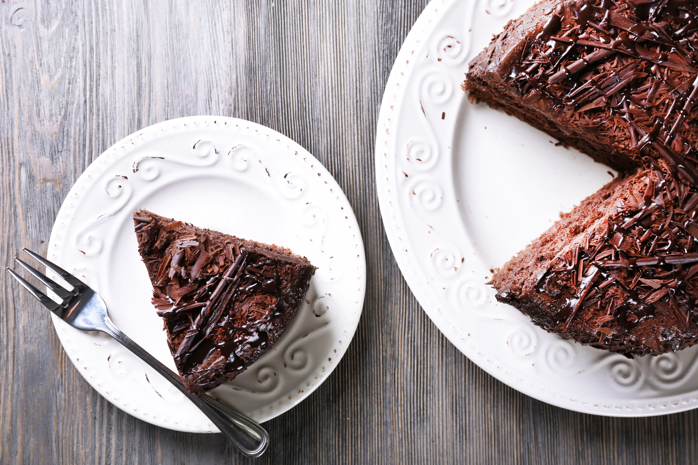
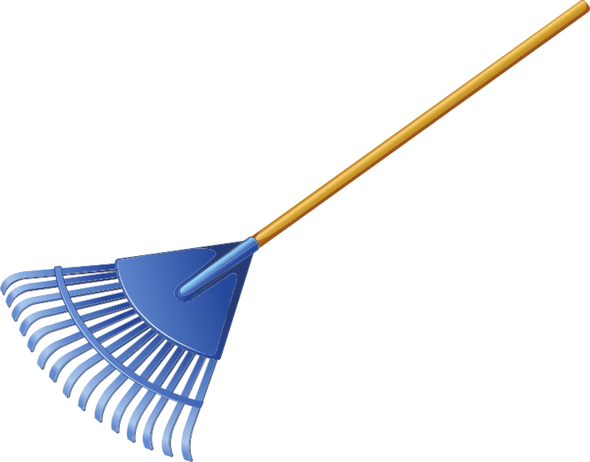
Let’s Practice CVCe Words!
cape
cake
rake
cape
cake
rake
Notes:
Notes to Teacher:
Teacher: “Let’s look at some more words that have the CVCe pattern.”
Click to show a picture of a a group of kids dressed as superheroes with an arrow pointing to a cape.
Click again to show a picture of a rake.
Click one more time to show a picture of a cake.
Ask the student to identify each picture, assisting if needed.
Click to show the word cape.
Ask the student to read the word to you (cape.)
Once the student reads the word cape, click to move the word cape above the arrow pointing to the picture of the cape.
Click to show the word cake.
Ask the student to read the word to you (cake.)
Once the student reads the word cake, click to move the word cake above the picture of the cake.
Click to show the word rake.
Ask the student to read the word to you (rake.)
Once the student reads the word rake, click to move the word rake next to the picture of the rake.
Applaud student’s effort and then click to go to the next slide.

Slide 4
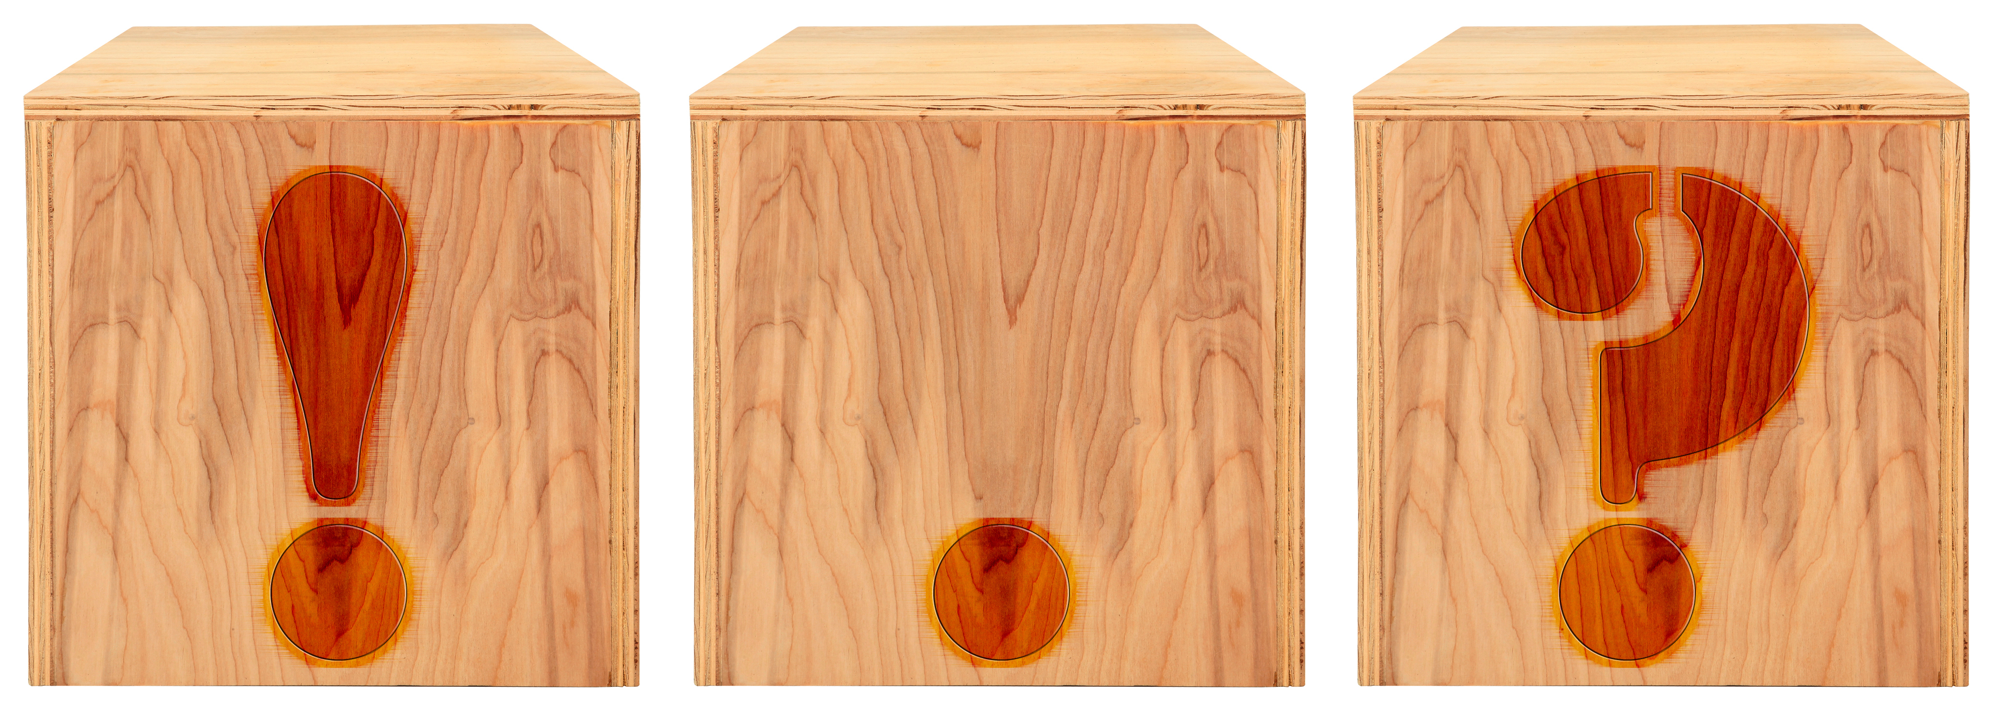
Sentences and Punctuation Marks
This sentence shows excitement or emotion.
This sentence makes a statement.
This sentence asks a question.
Interrogative
Declarative
Exclamatory
Notes:
Notes to Teacher: Click to show an image of punctuation marks. Have the student identify each punctuation mark: exclamation mark, period and a question mark.
Teacher: “This week, we are talking about different types of sentences. Let’s review each type.”
Teacher: “The first sentence type ends with an exclamation mark.”
Click to show the definition for an exclamatory sentence. Read the definition with the student.
Ask: “What type of sentence shows excitement or emotion?” (exclamatory.)
Click to reveal the word “Exclamatory.”
Teacher: “The next sentence type ends with a period.”
Click to show the definition for a declarative sentence. Read the definition with the student.
Ask: “What type of sentence tells us something?” (declarative.)
Click to reveal the word “Declarative.”
Teacher: “The last sentence type ends with a question mark.”
Click to show the definition for an interrogative sentence. Read the definition with the student.
Ask: “What type of sentence asks something?” (interrogative.)
Click to reveal the word “Interrogative.”
Applaud student’s effort and click to go to the next slide.

Slide 5

Sentence
Practice
Declarative
.
Interrogative
?
Exclamatory
!
.
I see the moon __
!
The sun is so hot __
Declarative
Exclamatory
?
Do you see the big dipper __
Interrogative
Notes:
Notes to Teacher:
Tell the student that we are going to review sentence types and punctuation marks.
Click to bring up the word bank. Review the sentence types with the student, as well as the punctuation marks.
Click to bring up the first sentence: (read this sentence with expression.) The sun is so hot__
Ask: “What punctuation mark belongs at the end of this sentence? (!)
Click to add the punctuation mark to the end of this sentence.
Ask: “What type of sentence is this?” (exclamatory)
Click to identify this as an exclamatory sentence.
Click to bring up the next sentence: Do you see the big dipper__
Ask: “What punctuation mark belongs at the end of this sentence? (?)
Click to add the punctuation mark to the end of this sentence.
Ask: “What type of sentence is this?” (interrogative)
Click to identify this as an interrogative sentence.
Click to bring up the last sentence: I see the moon__
Ask: “What punctuation mark belongs at the end of this sentence? (.)
Click to add the punctuation mark to the end of this sentence.
Ask: “What type of sentence is this?” (declarative)
Click to identify this as a declarative sentence.
Applaud the student’s effort and click to move to the next slide.

Slide 6
My Adventures –
Vocabulary Review
explore
constellation
space
Notes:
Notes to Teacher:
Teacher: “Let’s review our first three vocabulary words.”
Have the student read (or repeat) each vocabulary word as you bring it to the screen.
Click to show explore. Read the word and have the student repeat the word – explore.
Click to show constellation. Read the word and have the student repeat the word – constellation.
Click to show space. Read the word and have the student repeat the word – space.
Teacher: “I am going to tell you a definition. Tell me which word matches the definition.”
Ask the student: “Which vocabulary word matches this definition: - a group of stars that form a pattern.” (constellation.)
Allow the student time to tell you that a constellation is a group of stars that form a pattern.
Click to circle the word constellation.
Ask the student: “Which vocabulary word matches this definition: the region beyond Earth’s atmosphere?” (space)
Allow the student time to tell you that space is the region beyond Earth’s atmosphere.
Click to circle the word space.
Ask the student: “Which vocabulary word means to search through?” (explore.) Allow the student time to tell you that explore means to search through.
Circle the word explore.
Vocabulary:
explore – to search through.
constellation – group of stars that form a pattern
space – the region beyond Earth’s atmosphere
Before clicking to the next slide, applaud the student’s effort.
Click to go to the next slide.

Slide 7
Vocabulary Review Take Two!
orbit
solar system
gravity
Notes:
Notes to Teacher:
Teacher: “Let’s review the rest of our vocabulary words.”
Have the student read (or repeat) each vocabulary word as you bring it to the screen.
Click to show orbit. Read the word and have the student repeat the word – orbit.
Click to show solar system. Read the word and have the student repeat the word – solar system.
Click to show gravity. Read the word and have the student repeat the word – gravity.
Teacher: “I am going to tell you a definition like I did in our last activity. Tell me which word matches the definition.”
Ask the student: “What force pulls down on all objects on Earth?” (gravity.)
Allow the student time to tell you that gravity is the force that pulls downs on all objects on Earth.
Click to circle the word gravity.
Ask the student: “Which vocabulary word means to move in a circle around?” (orbit.)
Allow the student time to tell you that orbit means to move in a circle around.
Click to circle the word orbit.
Ask the student: “What is the name of a star with a group of planets, moons, asteroids and comets that orbit it called?” (solar system.) Allow the student time to tell you that the solar system is a star with a group of planets, moons, asteroids and comets that orbit it.
Circle the word solar system.
Vocabulary:
orbit – to move in a circle around.
solar system – a star with a group of planets, moons, asteroids, and comets that orbit it.
gravity – the force that pulls down on all objects on Earth.
Applaud the student’s effort and click to move to the next slide.

Slide 8

Our Vocabulary Adventure
Continues!
space
constellation
explore
Notes:
Notes to Teacher:
Teacher: “Let’s practice using some of our vocabulary words in a sentence.”
Click to bring up the word explore. Read the word aloud.
The student should use this word in a sentence.
*If the student uses the word correctly, applaud his/her answer.
*If the student is having trouble using the word in a sentence, you may assist the student by reviewing the definition below.
*Follow the same procedure for each of the three words.
Click to bring up the word constellation. Read the word aloud.
The student should use this word in a sentence.
Click to bring up the word space. Read the word aloud.
The student should use this word in a sentence.
Vocabulary:
explore – to search through.
constellation – group of stars that form a pattern.
space – the region beyond Earth’s atmosphere.
Applaud the student’s effort and then click to move to the next slide.

Slide 9
Main Idea and Details
Main Idea
Detail
Detail
Detail
Notes:
Notes to Teacher:
Tell the student that we are going to talk about the main idea and details of a story.
Click to show a graphic organizer for reviewing the main idea and details.
Ask: “What is the main idea?” (Allow the student the opportunity to talk about the main idea.) Remind the student that the main idea is what the story is mostly about.
Ask: “What are details?” (Allow the student the opportunity to talk about details.) Explain that the details tell more about the main idea.
Click to show detail graphic 1.
Click to show detail graphic 2.
Click to show detail graphic 3.
Explain that there are not always three details. The number of details will vary.
Tell the students that we will use this graphic organizer to talk about our story, Discovering Space.
Click to go to the next slide.

Slide 10
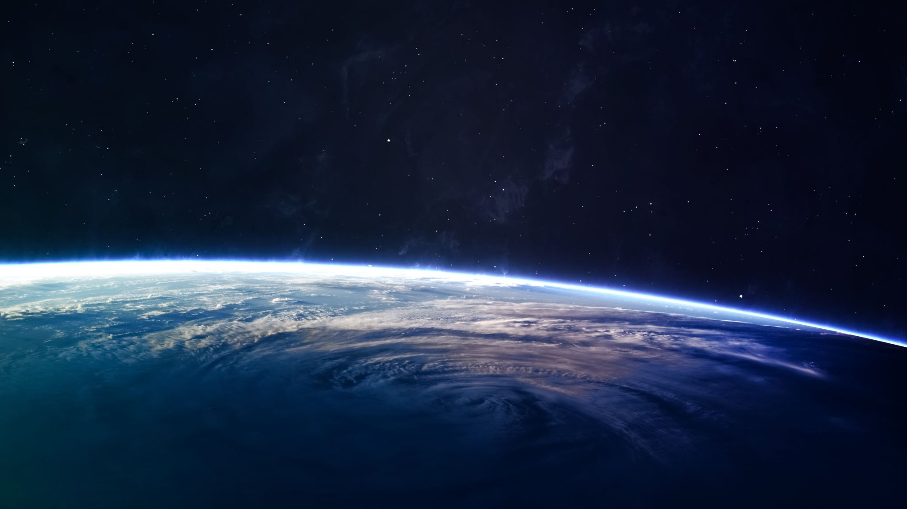
Discovering Space
All About Space
Main Idea
People travel to space and learn more about the moon.
The Big Dipper is a constellation in the sky.
Detail
Detail
Evan and Barkley enjoyed their adventures.
Detail
Notes:
Notes to Teacher:
Click to bring the title of the story to the image of space.
Remind the student that we read a story called, Discovering Space.
Click to bring the image of the “Main Idea/Details” graphic organizer.
Ask the student to tell you what the main idea of this story is.
Ask: “What was this story mostly about?” (This story talked about space. People have been wondering about and studying our night sky for a long time.)
Click to show the main idea: All About Space.
Tell the student that I am going to show three details. His/her job is to tell me if it is a detail from the story, Discovering Space.
Click to bring up the first sentence: The Big Dipper is a constellation in the sky.
Ask: “Is this a detail from this story?” (Yes.)
Click to show the next sentence: Evan and Barkley enjoyed their adventures.
Ask: “Is this a detail from this story?” (No.)
Click to take this detail off of the screen as this is not a detail from our story.
Click to show the next sentence: People travel to space and learn more about the moon.
Ask: “Is this a detail from the story?” (Yes.)
Review both details from the story.
Extension Activity (if time permits):
Ask the student to tell you something else they learned from the story.
Applaud student’s effort and click to move to the final slide.

Slide 11
Q & A
Any Questions?

