Slide 1
Growing Up
Conjunctions and vocabulary
Notes:
Say: Today we will review and practice conjunctions. We will also review our vocabulary words and end with the 5 finger retell.

Slide 2
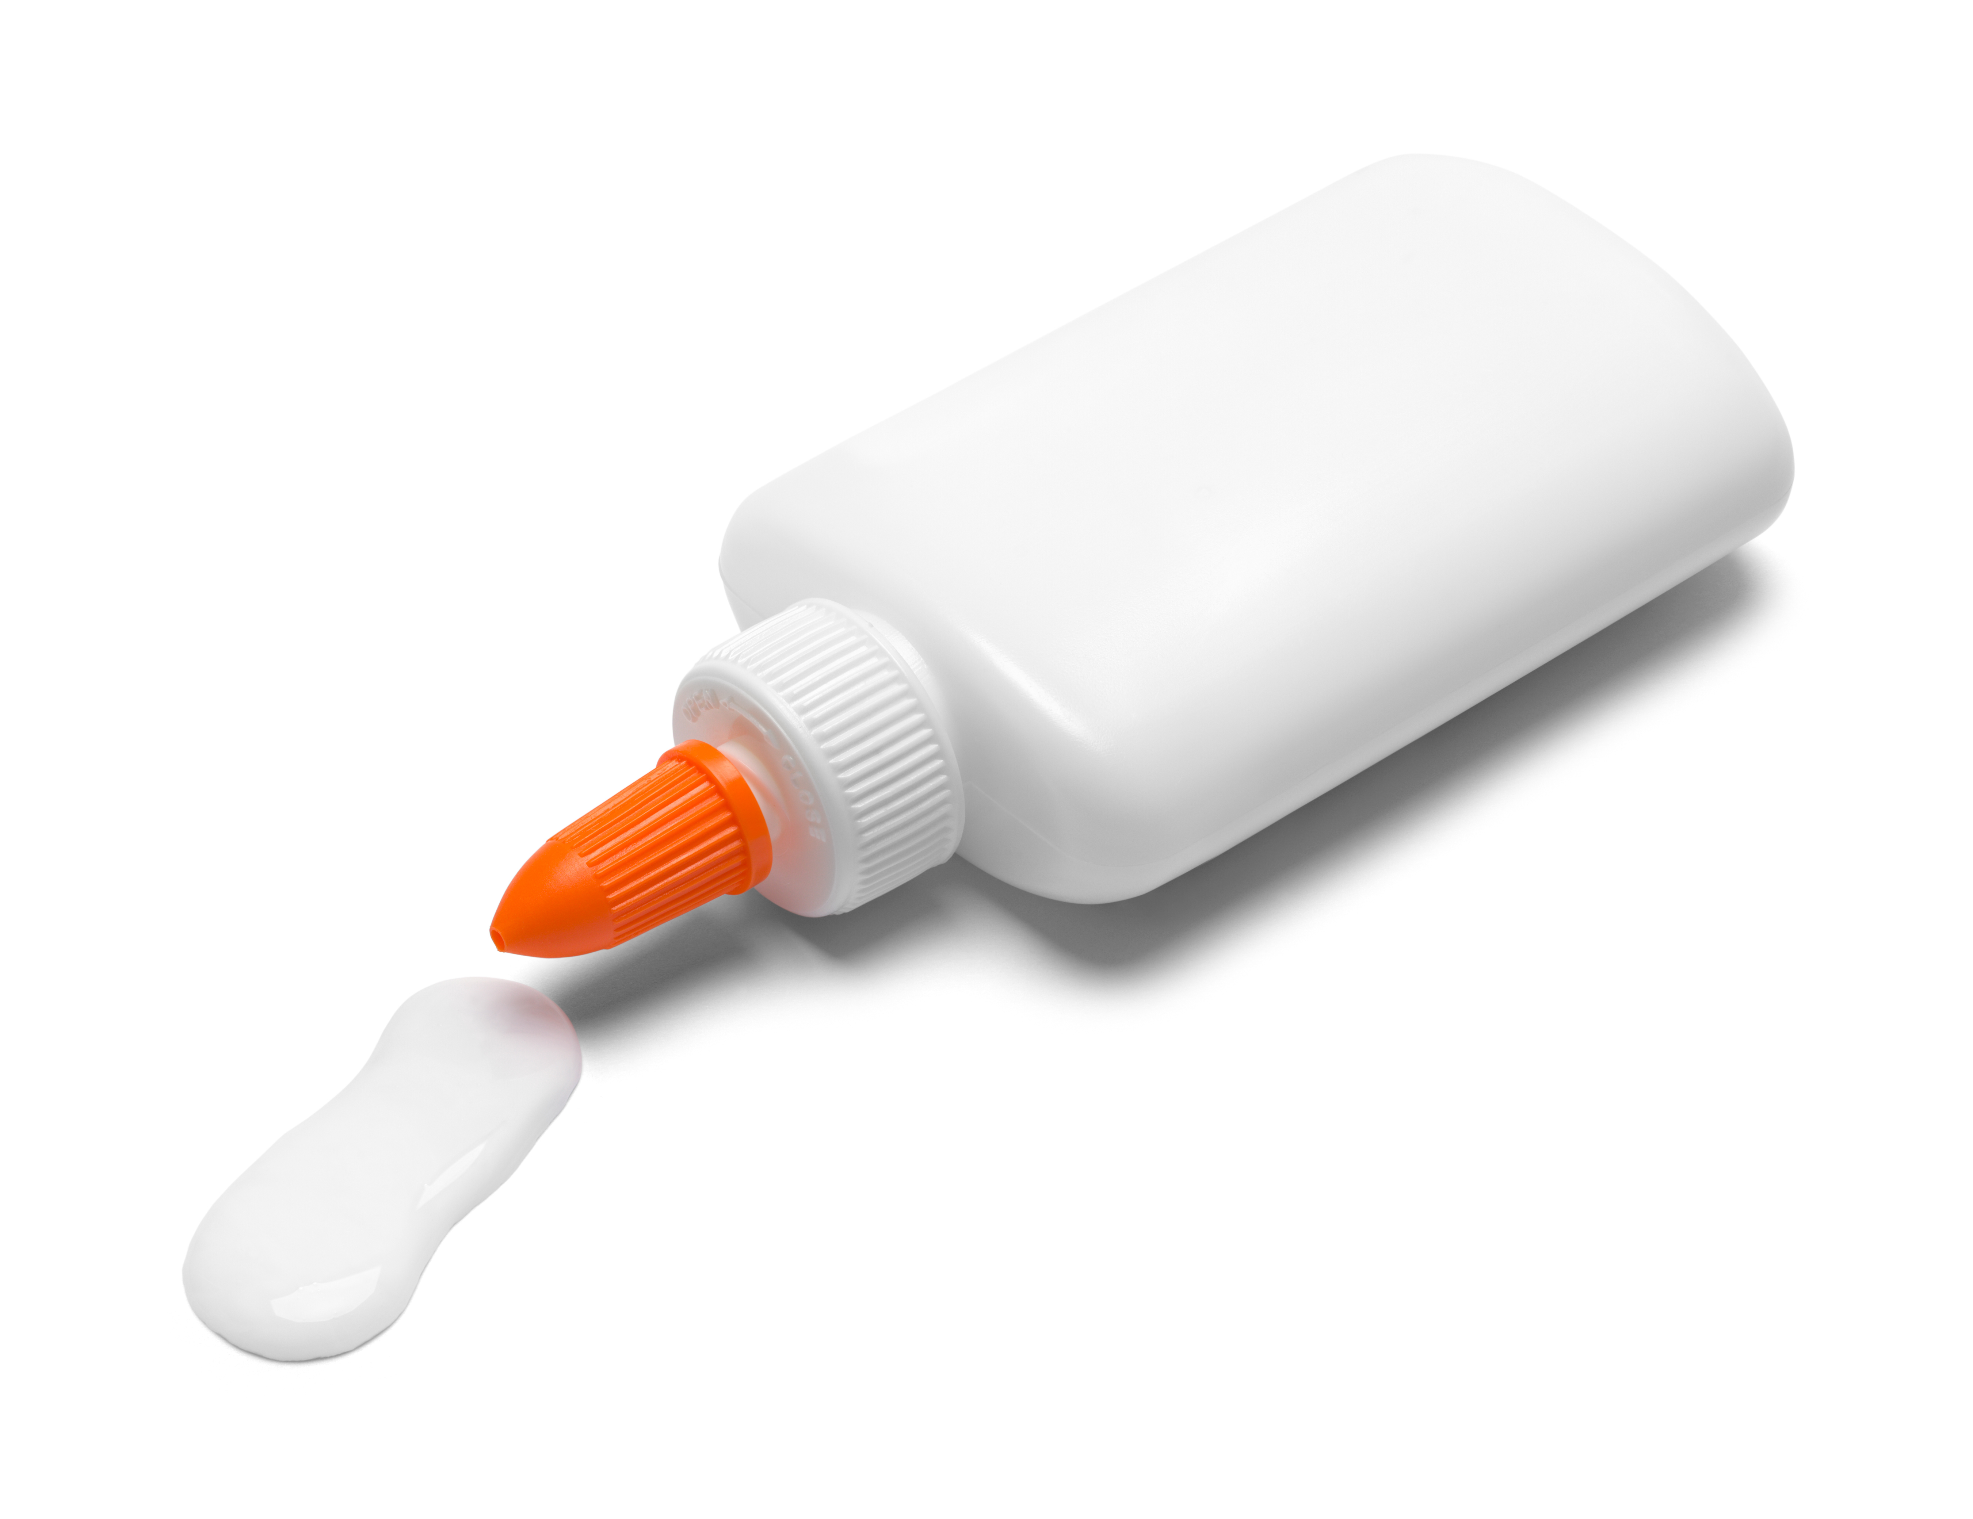
The function of a Conjunction
Abby bought apples and strawberries at the store.
He wanted to swim, but it started to rain
Notes:
Say: We’ve learned in a past module that conjunctions can join two simple sentences. Did you know they can also join words or groups of words together? Conjunctions help us create more complex sentences. It’s like glue. It helps words and phrases stick together. Let’s look at an example. (Click to show the sentence and have a student read it. “Abby bought apples and strawberries at the store.”)
The word “and” is the conjunction. Here is an example with two simple sentences. (Click to show the sentence and have a student read it. “He wanted to swim, but it started to rain.”)
“But” is the conjunction that connects these two simple sentences together.

Slide 3
Common Conjunctions
f
-for
a
-and
n
f a n b o y s
-nor
b
-but
o
-or
y
-yet
s
-so
Notes:
Say: There are several conjunctions, however some are used more often than others. There is a simple way to remember the most common conjunctions using the acronym “fanboys” (click to show letters). An Acronym is a word made from the first letters of words in a certain order. The letters in “fanboys” all represent the first letter of a commonly used conjunction. (Click to show the word vertically.) Do you know what any of them stand for? (Give the students a moment to answer as many as they can. As students give you answers, click on each letter to show each answer.
f-for
a-and
n-nor
b-but
o- or
y-yet
s-so)

Slide 4
Fill in the Conjunction
or
He wasn’t sure if he wanted a cat ____ a dog.
so
I was tired, ____ I went to sleep.
yet
She finished her work quickly _____ neatly.
for
He brought a gift ____ his friend.
Notes:
Say: Let’s practice!
I’ll show you a sentence. Please tell me which conjunction would work in the sentence. Here is the first one. (Click to show the sentence and have a student read it. Give the students a moment to answer, then click to show the answer. Repeat the process with each sentence.
1 He wasn’t sure if he wanted a cat __ a dog. -or
2 I was tired, __ I went to sleep.-so
3. She finished her work quickly __ neatly. -yet [but also works]
4. He brought a gift __ his friend. -for

Slide 5
Growing Up Vocabulary Review
to win over to a belief or action by argument or serious request
to push roughly
a violently unfriendly or aggressive attitude
a young bird not yet able to leave the nest
to follow as a pattern, model, or example
rarely
word bank
nestling
persuade
seldom
imitate
jostle
fierce
Notes:
Say: Let’s review our vocabulary words for the week. When I show you the definition, please tell me the word on the slide that matches. Here is an example. (Click to show- to push roughly. Read it to the students.)
Which word matches this definition? (Student should say “jostle”. Click to show the answer highlighted. Click again for a new sentence. Repeat the process with the remaining words.
rarely – seldom
a young bird not yet able to leave the nest - nestling
a violently unfriendly or aggressive attitude - fierce
to follow as a pattern, model, or example- imitate
to win over to a belief or action by argument or serious request) - persuade

Slide 6
Your Turn!
word bank
fierce
imitate
nestling
jostle
persuade
seldom
persuade
nestling
jostle
I tried to _______ my cat to take a bath, but he doesn’t like water.
Pedro found the tiny _______and gently placed it back in the nest.
My sister annoyed me by trying to ______ my every move.
The lion let loose a loud roar that made it sound very ______.
Peter had to ______ his way to the front of the crowded bus.
We tried to find a fox in the woods, but they are sly and ______ seen.
imitate
fierce
seldom
Notes:
Say: I’m going to show you some sentences The first one is on the screen. Please read the sentence and tell me the vocabulary word that fits best in the sentence. The word will then be crossed off in the box.
(Click to show each remaining sentence and give the students a moment to choose the best answer. Then click to show the correct answer appear in the sentence and be crossed off, click again for a new sentence to appear. Repeat for each sentence.
1. Peter had to ____ his way to the front of the crowded bus. -jostle
2. Pedro found the tiny ____and gently placed it back in the nest. -nestling
3. The lion let loose a loud roar that made it sound very ____. -fierce
4. I tried to ___ my cat to take a bath, but he doesn’t like water. -persuade
5. We tried to find a fox in the woods, but they are sly and __ seen. -seldom
6. My sister annoyed me by trying to ____ my every move. -imitate

Slide 7
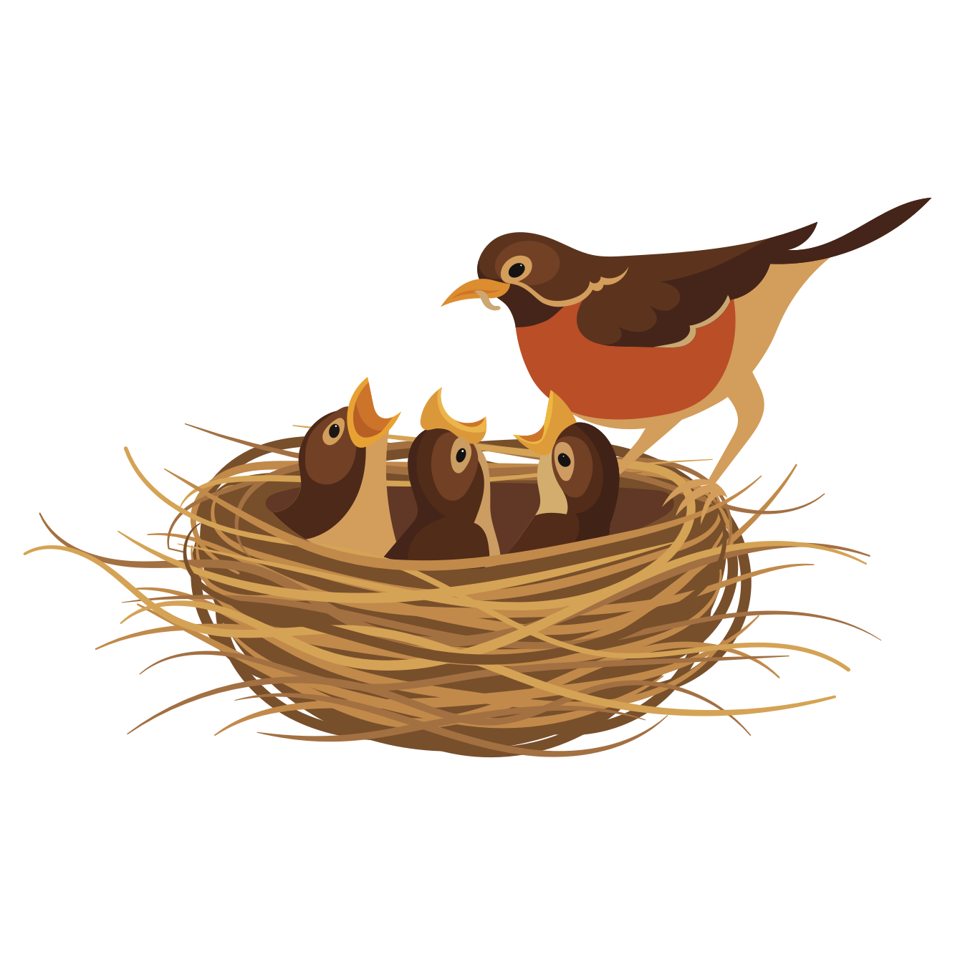
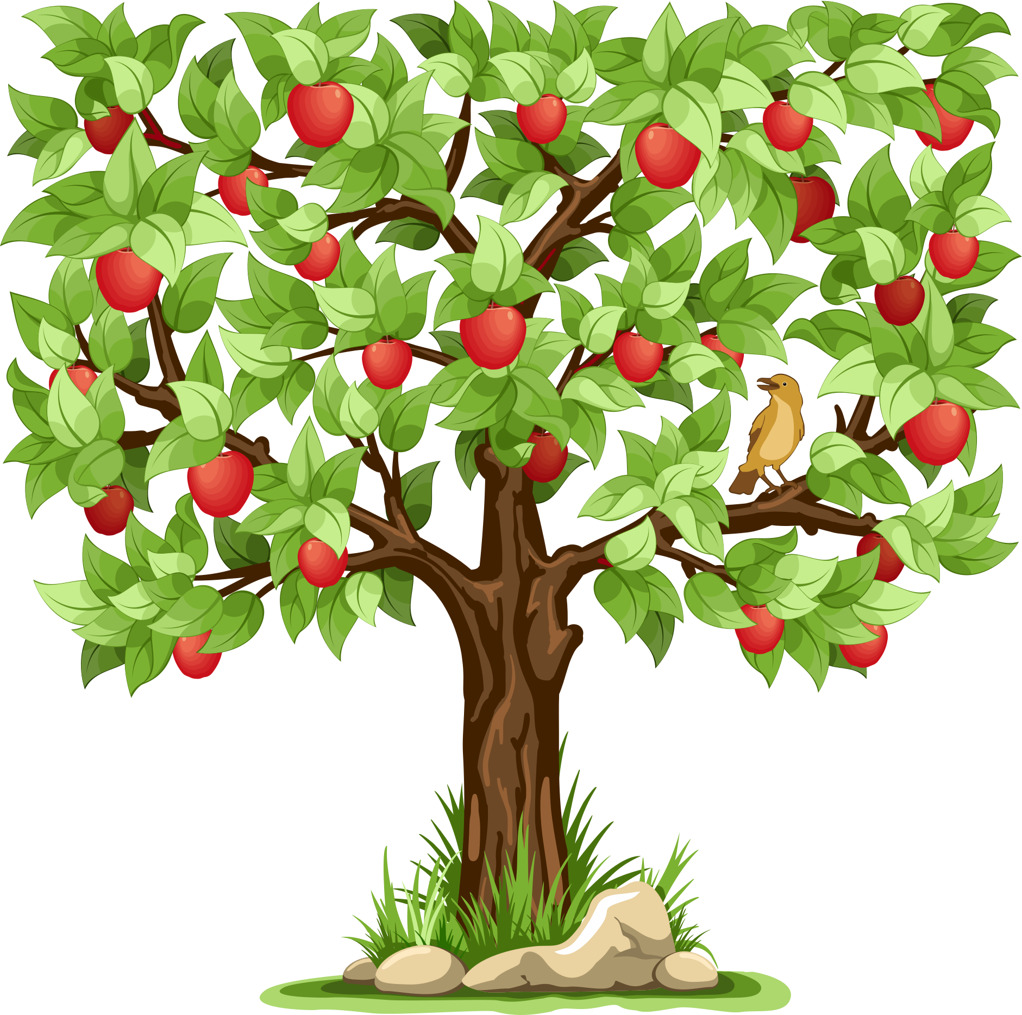
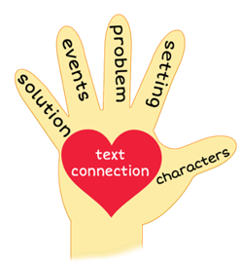
Give Me Five!
Notes:
Say: It’s time for the five finger retell! (Click to show the hand and images appear.)
Show me your fingers! (Have students hold up hand and point to each finger as they go through the retell.)
Characters- Jolly Robin and his family
Setting- Farmer Green’s apple tree and the ground below it
Problem- Jolly couldn't fly
Events-
*Jolly moved from his nest to the tree limb to get an angleworm from his father.
*Jolly’s mother taught him to stay quiet on the ground so the cat wouldn’t eat him.
*His mother taught him to glide, but he still couldn’t fly.
Solution- His father tricked him by yelling “cat” and flying onto a tree branch. Jolly was so scared that he flew without realizing it. Later his father told him the truth and Jolly laughed and laughed. This prompted his father to name him Jolly.
Text connection- Say to student: Jolly had a hard time learning to fly, however he kept trying and was finally able to. What is something that you have had to work really hard at?

Slide 8
Q & A
Any Questions?

