Slide 1
Oscar’s New Year Plan
Homographs, Nouns, Verbs, and Pronouns
Notes:
Say: Today we will review homographs and sentence diagraming. We will also review nouns, pronouns and verbs, and end with the 5 finger retell.

Slide 2
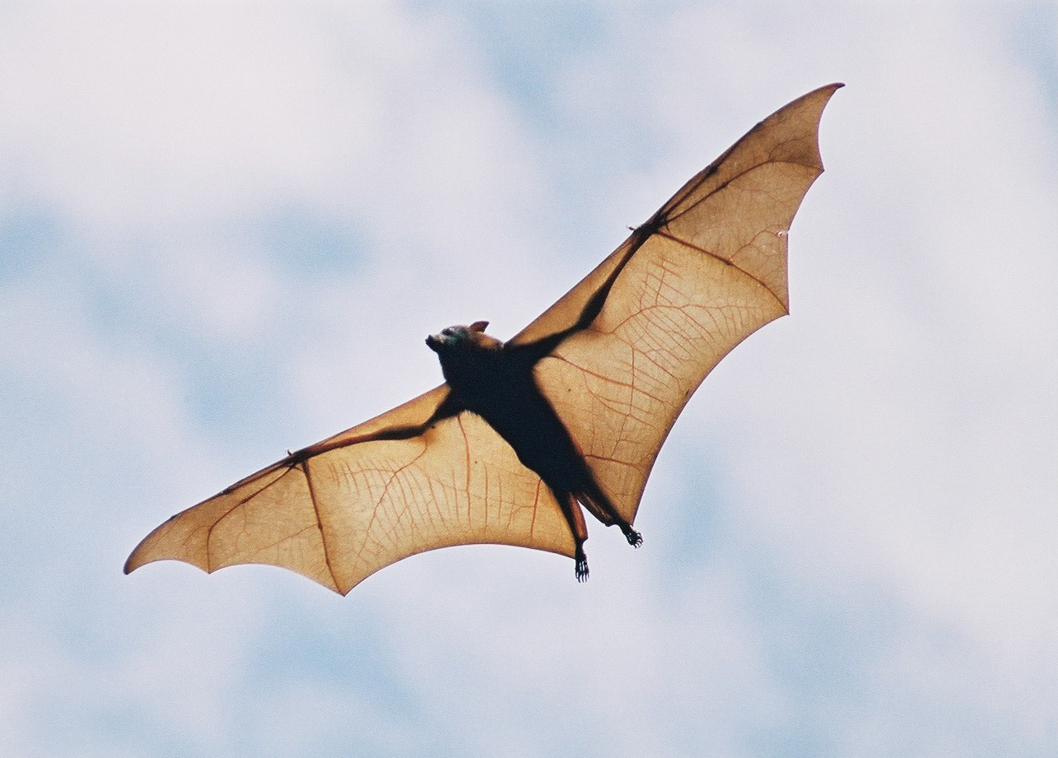



What Is a Homograph?
bat
bow
Notes:
Say: Homographs are words that are spelled the same but have different meanings and sometimes different pronunciations. For example, here we have the word bat (click to show the word). Can you give me two meanings for the word bat? (Give the students a moment to answer, then click to show a baseball bat and the animal bat.)
Great work! A bat is an animal, but also refers to something used to hit a ball. Let’s look at another one. (Click to show the word bow.)
What word is this? (Give the students a moment to answer.)
It’s pronounced one way to describe something tied a certain way (click to show the picture of a bow and say “bow”).
At the end of a play, the actors bow as the audience claps (pronounced like bough. Click to show a picture of someone bowing).

Slide 3




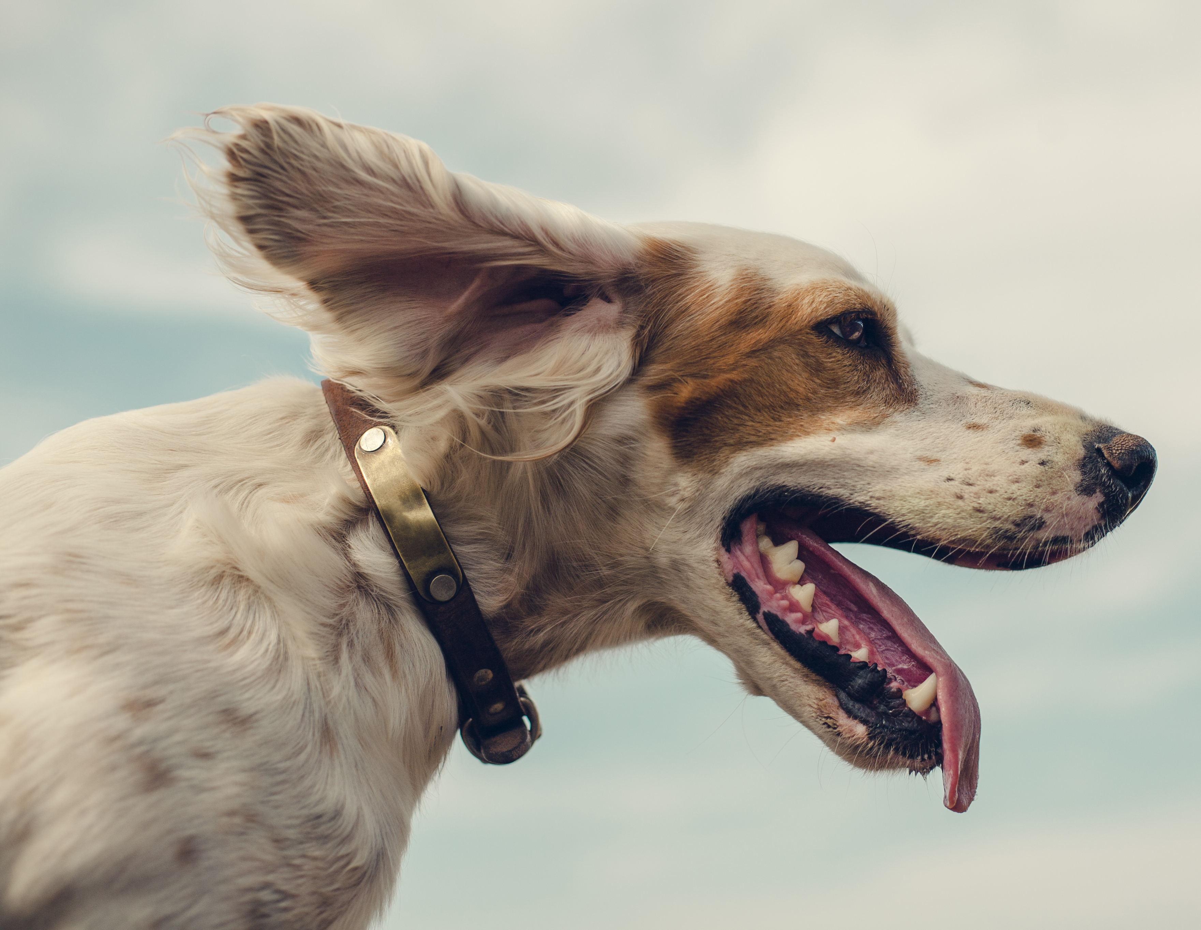


Homograph Practice
glasses
point
bark
letter
a, z, q, s, t, w
Notes:
Say: Let’s Practice! I’ll show you two pictures, and you tell me what the word is. (Click to make 2 pictures appear. Give the students a moment to answer, then click to show the answer. Click again for new pictures and repeat the process.
answers:
bark
point
letter
glasses)

Slide 4
Noun, Verbs, and Pronouns
noun | verb | pronoun
A person, place or thing | action words | takes the place of a noun
mom, camel, hospital | hiking, fishing, laughing | he, she, they, it
Notes:
Say: We have been learning about nouns, verbs, and pronouns. We know that a noun is a person, place, or a thing (click to show the definition). Can you give me an example? (Give the students a moment to answer, if in Zoom, you can share your whiteboard and have students take turns writing them. Click to show the examples. Examples: mom, camel, hospital)
Verbs are action words (click to show the definition).
Can you give me examples? (Give the students a moment to answer, if in Zoom, you can share your whiteboard and have students take turns writing them. Click to show the examples. Examples: hiking, fishing, laughing, )
Pronouns take the place of a noun (click to show the definition).
Can you give me examples? (Give the students a moment to answer, if in Zoom, you can share your whiteboard and have students take turns writing them. Click to show the examples. Examples: he, she, they, it)

Slide 5

Create a Sentence!
Jonelle is _________down the hill.
_____ slides into home plate.
Ronnie and Luis are sharing a giant____.
Notes:
Say: We’re going to make some sentences with our own nouns, verbs, and pronouns. When you see the sentence, please tell me if a noun, verb, or pronoun is missing. Here is the first one. (Click to show the sentence.)
Jonelle is _________down the hill.
The verb is missing from this sentence. What verb would fit here? (Take answers from the students. Any verb that fits will work. Students can come up with a few verbs that would fit and the class can vote on the one they like best. Ex: running, rolling, dancing, sliding Click for a new sentence and repeat the process.
Answers:
2. _____ slides into home plate.- pronoun-ex: He or She, if students give a proper noun as an answer, emphasize the use of pronouns.
3. Ronnie and Luis are sharing a giant________.-noun ex: pizza, brownie, piece of paper)

Slide 6
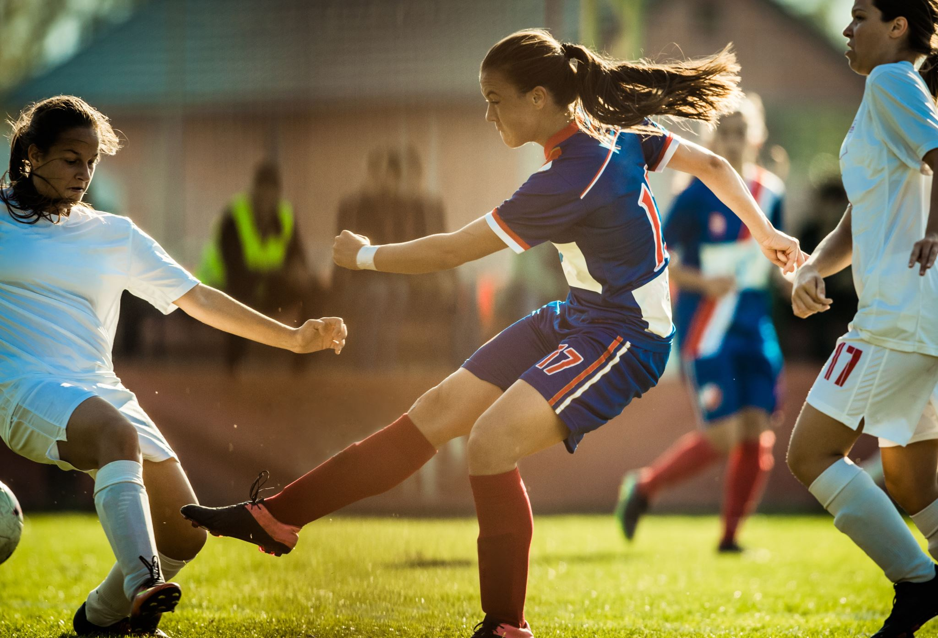
Diagraming Sentences
Maggie kicked the ball hard.
subject | verb
Maggie
kicked
Notes:
Say: Diagramming a sentence is important because it will help you make sure your sentences are written correctly. We will only be diagraming the subject and verb today. On the left side of the line, we have the subject, and on the right side we have the verb. (Click to show “subject” and “verb” diagram.)
Let’s diagram this sentence together. Who can tell me the subject? (Give the students a moment to answer-Maggie, then click to make Maggie appear in the box.)
Who can tell me the verb? (Give the students a moment to answer-kicked, then click to make kicked appear in the box.)
Nice work! Let’s practice more on the next slide!

Slide 7
Which Part Is Which?
The family splashed in the pool.
He ate three hotdogs!
They rolled down the grassy hill.
We jumped over the bench.
subject | verb
They
The family
He
splashed
jumped
We
rolled
ate
Notes:
Say: I will show you some sentences. For each one, please tell me which word is the subject, and which is the verb.
Here is the first one. (Click to show a sentence then have a student read it. - The family splashed in the pool.)
Who can tell me the subject? (Give the students a moment to answer-the family, then click to make it appear on the line.)
Who can tell me the verb? (Give the students a moment to answer-splashed, then click to make it appear in the box.
Click to show a new sentence and repeat with remaining sentences.
2. He ate three hotdogs! Subject-he, verb- ate
3. They rolled down the grassy hill. Subject-they, verb- rolled
4. We jumped over the bench. Subject-we, verb- jumped)

Slide 8
Vocabulary Review
a way of behaving that has become fixed by being repeated often
an opinion or suggestion offered about a decision
a sincere personal decision to do something
very impressive, bright, or smart
a center of activity or interest
to begin to deal with
word bank
focus
habit
approach
brilliant
advice
resolution
Notes:
Say to the students: Let’s review our vocabulary words for the week. We will match the definition to the word. (Click to show the definition.) The first definition is a sincere personal decision to do something.
Which word matches this definition? (Students should say resolution. Click to make the word disappear. Repeat with the remaining definitions.
a sincere personal decision to do something - resolution
a center of activity or interest - focus
very impressive, bright, or smart - brilliant
a way of behaving that has become fixed by being repeated often - habit
an opinion or suggestion offered about a decision - advice
to begin to deal with - approach

Slide 9


Give Me Five!
Notes:
Say: It’s time for the five finger retell! (Click to show the hand and image appear)
Show me your fingers! (Have students hold up hand and point to each finger as they go through the retell.
Characters- Oscar, Mom, brother Caleb, and sister Sasha
Setting- their home
Problem- Oscar made too many resolutions and can’t keep them all.
Events- *The family celebrates the New Year and makes resolutions. *Mom Says she wants to exercise more, Caleb wants to watch less tv, and Sasha wants to eat better.
*Oscar’s resolution includes all of those things.
*Oscar’s mom tells him to start with one, but he doesn’t want to listen.
*Oscar tries but can’t keep his resolution.
Solution- His mom helps him decide on one resolution and helps him find ways to keep it. Oscar talks to his brother and they agree to help each other out.
Text connection- Say: If you had to make a resolution, what would it be?

Slide 10
Q & A
Any Questions?

