Slide 1
Winter Holidays Around The World
Three and Four
Notes:
Notes to Teacher:
Say: Today we will be reviewing homophones, past and future subject /verb agreement, and vocabulary. We will end by discussing details from this week's passage.

Slide 2
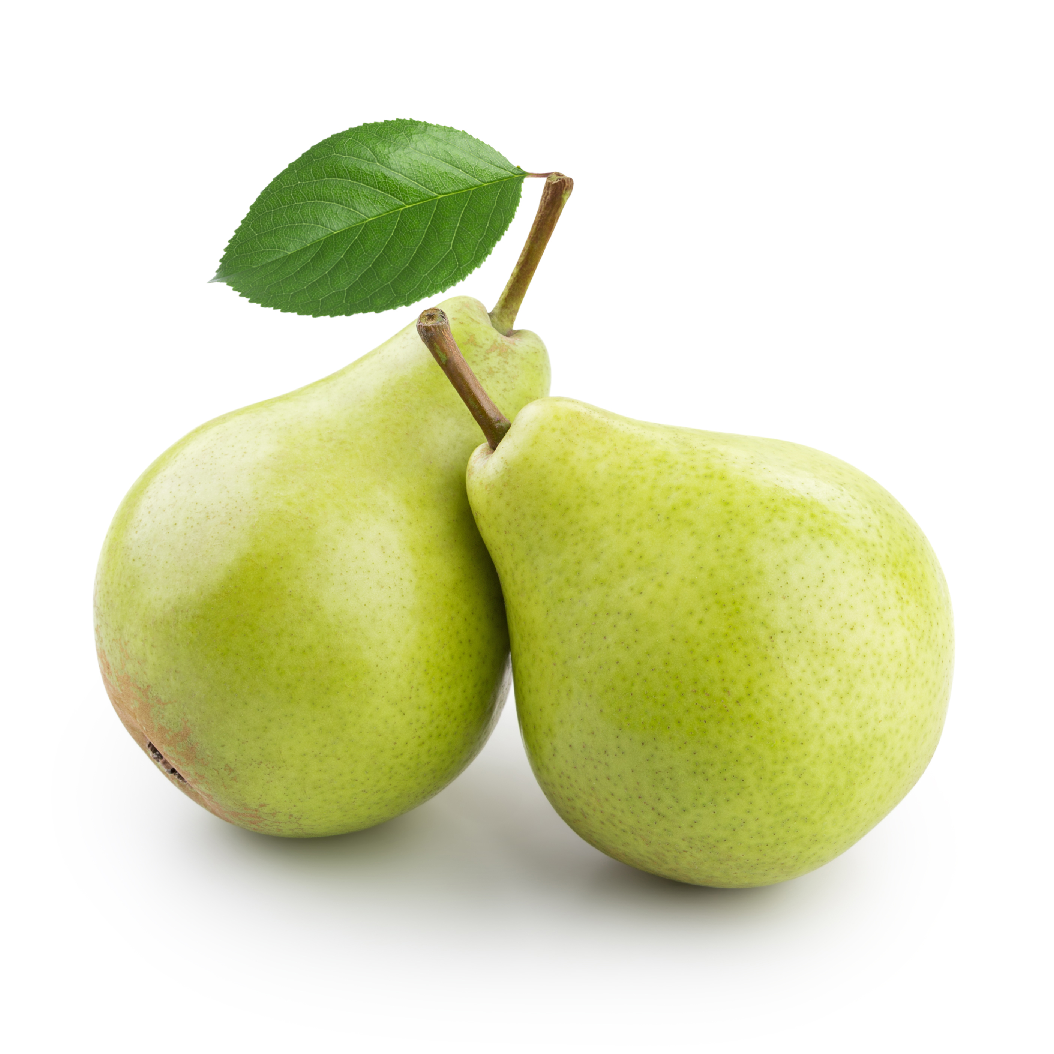
What Is a Homophone?
pair pear
We have a pair of pears.
Notes:
Notes to Teacher:
Say: Last week we learned about homophones. Let’s have a quick review! Can you tell me what a homophone is? (Give the students a moment to answer.)
Homophones are words that sound the same, however they are spelled differently and have different meanings. For example, pair and pear. (Click to make the words appear.)
(Click to make the sentence appear.) We have a pair of pears. What does the first word, p-a-i-r (spell it out) mean? (Give the students a moment to answer.)
That’s correct! P-a-i-r means two of something. The second pear, p-e-a-r, is the fruit.

Slide 3

The Knight Rides at Night!
She missed the big sail because she was on her sale boat.
The hole family worked together to fill the whole in the yard.
The knight rides at night.
Hour class will start in one our.
Where can I wear my new dress?
The whole family worked together to fill the hole in the yard.
She missed the big sale because she was on her sail boat.
Our class will start in one hour.
Notes:
Notes to Teacher:
Say: Let’s practice using homophones correctly in a sentence. I’ll show you some sentences. Please tell me if the homophones are used correctly or incorrectly. Here is the first one. (Click to show the sentence and give the students a moment to answer. Click to show a smiley face for a correct answer or a fixed sentence if it’s incorrect. Click again for a new sentence. Repeat the process until all of the sentences have appeared.
1. The knight rides at night.-correct
2. She missed the big sail because she was on her sale boat.-incorrect- She missed the big sale because she was on her sail boat.
3. The hole family worked together to fill the whole in the yard.-incorrect- The whole family worked together to fill the hole in the yard.
4. Where can I wear my new dress?- correct
5. Hour class will start in one our. Incorrect- Our class will start in one hour)

Slide 4
Subject Verb Agreement
If it ends in e, just add d.
like
→ liked
Drop the y and add ied.
try
→ tried
Double the consonant and add ed.
shop
→ shopped
Notes:
Notes to Teacher:
Say: This week we are learning about past and future tense subject/verb agreement. In a sentence, the subject and verb must agree, or the sentence won’t be correct. Let's review our rules for past tense verbs.
If the verb ends in an e, just add d. For example, let’s change the verb like (click to show the word ).
How would like be spelled? (Allow a student to answer-liked and click to show the correct spelling.)
If the verb ends in a y, we change the y to an i before we add the ending. (Click to show the rule.) For example, let’s change the verb try (click to show the word).
We drop the y and add ied. (Click to show the new spelling.)
One syllable verbs that end in a consonant, have their consonants doubled. (Click to show the rule.) For example, let’s change the verb shop (click to show the word).
How would shop be spelled (allow a student to answer-shopped)?
Correct! The word is shopped. We double the p then add the ed. (Click to show the correct spelling.)
Let’s look at future tense verbs on the next slide.

Slide 5
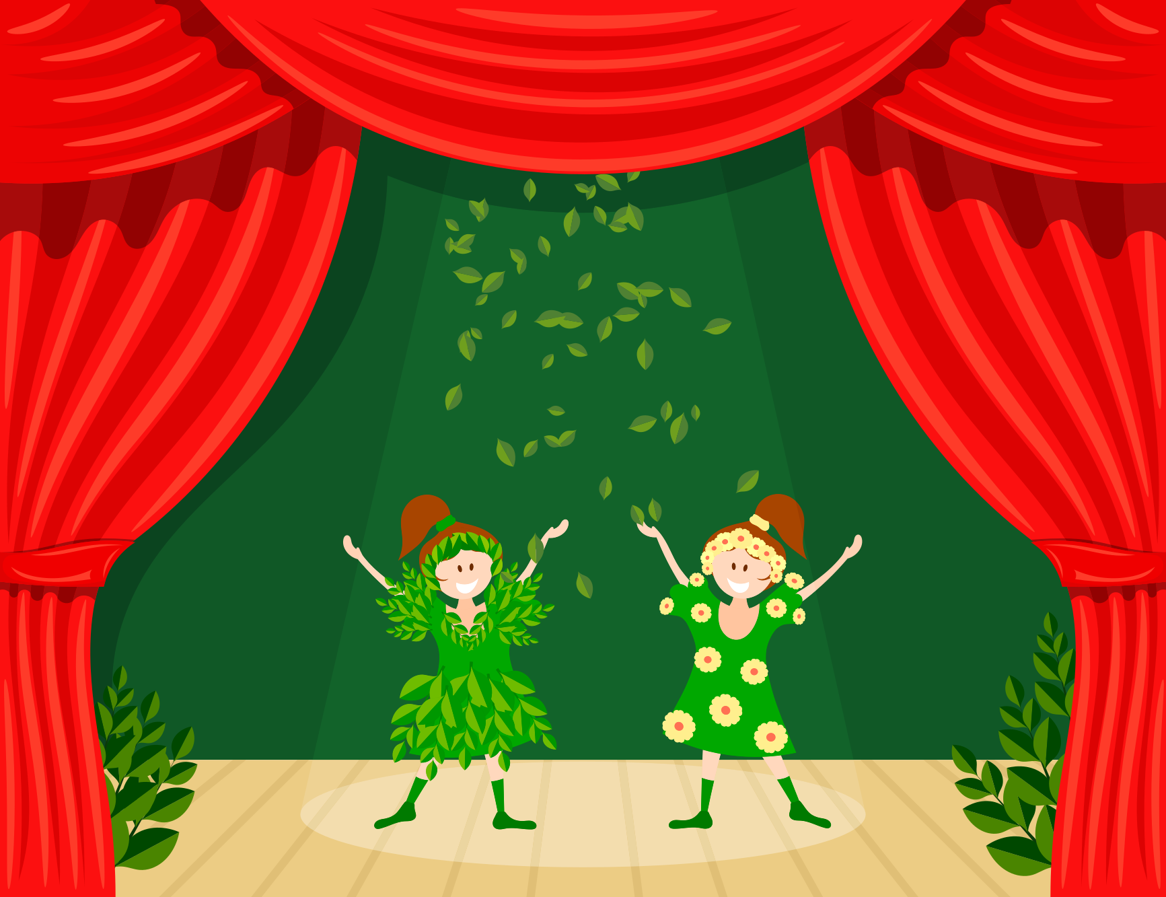
Future Tense
We will go to see the holiday play.
She will have fallen asleep by the end of the play.
Notes:
Notes to Teacher:
Say: Future tense verbs are a bit easier to remember because there are not many rules. We add the word “will” before the verb. It doesn’t matter if the subject is plural or singular. For example, In the following sentence we added will in front of the verb. (Click to show a sentence and have a student read it. “We will go to see the holiday play.”)
There is also a future perfect tense. This tense is used when the action will be finished before another point in time. We add will have in front of the verb. For example, let’s look at this sentence. (Click to show a sentence and have a student read it. “She will have fallen asleep by the end of the play”).
Let’s practice on the next slide!

Slide 6
How Do You Spell It?
Word | Past tense | Future tense
cry | cried | will cry
bake | baked | will bake
dry | dried | will dry
drop | dropped | will drop
Notes:
Notes to Teacher:
Say: Let’s practice changing some words. When I show you the verb, please tell me the correct way to change it to past tense and future tense. (Click to show the word cry in the chart) For example, here is the word cry. To change it to past tense, we would drop the y and add ied. (Click to show the new spelling in the chart.)
The future tense is will cry. (Click to show in the chart)
Now you try the next few. We will start with past tense and then do future tense. (Click to show each word, then give the students a moment to answer. Then click to show the correct spelling. Repeat the process with the future tense words. All answers are in the chart. )
Additional words: bake, dry, drop.

Slide 7
Winter Holiday Vocabulary Review
arrange belief
customs pastime
tradition culture
Notes:
Notes to Teacher:
Say: Let’s review our vocabulary words from this week. When I read a definition, please tell me which word matches the definition. Here is the first one- something that one thinks is true. Which word matches this definition? (Give the students a moment to answer then click to circle the correct answer. -belief. Repeat the process with the remaining words.
The beliefs, social practices, and characteristics of a racial, religious, or social group - culture
The handing down of information, beliefs, or customs from one generation to another - tradition
To put in order - arrange
Something that helps to make time pass agreeably - pastime
The usual practice of a person or group, or usual way of doing things - customs)

Slide 8
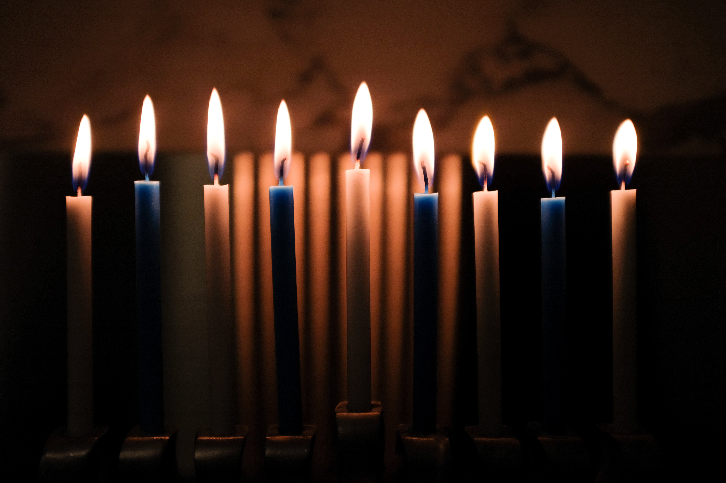
Your Turn!
custom
tradition
arrange
culture
belief
pastime
Notes:
Notes to Teacher:
Say: Let’s practice using our vocabulary words in a sentence. When I show you the word, please use it in a sentence for me. Here is an example. (Click to show the word custom.)
Custom. Our holiday custom is to light a menorah during Hanukkah. Can you please give me a sentence for the word tradition? (Click to show the word.)
(Repeat process for remaining words- click to show each one. If a student struggles, review the meaning of the word on the previous slide.
3. arrange
4. culture
5. belief
6. pastime)

Slide 9

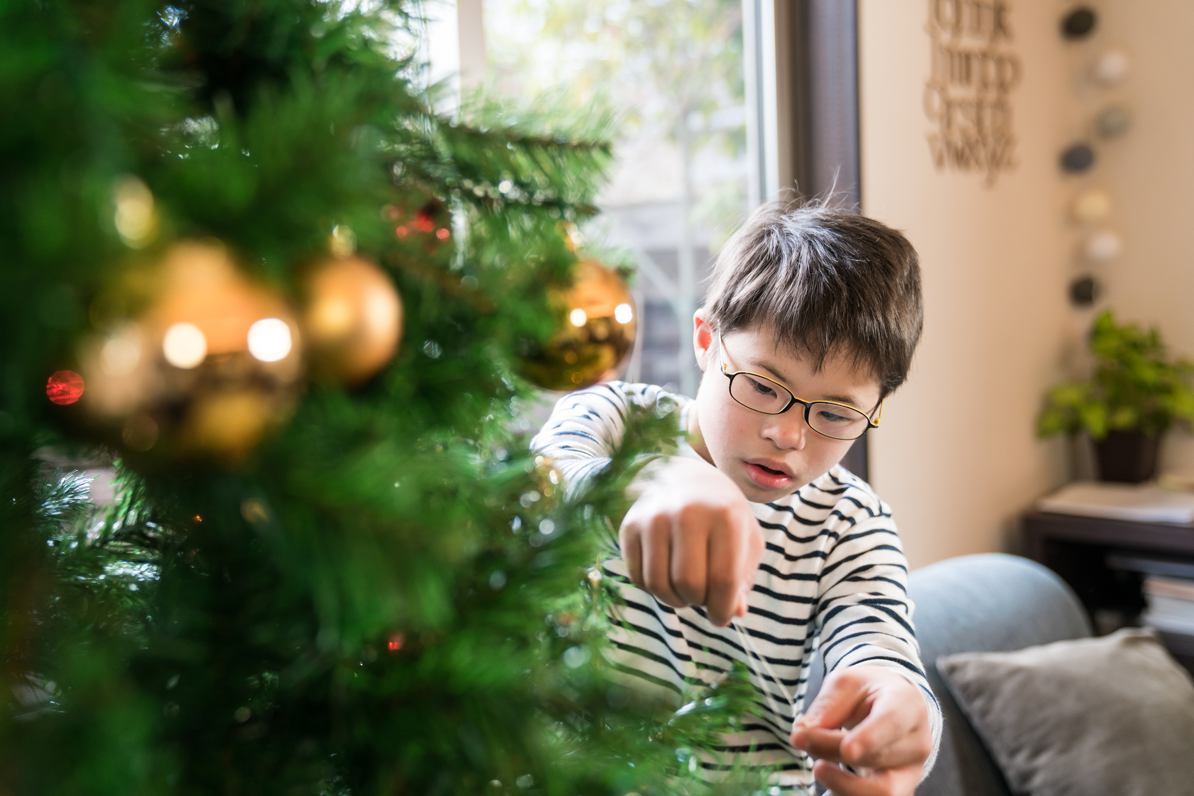
It’s All In the Details!
People celebrate different winter holidays around the world.
#1
#2
#3
Notes:
Notes to Teacher:
Say: The main idea of this week's story is that people celebrate different winter holidays around the world. (Click to show the main idea appear.) Please give me three details to support the main idea. (Click to show three numbers. Give the students time to answer. Answers may vary, but should include information about some of the holidays covered in the reading.-Diwali, Christmas, Hanukkah, Chinese New Year, Kwanzaa)

Slide 10
Q & A
Any Questions?

